Slide 1
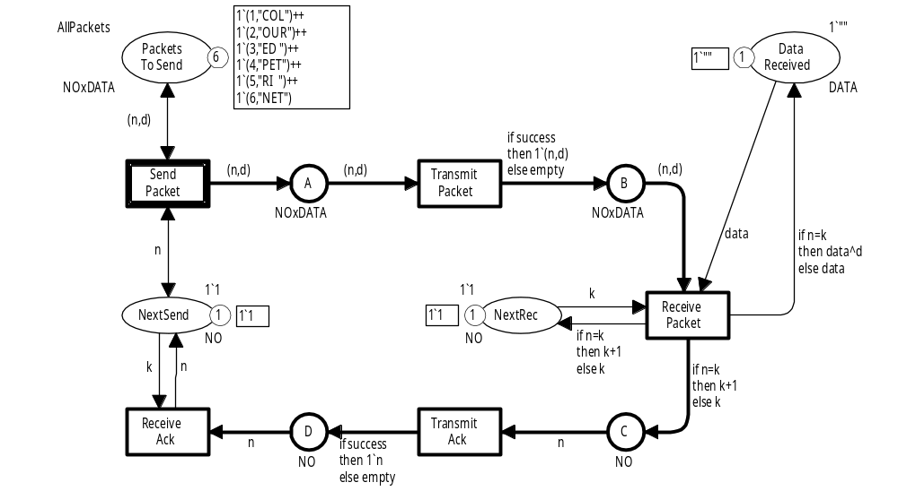
Coloured Petri Nets
Modelling and Validation of Concurrent Systems
Chapter 2:
Non-hierarchical Coloured Petri Nets
Kurt Jensen &
Lars Michael Kristensen
{kjensen,lmkristensen}
@cs.au.dk
Coloured Petri Nets
Department of Computer Science

Slide 2
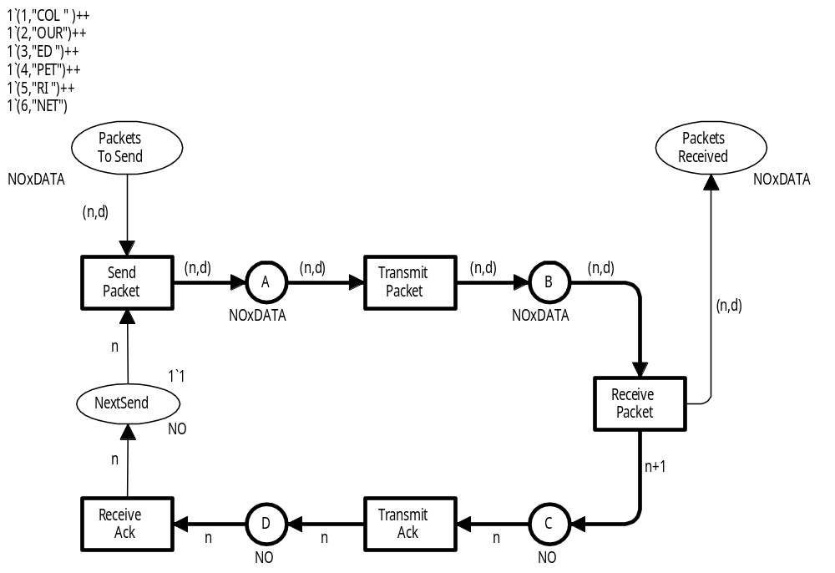
Simple protocol
Coloured Petri Nets
Department of Computer Science

Slide 3
Informal description
No loss of packets
No overtaking
Sender
Network
Receiver
Coloured Petri Nets
Department of Computer Science

Slide 4
Coloured Petri Net
Place
Nodes
Arc
Transition
Net inscriptions
Coloured Petri Nets
Department of Computer Science

Slide 5

Places represent the state of the system
Initial marking (multiset of tokens)
Each token in the initial marking must have a colour that belongs to the colour set
Name
(no formal meaning;
large impact on readability)
Definition of colour sets:
colset NO = int; (* integers *)
colset DATA = string; (* text strings *)
colset NOxDATA = product NO * DATA;
Each place contains a number of tokens.
Each token carries a colour (data value).
The colour set specifies the set of allowed token colours.
Colour set
(type)
Coloured Petri Nets
Department of Computer Science

Slide 6
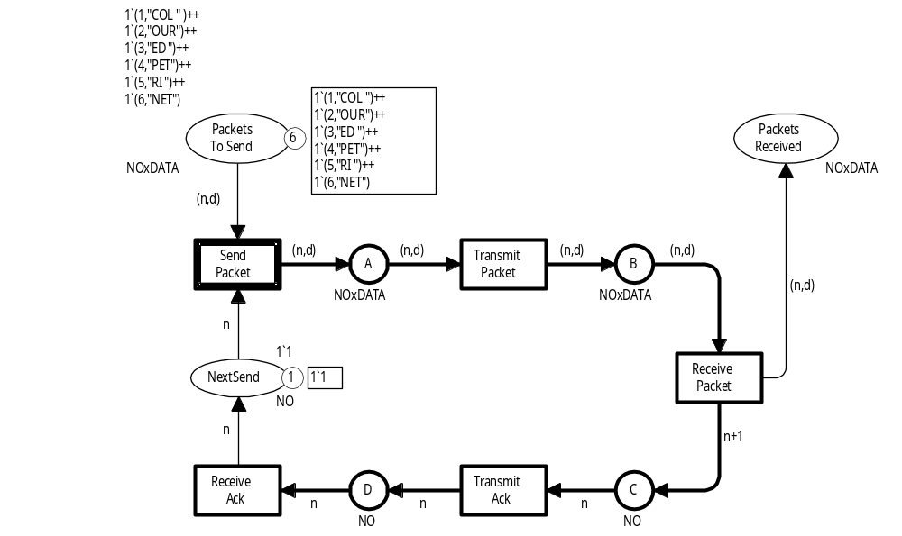
Current marking during simulation
Circle: 6 tokens
Values:
Token colours
(multiset of actual token colours)
Type:
Colour set
(set of allowed token colours)
Square: Detailed
token values
The thick border line indicates that the
transition is enabled (ready to occur)
Information about
current marking
(changes during simulation)
One token with value 1
Coloured Petri Nets
Department of Computer Science

Slide 7
Transitions and arcs
Arc expression
The arc expression must evaluate to a colour in the colour set of the attached place
(or a multiset of such colours)
Declaration of variables:
var n : NO; (* integers *)
var d : DATA; (* strings *)
Name
(no formal meaning)
Binding of variables:
<n=3,d="CPN">
Evaluation of expressions:
(n,d) → (3,"CPN") : NOxDATA
n → 3 : NO
Coloured Petri Nets
Department of Computer Science

Slide 8
Enabling of transition
Two variables:
var n : NO; (* integers *)
var d : DATA; (* strings *)
?
Binding: < n=? , d=? >
NO DATA
?
Transition is enabled if we can find a binding so that each input arc expression evaluates to one or more colours that are present on the corresponding input place
Coloured Petri Nets
Department of Computer Science

Slide 9
Enabling of SendPacket
Binding: < n=1 , d=? >
We want to find a binding for the variable n such that the arc expression n evaluates to a colour which is present on the place NextSend
Arc expression
One token with value 1
Coloured Petri Nets
Department of Computer Science

Slide 10
Enabling of SendPacket
Six different tokens
Arc expression
Binding: < n=1 , d=? >
Binding: < n=1 , d="COL" >
We want to find a binding for the variable d such that the arc expression (n,d) evaluates to a colour which is present on the place PacketsToSend
Coloured Petri Nets
Department of Computer Science

Slide 11
Enabling of SendPacket
We have found a binding so that each input arc expression evaluates to a colour that is present on the corresponding input place
(1,"COL")
Binding: < n=1 , d="COL" >
1
Transition is enabled
(ready to occur)
Coloured Petri Nets
Department of Computer Science

Slide 12
Occurrence of SendPacket in binding <n=1,d=“COL”>
Remove: (1,"COL")
(1,"COL")
(1,"COL")
Add a new token: (1,"COL")
1
Remove: 1
Coloured Petri Nets
Department of Computer Science

Slide 13
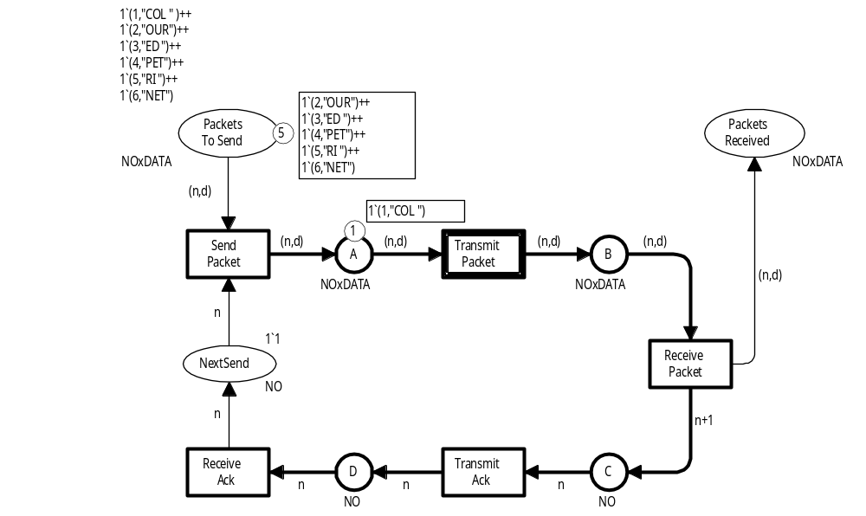
New marking after occurrence of SendPacket in binding <n=1,d=“COL”>
The first packet has been removed
Transition is no longer enabled
(thin border line)
A copy of the first packet has been put on A
No token on this place
Coloured Petri Nets
Department of Computer Science

Slide 14
New marking M₁
Transition enabled
Coloured Petri Nets
Department of Computer Science

Slide 15
Binding of TransmitPacket
Current marking
Arc expression
Binding: < n=? , d=? >
Binding: < n=1 , d="COL" >
Coloured Petri Nets
Department of Computer Science

Slide 16
Occurrence of TransmitPacket in binding <n=1,d=“COL”>
Remove: (1,"COL")
Add a new token: (1,"COL")
(1, "COL")
(1, "COL")
Coloured Petri Nets
Department of Computer Science

Slide 17
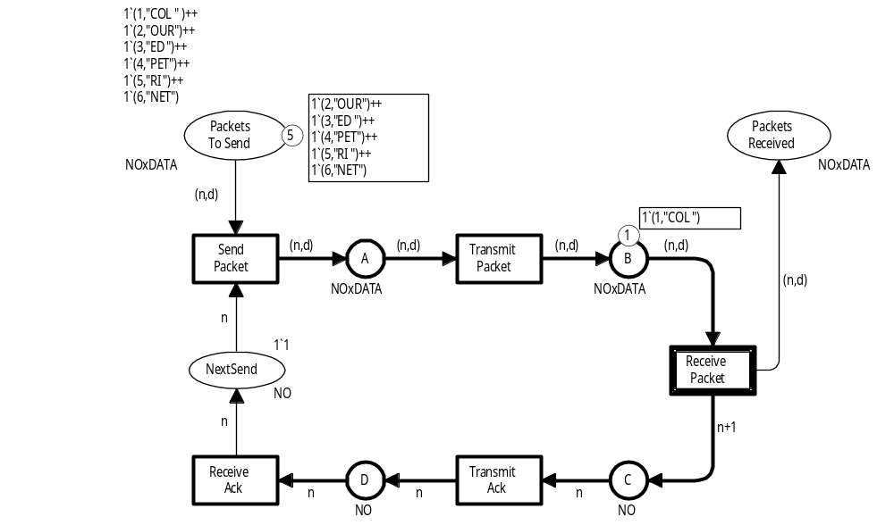
New marking M₂
1`(1,"COL")
1
XXXX
Binding: <n=1,d="COL">
1`2
1
Coloured Petri Nets
Department of Computer Science

Slide 18
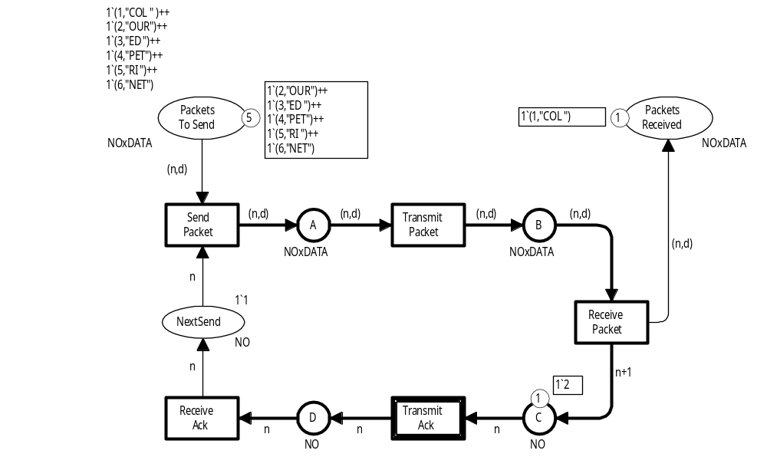
New marking M₃
1`2
Binding: <n=2>
XXX
1
Coloured Petri Nets
Department of Computer Science

Slide 19
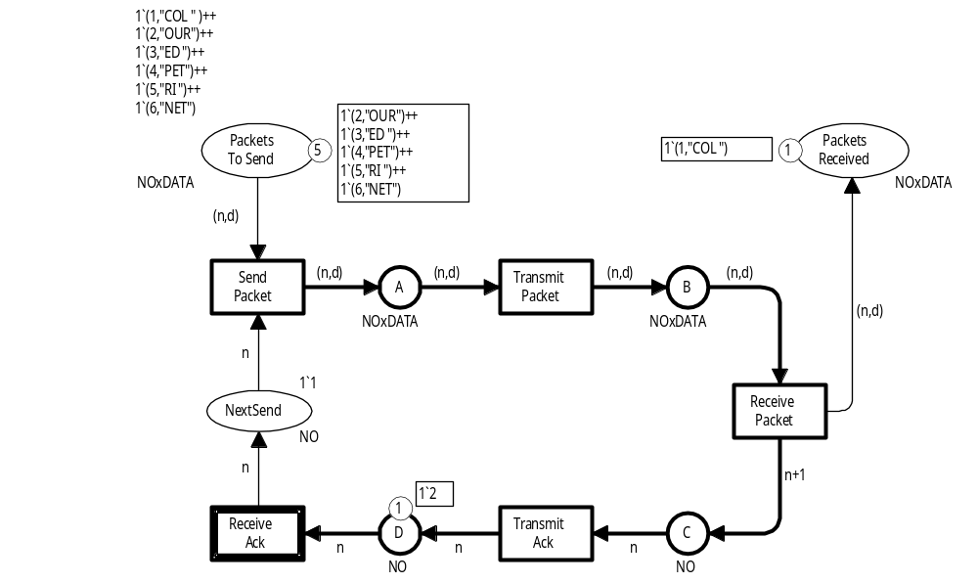
New marking M₄
1
1`2
XXX
Binding: <n=2>
Coloured Petri Nets
Department of Computer Science

Slide 20
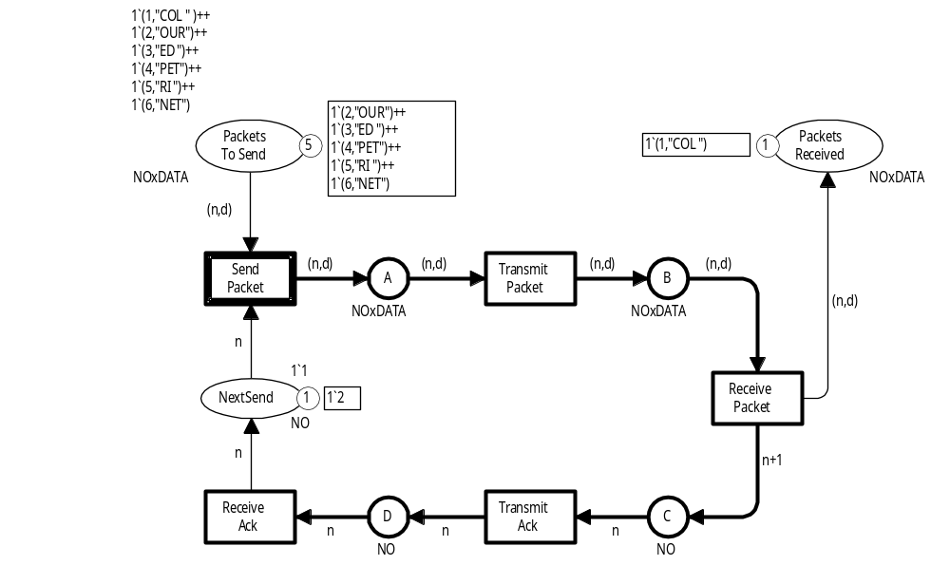
New marking M₅
We have successfully transmitted
the first packet and the acknow-ledgement for it
We are ready to start transmission of packet number two
Coloured Petri Nets
Department of Computer Science

Slide 21
First five steps
1 (SendPacket ,<n=1, d="COL">)
2 (TransmitPacket , <n=1, d="COL">)
3 (ReceivePacket , <n=1, d="COL">)
4 (TransmitAck , <n=2>)
5 (ReceiveAck , <n=2>)
Transition
Binding
( , )
Binding element
Coloured Petri Nets
Department of Computer Science

Slide 22
New marking M₅
4
1`(2,"OUR")
1
Binding:
<n=2,d="OUR">
Coloured Petri Nets
Department of Computer Science

Slide 23
New marking M₆
4
1`(2,"OUR")
1`(2,"OUR")
1
1
Binding:
<n=2,d="OUR">
Coloured Petri Nets
Department of Computer Science

Slide 24
New marking M₇
4
2
1`(2,"OUR")
1`(2,"OUR")
1
Binding:
<n=2,d="OUR">
1`3
1
Coloured Petri Nets
Department of Computer Science

Slide 25
New marking M₈
4
2
1`(2,"OUR")
1`3
Binding: <n=3>
1`3
1
1
Coloured Petri Nets
Department of Computer Science

Slide 26
New marking M₉
4
2
1`(2,"OUR")
1`3
Binding:
<n=3>
1`3
1
Coloured Petri Nets
Department of Computer Science

Slide 27
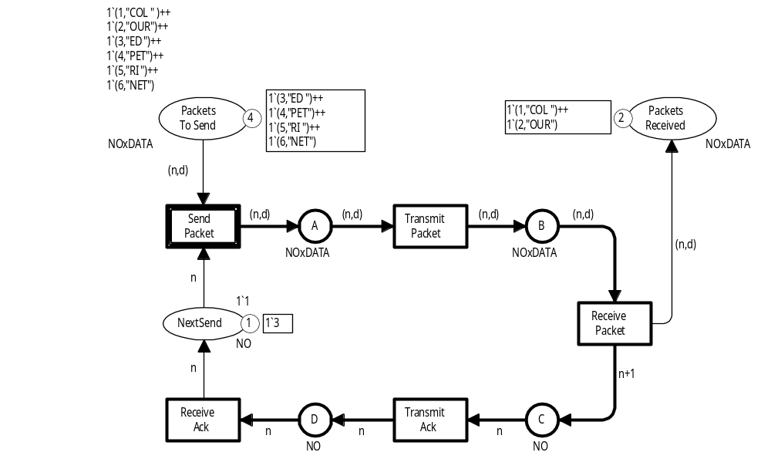
New marking M₁₀
We have successfully transmitted
the first two
packets and the acknowledgements for them
We are ready to start transmission of packet number three
Coloured Petri Nets
Department of Computer Science

Slide 28
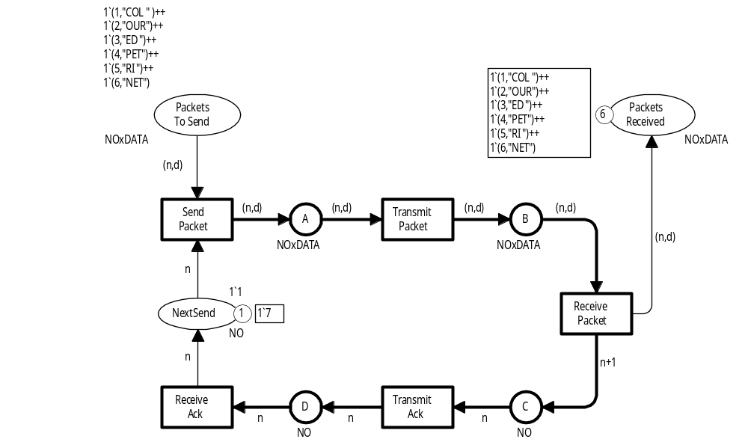
Marking after 30 steps
We have successfully transmitted all six packets and the acknowledgements for them
There are no more packets to transmit
Dead marking (no transitions are enabled)
Coloured Petri Nets
Department of Computer Science

Slide 29
Second version of protocol
Constant
Coloured Petri Nets
Department of Computer Science

Slide 30
Declaration of constants
We use the following constant to specify the initial marking of PacketsToSend.
val AllPackets = 1‘(1,"COL") ++ 1‘(2,"OUR") ++
1‘(3,"ED ") ++ 1‘(4,"PET") ++
1‘(5,"RI ") ++ 1‘(6,"NET");
Saves a little bit of space in the diagram.
Enhances readability.
Can be reused (at other places).
Coloured Petri Nets
Department of Computer Science

Slide 31
Double-headed arcs
A double-headed arc is a shorthand for two oppositely directed arcs with the same arc expression
Double-headed arc
We no longer remove the tokens from the input places
Double-headed arc
Retransmission becomes possible
Coloured Petri Nets
Department of Computer Science

Slide 32
More complicated arc expression
More complicated
arc expression
(if-then-else expression)
Coloured Petri Nets
Department of Computer Science

Slide 33
If-then-else expression
1`(1,"COL")
1`(1,"COL")
1
1
success = true
New variable:
1`(1,"COL")
var success : BOOL;
Successful transmission
over the network
b⁺ = <n=1, d="COL", success=true>
b – = <n=1, d="COL", success=false>
Coloured Petri Nets
Department of Computer Science

Slide 34
If-then-else expression
No packet is added
1`(1,"COL")
1
success = false
empty
var success : BOOL;
Packet is lost during transmission
b⁺ = <n=1, d="COL", success=true>
b – = <n=1, d="COL", success=false>
Coloured Petri Nets
Department of Computer Science

Slide 35
New name and new type
New name
Initial marking:
empty text string
New type
Coloured Petri Nets
Department of Computer Science

Slide 36
New place: NextRec
Plays a similar role as NextSend
New place
Contains the number of the expected packet
Coloured Petri Nets
Department of Computer Science

Slide 37
Correct packet arrives
Empty text string
1`""
1
1
1`"COL"
Packet no 1 arriving
Binding:
<n=1, d="COL", k=1, data="">
1`(1,"COL")
1`(1,"COL")
1
1
^ is the concatenation operator
Packet no 1 expected
"COL"
1`1
1`2
1
1
Update NextRec (from 1 to 2)
2
Send acknoweledgement
(with sequence number of next packet)
1`2
1
2
Add received data: "COL” to DataReceived
Coloured Petri Nets
Department of Computer Science

Slide 38
Wrong packet arrives
1`"COLOUR"
1`"COLOUR"
1
1`(1,"COLOUR")
1
1
Packet no 1 arriving
Binding:
<n=1, d="COL", k=3, data="COLOUR">
1`(1,"COL")
1`(1,"COL")
1
1
Packet no 3 expected
"COLOUR"
1`3
1`3
1`3
1
1
1
Do not change NextRec
3
Send acknowledgement
(with sequence number of next packet )
1`3
1
3
No data is added to DataReceived
Coloured Petri Nets
Department of Computer Science

Slide 39
Acknowledgements can be lost
Also possible to loose acknowledgements
Coloured Petri Nets
Department of Computer Science

Slide 40
NextSend is updated
NextSend is updated with sequence number from acknowledgement
Coloured Petri Nets
Department of Computer Science

Slide 41
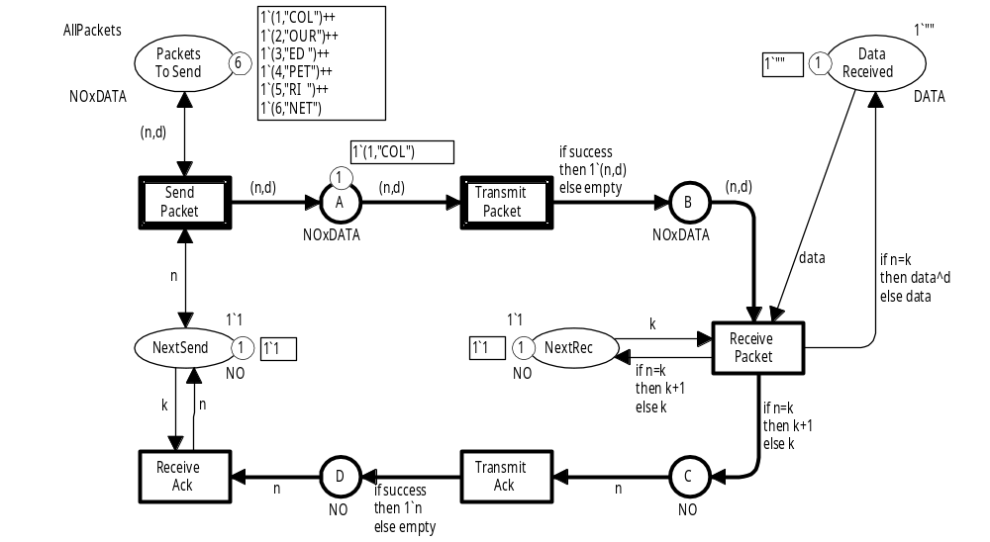
Two enabled transitions
These binding elements
need the same token
They are in conflict
with each other
SP = (SendPacket, <n=1, d="COL">)
TP⁺ = (TransmitPacket, <n=1, d="COL", success=true>)
TP – = (TransmitPacket, <n=1, d="COL", success=false>)
Coloured Petri Nets
Department of Computer Science

Slide 42
Two enabled transitions
These bindings elements
use different tokens
They are concurrently enabled
and can occur concurrently
SP = (SendPacket, <n=1, d="COL">)
TP⁺ = (TransmitPacket, <n=1, d="COL", success=true>)
TP – = (TransmitPacket, <n=1, d="COL", success=false>)
Coloured Petri Nets
Department of Computer Science

Slide 43
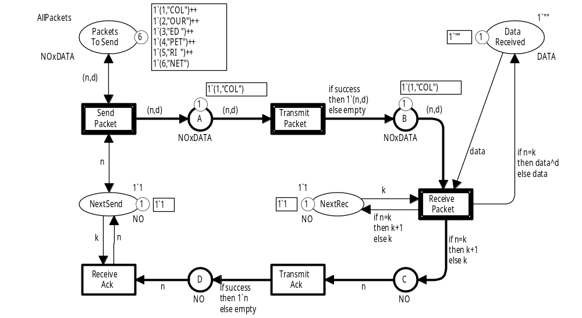
Three enabled transitions
These binding elements
are in conflict
All other binding elements are concurrently enabled
SP = (SendPacket, <n=1, d="COL">)
TP⁺ = (TransmitPacket, <n=1, d="COL", success=true>)
TP – = (TransmitPacket, <n=1, d="COL", success=false>)
RP = (ReceivePacket, <n=1, d="COL", k=1, data="">)
Coloured Petri Nets
Department of Computer Science

Slide 44
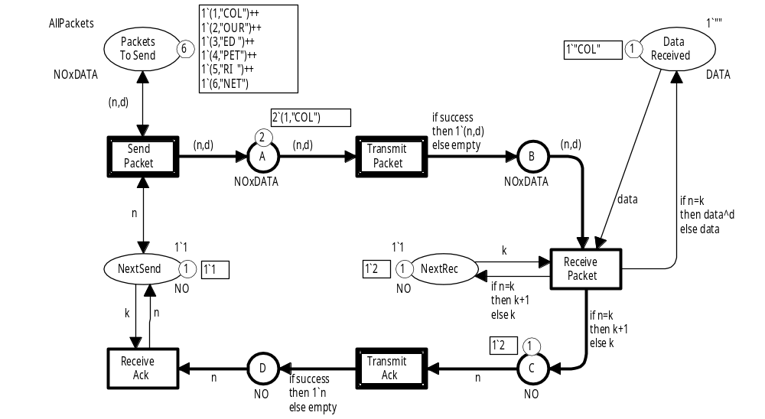
Three enabled transitions
35 different enabled steps
All other binding elements are concurrently enabled
SP = (SendPacket, <n=1, d="COL">)
TP⁺ = (TransmitPacket, <n=1, d="COL", success=true>)
TP – = (TransmitPacket, <n=1, d="COL", success=false>)
TA⁺ = (TransmitAck, <n=2, success=true>)
TA– = (TransmitAck, <n=2, success=false>)
Coloured Petri Nets
Department of Computer Science

Slide 45
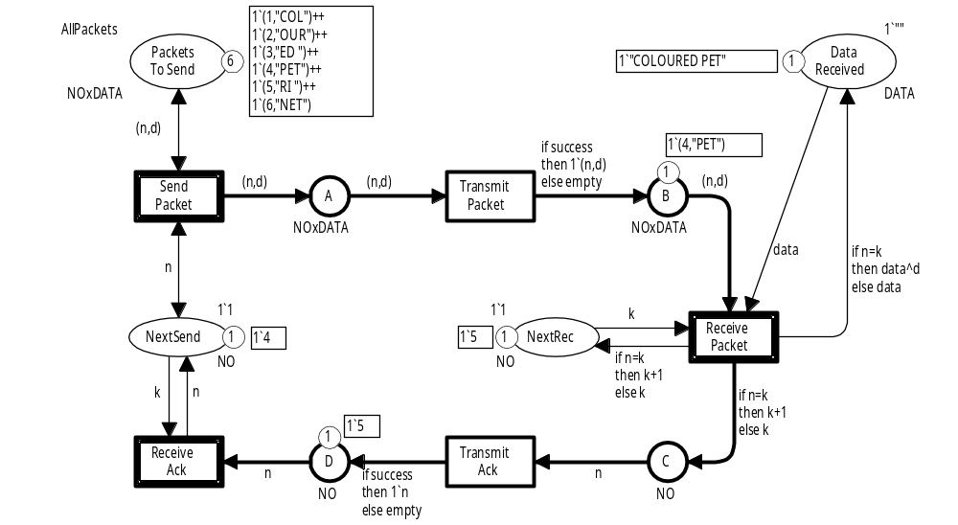
Possible marking after 50 steps
This packet
will be discarded
Sender is still
sending packet no. 4
Receiver is waiting for packet no. 5
An acknowledgement requesting packet no. 5 is arriving
When it is received, the sender will start sending packet no. 5
Coloured Petri Nets
Department of Computer Science

Slide 46
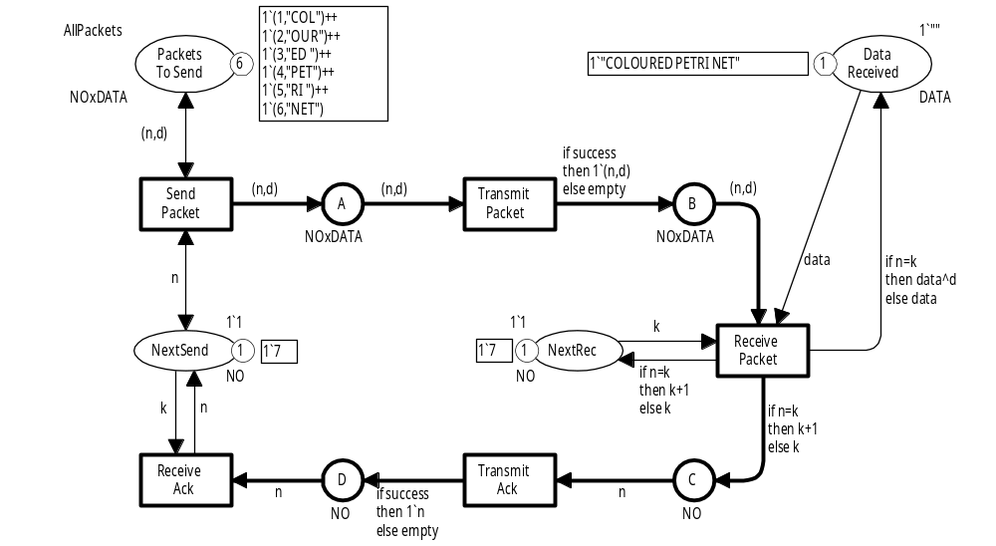
Dead marking at the end of simulation
There is no packet no. 7
All packets have been received
in the correct order
Sender is ready to
send packet no. 7
Receiver is waiting for packet no. 7
All buffer places
are empty
Coloured Petri Nets
Department of Computer Science

Slide 47
Simulation report
Step Time Transition Module
1 0 SendPacket @ (1:Protocol)
- d = "COL"
- n = 1
2 0 TransmitPacket @ (1:Protocol)
- n = 1
- d = "COL"
- success = true
3 0 ReceivePacket @ (1:Protocol)
- k = 1
- data = ""
- n = 1
- d = "COL"
4 0 TransmitAck @ (1:Protocol)
- n = 2
- success = true
5 0 ReceiveAck @ (1:Protocol)
- k = 1
- n = 2
6 0 SendPacket @ (1:Protocol)
- d = "OUR"
- n = 2
Binding of variables
Specifies the occurring transitions and their bindings.
Automatically generated by the CPN Tools simulator.
Coloured Petri Nets
Department of Computer Science

Slide 48
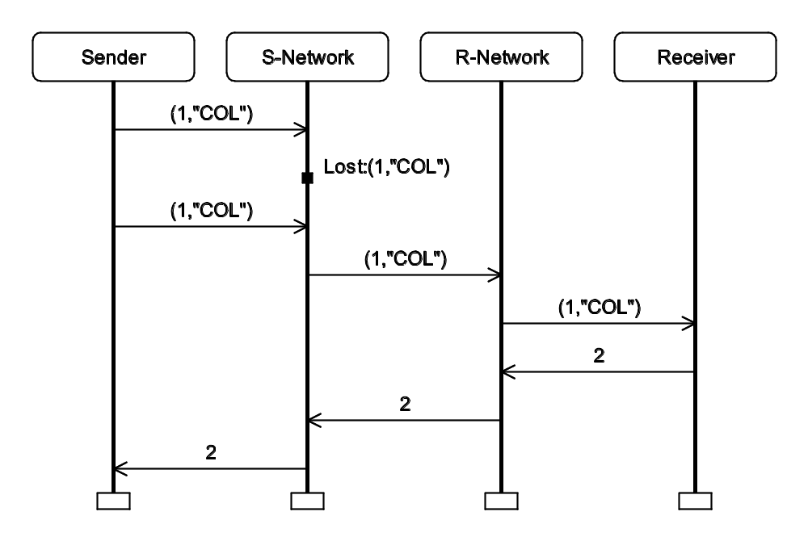
Visualisation by message sequence chart
Graphical high-level representation of occurrence sequence.
Automatically generated by the
CPN Tools simulator.
Makes it easy to see what happened – also for non-CPN experts.
Coloured Petri Nets
Department of Computer Science

Slide 49
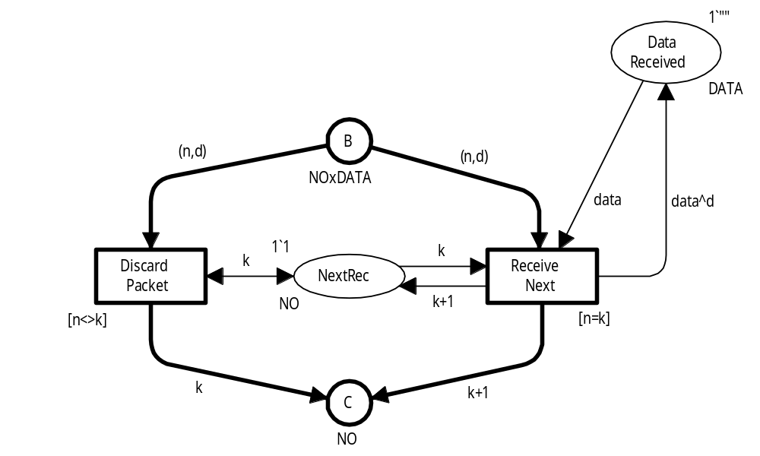
Transitions can have a guard
Boolean expression which must evaluate to true for the binding element to be enabled.
Additional enabling condition.
Wrong
packets
Correct
packets
Guard
(<> is the
Inequality operator)
Guard
(tests whether n and k
are equal)
Coloured Petri Nets
Department of Computer Science

Slide 50
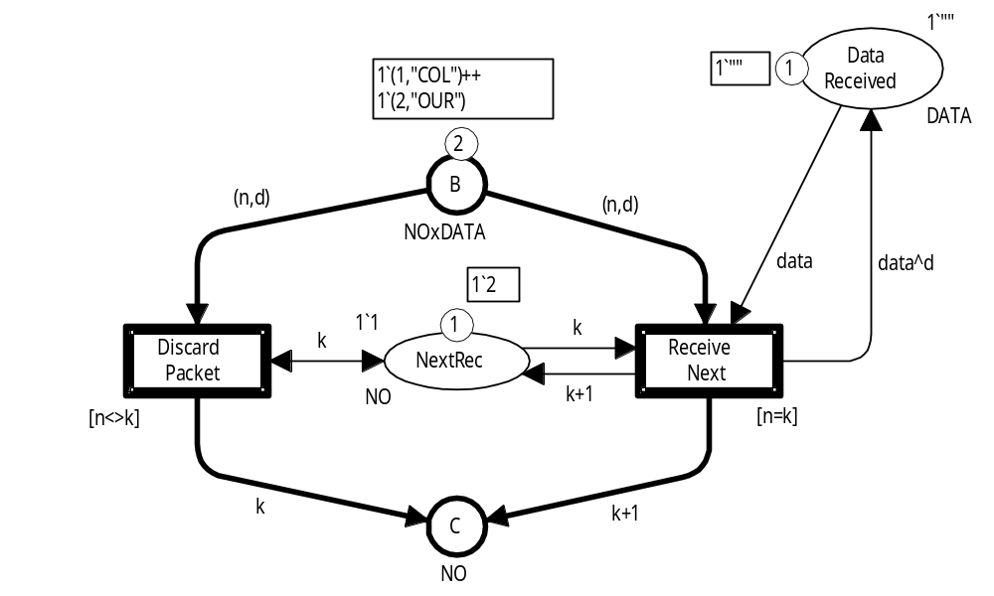
Guard must evaluate to true
1`"COL"
[n=k]
false
RN₁ = (ReceiveNext, <n=1, k=2, d="COL", data="COL">)
RN₂ = (ReceiveNext, <n=2, k=2, d="OUR", data="COL">)
true
Coloured Petri Nets
Department of Computer Science

Slide 51
Guard must evaluate to true
1`"COL"
[n<>k]
true
DP₁ = (DiscardPacket, <n=1, k=2, d="COL" )
DP₂ = (DiscardPacket, <n=2, k=2, d="OUR")
false
Coloured Petri Nets
Department of Computer Science

Slide 52

Questions
Coloured Petri Nets
Department of Computer Science

