Slide 1
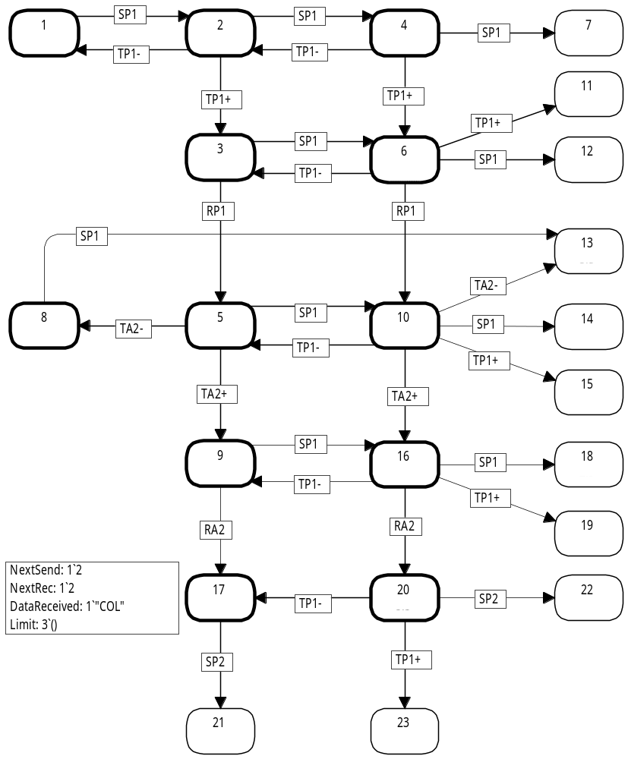
Coloured Petri Nets
Modelling and Validation of Concurrent Systems
Chapter 7: State Spaces and Behavioural Properties
1
2
4
7
Kurt Jensen &
Lars Michael Kristensen
{kjensen,lmkristensen}@cs.au.dk
11
3
6
12
13
8
5
10
14
15
9
16
18
19
17
20
22
21
23
Coloured Petri Nets
Department of Computer Science

Slide 2
State spaces
A state space is a directed graph with:
  A node for each reachable marking (state).
  An arc for each occurring binding element.
State spaces can be used to investigate the behavioural properties of the CPN model.
2
Cycle:
- No guarantee for
termination
5
1
3
7
6
4
Deadlock:
- Marking with no enabled
binding elements
8
Coloured Petri Nets
Department of Computer Science

Slide 3
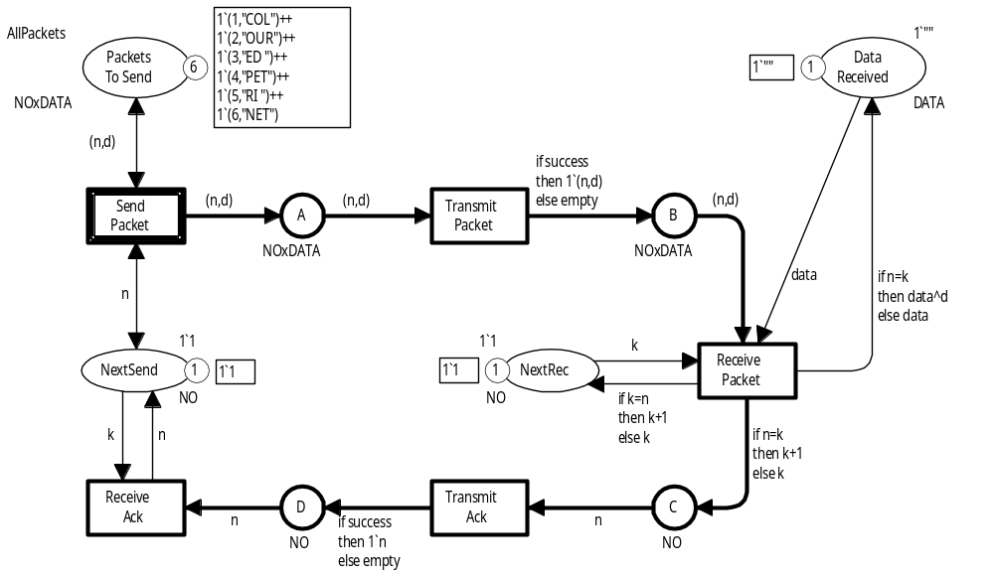
Simple protocol
SendPacket can occur an unlimited number of times producing an unlimited number of tokens on place A.
This means that the state space becomes infinite.
Coloured Petri Nets
Department of Computer Science

Slide 4
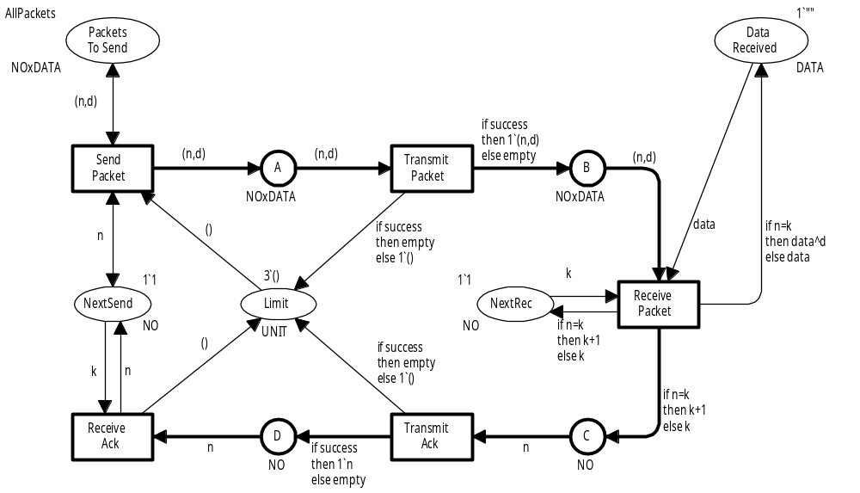
Simple protocol for state space analysis
We add a new place Limit, which limits the total number of tokens on the buffer places A, B, C, and D.
This makes the state space finite.
colset UNIT = unit;
Three “uncoloured” tokens
Coloured Petri Nets
Department of Computer Science

Slide 5
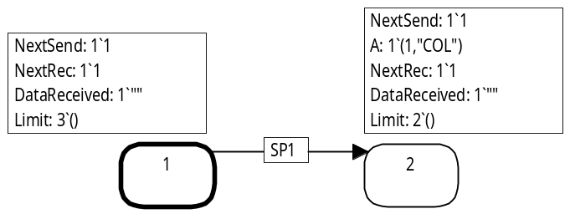
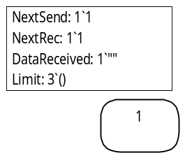
State space
1
2
Construction of the state space starts with the processing of node 1 which represents the initial marking.
1
Node 1 has one enabled binding element:
SP1 = (SendPacket, <n=1, d="COL">)
This gives us one new arc and one new node 2.
Node 2 has one copy of data packet 1 on place A.
Node 1 is now marked as processed (thick border line).
Coloured Petri Nets
Department of Computer Science

Slide 6
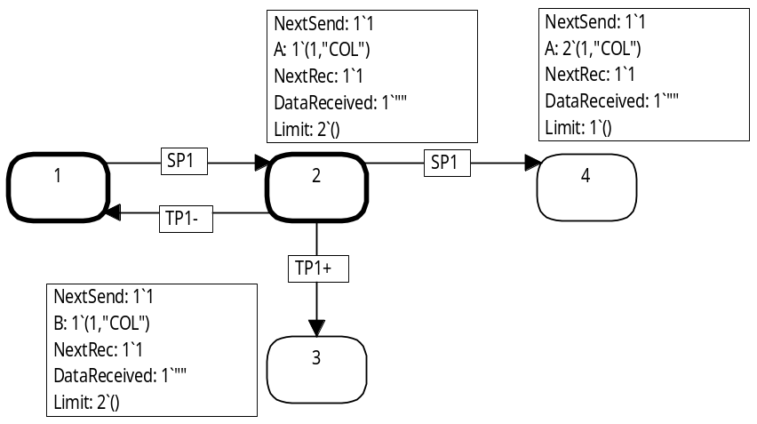
State space
1
2
4
Next we process node 2.
It has three enabled binding elements:
3
SP1 = (SendPacket, <n=1, d="COL">)
TP1+ = (TransmitPacket, <n=1, d="COL", success=true>)
TP1– = (TransmitPacket, <n=1, d="COL", success=false>)
This gives us three new arcs and two new nodes 3 and 4.
Node 3 has one copy of data packet 1 on place B.
Node 4 has two copies of data packet 1 on place A.
Node 2 is now marked as processed (thick border line).
Coloured Petri Nets
Department of Computer Science

Slide 7
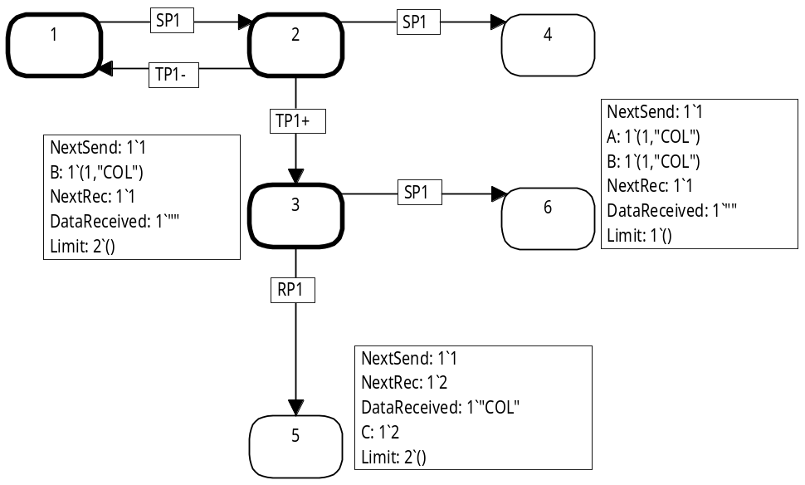
State space
1
2
4
Next we choose one of the unprocessed nodes: 3.
It has two enabled binding elements:
3
6
SP1 = (SendPacket, <n=1, d="COL">)
RP1 = (ReceivePacket,
<n=1, d="COL", k=1, data = "">)
5
This gives us two new arcs and two new nodes 5 and 6.
Node 5 has one copy of acknowledgement 2 on place C.
Node 6 has one copy of packet 1 on place A and another on place B.
Node 3 is now marked as processed (thick border line).
Coloured Petri Nets
Department of Computer Science

Slide 8
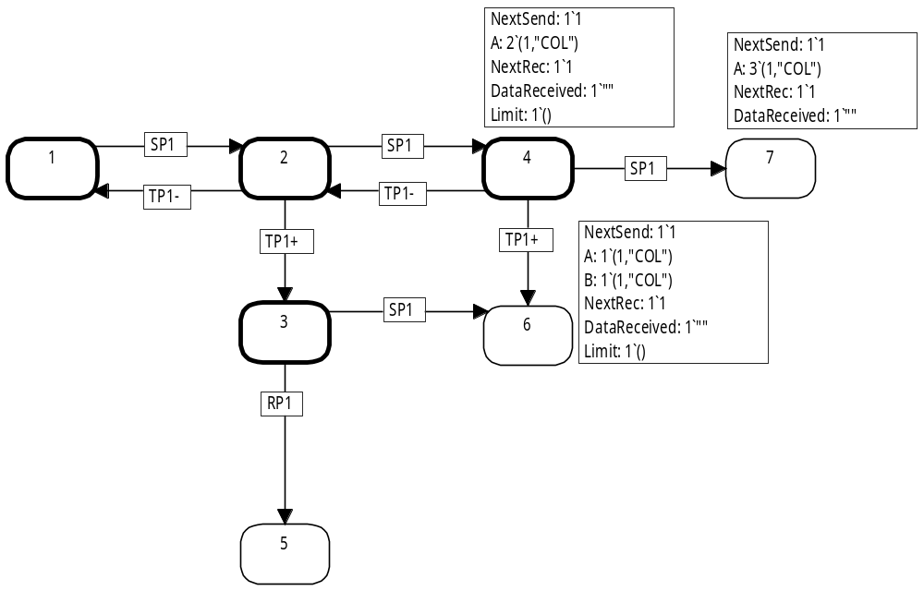
State space
1
2
4
7
Next we choose one of the unprocessed nodes: 4.
It has three enabled binding elements:
3
6
SP1 = (SendPacket, <n=1, d="COL">)
TP1+ = (TransmitPacket, <n=1, d="COL", success=true>)
TP1– = (TransmitPacket, <n=1, d="COL", success=false>)
5
This gives us a three new arcs and one new node 7.
Node 7 has three copies of data packet 1 on place A.
Node 4 is now marked as processed (thick border line).
Coloured Petri Nets
Department of Computer Science

Slide 9
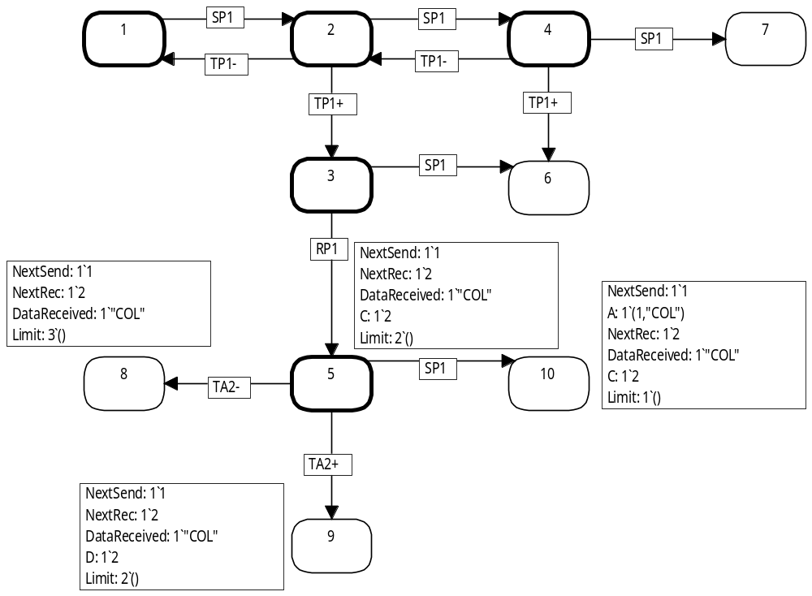
State space
1
2
4
7
3
6
Next we choose one of the unprocessed nodes: 5.
It has three enabled binding elements:
8
5
10
SP1 = (SendPacket, <n=1, d="COL">)
TA2+ = (TransmitAck, <n=2, success=true>)
TA2– = (TransmitAck, <n=2, success=false>)
9
This gives us three new arcs and three new nodes 8, 9 and 10.
Node 8 is identical to the initial marking except that NextRec and Data Received have been changed.
Node 5 is now marked as processed (thick border line).
Coloured Petri Nets
Department of Computer Science

Slide 10
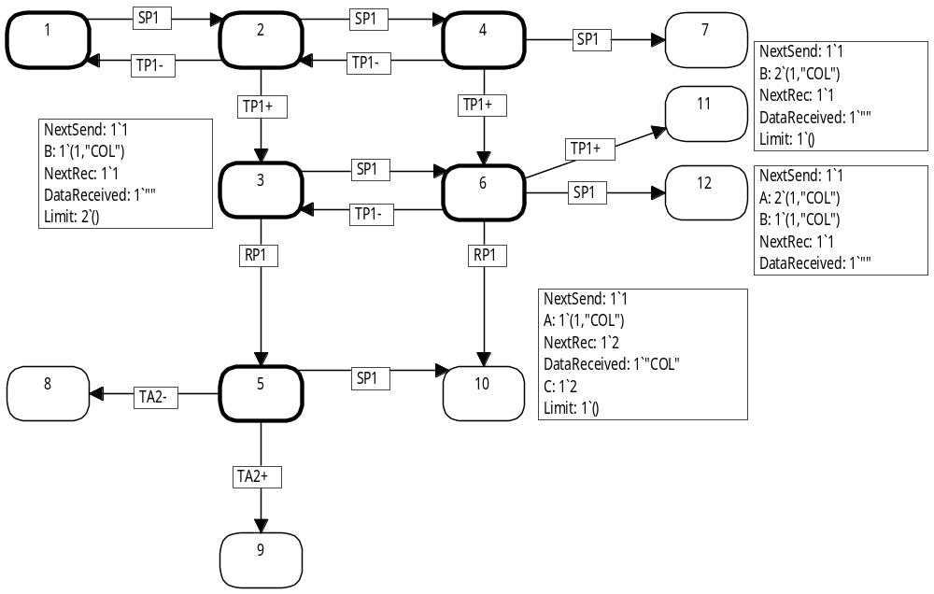
State space
1
2
4
7
11
3
6
12
Next we choose one of
the unprocessed nodes: 6.
It has four enabled
binding elements:
8
5
10
SP1 = (SendPacket, <n=1, d="COL">)
TP1+ = (TransmitPacket,
<n=1, d="COL", success=true>)
TP1– = (TransmitPacket,
<n=1, d="COL", success=false>)
RP1 = (ReceivePacket,
<n=1, d="COL", k=1, data = "">)
9
This gives us four new arcs and two new nodes 11 and 12.
Node 6 is now marked as processed.
Coloured Petri Nets
Department of Computer Science

Slide 11
State space
1
2
4
7
We continue to process
the nodes one by one.
If the state space is finite
construction terminates
when all reachable markings have been processed.
Otherwise, we continue forever – obtaining a larger and larger part of the state space.
11
3
6
12
13
8
5
10
14
15
9
16
18
This partial state space is visualised using the drawing facilities of the CPN state space tool.
19
17
20
22
Packet no. 1 and its acknowledgement have been successfully transmitted
21
23
Coloured Petri Nets
Department of Computer Science

Slide 12
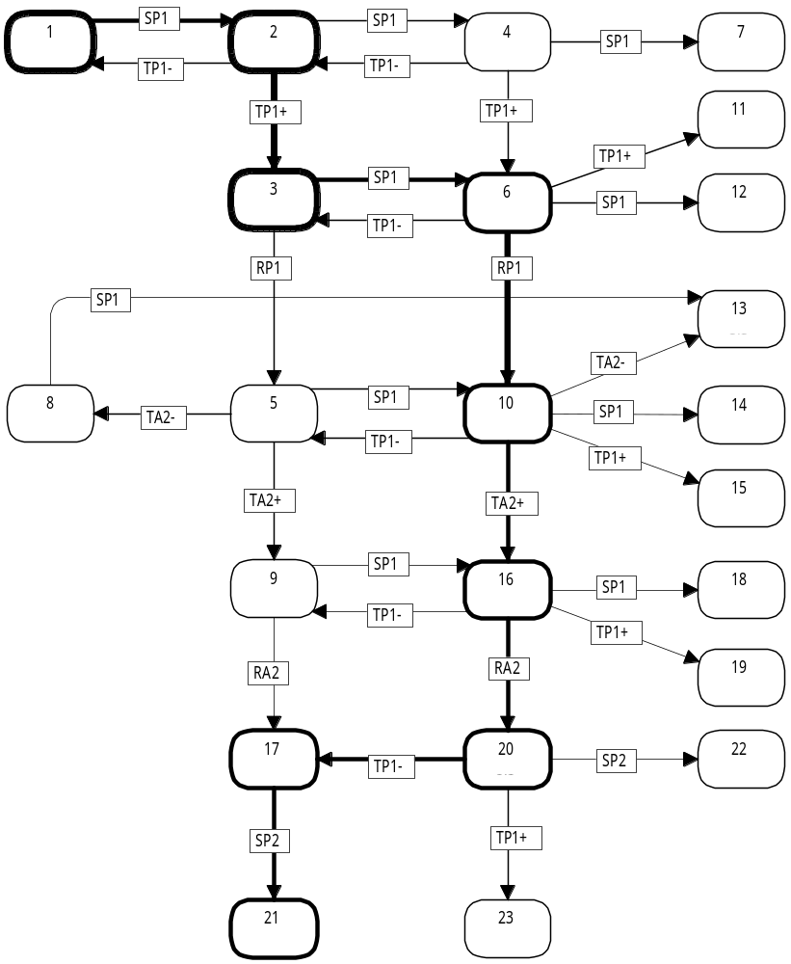
Directed path
1
2
4
7
11
A directed path is an alternating sequence of nodes and arcs.
Each directed path in the
state space corresponds
to an occurrence sequence where all steps contain a
single binding element.
3
6
12
13
8
5
10
14
15
9
16
18
Loops can be repeated.
Infinite number of occurrence
sequences.
19
17
20
22
21
23
Coloured Petri Nets
Department of Computer Science

Slide 13
Strongly connected components
A strongly connected component (SCC) is a maximal subgraph in which all nodes are reachable from each other.
Initial SCC
(no ingoing arcs)
The SCCs are mutually disjoint.
Each node is in exactly one SCC.
SCC graph contains:
A node for each SCC.
An arc from S_{i} to S_{j} for each state space arc from a node n_{i}∈S_{i} to a node n_{j}∈S_{j} (i≠j).
The SCC graph is acyclic.
Trivial SCC
(one node and no arcs)
Terminal SCC
(no outgoing arcs)
Coloured Petri Nets
Department of Computer Science

Slide 14
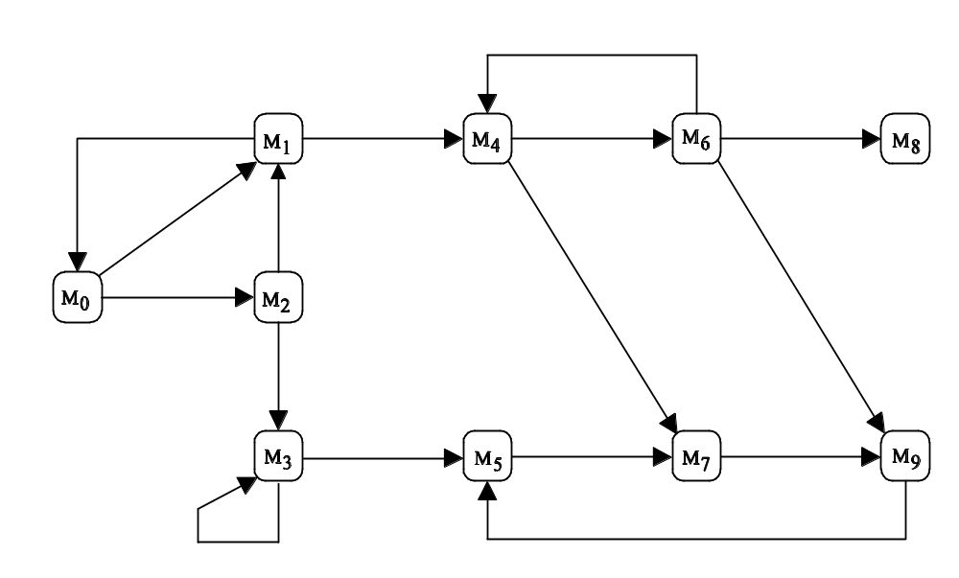
State space (example)
10 nodes and 16 arcs.
M₁
M₄
M₆
M₈
M₀
M₂
M₃
M₅
M₇
M₉
Coloured Petri Nets
Department of Computer Science

Slide 15
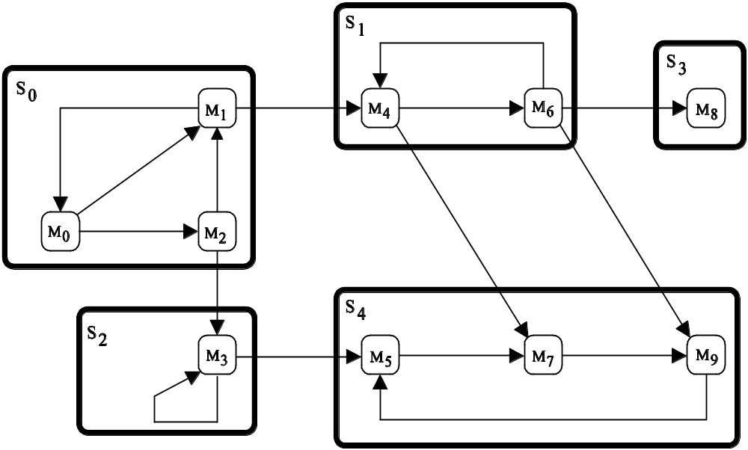
Strongly connected components
5 different SCCs.
S₁
S₃
S₀
M₁
M₄
M₆
M₈
Trivial SCC
(one node and no arcs)
M₀
M₂
S₄
S₂
M₃
M₅
M₇
M₉
Non-trivial SCC
(due to the arc)
Coloured Petri Nets
Department of Computer Science

Slide 16
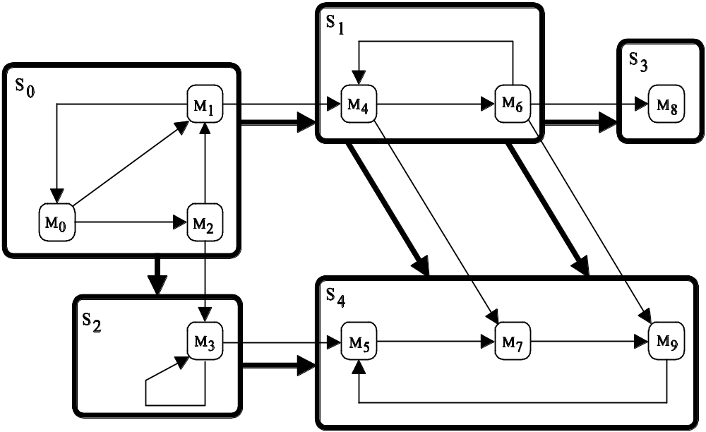
SCC graph
5 nodes and 6 arcs.
S₁
S₃
S₀
M₁
M₄
M₆
M₈
Two terminal SCCs
(no outgoing arcs)
M₀
M₂
S₄
S₂
M₃
M₅
M₇
M₉
Coloured Petri Nets
Department of Computer Science

Slide 17
State space construction and analysis
State spaces may be very large and hence we need computer tools to construct and analyse them.
Analysis of the state space starts with the generation of the state space report.
This is done totally automatic.
The report contains a lot of useful information about the behavioural properties of the CPN model.
The report is excellent for locating errors or increase our confidence in the correctness of the system.
Coloured Petri Nets
Department of Computer Science

Slide 18
State space report
The state space report contains information about standard behavioural properties which make sense for all CPN models:
  Size of the state space and the time used to generate it.
  Bounds for the number of tokens on each place and information about the possible token colours.
  Home markings.
  Dead markings.
  Dead and live transitions.
  Fairness properties for transitions.
Coloured Petri Nets
Department of Computer Science

Slide 19
State space report: size and time
State Space Statistics
State Space Scc Graph
Nodes: 13,215 Nodes: 5,013
Arcs: 52,784 Arcs: 37,312
Secs: 53 Secs: 2
Status: Full
State space contains more than 13.000 nodes and more than 52.000 arcs.
The state space was constructed in less than one minute and it is full – i.e. contains all reachable markings.
The SCC graph is smaller. Hence we have cycles.
The SCC graph was constructed in 2 seconds.
Coloured Petri Nets
Department of Computer Science

Slide 20
Reachability properties
1
2
4
7
11
3
6
12
The standard query function below checks whether marking M₁₇ is reachable from M₁
– i.e. whether there is a
path from node 1 to node 17.
13
8
5
10
14
15
Reachable (1,17);
true
9
16
18
19
We can also check whether M₁ is reachable from M₁₇:
17
20
22
Reachable (17,1);
false
21
23
Coloured Petri Nets
Department of Computer Science

Slide 21
Reachability properties (SCC)
1
2
4
7
11
3
6
12
It is also possible (and more efficient) to check reachability from the SCC graph.
Then we check whether there exists a path from the SCC containing the first marking to the SCC containing the second marking.
13
8
5
10
14
15
9
16
18
19
SccReachable (1,17);
true
17
20
22
SccReachable (17,1);
false
21
23
Coloured Petri Nets
Department of Computer Science

Slide 22
Desired terminal marking
The following predicate checks whether node n represents a marking in which all data packets have been successfully received.
fun DesiredTerminal n =
((Mark.Protocol’NextSend 1 n) == 1‘7) andalso
((Mark.Protocol’NextRec 1 n) == 1‘7) andalso
((Mark.Protocol’A 1 n) == empty) andalso
((Mark.Protocol’B 1 n) == empty) andalso
((Mark.Protocol’C 1 n) == empty) andalso
((Mark.Protocol’D 1 n) == empty) andalso
((Mark.Protocol’PacketsToSend 1 n) == AllPackets) andalso
((Mark.Protocol’DataReceived 1 n) == 1‘"COLOURED PETRI NET")
Structure
Module
Place
Equality of two multisets
Predefined function:
- Returns the marking of DataReceived
State space node
Instance number
Coloured Petri Nets
Department of Computer Science

Slide 23
Reachability of desired terminal marking
The following query checks whether the desired terminal marking is reachable:
ReachablePred DesiredTerminal;
true
Standard query function:
- Searches through all nodes
- Determines whether some of these fulfil the predicate
It is also possible to find the node(s) which represent the desired terminal marking:
PredAllNodes DesiredTerminal;
[4868]
Standard query function:
- Searches through all nodes
- Returns a list with those that fulfil the predicate
Coloured Petri Nets
Department of Computer Science

Slide 24
State space report: reachability properties
The state space report does not contain information about reachability properties.
The specific markings which it is of interest to investigate is highly model dependent – and there are too many to investigate all pairs.
The statistics in the state space report for the protocol shows that there are more than one SCC.
This implies that not all nodes in the state space are mutually reachable – as demonstrated above using standard query functions.
Coloured Petri Nets
Department of Computer Science

Slide 25
Integer bounds
Integer bounds counts the number of tokens on a place.
The best upper integer bound for a place is the maximal number of tokens on the place in a reachable marking.
The best lower integer bound for a place is the minimal number of tokens on the place in a reachable marking.
Places with an upper integer bound are bounded.
Places with no upper integer bound are unbounded.
0 is always a lower integer bound, but it may not be the best.
Coloured Petri Nets
Department of Computer Science

Slide 26
State space report: integer bounds
Best Integers Bounds Upper Lower
PacketsToSend 6 6
DataReceived 1 1
NextSend, NextRec 1 1
A, B, C, D 3 0
Limit 3 0
PacketsToSend has exactly 6 tokens in all reachable markings.
DataReceived, NextSend and NextRec have exactly one token each in all reachable markings.
The remaining five places have between 0 and 3 tokens each in all reachable markings.
Coloured Petri Nets
Department of Computer Science

Slide 27
More general integer bounds
It is also possible to find integer bounds for a set of places.
As an example, we might investigate how many tokens we have simultaneously on places A and B.
fun SumMarkings n =
(Mark.Protocol’A 1 n) ++
(Mark.Protocol’B 1 n);
Calculates the marking of A and B in marking n
UpperInteger SumMarkings;
LowerInteger SumMarkings;
3
0
Standard query functions
Argument must be a function mapping from a state space node into a multiset type: ’a ms
Coloured Petri Nets
Department of Computer Science

Slide 28
More general integer bounds
It is also possible to investigate integer bounds which consider only certain token colours and places.
As an example, we will investigate the minimal and maximal number of tokens with the colour (1,"COL") that can simultaneously reside on the places A and B:
Standard list function:
- Takes a predicate and
a list as arguments
- Returns those elements
that fulfil the predicate
fun SumFirstDataPacket n =
(List.filter
(fn p => p = (1,"COL"))
(SumMarkings n));
Marking of places A and B
CPN tools represents multisets as lists
UpperInteger SumFirstDataPacket;
LowerInteger SumFirstDataPacket;
3
0
Coloured Petri Nets
Department of Computer Science

Slide 29
Multiset bounds
Integer bounds count the number of tokens ignoring the token colours.
Multiset bounds provide information about the possible token colours.
The best upper multiset bound for a place is a multiset over the colour set of the place.
The coefficient for a colour c is the maximal number of occurrences of tokens with colour c in a reachable marking.
The best lower multiset bound for a place is a multiset over the colour set of the place.
The coefficient for a colour c is the minimal number of occurrences of tokens with colour c in a reachable marking.
Coloured Petri Nets
Department of Computer Science

Slide 30
State space report: upper multiset bounds
Best Upper Multiset Bounds
PacketsToSend 1‘(1,"COL")++1‘(2,"OUR")++1‘(3,"ED ")++
1‘(4,"PET")++1‘(5,"RI ")++1‘(6,"NET")
DataReceived 1‘""++1‘"COL"++1‘"COLOUR"++1‘"COLOURED "++
1‘"COLOURED PET"++1‘"COLOURED PETRI "++
1‘"COLOURED PETRI NET"
NextSend, NextRec 1‘1++1‘2++1‘3++1‘4++1‘5++1‘6++1‘7
A, B 3‘(1,"COL")++3‘(2,"OUR")++3‘(3,"ED ")++
3‘(4,"PET")++3‘(5,"RI ")++3‘(6,"NET")
C, D 3‘2++3‘3++3‘4++3‘5++3‘6++3‘7
Limit 3‘()
The upper bound for DataReceived is a multiset with seven elements although the place always has exactly one token.
Coloured Petri Nets
Department of Computer Science

Slide 31
State space report: lower multiset bounds
Best Lower Multiset Bounds
PacketsToSend 1‘(1,"COL")++1‘(2,"OUR")++1‘(3,"ED ")++
1‘(4,"PET")++1‘(5,"RI ")++1‘(6,"NET")
DataReceived empty
NextSend, NextRec empty
A, B, C, D empty
Limit empty
The lower bound for DataReceived is empty although the place always has exactly one token.
Coloured Petri Nets
Department of Computer Science

Slide 32
More general multiset bounds
Upper and lower multiset bounds can be generalised to
sets of places in a similar way as described for integer bounds.
UpperMultiSet SumMarkings;
LowerMultiSet SumMarkings;
Standard query functions
Argument must be a function mapping from a state space node into a multiset type: ’a ms
3‘(1,"COL") ++ 3‘(2,"OUR") ++ 3‘(3,"ED ") ++
3‘(4,"PET") ++ 3‘(5,"RI ") ++ 3‘(6,"NET")
empty
Coloured Petri Nets
Department of Computer Science

Slide 33
More general multiset bounds
Upper and lower multiset bounds can also be generalised to specific token colours residing on a set of places in a similar way as described for integer bounds.
UpperMultiSet SumFirstDataPacket;
LowerMultiSet SumFirstDataPacket;
3‘(1,"COL")
empty
Standard query functions
Argument must be a function mapping from a state space node into a multiset type ’a ms
Coloured Petri Nets
Department of Computer Science

Slide 34
Integer and multiset bounds
The two kinds of bounds supplement each other and provides different kinds of information.
DataReceived 1
Tells us that DataReceived has at most one token, but gives us no information about the token colours.
DataReceived 1‘""++1‘"COL"++1‘"COLOUR"++1‘"COLOURED "++
1‘"COLOURED PET"++1‘"COLOURED PETRI "++
1‘"COLOURED PETRI NET"
Tells us that DataReceived can have seven different token colours, but not whether they can be present simultaneously.
Coloured Petri Nets
Department of Computer Science

Slide 35
Home marking
A home marking is a marking M_{home} which can be reached from any reachable marking.
M₀
M
M_{home}
Initial marking
Arbitrary
reachable marking
Home
marking
This means that it is impossible to have an occurrence sequence which cannot be extended to reach M_{home}.
The home property tells that it is possible to reach M_{home}.
However, there is no guarantee that this will happen.
Coloured Petri Nets
Department of Computer Science

Slide 36
State space report: home markings
Home Properties
Home Markings: [4868]
There is a single home marking represented by node number 4868.
The marking of this node can be shown in the
CPN simulator.
Coloured Petri Nets
Department of Computer Science

Slide 37
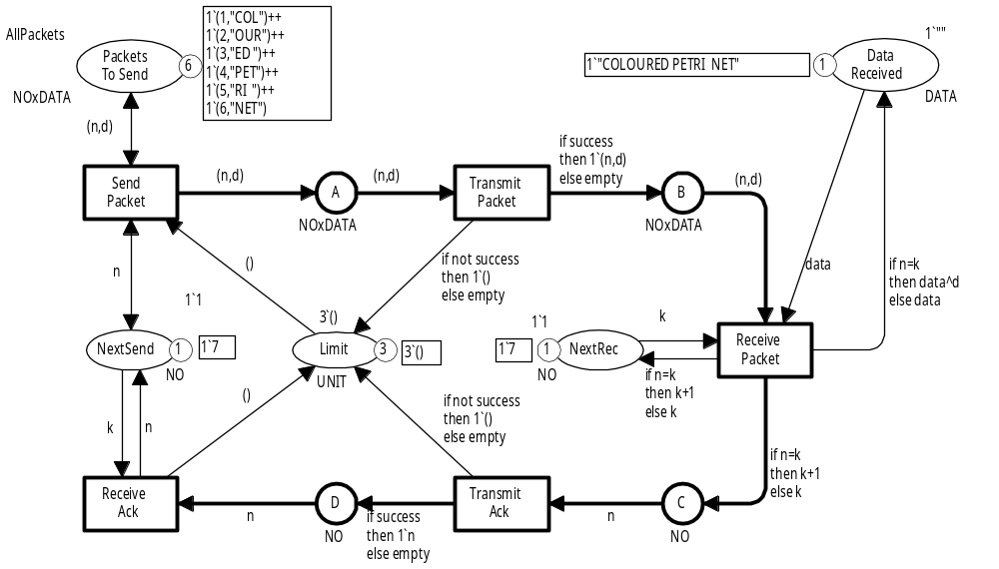

Home marking
All packets have been received
in the correct order
Sender is ready to send packet no. 7
Receiver is waiting for packet no. 7
All buffer places
are empty
Successful completion of transmission.
Coloured Petri Nets
Department of Computer Science

Slide 38
Home space
A home space is a set of markings M*_{home} such that at least one marking in M*_{home} can be reached from any reachable marking.
M₁₃
M₂₄
M*_{home}
M₀
M
M₅₇
M₄₅₆
Initial
marking
Arbitrary
reachable marking
M₅₂₇₈
Home space
This means that it is impossible to have an occurrence sequence which cannot be extended to reach a marking in M*_{home}.
The home property tells that it is possible to reach a
marking in M*_{home}.
However, there is no guarantee that this will happen.
Coloured Petri Nets
Department of Computer Science

Slide 39
Home predicate
A home predicate is a predicate on markings Pred_{home} such that at least one marking satisfying Pred_{home} can be reached from any reachable marking.
M₂₃
M₄₇
M₀
M
M₅₁₇
M₈₁₆
Initial
marking
Arbitrary
reachable marking
Markings
satisfying Pred_{home}
This means that it is impossible to have an occurrence sequence which cannot be extended to reach a marking satisfying Pred_{home}.
The home property tells that it is possible to reach a
marking satisfying Pred_{home}.
However, there is no guarantee that this will happen.
Coloured Petri Nets
Department of Computer Science

Slide 40
Use of home predicate
Instead of inspecting node 4868 in the CPN simulator we can check whether DesiredTerminal is a home predicate:
fun DesiredTerminal n =
((Mark.Protocol’NextSend 1 n) == 1‘7) andalso
((Mark.Protocol’NextRec 1 n) == 1‘7) andalso
((Mark.Protocol’A 1 n) == empty) andalso
((Mark.Protocol’B 1 n) == empty) andalso
((Mark.Protocol’C 1 n) == empty) andalso
((Mark.Protocol’D 1 n) == empty) andalso
((Mark.Protocol’PacketsToSend 1 n) == AllPackets) andalso
((Mark.Protocol’DataReceived 1 n) == 1‘"COLOURED PETRI NET")
HomePredicate DesiredTerminal;
true
Standard query function
Argument must be a predicate on markings
Coloured Petri Nets
Department of Computer Science

Slide 41
Use of home properties to locate errors
Home properties are excellent to locate certain kinds of errors.
As an example, consider a CPN model of a telephone system.
If all users stop calling and terminate all ongoing calls, the system is expected to reach an idle system state in which all lines and all equipment are unused and no calls are in progress.
The idle system state will be represented:
  by a home marking (if the system is without memory),
  by a home space (if information is stored about prior activities).
If one or more reachable markings exist from which we cannot reach the idle system state, we may have made a modelling error or a design error – e.g., forgotten to return some resources.
Coloured Petri Nets
Department of Computer Science

Slide 42
Home markings and SCCs
The existence of home markings can be determined from the number of terminal SCCs.
S₀
Only one terminal SCC:
  All markings in the terminal SCC are home markings.
  No other markings are home markings.
S₁
S₂
S₃
More than one terminal SCC:
  No home markings.
S₀
S₁
S₂
S₃
S₄
Coloured Petri Nets
Department of Computer Science

Slide 43
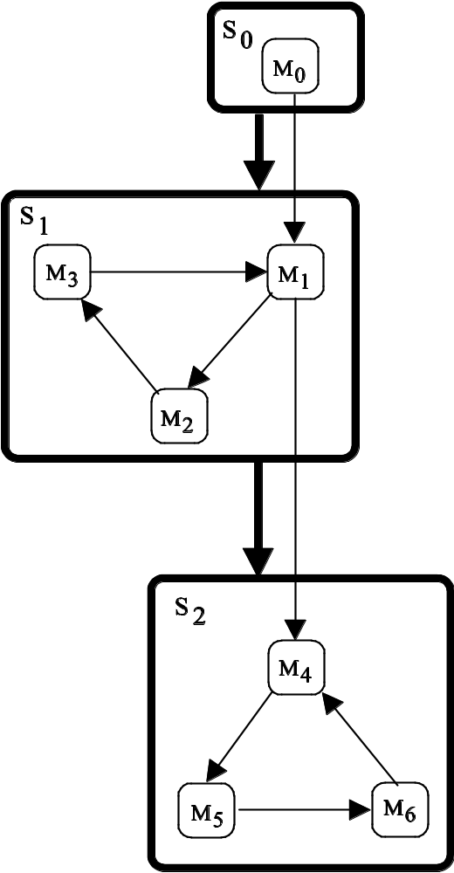
Single terminal SCC
S₀
M₀
S₁
All markings in the terminal SCC S₂ are home markings.
No other markings are home markings.
M₃
M₁
M₂
S₂
M₄
M₅
M₆
Coloured Petri Nets
Department of Computer Science

Slide 44
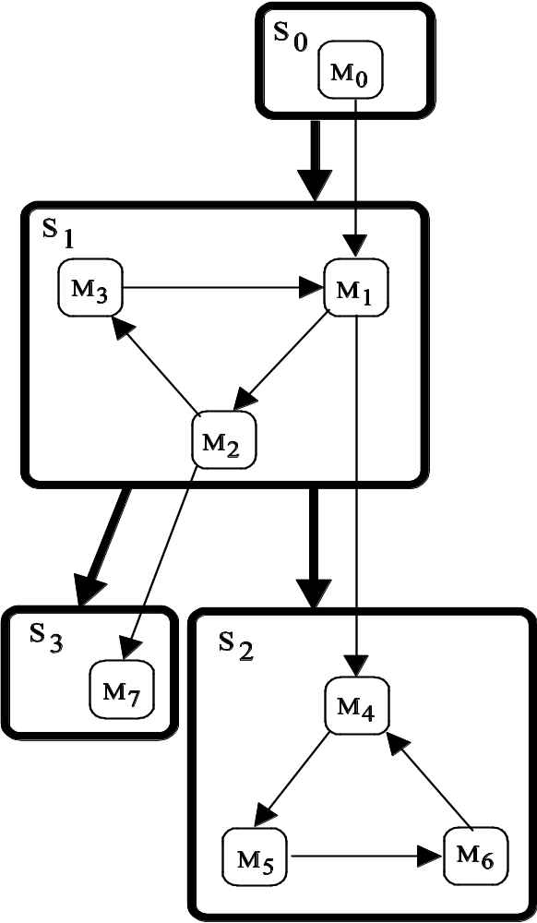
More than one terminal SCC
S₀
M₀
S₁
M₃
M₁
No home markings.
When one of the terminal SCCs S₂ and S₃ has been reached, it is impossible to leave it again.
M₂
S₃
S₂
M₇
M₄
M₅
M₆
Coloured Petri Nets
Department of Computer Science

Slide 45
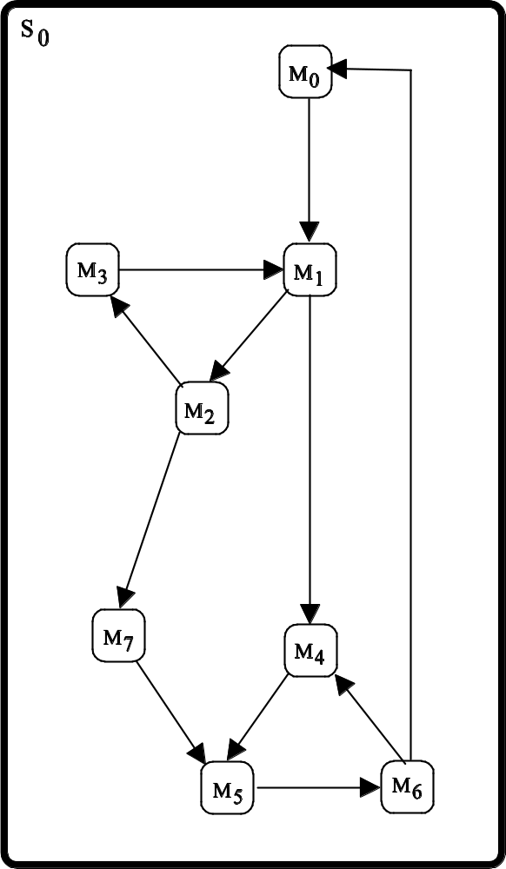
Single SCC
S₀
M₀
All reachable markings are home markings.
They are mutually reachable from each other.
M₃
M₁
M₂
M₇
M₄
M₅
M₆
Coloured Petri Nets
Department of Computer Science

Slide 46
Calculation of home markings
The CPN state space tool uses the following query to calculate the set of all home markings:
fun ListHomeMarkings () =
let
val Terminal_Sccs = PredAllSccs SccTerminal;
in
case Terminal_Sccs of
[scc] => SccToNodes scc
| _ => []
end;
Checks whether an SCC is terminal
Standard query function:
- Searches through all
nodes in the SCC graph
- Returns those which
fulfil the predicate
Exactly one terminal SCC
Returns the state space nodes in the strongly connected component scc
Coloured Petri Nets
Department of Computer Science

Slide 47
Home spaces and SCCs
The size of home spaces can be determined from the number of terminal components in the SCC graph.
A set of markings is a home space if and only if it contains a node from each terminal SCC.
Home spaces must have at least as many elements as there are terminal SCCs.
S₀
S₁
S₂
S₃
S₄
Each home marking is a home space with only one element.
A system may have home spaces without having home markings.
Coloured Petri Nets
Department of Computer Science

Slide 48
Liveness properties – being dead
A marking M is dead if M has no enabled transitions.
A transition t is dead if t never can occur – i.e. is disabled in all reachable markings.
Generalisations:
A binding element is dead if it can never become enabled.
A set of binding elements is dead if none of the binding elements can become enabled.
A set of transitions is dead if the union of their binding elements is dead.
Coloured Petri Nets
Department of Computer Science

Slide 49
State space report: being dead
Liveness Properties
Dead Markings: [4868]
Dead Transitions: None
Live Transitions: None
There is a single dead marking represented by node number 4868.
  Same marking as home marking.
There are no dead transitions.
Coloured Petri Nets
Department of Computer Science

Slide 50
Marking no 4868
We have seen that marking M₄₈₆₈ represents the state in which we have achieved successful completion of the transmission.
M₄₈₆₈ is the only dead marking.
Tells us that the system is partially correct. If execution terminates we will have the correct result.
M₄₈₆₈ is a home marking.
Tells us that it always is possible to reach the correct result
– independently of the number of losses and overtakings.
Coloured Petri Nets
Department of Computer Science

Slide 51
Being dead
It is straightforward to check whether markings, transitions and binding elements are dead.
A marking is dead if the corresponding state space node has no outgoing arcs.
A transition is dead if it does not appear on an arc in the state space.
A binding element is dead if it does not appear on an arc in the state space.
A set of binding elements is dead if no binding element in the set appears on an arc in the state space.
A set of transitions is dead if none of their binding elements appear on an arc in the state space.
Coloured Petri Nets
Department of Computer Science

Slide 52
Calculation of dead markings
The CPN state space tool uses the following query to calculate the set of all dead markings:
Maps a state space node into its outgoing arcs
fun ListDeadMarkings () =
PredAllNodes (fn n => (OutArcs n) = []);
Standard query function:
- Searches through all
nodes in the state space
- Returns a list with those
that fulfil the predicate
Checks whether the set of output arcs is empty
Coloured Petri Nets
Department of Computer Science

Slide 53
Calculation of dead transitions
The CPN state space tool uses the following query to check whether a transition instance is dead:
Maps a state space arc into its transition instance
fun TransitionInstanceDead ti =
(PredAllArcs (fn a => ArcToTI a = ti)) = [];
Standard query function:
- Searches through all
arcs in the state space
- Returns a list with those
that fulfil the predicate
Checks whether the arc a has the transition instance ti in its label
Coloured Petri Nets
Department of Computer Science

Slide 54
Calculation of dead binding elements
We want to check whether the Sender can receive an acknowledgement with sequence number 1.
BEsDead ( [Bind.Protocol’ReceiveAck (1,{k=1,n=1}),
Bind.Protocol’ReceiveAck (1,{k=2,n=1}),
Bind.Protocol’ReceiveAck (1,{k=3,n=1}),
Bind.Protocol’ReceiveAck (1,{k=4,n=1}),
Bind.Protocol’ReceiveAck (1,{k=5,n=1}),
Bind.Protocol’ReceiveAck (1,{k=6,n=1}),
Bind.Protocol’ReceiveAck (1,{k=7,n=1})],1);
Standard query function
List of binding elements
Structure
Module
Transition
Instance
Binding
Initial
Marking
Constructor
Returns the specified binding element
true
Not possible to receive such acknowledgments.
Coloured Petri Nets
Department of Computer Science

Slide 55
Liveness properties – being live
A transition t is live if we from any reachable marking can find an occurrence sequence containing t.
M₀
M₁
M₂
t
Initial marking
Arbitrary
reachable marking
Marking where t is enabled
Liveness tells that it is possible for t to occur.
However, there is no guarantee that this will happen.
Coloured Petri Nets
Department of Computer Science

Slide 56
Liveness is a strong property
M₀
M₁
M₂
t
Initial marking
Arbitrary
reachable marking
Marking where t is enabled
If the live transition t occurs in the marking M₂ we reach another reachable marking.
We can use the new marking as M₁ and hence t is able to occur once more, and so on.
This means that there exists infinite occurrence sequences in which t occurs infinitely many times.
It is possible to be non-dead without being live.
Coloured Petri Nets
Department of Computer Science

Slide 57
State space report: being live
Liveness Properties
Dead Markings: [4868]
Dead Transitions: None
Live Transitions: None
There are no live transitions
Trivial consequence of the existence of a dead marking.
Coloured Petri Nets
Department of Computer Science

Slide 58
Generalisations of liveness
A binding element is live if it can always become enabled.
A set of binding elements is live if it is always possible to enable at least one binding element in the set.
A set of transitions is live if the union of their binding elements is live.
Coloured Petri Nets
Department of Computer Science

Slide 59
Liveness properties and SCCs
S₀
Liveness can be determined from the SCC graph.
S₁
S₂
S₃
S₄
A transition/binding element is live if and only if it appears on at least one arc in each terminal SCC.
A set of transitions/binding elements is live if and only if each of the terminal SCCs contains at least one arc with a transition/binding element from the set.
Coloured Petri Nets
Department of Computer Science

Slide 60
Single terminal SCC
S₀
M₀
S₁
A transition is live if it appears on an arc in the terminal SCC S₂.
M₃
M₁
M₂
S₂
M₄
M₅
M₆
Coloured Petri Nets
Department of Computer Science

Slide 61
More than one terminal SCC
S₀
M₀
S₁
M₃
M₁
A transition is live if it appears on an arc in each terminal SCC.
No live transitions.
S₃ is terminal and trivial.
M₇ is a dead marking.
M₂
S₃
S₂
M₇
M₄
M₅
M₆
Coloured Petri Nets
Department of Computer Science

Slide 62
Single SCC
S₀
M₀
A transition is live if it appears on an arc in the SCC.
In this case we have:
A transition is live if and only is it is non-dead.
M₃
M₁
M₂
M₇
M₄
M₅
M₆
Coloured Petri Nets
Department of Computer Science

Slide 63
Fairness properties
A transition t is impartial if t occurs infinitely often in all infinite occurrence sequences.
M₀
M₁’
M₂”
M₃’
M₄”
t
t
t
t
M₁”
M₂’
M₃”
M₄’
Coloured Petri Nets
Department of Computer Science

Slide 64
State space report: fairness properties
Fairness Properties
Impartial Transitions: [SendPacket 1,TransmitPacket 1]
Instance no
Instance no
SendPacket and TransmitPacket are impartial.
If one of these are removed (or blocked by the guard false) the protocol will have no infinite occurrence sequences.
The other three transitions are not impartial.
If we remove the Limit place only SendPacket will be impartial.
Adding the Limit place has changed the behavioural properties.
Coloured Petri Nets
Department of Computer Science

Slide 65
Generalisations of impartial
A binding element is impartial if it occurs infinitely often in all infinite occurrence sequences.
A set of binding elements is impartial if binding elements from the set occurs infinitely often in all infinite occurrence sequences.
A set of transitions is impartial if the union of their binding elements is impartial.
Coloured Petri Nets
Department of Computer Science

Slide 66
Fairness properties and SCCs
Impartiality of a transition/binding element X can be checked by means of an SCC graph:
Construct the pruned state space in which all arcs with X are removed.
Construct the SCC graph of the pruned state space.
X is impartial if and only if the two graphs have the same size (are isomorphic).
Impartiality of a set of transitions/binding elements is checked in a similar way.
Coloured Petri Nets
Department of Computer Science

Slide 67
Use of fairness properties
As an example, we will investigate whether the set of binding elements corresponding to loss of data packets and acknowledgements is impartial.
If the protocol does not terminate we expect this to be because the network keeps losing packets, and we therefore expect this set of binding elements to be impartial.
Coloured Petri Nets
Department of Computer Science

Slide 68
Use of fairness properties
Binding elements which lose a data packet
BEsImpartial
(List.map
(fn (n,d) =>
Bind.StateSpaceProtocol’TransmitPacket
(1,{n=n,d=d,success=false}))
AllPackets)
^^
(List.map
(fn (n,_) =>
Bind.StateSpaceProtocol’TransmitAck
(1,{n=n+1,success=false}))
AllPackets);
Standard query function
List concatenation
true
Binding elements which lose an acknowledgement
Coloured Petri Nets
Department of Computer Science

Slide 69
State space report / query functions
The state space report contains information about standard behavioural properties which make sense for all CPN models.
Non-standard behavioural properties can be investigated by means of queries.
For some purposes it is sufficient to provide arguments to a predefined query function – e.g. to check whether a set of markings constitute a home space.
For other more special purposes it is necessary to write your own query functions using the CPN ML programming language.
Coloured Petri Nets
Department of Computer Science

Slide 70
Example of user-defined query function
We want to check whether the protocol obeys the stop-and-wait strategy – i.e. that the sender always sends the data packet expected by the receiver (or the previous one).
Converts a multiset 1`x with one element to the colour x
fun StopWait n =
let
val NextSend = ms_to_col (Mark.Protocol’NextSend 1 n);
val NextRec = ms_to_col (Mark.Protocol’NextRec 1 n);
in
(NextSend = NextRec) orelse (NextSend = NextRec - 1)
end;
val SWviolate = PredAllNodes (fn n => not (StopWait n));
Predefined search function
Negation
The stop-and-wait strategy is not satisfied (7020 violations).
We check whether some states violate the property.
This is easier than checking that all states fulfil the property.
Coloured Petri Nets
Department of Computer Science

Slide 71
Violation of stop-and-wait strategy
Acknowledgements may overtake each other on C and D.
This means that it is possible for the sender to receive an old acknowledgement which decrements NextSend.
Coloured Petri Nets
Department of Computer Science

Slide 72
Shortest counterexample
We want to construct a shortest counterexample – i.e. to find one of the shortest occurrence sequences leading from the initial marking to a marking where the predicate does not hold.
The state space is generated in breadth-first order.
Hence, we search for the lowest numbered node in the list SWviolate.
Coloured Petri Nets
Department of Computer Science

Slide 73
Lowest node in SWviolate
List.foldr
Int.min
(List.hd SWviolate)
(List.tl SWviolate);
Combination function
Predefined function:
- Takes 3 arguments
Initial value
List
The function iterates over the list.
In each iteration the combination function is applied to the pair consisting of the current element in the list and the value returned by the previous application of the combination function.
In the first iteration, the initial value plays the role of the result from the previous application.
557
Violating marking (as close to M₀ as possible)
Can be expected in the simulator
Coloured Petri Nets
Department of Computer Science

Slide 74
Shortest counterexample
[1,3,9,16,27,46,71,104,142
201,265,362,489,652, 854
1085,1354,1648]
ArcsInPath(1,557);
18 arcs
Predefined function:
- Returns the arcs in one of the
shortest paths from 1 to 557
Lowest numbered node in the list SWviolate
The path can be visualised using the drawing facilities in the CPN state space tool.
This is the same drawing facilities that were used to visualise the initial fragment of the state space (at the beginning of this lecture).
Coloured Petri Nets
Department of Computer Science

Slide 75
Bindings elements in counterexample
The binding elements in the shortest path can be obtained by the following query:
List.map (ArcToBE (ArcsInPath(1,557)));
Maps a state space arc into its binding element
Shortest path with counterexample
Coloured Petri Nets
Department of Computer Science

Slide 76
Shortest counterexample
1 (SendPacket, <d="COL",n=1>)
2 (TransmitPacket, <n=1,d="COL",success=true>)
3 (ReceivePacket, <k=1,data="",n=1,d="COL“>)
4 (SendPacket, <d="COL",n=1>)
5 (TransmitAck, <n=2,success=true>)
6 (ReceiveAck, <k=1,n=2>)
7 (SendPacket, <d="OUR",n=2>)
8 (TransmitPacket, <n=1,d="COL",success=true>)
9 (TransmitPacket, <n=2,d="OUR",success=true>)
10 (ReceivePacket, <k=2,data="COL",n=1,d="COL“>)
11 (ReceivePacket, <k=2,data="COL",n=2,d="OUR“>)
12 (TransmitAck, <n=3,success=true>)
13 (ReceiveAck, <k=2,n=3>)
14 (SendPacket, <d="ED ",n=3>)
15 (TransmitPacket, <n=3,d="ED ",success=true>)
16 (ReceivePacket, <k=3,data="COLOUR",n=3,d="ED “>)
17 (TransmitAck, <n=2,success=true>)
18 (ReceiveAck, <k=3,n=2>)
Packet no 1 and its ack
Packet no 2 and its ack
Packet no 3 NextRec = 4
Retrans-mission
NextSend = 2
Coloured Petri Nets
Department of Computer Science

Slide 77
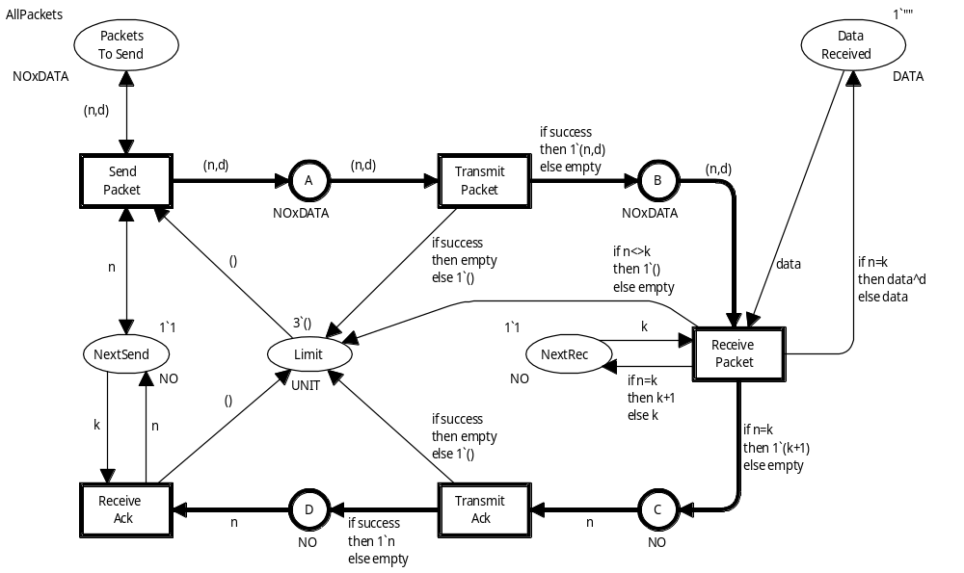
Revised protocol
Now we only send an acknowledgement when an expected packet is received.
Is the
new protocol correct?
Are the behavioural properties the same as before?
Coloured Petri Nets
Department of Computer Science

Slide 78

State space for revised protocol
The state space contains 1,823 nodes and 6,829 arcs.
Before we had 13,215 nodes and 52,874 arcs.
As before there is a single dead marking which corresponds to the desired terminal marking, where all packets have been successfully transmitted.
The new protocol is partially correct.
Now there are no home markings.
We can reach situations from which it is impossible to reach the desired terminal marking.
Coloured Petri Nets
Department of Computer Science

Slide 79
Analysis of revised protocol
The dead marking is no longer a home marking and hence we must have one or more terminal SCCs from which we cannot reach the dead marking.
These terminal SCCs can be found by the following query which returns all SCCs that are terminal but not trivial:
PredAllSccs (fn scc => SccTerminal scc andalso
not (SccTrivial scc));
Standard query function:
- Searches through all nodes in the SCC graph
- Returns those which fulfil the predicate
The result of the query is a list with six SCCs.
The state space nodes in the six SCCs can be obtained using the function SccToNodes.
To get a shortest counterexample, we choose the lowest numbered node which is node 12.
Coloured Petri Nets
Department of Computer Science

Slide 80
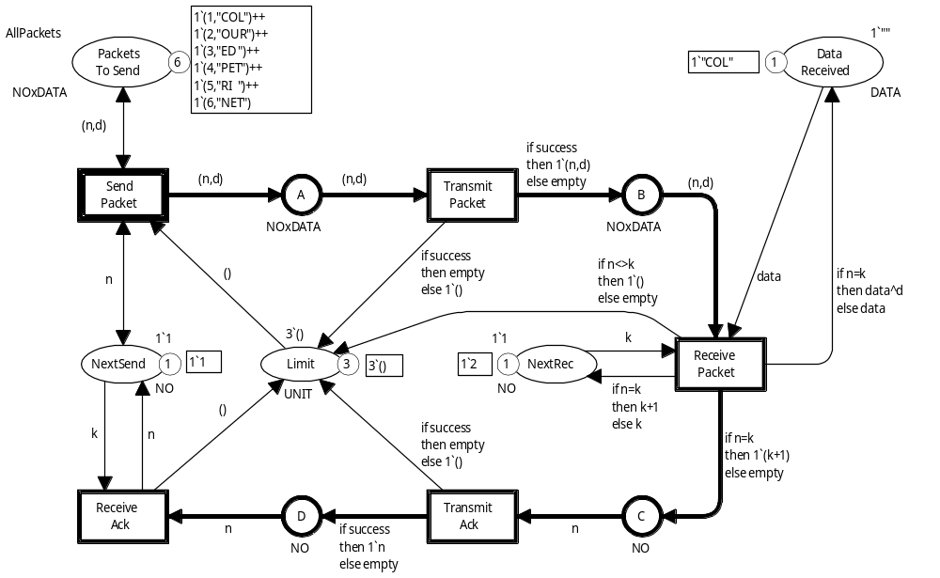
Marking no 12
Receiver has received packet no 1 and is now waiting for packet no 2
Sender is sending packet no 1
Acknowledgement requesting packet no 2 has been lost
All data packets will we “wrong”.
No acknowledgements will be sent – no progress.
Coloured Petri Nets
Department of Computer Science

Slide 81
What is wrong
The analysis of marking no 12 has told us what the problem is.
The sender continues to send wrong packets and the receiver never sends an acknowledgement which can correct the problem.
We might also want to know how we arrived at this unfortunate situation.
This is done by constructing an error trace / counterexample.
Coloured Petri Nets
Department of Computer Science

Slide 82
Counterexample
The query below returns a list with all the arcs in one of the shortest paths from node 1 (initial marking) to node number 12:
ArcsInPath(1,12);
The binding elements in the shortest path can be obtained by the following query:
List.map (ArcToBE (ArcsInPath(1,12)));
Maps a state space arc into its binding element
Coloured Petri Nets
Department of Computer Science

Slide 83
Counterexample
The result of the query is the following list of binding elements:
1 (SendPacket, <d="COL", n=1>)
2 (TransmitPacket, <d="COL",n=1,success=true>)
3 (ReceivePacket, <d="COL",n=1,k=1, data="">)
4 (TransmitAck, <n=2,success=false>)
We see that data packet no 1 was sent, successfully transmitted, and received.
However, the acknowledgment requesting data packet no 2 was lost on the network.
Coloured Petri Nets
Department of Computer Science

Slide 84
System configurations
With state space analysis we always investigate a system for a particular configuration of the system parameters.
In practice it is often sufficient to consider a few rather small configurations – although we cannot be totally sure that larger configurations will have the same properties.
As system parameters increase the size of the state space increases – often in an exponential way.
This is called state space explosion, and it is one of the most severe limitations of the state space method.
Coloured Petri Nets
Department of Computer Science

Slide 85
Different system configurations
Limit | Packets | Nodes | Arcs | Limit | Packets | Nodes | Arcs
1 | 10 | 81 | 110 | 5 | 1 | 217 | 760
1 | 20 | 161 | 220 | 5 | 2 | 2,279 | 10,645
1 | 50 | 401 | 550 | 5 | 3 | 17,952 | 97,963
1 | 100 | 801 | 1,100 | 5 | 4 | 82,260 | 483,562
1 | 600 | 4,801 | 6,600 | 5 | 5 | 269,680 | 1,655,021
2 | 1 | 26 | 53 | 7 | 1 | 576 | 2,338
2 | 5 | 716 | 1,917 | 7 | 2 | 11,280 | 64,297
2 | 10 | 3,311 | 9,062 | 7 | 3 | 148,690 | 1,015,188
2 | 20 | 14,276 | 39,402 | 10 | 1 | 1,782 | 8,195
2 | 50 | 93,371 | 258,822 | 10 | 2 | 76,571 | 523,105
3 | 1 | 60 | 159 | 12 | 1 | 3,276 | 15,873
3 | 5 | 7,156 | 28,201 | 12 | 2 | 221,117 | 1,636,921
3 | 10 | 70,131 | 286,746 | 13 | 1 | 4,305 | 21,294
3 | 15 | 253,656 | 1,047,716 | 13 | 2 | 357,957 | 2,737,878
Coloured Petri Nets
Department of Computer Science

Slide 86
Is it worthwhile?
State space analysis can be a time consuming process where it takes many hours to generate the state spaces and verify the desired properties.
However, it is fully automatic and hence requires much less human work than lengthy simulations and tests.
It may take days to verify the properties of a system by means of state spaces.
However, this is still a relatively small investment:
  compared to the total number of resources used in a system development project.
  compared to the cost of implementing, deploying and correcting a system with errors that could have been detected in the design phase.
Coloured Petri Nets
Department of Computer Science

Slide 87
Partial state spaces
It is sometimes impossible to generate the full state space for a given system configuration – either because it is too big or takes too long time.
This means that only a partial state space – i.e. a fragment of the state space is generated.
Partial state spaces cannot in general be used to verify properties, but they may identify errors.
As an example, an undesirable dead marking in a partial state space will also be present in the full state space.
Partial state spaces can in that sense be viewed as being positioned between simulation and state spaces.
The CPN state space tool has a number of parameters to control the generation of partial state spaces.
Coloured Petri Nets
Department of Computer Science

Slide 88
State spaces - summary
State spaces are powerful and easy to use.
  Construction and analysis can be automated.
  The user do not need to know the mathematics behind the analysis methods.
The main drawback is the state explosion – i.e. the size of the state space.
  The present CPN state space tool handles state spaces with up to one million states.
  For many systems this is not sufficient.
  A much more efficient state space tool is under development.
Coloured Petri Nets
Department of Computer Science

Slide 89
Reduced state spaces
Fortunately, it is often possible to construct reduced state spaces – without losing analytic power.
This is done by exploiting:
  Progress measure.
  Symmetries in the modelled system.
  Other kinds of equivalent behaviour.
  Concurrency between events.
The reduction methods rely on complex mathematics.
Coloured Petri Nets
Department of Computer Science

Slide 90

Questions
Coloured Petri Nets
Department of Computer Science

