Slide 1
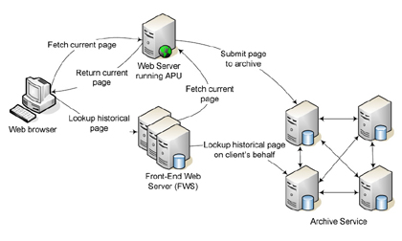
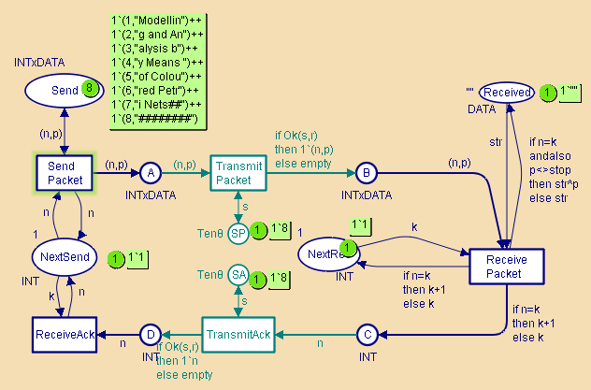
Coloured Petri Nets
Modelling and Validation of Concurrent Systems
Chapter 1: Modelling and Validation
Kurt Jensen & Lars Michael Kristensen
{kjensen,
lmkristensen}
@cs.au.dk
Concurrent system
Model
Coloured Petri Nets
Department of Computer Science

Slide 2
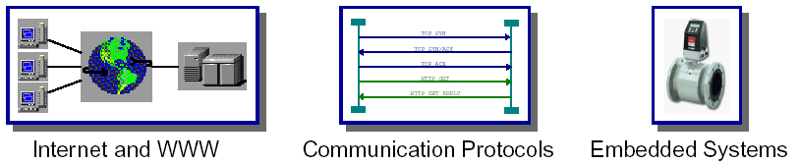
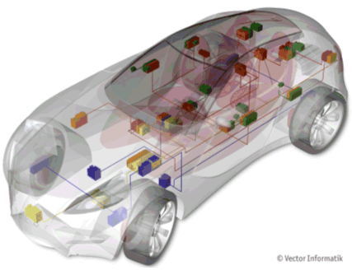
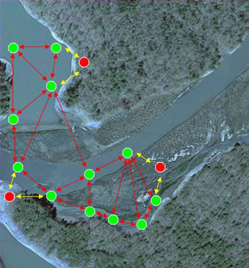
Concurrent systems
Most modern it systems are distributed and concurrent:
Internet and WWW
Modern car
Sensor network
Coloured Petri Nets
Department of Computer Science

Slide 3
Concurrent systems are difficult to design
They possess concurrency and non-determinism.
The execution may proceed in many different ways, e.g. depending on:
  Whether messages are lost during transmission.
  The scheduling of processes.
  The time at which input is received from the environment.
Concurrent systems have an astronomical number of possible executions.
  It is easy for the designer to miss important interaction patterns.
  This may lead to gaps or malfunctions in the system design.
Coloured Petri Nets
Department of Computer Science

Slide 4
Concurrent systems are often critical
For many concurrent systems it is essential that they
work correctly from the very beginning:
  Nuclear power-plants.
  Aircraft control systems.
  Hospital life support equipment.
  Computer networks.
  Bank system.
To cope with the complexity of modern concurrent systems, it is crucial to provide methods that enable debugging and testing of central parts of the system designs prior to implementation and deployment.
Coloured Petri Nets
Department of Computer Science

Slide 5
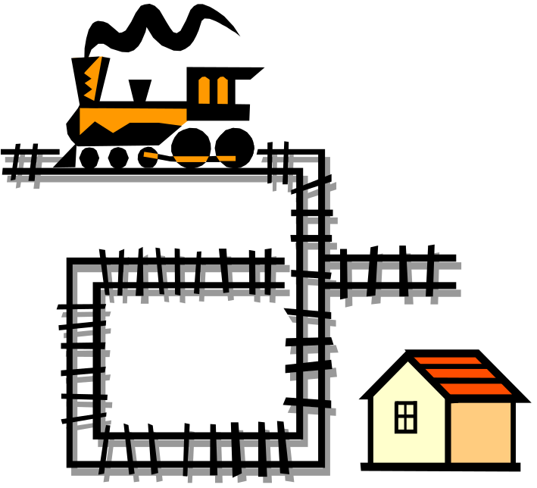
Modelling
One way to approach the challenge of developing concurrent systems is to build a model of the system.
Modelling is a universal technique that can be used across many of the activities in system development.
Many modelling languages
exist, e.g.:
  Unified Modelling
  Language (UML).
  De-facto standard of
  the software industry.
Coloured Petri Nets
Department of Computer Science

Slide 6
Model based system development
One way to approach the challenges posed by concurrent systems is to build a model.
A model is an abstract representation which can be manipulated by means of a computer tool.
Concurrent system
Model
Using a model it becomes possible to investigate how the system will behave and the properties it will possess.
Coloured Petri Nets
Department of Computer Science

Slide 7
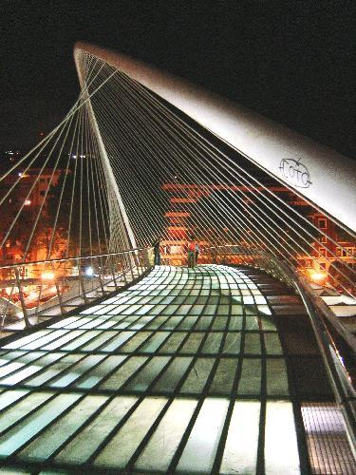
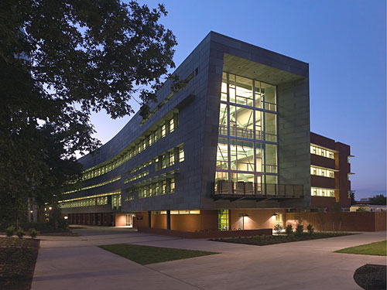
Modelling is also used in other disciplines
Modelling is also used in many other disciplines:
  When engineers construct a bridge.
  When architects design a building.
For a bridge models can be used to test the:
  Aesthetics.
  Strength.
  Wind turbulence.
  Traffic load.
  and so on.
Modelling is typically done in the early phases of system development.
Coloured Petri Nets
Department of Computer Science

Slide 8
Models created by architects
Architects make:
  Architectural drawings (on paper or on a computer).
  3D models in cardboard, plastic or plywood.
  Computerised 3D-animation.
The purpose is to get a better impression of the building.
The models allow the architect, the owners, and the users of the building to imagine how the building will look and how it will function, e.g.:
  Whether some corridors are too narrow.
  Some doors so close to each other that they may create dangerous situations.
It is obviously preferable to detect and correct design errors and other shortcomings before the construction of the real building commences.
Coloured Petri Nets
Department of Computer Science

Slide 9

Why do we make models?
We make models to:
Gain insight in the system
which is being designed.
Get ideas to improve the design.
Models also help us:
To ensure completeness in the design.
Improve the correctness of the design.
Coloured Petri Nets
Department of Computer Science

Slide 10
Gain insight
Modelling and simulation usually leads to significant new insights into the design and operation of the system.
  The modeller gains an elaborate and more complete understanding of the system (e.g., compared to reading design documents).
  The same applies to people for who witness a presentation of a model.
The new insight often results in a simpler and more streamlined design.
  By investigating a model, similarities can be identified that can be exploited to unify and generalise the design and make it more logical.
  We may also get ideas to improve the usability of the system.
Coloured Petri Nets
Department of Computer Science

Slide 11
Completeness
The construction of an executable model usually leads to a more complete specification of the design.
Gaps in the specification of the system become explicit:
  They will prohibit the model from being executed because certain parts are missing.
  During simulation the designers and users will discover that certain expected events are impossible in the current state.
Modelling leads to a more complete identification and understanding of the requirements to the system.
Models can be used to mediate discussions among designers and users of the system.
Coloured Petri Nets
Department of Computer Science

Slide 12
Correctness
Modelling often reveals a number of design errors and flaws.
It is possible to control the execution of a model (unlike the real system). This means that:
  Problematic scenarios can be reproduced.
  It is possible to check whether a proposed modification of the design works as intended.
Simulating a number of different scenarios does not necessarily lead to correct designs:
  There may be too many scenarios to investigate.
  The modeller may fail to identify some important scenarios.
However, a systematic investigation of scenarios often significantly decreases the number of design errors.
Coloured Petri Nets
Department of Computer Science

Slide 13
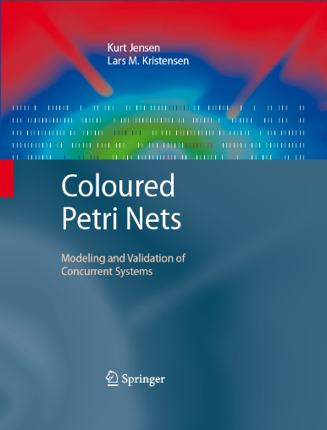
Coloured Petri Nets
Petri Nets:
graphical notation
concurrency
communication
synchronisation
CPN ML (Standard ML):
  data manipulation
  compact modelling
  parameterisable models
Graphical modelling language for concurrent systems.
Combination of Petri Nets and programming language.
www.cs.au.dk/CPnets/cpnbook/
Coloured Petri Nets
Department of Computer Science
Notes:
Make a short demonstration of CPN Tools here

Slide 14
General purpose language
The CPN modelling language is a general purpose modelling language aimed towards many kinds of concurrent systems.
Typical application domains of CP-nets are:
  communication protocols,
  data networks,
  distributed algorithms,
  embedded systems,
  business processes and workflows,
  manufacturing systems,
  agent systems.
A list of more than 100 industrial applications of CP-nets within different domains can be found on the CPN web pages:
  www.cs.au.dk/CPnets/
Coloured Petri Nets
Department of Computer Science

Slide 15
High-level Petri Nets
Petri Nets are divided into low-level and high-level Petri Nets.
Coloured Petri Nets are high-level Petri Nets.
Low-level Petri Nets (such as Place/Transitions Nets) are primarily suited as a theoretical model for concurrency, but are also applied for modelling and verification of hardware systems.
High-level Petri Nets (such as CP-nets and Predicate/Transitions Nets) are aimed at practical use, in particular because they allow for construction of compact and parameterised models.
High-level Petri Nets is an ISO/IEC standard and the CPN modelling language and supporting computer tools conform to this standard.
Coloured Petri Nets
Department of Computer Science

Slide 16
Interactive simulation
CP-nets can be simulated interactively or automatically.
An interactive simulation is similar to single-step debugging.
It provides a way to ”walk through” a CPN model, investigating different scenarios in detail and checking whether the model works as expected.
The modeller is in charge and determines the next step by selecting between the enabled events in the current state.
It is possible to observe the effects of the individual steps directly on the graphical representation of the CPN model.
This is similar to an architect, who decides the exact route to follow while performing an interactive walk through a 3D computer model of a building.
Coloured Petri Nets
Department of Computer Science

Slide 17
Automatic simulation
Automatic simulation is similar to program executions.
The purpose is to execute the CPN models as fast and efficiently as possible, without detailed human interaction and inspection.
Automatic simulation is typically used for testing and performance analysis.
For testing the modeller typically sets up appropriate break-points and stop criteria.
For performance analysis the model is instrumented with data collectors to collect data concerning the performance of the system.
Coloured Petri Nets
Department of Computer Science

Slide 18
Time
Time plays a significant role in a wide range of concurrent systems.
  The correct functioning of some systems crucially depends on the time taken by certain activities.
  Different design decisions may have a significant impact on the performance of a system.
CP-nets include a time concept that makes it possible to capture the time taken by events in the system.
This means that CP-nets can be applied for:
  Simulation-based performance analysis (investigating performance measures such as delays, throughput, and queue lengths).
  Modelling and validation of real-time systems.
Coloured Petri Nets
Department of Computer Science

Slide 19
Abstraction is necessary
To be able to construct a model it is necessary to make abstractions – i.e. decide to omit a number of details.
Example:
An architect constructing an architectural model of a building using cardboard, plastic or plywood is unlikely to include any information about the plumbing and wiring of the building.
These things are irrelevant for the purpose of this kind of model, which usually is to be able to judge the aesthetics of the architectural design.
The architect constructs other models which contain a detailed specification of the wiring and plumbing.
Coloured Petri Nets
Department of Computer Science

Slide 20
How to find a good abstraction level?
The first questions to ask ourselves should be:
  What is the purpose of our model?
  What do we want to learn about the system from the model?
  What kinds of properties are we interested in investigating?
Without these questions it is impossible to make a good model.
We will be unable to decide:
  what should be included in the model,
  what can be omitted (abstracted away) without compromising
  the correctness of the conclusions to be drawn from the model.
CPN supports modelling at different abstraction levels.
Finding suitable abstraction levels is one of the arts of modelling.
Coloured Petri Nets
Department of Computer Science

Slide 21
Modules
CPN models can be structured into a set of modules.
  Important when dealing with CPN models of large systems.
The modules interact with each other through a set of well-defined interfaces (as known from programming languages).
The module concept of CP-nets is based on a hierarchical structuring mechanism allowing:
  a module to have submodules,
  a set of modules to be composed to form a new module,
  reuse of submodules in different parts of the model.
This enables the modeller to work both top-down and
bottom-up when constructing CPN models.
Coloured Petri Nets
Department of Computer Science

Slide 22
Different abstraction levels
It is possible to capture different abstraction levels of the modelled system in the same CPN model.
A CPN model with a high level of abstraction is typically constructed in the early stages of design or analysis.
This model is then gradually refined to yield a more detailed and precise description of the system under consideration.
This way of working makes CPN modelling a very cost-effective way to obtain a first executable prototype of a system.
Coloured Petri Nets
Department of Computer Science

Slide 23
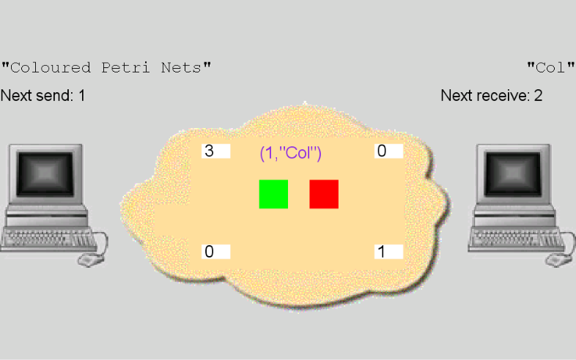
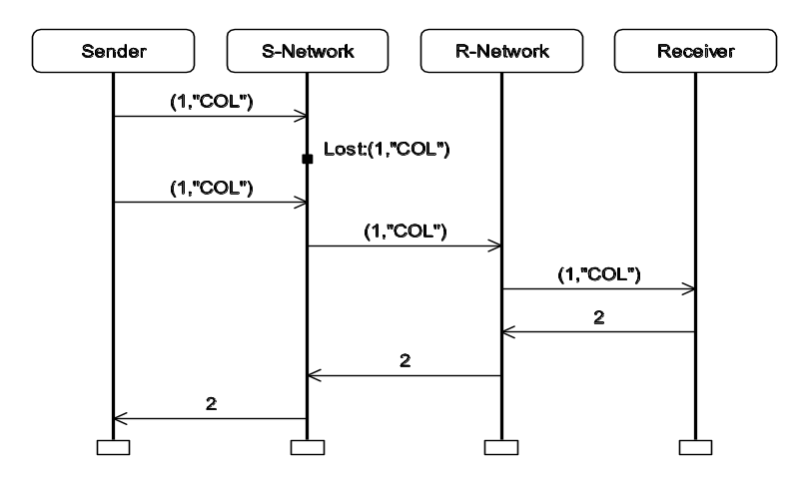
Visualisation
CPN supports visualisation making it possible to:
  present design ideas and analysis results using application domain concepts (instead of CPN concepts).
  hide some of the details in a complex simulation.
Visualisation is particularly important in discussions with people and colleagues unfamiliar with CP-nets.
Sender
S-Network
R-Network
Receiver
Coloured Petri Nets
Col
(1,”COL”)
(1,”COL”)
Lost:(1,”COL”)
(1,”COL”)
(1,”COL”)
2
2
2
Coloured Petri Nets
Department of Computer Science

Slide 24
CPN models are formal
The CPN modelling language has a mathematical definition of both its syntax and semantics.
The formal representation is the foundation for the definition of the different behavioural properties and the analysis methods.
Without the formal representation it would have been impossible to develop a sound and powerful CPN language.
Formal models can be used to verify system properties, i.e., prove that certain desired properties are fulfilled or that certain undesired properties are guaranteed to be avoided.
Coloured Petri Nets
Department of Computer Science

Slide 25
Verification
Verification involves a mathematical formulation of a property and a computer-assisted proof that this property is fulfilled by the model.
When verifying system properties, it is necessary to argue that the model captures those aspects that are relevant for the properties we are verifying.
It must also be ensured that the verified properties are those that we want the system to possess.
This means that formal verification is always accompanied by informal justifications.
Coloured Petri Nets
Department of Computer Science

Slide 26
State space method
Verification of CPN models and system properties is supported by the state space method.
The basic idea of state spaces is to compute all reachable states and state changes of the CPN model and represent these as a directed graph, where:
  nodes represent states,
  arcs represent
  occurring events.
State spaces can
be constructed
fully automatically.
2
5
1
3
7
6
4
8
Coloured Petri Nets
Department of Computer Science

Slide 27
Behavioural questions
From a state space it is possible to answer a large set of questions concerning the behaviour of the system such as:
  Are there any deadlocks?
  Is it always possible to reach a specified state?
  Is the system guaranteed to provide a given service?
2
5
Cycle (no guarantee for termination)
1
3
7
6
Deadlock
4
8
Coloured Petri Nets
Department of Computer Science

Slide 28
State spaces – pros
State spaces are relatively easy to use, and they have a high degree of automation.
  It is possible to hide a large portion of the underlying mathematics from the user.
  Often the user only needs to formulate the property which is to be verified and then apply a computer tool.
State spaces can provide counterexamples (error-traces) giving detailed debugging information specifying why an expected property does not hold.
Coloured Petri Nets
Department of Computer Science

Slide 29
State spaces – cons
The main disadvantage of state spaces is the state explosion problem.
Even relatively small systems may have an astronomical or even infinite number of reachable states.
A wide range of state space reduction methods have been developed to alleviate the state explosion problem.
Coloured Petri Nets
Department of Computer Science

Slide 30
Validation
Practical use of CP-nets typically relies on a combination of:
    interactive and automatic simulation,
    visualisation,
    state space analysis,
    performance analysis.
  This set of activities results in a validation of the system.
    It is justified that the system has the desired properties.
    A high degree of confidence and understanding of the system is obtained.
Coloured Petri Nets
Department of Computer Science

Slide 31

History of CP-nets
CP-nets has been developed by the
CPN group at Aarhus University,
Denmark since 1979.
The first version was part of the PhD thesis of Kurt Jensen and was published in 1981.
  It was inspired by the pioneering work of Hartmann Genrich and Kurt Lautenbach on Predicate/Transition Nets.
Since then the CPN group has been working with:
  consolidation of the basic modelling language,
  extensions to cope with modules and time,
  methods for analysis by means of state spaces and simulation based performance analysis.
Coloured Petri Nets
Department of Computer Science

Slide 32
Role of CP-nets
The development of CP-nets has been driven by the desire to develop:
  an industrial strength modelling language, which is
  theoretically well-founded and
  versatile enough to be used in practice for systems of the size and complexity found in typical industrial projects.
CP-nets is not a modelling language designed to replace other modelling languages (such as UML).
CP-nets should be used as a supplement to existing modelling languages and methodologies and can be used together with these or even integrated into them.
Coloured Petri Nets
Department of Computer Science

Slide 33
Other examples of modelling languages
Other prominent examples of modelling languages developed for concurrent and distributed systems are:
  Unified Modelling Language (UML) supported by the Rhapsody Rose tool.
  Statecharts supported the VisualState tool.
  Calculus of Communicating Systems (CCS) supported by the Edinburgh Concurrency Workbench.
  Timed Automata supported by the UPPAAL tool.
  Communicating Sequential Processes (CSP) supported by the FDR tool.
  Promela supported by the SPIN tool.
Coloured Petri Nets
Department of Computer Science

Slide 34
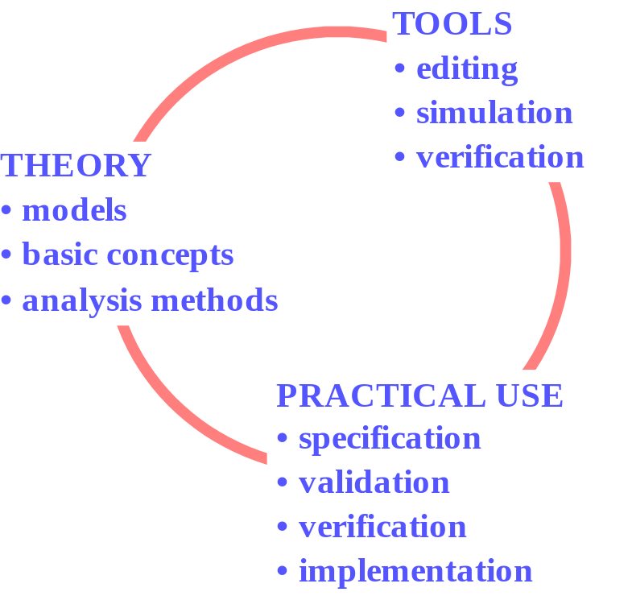
Tool support and practical use
The CPN group has developed and distributed industrial-strength computer tools, such as:
  Design/CPN (vers. 1 in 1990).
  CPN Tools (vers. 1 in 2003).
The CPN group has also been
involved in numerous application projects where CP-nets and their tools have been used together with industrial partners.
Coloured Petri Nets
Department of Computer Science

Slide 35
CPN Tools
CPN Tools is a computer tool for CPN models supporting:
  Editing and syntax check.
  Interactive and automatic simulation.
  State space analysis.
  Performance analysis.
CPN Tools is developed at Aarhus University, Denmark.
There are more than 10,000 licenses in 150 different countries.
Coloured Petri Nets
Department of Computer Science

Slide 36
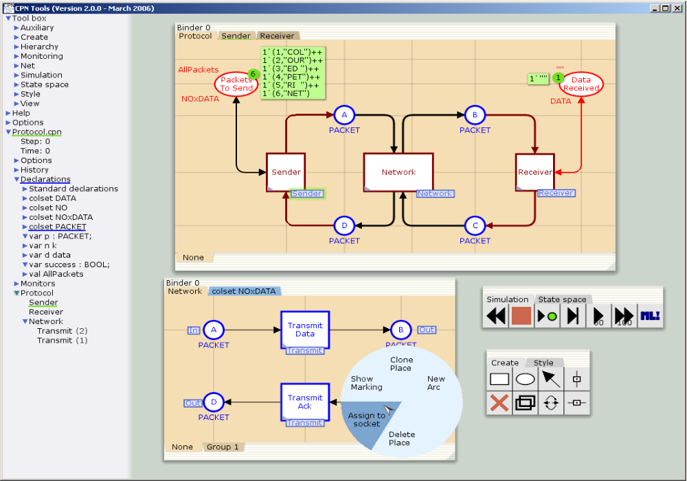
CPN Tools userinterface
Coloured Petri Nets
Department of Computer Science

Slide 37
Industrial projects
In chapter 14, we present four projects where CP-nets and their supporting computer tools have been used for system development in an industrial context.
The projects illustrate that CP-nets can be used in many different phases of system development – ranging from requirement specification to design, validation, and implementation.
The CPN models have been constructed in joint projects between our research group at Aarhus University and industrial partners.
More than 100 examples of documented industrial projects can be found at:
  www.cs.au.dk/CPnets/intro/example_indu.html
Coloured Petri Nets
Department of Computer Science

Slide 38
First industrial project:
Protocol design at Ericsson Telebit
Design of an Edge Router Discovery Protocol (ERDP) for mobile ad-hoc networks.
A CPN model was constructed constituting a formal executable specification of the ERDP protocol.
Simulation and message sequence charts were used for initial investigations of the protocol’s behaviour.
State space analysis was applied to conduct a formal verification of key properties of ERDP.
Coloured Petri Nets
Department of Computer Science

Slide 39
Conclusions from ERDP project
The application of CPN technology in the development of ERDP was successful.
The CPN modelling language and computer tools were powerful enough to handle a real-world communication protocol and could easily be integrated in the conventional protocol development process.
Modelling, simulation and state space analysis identified several non-trivial design problems which otherwise might not have been discovered until implementation/test/deployment.
Only 100 man-hours were used for CPN modelling and analysis. This is a relatively small investment compared to the many problems that were identified and resolved early in the development.
Coloured Petri Nets
Department of Computer Science

Slide 40
Second industrial project:
Requirements engineering at Systematic
Specification of workflows (business processes) at
Aarhus County Hospital and their support by a new Pervasive Health Care IT System.
Behavioural visualisation driven by a CPN model was used to engineer requirements through discussions with nurses and doctors who were not familiar with the CPN modelling language.
Coloured Petri Nets
Department of Computer Science

Slide 41
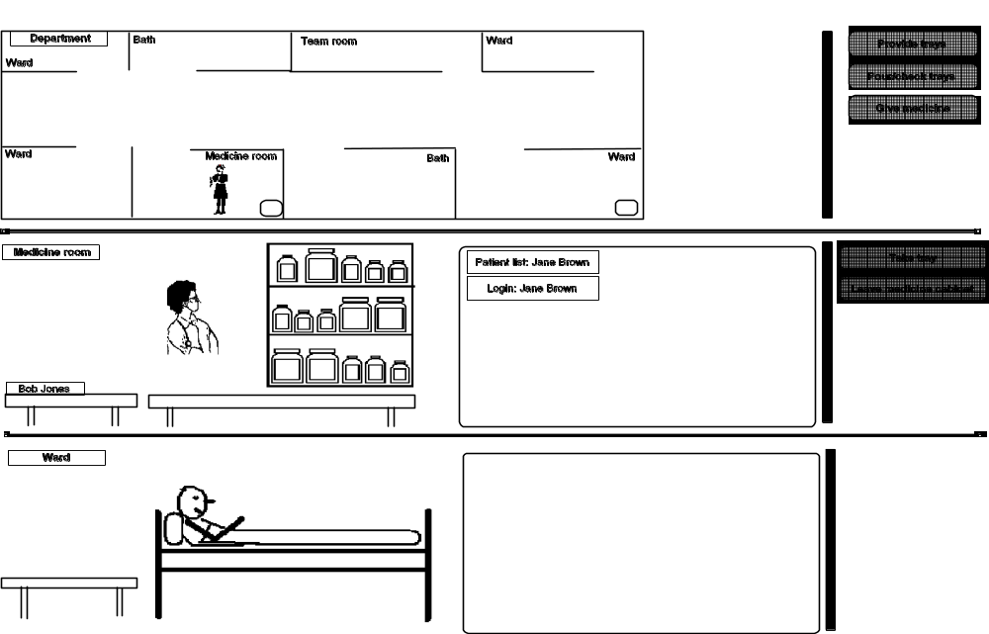
Interaction graphics
User has four choices
(corresponding to four enabled transitions in the CPN model)
Ward
Bath
Team room
Ward
Provide Trays
Pour/check Trays
Department
Give Medicine
Medicine room
Ward
Nurse
PC
Bath
Ward
PC
Medicine cabinet
Patient list: Jane Brown
Computer screen
Take Tray
Nurse
Login: Jane Brown
Leave Medicine Room
Medicine room
Two buttons
for Jane Brown
Medicine tray
Bob Jones
Computer screen
Patient
Ward
Blank screen
Coloured Petri Nets
Department of Computer Science

Slide 42
Conclusions from PHCS project
CPN models are able to support requirements engineering.
The CPN model and the visualisation graphics was built
“on top” of prose descriptions (of work processes and the intended computer support).
The interaction graphics enabled users like nurses and doctors to be actively engaged in specification analysis
– increasing the probability that a system is built that fits the future users’ work processes.
This provided valuable input for the system requirements.
Coloured Petri Nets
Department of Computer Science

Slide 43
Third industrial project:
Embedded system at Bang & Olufsen
Concerned with the design and analysis of the BeoLink system which distributes audio and video sources (such as radios, CD/DVD players, and TVs) to different rooms via a dedicated network.
A timed CPN model was developed for the lock management subsystem which is responsible for the basic synchronisation of devices in the BeoLink system.
State spaces (including a number of advanced state space methods) were used to verify the lock management system.
Coloured Petri Nets
Department of Computer Science

Slide 44
Conclusions from BeoLink project
CP-nets can be used to model and validate a real-time system (in which the correctness depends on timing information).
The construction of the CPN model was done in close cooperation with engineers at Bang & Olufsen.
The engineers were given a four day course on CP-nets enabling them to construct large parts of the CPN model.
Using advanced state space methods, we could verify larger configurations (and often cover all configurations that are expected to appear in practice).
Coloured Petri Nets
Department of Computer Science

Slide 45
Fourth industrial project:
Scheduling at Australian defence
Development of a scheduling tool (called COAST).
CPN modelling was used to conceptualise and formalise the planning domain to be supported by the tool.
A CPN model was extracted in executable form from CPN Tools and embedded into the COAST server together with a number of tailored state space analysis algorithms.
We bridged the gap between the design (specified as a CPN model) and the implementation of the system.
Coloured Petri Nets
Department of Computer Science

Slide 46
Conclusions from COAST project
CPN modelling was used in the development and specification of the planning framework.
The CPN model was used to implement the COAST server (closing the gap between design and implementation).
State spaces are used to compute and analyse schedules.
The project demonstrates the value of having a full programming language environment in the form of the Standard ML compiler integrated in CPN Tools.
Coloured Petri Nets
Department of Computer Science

Slide 47

Questions
Coloured Petri Nets
Department of Computer Science

