Slide 1
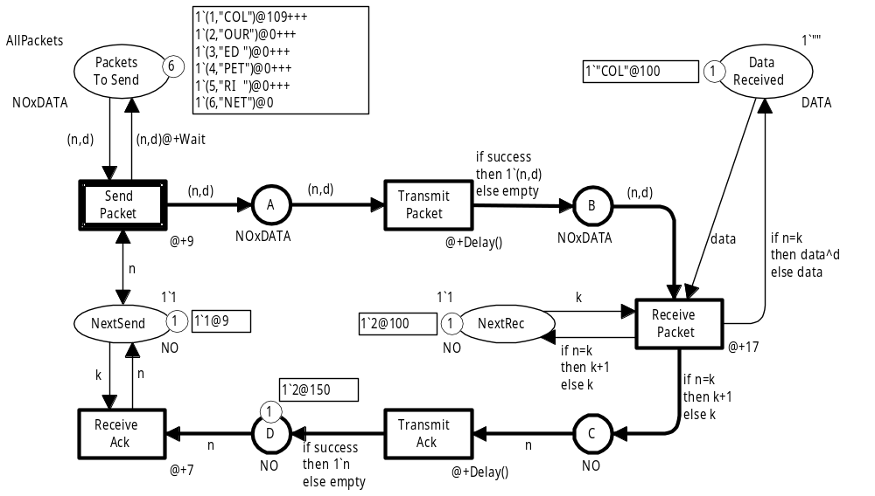
Coloured Petri Nets
Modelling and Validation of Concurrent Systems
Chapter 10: Timed Coloured Petri Nets
Kurt Jensen &
Lars Michael Kristensen
{kjensen,lmkristensen}@cs.au.dk
Coloured Petri Nets
Department of Computer Science

Slide 2
Two kinds of properties
Up to now we have concentrated on the functional/logical properties of the modelled system such as deadlocks and home markings.
It is also important to be able to analyse how efficient a system performs its operations.
This is done by means of timed CPN models.
A timed CPN model allows us to investigate performance measures such as queue lengths and waiting times.
Coloured Petri Nets
Department of Computer Science

Slide 3
CPN language can be used for both
The CPN modelling language can be used to investigate both:
  Functional/logical properties.
  Performance properties.
Most other modelling languages can only be used to analyse either functional/logical properties or performance properties.
It is an obvious advantage to be able to make both kinds of analysis by means of the same modelling language.
Usually we have two slightly different but closely related
CPN models.
Coloured Petri Nets
Department of Computer Science

Slide 4
Timed CPN models
In a timed CPN model tokens have:
  A token colour.
  A timestamp.
The timestamp is a non-negative integer belonging to
the type TIME.
The timestamp tells us the time at which the token is ready to be removed by an occurring transition.
The system has a global clock representing model time.
The global clock is shared by all modules in the CPN model.
Coloured Petri Nets
Department of Computer Science

Slide 5
Multisets
Addition of
timed multisets
Untimed multiset:
  1`(1,"COL") ++
  1`(1,"OUR") ++
  1`(1,"ED ") ++
  1`(1,"PET") ++
  1`(1,"RI ") ++
  1`(1,"NET")
Timed multiset:
  1`(1,"COL")@218 +++
  1`(1,"OUR")@2095 +++
  1`(1,"ED ")@2664 +++
  1`(1,"PET")@2906 +++
  1`(1,"RI ")@3257 +++
  1`(1,"NET")@3499
Coefficient
Token colour
Coefficient
Token colour
Timestamp
Coloured Petri Nets
Department of Computer Science

Slide 6
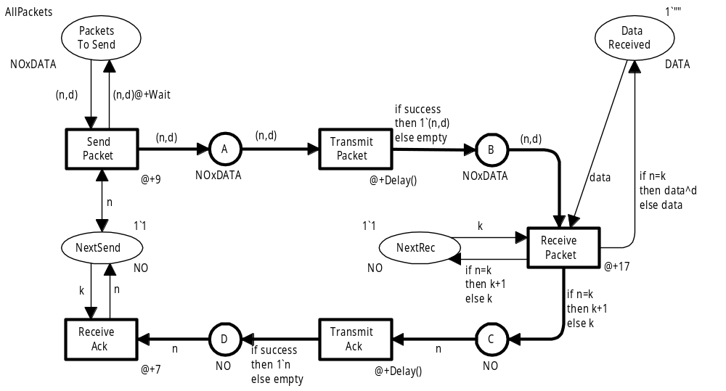
Timed CPN model for our protocol
Transitions and arcs may have time delay inscriptions
They describe the duration of activities
Coloured Petri Nets
Department of Computer Science

Slide 7
Definitions and declarations
Definitions of colour sets:
CPN ML keyword
colset NO = int timed;
colset DATA = string timed;
colset NOxDATA = product NO * DATA timed;
colset BOOL = bool;
Tokens of type NO, DATA, and NOxDATA will carry timestamps.
Declarations of variables and constants:
var n,k : NO;
var d, data : DATA;
var success : BOOL;
val Wait = 100;
New symbolic constant specifying the delay between retransmissions
Coloured Petri Nets
Department of Computer Science

Slide 8
New function
Definition of function:
fun Delay() = discrete(25,75);
Predefined function returning an arbitrary integer in the interval specified by its argument
Delay returns an integer between 25 and 75.
All 51 values have the same probability to be chosen.
The choice is made by a random number generator.
The Delay function will be used to model the transmission time for data packets and acknowledgements.
The transmission time may vary between 25 and 75
time units – e.g. depending on the network load.
Coloured Petri Nets
Department of Computer Science

Slide 9
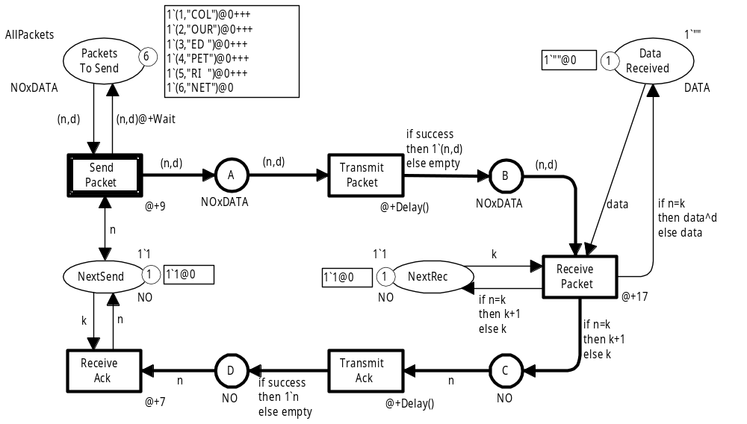
Initial marking M₀
SP1 will be ready to occur at time 0
SP1 = (SendPacket, <n=1, d="COL">)
0
Coloured Petri Nets
Department of Computer Science

Slide 10
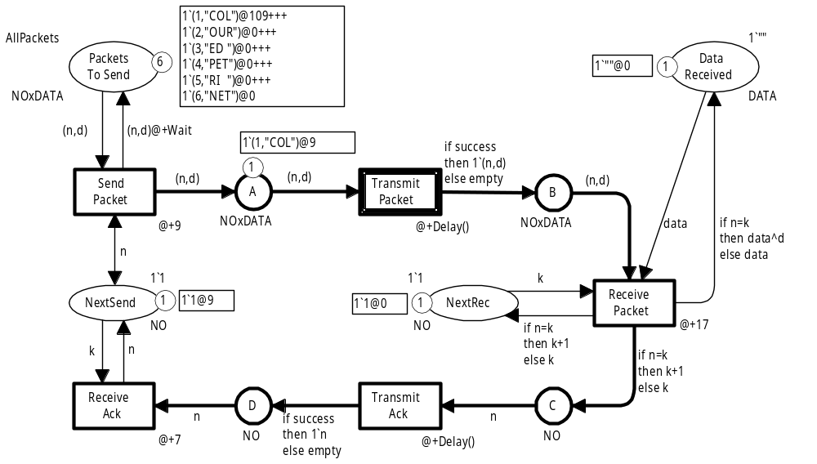
Marking M₁
SP1 has occurred at time 0.
Time of occurrence: 0
Transition time delay: 9
Token for NextSend: 9
Time of occurrence: 0
Transition time delay: 9
Token for A: 9
Time of occurrence: 0
Transition time delay: 9
Arc time delay: 100
PacketsToSend: 109
Coloured Petri Nets
Department of Computer Science

Slide 11
Time delays
Transitions and arcs may have time delay inscriptions.
They are CPN ML expressions of type TIME – i.e. they evaluate to a non-negative integer.
A time delay at a transition applies to all tokens produced by the transition.
A time delay at an output arc applies to all tokens produced by that arc.
An omitted time delay is a shorthand for a zero
time-delay.
Coloured Petri Nets
Department of Computer Science

Slide 12
Transitions occur instantaneously
The occurrence of a transition is always instantaneous, i.e. takes no time.
The time delay ∆ of a transition can be interpreted
as the duration of the operation which is modelled
by the transition.
The output tokens of the transition will not be available for other transitions until ∆ time units later.
X
x
T1
x
@+16
X
x
If T1 occurs at time 45 it will produce a token with timestamp 61.
T2
x
@+23
This implies that T2 cannot occur until 16 time units after the beginning of the operation modelled by T1.
X
Coloured Petri Nets
Department of Computer Science

Slide 13
Another possibility
At a first glance, it may look simpler to define the occurrence of a transition with time delay ∆ to take ∆ time units:
  Removing input tokens when the occurrence starts.
  Adding output tokens when the occurrence ends.
This would imply that a timed CPN model has a number of intermediate markings with no counterparts in the corresponding untimed CPN model:
  Some transitions have occurred partially.
  Their input tokens have already been removed.
  Their output tokens have not yet been added.
Coloured Petri Nets
Department of Computer Science

Slide 14
Marking M₁
TP1+ and TP1– are ready to occur at time 9.
They are in conflict with each other
SP1 is colour enabled but it is not ready until time 109
It is not enabled
Assume that TP1+ occurs and Delay returns the value 38
SP1 = (SendPacket, <n=1, d="COL">)
TP1+ = (TransmitPacket, <n=1, d="COL", success=true>)
TP1– = (TransmitPacket, <n=1, d="COL", success=false>)
109
9
9
Coloured Petri Nets
Department of Computer Science

Slide 15
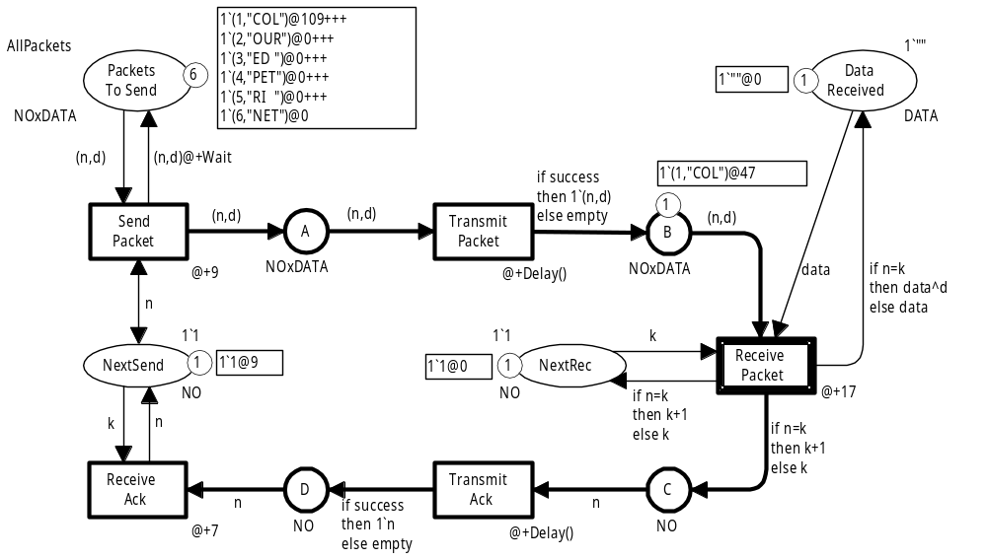
Marking M₂
RP1 is ready to occur at time 47
SP1 is colour enabled but it is not ready until time 109
RP1 will occur at time 47
SP1 = (SendPacket, <n=1, d="COL">)
RP1 = (ReceivePacket, <n=1, d="COL", k=1, data = "">)
109
47
Coloured Petri Nets
Department of Computer Science

Slide 16
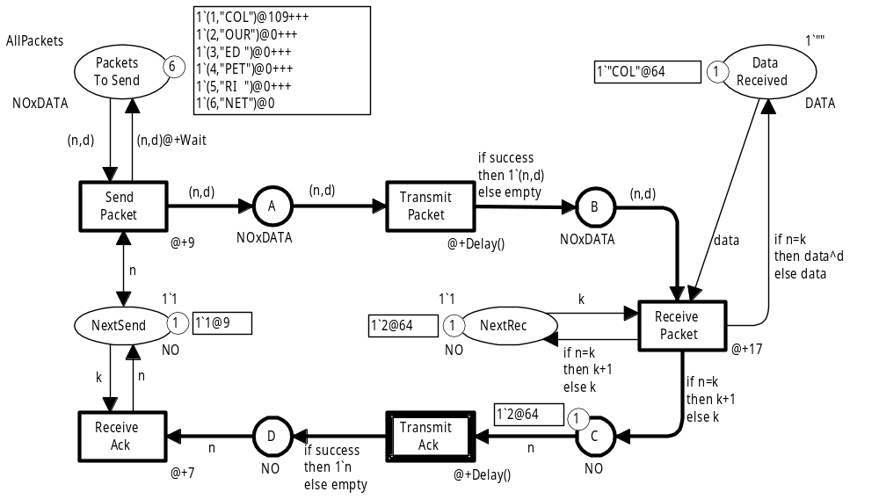
Marking M₃
SP1 = (SendPacket, <n=1, d="COL">)
TA2+ = (TransmitAck, <n=2, success=true>)
TA2– = (TransmitAck, <n=2, success=false>)
109
64
64
Assume that TA2+ occurs at time 64 and Delay returns the value 33
Coloured Petri Nets
Department of Computer Science

Slide 17
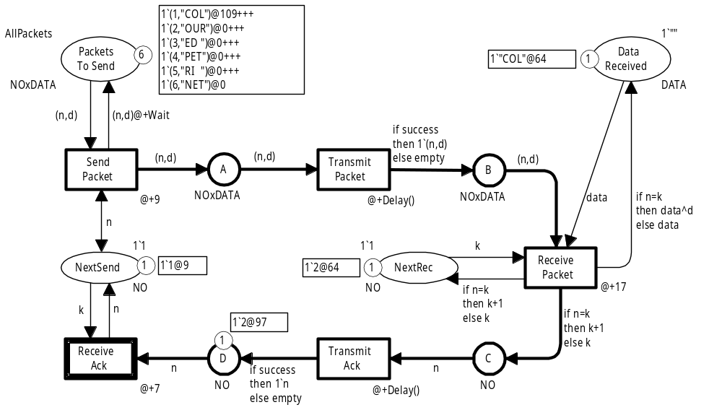
Marking M₄
SP1 = (SendPacket, <n=1, d="COL">)
RA2 = (ReceivePacket, <n=2, k=1>)
109
97
RA2 will occur at time 97
Coloured Petri Nets
Department of Computer Science

Slide 18

Marking M₅
SP2 = (SendPacket, <n=2, d="OUR">)
104
SP2 will occur at time 104
Coloured Petri Nets
Department of Computer Science

Slide 19
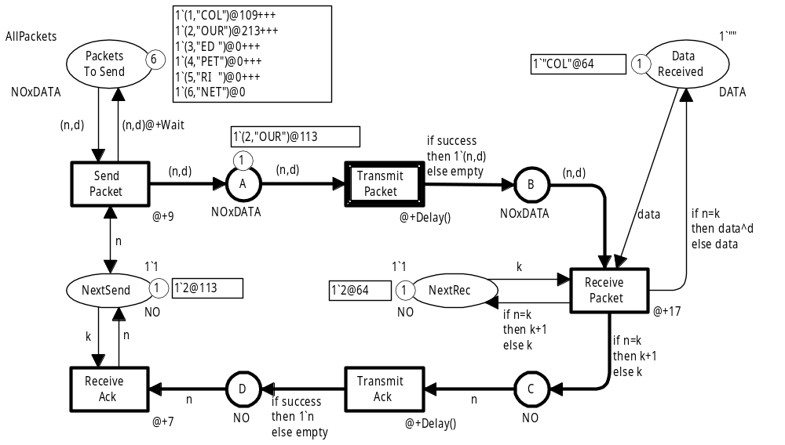
Marking M₆
Coloured Petri Nets
Department of Computer Science

Slide 20
Retransmissions
In the investigated occurrence sequence it turned out to be unnecessary to retransmit data packet no 1.
The acknowledgement requesting data packet no 2 arrived at time 97 while the retransmission would have started at time 109.
When the delays on the network are larger the situation is different and we may, e.g., reach the following marking.
Coloured Petri Nets
Department of Computer Science

Slide 21
Marking M₄*
SP1 = (SendPacket, <n=1, d="COL">)
RA2 = (ReceivePacket, <n=2, k=1>)
109
150
SP1 will occur at time 109
Acknowledgement arrives too late A retransmission will occur
Coloured Petri Nets
Department of Computer Science

Slide 22
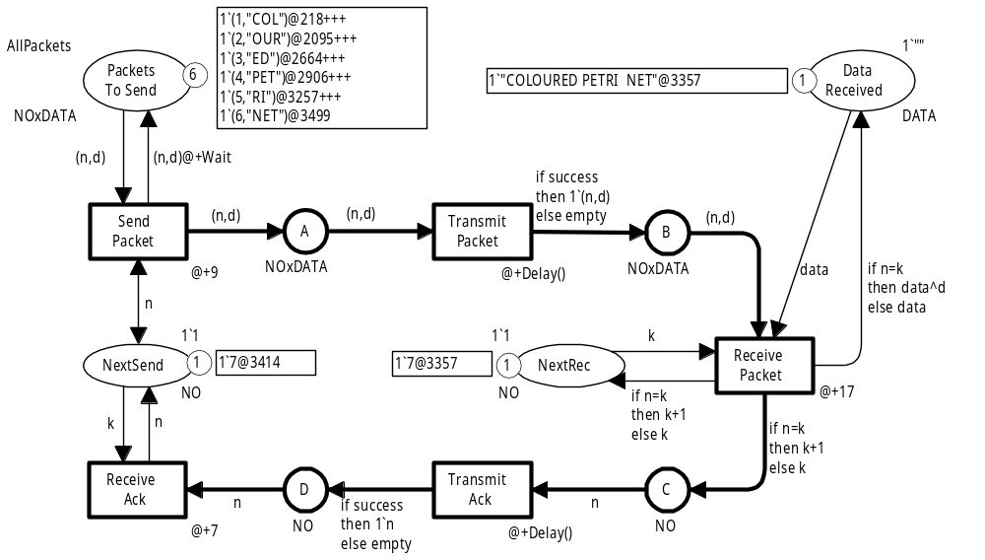
Dead marking at the end of simulation
Times at which the individual packets would have been retransmitted
All packets successfully received
Last packet received at time 3357
Last acknowledgement received at time 3414
Coloured Petri Nets
Department of Computer Science

Slide 23
Non-deterministic simulation
The chosen occurrence sequence depends on:
  The values returned by the Delay function.
  The choices between conflicting binding elements.
In an automatic simulation both sets of choices are made by means of a random number generator.
A new simulation will result in a new dead marking.
  The token colours will be the same.
  The timestamps will be different.
Coloured Petri Nets
Department of Computer Science

Slide 24
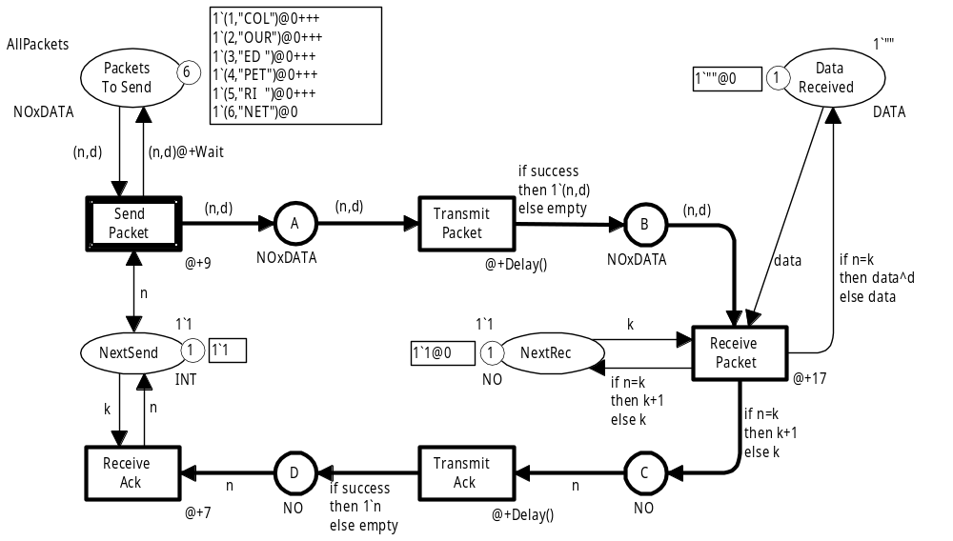
Slightly different model
Untimed place
Token without timestamp
Untimed colour set
Coloured Petri Nets
Department of Computer Science

Slide 25
Parallel sender operations
The revised CPN model represents a system in which the sender can perform several SendPacket and ReceiveAck operations in parallel.
The beginning of each operation is modelled by the occurrence of a transition.
Several operations can start at the same moment of model time, or shortly after each other.
In the original CPN model SendPacket and ReceiveAck have to wait for the timed token on place NextSend.
Hence no other sender operation can begin until:
  9 time units after the beginning of a SendPacket operation.
  7 time units after the beginning of a ReceiveAck operation.
Coloured Petri Nets
Department of Computer Science

Slide 26
Event queue
The execution of a timed CPN model is controlled by the global clock.
This is similar to the event queue found in many simulation engines for discrete event simulation.
The model remains at a given model time as long as there are binding elements that are enabled, i.e., are both:
  Colour enabled (have the necessary input tokens).
  Ready for execution (the required input tokens have time-stamps that are smaller than or equal to the global clock).
When there are no more enabled binding elements, the simulator advances the global clock to the earliest next model time at which one or more binding elements become enabled.
If no such model time exists the marking is dead.
Coloured Petri Nets
Department of Computer Science

Slide 27
Markings, conflicts and concurrency
Each marking exists in a closed interval of model time
– which may be a point, i.e., a single moment.
As for untimed CPN models we may have conflicts and concurrency between binding elements (and binding elements may occur concurrently to themselves).
This can only happen when the binding elements are enabled
at the same moment of model time.
Coloured Petri Nets
Department of Computer Science

Slide 28
Behaviour of timed CPN models
The behavioural properties of timed CPN models are defined in a similar way as in the untimed CPN case:
  Occurrence sequences.
  Reachability.
  Integer and multiset bounds.
  Home markings, home spaces and home predicates.
  Dead markings.
  Dead and live transitions/binding elements.
  Fairness properties.
For multiset bounds and home markings/spaces we consider the untimed markings – i.e. we ignore the timestamps.
Coloured Petri Nets
Department of Computer Science

Slide 29
Time delays are additional constraints
Each timed CPN model determines an underlying
untimed CPN model – obtained by removing all time delay inscriptions (and all timestamps).
The occurrence sequences of a timed CPN model form a subset of the occurrence sequences for the corresponding untimed CPN model.
The time delay inscriptions enforce a set of additional enabling constraints – forcing the binding elements to be executed in the order in which they become enabled.
CPN Tools use the same simulation engine to handle timed and untimed CPN models.
For untimed CPN models the global clock remains at 0.
Coloured Petri Nets
Department of Computer Science

Slide 30
Start with an untimed CPN model
It often beneficial for the modeller to start by constructing and validating an untimed CPN model.
In this way the modeller can concentrate on the functional/logical properties of the system.
The functional/logical properties should as far as possible be independent of concrete assumptions about execution times and waiting times.
It is possible to describe the existence of time-related system features, such as retransmissions and the expiration of a timer, without explicitly specifying waiting times or the duration of the individual operations.
Coloured Petri Nets
Department of Computer Science

Slide 31
Continue with a timed CPN model
When the functional/logical properties of a system have been designed and thoroughly validated, the user may analyse and improve the efficiency by which the system performs its operations.
This is done by adding time delays describing the duration of the individual operations.
From our remarks above, it follows that these time delays cannot introduce new behaviour in the system – they merely restrict the possible occurrence sequences.
Coloured Petri Nets
Department of Computer Science

Slide 32
Revised protocol
To illustrate other aspects of timed CPN models, we provide a modified version of the sender.
We now explicitly model a timer controlling the retransmission of packets.
We show how to use time delay inscriptions on input arcs.
Coloured Petri Nets
Department of Computer Science

Slide 33
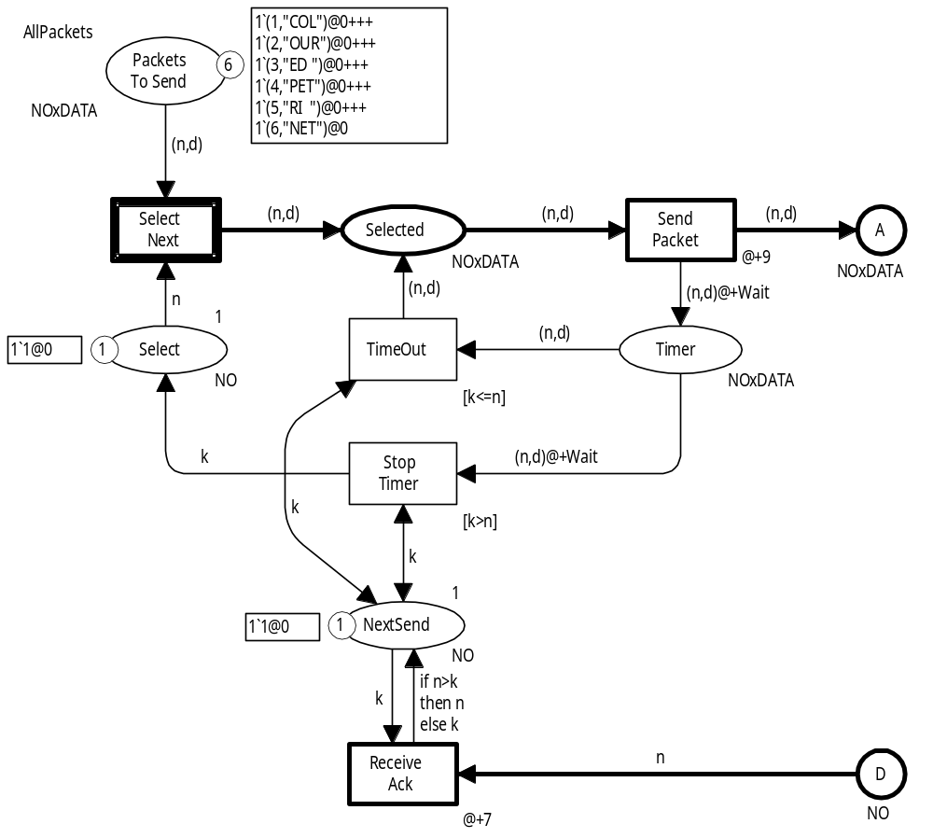
Modified sender – initial marking M₀
SelectNext moves the
next packet to be sent.
The packet number is determined by the token colour on Select.
SelectNext operation is instantaneous, i.e. so fast that it is modelled to take zero time.
Coloured Petri Nets
Department of Computer Science

Slide 34
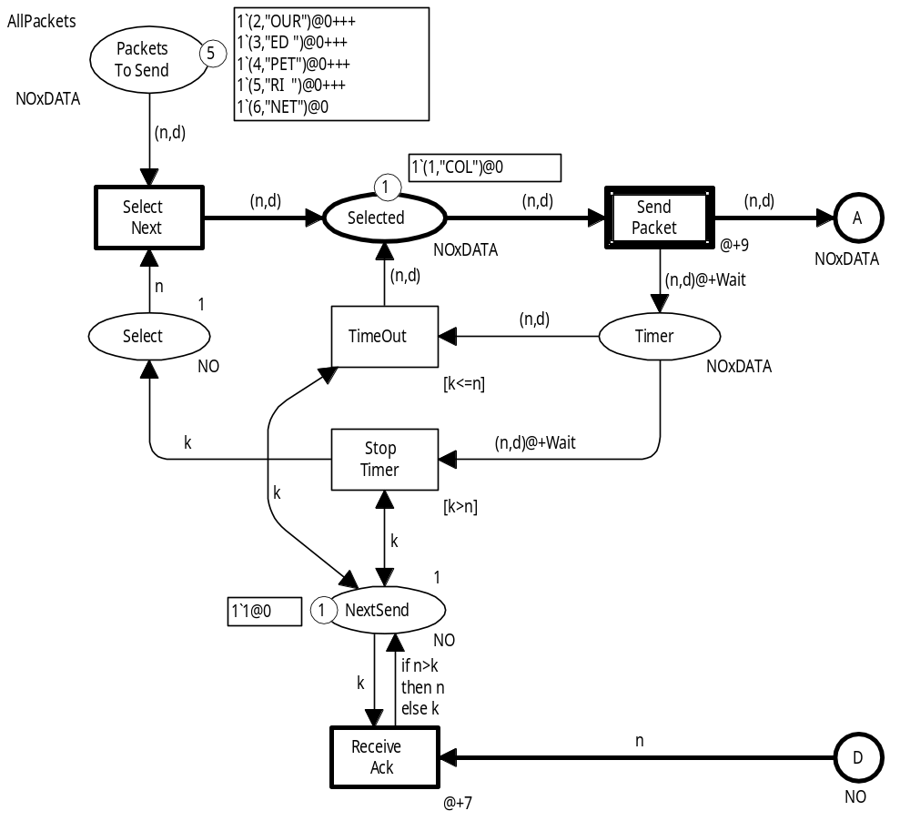
Modified sender – marking M₁
Selected packet is
ready to be sent by SendPacket.
Simultaneously a token will be put on place Timer
– modelling the start of a timer.
Coloured Petri Nets
Department of Computer Science

Slide 35
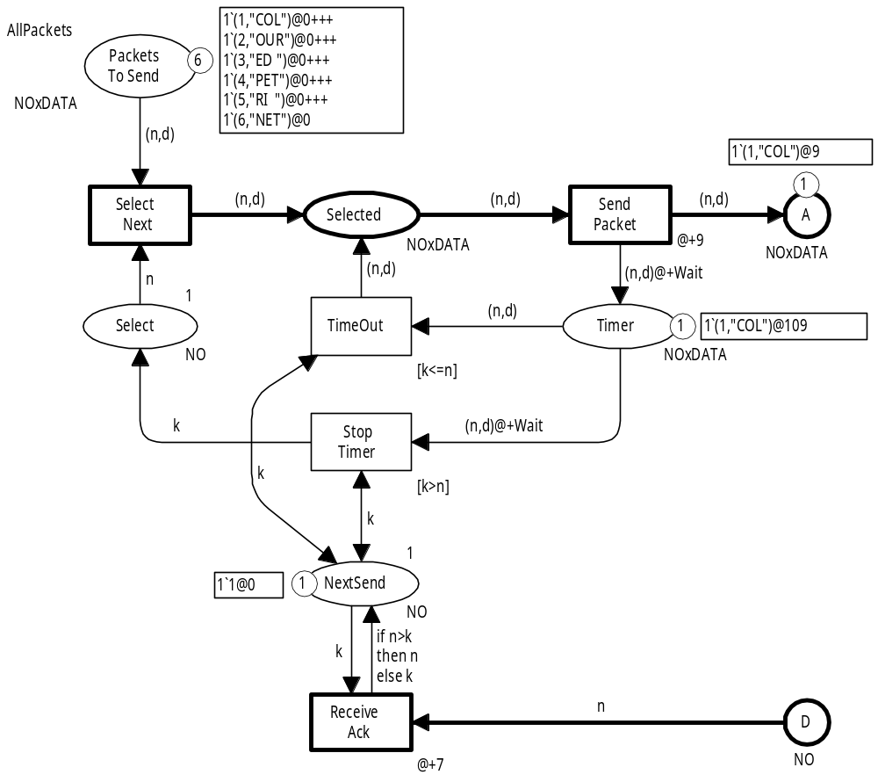
Modified sender – marking M₂
Data packet no 1
has been sent.
Timer has been started and it will expire at
time 109.
If no acknowledgement is received before time 109, the TimeOut transition will occur.
This will enable SendPacket and a retransmission of data packet no 1 will occur.
Coloured Petri Nets
Department of Computer Science

Slide 36
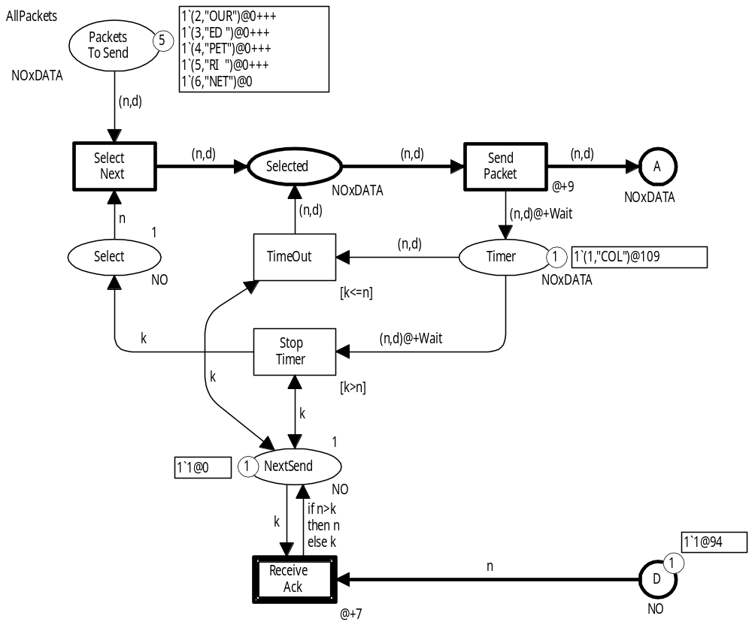
Modified sender – marking M₃
Acknowledgement requesting packet no 2
is arriving at time 94.
ReceiveAck will occur
and update NextSend.
The new value of NextSend is the highest value of n and k.
This means that NextSend never is decreased.
It holds the highest packet number requested by an acknowledgement.
Coloured Petri Nets
Department of Computer Science

Slide 37
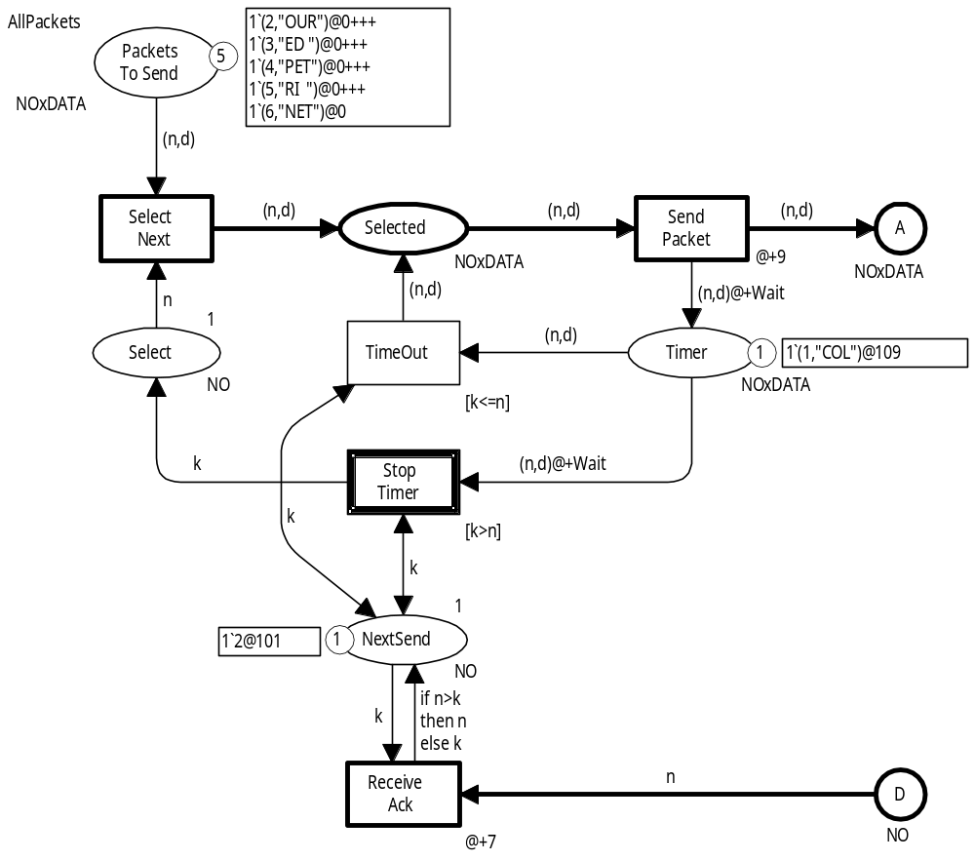
Modified sender – marking M₄
StopTimer will remove
a token with timestamp
109 from place Timer.
The input arc from Timer
has its own time delay
inscription.
This allows the transition to
remove the token Wait time
units ahead of the timestamp.
This means that StopTimer will
be ready to occur at time 101.
StopTimer operation is instantaneous.
Coloured Petri Nets
Department of Computer Science

Slide 38
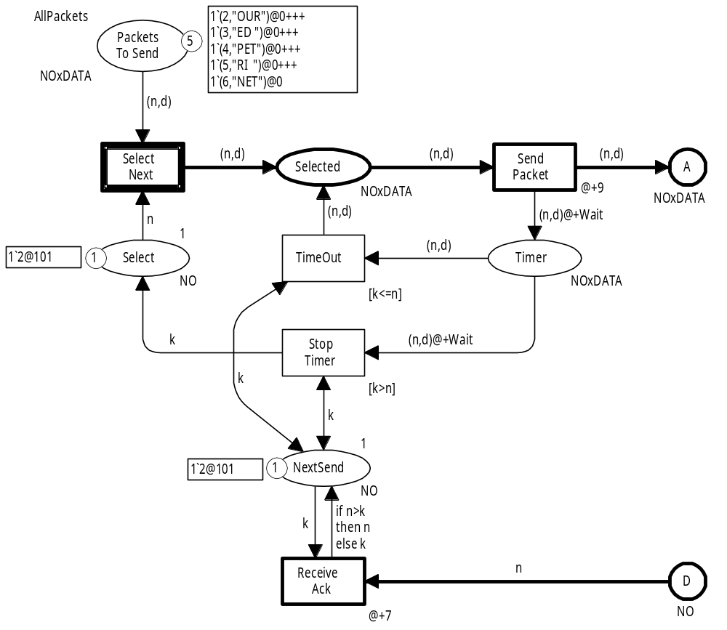
Modified sender – marking M₅
Timer has been stopped.
Select has been updated to the packet number specified by NextSend.
Data packet no 2
can now be selected at time 101.
Coloured Petri Nets
Department of Computer Science

Slide 39
Time delay inscriptions on input arcs
The use of time delay inscriptions on input arcs allow us to remove tokens ahead of time.
This can be very useful to model the interruption of an ongoing operation – e.g. a running timer.
Without such a facility one would need additional bookkeeping – to remember that a token should be removed when the model time becomes high enough to allow this.
When a time delay inscription is used on a double-headed arc, it is used for both the input arc and the output arc.
If the time delay inscription only should be used for one of the arcs, it is necessary to draw two separate arcs.
Coloured Petri Nets
Department of Computer Science

Slide 40
State spaces for timed CPN models
State spaces for timed CPN models are defined in a similar way as state spaces for untimed models.
Each state space node represents a timed marking:
  Timed multiset for each timed place.
  Untimed multiset for each untimed place.
  Global clock.
CPN Tools supports construction and analysis of state spaces for timed CPN models.
Coloured Petri Nets
Department of Computer Science

Slide 41
State spaces for timed CPN models
OccSeq_{Timed} ⊆ OccSeq_{Untimed}
This implies that the nodes in a timed state space have fewer out-going arcs (lower out-degree).
Two timed markings may have:
  Identical token colours.
  Different timestamps and different values for the
  global clock.
This implies that a timed state space may have more nodes.
The timed state space may be infinite even though the untimed state space is finite.
It is possible to use equivalence classes to reduce the number of nodes in a timed state space.
Coloured Petri Nets
Department of Computer Science

Slide 42
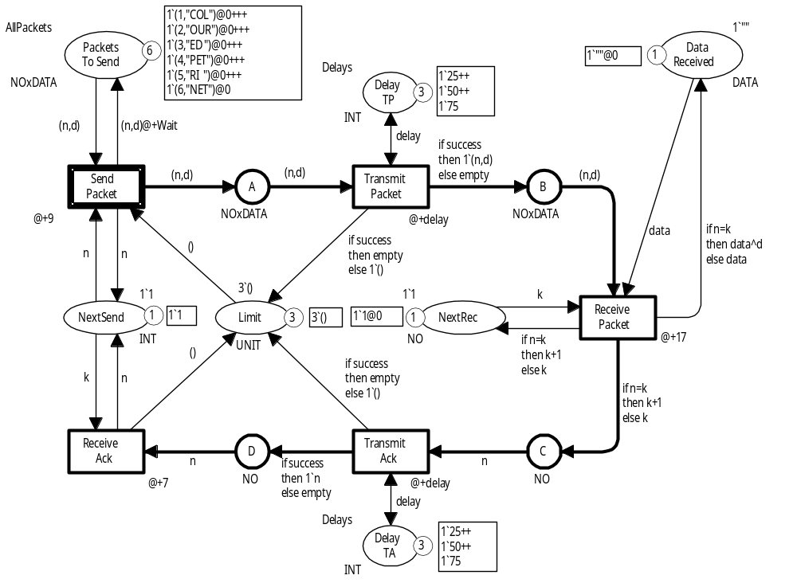
Timed protocol for state spaces
New place
Two new places specify the
possible delays.
For state spaces
we cannot use
the Delay function returning a
random value.
This would make the construction of the state space non-deterministic.
Limit
New place
Coloured Petri Nets
Department of Computer Science

Slide 43

Modelling of delays
To reduce the size of the state space we want fewer possible delays.
In this case we
only have three.
1`(1,”COL”)@9
1
At time 9
we have six
enabled bindings.
All of them are in conflict with each other.
<n=1, d="COL", success=true, delay=25>
<n=1, d="COL", success=true, delay=50>
<n=1, d="COL", success=true, delay=75>
<n=1, d="COL", success=false, delay=25>
<n=1, d="COL", success=false, delay=50>
<n=1, d="COL", success=false, delay=75>
Success
Failure
Copy of data packet no 1 on place B with timestamp 59.
Coloured Petri Nets
Department of Computer Science

Slide 44
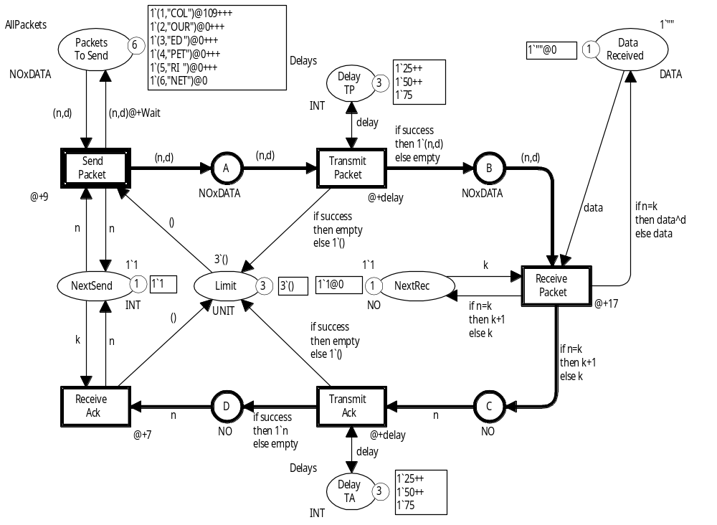
New marking – similar to initial marking
One of the
timestamps on PacketsToSend has been increased.
New marking ⇒ New state space node.
Coloured Petri Nets
Department of Computer Science

Slide 45
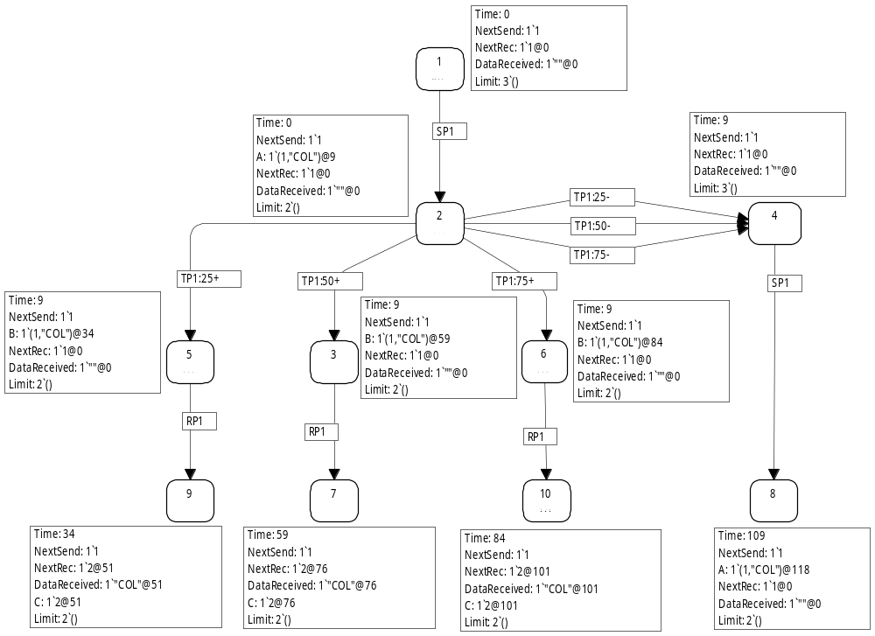
Timed state space
Creation time for marking
1
Markings 5, 3, and 6 are identical – except for the timestamps
4
2
Success
2
5
3
6
5
3
6
Markings 9, 7, and 10 are identical – except for the timestamps (and the global clock)
9
7
10
8
9
7
10
Coloured Petri Nets
Department of Computer Science

Slide 46
Timed state space
1
1
Markings 1 and 4 are identical – except for the global clock (and one of the timestamps on SendPacket)
Failure
4
2
4
2
5
3
6
9
7
10
8
Coloured Petri Nets
Department of Computer Science

Slide 47
Size of timed state space
We may continue to send and lose the first data packet.
Hence, the timed state space is infinite.
Clock | Nodes | Arcs
10 | 12 | 19
20 | 48 | 87
30 | 156 | 269
40 | 397 | 644
50 | 814 | 1,273
60 | 3,005 | 4,583
70 | 7,822 | 12,154
80 | 17,996 | 28,002
90 | 49,928 | 79,224
100 | 103,377 | 165,798
To obtain a finite state space we put an upper bound on the value of the global clock.
In this way we obtain a partial state space.
We can, e.g., investigate whether a certain packet has arrived before a certain time.
Coloured Petri Nets
Department of Computer Science

Slide 48
Time equivalence method
Special case of the equivalence method from Chapter 8.
The basic idea is to replace the absolute time values in the global clock and timestamps with relative values.
The reduced state space is finite whenever the state space of the underlying untimed CPN model is finite.
From the reduced state space it is possible to verify all behavioural properties of the timed CPN model.
Coloured Petri Nets
Department of Computer Science

Slide 49
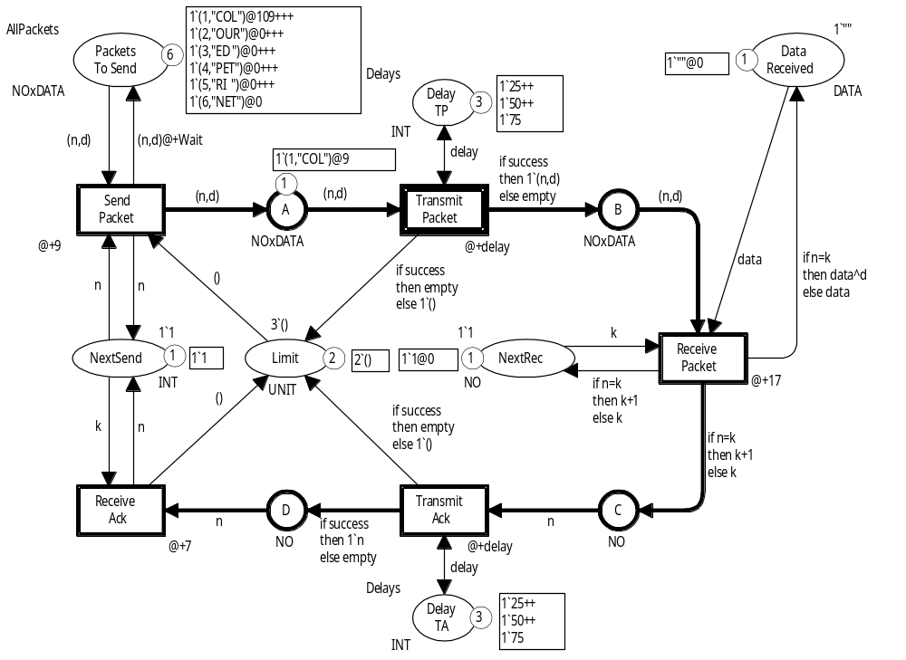
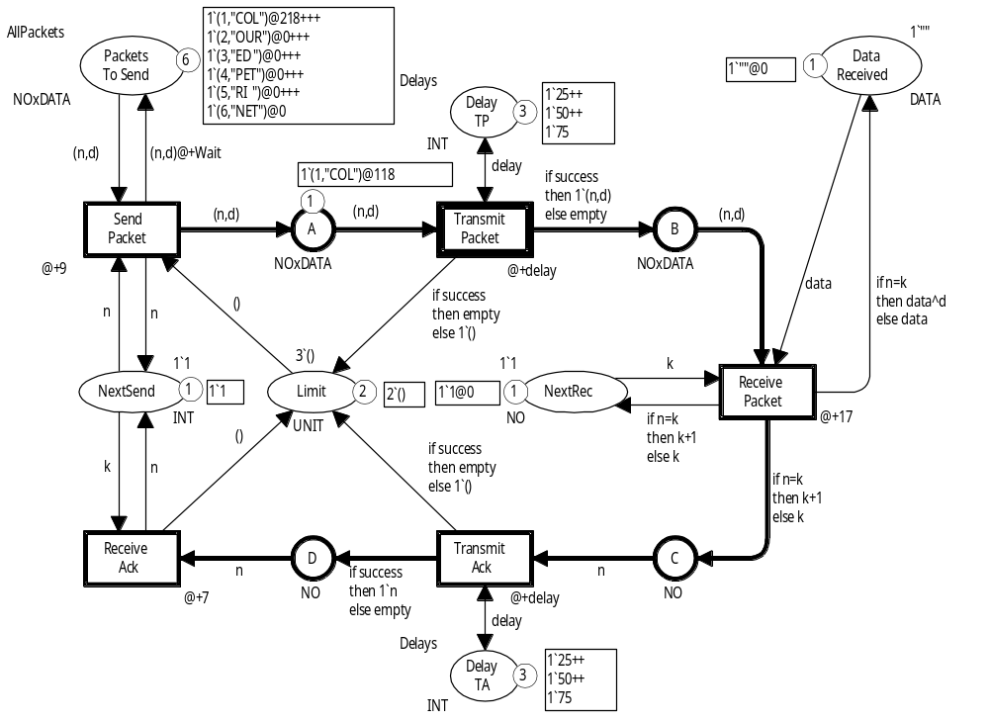
Markings have different time values
Clock: 9
The state spaces of timed CPN models become infinite for models with cyclic behaviour.
The time values (in the global clock and the timestamps) continue to increase.
We want M₁ and M₂ to be equivalent.
M₁
Clock: 118
M₂
Coloured Petri Nets
Department of Computer Science

Slide 50
Canonical representative
We map each marking into a canonical representative:
model time: set to zero
timestamps ≥ model time ⇒ subtract model time
timestamps ≤ model time ⇒ set to zero
Two markings are equivalent if they have identical canonical representative.
Coloured Petri Nets
Department of Computer Science

Slide 51

Canonical representative
Clock: 9
Clock: 0
M₁
Clock: 118
The two markings have the same canonical representation
– hence they are equivalent
M₂
Coloured Petri Nets
Department of Computer Science

Slide 52
Condensed state spaces
Condensed state spaces for a timed CPN model can be computed fully automatically.
  Consistency of the equivalence has been proven once and for all.
  Predicates for the equivalence tests are implemented in CPN Tools once and for all.
All properties expressible in the real-time temporal logic
RCCTL∗ are preserved in the time condensed state space.
This includes all standard behavioural properties of
CPN models.
Coloured Petri Nets
Department of Computer Science

Slide 53
Statistics for time equivalence method
Limit | Packets | Nodes | Arcs | Limit | Packets | Nodes | Arcs
1 | 10 | 81 | 110 | 5 | 2 | 88,392 | 158,351
1 | 20 | 161 | 220 | 5 | 4 | 307,727 | 556,212
1 | 50 | 401 | 550 | 7 | 1 | 13,198 | 23,400
1 | 100 | 801 | 1,100 | 7 | 2 | 145,926 | 285,848
2 | 5 | 3,056 | 4,424 | 7 | 3 | 323,129 | 657,650
2 | 10 | 6,706 | 9,694 | 10 | 1 | 20,062 | 36,250
2 | 20 | 14,006 | 20,234 | 10 | 2 | 244,990 | 502,916
2 | 50 | 35,906 | 51,854 | 12 | 1 | 24,630 | 44,802
3 | 1 | 2,699 | 4,126 | 12 | 2 | 335,651 | 697,127
3 | 5 | 85,088 | 129,858 | 13 | 1 | 26,914 | 49,078
3 | 15 | 306,118 | 466,408 | 13 | 2 | 391,743 | 818,021
Coloured Petri Nets
Department of Computer Science

Slide 54

Questions
Coloured Petri Nets
Department of Computer Science

