Slide 1
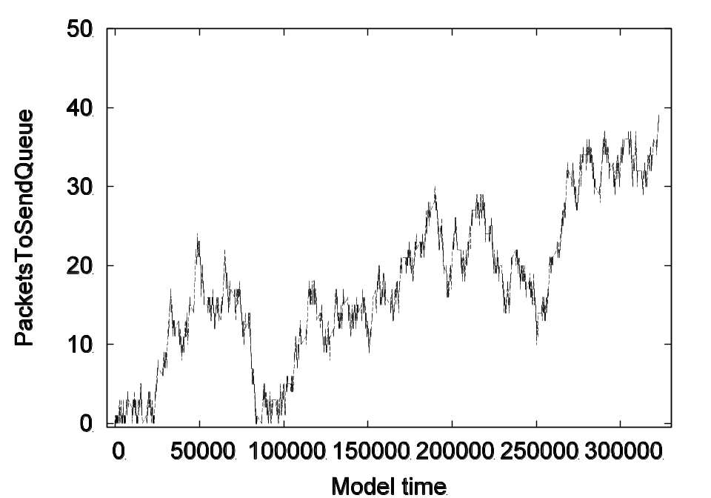
Coloured Petri Nets
Modelling and Validation of Concurrent Systems
Chapter 12:
Simulation-based Performance Analysis
Kurt Jensen &
Lars Michael Kristensen
{kjensen,lmkristensen}
@cs.au.dk
Coloured Petri Nets
Department of Computer Science

Slide 2
Performance analysis
Performance analysis is a central issue in the development and configuration of concurrent systems:
  Evaluate existing or planned systems.
  Compare alternative implementations of a system.
  Search for optimal configuration(s) of a system.
Performance measures of interests include average queue lengths, average delay, throughput, and resource utilisation.
Performance analysis of timed CPN models is done by automatic simulations.
  To estimate performance measures, numerical data is collected from the occurring binding elements and markings reached.
  To get reliable results the simulations must be lengthy or repeated a number of times (e.g. with different parameters).
Coloured Petri Nets
Department of Computer Science

Slide 3
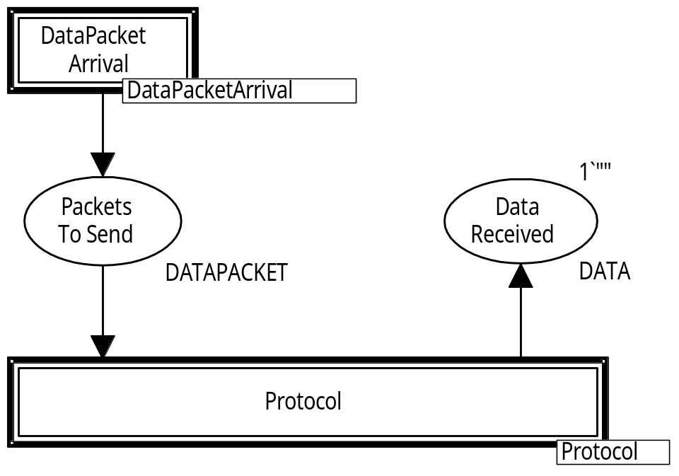
Timed protocol for performance analysis
To be able to estimate performance measures we make a few modifications of the timed CPN model for the protocol.
We now have a hierarchical model with three modules:
  Overview.
  Generation of packets to be transmitted (workload).
  Protocol to transmit packets and acknowledgments.
Coloured Petri Nets
Department of Computer Science

Slide 4
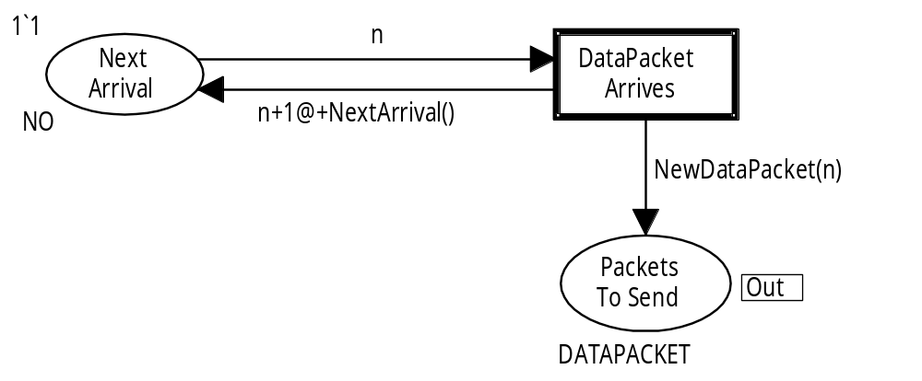
Generation of data packets
colset NO = int timed;
var n : NO;
Used to record
Time Of Arrival
colset DATA = string timed;
colset TOA = int; (* Time Of Arrival *)
colset DATAPACKET = product NO * DATA * TOA timed;
fun NextArrival() = discrete(200,220);
Uniform discrete distribution
fun NewDataPacket n = (n, "p"^NO.mkstr(n)^" ", ModelTime());
Returns value of global clock
Coloured Petri Nets
Department of Computer Science

Slide 5
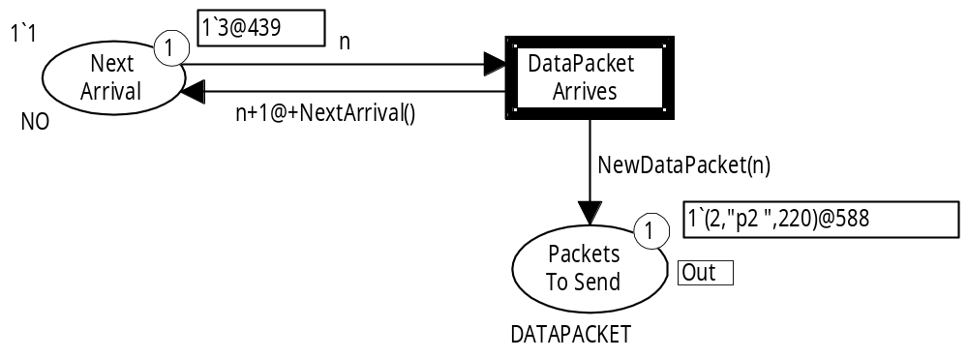
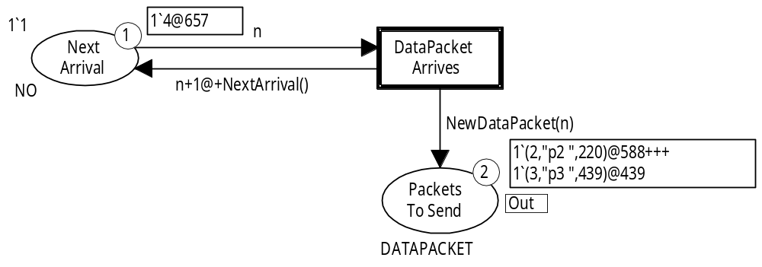
Data packet arrival
(DataPacketArrives, <n=3>)
439
Next packet
NextArrival() = 218
New packet
Next data packet will arrive at time 657 = 439 + 218.
Coloured Petri Nets
Department of Computer Science

Slide 6
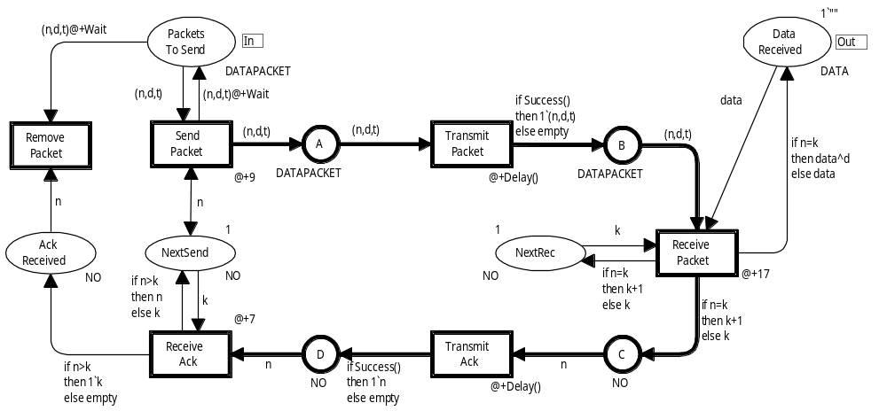
Protocol module
More fine-grained modelling of success rate
Data packets are removed when they are acknowledged
val successrate = 0.9;
fun Success () = uniform(0.0,1.0) <= successrate;
Uniform continuous distribution
Coloured Petri Nets
Department of Computer Science

Slide 7
Data collection monitors
Data collection in CPN Tools is done by data collection monitors.
They extract numerical data from occurring binding elements and the markings reached in a simulation.
The monitors are defined by means of four monitor functions:
  Predicate function determines when data is collected.
  Observation function determines what data is collected.
  Start function (optional) collects data from the initial marking.
  Stop function (optional) collects data from the final marking.
M₀
M
M’
M_{final}
(t,b)
start(M₀)
if pred((t,b),M’)
then obs((t,b),M’)
stop(M_{final})
Coloured Petri Nets
Department of Computer Science

Slide 8
Monitor functions
Monitor functions are implemented in CPN ML and consist typically of 5-10 lines of code.
CPN Tools:
  supports a set of standard data collection monitors for which the monitor functions are generated automatically.
  generates template code for user-defined data collection monitors –which can then be adapted by the user.
A monitor has an associated set of places and transitions determining what can be referred to in monitor functions.
This is exploited by CPN Tools to reduce the number of times monitor functions are invoked.
Coloured Petri Nets
Department of Computer Science

Slide 9
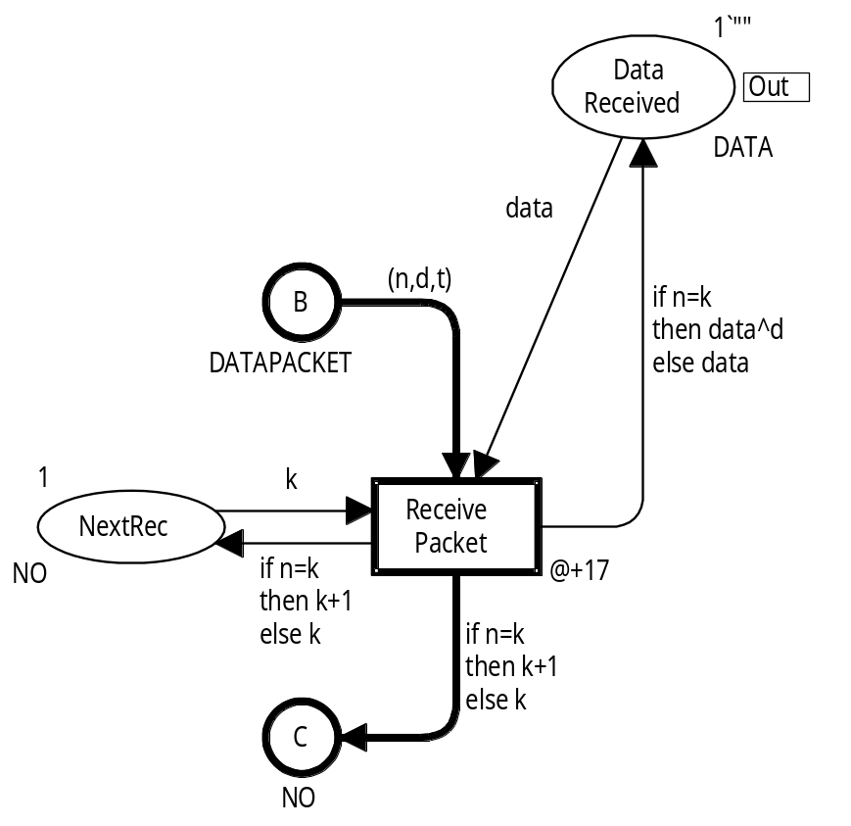
Data packets reception monitor
Calculates the number of data packets being received by the receiver, i.e. the number of occurrences of the ReceivePacket.
Implemented by a standard data collection monitor: CountTransitionOccurrences.
  The user only needs to select
  the transition.
  Not necessary to write any code.
  A counter within the monitor
  holds the number of
  occurrences.
Coloured Petri Nets
Department of Computer Science

Slide 10
Duplicate receptions monitor
Calculates the number of duplicate data packets received, i.e. the number of occurrences of ReceivePacket with a binding where n<>k.
A user-defined data collection monitor is required since the property is model-specific.
Predicate function:
fun pred (Protocol’Receive_Packet
(1,{d,data,k,n,t})) = true
| pred _ = false;
Observation function:
fun obs (Protocol’Receive_Packet (1,{d,data,k,n,t})) =
if n<>k then 1 else 0
| obs _ = 0;
Coloured Petri Nets
Department of Computer Science

Slide 11
Data packet delay monitor
Calculates the delay from a data packet arrives on
PacketsToSend until it is received on DataReceived.
Uses the time of arrival field in the data packets.
colset DATAPACKET = product NO * DATA * TOA timed;
var t : TOA; (* Time Of Arrival *)
Predicate function:
fun pred (Protocol’Receive_Packet (1,{d,data,k,n,t})) = n=k
| pred _ = false
Observation function:
fun obs (Protocol’Receive_Packet
(1, {d,data,k,n,t})) = ModelTime()-t+17
| obs _ = 0
Coloured Petri Nets
Department of Computer Science

Slide 12
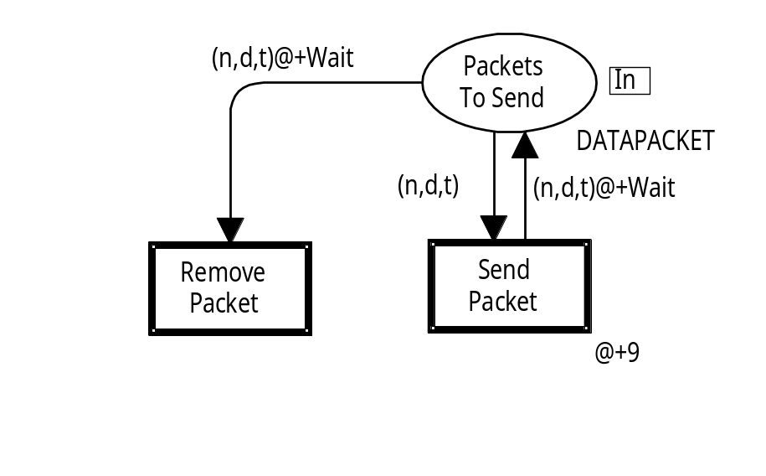
PacketsToSend queue monitor
Calculates the average number of data packets in queue at the sender, i.e. the number of tokens on PacketsToSend.
Implemented by a standard data
collection monitor: MarkingSize.
  The user only needs to select
  the place.
  Not necessary to write any code.
  The monitor takes into account the amount of time that tokens are present on the place.
Coloured Petri Nets
Department of Computer Science

Slide 13
Example simulation
Step Time Binding element Tokens
0 0 – 0
1 0 (DataPacketArrives, n=1) 1
2 0 (SendPacket, n=1, d="p1", t=0) 1
3 9 (TransmitPacket, n=1,d="p1", t=0) 1
4 184 (SendPacket, n=1, d="p1", t=0) 1
5 193 (TransmitPacket, n=1, d="p1", t=0) 1
6 216 (DataPacketArrives, n=2) 2
7 231 (ReceivePacket, n=1, d="p1", t=0, data="",k=1) 2
8 248 (TransmitAck, n=2, t=0) 2
9 276 (ReceiveAck, n=2, t=0,k=2) 2
10 283 (SendPacket, n=2,d="p2 ",t=436) 2
11 283 (RemovePacket, n=1, t=0,d="p1 ") 1
12 292 (TransmitPacket, n=2,d="p2 ", t=216) 1
13 347 (ReceivePacket, n=2,k=2,d="p2 ",t=216, data="p1 ") 1
Coloured Petri Nets
Department of Computer Science

Slide 14
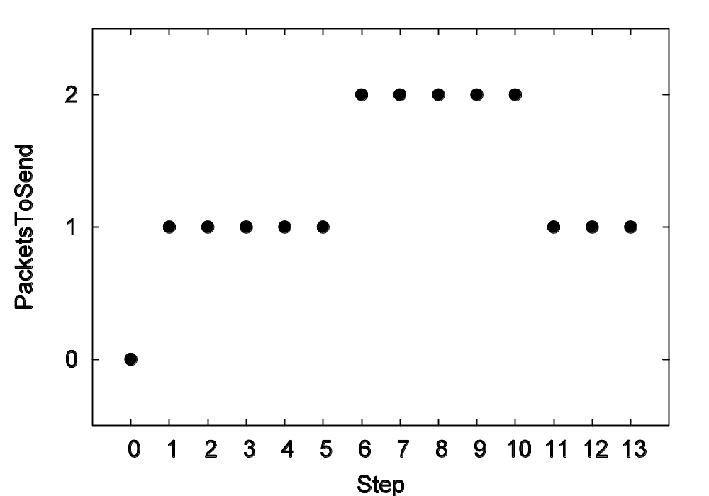
Discrete-parameters statistics
Average number of tokens:
Σ_{i=1} x_{i}
n
avrg =
n
0+1+1+1+1+1+2+2+2+2+2+1+1+1
= 1.29
14
Coloured Petri Nets
Department of Computer Science

Slide 15
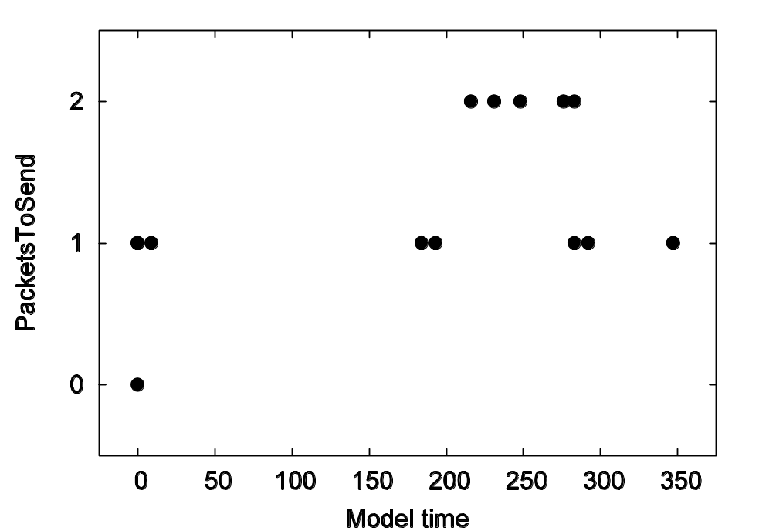
Continuous-time statistics
Time-average number of tokens:
sum_{t} = (Σ_{i=1} x_{i} (t_{i+1}– t_{i})) + x_{n}(t – t_{n})
n–1
sum_{t}
Time of calculation
avrg_{t} =
t – t₁
The individual values are weighted with their duration
0x0 + 1x0 + 1x9 + 1x175 + 1x9 + 1x23 + 2x15 +
2x17 + 2x28 + 2x7 + 2x0 + 1x9 + 1x55 + 1x0 = 414
Untimed average
avrg₃₄₇ = 414/347 = 1.19
1.29
Coloured Petri Nets
Department of Computer Science

Slide 16
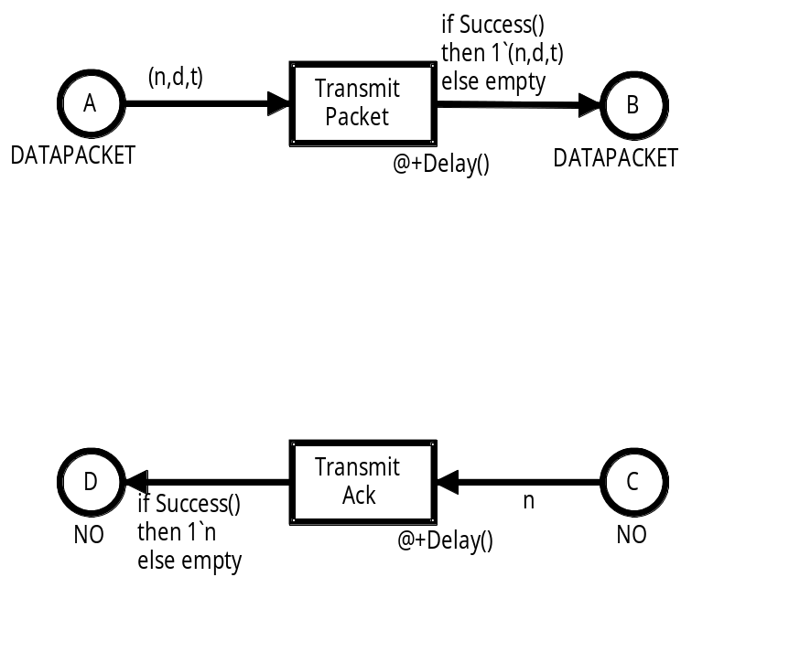
Network buffer queue monitor
Calculates the average number of data packets and acknowledgements on the network, i.e. the number of tokens on the places B and D:
Implemented by a user-defined data collection monitor.
Coloured Petri Nets
Department of Computer Science

Slide 17
Network buffer queue monitor
Predicate function returns true whenever one of the transitions TransmitPacket, ReceivePacket, TransmitAck or ReceiveAck occurs.
Observation function:
fun obs (bindelem, Protocol’B_1_mark : DATAPACKET tms,
Protocol’D_1_mark : ACK tms) =
(size Protocol’B_1_mark) + (size Protocol’D_1_mark);
We also need to make an observation at the simulation start.
Start function:
fun start (Protocol’B_1_mark : DATAPACKET tms,
Protocol’D_1_mark : ACK tms) =
SOME ((size Protocol’B_1_mark) + (size Protocol’D_1_mark));
Data collection in initial marking is optional
Coloured Petri Nets
Department of Computer Science

Slide 18
Throughput monitor
Calculates the number of non-duplicate data packets delivered by the protocol per time unit.
Existing monitor (makes an observation for each received non-duplicate packet)
Number of observations
Stop function:
fun stop () =
let
val received = Real.fromInt (DataPacketDelay.count ());
val modeltime = Real.fromInt (ModelTime());
in
SOME (received / modeltime)
end;
Data collection at the end of the simulation is optional
Coloured Petri Nets
Department of Computer Science

Slide 19

Receiver utilisation monitor
Calculates the proportion of time that the receiver is busy processing packets.
Can be computed by considering the number of occurrences of the ReceivePacket transition which each takes 17 units of model time.
Simulation may have been stopped before the last receive operation has ended.
Last occurrence of ReceivePacket
Simulation stopped
model time
17
excess time
Coloured Petri Nets
Department of Computer Science

Slide 20
Receiver utilisation monitor
Stop function:
Existing monitor (makes an observation for each received packet)
Number of observations
fun stop (Protocol’NextRec_1_mark : NO tms) =
let
val busytime = DataPacketReceptions.count () * 17;
val ts = timestamp (Protocol’NextRec_1_mark);
val excesstime = Int.max (ts – ModelTime(),0);
val busytime’ = Real.fromInt (busytime – excesstime);
in
SOME (busytime’/(Real.fromInt (Modeltime())))
end;
End of last occurrence of ReceivePacket
Coloured Petri Nets
Department of Computer Science

Slide 21
Simulation output
System parameters:
val successrate = 0.9;
fun NextArrival() = discrete(200,220);
fun Delay() = discrete(25,75);
val Wait = 175;
Log file for PacketsToSendQueue monitor:
#data counter step time
0 1 0 0
1 2 1 0
1 3 2 0
1 4 4 184
2 5 6 216
2 6 10 283
1 7 11 283
Coloured Petri Nets
Department of Computer Science

Slide 22
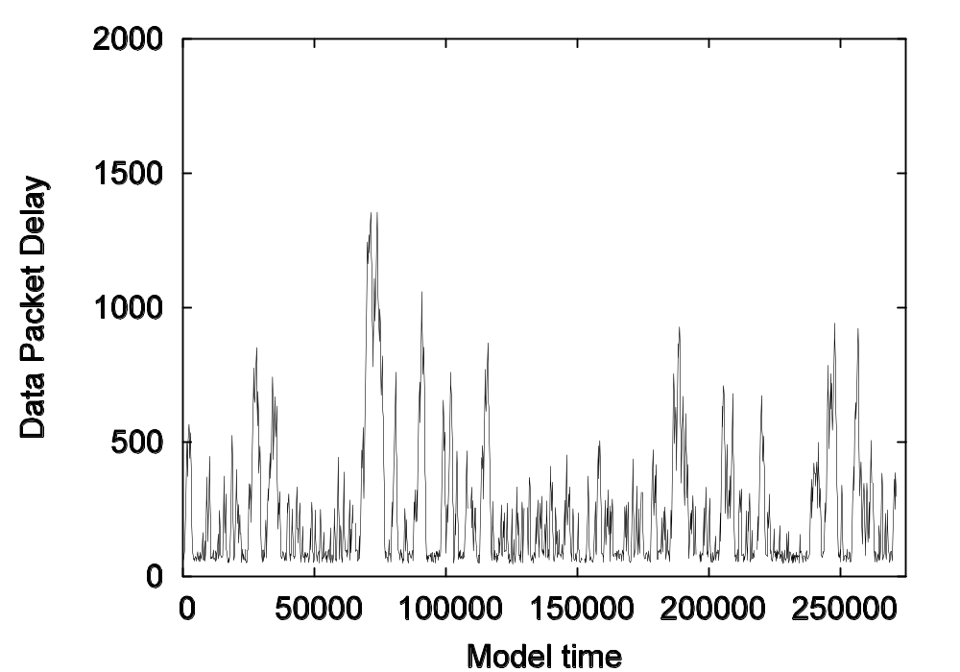
Log files can be post-processed
Data collection log files can be imported into a spreadsheet or plotted.
CPN Tools generates scripts for plotting log files using gnuplot.
Easy to create a number of different kinds of graphs.
Coloured Petri Nets
Department of Computer Science

Slide 23
Statistics from simulations
Monitors make repeated observations of numerical values, such as packet delay, reception of duplicate data packets, or the number of tokens on a place.
The individual observations are often of little interest, but it is interesting to calculate statistics for the total set of observations:
  It is not interesting to know the packet delay of a single data packet.
  But it is interesting to know the average and maximum packet delay for the entire set of the data packets.
A statistic is a quantity, such as the average or maximum, that is computed from an observed data set.
Coloured Petri Nets
Department of Computer Science

Slide 24
Discrete-parameter / continuous-time
A monitor calculates either:
  the regular average or
  the time-average
for the data values it collects.
A monitor that calculates the (regular) average is said to calculate discrete-parameter statistics.
A monitor that calculates time-average is said to calculate continuous-time statistics.
An option for the monitor determines which kind of statistics it calculates.
Coloured Petri Nets
Department of Computer Science

Slide 25
Statistics from monitors
Monitors calculate a number of different statistics such as:
  count (number of observations),
  minimum and maximum value,
  sum,
  average,
  first and last (i.e. most recent) value observed.
Continuous-time monitors also calculate:
  time of first and last observation,
  interval of time since first observation.
Statistics are accessed by a set of predefined functions
such as count, sum, avrg, and max.
  DataPacketDelay.count () – used in the Throughput monitor.
Coloured Petri Nets
Department of Computer Science

Slide 26
Simulation performance report
Contains statistics calculated during a single simulation:
Length of simulation: 275,201 time units and 10,000 steps.
Continuous-time statistics:
Monitor Count Average StD Min Max
PacketsToSendQueue 4,219 1.2583 0.9207 0 5
NetworkBufferQueue 5,784 0.5004 0.5000 0 1
Discrete-parameter statistics:
Monitor Count Sum Average StD Min Max
DataPacketDelay 1,309 243,873 186.30 152.89 51 851
DataPacketReceptions 1,439 1,439 1.0 0.0 1 1
DuplicateReceptions 1,439 130 0.0903 0.2868 0 1
Throughput 1 0.0048 0.0048 0.0 0.0048 0.0048
ReceiverUtilization 1 0.0889 0.0889 0.0 0.0889 0.0889
Coloured Petri Nets
Department of Computer Science

Slide 27
Simulation experiments
Most simulation models contain random behaviour.
  Simulation output data also exhibits random behaviour.
  Different simulations will result in different estimates.
  Care must be taken when interpreting and analysing the output data.
Average of monitors calculated for five different simulations:
Performance Measure 1 2 3 4 5
PacketsToSendQueue 1.5702 1.2567 1.3853 1.2824 1.2762
NetworkBufferQueue 0.5047 0.4946 0.5093 0.5125 0.5073
DataPacketDelay 250.95 184.34 210.20 191.93 189.07
DuplicateReceptions 0.1026 0.0938 0.1137 0.0983 0.1073
Throughput 0.004768 0.004758 0.004766 0.004763 0.004760
ReceiverUtilisation 0.089749 0.088802 0.090570 0.088693 0.089821
Coloured Petri Nets
Department of Computer Science

Slide 28
Confidence intervals
Standard technique for determining how reliable estimates are.
A 95% confidence interval is an interval which is determined such that there is a 95% likelihood that the true value of the performance measure is within the interval.
The most frequently used confidence intervals are confidence intervals for averages of estimates of performance measures.
CPN Tools can automatically compute confidence intervals and save these in performance report files.
Coloured Petri Nets
Department of Computer Science

Slide 29
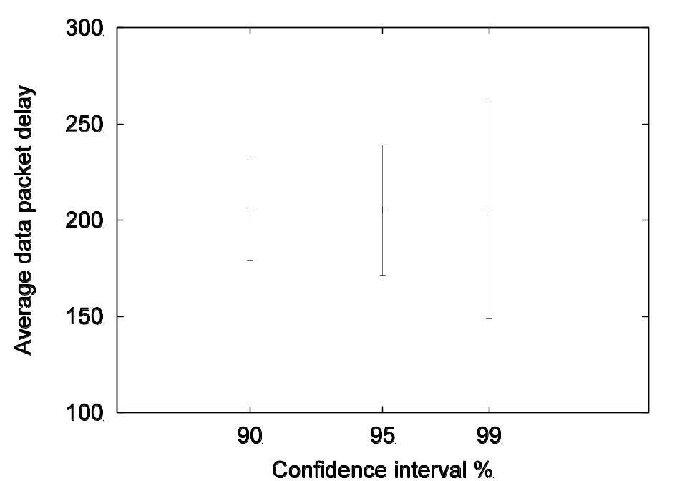
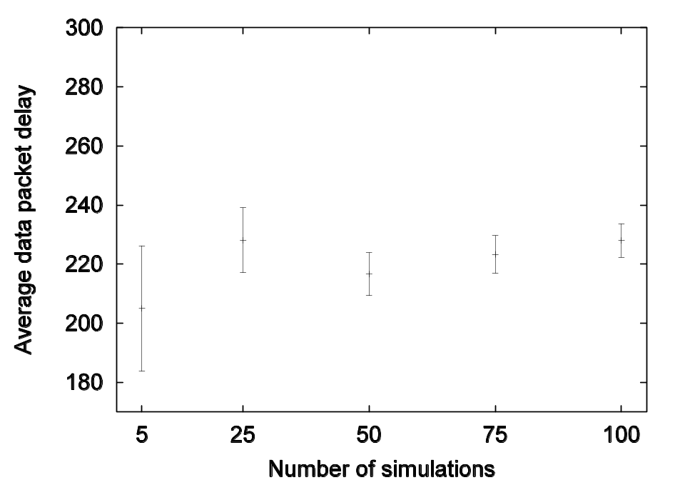
Confidence intervals for Data Packet Delay
90%, 95% and 99%.
Number of simulations (95%).
Coloured Petri Nets
Department of Computer Science

Slide 30
Simulation replications
We want to calculate estimates of performance measures from a set of independent, statistically identical simulations:
  Start and stop in the same way (e.g. when 1,500 unique data packets have been received).
  Same system parameters (e.g., the time between data packet arrivals).
Replications.run 5;
Run five simulations and gather statistics from them
Predefined function
Coloured Petri Nets
Department of Computer Science

Slide 31
Packets received monitor
Simulations can be stopped by a breakpoint monitor.
Stops the simulation when the predicate function
evaluates to true.
We may e.g. want to stop when 1,500 unique data packets have been received.
fun pred (Protocol’Receive_Packet (1, {k,...})) = k > 1500
| pred _ = false;
Coloured Petri Nets
Department of Computer Science

Slide 32
Simulation replication report
Simulation no.: 1
Steps.........: 11,530
Model time....: 314,810
Stop reason...: The following stop criteria are fulfilled:
- Breakpoint: PacketsReceived
Time to run simulation: 2 seconds
Simulation no.: 2
Steps.........: 11,450
Model time....: 315,488
Stop reason...: The following stop criteria are fulfilled:
- Breakpoint: PacketsReceived
Time to run simulation: 3 seconds
Simulation no.: 3
......
Coloured Petri Nets
Department of Computer Science

Slide 33
Performance report from a set of repeated simulations
Combines the results from a set of repeated simulations (with the same system parameters). This allows us to:
  get more precise results,
  estimate the precision of our results (by calculating confidence intervals).
Monitor Average 95 % StD Min Max
PacketsToSendQueue 1.3542 0.1025 0.1169 1.2567 1.5702
NetworkBufferQueue 0.5057 0.0053 0.0061 0.4946 0.5125
DataPacketDelay 205.30 21.43 24.45 184.34 250.95
Confidence interval
Standard deviation
Coloured Petri Nets
Department of Computer Science

Slide 34
System parameters
The performance of a modelled system is often dependent on a number of parameters.
Simulation-based performance analysis may be used to compare different scenarios or configurations of the system.
In some studies, the scenarios are given, and the purpose of the study is to compare the given configurations and determine the best of these configurations.
If the scenarios are not predetermined, one goal of the simulation study may be to locate the parameters that have the most impact on a particular performance measure.
Coloured Petri Nets
Department of Computer Science

Slide 35
How to change parameters?
Simulation parameters are typically defined by symbolic constants and functions, e.g.:
val successrate = 0.9;
fun Success() = uniform(0.0,1.0) <= successrate;
The parameter can be changed by modifying the declaration of the symbolic constant successrate.
In CPN Tools, these changes must be done manually.
The declaration and those parts of the model that depend upon it are rechecked and new code generated for them.
Coloured Petri Nets
Department of Computer Science

Slide 36
Reference variables
To avoid manual changes and time-consuming rechecks and code generation, we use reference variables to hold parameter values:
globref successrate = 90;
globref packetarrival = (200,220);
globref packetdelay = (25,75);
globref retransmitwait = 175;
The keyword globref specifies that a global reference variable is being declared that can be accessed from any part of the CPN model.
Coloured Petri Nets
Department of Computer Science

Slide 37
Manipulation of reference variables
The values of the reference variables can be accessed by means of the ! operator:
fun Success() = discrete(0,100) <= (!successrate);
fun Delay() = discrete(!packetdelay);
fun NextArrival() = discrete(!packetarrival);
fun Wait() = !retransmitwait;
The values of the reference variables can be changed by means of the := operator:
successrate := 75;
It is not necessary to recheck the syntax of any part of a CPN model when the value of a reference variable is changed.
Coloured Petri Nets
Department of Computer Science

Slide 38

Modified Protocol module
Function instead of symbolic constant
Coloured Petri Nets
Department of Computer Science

Slide 39
Configurations
Colour set declaration:
colset INT = int;
colset INTxINT = product INT * INT;
colset CONFIG = record successrate : INT *
packetarrival : INTxINT *
packetdelay : INTxINT *
retransmitwait : INT;
Example value:
{successrate = 90,
packetarrival = (200,220),
packetdelay = (25,75)
retransmitwait = 175}
Update of reference variables:
fun setconfig (config : CONFIG) =
(successrate := (#successrate config);
packetarrival := (#packetarrival config);
packetdelay := (#packetdelay config);
retransmitwait := (#retransmitwait config));
Coloured Petri Nets
Department of Computer Science

Slide 40
Multiple simulation runs
30 configurations with retransmitwait ∈ {10,20,30,...,300}.
Pred-declared function
val configs = List.tabulate
(30,fn i =>
{successrate = 90,
packetarrival = (200,220),
packetdelay = (25,75),
retransmitwait = 10+(i*10)});
Number of configurations
Function to be used on each element in the list [0,1,2,…29] of length 30
Run n repeated simulations of config.
fun runconfig n config = (setconfig config;
Replications.run n);
Five runs of each configuration in configs.
List.app (runconfig 5) configs;
Coloured Petri Nets
Department of Computer Science

Slide 41
Performance results
The CPN simulator conducts the specified set of simulations while saving the simulation output in log files and performance reports as described above.
Based on the log files we can create graphs for the monitors:
  Data Packet Delay.
  PacketsToSend Queue.
  Network Buffer Queue.
  Receiver Utilisation.
  Throughput.
Coloured Petri Nets
Department of Computer Science

Slide 42
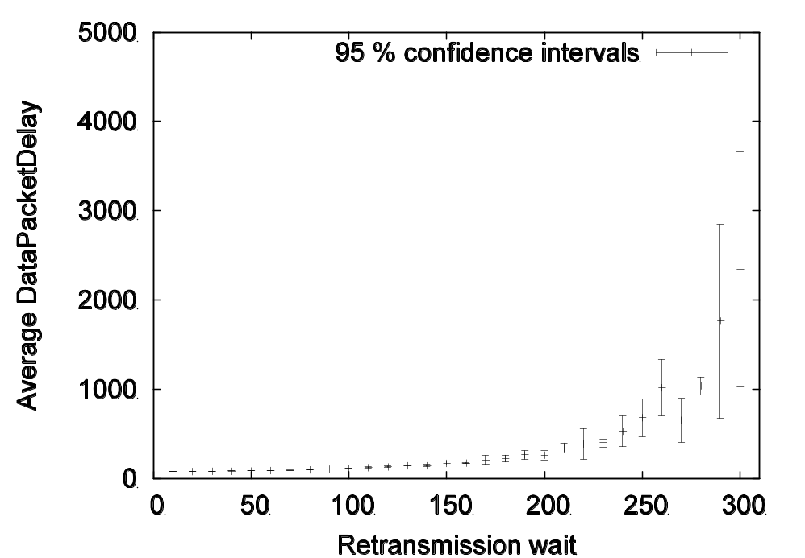
Data Packet Delay
For small time values we get accurate estimates.
For higher time values the confidence intervals become wider.
The retransmission wait has relatively small effect on the average data packet delay as long as it is below 150 time units.
When the retransmission wait is above 250 time units, large average data packet delays are observed because lost data packets now wait a long time before being retransmitted.
Coloured Petri Nets
Department of Computer Science

Slide 43
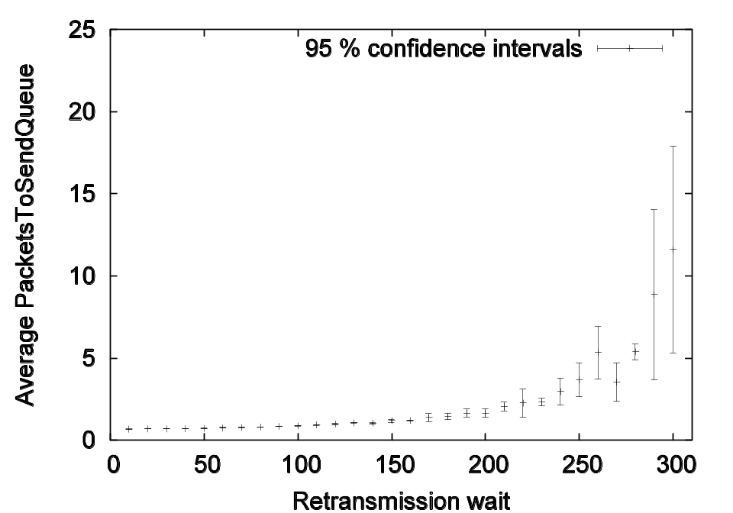
PacketsToSend Queue
The curve (and the confidence intervals) is similar to the curve for DataPacketDelay.
When the retransmission wait becomes high, a queue of data packets starts to build up – contributing to the increased data packet delay observed on the previous graph.
To investigate this we consider a log file from a simulation with retransmission wait equal to 300.
Coloured Petri Nets
Department of Computer Science

Slide 44
PacketsToSend Queue
Log file from a simulation with retransmission wait equal to 300.
The system has become unstable.
Performance measure estimates must be interpreted with great care.
The average number of tokens will depend on how long the simulation is running and can be made arbitrarily large by making the simulation longer.
Coloured Petri Nets
Department of Computer Science

Slide 45
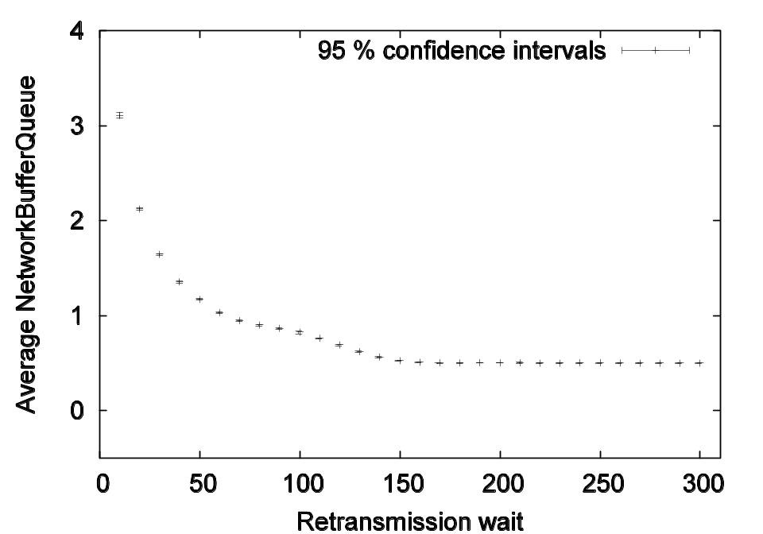
Network Buffer Queue
We measure the average number of tokens on places B and D.
For all values, we get accurate estimates.
With a small retransmission wait there are more packets on the network – because the frequent retransmissions introduce more packets to be sent.
Coloured Petri Nets
Department of Computer Science

Slide 46
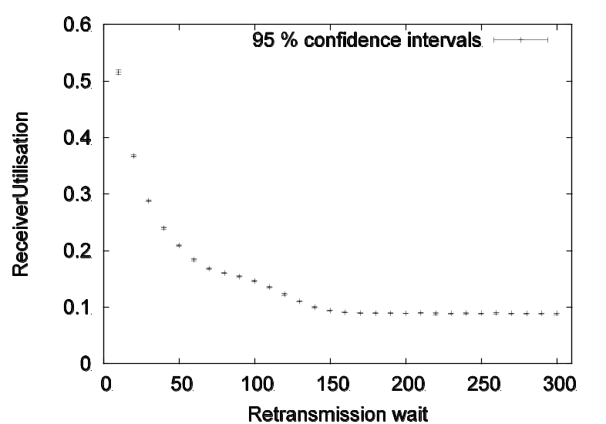
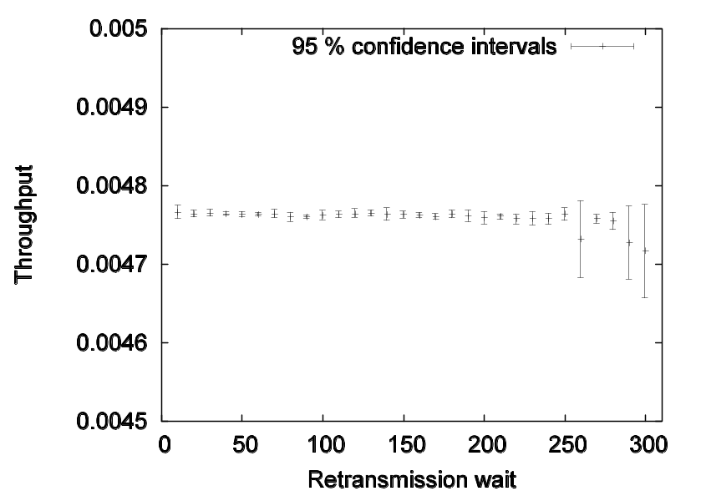
Receiver Utilisation
When retransmission wait is above 150 there are very few unnecessary retransmissions of data packets.
Hence, the receiver utilisation no longer decreases.
Throughput
When retransmission wait is above 250, throughput decreases and the confidence intervals become large.
Coloured Petri Nets
Department of Computer Science

Slide 47

Questions
Coloured Petri Nets
Department of Computer Science

