Slide 1
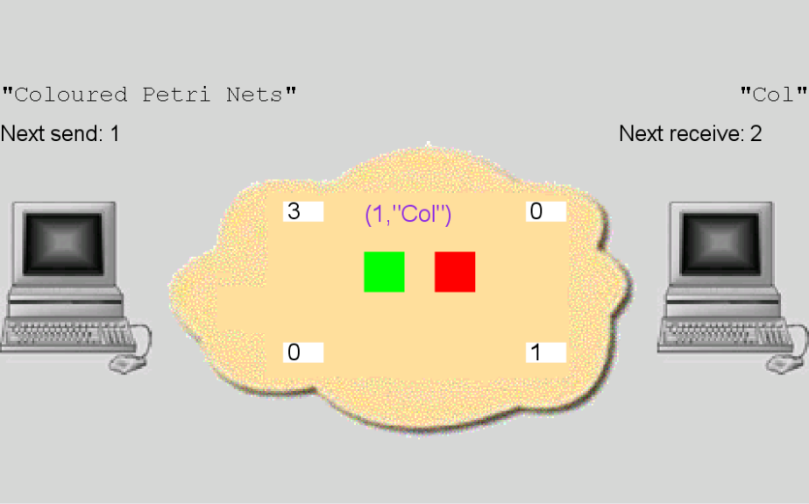
Coloured Petri Nets
Modelling and Validation of Concurrent Systems
Chapter 13: Behavioural Visualisation
Kurt Jensen &
Lars Michael Kristensen
{kjensen,lmkristensen}
@cs.au.dk
Coloured Petri Nets
Col

Slide 2
CPN models may be complex
The CPN modelling language offers:
  abstraction,
  hierarchical module concept.
There can still be an overwhelming amount of detail.
Observing every single step in a simulation is often too detailed, especially for large CPN models.
When presenting and discussing a CPN model with people unfamiliar with the CPN modelling language, we need more natural ways to follow a simulation.

Slide 3
Visualisation of the behaviour
The basic idea of behavioural visualisation is to augment the CPN model with visualisation graphics that reflect the execution of the model.
Feedback from simulations can be investigated at a more adequate level of detail using concepts that are specific for the system and domain being modelled.
Behavioural visualisation can be applied in such a way that the underlying formal CPN model becomes fully invisible to the observer.

Slide 4
BRITNeY visualisation tool
CPN Tools can use the BRITNeY visualisation tool to create system and domain-specific graphics on top of CPN models.
The BRITNeY tool is a stand-alone application supporting a wide range of diagram types via a plug-in architecture.
CPN Tools invokes the primitives of BRITNeY via remote procedure calls.
Here we shall present:
  Message Sequence Charts.
  Interaction Graphics.

Slide 5
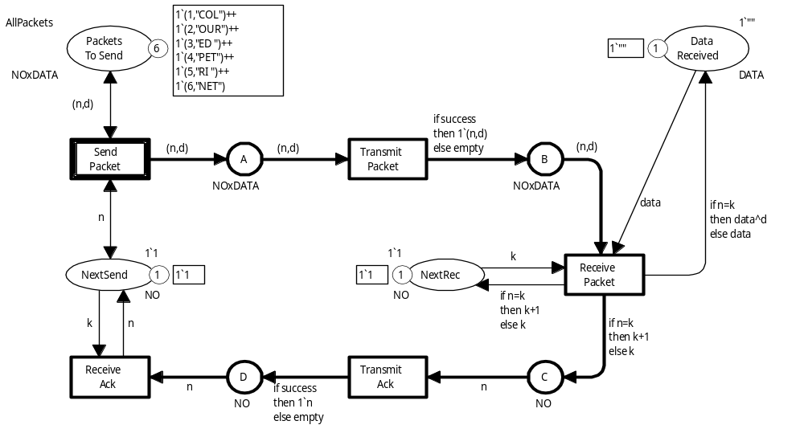
CPN model for protocol

Slide 6
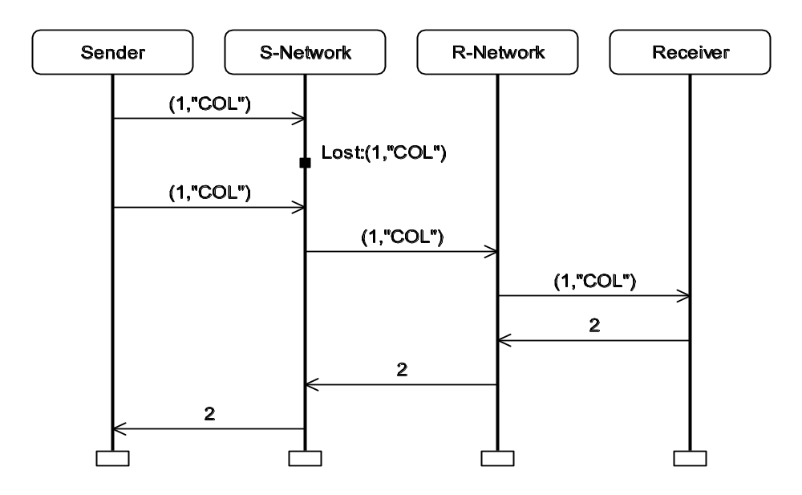
Message sequence charts
Message Sequence Charts (MSCs) are used to describe the interaction patterns between processes/entities.
Also known as sequence diagrams (in UML).
Widely used in the telecommunication area (with an international standard).
They are used to specify use cases (i.e. typical scenarios).
CPN Tools supports Message Sequence Charts that are updated during the simulation of a CPN model.
They show what happened during that particular simulation.
Sender
S-Network
R-Network
Receiver
(1,”COL”)
(1,”COL”)
Lost:(1,”COL”)
(1,”COL”)
(1,”COL”)
2
2
2

Slide 7
Creation of message sequence charts
To create and initialise a MSC diagram we use primitives provided by BRITNeY.
The following CPN ML code is added to the declarations of the CPN model:
structure Msc = MSC (val name = "Protocol");
Name of a new structure
Predefined functor (provided by BRITNeY)
Structures and functors are the basic CPN ML constructs that allows larger CPN ML programs to be structured into modules each with their own name space.
Structures are similar to objects as known from e.g. Java.

Slide 8
Creation of columns
The four columns of the MSC can now be created by the following sequence of CPN ML expressions (separated by semicolons):
(Msc.addProcess "Sender";
Msc.addProcess "S-Network";
Msc.addProcess "R-Network";
Msc.addProcess "Receiver");
Structure
Function in structure
Argument (name of column)
The sequence is evaluated by evaluating the individual expressions one by one after each other.
The result of sequence is the result of the last expression.

Slide 9
Code segments
The MSC is updated by means of code segments associated with the transitions of the CPN model.
Piece of Standard ML code which is evaluated each time the transition occurs.
Code segments are typically used to:
  update visualisations,
  perform nondeterministic calculations, or
  read and write files.

Slide 10
Code segment for SendPacket
SendPacket has the following code segment:
input (n,d);
action
SPmsc(n,d);
Input part (specifies the variables of the transition which can be used in the action part)
Action part (contains the code to be evaluated when the transition occurs)
SPmsc is a function defined as:
fun SPmsc (n,d)=
Msc.addEvent("Sender","S-Network",NOxDATA.mkstr(n,d));
Function in
Msc structure
Creates an arrow in the MSC
Takes three parameters
Start of arrow
Sender column
End of arrow
S-Network column
Label of arrow
Text representation of (n,d)
Sender
S-Network
(1,”COL”)

Slide 11
Code segment for TransmitPacket
input (n,d,success);
action
TPmsc(n,d);
TPmsc is a function defined as:
fun TPmsc (n,d,success)
if success
then Msc.addEvent("S-Network","R-Network",NOxDATA.mkstr(n,d))
else Msc.addInternalEvent("S-Network","Lost:"ˆ(NOxDATA.mkstr(n,d)));
Creates a small black square
Creates an arrow (as before)
Sender
S-Network
R-Network
(1,”COL”)
Loss of packet
Lost:(1,”COL”)
(1,”COL”)
Successful transmission
(1,”COL”)

Slide 12
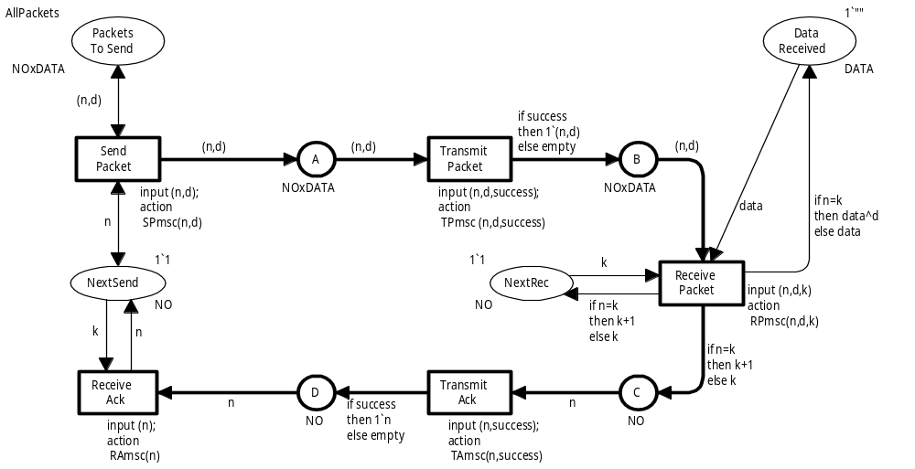
CPN model with code segments for MSC visualisation
In this model all action parts are function calls, but in general
they can be any CPN ML expression of the proper type
Using function calls saves space in the
graphical representation of the CPN model

Slide 13
Monitor instead of code segments
The visualisation can also be controlled by means of a
monitor (as known from performance analysis).
Invokes the appropriate visualisation primitives depending on which transition occurs.
Observation function:
fun obs (Protocol’Send_Packet(1,{n,d})) = SPmsc (n,d)
| obs (Protocol’Transmit_Packet(1,{n,d,success})) = TPmsc (n,d,success)
| obs (Protocol’Receive_Packet(1,{n,d,k,data})) = RPmsc (n,d,k)
| obs (Protocol’Transmit_Ack(1,{n,success})) = TAmsc (n,success)
| obs (Protocol’Receive_Ack(1,{n,k})) = RAmsc (n);
By using a monitor we avoid cluttering the graphical representation of the CPN model with code segments.
Moreover, it becomes easy to turn the visualisation on/off by turning the corresponding monitor on/off.

Slide 14
System-specific interaction graphics
Shows the current state of the protocol system in a way that can be interpreted without any knowledge of CP-nets.
Sender
Network
Receiver
Text string to be transmitted
Text string received
Coloured Petri Nets
Col
Next packet to be sent
Next packet to
be received
By clicking on the green/red button the user can determine whether (1,”COL”) is lost or not.
Number of packets on the network buffers

Slide 15
How to specify the interaction graphics
The interaction graphics is created based on a SceneBeans file.
XML file describing the different elements in the visualisation:
  the computer icons,
  the network cloud,
  the text labels,
  the green/red buttons.
The scene file also describes the:
  behaviour and timing of the animated graphical objects,
  commands that can be invoked from the CPN model.
The BRITNeY visualisation tool contains an editor which can be used to develop the SceneBeans file.

Slide 16
Initialisation of interaction graphics
The interaction graphics is initialised by the following lines of CPN ML code added to the declarations of the CPN model.
Creates structure representing the interaction graphics diagram
Functor provided by BRITNeY
structure Vis = SceneBeans (val name = "Protocol");
val _ = Vis.setVisualisation ("visualisation.xml");
structure DataDialog =
GetString (val name = "Enter message");
globref networkcount = Array.array(4,0);
Loads the SceneBeans XML file into the diagram
Creates a dialog box to
be used for entering the message to be transmitted
Creates an array used to keep track of the number of packets on the 4 network buffers

Slide 17
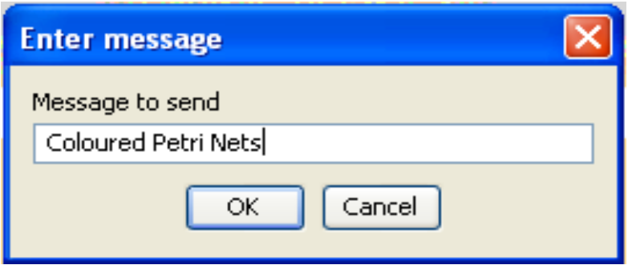
Dialog box
When a simulation is started, a dialog box pops up allowing the user to enter the text string to be transmitted.
Simulation pauses until the user has entered the text string.
Message to send
Coloured Petri Nets
OK
Cancel

Slide 18
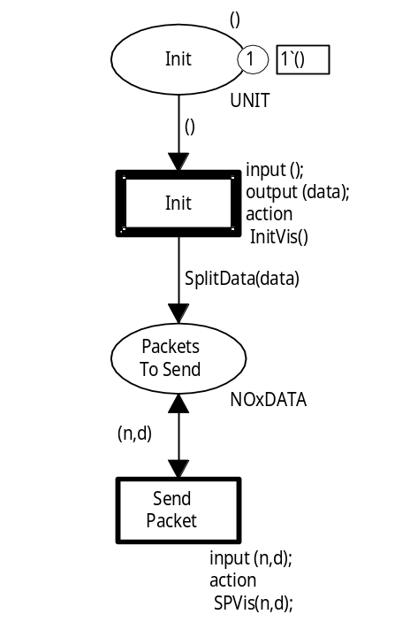
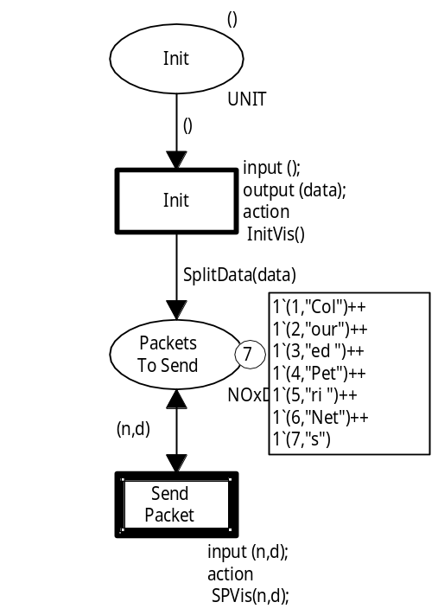
How to invoke the dialog box
The dialog box is invoked by a code segment associated with a new transition Init – which is the only enabled transition when simulation starts.
The action part contains a function InitVis which:
  pops up the dialog box,
  binds the text string entered by the user to the variable data in the output part of the code segment.
After occurrence of Init transition
Function SplitData splits the text string into a number of tokens.

Slide 19
InitVis function
Opens dialog box and gets the string entered by the user
fun InitVis () =
let
val data = DataDialog.getString("Message to send","")
val _ = Vis.setTextValue("send message",data)
val _ = Vis.setTextValue("receive message","")
val _ = (networkcount := Array.array(4,0))
in
data
end;
Initialises the two
labels holding the text to be sent and the text received
Resets array to 0s (necessary when we have multiple simulations)

Slide 20
Code segment for SendPacket
The SPvis function:
  visualises the movement of a data packet from the sender into the network.
  (by displaying some moving coloured dots).
  increments the counter in the upper left edge of the network cloud.
input (n,d);
action
SPvis(n,d);
Sets label of packet to be visualised, e.g. (1,”COL”)
fun SPvis (n,d) =
(Vis.setValue ("packet","text",NOxDATA.mkstr(n,d));
InvokeCommand("send packet");
IncNetworkCount(1));
Performs visualisation by moving dots
Increments counter

Slide 21
Code segment for TransmitPacket
The TPvis function:
  makes the green and red squares visible.
  binds the variable success to true/false depending on the choice of the user.
input (n,d);
output (success);
action
TPvis(n,d);
Sets label of packet to be visualised, e.g. (1,”COL”)
fun TPvis (n,d) =
(Visualisation.setValue
("packet","text",NOxDATA.mkstr(n,d));
DecNetworkCount(1);
InvokeCommand("show buttons");
case Visualisation.getNextEvent () of
"success" => (IncNetworkCount(2);true)
| _ => false);
Decrements counter in upper left corner
Makes the green and red squares visible
Increments counter in upper right corner and returns true
Returns false

Slide 22
Monitor instead of code segments
To update the interaction graphics we could consider using a monitor – in a similar way as we did for the MSC.
This is, unfortunately, not possible.
We want to allow the user to interact with the simulation:
  input the text string to be sent,
  choose between successful transmission and loss.
To do this we need input during the simulation step
(to determine the binding of certain variables of the transition).
This is possible with code segments (which are executed during the step) but impossible with monitors (which are executed after the step).

Slide 23

Questions

