Slide 1
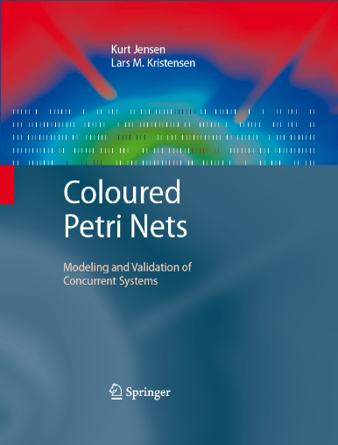
Coloured Petri Nets
Modelling and Validation of Concurrent Systems
Chapter 15: Teaching CP-nets
Kurt Jensen & Lars Michael Kristensen
{kjensen,lmkristensen}@cs.au.dk

Slide 2
Course on modelling and validation of concurrent systems at Aarhus University
The course introduces CP-nets as a formal modelling language for concurrency.
Students are introduced to the CPN modelling language, its analysis methods, and its supporting computer tools.
Students are exposed to the benefits of applying formal modelling to study the behaviour of concurrent systems.
We present four industrial projects where CP-nets have been used for the modelling and validation of systems.
We emphasise the practical use of modelling and validation and has less focus on the formal foundation of CP-nets.

Slide 3
Course on modelling and validation of concurrent systems
After the course, the students will have a detailed knowledge of CP-nets and practical experience with modelling and validation of concurrent systems.
Slide sets, CPN models, and suggestions for exercises and projects are available via the web pages for the new CPN book:
  www.cs.au.dk/CPnets/cpnbook/

Slide 4
Course organisation
The course is divided into two parts.
Students may take both parts or only the first part.
Each part
  lasts for seven weeks in which the students are expected to spend one-third of their study time on the course,
  corresponds to 5 ECTS credit points,
  has a separate exam.
The course is an optional advanced course.
Most participants are in their 3.-5. year of studies.
The course usually has 15–20 participants.

Slide 5

Constructive alignment
The organisation and contents of the course are based on the theory of constructive alignment by John Biggs.
Teaching methods
Intended
learning outcomes
Assessment methods

Slide 6
Constructive alignment
Intended learning outcomes should be the focal point of the course.
Teaching methods and activities should be
chosen so that they support the students in achieving the intended learning outcomes.
Exams must measure the degree to which the students have fulfilled the intended learning outcomes.
The goal is to encourage students to work actively with the topics instead of just using minimum effort to pass the exam.

Slide 7
Aims and prerequisites
The aim of the first part of the course is that the students will:
  obtain a detailed knowledge of CP-nets,
  gain experience in the modelling and validation of small concurrent systems.
At the beginning of the course, we assume that the students are familiar with conventional programming-language concepts such as variables, types, procedures, and modules.
We introduce the CPN modelling language in a way similar to that in which programming languages are introduced, i.e., through concrete examples that illustrate:
  the constructs of the modelling language,
  the more general concepts of concurrency, synchronisation, and communication.

Slide 8
SOLO taxonomy
The intended learning outcomes are formulated using a taxonomy developed by John Biggs:
Level 1: No competences have been obtained.
Level 2: A minimalistic but sufficient understanding of each topic in isolation (memorise, identify, and recognise).
Level 3: Solid competences within each topic and a basic understanding of the boundaries of each topic
(classify, describe, and list).
Level 4: Competences in orchestrating facts, theory, actions, and purposes (apply, integrate, analyse, and explain).
Level 5: Competences beyond what has been dealt with in the actual teaching (theorise, hypothesise, generalise, reflect, and generate).

Slide 9
Intended learning outcomes of part 1
1. Explain⁴ the constructs and concepts of the CPN modelling language.
2. Define² and explain⁴ the syntax and semantics of
non-hierarchical untimed CP-nets.
3. Define² and explain⁴ properties used for characterising the behaviour of concurrent systems.
4. Explain⁴ the basic concepts and techniques underlying
state space analysis methods.
5. Explain⁴ the basic concepts and techniques underlying simulation-based performance analysis.
6. Apply⁴ CP-nets and CPN Tools to the modelling and validation of small concurrent systems.
7. Judge⁴ the practical application of CP-nets to the modelling and validation of concurrent systems.

Slide 10
1. Explain⁴ the constructs and concepts of the
CPN modelling language
The students must learn the constructs and concepts of the CPN modelling language such as:
  net structure,
  CPN ML inscription language,
  hierarchical and timed CPN models,
  binding elements, steps, markings,
  concurrency and conflict.

Slide 11
2. Define² and explain⁴ syntax and semantics of non-hierarchical untimed CP-nets
The students must be able to formally define and explain the syntax and semantics of CP-nets.
We only demand that they know the formal definition of non-hierarchical and untimed CP-nets.
The purpose is to make the students understand that
CP-nets rely on a formal foundation.
When introduced to the formal definitions, the students explore CP-nets from a different angle than the example-driven introduction to the language.
The formal definitions represent a complementary view of the modelling constructs that can help the students to consolidate their understanding.

Slide 12
3. Define² and explain⁴ properties used for characterising the behaviour of concurrent systems
The students must be able to define and explain:
  standard behavioural properties of CP-nets such as boundedness properties, dead markings, and live transitions,
  quantitative performance properties such as delays, throughput, and utilisation.
These concepts are used when the students work with the analysis methods of CP-nets, which include state space analysis and simulation-based performance analysis.

Slide 13
4. Explain⁴ basic concepts and techniques underlying state space analysis methods
The students must be able to explain:
  the concepts of state spaces and SCC graphs,
  the techniques used to check the standard behavioural properties of CPN models from the state space and the SCC graph,
  basic ideas underlying advanced state space methods.

Slide 14
5. Explain⁴ basic concepts and techniques underlying simulation-based performance analysis
The students must be able to explain:
  techniques underlying simulation-based performance analysis such as workload generation, data collection monitors, and simulation replications,
  statistical concepts related to discrete- and
  continuous-time statistics.

Slide 15
6. Apply⁴ CP-nets and CPN Tools to modelling and validation of small concurrent systems
The students must be able to apply the modelling language and the analysis methods in practice.
They must have an operational knowledge of the topics taught in the course.
They must be able to use CPN Tools in an efficient way.

Slide 16
7. Judge⁴ the practical application of CP-nets to the modelling and validation of concurrent systems
The students must be able to judge whether CP-nets
constitute an appropriate choice for modelling and validating systems within a given application domain.
They must be able to determine whether:
  CP-nets are suitable for the modelling of a concrete system,
  validation of the properties of interest.

Slide 17
Course program for part 1
Session Topic Method Material Projects
1 Why modelling and validation? Lecture Chap. 1
2 Non-hierarchical CP-nets Lecture Chap. 2
3 CPN ML programming Lecture Chap. 3
4 Practical modelling Workshop Exercises
5 Formal definition of CP-nets Lecture Chap. 4
6 Practical modelling Workshop Project 1
7 Hierarchical CP-nets Lecture Chap. 5
8 State space analysis (1) Lecture Chaps. 7-8
9 State space analysis (2) Lecture Chaps. 7-8
10 Practical state space analysis Workshop Project 2
11 Timed CP-nets Lecture Chap. 10
12 Performance analysis Lecture Chap. 12
13 Practical performance analysis Workshop Project 3
14 Industrial applications Lecture Chap. 14
Session = 2 * 45 min
Modelling
State space analysis
Perfor-mance analysis

Slide 18
Three mandatory projects
The projects are conducted in groups of 2-3 students and are documented in a 5–10 page written group report.
In project 1 the students extend the protocol model from
Chap. 2 to model a sliding-window protocol. The model is validated using simulation.
In project 2 the students use state space analysis on the model developed in project 1 to verify the correctness of the protocol.
  50–75% of the groups discover errors in their design;
  errors that they did not find by the simulation in project 1.
  They experience the power of formal verification techniques.
In project 3 the students use performance analysis on the model developed in project 1 They compare the results to those described in Chap. 12.

Slide 19
Four workshops
The students work in groups of 2-3 persons in front of a PC using CPN Tools to solve exercises and projects.
The lecturers are present to help with technical questions and other issues related to the projects and exercises.
The workshops enable face-to-face discussion with the students and are effective in highlighting issues that need to be discussed in more detail.
The workshops constitute an interactive teaching–learning environment.

Slide 20
Examination for part 1
We have a 20-minute oral exam and the students have approximately one week for preparation.
Exam questions are very broad:
  Non-hierarchical CP-nets (Chap. 2)
  Formal definition of non-hierarchical CP-nets (Chap. 4)
  Hierarchical CP-nets (Chap. 5)
  State spaces and behavioural properties (Chap. 7)
  Advanced state space methods (Chap. 8)
  Timed CP-nets (Chap. 10)
  Simulation-based performance analysis (Chap. 12)
  Industrial applications (Chap. 14)

Slide 21
Part 2 of the course (last 7 weeks)
The students conduct a larger modelling and validation project in groups of 2-3 persons.
The working methods are intended to train the students to plan and complete projects.
There are no conventional lectures or workshops.
The individual groups contact the lecturers when they need help (e-mail or meetings).
There are two progress workshops where each group gives a
25-minute oral presentation of the current state of their project for the lecturers and the other students:
  The first progress workshop focuses on modelling.
  The second progress workshop focuses on validation and verification.

Slide 22
Intended learning outcomes of part 2
8. Construct³ and structure³ CPN models of larger
concurrent systems.
9. Apply⁴ analysis methods for CP-nets to the validation of larger concurrent systems.
10. Discuss⁵ the application of CP-nets to the modelling and validation of larger concurrent systems.

Slide 23
8. Construct³ and structure³ CPN models of larger concurrent systems
The students must be able to model concurrent systems of a size and complexity that appear in real system development projects.
They must be able to make well-structured hierarchical
CP-nets.

Slide 24
9. Apply⁴ analysis methods for CP-nets to the validation of larger concurrent systems
The students must be able to validate concurrent systems of a size and complexity that appear in real system development projects.
They must be able to validate hierarchical CP-nets.

Slide 25
10. Discuss⁵ the application of CP-nets to modelling and validation of larger concurrent systems
The students must be able to discuss the results of their modelling and validation.
They must be able to present the results to colleagues.

Slide 26
Projects in part 2
Each year we propose 5-10 different projects, but students may also choose other systems as a basis for their projects.
Many of the projects have focused on communication protocols and distributed algorithms, but it is possible to choose systems from other domains such as workflow systems, manufacturing systems, and embedded systems.
The assessment of part 2 consists of:
  the evaluation of a written group report, which is required to have a length of 15–20 pages,
  an individual oral exam, where each student is required to give a presentation of the group project.

Slide 27
Examples of projects in part 2
Distributed file systems
based on a chapter in a the textbook by Colouris et. al.
Dynamic Host Configuration Protocol (DHCP)
based on an IETF Request for Comments document.
Data dissemination protocol
based on a local research paper.
Dynamic MANET On-demand (DYMO) routing protocol
based on an IETF Internet-Draft.
Internet Key Exchange (IKE) protocol
based on an IETF Request for Comments document.
Mutual exclusion algorithms
based on selected algorithms from a textbook by Raynal.
PathFinder scheduling mechanism
based on a description in a paper by Holzmann et. al.

Slide 28
Example of student project
A group modelled the Dynamic MANET On-demand (DYMO) protocol which is being developed by the IETF MANET working group.
The basis for the work was a 35-page Internet-Draft providing a natural-language specification of the protocol.
The constructed CPN model captured a large subset of the DYMO protocol specification.
The group discovered several ambiguities and missing parts in the DYMO specification.
They used state space analysis to investigate nontrivial issues related to the operation of the DYMO protocol.

Slide 29
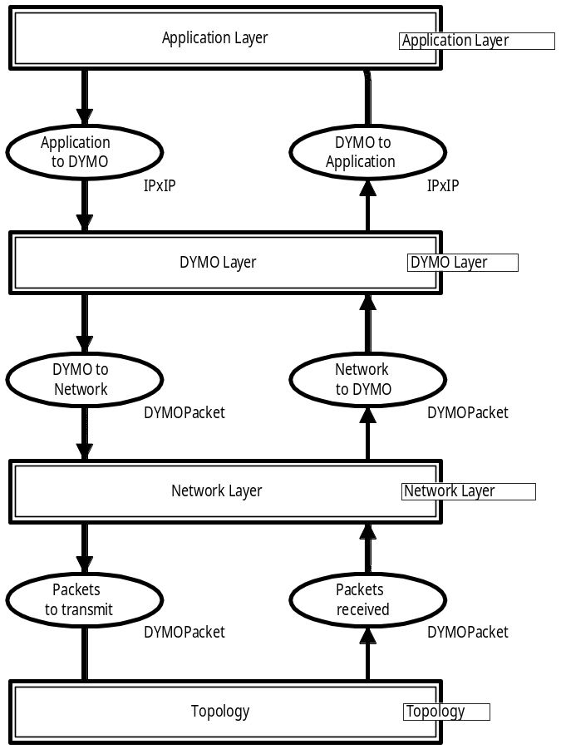
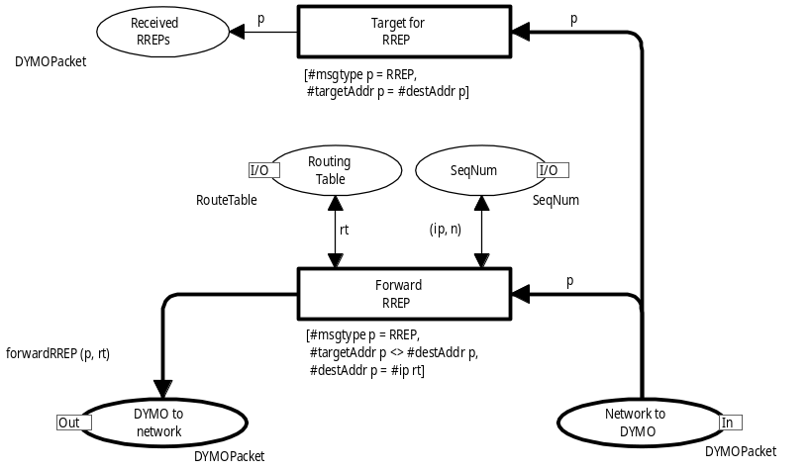
Excerpts from CPN model
Module hierarchy
Most abstract module
Less abstract module

Slide 30
Evaluation of the course
After each part of the course we spend 30 minutes with the students evaluating and discussing the course in an informal way.
This is supplemented by a more formal on-line evaluation.
In terms of achieving the course goals, content, and level of interest, the students are positive.
Students are also positive with respect to achieving learning outcomes and the quality of lectures, workshops, and textbook.
The students do not find the course difficult.
  They are expected to spend 1/3 of their study time on the course, but they spend less.
  This may be due the workshops, where the students work
  on their projects under our supervision.

Slide 31
Important choices for the course
We introduce CP-nets directly without first introducing
low-level Petri nets.
This enables us to motivate the students by using realistic model examples from the very beginning of the course.
The course relies heavily on the integrated use of CPN Tools encouraging the students to work actively with the topics.
We use considerable time to introduce the CPN ML programming language since it is crucial for the mastering of CPN modelling.

Slide 32
Constructive alignment
As described above, we use the theory of constructive alignment and the SOLO taxonomy for describing course aims and learning outcomes of the course.
This is done for all courses at our faculty.
Very good and practically applicable framework for reflecting upon the teaching and assessment methods used in a course.
A fun and easy way to learn more about the SOLO taxonomy and the difference between surface learning and deep learning is to watch the award-winning 19-minute short film:
  “Teaching Teaching and Understanding Understanding”
  www.daimi.au.dk/˜brabrand/short-film/

Slide 33

Questions

