Slide 1
Coloured Petri Nets
Modelling and Validation of Concurrent Systems
Chapter 3: CPN ML Programming
Kurt Jensen &
Lars Michael Kristensen
{kjensen,lmkristensen}
@cs.au.dk
colset PACKETS = list PACKET;
var packets : PACKETS;
fun member (e,l) =
let
fun equal x = (e=x)
in
exists (equal,l)
end;
Coloured Petri Nets
Department of Computer Science

Slide 2
CPN ML programming language
Based on the functional programming language Standard ML.
CPN ML extends the Standard ML environment with:
  Constructs for defining colour sets and declaring variables.
  Concept of multisets and associated functions and operators.
Standard ML plays a major role in CPN modelling and CPN Tools:
  Provides the expressiveness required to model data and data manipulation as found in typical industrial projects.
  Used to implement simulation, state space analysis, and performance analysis in CPN Tools.
  Supports a flexible and open architecture that makes it possible to develop extensions and prototypes in CPN Tools.
Coloured Petri Nets
Department of Computer Science

Slide 3
Why Standard ML?
Formal definition of CP-nets uses types, variables, and evaluation of expressions, which are basic concepts from functional programming.
Patterns in functional programming languages provide an elegant way of implementing enabling inference.
Standard ML is based on the lambda-calculus which has a formal syntax and semantics. This implies that CPN Tools get an expressive and sound formal foundation.
Standard ML is supported by mature compilers, associated documentation and textbooks.
Coloured Petri Nets
Department of Computer Science

Slide 4
Functional programming and CPN ML
Computation proceeds by evaluation of expressions not by executing statements making modifications to memory locations.
Strong typing means that all expressions have a type that can be determined at compile time. This eliminates many run-time errors.
Types of expressions are inferred by the type system rather than being declared by the user.
Functions are first-order values and is treated in the same way as basic types such as integers, Booleans, and strings.
Functions can be polymorphic and hence operate on different types of values.
Recursion is used to express iterative constructs.
Coloured Petri Nets
Department of Computer Science

Slide 5
Simple colour sets
A set of basic types for defining simple colour sets:
  Integers - int: {…, ~2 , ~1 , 0 , 1 , 2 ,…}
  Strings - string: {"a" , "abc" ,…}
  Booleans - bool: {true,false}
  Unit - unit: {()}
Standard colour set definitions:
colset INT = int;
colset STRING = string;
colset BOOL = bool;
colset UNIT = unit;
Two other kinds of simple colour sets:
  enumeration colour sets.
  indexed colour sets.
Coloured Petri Nets
Department of Computer Science

Slide 6
Structured colour sets
Structured colours sets are defined using colour set constructors:
  Products
  Records
  Unions
  Lists
  Subsets
colset NOxDATA = product NO * DATA;
colset DATAPACK = record seq:NO * data:DATA;
colset PACKET = union Data:DATAPACK + Ack:ACKPACK;
colset PACKETS = list PACKET;
Coloured Petri Nets
Department of Computer Science

Slide 7
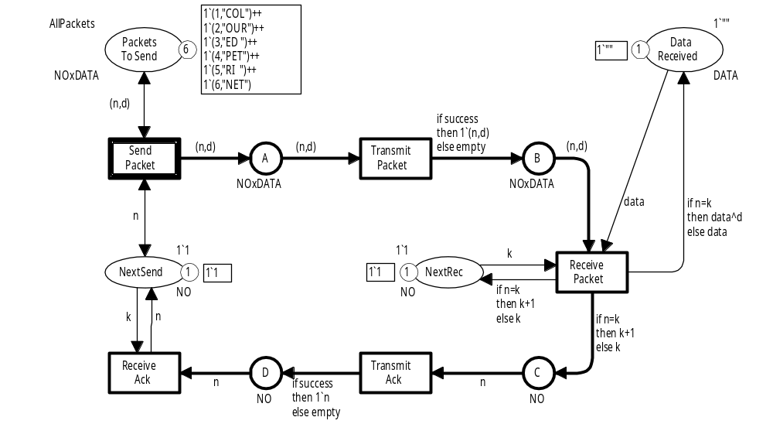
Simple protocol
The previous versions use products to
represent data packets.
We will now develop a new version where:
  Data packets are modelled as a record colour set.
  Data packets and acknowledgement packets are modelled by a common union colour set.
  We have duplication of packets – in addition to loss and successful transmission.
Coloured Petri Nets
Department of Computer Science

Slide 8
Revised colour set definitions
Old definitions:
colset DATA = string;
colset NO = int;
colset NOxDATA = product NO * DATA;
New definitions:
Record field names
colset DATAPACK = record seq : NO * data : DATA;
colset ACKPACK = NO;
colset PACKET = union Data : DATAPACK + Ack : ACKPACK;
Data constructors
Enumeration colour set (with three explicitly specified data values)
colset RESULT = with success | failure | duplicate;
Coloured Petri Nets
Department of Computer Science

Slide 9
Example values
Record colour set:
colset DATAPACK = record seq : NO * data : DATA;
{seq=1,data="COL"}
{data="COL",seq=1,}
Same data value
Union colour set:
Data constructors
colset PACKET = union Data : DATAPACK + Ack : ACKPACK;
Data{seq=1,data="COL"}
Data packet
Ack(2)
Acknowledgement packet
colset ACKPACK = NO;
Coloured Petri Nets
Department of Computer Science

Slide 10
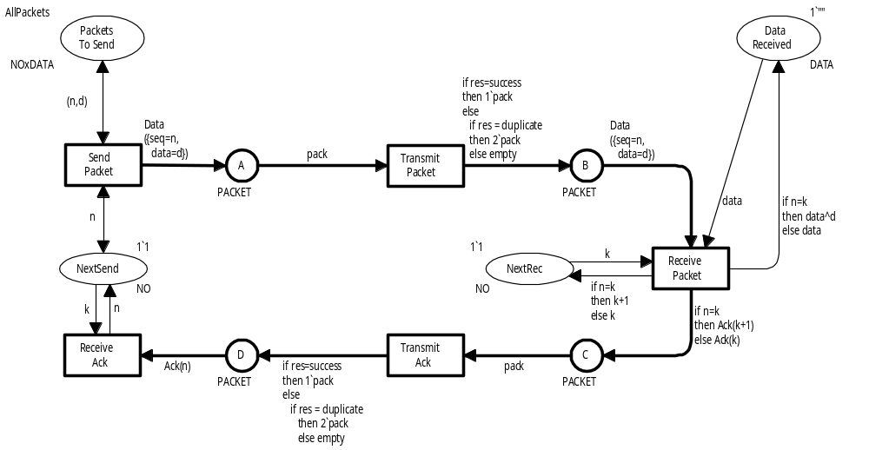
Revised CPN model
var n,k : NO;
var d,data : DATA;
var pack : PACKET;
var res : RESULT;
Coloured Petri Nets
Department of Computer Science

Slide 11
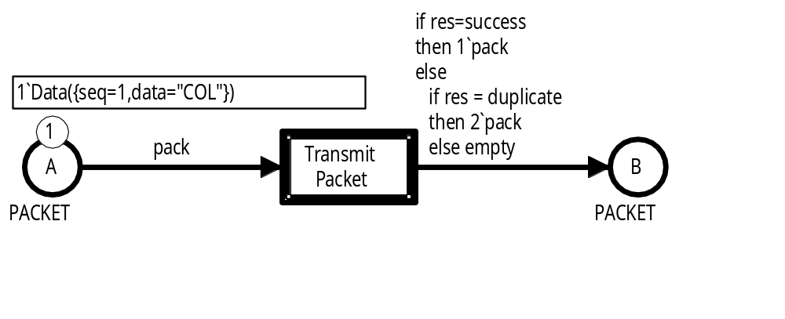
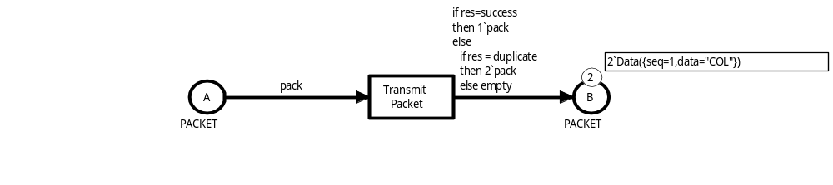
Transmit Packet transition
var pack : PACKET;
var res : RESULT;
b⁺ = <pack=Data({seq=1,data="COL"}), res=success>
b – = <pack=Data({seq=1,data="COL"}), res=failure>
b⁺⁺ = <pack=Data({seq=1,data="COL"}), res=duplicate>
Coloured Petri Nets
Department of Computer Science

Slide 12
Tuples and records
Tuple components and record fields can be accessed using the family of # operators.
Examples:
#seq {seq=1,data="COL"}
1
Records
#data {seq=1,data="COL"}
"COL"
#1 (3,"ED ")
3
Products
#2 (3,"ED ")
"ED "
Coloured Petri Nets
Department of Computer Science

Slide 13
Receiver part
Binds the variables n and d
Coloured Petri Nets
Department of Computer Science

Slide 14
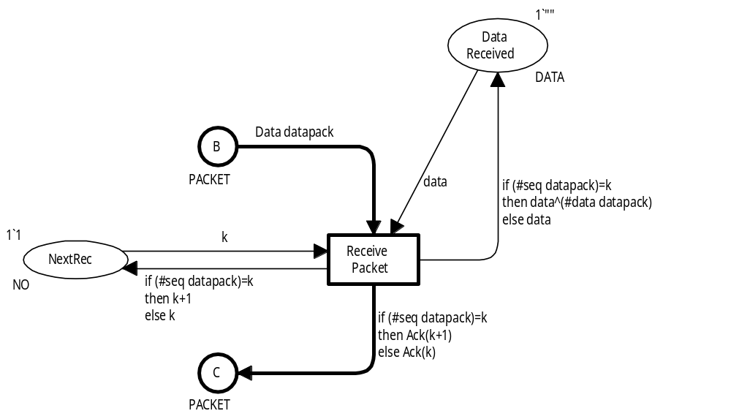
First variant of receiver
Binds variable datapack
var datapack : DATAPACK;
#seq datapack
is used three times
Coloured Petri Nets
Department of Computer Science

Slide 15
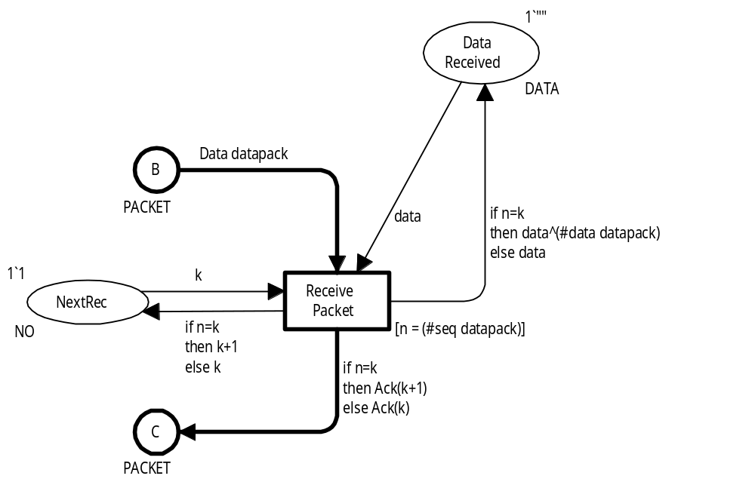
Second variant of the receiver
var datapack : DATAPACK;
var n : NO;
Binds variable datapack
Guard binds variable n
using selector
Coloured Petri Nets
Department of Computer Science

Slide 16
Sender part
Binds variables n and d
Coloured Petri Nets
Department of Computer Science

Slide 17
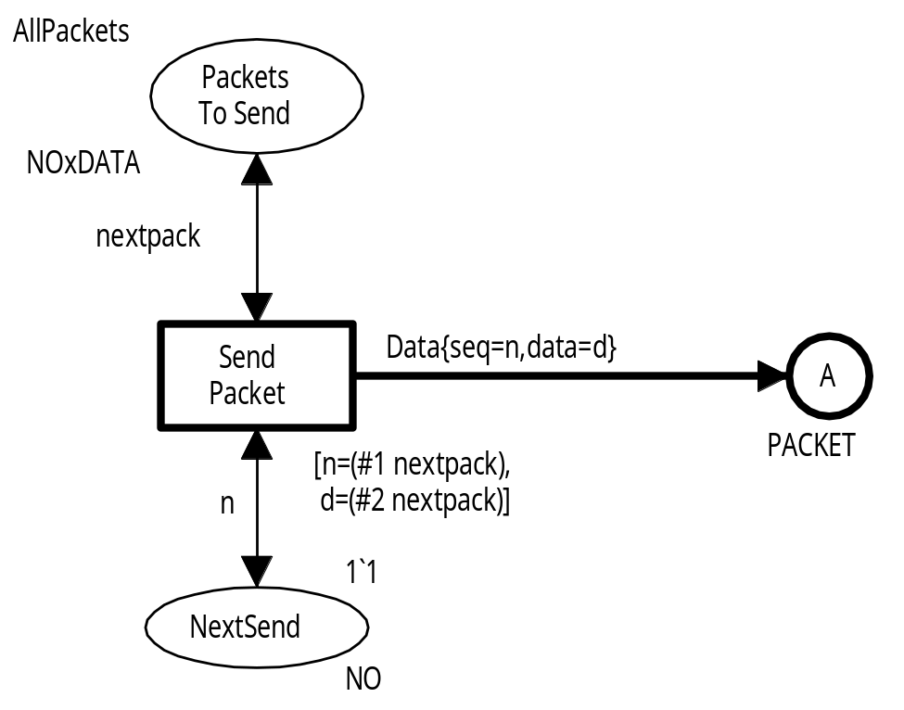
Variant of the sender
var nextpack : NOxDATA;
var n : NO;
var d : DATA;
Binds variable nextpack
Guard binds variables n and d using selectors
Coloured Petri Nets
Department of Computer Science

Slide 18
Products or records?
There is a always a choice between using product or record colour sets.
Products may give shorter net inscriptions, because we avoid the selector names used in records.
Records may give more readable net inscriptions due to the mnemonic selector names. The same effect can often be achieved for products by using variables with mnemonic names, e.g. (seq,data).
As a rule of thumb we do not recommend using products with more than 4-5 components. In such cases it is better to use records.
Coloured Petri Nets
Department of Computer Science

Slide 19
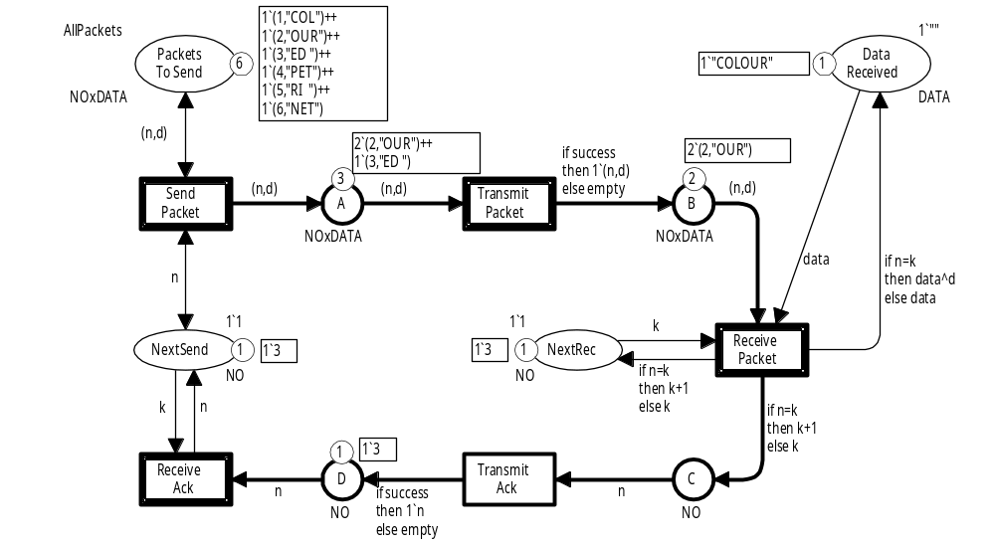
Overtaking is possible
We will develop a new version where overtaking of data packets and acknowledgements is impossible.
Coloured Petri Nets
Department of Computer Science

Slide 20
List colour sets
Colour set definitions:
colset DATAPACKS = list NOxDATA;
colset ACKPACKS = list NO;
Example values:
[(1,"COL"),(1,"COL"),(2,"OUR")]
Three data packets
[2,2,3,3]
Four acknowledgement packets
[]
Empty list (polymorphic)
Coloured Petri Nets
Department of Computer Science

Slide 21
List concatenation (^^)
Application:
[(1,"COL"),(1,"COL")]^^[(2,"OUR"),(3,"ED ")]
List
List
Result:
[(1,"COL"),(1,"COL"),(2,"OUR"),(3,"ED ")]
List
Coloured Petri Nets
Department of Computer Science

Slide 22
List construction (::)
Application:
(1,"COL")::[(1,"COL"),(2,"OUR")]
Element
List
Result:
[(1,"COL"),(1,"COL"),(2,"OUR")]
List
Coloured Petri Nets
Department of Computer Science

Slide 23
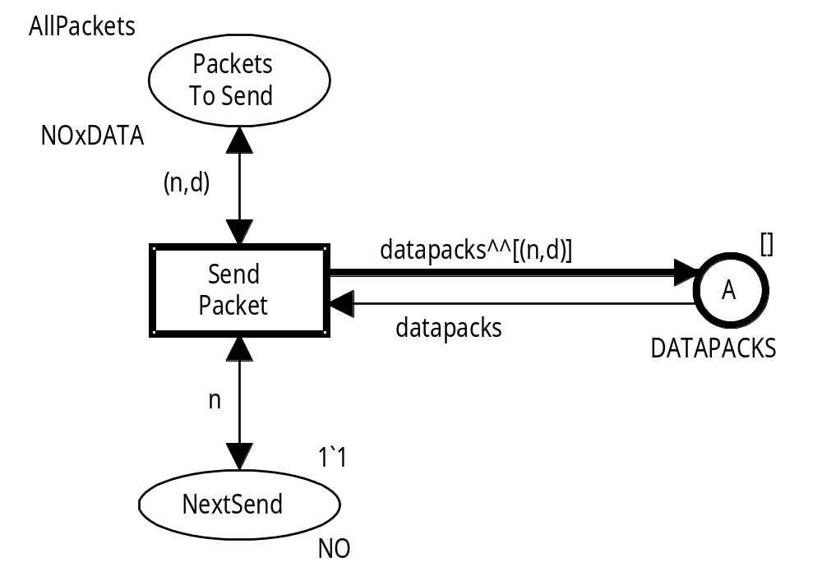
Revised SendPacket
var n : NO;
var d : DATA;
var datapacks : DATAPACKS;
Initial marking is the empty list
List colour set
Coloured Petri Nets
Department of Computer Science

Slide 24
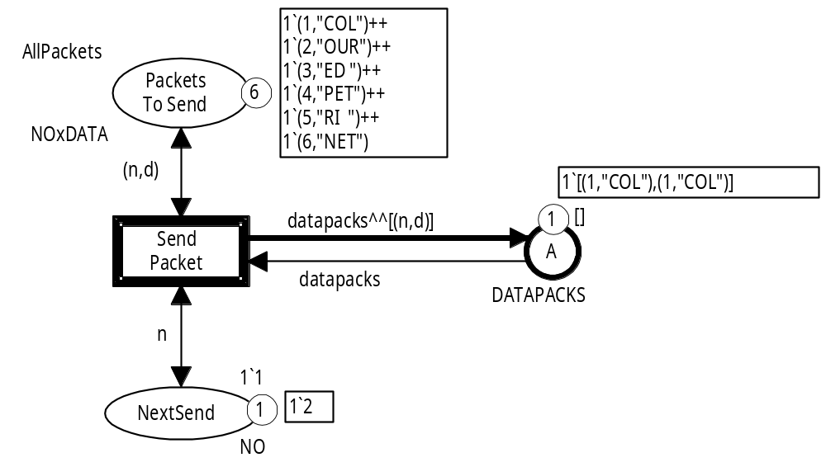
Enabling of SendPacket
[(1,"COL"),(1,"COL"),(2,"OUR")]
<n=2,d="OUR",
datapacks=[(1,"COL"),(1,"COL")]>
Coloured Petri Nets
Department of Computer Science

Slide 25
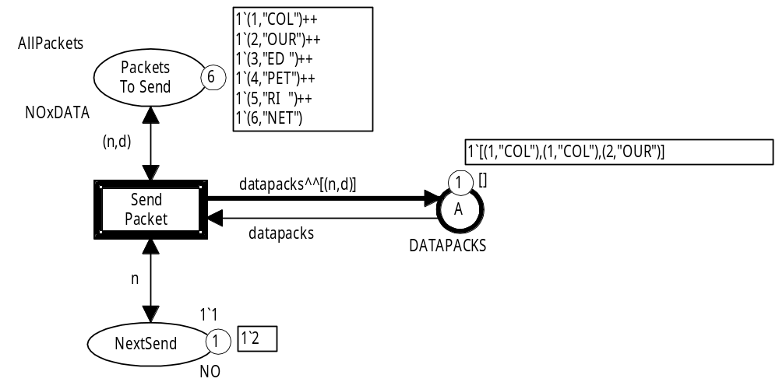
Occurrence of SendPacket
A copy of packet number two has been added to the end of the list
Coloured Petri Nets
Department of Computer Science

Slide 26
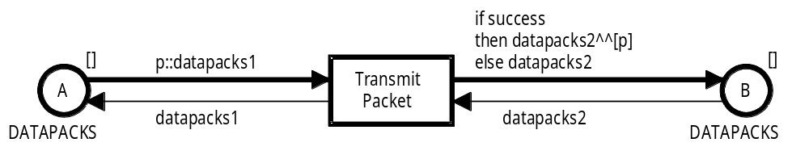
Revised TransmitPacket
Initial marking is the empty list
Initial marking is the empty list
List colour set
List colour set
var p : NOxDATA;
var success : BOOL;
var datapacks1,datapacks2 : DATAPACKS;
Coloured Petri Nets
Department of Computer Science

Slide 27
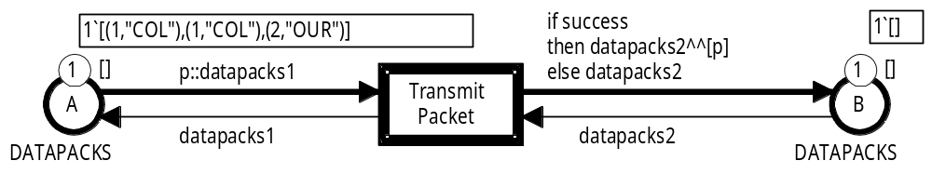
Enabling of TransmitPacket
b⁺ = <p=(1,"COL"),datapacks1=[(1,"COL"),(2,"OUR")], success=true,datapacks2=[ ]>
b – = <p=(1,"COL")},datapacks1=[(1,"COL"),(2,"OUR")],
success=false,datapacks2=[ ]>
Coloured Petri Nets
Department of Computer Science

Slide 28
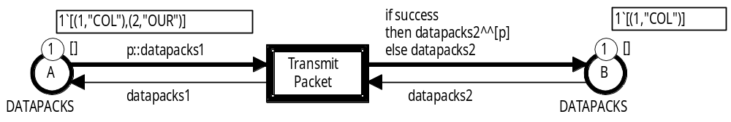
Successful transmission
[(1,"COL")]
[(1,"COL"),(2,"OUR")]
b⁺ = <p=(1,"COL"),datapacks1=[(1,"COL"),(2,"OUR")], success=true,datapacks2=[ ]>
The first element from the A-list has been moved to the end of the B-list
Coloured Petri Nets
Department of Computer Science

Slide 29
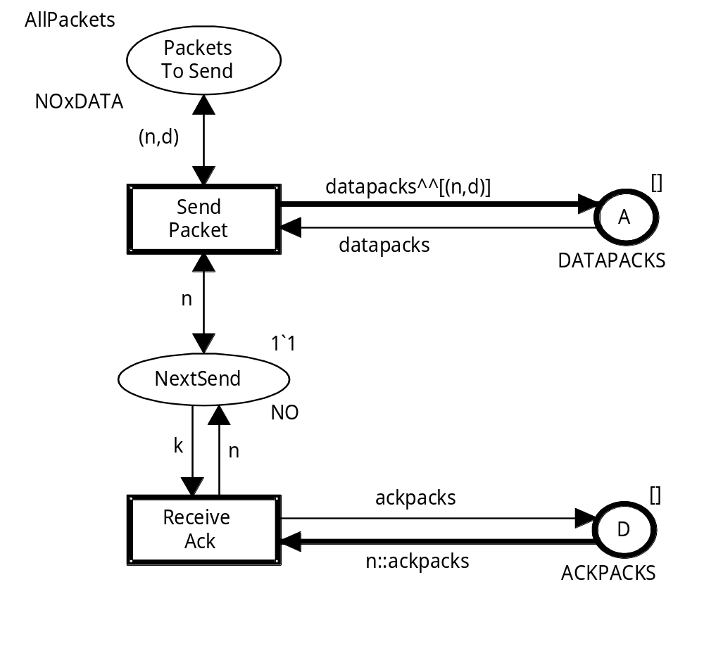
Revised sender
var n : NO;
var d : DATA;
var ackpacks : ACKPACKS;
var datapacks : DATAPACKS;
Coloured Petri Nets
Department of Computer Science

Slide 30
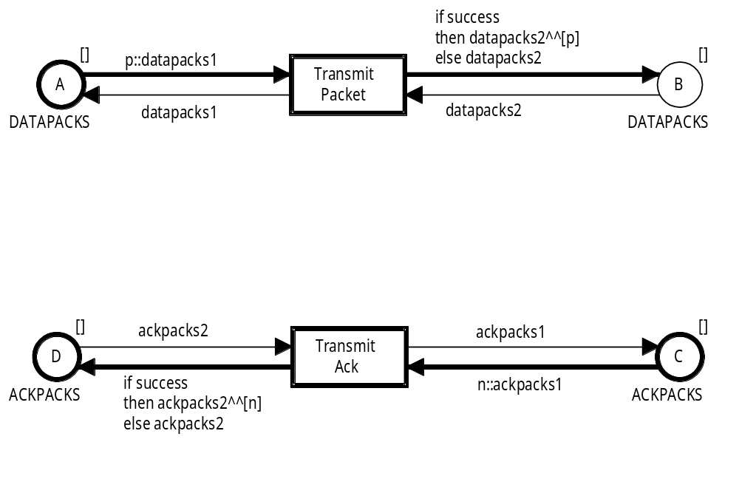
Revised network
var n : NO;
var p : DATAPACK;
var success : BOOL;
var ackpacks1,ackpacks2 : ACKPACKS;
var datapacks1,datapacks2 : DATAPACKS;
Coloured Petri Nets
Department of Computer Science

Slide 31
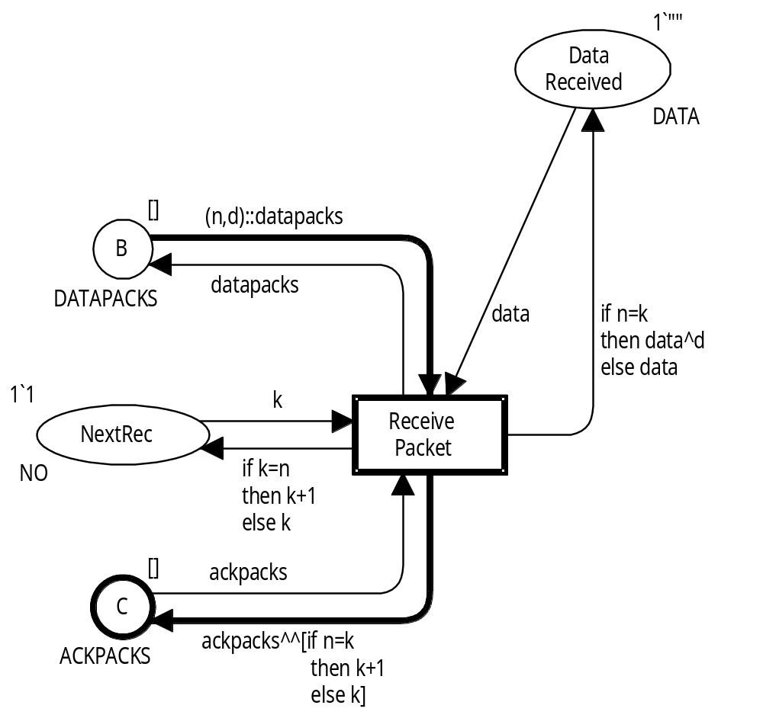
Revised receiver
var n,k : NO;
var d,data : DATA;
var ackpacks : ACKPACKS;
var datapacks: DATAPACKS;
Coloured Petri Nets
Department of Computer Science

Slide 32
Expressions and types
The complete set of Standard ML expressions can be used in
net inscriptions provided that they have the proper type:
  The type of an arc expression must be equal to the colour set of the place connected to the arc (or a multiset over the colour set of the place).
  The type of an initial marking must be equal to the colour set of the place (or a multiset over the colour set of the place).
  A guard must be a Boolean expression (or a list of Boolean expressions).
The CPN ML type system checks that all net inscriptions are
type consistent and satisfies the above type constraints.
This is done by automatically inferring the types of expressions.
Coloured Petri Nets
Department of Computer Science

Slide 33
Example of type checking
Coloured Petri Nets
Department of Computer Science

Slide 34
Type checking of (n,d)
colset NOxDATA = product NO * DATA;
var n : NO;
var d : DATA;
Arc expression
(n,d)
NO * DATA
NO
n
d
DATA
Sub-expressions
(n,d) is type consistent and of type NO * DATA (which is the colour set of the connected place).
Coloured Petri Nets
Department of Computer Science

Slide 35
Second example of type checking
Coloured Petri Nets
Department of Computer Science

Slide 36
Type checking of if expression
colset DATA = string;
Arc expression
if n=k
then data^d
else data
DATA
var n,k : NO;
var d,data : DATA;
bool
n=k
data^d
DATA
data
DATA
NO
n
k
NO
DATA
data
d
DATA
If expression is type consistent and of type DATA (which is the colour set of the connected place).
Coloured Petri Nets
Department of Computer Science

Slide 37
Third example of type checking
Coloured Petri Nets
Department of Computer Science

Slide 38
Type checking of if expression
Arc expression
var n : NO;
var d : DATA;
var success : BOOL;
if success
then 1`(n,d)
else empty
(NO * DATA) ms
BOOL
success
1`(n,d)
(NO * DATA) ms
empty
'a ms
int
1
(n,d)
NO * DATA
NO
n
d
DATA
If expression is type consistent and of type NO * DATA ms
(multisets over the colour set of the connected place).
Coloured Petri Nets
Department of Computer Science

Slide 39
Functions
Functions can be used in all kinds of net expressions:
  Guards.
  Arc expressions.
  Initial markings.
Functions are used when:
  Complex expressions takes up too much space in the graphical representation.
  Same functionality is required in different parts of the model.
Functions make CPN models easier to read and maintain.
Coloured Petri Nets
Department of Computer Science

Slide 40
Simple protocol
AddData (data,d,n,k)
UpdSeq (n,k)
Coloured Petri Nets
Department of Computer Science

Slide 41
Definition of two functions
fun UpdSeq (n,k) = if n=k
then k+1
else k;
Function Name
Function Parameter
fun AddData (data,d,n,k) = if n=k
then data^d
else data;
All functions in Standard ML take a single parameter which may be a tuple.
Coloured Petri Nets
Department of Computer Science

Slide 42
Inference of function type
fun UpdSeq (n,k) = if n=k
then k+1
else k;
n : INT
k : INT
int * int -> int
Function evaluates to an integer
The variables n and k are local to the function definition.
They should not be confused with the variables n and k of type NO used as arguments in the function call.
Coloured Petri Nets
Department of Computer Science

Slide 43
Inference of function type
n and k must have the same type
fun AddData (data,d,n,k) = if n=k
then data^d
else data;
data : string d : string
Function evaluates to a string
string * string * ''a * ''a -> string
Type variable:
Some type with equality operation
Polymorphic function.
Can be called with different types of arguments.
Coloured Petri Nets
Department of Computer Science

Slide 44
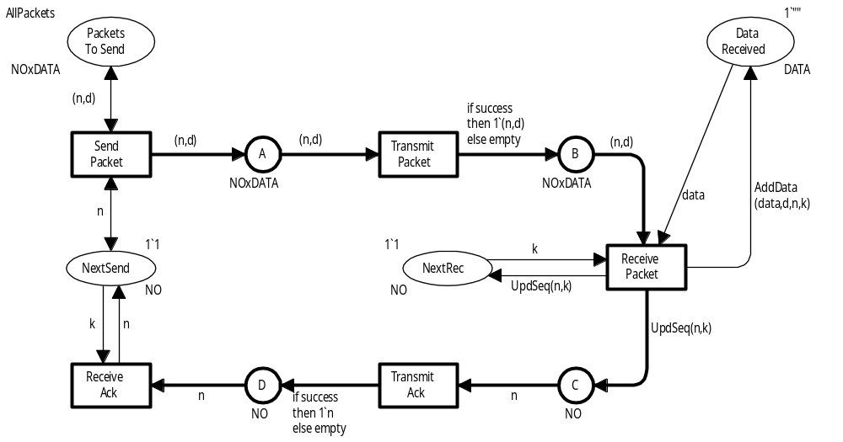
CPN model with functions
Coloured Petri Nets
Department of Computer Science

Slide 45
Exploiting polymorphism
fun Transmit (success,pack) = if success
then 1`pack
else empty;
success : bool
bool * 'a -> 'a ms
Function evaluates to a
multiset over the type of pack
Multiset
Type variable: Some type where
equality operation not required
Polymorphic function.
Can be called with different types of arguments:
  Transmit (success,(n,d))
  Transmit (success,n)
To transmit data packets
To transmit acknowledgments
Coloured Petri Nets
Department of Computer Science

Slide 46
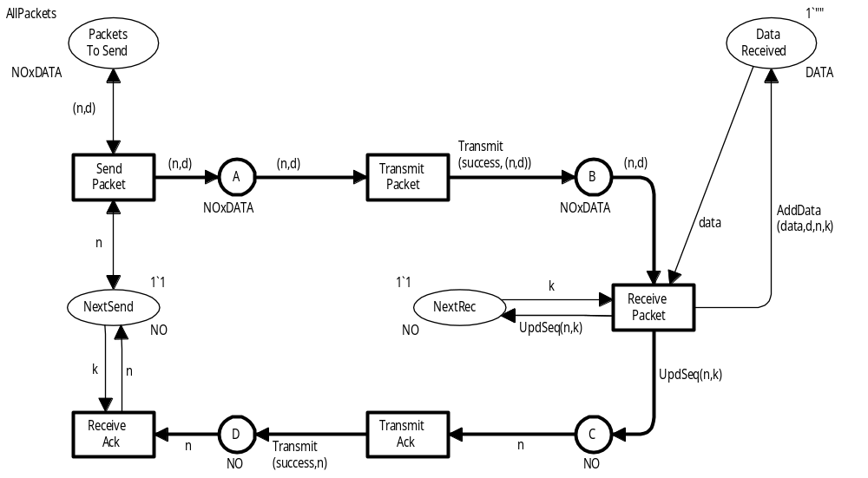
CPN model with polymorphic function
Coloured Petri Nets
Department of Computer Science

Slide 47
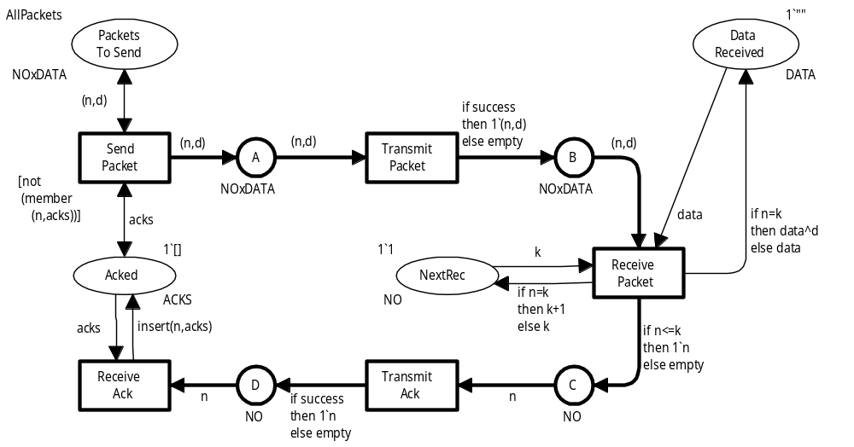
Revised protocol
Sender can send any unacknowledged data packet.
colset ACKS = list NO;
var acks : ACKS;
Function to check for list membership
Keeps
a list of received acks
Function to insert element in list
Coloured Petri Nets
Department of Computer Science

Slide 48
Function member
Checks whether the element e is present in the list l.
fun member (e,l) =
if l = []
then false
else
if (e = List.hd l)
then true
else member (e,List.tl l);
Library functions
Recursive call
Coloured Petri Nets
Department of Computer Science

Slide 49
Function insert
Inserts the element e in the list l if it is not already present.
fun insert (e,l) =
if member (e,l)
then l
else e::l;
Uses the
member function
Coloured Petri Nets
Department of Computer Science

Slide 50
Local environments
Can be introduced using a let expression:
Comments
fun member (e,l) =
if l = []
then false (* if list empty, e is not a member *)
else (* list is not empty *)
let
(* extract head and tail of the list *)
val head = List.hd l
val tail = List.tl l
in
if e = head
then true (* e was equal to the head *)
else member (e,tail) (* check the tail *)
end;
Even short ML functions can be tricky to read and understand. Hence it is a very good idea to use comments.
Coloured Petri Nets
Department of Computer Science

Slide 51
Higher-order functions
A function taking a function as parameter or returning a function is a higher-order function.
Member is a special case of determining whether there exists an element in the list l satisfying a Boolean predicate p:
fun exists (p,l) =
if l = []
then false
else
if p (List.hd l)
then true
else exists (p,List.tl l);
(''a -> bool) * ''a list -> bool
fun member (e,l) =
let
fun equal x = (e=x)
in
exists (equal,l)
end;
''a * ''a list -> bool
Coloured Petri Nets
Department of Computer Science

Slide 52
Anonymous and curried functions
Anonymous functions are specified without an explicit name:
fn x => (e=x);
fun member (e,l) = exists (fn x => (e=x),l);
Curried functions take their parameters one at a time:
fun equal e x = (e=x);
''a -> ''a -> bool
equal e;
''a -> bool
fun member (e,l) = exists (equal e,l);
Coloured Petri Nets
Department of Computer Science

Slide 53
Patterns in function applications
Expressions are built from constants, constructors, and variables.
Can be matched with arguments to bind values to the variables.
fun member (e,l) =
if l = []
then false
else
if (e = List.hd l)
then true
else member (e,List.tl l);
Pattern
member (2,[1,3,4])
Function call
The argument (2,[1,3,4]) is matched with the pattern (e,l).
Coloured Petri Nets
Department of Computer Science

Slide 54
Patterns in function definitions
Not used
Matches the empty list
fun member (e,[]) = false
| member (e,x::l) =
if (x = e)
then true
else member (e,l);
Matches a non-empty list
Wilcard (matches everything)
fun member (_,[]) = false
| member (e,x::l) =
if (x = e)
then true
else member (e,l);
Coloured Petri Nets
Department of Computer Science

Slide 55
Patterns in case expressions
Case expressions can be used instead of nested if expressions.
case res of
success => 1`p
| duplicate => 2`p
| failure => empty;
if res = success
then 1`pack
else if res = duplicate
then 2`pack
else empty;
Three patterns
Alternative:
(case res of
success => 1
| duplicate => 2
| failure => 0)`pack
Coloured Petri Nets
Department of Computer Science

Slide 56
Common patterns pitfalls
Redundant match:
case res of
_ => empty
| success => 1`p
| duplicate => 2'p;
Programming error:
  Everything will match the first clause.
  The other clauses will never be used.
Warning!
Non-exhaustive match:
fun member (e,x::l) =
if (e = x)
then true
else member (e,l);
NO:
  Recursion will always end with a call involving the empty list.
Warning! – Is it wise to ignore the warning?
Coloured Petri Nets
Department of Computer Science

Slide 57
Patterns in records
colset DATAPACK = record seq:NO * data:DATA;
fun ExtractData (datapack : DATAPACK) = #data datapack;
Pattern match:
fun ExtractData ({seq=n,data=d}) = d;
Pattern match without explicit local variables:
fun ExtractData ({seq,data}) = data;
Coloured Petri Nets
Department of Computer Science

Slide 58
Records with many fields
colset DATAPACK = record seq:NO * data:DATA * ………;
Extract data:
fun ExtractData ({data,...} : DATAPACK) = data;
Wildcard symbol
Update data:
DATAPACK.set_data r d
Updates the record r by changing the data field to d
Library function
Coloured Petri Nets
Department of Computer Science

Slide 59
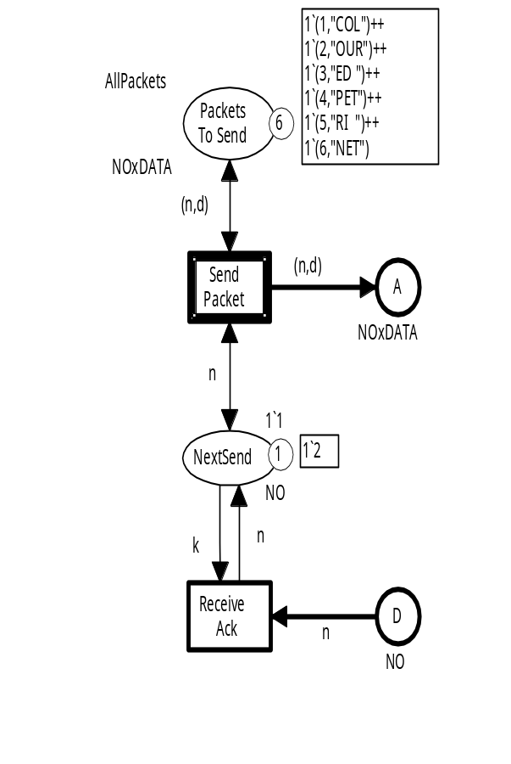
Patterns and enabling inference
Patterns are exploited when calculating the set of enabled binding elements in a marking.
Token values are matched with
patterns on input arcs of transitions.
Candidate binding elements:
Pattern
<n=1,d="COL">
<n=2,d="OUR">
<n=3,d="ED ">
<n=4,d="PET">
<n=5,d="RI ">
<n=6,d="NET">
Check
Coloured Petri Nets
Department of Computer Science

Slide 60
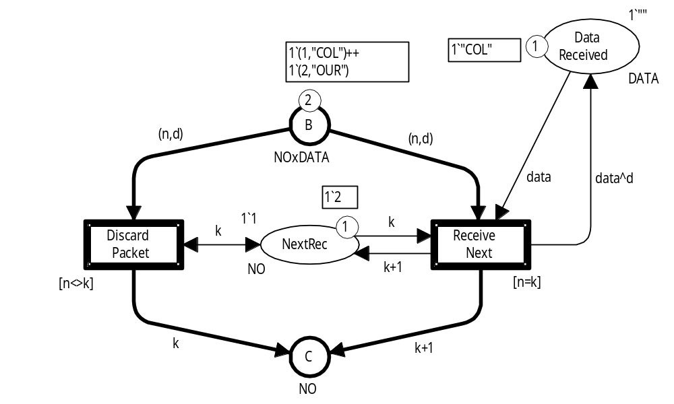
Enabling inference example
We may have to use patterns in different input arc expressions to bind all variables.
<n=1,d="COL",k=?,data=?>
<n=2,d="OUR",k=?,data=?>
<n=1,d="COL",k=?,data="COL">
<n=2,d="OUR",k=?,data="COL">
<n=1,d="COL",k=2,data="COL">
<n=2,d="OUR",k=2,data="COL">
OK
Coloured Petri Nets
Department of Computer Science

Slide 61
Variables can be bound in guards
When the variable(s) in one side of the guard [n= k] has been bound, we can use the guard to bind the other side.
<n=1,d="COL",k=?,data=?>
<n=2,d="OUR",k=?,data=?>
<n=1,d="COL",k=?,data="COL">
<n=2,d="OUR",k=?,data="COL">
<n=1,d="COL",k=1,data="COL">
<n=2,d="OUR",k=2,data="COL">
OK
Can also be done for more complex guards: [(n,d)=pack].
When n and d have been bound, we can bind pack.
Coloured Petri Nets
Department of Computer Science

Slide 62


Binding of variables in CPN Tools
CPN Tools requires that it must be possible to bind each variable of a transition by using patterns on input arcs or in guards.
The only exception to this rule is variables of small colour sets which by default are colour sets with less than 100 values.
Variable success is of type Boolean which only has two values.
Hence, it makes sense to try both of them.
Coloured Petri Nets
Department of Computer Science

Slide 63

Questions
Coloured Petri Nets
Department of Computer Science

