Slide 1
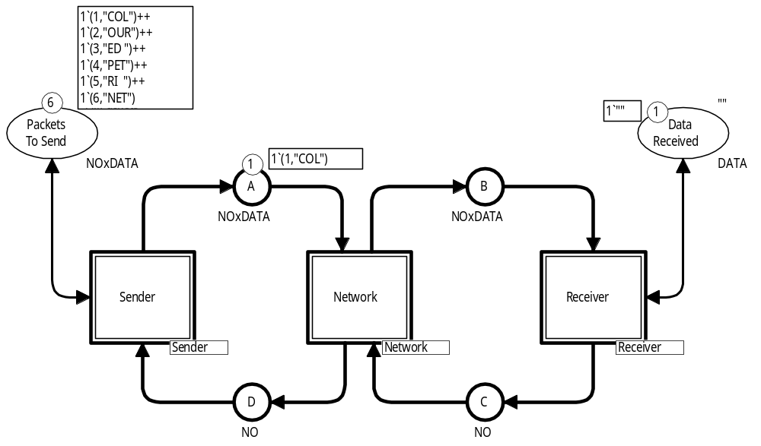
Coloured Petri Nets
Modelling and Validation of Concurrent Systems
Chapter 5: Hierarchical Coloured Petri Nets
Kurt Jensen &
Lars Michael Kristensen
{kjensen,lmkristensen}
@cs.au.dk
Coloured Petri Nets
Department of Computer Science

Slide 2
CPN models can be divided into modules
CPN modules play a similar role as modules in ordinary programming languages.
They allow the model to be split into
manageable parts with well-defined interfaces.
CPN nets with modules are also called
hierarchical Coloured Petri Nets.
Coloured Petri Nets
Department of Computer Science

Slide 3
Why do we need modules?
Impractical to draw a CPN model of a large system as a single net.
  Would become very large and unhandy.
  Could be printed on separate sheets and glued together,
  but it would be difficult to get an overview and make a nice layout.
The human modeller needs abstractions that make it possible to
concentrate on only a few details at a time.
  CPN modules can be seen as black-boxes, where the modeller
  (when desired) can forget about the details within the modules.
  This makes it possible to work at different abstraction levels.
There are often system components that are used repeatedly.
  Inefficient to model these components several times.
  Instead we define a module, and use the module repeatedly.
  In this way there is only one description to read, and one description to modify when changes are necessary.
Coloured Petri Nets
Department of Computer Science

Slide 4
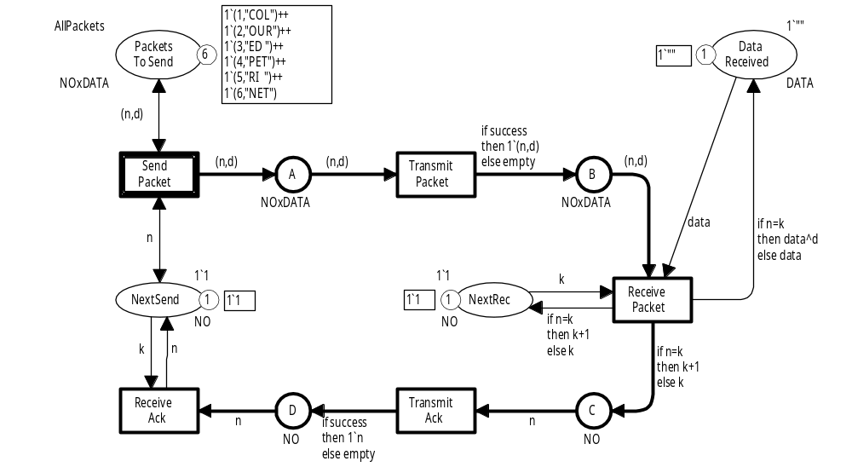
Simple protocol
The protocol model can be divided into three modules:
  Sender.
  Network.
  Receiver.
We “cut” the model into three parts:
  Using the buffer places as interfaces between the modules.
Sender
Network
Receiver
Coloured Petri Nets
Department of Computer Science

Slide 5
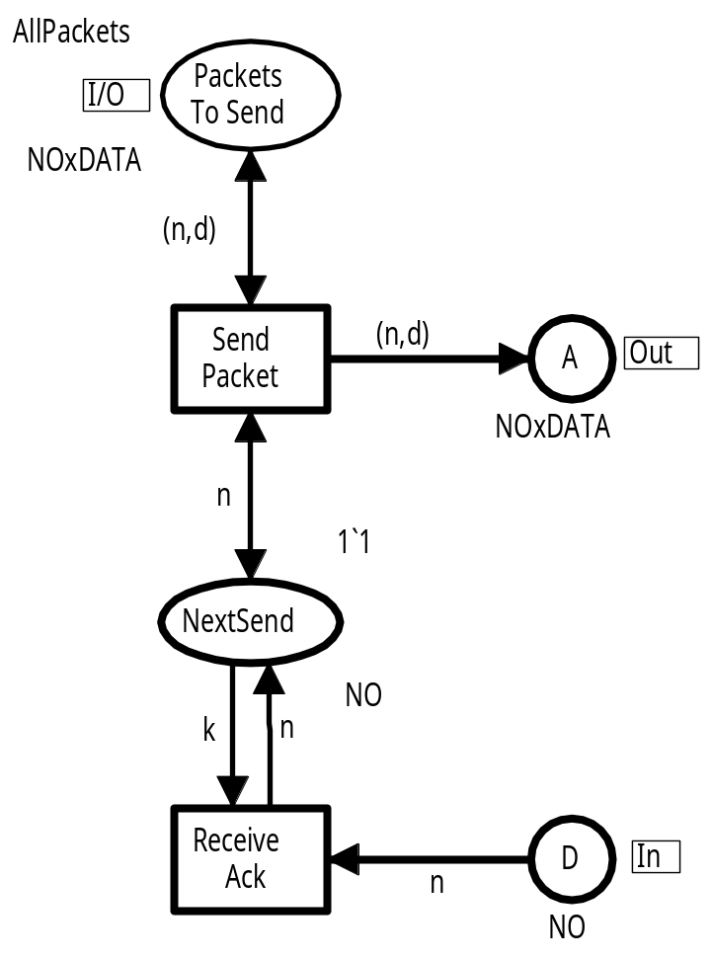
Sender module
Input/output port
Used to import and export tokens
Output port
Used to export tokens to the environment
Internal place
Local to the
module
The module interacts with other modules via three port places.
Input port
Used to import tokens from the environment
Coloured Petri Nets
Department of Computer Science

Slide 6
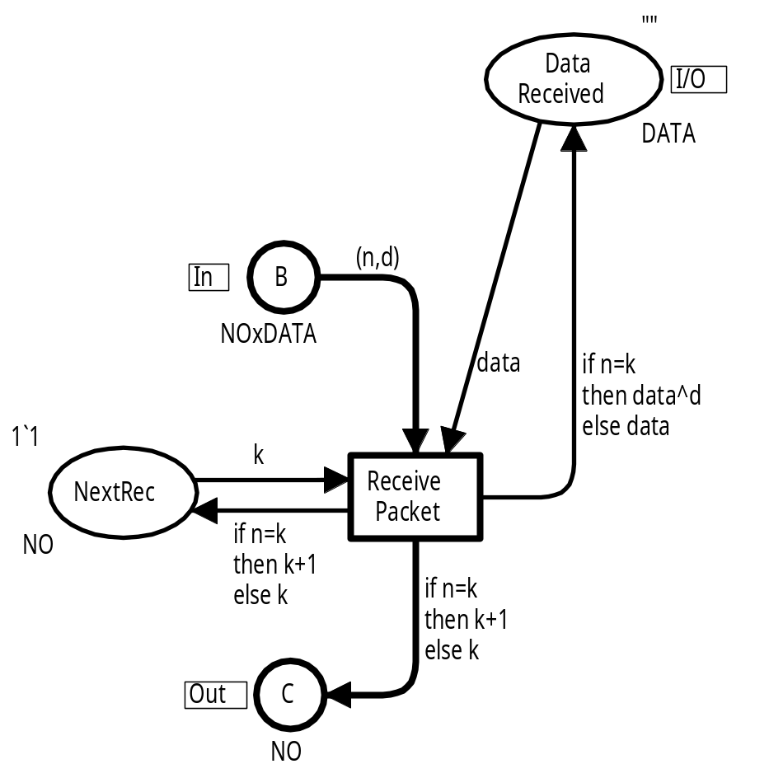
Receiver module
Input/output port
Used to import and
export tokens
Input port
Used to import tokens from the environment
Internal place
Local to the module
Output port
Used to export tokens to the environment
Coloured Petri Nets
Department of Computer Science

Slide 7
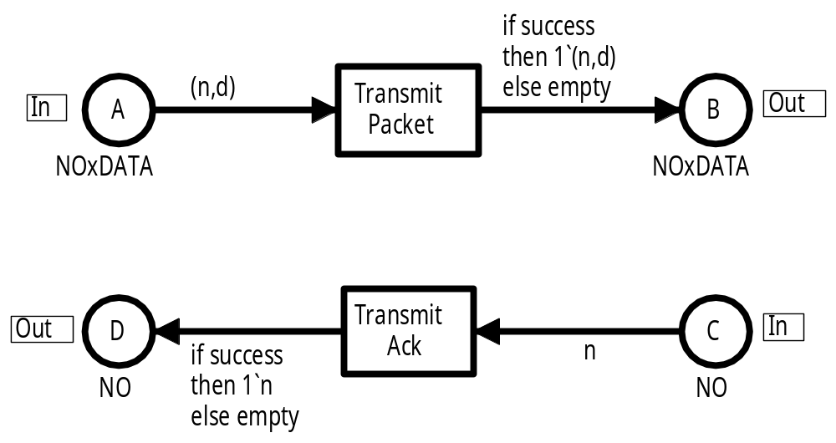
Network module
Input port
Output port
Interaction with the sender
Interaction with the receiver
Output port
Input port
Coloured Petri Nets
Department of Computer Science

Slide 8
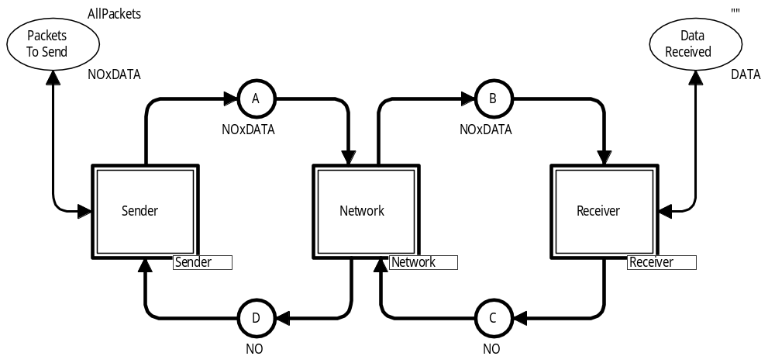
Protocol module
Provides a more abstract view of the protocol system.
“Glues” the three other modules together.
Name of substitution transition
Name of submodule
Three substitution transitions referring to three different modules.
Coloured Petri Nets
Department of Computer Science

Slide 9
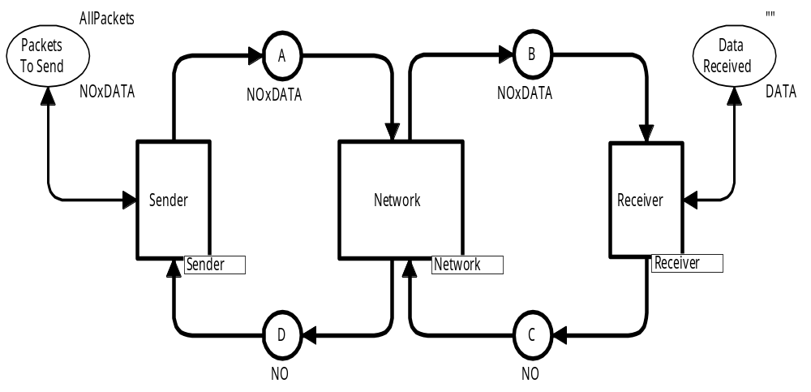

Protocol module
Sender
Network
Receiver
Coloured Petri Nets
Department of Computer Science

Slide 10
Protocol module
The places surrounding substitution transitions are socket places.
They constitute the interface for the substitution transition.
Input socket for Network substitution transition
Output socket for Sender substitution transition
Input/output socket
for Sender substitution
transition
Coloured Petri Nets
Department of Computer Science

Slide 11
Port-socket relation
The interfaces must be related to each other.
Each port place of a submodule is related to a socket place of its substitution transition:
  input port ↔ input socket.
  output port ↔ output socket.
  input/output port ↔ input/output socket.
Ports and sockets that are related to each other constitute different views of a single compound place.
  They have the same marking.
  When a token is added/removed at one of them it is also added/removed at the other.
  Also the colour sets and initial markings are identical.
For the protocol system ports and sockets have identical names, but this is not required in general.
Coloured Petri Nets
Department of Computer Science

Slide 12
Port-socket relation
Sender
Network
Receiver
Coloured Petri Nets
Department of Computer Science

Slide 13
Substitution transitions
Substitution transitions do not have arc expressions and guards.
They do not become enabled and they do not occur.
Instead they represent the compound behaviour of their submodules.
Coloured Petri Nets
Department of Computer Science

Slide 14
Abstraction levels
In the protocol system we only have two different levels of abstraction.
  Highest: Protocol module.
  Lowest: Sender, Network and Receiver modules.
CPN models of larger systems typically have up to
10 abstraction levels.
Coloured Petri Nets
Department of Computer Science

Slide 15
Second version of hierarchical protocol
The two transitions in the Network module have a similar behaviour.
  The upper transition transmits packets.
  The lower transition transmits acknowledgements.
We would like to define a single Transmit module and use this twice.
To do this we need to make the colours sets identical.
Coloured Petri Nets
Department of Computer Science

Slide 16
Packets and acknowledgements
Until now:
One colour set for acknowledgement packets
colset NO = int;
colset DATA = string;
colset NOxDATA = product NO * DATA;
Another colour set for data packets
Instead we define a common colour set which can be used for both data packets and acknowledgement packets:
colset PACKET = union Data : NoxDATA + Ack : NO;
Data(1,"COL")
Ack(2)
Data
Acknowledgement
Coloured Petri Nets
Department of Computer Science

Slide 17
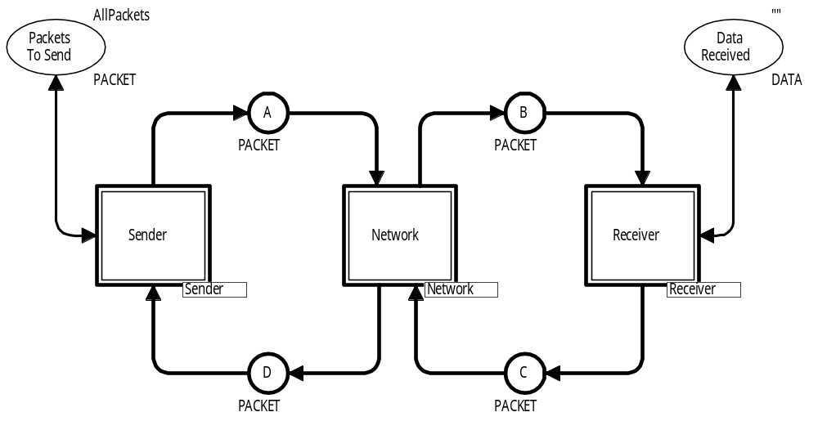
Modified Protocol module
Uses the new type. Otherwise there are no changes.
Coloured Petri Nets
Department of Computer Science

Slide 18
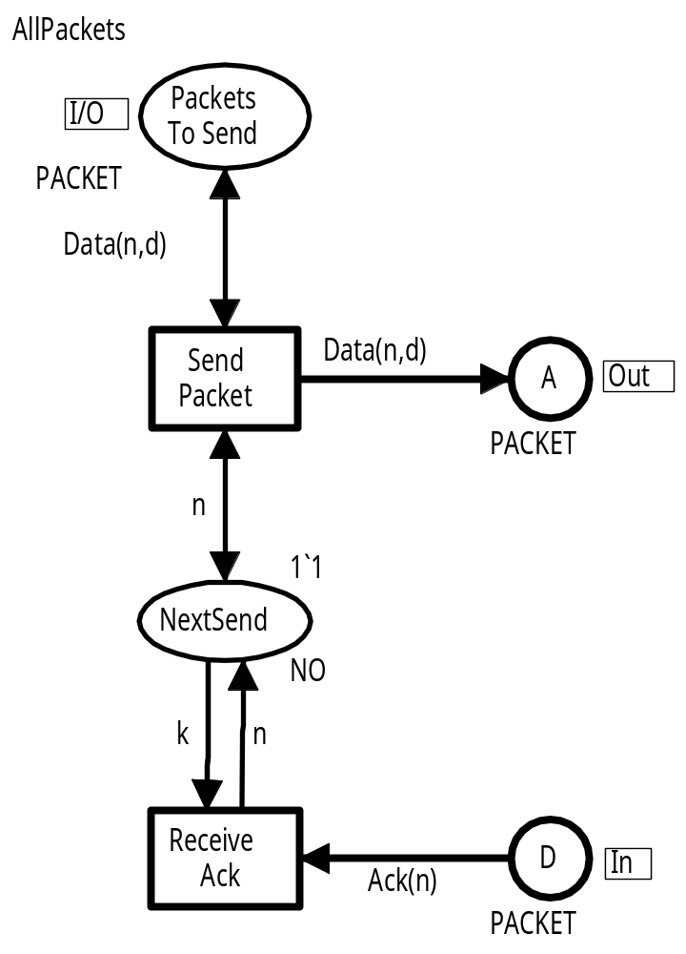
Modified Sender Module
Uses the new type.
Arc expressions have been modified to match the new type.
Coloured Petri Nets
Department of Computer Science

Slide 19
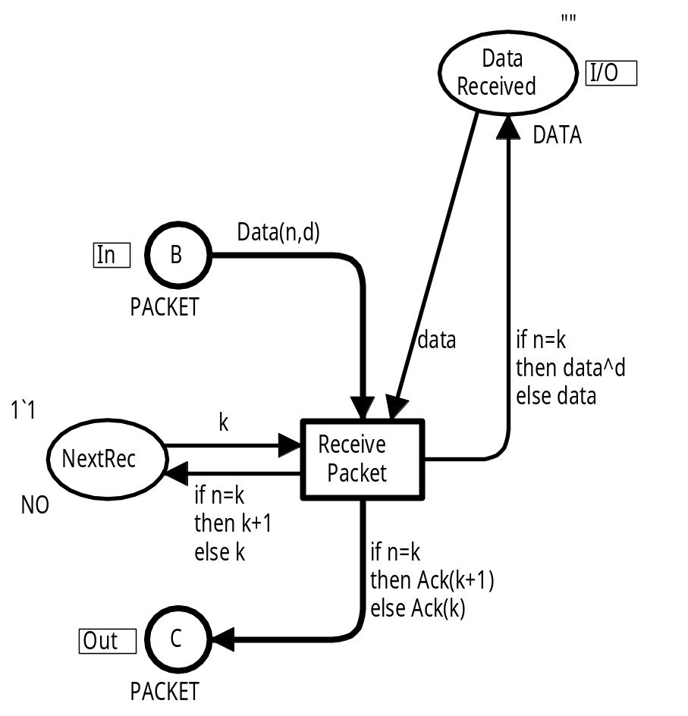
Modified Receiver module
Uses the new type.
Arc expressions have been modified to match the new type.
Coloured Petri Nets
Department of Computer Science

Slide 20
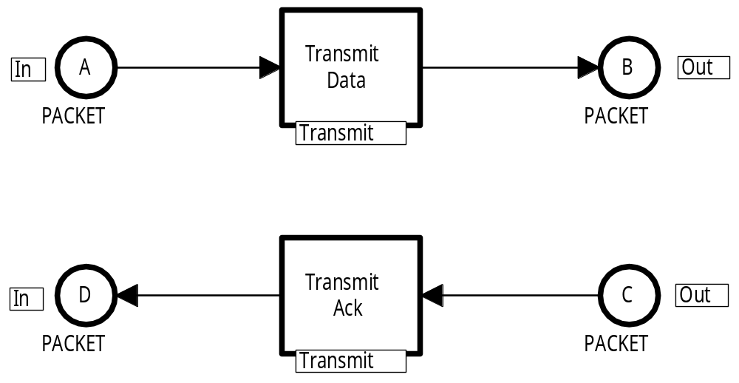
Modified Network module
Uses the new type.
Contains two substitution transitions.
Substitution transitions (refers to same module)
The two substitution transitions refer to the same submodule.
Coloured Petri Nets
Department of Computer Science

Slide 21
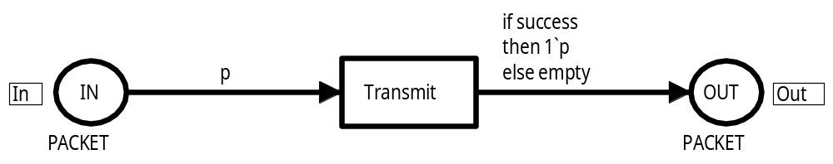
Transmit module
The Transmit module can handle both data packets and acknowledgement packets.
colset PACKET = union Data : NoxDATA + Ack : NO;
var p : PACKET;
The variable p can be bound to a data packet
such as Data(1,"COL").
It can also be bound to an acknowledgement packet
such as Ack(2).
Both kinds of packets are handled in the same way.
Coloured Petri Nets
Department of Computer Science

Slide 22
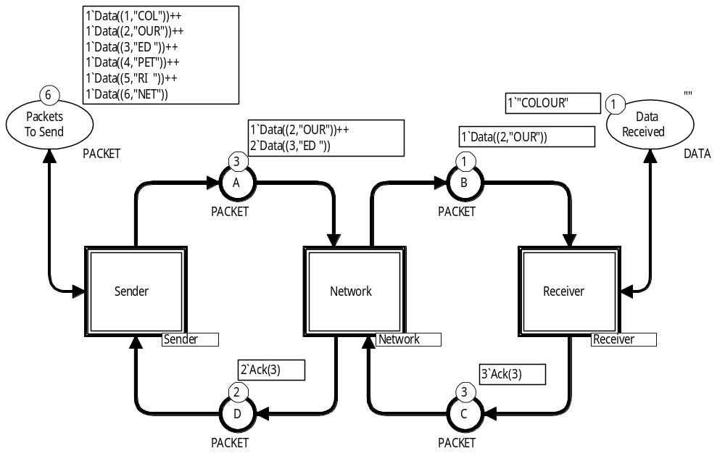
Marking of Protocol module after some steps
Coloured Petri Nets
Department of Computer Science

Slide 23
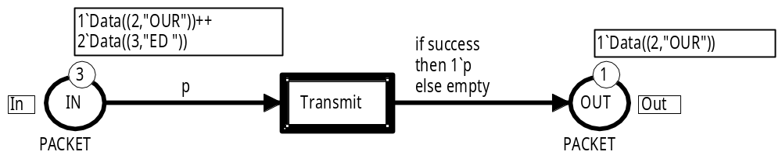
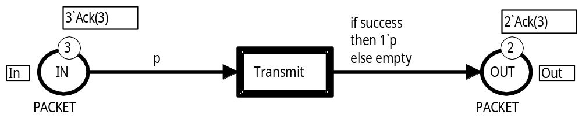
Marking of Transmit module
There are two instances of the transmit module.
One instance for each substitution transition that uses to the module.
Instance related to Transmit Data
Instance related to Transmit Ack
Each instance has its own marking which is independent of the
marking of the other instance.
Coloured Petri Nets
Department of Computer Science

Slide 24
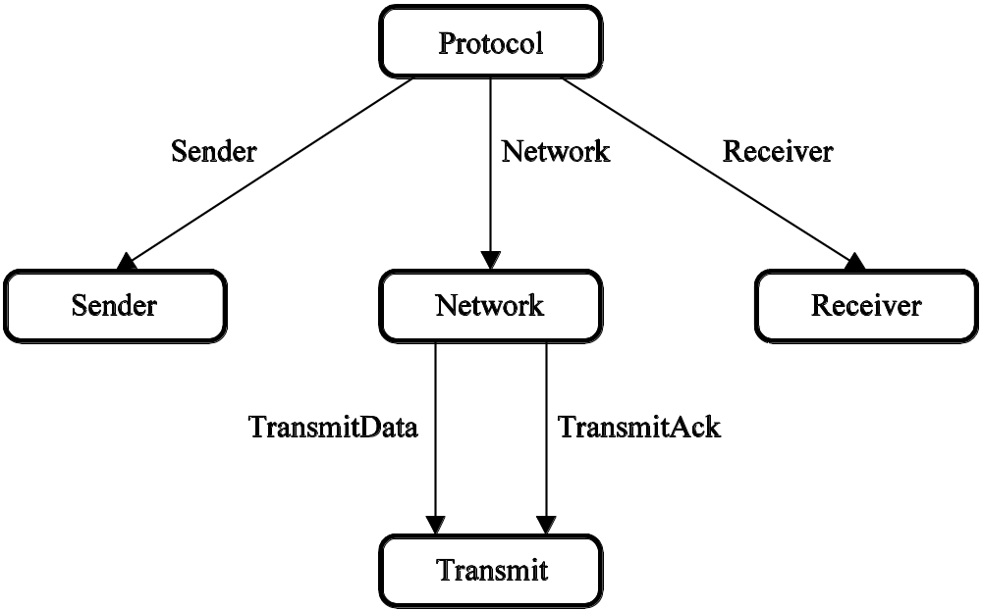
Module hierarchy
Represents the relationship between modules.
Each node represents a module.
Each arc is labelled by a substitution transition.
The Protocol module contains a substitution transition Receiver which refers to the Receiver module
Coloured Petri Nets
Department of Computer Science

Slide 25
Module hierarchy
The roots are called prime modules.
Each module has as many
instances as there are paths
from a prime module.
Path of length 0
1
Prime module
1
1
1
The module hierarchy must be an acyclic graph.
This guarantees that each module has a finite number of instances.
2
Coloured Petri Nets
Department of Computer Science

Slide 26
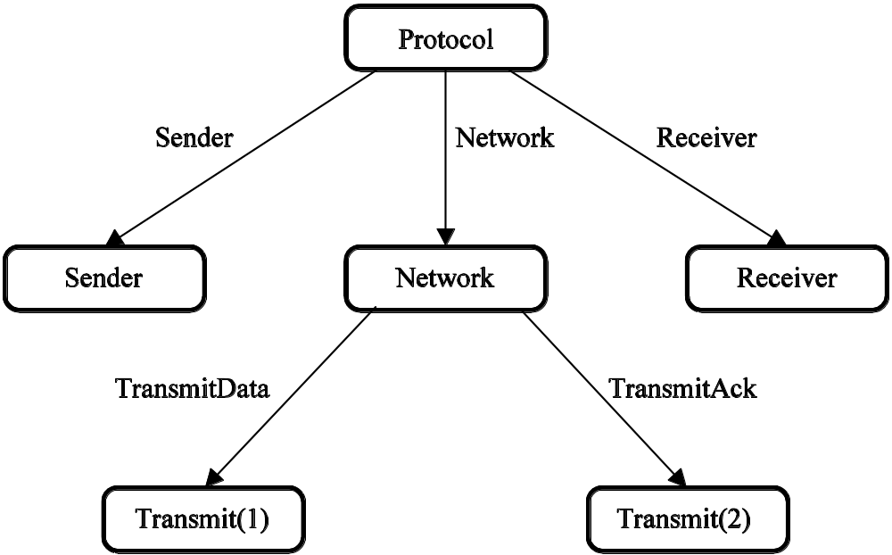
Instance hierarchy
Similar to the module hierarchy, but now the two instances of the Transmit module are drawn as two separate nodes.
The instance hierarchy is an unfolded version of the module hierarchy. It is a directed tree.
Coloured Petri Nets
Department of Computer Science

Slide 27
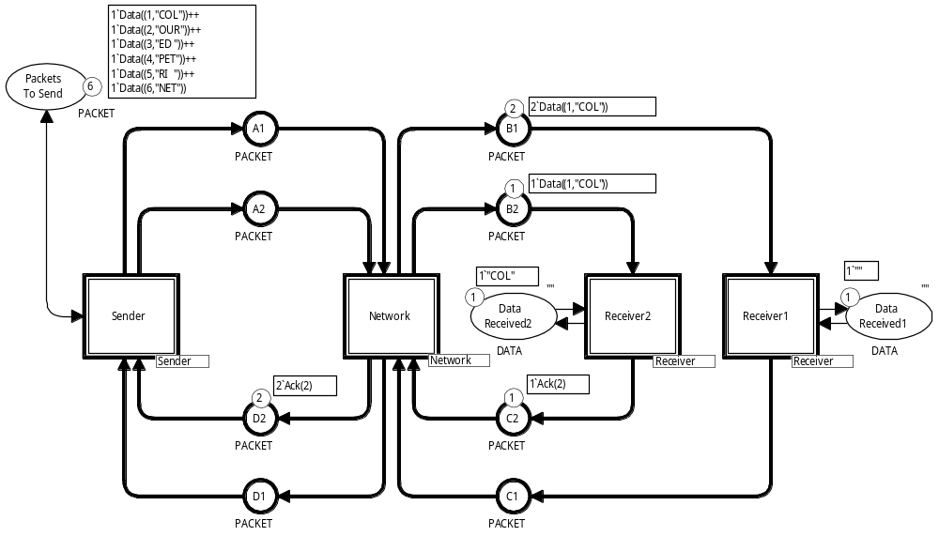
Protocol with multiple receivers
Data and acknowledgments to/from the first receiver
Two different receivers
Data and acknowledgments to/from the second receiver
Coloured Petri Nets
Department of Computer Science

Slide 28
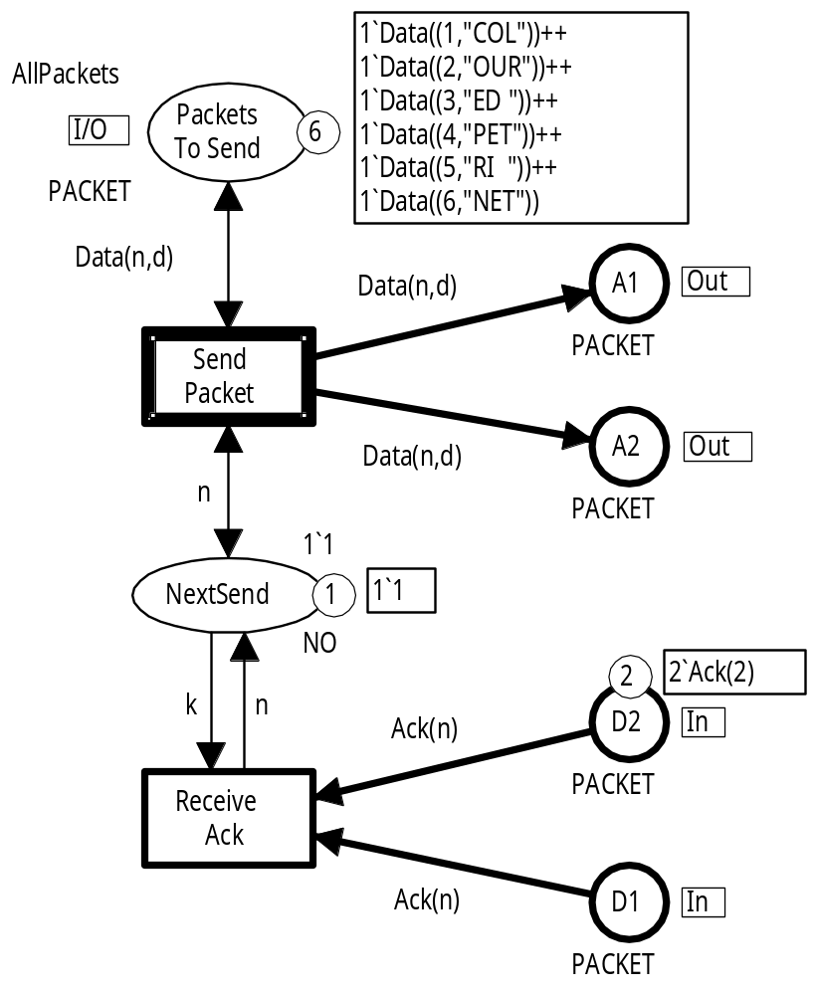
Sender module
Identical data packets are broadcasted to the two receivers (via A1 and A2).
ReceiveAck can only occur when there are identical acknowledgements from the two receivers (on D1 and D2).
Coloured Petri Nets
Department of Computer Science

Slide 29
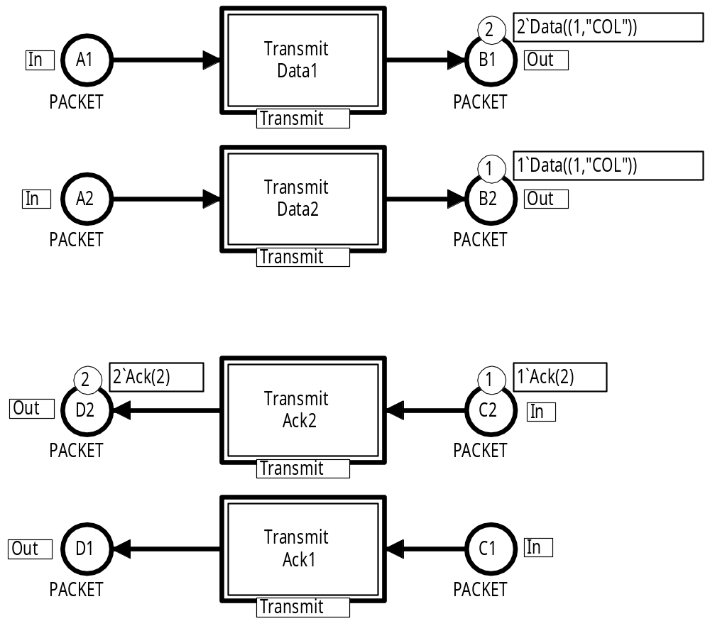
Network module
Data to the first receiver
Data to the second receiver
Acknowledgements from second receiver
Acknowledgements from first receiver
Coloured Petri Nets
Department of Computer Science

Slide 30
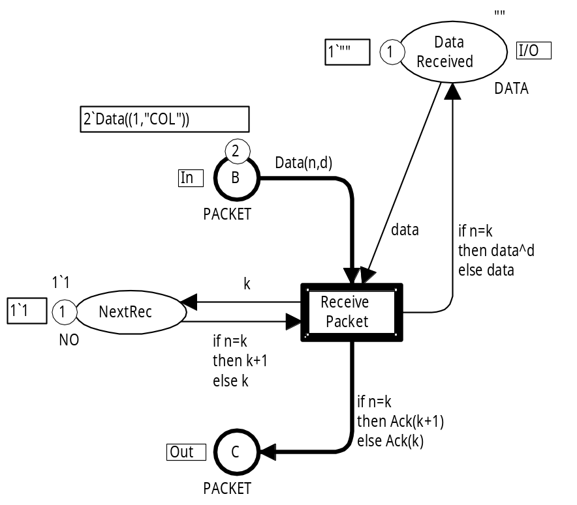

Receiver module (2 instances)
Each instance has its own marking.
Waiting for packet no. 1
Waiting for packet no. 2
Receiver 1
Receiver 2
Coloured Petri Nets
Department of Computer Science

Slide 31
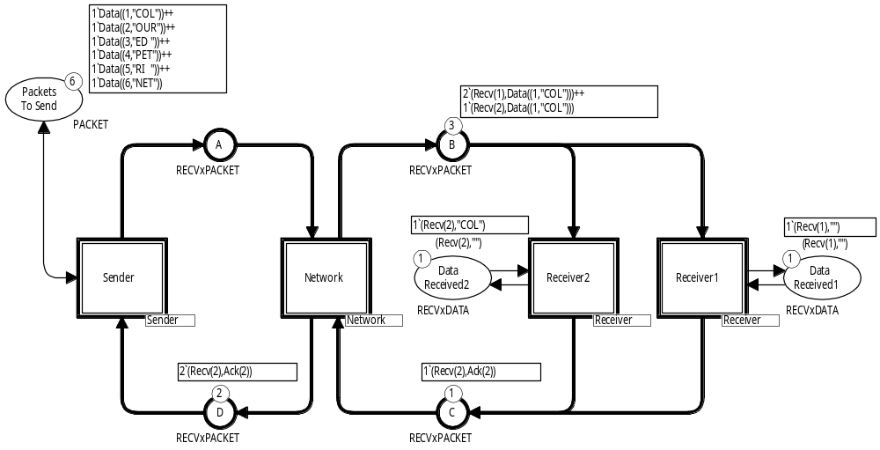
Second version with multiple receivers
A1 and A2 have been folded into a single place A.
Analogously, for B1 and B2, C1 and C2, D1 and D2.
Two different receivers
Coloured Petri Nets
Department of Computer Science

Slide 32
Packets and acknowledgements
To be able to make the folding we define an index colour set:
colset RECV = index Recv with 1..2;
Recv(1)
Two different values
Recv(2)
Instead of using two different places such as A1 and A2 we use the token colour to tell which receiver the data goes to / acknowledgements comes from.
colset RECVxPACKET = product RECV * PACKET;
(Recv(1),Data(2,"OUR"))
Data packet for the first receiver
(Recv(2),Ack(3))
Acknowledgement from the second receiver
Coloured Petri Nets
Department of Computer Science

Slide 33
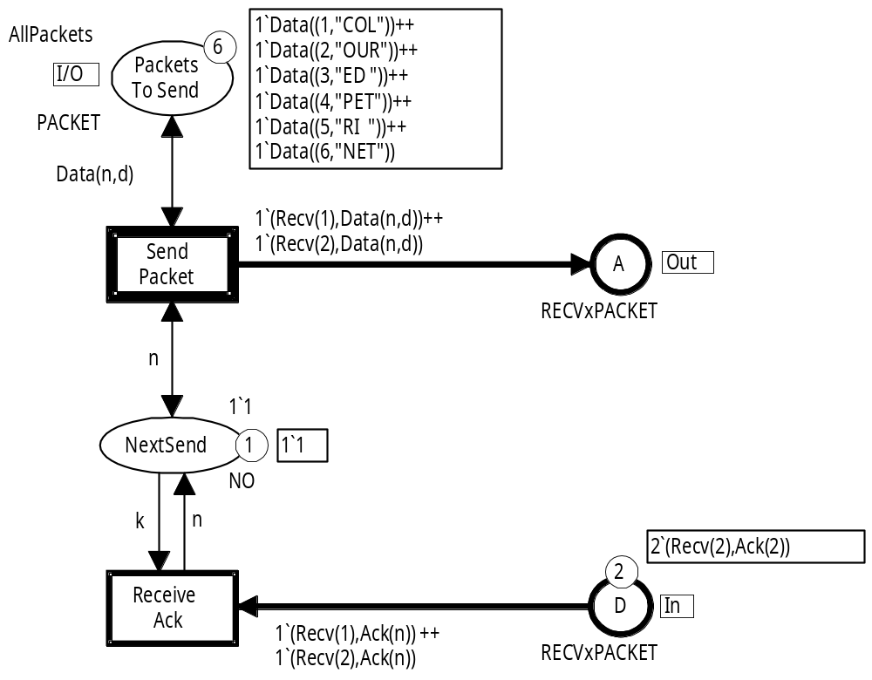
Sender module
Uses the new type.
Arc expressions have been modified to match the new type.
Similar changes in the other three modules
Coloured Petri Nets
Department of Computer Science

Slide 34
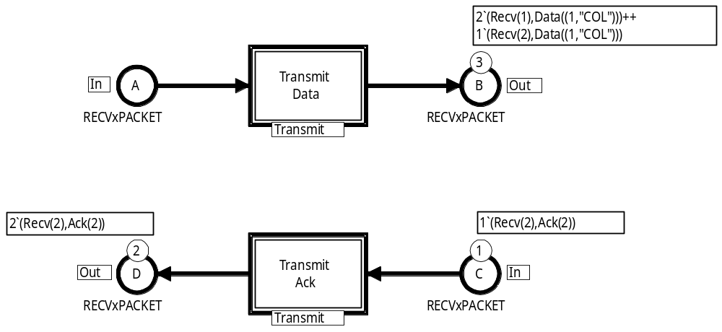
Network module
Uses the new type.
Now we only need two instances of the Transmit module.
Data to both receivers
Acknowledgements from both receivers
Coloured Petri Nets
Department of Computer Science

Slide 35
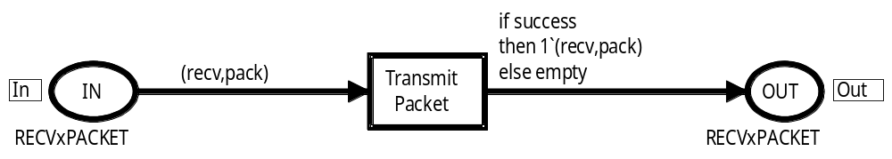
Transmit module
Uses the new type.
Arc expressions have been modified to match the new type.
A new variable has been introduced.
var recv : RECV;
Coloured Petri Nets
Department of Computer Science

Slide 36
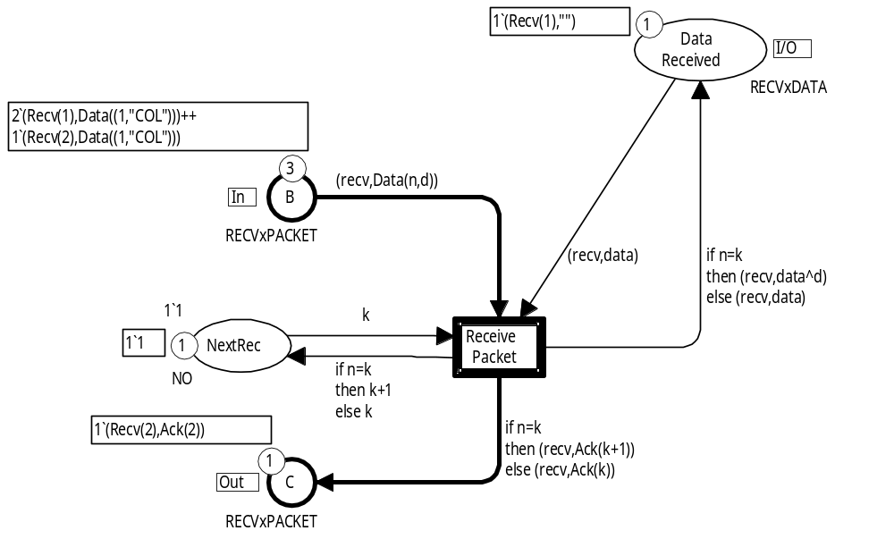
Receiver module
Receiver no 1
The first receiver has not yet received any data
Two data packets for Receiver1
The first receiver is waiting
for data packet no. 1
Coloured Petri Nets
Department of Computer Science

Slide 37
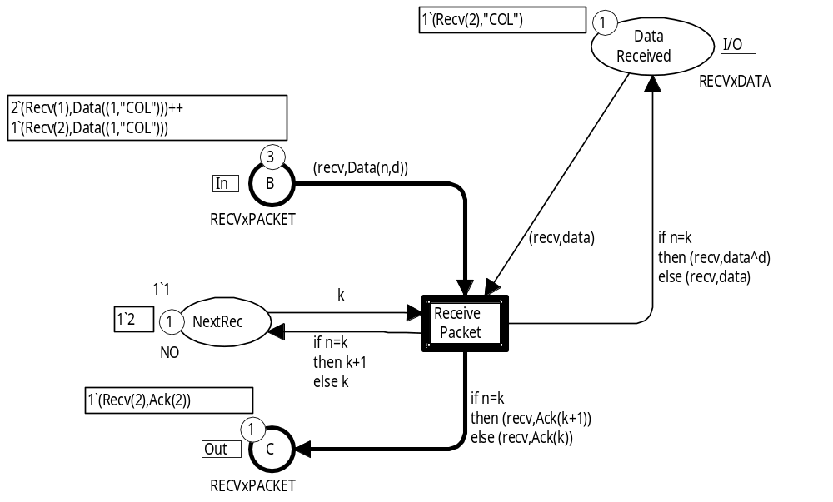
Receiver module
Receiver no 2
The second receiver has received the first data packet
A data packet for Receiver2
The second receiver is waiting
for data packet no. 2
An acknowledgement from Receiver2
Coloured Petri Nets
Department of Computer Science

Slide 38
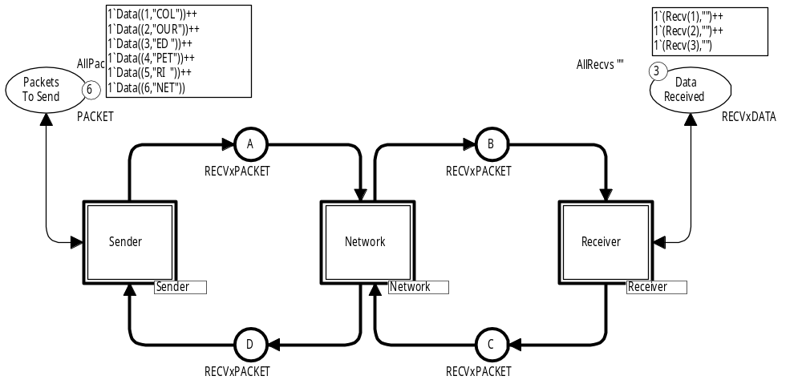
Third version with multiple receivers
We only have a single Receiver module.
The Receiver module represents an arbitrary number of receivers.
We will use token colours to distinguish the receiver tokens from each other.
One token for each receiver
Coloured Petri Nets
Department of Computer Science

Slide 39
Packets and acknowledgements
We define the number of receivers by means of a constant.
Can easily be changed without modifying the other definitions.
val NoRecv = 3;
colset RECV = index Recv with 1..NoRecv;
As before we add a RECV component to DATA tokens and PACKET tokens:
colset RECVxDATA = product RECV * DATA;
colset RECVxPACKET = product RECV * PACKET;
We do the same for NO tokens:
colset RECVxNO = product RECV * NO;
Coloured Petri Nets
Department of Computer Science

Slide 40
Initial marking for DataReceived
For three receivers we want the initial marking to be:
1`(Recv(1),"") ++ 1`(Recv(2),"") ++ 1`(Recv(3),"")
For six receivers we want the initial marking to be:
1`(Recv(1),"") ++ 1`(Recv(2),"") ++ 1`(Recv(3),"") ++
1`(Recv(4),"") ++ 1`(Recv(5),"") ++ 1`(Recv(6),"")
The initial marking should change automatically when the number of receivers changes.
To obtain this, we define the initial marking by means of a function called AllRecvs.
Coloured Petri Nets
Department of Computer Science

Slide 41
Definition of function AllRecvs
fun AllRecvs v = List.map (fn recv => (recv,v))(RECV.all());
Anonymous function
All receivers
Curried library function:
Applies a function
(given as first argument)
on all elements in a list
(given as second argument)
1`Recv(1) ++ 1`Recv(2) ++ 1`Recv(3)
[Recv(1),Recv(2),Recv(3)]
CPN tools represents multisets as lists
[(Recv(1),v),(Recv(2),v),(Recv(3),v)]
1`(Recv(1),v) ++ 1`(Recv(2),v) ++ 1`(Recv(3),v)
AllRecvs ""
1`(Recv(1),"") ++ 1`(Recv(2),"") ++ 1`(Recv(3),"")
Coloured Petri Nets
Department of Computer Science

Slide 42
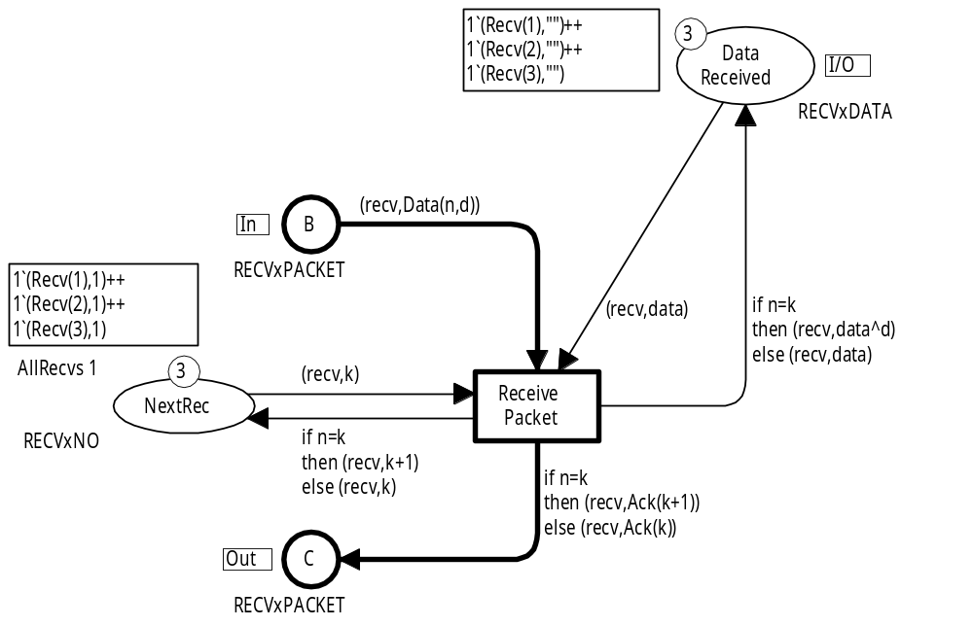
Receiver module
One token for each receiver
One token for each receiver
Initialisation expression
Coloured Petri Nets
Department of Computer Science

Slide 43
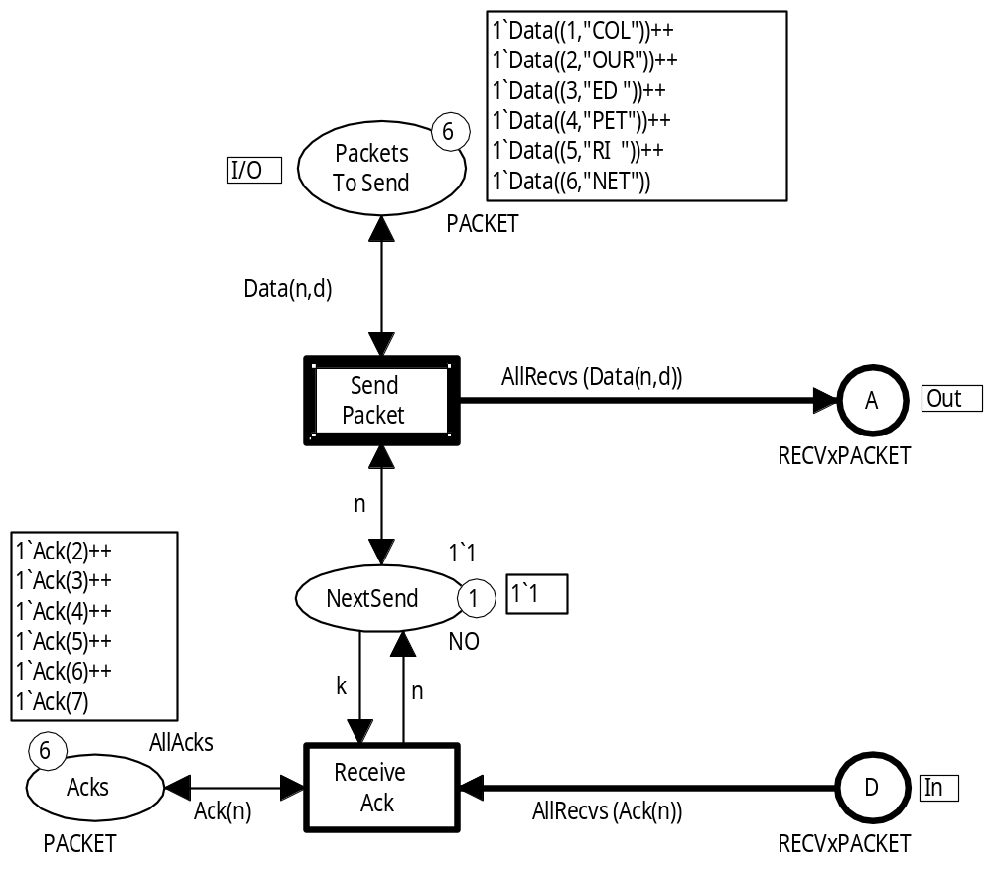

Sender module
AllRecvs (Ack(n))
is not a pattern
– because it involves a function call.
This implies that the CPN simulator cannot find a binding for the variable n.
AllRecvs
To solve this problem we add a new place Acks.
Coloured Petri Nets
Department of Computer Science

Slide 44
Modified Sender module
Ack(n) is a pattern.
Ack is a data constructor – not a function call.
Hence the CPN simulator can find a binding for the variable n.
All possible acknowledgements
The initial marking of Acks is defined by means of the symbolic constant AllAcks.
Coloured Petri Nets
Department of Computer Science

Slide 45
Definition of AllAcks
val AllAcks = List.map (fn Data(n,_) => Ack(n+1)) AllPackets;
Anonymous function
All packets
Curried library function:
Applies a function
(given as first argument)
on all elements in a list
(given as second argument)
1‘Data((1,"COL")) ++ 1‘Data((2,"OUR")) ++
1‘Data((3,"ED ")) ++ 1‘Data((4,"PET")) ++
1‘Data((5,"RI ")) ++ 1‘Data((6,"NET"))
[Data((1,"COL")),Data((2,"OUR")),
Data((3,"ED ")),Data((4,"PET")),
Data((5,"RI ")),Data((6,"NET"))]
[Ack(2),Ack(3),Ack(4),Ack(5),Ack(6),Ack(7)]
CPN tools represents multisets as lists
1`Ack(2) ++ 1`Ack(3) ++ 1`Ack(4) ++ 1`Ack(5) ++ 1`Ack(6) ++ 1`Ack(7)
Coloured Petri Nets
Department of Computer Science

Slide 46
Fusion sets
Modules can exchange tokens via:
  Port and socket places.
  Fusion sets.
Fusion sets allow places in different modules to be “glued” to one compound place ― across the hierarchical structure of the model.
Fusion sets are in some sense similar to global variables known from many programming languages and should therefore be used with care.
Coloured Petri Nets
Department of Computer Science

Slide 47
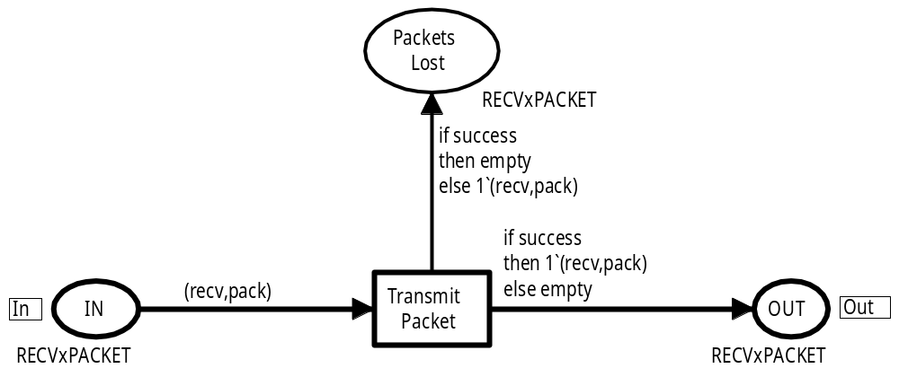
Collecting lost packets
We collect a copy of the lost packets on place PacketsLost.
Each instance of the Transmit module collects separately.
Coloured Petri Nets
Department of Computer Science

Slide 48
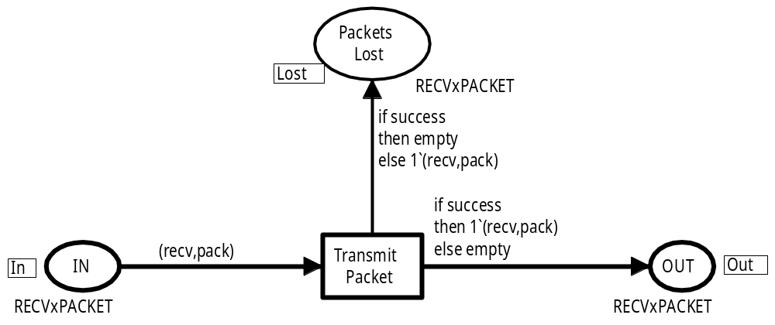
Collecting at a single place
All instances of the place PacketsLost are “glued together” to become a single compound place – sharing the same marking.
Member of fusion set
Coloured Petri Nets
Department of Computer Science

Slide 49
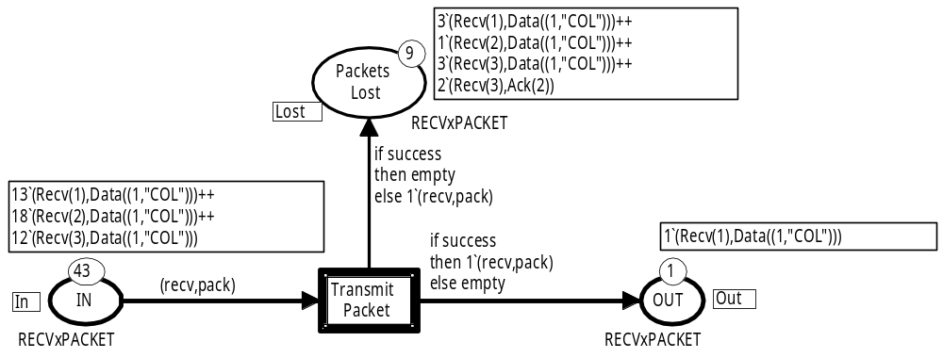
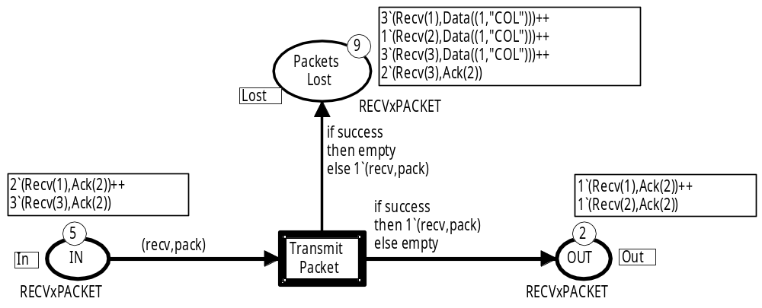
Marking
Shared
TransmitData
Local
Local
Shared
TransmitAck
Local
Local
Coloured Petri Nets
Department of Computer Science

Slide 50
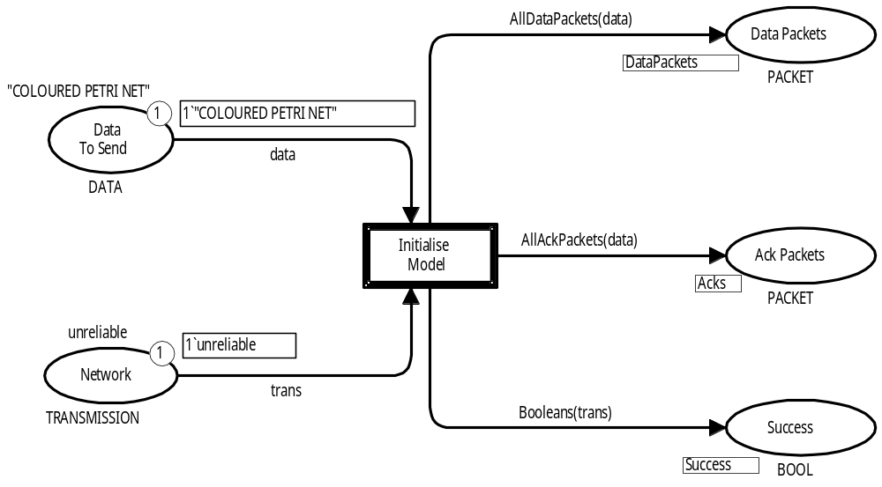
Initialisation module
Initialisation of the CPN model is done in a specific module.
Tokens are distributed to the other modules via fusion sets.
Data to be transmitted
Fusion set
Fusion set
Network properties
Fusion set
Coloured Petri Nets
Department of Computer Science

Slide 51
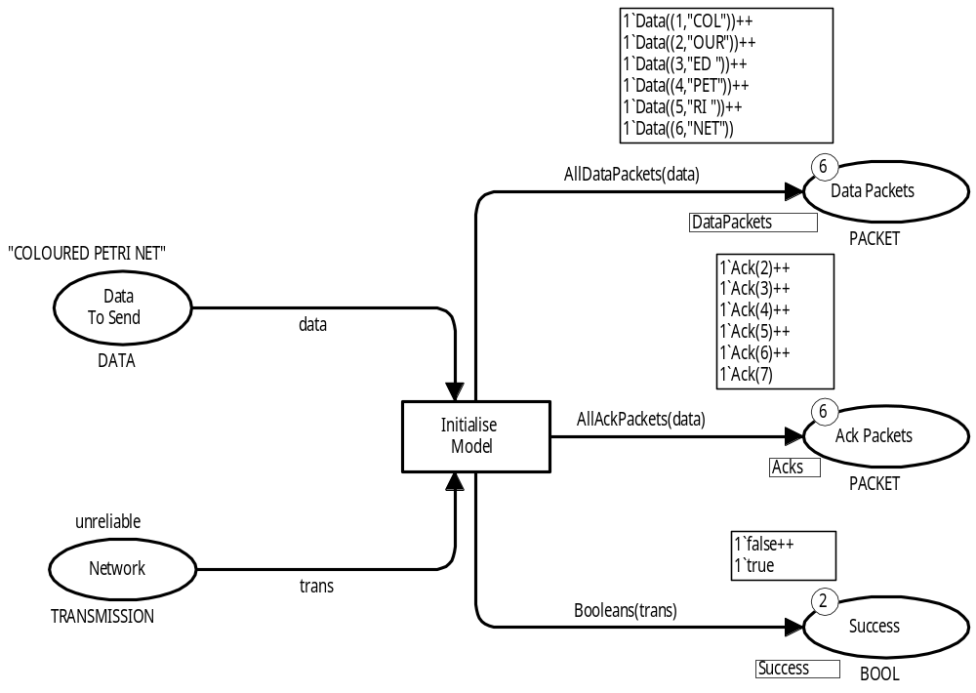
Marking after initialisation
Tokens to Sender module
Tokens to Transmit module
Coloured Petri Nets
Department of Computer Science

Slide 52
SplitData
val PacketLength = 3;
Symbolic constant: max length of each packet
fun SplitData (data) =
let
val pl = PacketLength;
fun splitdata (n,data) =
let
val dl = String.size (data)
in
if dl <= pl
then [(n,data)]
else (n,substring (data,0,pl))::
splitdata (n+1,substring (data,pl,dl-pl))
end;
in
splitdata (1,data)
end;
Local symbolic constant:
Max length of each packet
Local auxiliary function
Coloured Petri Nets
Department of Computer Science

Slide 53
AllDataPackets and AllAckPackets
Function to initialise place PacketsToSend in the Sender module:
fun AllDataPackets (data) =
(List.map (fn (n,d) => Data(n,d)) (SplitData (data)));
[(1,"COL"),(2,"OUR"),(3,"ED "),(4,"PET"),(5,"RI "),(6,"NET")]
Function to initialise place Acks in the Sender module:
fun AllAckPackets (data) =
(List.map (fn (n,_) => Ack(n+1)) (SplitData (data)));
Coloured Petri Nets
Department of Computer Science

Slide 54
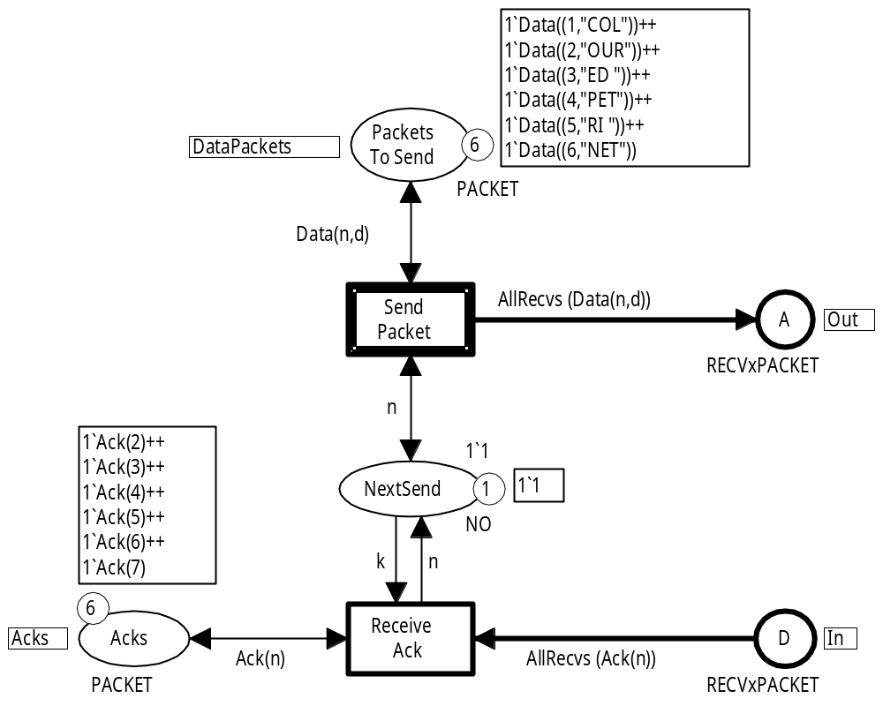
Marking of Sender module after initialisation
AllDataPackets (data)
AllAckPackets (data)
data = "COLOURED PETRI NET"
Coloured Petri Nets
Department of Computer Science

Slide 55
Reliable/unreliable transmission
New colour set:
colset TRANSMISSION = with reliable | unreliable;
No packets are lost:
success can only be bound to true
Packets may be lost:
success can be bound to either true or false
Function to initialise place Success in the Transmit module:
(* Produces the boolean values to which the
variable success can be bound *)
fun Booleans reliable = 1`true
| Booleans unreliable = 1`true ++ 1`false;
Coloured Petri Nets
Department of Computer Science

Slide 56
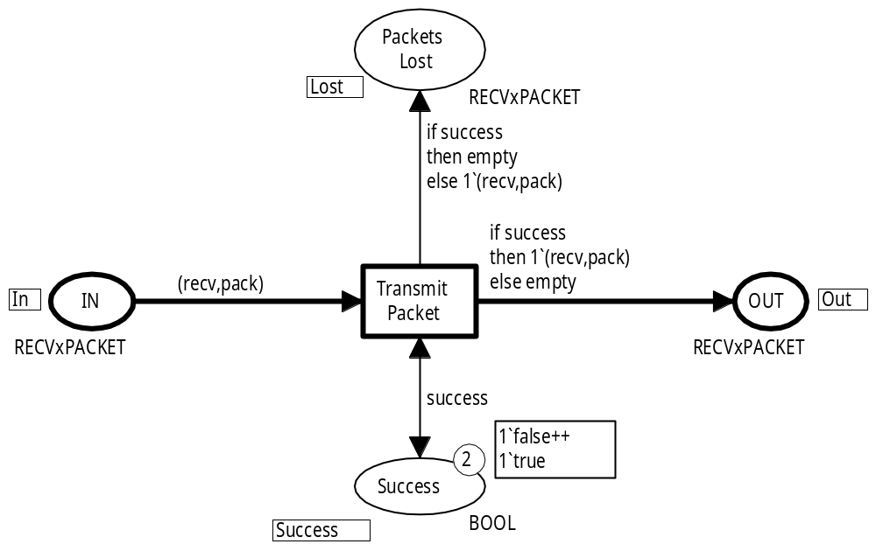
Marking of Transmit module after initialisation
Booleans (unreliable)
Coloured Petri Nets
Department of Computer Science

Slide 57
Unfolding hierarchical CPN models
A hierarchical CPN model can always be unfolded to an equivalent non-hierarchical CPN model
Three steps:
Replace each substitution transition with the content of its submodule (related port and socket places are merged into a single place).
Collect the contents of all prime modules in a single module.
Merge places which belong to the same fusion set.
Coloured Petri Nets
Department of Computer Science

Slide 58
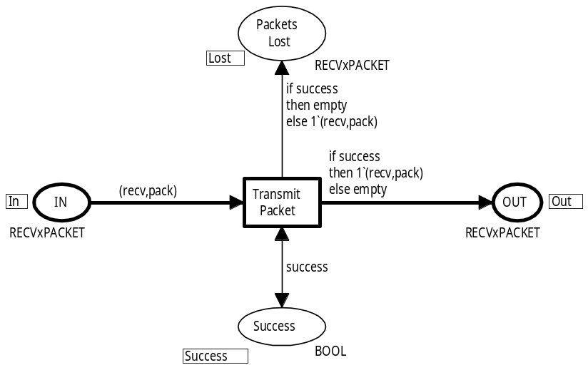
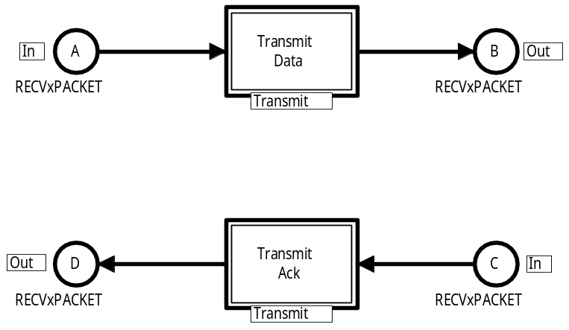
Example of folding
Replace
Merge
Merge
Merge
Merge
Replace
Coloured Petri Nets
Department of Computer Science

Slide 59
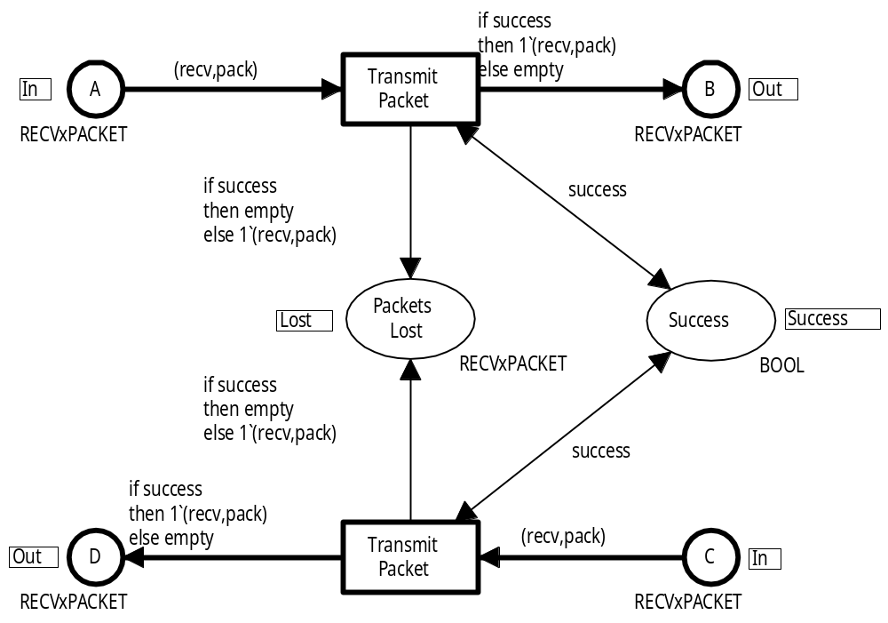
Non-hierarchical CPN model
TransmitData
TransmitAck
Coloured Petri Nets
Department of Computer Science

Slide 60
Hierarchical versus non-hierarchical nets
A hierarchical CPN model can always be transformed into an equivalent non-hierarchical CPN model.
In theory, this implies that the hierarchy constructs of CP-nets do not add expressive power to the modelling language.
Any system that can be modelled with a hierarchical CPN model can also be modelled with a non-hierarchical CPN model.
In practice, the hierarchy constructs are very important.
They make it possible to structure large models and thereby cope with the complexity of large systems.
Hence they add modelling power.
Coloured Petri Nets
Department of Computer Science

Slide 61

Questions
Coloured Petri Nets
Department of Computer Science

