Slide 1
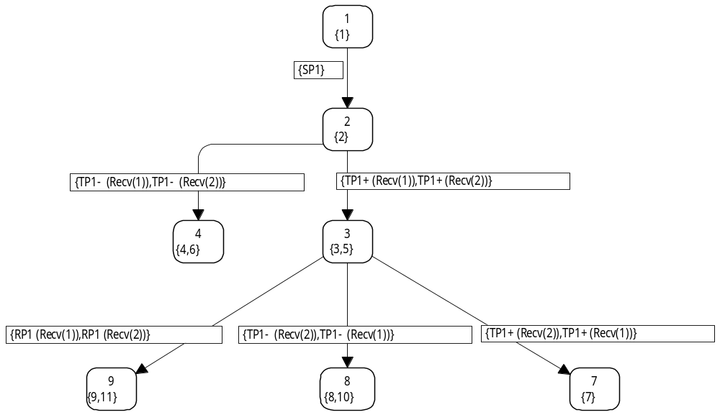
Coloured Petri Nets
Modelling and Validation of Concurrent Systems
Chapter 8: Advanced State Space Methods
1
{1}
Kurt Jensen &
Lars Michael Kristensen
{kjensen,lmkristensen}
@cs.au.dk
2
{2}
4
{4,6}
3
{3,5}
9
{9,11}
8
{8,10}
7
{7}
Coloured Petri Nets
Department of Computer Science

Slide 2
State space methods
The main limitation of using state spaces to verify behavioural properties of systems is the state explosion problem.
State spaces of many systems have an astronomical number of reachable states.
This means that they are too large to be handled with the available computing power:
  memory,
  CPU speed.
Coloured Petri Nets
Department of Computer Science

Slide 3
State space reduction methods
Methods for alleviating the state explosion problem is an active area of research. They allow:
  faster construction,
  more compact representation (less memory).
A large collection of state space reduction methods exists.
The reduction methods have significantly increased the class of systems that can be verified in practice.
State spaces can now be used to verify systems of
industrial size.
Coloured Petri Nets
Department of Computer Science

Slide 4
Independent of modelling language
Most state space reduction methods are independent of the concrete modelling language and hence applicable for a large class of such languages (e.g. all transition systems).
Some of the reduction methods have been developed within the context of the CPN modelling language:
  Sweep-line method.
  Symmetry method.
  Equivalence method.
Other reduction methods have been developed outside the context of the CPN modelling language.
Coloured Petri Nets
Department of Computer Science

Slide 5
Why different reduction methods?
State space reduction methods typically exploit certain characteristics of the system under analysis.
No single reduction method works well for all kind of systems.
Furthermore, the methods often limit the verification questions that can be answered.
When verifying a concrete system one must therefore choose a method that:
  exploits characteristics present in the system,
  preserves the behavioural properties to be verified.
Coloured Petri Nets
Department of Computer Science

Slide 6
On-the-fly verification
Many reduction methods are based on the paradigm of on-the-fly verification.
The verification question is stated before the exploration of the state space starts.
The state space exploration is done relative to the provided verification question.
This makes it possible to terminate the state space exploration as soon as the answer to the verification question has been obtained – ignoring irrelevant parts.
Coloured Petri Nets
Department of Computer Science

Slide 7
Model checking
Many advanced state space reduction methods use temporal logic for stating the verification questions:
  Linear-time temporal logic (LTL).
  Computation tree temporal logic (CTL).
The use of temporal logic for stating and checking verification questions is referred to as model checking.
Coloured Petri Nets
Department of Computer Science

Slide 8
State spaces are kept in main memory
The amount of available main memory is often the limiting factor in the practical use of state spaces.
During construction of the state space, the set of markings encountered are kept in main memory.
This allows us to recognise already visited markings and thereby ensure that the state space exploration terminates.
Coloured Petri Nets
Department of Computer Science

Slide 9
Method 1: Sweep-line method
The basic idea of the sweep-line method is to exploit a certain kind of progress exhibited by many systems.
Exploiting progress makes it possible to explore all the reachable markings of a CPN model, while only storing small fragments of the state space in main memory at a time.
This means that the peak memory usage is significantly reduced.
The sweep-line method is aimed at on-the-fly verification of safety properties (e.g., determining whether a reachable marking exists satisfying a given predicate).
Coloured Petri Nets
Department of Computer Science

Slide 10
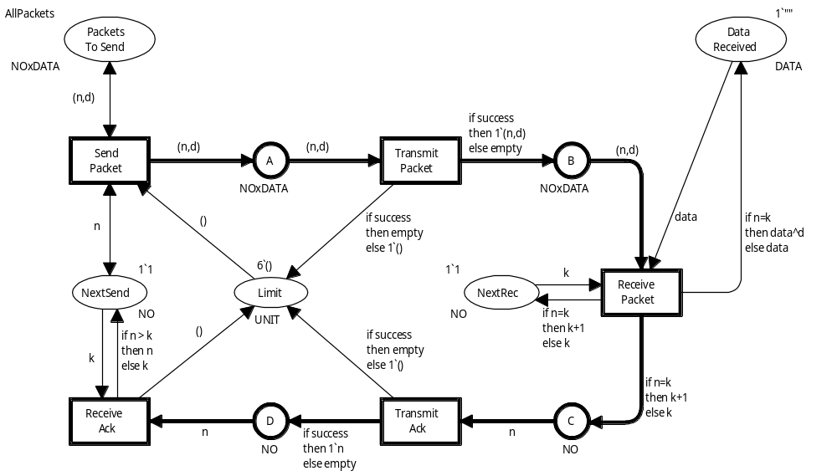
Simple protocol (slightly modified)
The token colour on NextSend never decreases
The token value on NextRec increases during execution.
It is never decreased.
Measures the progress of the transmission
Coloured Petri Nets
Department of Computer Science

Slide 11
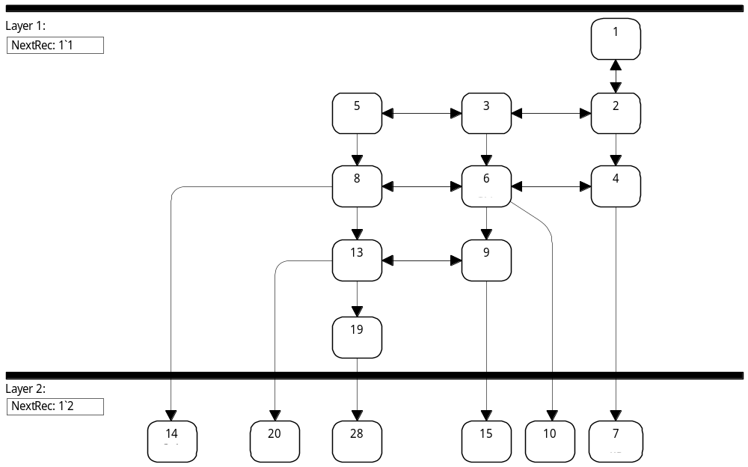
Initial fragment of state space
Each marking has successor markings either in the same layer or in higher layers – never in lower layers.
NextRec: 1`1
1
5
3
2
Layer 1
8
6
4
No backward arcs from layer 2 to layer 1
13
9
19
Follows from progress property
14
20
28
15
10
7
NextRec: 1`2
Layer 2
Coloured Petri Nets
Department of Computer Science

Slide 12
We process markings layer by layer
We process the markings (i.e., calculate successor markings) one layer at a time.
We only move from one layer to the next when all markings in the first layer have been processed.
We can think of this as a sweep-line moving through the state space (layer by layer).
At any time during state space exploration, the sweep-line corresponds to a single layer.
  All markings in the layer are “on” the sweep-line.
  All new markings calculated are either on the sweep-line or in front of the sweep-line (i.e. in a higher layer).
Coloured Petri Nets
Department of Computer Science

Slide 13
Progress measure
The progress in the protocol system is captured by a progress measure which is a function mapping each marking into a progress value.
Converts a multiset 1`x with one element to the colour x
fun ProtocolPM n = ms_to_col (Mark.Protocol’NextRec 1 n);
Monotonic progress measure:
M’ ∈ ℜ(M) ⇒ ProtocolPM M ≤ ProtocolPM M’
Coloured Petri Nets
Department of Computer Science

Slide 14
Statistics for sweep-line method
Limit | Packets | Nodes | Arcs | Nodes (peak) | Nodes | Time
1 | 4 | 33 | 44 | 33 | 1.00 | 1.00
2 | 4 | 293 | 764 | 134 | 2.19 | 1.00
3 | 4 | 1,829 | 6,860 | 758 | 2.41 | 1.00
4 | 4 | 9,025 | 43,124 | 4,449 | 2.03 | 1.78
5 | 4 | 37,477 | 213,902 | 20,826 | 1.80 | 1.65
6 | 4 | 136,107 | 891,830 | 82,586 | 1.65 | 1.51
4 | 5 | 20,016 | 99,355 | 8,521 | 2.35 | 1.95
4 | 6 | 38,885 | 198,150 | 14,545 | 2.67 | 2.19
4 | 7 | 68,720 | 356,965 | 22,905 | 3.00 | 2.27
4 | 8 | 113,121 | 596,264 | 33,985 | 3.33 | 2.41
Configuration
Standard method
Sweep-line
Gain
Coloured Petri Nets
Department of Computer Science

Slide 15
Summary for sweep-line method
From the statistics on the previous slide, it can be seen that the sweep-line method yields a reduction in both space and time.
The space reduction was expected since markings are deleted during state space exploration.
The time reduction is because the deletion of states implies that there are fewer markings to compare with when determining whether a marking has been seen before (and because it is faster to store new markings).
For timed CP-nets the global clock can be used a a progress measure.
Coloured Petri Nets
Department of Computer Science

Slide 16
Generalised sweep-line method
Above we have used a monotonic progress measure:
M’ ∈ ℜ(M) ⇒ ProtocolPM M ≤ ProtocolPM M’
It is also possible to use a generalised sweep-line method
where the monotonicity property only is satisfied by most steps.
The generalised sweep-line method performs multiple sweeps of the state space, and it makes certain markings persistent which means that they cannot be deleted from memory.
The sweep-line method has also been generalised to use external storage such that counterexamples and other diagnostic information can be obtained.
This is not possible in the basic method since it deletes the markings from memory.
Coloured Petri Nets
Department of Computer Science

Slide 17
Method 2: Symmetry method
Many concurrent systems possess a certain degree of symmetry.
They may e.g. have similar components whose identities are interchangeable from a verification point of view.
The basic idea in the symmetry method is to represent symmetric markings and symmetric binding elements using equivalence classes.
  Each node represents a class of equivalent markings (instead of a single marking).
  Each arc represents a class of equivalent binding elements (instead of a single binding element).
Coloured Petri Nets
Department of Computer Science

Slide 18
Construction and analysis
Symmetry condensed state spaces are typically orders of magnitude smaller than the corresponding full state spaces.
They can be constructed directly without first constructing the full state space and then grouping nodes and arcs into equivalence classes.
Furthermore, behavioural properties can be verified directly on the symmetry condensed state space without unfolding to the full state space.
Coloured Petri Nets
Department of Computer Science

Slide 19
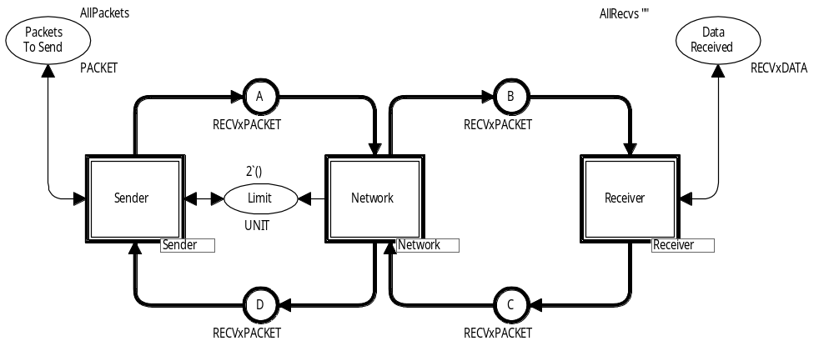
Protocol with multiple receivers
A Limit place has been added to make the state space finite
The receivers in the protocol system are symmetric, in the sense that they all behave in the same way.
They are only distinguishable by their identity.
Coloured Petri Nets
Department of Computer Science

Slide 20
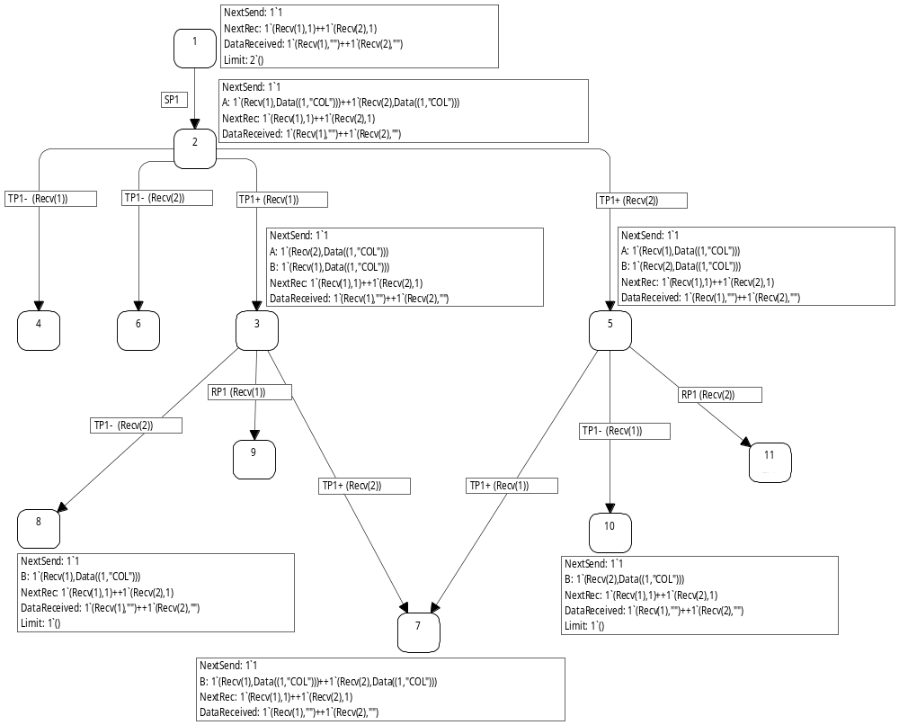
State space (ordinary for 2 receivers)
1
Two copies of packet no 1 to Recv(1) and Recv(2)
2
Successful transmission to Recv(1)
Successful transmission to Recv(2)
Loss to Recv(1)
Loss to Recv(2)
4
6
3
5
Symmetric markings (one can be reached from the other by interchanging Recv(1) and Recv(2)
Symmetric markings
Coloured Petri Nets
Department of Computer Science

Slide 21
Symmetric successors
3
Symmetric markings
5
Symmetric binding elements leading to symmetric markings
9
11
8
10
7
Coloured Petri Nets
Department of Computer Science

Slide 22
Symmetric markings
On the previous slide we saw that the symmetric markings M₃ and M₅ have:
  symmetric sets of enabled binding elements,
  symmetric sets of direct successor markings.
By induction this property can be extended to finite and infinite occurrence sequences:
  For any occurrence sequence starting in a marking M and all markings M′ symmetric with M there exists a symmetric occurrence sequence starting in M′.
  The things which can happen from M can also happen
  from M’ (up to symmetry).
Coloured Petri Nets
Department of Computer Science

Slide 23
Symmetry condensed state space
1
{1}
2
{2}
4
{4,6}
3
{3,5}
Some of the nodes represent two different markings
9
{9,11}
8
{8,10}
7
{7}
Coloured Petri Nets
Department of Computer Science

Slide 24
Soundness criteria
The symmetries used to reduce the state space are required to be symmetries actually present in the CPN model:
All initial marking inscriptions must be symmetric (applying a permutation to the initial marking does not change the initial marking).
All guard expressions must be symmetric (evaluating the guard in a binding must give the same result as first permuting the binding element and then evaluating the guard).
All arc expressions must be symmetric (evaluating the arc expression in a binding and then applying a permutation must give the same result as first permuting the binding element and then evaluating the arc expression).
Static checks by local examination of net inscriptions
Coloured Petri Nets
Department of Computer Science

Slide 25
Specification of symmetries
Colour sets are divided into:
  Atomic (Int, Bool, String, Unit, enumerations, indexed).
  Structured (products, records, unions, lists, subsets).
Each atomic colour set is associated with an algebraic group of allowed permutations.
The structured colours sets inherits their permutations from the colour sets from which they are constructed.
Examples of permutation groups are:
  all permutations in the colour set,
  all rotations in an ordered colour set,
  identity element alone (no permutation allowed).
Coloured Petri Nets
Department of Computer Science

Slide 26
Protocol with multiple receivers
Atomic colour sets:
colset NO = int;
colset DATA = string;
colset RECV = index Recv with 1..NoRecv;
No permutations
All permutations
Structured colour sets:
No permutations
colset NOxDATA = product NO * DATA;
colset PACKET = union Data : NoxDATA + Ack : NO;
colset RECVxDATA = product RECV * DATA;
colset RECVxPACKET = product RECV * PACKET;
colset RECVxNO = product RECV * NO;
All permutations of Recv-component
Coloured Petri Nets
Department of Computer Science

Slide 27
Statistics for symmetry method
L P R | Nodes | Arcs | Nodes | Arcs | Nodes | Arcs | Time | R!
2 3 2 | 921 | 1,832 | 477 | 924 | 1.93 | 1.98 | 0.7 | 2
3 3 3 | 22,371 | 64,684 | 4,195 | 11,280 | 5.33 | 5.73 | 2.0 | 6
4 3 4 | 172,581 | 671,948 | 9,888 | 32,963 | 17.45 | 20.38 | 23.9 | 24
5 2 5 | 486,767 | 2,392,458 | 8,387 | 31,110 | 58.04 | 76.90 | — | 120
6 2 6 | 5,917,145 | 35,068,448 | 24,122 | 101,240 | 245.30 | 346.39 | — | 720
Configuration
Standard method
Symmetry
Gain
L = Limit
P = Packets
R = Receivers
Number of possible permutations
Coloured Petri Nets
Department of Computer Science

Slide 28
Summary for symmetry method
Significant reductions can be obtained as illustrated on the protocol with multiple receivers.
The method can be used to check all behavioural properties
that are invariant under symmetry.
Computation of the canonical representations of markings
and binding elements is computational expensive.
  At least as hard as the graph isomorphism problem for
  which no polynomial time algorithm is known.
  The present algorithms exploits a number of advanced algebraic techniques and can efficiently deal with systems where the number of permutation symmetries are below 10!
  This is usually sufficient in practice.
Coloured Petri Nets
Department of Computer Science

Slide 29
Method 3: Equivalence method
The equivalence method is a generalisation of the symmetry method.
In the symmetry method we have equivalence relations on the markings and on the binding elements.
The equivalence relations are induced by the permutation symmetries.
In the equivalence method the equivalence relations are specified directly (without the use of symmetries).
Soundness criteria: Equivalent markings must have equivalent sets of enabled binding elements and equivalent sets of successor markings.
Coloured Petri Nets
Department of Computer Science

Slide 30
Simple protocol (slightly modified)
The token colour on NextSend never decreases
Coloured Petri Nets
Department of Computer Science

Slide 31
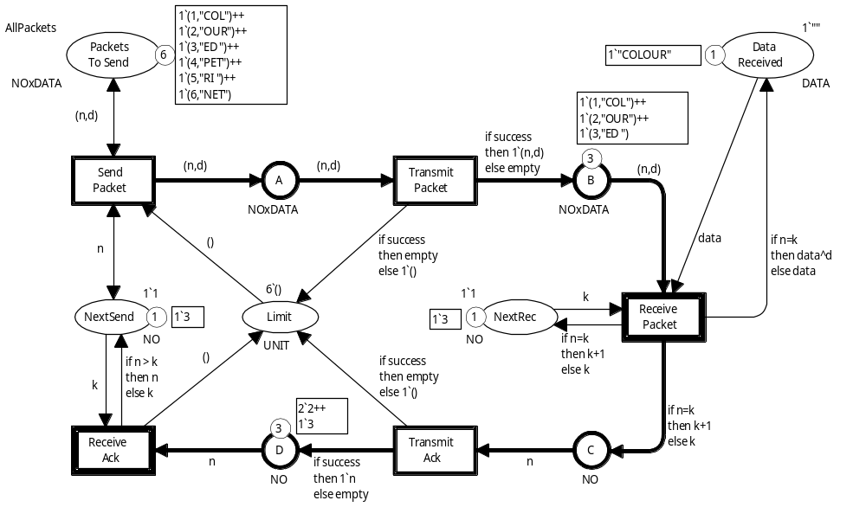
Old packets
Old packets
Expected packet
Receiver is waiting for packet no 3
Coloured Petri Nets
Department of Computer Science

Slide 32
Old acknowledgments
Sender is sending packet no 3
Old acknowledgments
Coloured Petri Nets
Department of Computer Science

Slide 33
Equivalence relation for markings
Basic idea:
  Old data packets can be replaced by other old data packets.
  Old acknowledgements can be replaced by other old acknowledgements.
Two markings are equivalent if the following conditions hold:
  Markings of A, B, C, and D: Identical non-old packets and the same number of old packets.
  All other places must have identical markings.
Coloured Petri Nets
Department of Computer Science

Slide 34
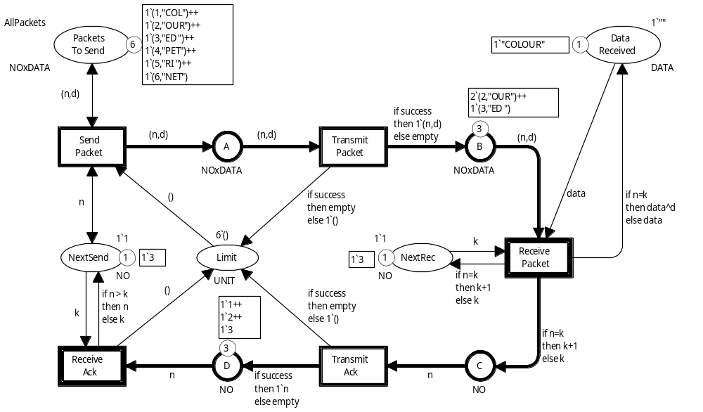
Two equivalent markings
2 old data packets
Identical new packet
3 old acks
0 new acks
M₁
All other places have identical markings
2 old data packets
The two markings are equivalent to each other
Identical new packet
3 old acks
0 new acks
M₂
Coloured Petri Nets
Department of Computer Science

Slide 35
Equivalence relation for binding elements
Two bindings of the same transition are equivalent to each other if they both involve old data packets or both involve old acknowledgements.
All other binding elements are non-equivalent.
Coloured Petri Nets
Department of Computer Science

Slide 36
Statistics for equivalence method
L P | Nodes | Arcs | Nodes | Arcs | Nodes | Arcs | Time
1 4 | 33 | 44 | 33 | 44 | 1.00 | 1.00 | 1.00
2 4 | 293 | 764 | 155 | 383 | 1.89 | 1.99 | 1.00
3 4 | 1,829 | 6,860 | 492 | 1,632 | 3.72 | 4.20 | 0,90
4 4 | 9,025 | 43,124 | 1,260 | 5,019 | 7.16 | 8.59 | 1.56
5 4 | 37,477 | 213,902 | 2,803 | 12,685 | 13.37 | 18.86 | 4.09
6 4 | 136,107 | 891,830 | 5,635 | 28,044 | 24.15 | 31.80 | 13.58
Configuration
Standard method
Equivalence
Gain
L = Limit
P = Packets
Coloured Petri Nets
Department of Computer Science

Slide 37
Summary for equivalence method
The equivalence method allows a more dynamic/general notion of equivalence than the symmetry method.
Hence it can be used in situations where the symmetry method are of no use.
The consistency proof must be done manually.
The equivalence relations must be implemented manually (as ML functions).
Later we shall see that the equivalence method can be used to reduce state spaces for timed CPN models (without manual consistency proof and with automatic implementation).
Coloured Petri Nets
Department of Computer Science

Slide 38
Multiple reduction methods
It is often possible to simultaneously use two or more state space reduction methods.
This leads to more reduction than each method used in isolation:
  in CPU, and
  memory usage
The sweep-line, symmetry, and equivalence methods can be used simultaneously with each other.
Coloured Petri Nets
Department of Computer Science

Slide 39

Questions
Coloured Petri Nets
Department of Computer Science

