Slide 1
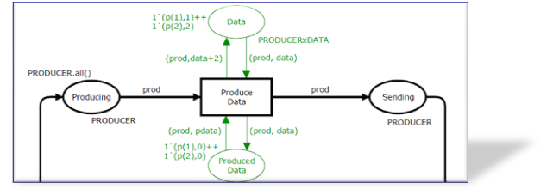
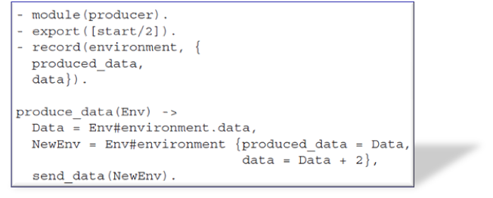
Automatic Structure-based Code Generation from Coloured Petri Nets: A Proof of Concept
Michael Westergaard
Department of Mathematics and Computer Science,
Technical University of Eindhoven, The Netherlands
Lars M. Kristensen
Department of Computer Engineering,
Bergen University College, Norway
Email: lmkr@hib.no / Web: www.hib.no/ansatte/lmkr
Notes:
The work presented here is joint work with Michael Westergaard an is concerned with automatic code generation from formal specification.
The formal specification – or modelling language – that we are focussing on is that of Coloured Petri Nets

Slide 2
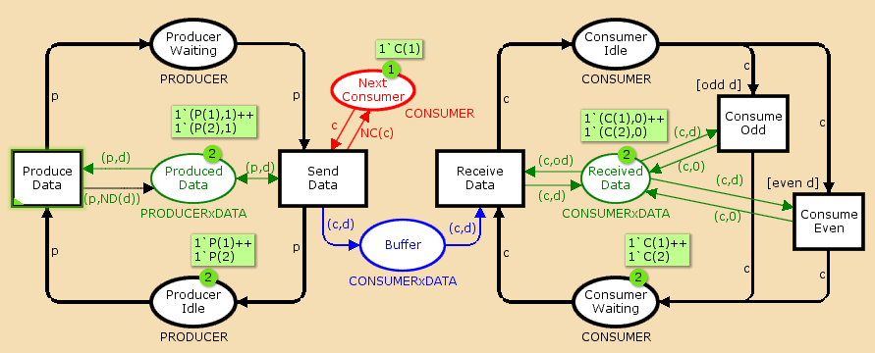
Coloured Petri Nets (CPNs)
[Jensen’91, Jensen and Kristensen’09]
Petri Nets and a programming language:
Petri Nets:
concurrency
control structures
synchronisation
communication
PROD-CONS
Standard ML:
data manipulation
compact modelling
Modelling, simulation, and analysis of CPNs are supported by CPN Tools. [ www.daimi.au.dk/CPNTools ]
Notes:
BRUK AV IDLE/WAITING I CONSUMER ER LIDT UHELDIG – BURDE BYTTES RUNDT.
Belongs to the class of Petri nets called high-level Petri nets and are based on the idea of combining Place/transitions Petri nets with a programming language.
The idea is to use Petri for …
And a programming language – in this case the functional programming language Standard ML – which used used for modelling data and data manipulation and for creating compact and parameteriseable models. The latter is quite important in practical modelling and modelling data manipulation with ordinary low-level Petri nets is rather inconvient and unnatural.
Video: a small producer/consumer system – places, transitions, arcs as in ordinary Petri nets but now also colour sets, arc expressions, and transition guards.

Slide 3
Motivation and Background
CPNs have been widely used for modelling and validation of concurrent software systems*:
  Danfoss Flowmeter and Bang & Olufsen Beolink Systems.
  Ericsson Edge Router Discovery Protocol.
  Several Internet protocols (e.g., IOTP, DCCP, SIP, DYMO).
Limited work on automatic code generation:
  Simulation-based: the model simulator is embedded directly in the implementation.
  State space-based: the state space of the model is computed and used as a basis for implementation.
  Structure-based: structural analysis of the model for translation into programming language constructs.
  *for a comprehensive list, see http://www.cs.au.dk/CPnets/intro/industrial.shtml
Notes:
And the modelling, simulation, verification have yielded useful insight into the design and behaviour of a system.
The construction of the model has hopefully indirectly contributed to make, e.g., a manual implementation easier but it would be nice to have some automatic support for code generation.
But there exists only limited work on automatic code-generation from CPNs:
A couple of example of simulation-based code generation where the idea is…
Limited examples of state-space-based due to inhereint problem with state space size and limitation to finite state systems.
Hardly any work on structure-based code generation despite it obvios advantages compared to simulation and state-space based approaches.

Slide 4
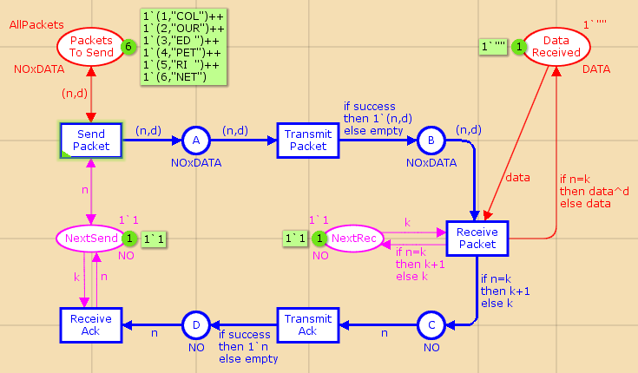
An Observation …
It is difficult (in general) to recognize programming language constructs in CPNs:
Control flow: if-then-else, case, while,…?
Communication, synchronisation, message passing, shared data,…?
Conclusion: some additional syntactical constraints and annotations are required.
Notes:
Eksemplet burde ligne det foregående lidt mere.
We can infer that kind of information from our understanding of what is being modelled and how the model has been constructed – but a computer tool that are to generate an implementation does not have such intuition and understanding.
Point: we need to restrict the set of CPNs to do it in a meaningful way such that this information becomes visible.
Put some requirements.

Slide 5
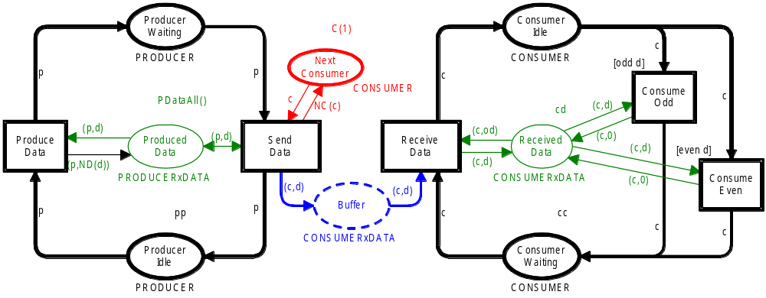
Process Partitioned CPNs
Key concepts:
  Process subnets and places.
  Buffer places.
  Shared and local places.
Explicit separation of:
  Control flow of processes.
  Message passing.
  Shared and local data.
Producer
Consumer
Notes:
This is the motivation for introducing process-partitioned CPNs which is a subclass of CPNs that provide …
Process partitions: Program executed by one or more processes.
Process places: Control flow locations of processes
Local places: data local to a process.
Shared places: data shared between processes.
Buffer places: messages passed to a process.
Add animation of the different parts.

Slide 6
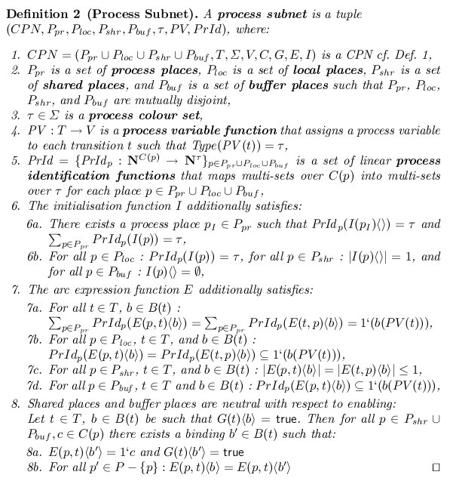
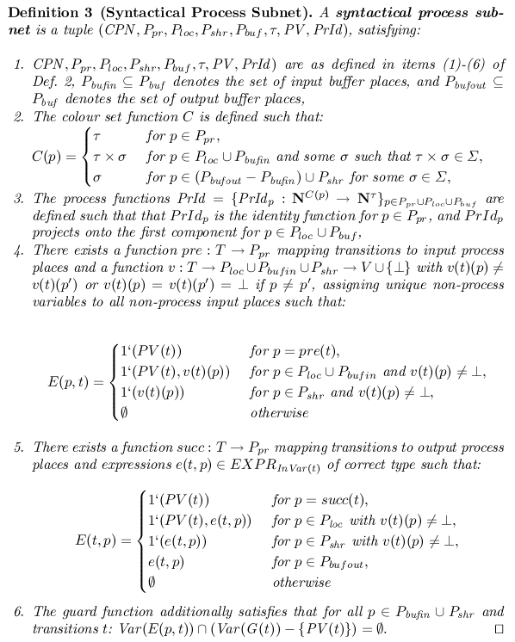

Formal Definitions
Notes:
We provide a formal definition – a semantical one and a syntactical one.
A process-partitioned CPN is then a union of process subnets required to be disjoint except on buffer places.
The key point is to make a semantical definition on the requirements to make the approach as general as possible, and then a syntactical structural charaterisation which implies the semantical one and which the one that one will use in a practical tool implementing the approach.

Slide 7
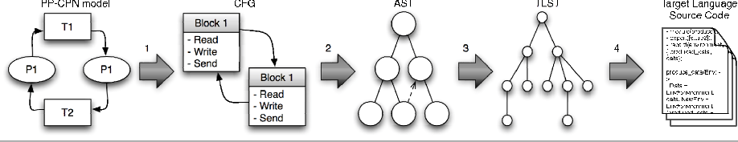
Approach: Overview
The translation of Process-Partitioned CPNs into target source code is divided into phases:
Target Language
Syntax Tree
Target Language
Source Code
PP-CPN Model
Control Flow Graph
Abstract Syntax Tree
The abstract syntax tree (AST) is independent of a particular target programming language.
The Erlang programming language was used as a concrete target programming language.
Notes:
CFG is a directed graph that reflects the control flow of the processes and the blocks of the CFG corresponds to a group of statements that are to be executed.
The AST includes a tree representation of the statements from the CFG and the inscriptions used in the CPN model.
A main point is to be independent of the concrete target language for as long as possible.
To make things run we of course need a concrete target language and the last two phases of the translation are target language specific:
The erlang programming language is a programming language developed by Ericsson in the late 1980s for implementing concurrent and fault-tolerant software – in particular for telephone switches and networking. It is sometimes referred to as a concurrency-oriented programming language because concurrency has been built-in from the very beginning of the design of the language – in a similar way as Petri net can be considered a concurrency-oriented modelling language.
In that respect there is a nice conceptual match between Erlang and Coloured Petri nets and a lot of the construct found in Erlang for sequence programming is similar to Standard ML
The code generation did not consider the sequential CPN ML parts of the CPN model. The ML to Erlang translation concrerning the sequential parts are not where the interesting problems lies.

Slide 8
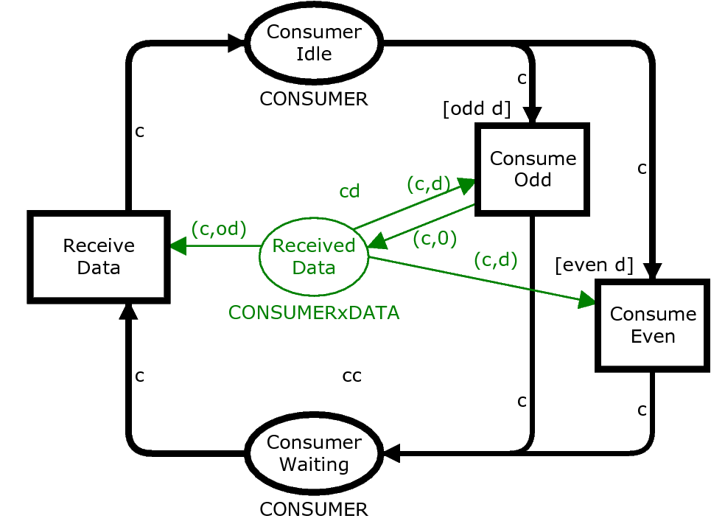
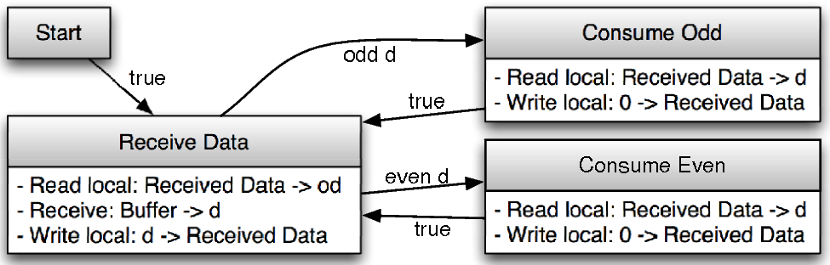
Phase 1: Translating to CFG
Constructs a control-flow graph (CFG) for each process subnet:
The CFG nodes are blocks of statement to be executed.
The CFG arcs are guarded jump statements.
Notes:
Nodes in the control-flow graph corresponds to a group of statements to be executed …

Slide 9
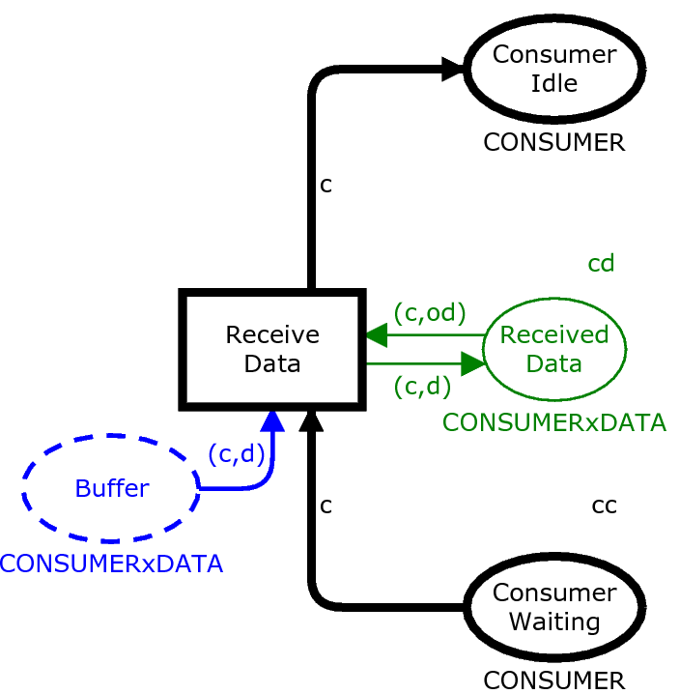
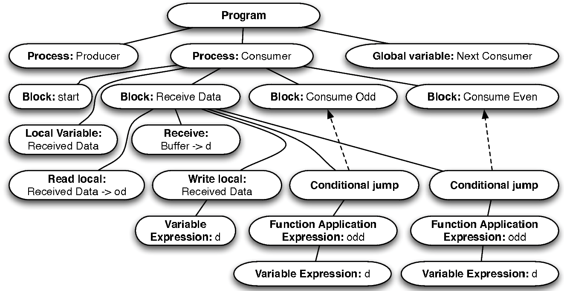
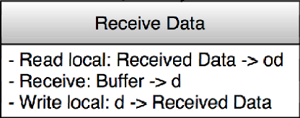
Phase 2: CFG to AST Translation
Translates blocks and statements of the CFG into an abstract syntax tree (AST):
even
Notes:
The arc back to the send data block is represented with a conditional jump.
Den ene “odd” burde vere “even”

Slide 10
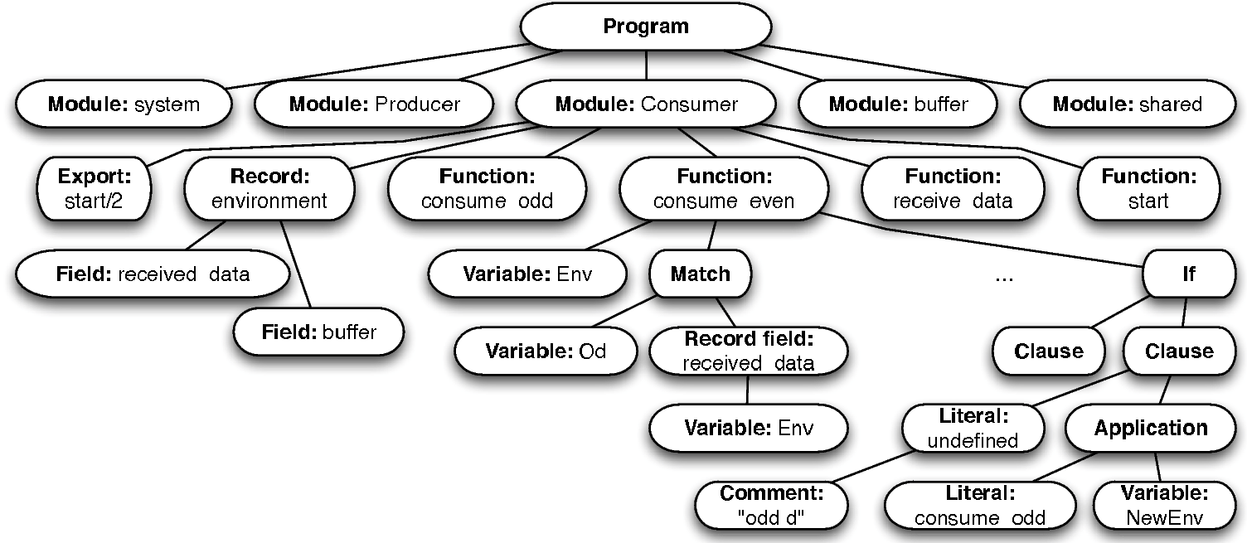
Phase 3: AST to EST Translation
Translates the abstract syntax tree (AST) into an Erlang syntax tree (EST):
even
Notes:
As an example, everything sitting underneath the Consumer is translated into erlang

Slide 11
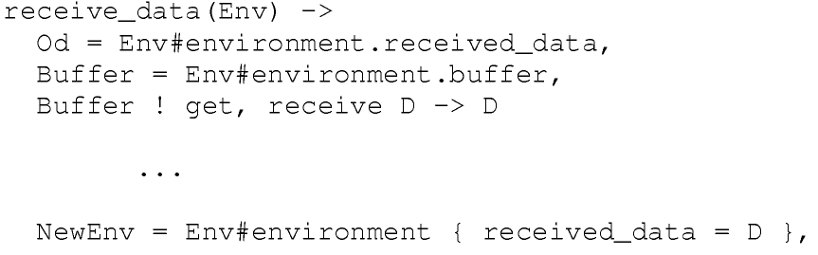

Phase 4: EST to Erlang Code
Traverse the EST and writes out a textual representation of the Erlang program:
Notes:
This part needs to be updated – information is in the submitted version which contained code.
The 2 in export states that the exported function start expects two so-called input variabes.
Note: the earlier produced data is ignored (Od).

Slide 12
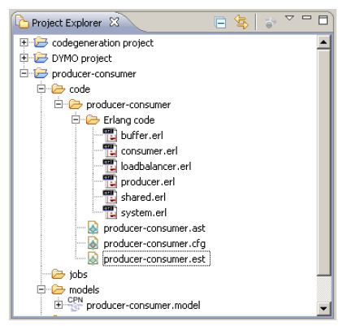
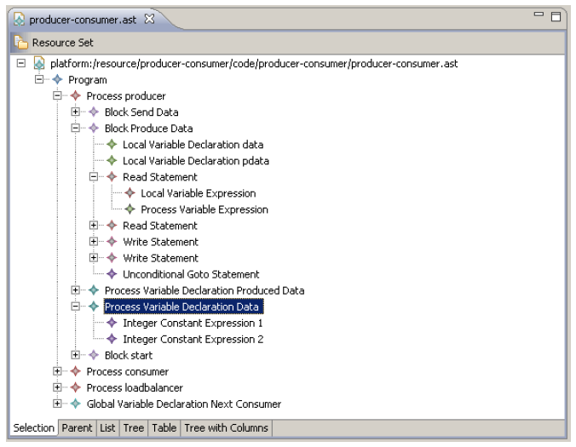
Computer Tool Support
Prototype developed using Access/CPN* and the Eclipse Modelling Framework.
*M. Westergaard and L.M. Kristensen. The Access/CPN Framework: A Tool for Interacting
with the CPN Tools Simulator. In Proc. ICATPN’2009, LNCS Vol 5606, pp. 313-322, 2009.
Notes:
The use of EMF means that editors to inspect the artefacts generated in the various phases of the translation can be obtained fully automatically.
The figure to the left shows the simple editor and browser obtaibed for the control flow graphs.

Slide 13
A Larger Example:
The DYMO Mobile Ad-hoc Network Routing Protocol

Slide 14

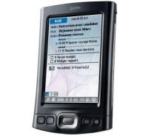

Mobile Ad-hoc Networks
Collection of mobile nodes autonomously forming a communication infrastructure for common use:
C
A
B
The nodes in an ad-hoc network operate in a fully self-configuring and distributed manner.
DYMO* is an on-demand protocol for multi-hop routing in mobile ad-hoc networks.
* http://datatracker.ietf.org/doc/draft-ietf-manet-dymo/
Notes:
such as laptops, personal digital assistants, and mobile phones.
Does not rely on any preexisting infrastructure except 1-hop wireless communication, and each node is able act as a router relaying packet to other nodes in the ad-hoc network.
DYMO is developed by the Internet engineering task force (IETF).

Slide 15
DYMO Protocol
Node 1
Node 2
Node 3
Node 4
Node 5
Node 6
Originator: node 1
Target: node 6
RREQ
RREQ
RREQ
4
RREQ
RREQ
RREQ
2
5
RREQ
RREQ
RREQ
RREQ
1
RREQ
RREQ
RREQ
3
6
RREP
RREQ
RREP
RREQ
RREP
RREP
RREQ = Route request
RREP = Route reply
(1,1)
(1,1)
(1,1)
(1,2)
(1,2)
(1,3)
(1,3)
(6,3)
(6,3)
(6,6)
(6,6)
Notes:
This slide could possibly be skipped. Add a forward step on the previous slide.

Slide 16
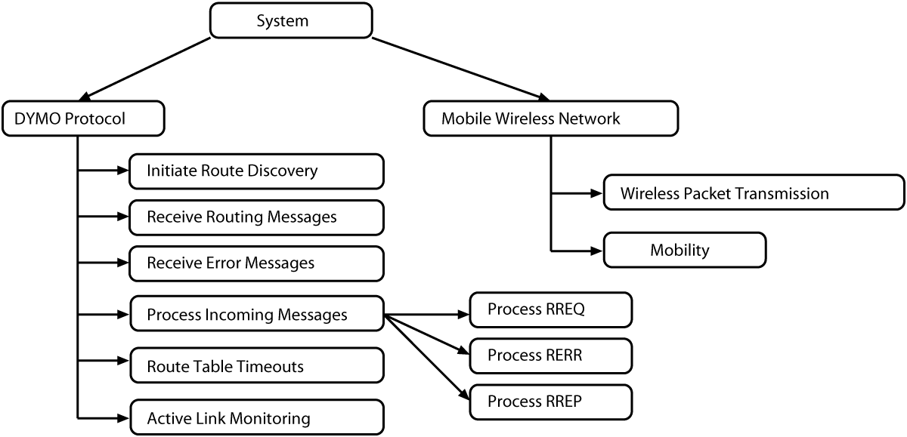
DYMO CPN Model*
Refined to satisfy the syntactical constraints of Process-Partitioned CPNs in approximately 20 person-hours.
*K. L. Espensen, M. K. Kjeldsen, and L.M. Kristensen. Modelling and Initial Validation of the DYMO Routing Protocol for Mobile Ad-Hoc Networks. In Proc. of ICATPN’2008. Vol. 5062 of LNCS, pp. 152-170. Springer, 2008.
Notes:
The adjustment could very much be viewed as refinement steps going from an abstract model to a refined model with detail corresponding to be a process-partitioned CPN.

Slide 17
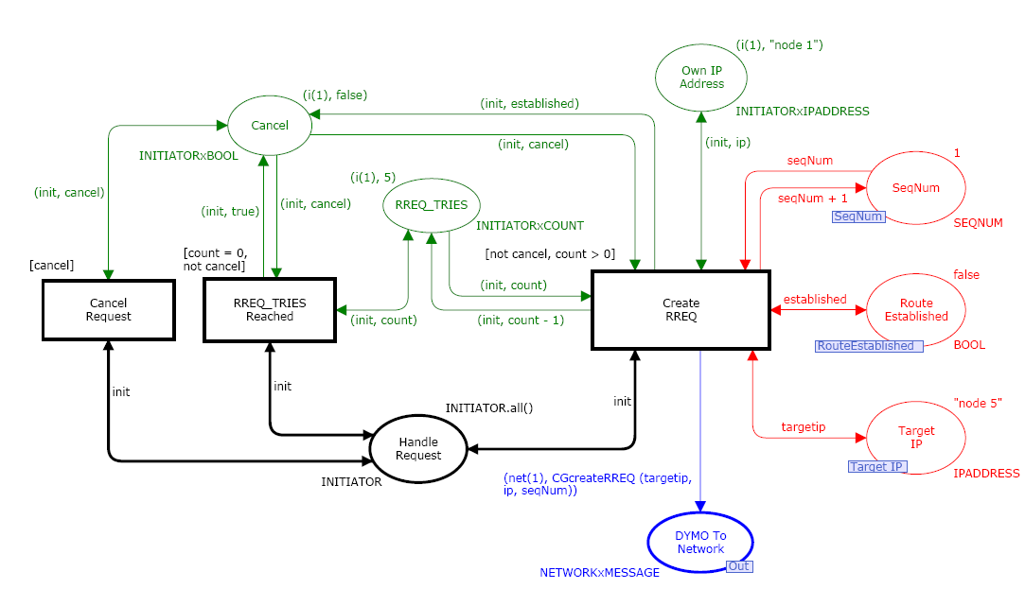
Example: Initiate Module
Notes:
Colour coding is the same as in the earlier slides:
Black – process/places
Red – shared places
Green – local places
Blue – buffer places

Slide 18
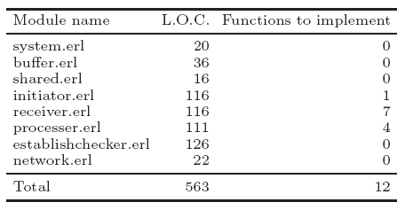
Code Generation and Validation
Statistics from code generation:
Approximately 12 person-hours for implementation of the sequential functions.
The generated code was validated by setting up a distributed Erlang system:
  Executes a set of Erlang nodes (run-time systems) on a single PC.
  Nodes communicate by means of an underlying network simulator.
  The Erlang nodes concurrently executes the generated code for the DYMO protocol entities.
Notes:
The sequence functions are for example functions that manipulate entries in the routing tables – but because Erlang in some sense is close to SML the translation is not that hard.
Different manet configurations were investigated and it was checked that the routing tables were set up properly by the implementation.

Slide 19
Conclusions and Future Work
A proof-of-concept for structure-based code generation has been established:
  Erlang programming language used as target language.
  Applied on an large example: the DYMO Routing Protocol.
Main ideas for automatic code generation:
  Introduce a CPN model class with explicit notions of control flow, messaging passing, and shared and local data.
  Translation divided into four phases deferring the choice of the target programming language.
Some directions for future work:
  Extending the class of Process-Partitioned CPNs and improved CFG control structure recognition.
  A framework supporting stepwise refinement from abstract CPN models to Process-Partitioned CPNs.
Notes:
Kunne diskuteres i sidste punkt:
Gained by CPNs? Have the ability to model at different abstraction levels. Typically first a very abstract model which is gradually refined to a PP-CPN. A lot of research could be done on the refinements steps (which properties preserved) given thar vefification is may typically be done at the abstract models.
Typically more concurrent that required in the abstract models which needs to be elimenated when moving to PP-CPNs.
The refinement issues would be a good topic to work on – together with how CPNs can be made to fit as a component into other software. This is a good argument for being able to map a CPN model to JVM using the simulation-based approach.

Slide 20
Thank you for your attention!

