Slide 1
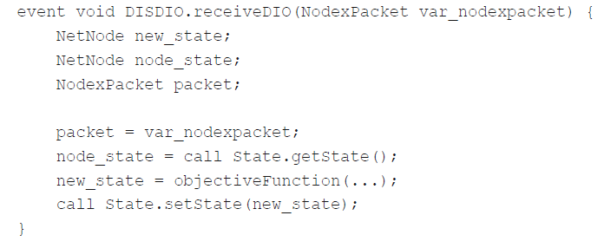
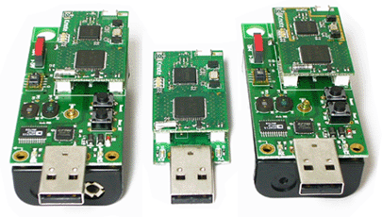
Transforming Platform Independent CPN Models into Code for the TinyOS Platform: A Case Study
Vegard Veiset and Lars M. Kristensen
Department of Computing
Bergen University College of Applied Sciences, NORWAY
Email: vegard.veiset@stud.hib.no / lmkr@hib.no
Notes:
The work presented here is joint work with Sami Evangelista at University of Paris Nord.
This work is linked to the sweep-line method which is one of out a wide collection of techniques available to alleviate the effect of the state explosion problem.

Slide 2
Motivation

Slide 3

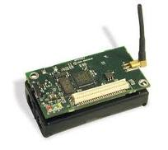
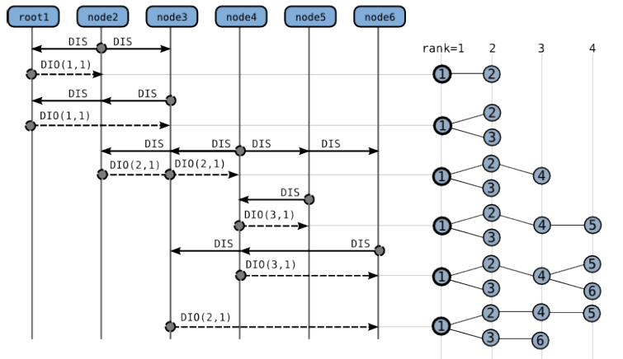
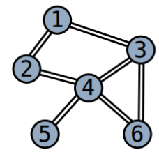
IEFT RPL Protocol
Routing protocol for sensor networks currently developed by the IETF:
Supports a collection of sensor to establish a DODAG for data collection

Slide 4
CPN RPL Model

Slide 5

Platform: TinyOS and nesC

Slide 6
Refinement Methodology

Slide 7
Pragmatics

Slide 8
Step 1:

Slide 9
Step 2:

Slide 10
Step 3:

Slide 11
Step 4:

Slide 12
Step 5:

Slide 13
Code Generation
A template-based code generator has been implemented based on the Access/CPN Framework.
Exploits the pragmatics to determine the templates to be applied during ased approach to code generation

Slide 14
Conclusion and Future Work

