Slide 1
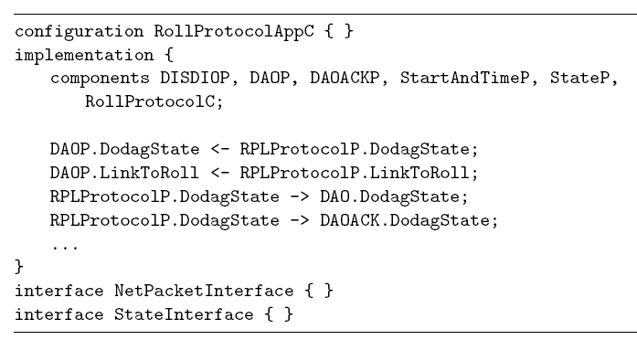
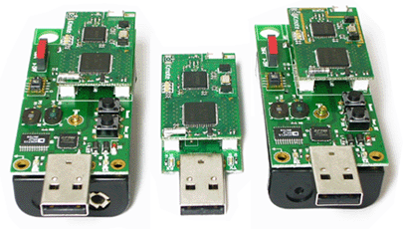
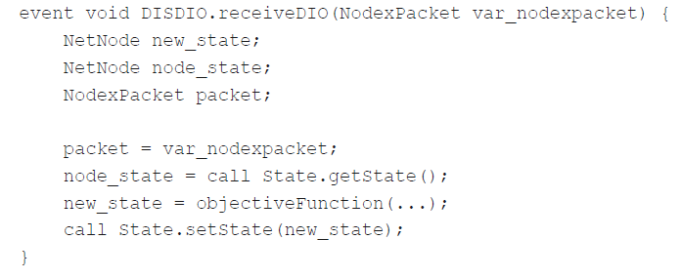
Transforming Platform Independent CPN Models into Code for the TinyOS Platform: A Case Study
?
Vegard Veiset and Lars M. Kristensen
Department of Computing
Bergen University College of Applied Sciences, NORWAY
Email: vegard.veiset@stud.hib.no / lmkr@hib.no
Notes:
The work presented here is joint work with Sami Evangelista at University of Paris Nord.
This work is linked to the sweep-line method which is one of out a wide collection of techniques available to alleviate the effect of the state explosion problem.

Slide 2
Motivation
Coloured Petri Nets (CPNs) widely used for modelling and verification of concurrent systems*.
It is desirable to leverage the modelling and analysis efforts for automated code generation.
Limited work investigating automated code generation from CPN models.
Challenges in using CPN models for code automated code generation purposes:
CPN models constructed for specification and verification are often at a too high-level of abstraction.
CPN models are target platform-independent and without any obvious mapping from model element to target code
*for a comprehensive list, see http://www.cs.au.dk/CPnets/intro/industrial.shtml
Notes:
And the modelling, simulation, verification have yielded useful insight into the design and behaviour of a system.
The construction of the model has hopefully indirectly contributed to make, e.g., a manual implementation easier but it would be nice to have some automatic support for code generation.
But there exists only limited work on automatic code-generation from CPNs:
A couple of example of simulation-based code generation where the idea is…
Limited examples of state-space-based due to inhereint problem with state space size and limitation to finite state systems.
Hardly any work on structure-based code generation despite it obvios advantages compared to simulation and state-space based approaches.

Slide 3

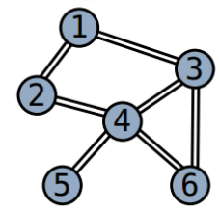
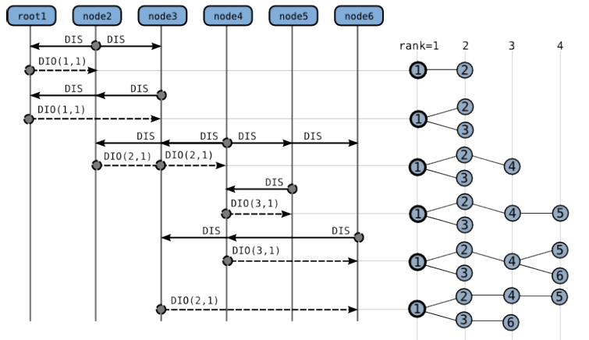
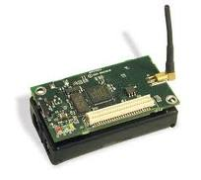
IEFT RPL Protocol
Routing protocol for distributed sensor networks currently being developed by the IETF:
Supports a collection of sensor to establish a DODAG for data collection purposes.

Slide 4
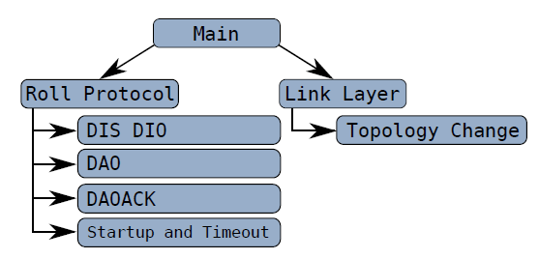
RPL CPN Model
A platform independent model specifying the operation of the RPL Protocol:

Slide 5
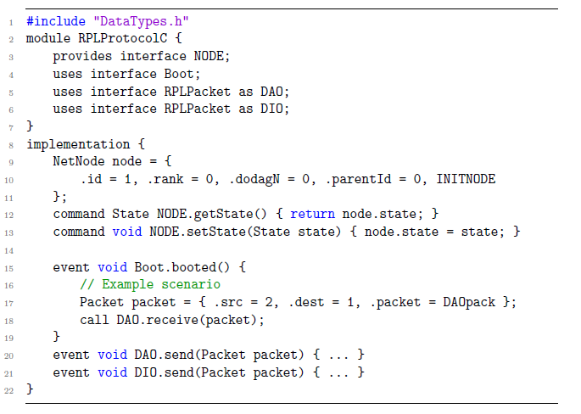

Platform: TinyOS and nesC
Operating system and programming language targeting resource constrained devices.
Applications are structured into components providing and using interfaces.
Component are wired into a configuration constituting an application.
Split-phase programming model based on commands, events, calls, and signals.

Slide 6
Refinement Methodology
A five step methodology for refining the model to an abstraction level suited for code generation:
Component architecture identifying components and interfaces, and determining an application configuration.
Resolving interface conflicts allowing use of the same interface in multiple components of the application.
Component and interface signatures identifying commands and events and associated types.
Component classification specifying components as boot-, dispatch-, external-, timed-, and regular components.
Internal component behaviour providing control flow oriented modelling of command and event implementation.
Each step adds model details and pragmatic annotations to the CPN model elements.

Slide 7
Pragmatic <<annotations>>
Syntactical annotations added to CPN model elements.
Adds platform dependent elements to the CPN model.
Used to direct the code generation via binding to code generation templates.
Bridges the gap between a platform independent model and the target platform.

Slide 8
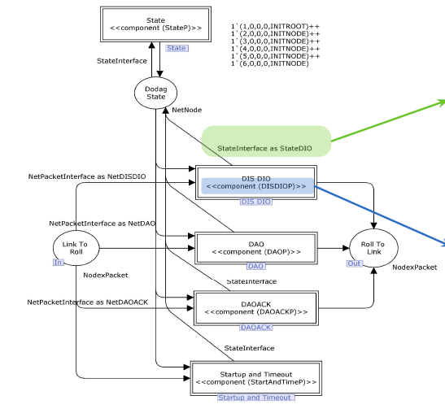
Step 1: Component Architecture
Identifies components and interfaces used and provided at the top-level of the CPN model:

Slide 9
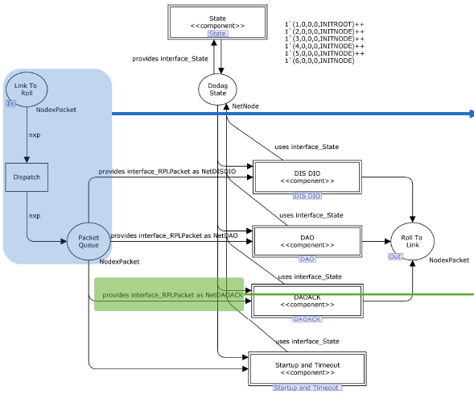
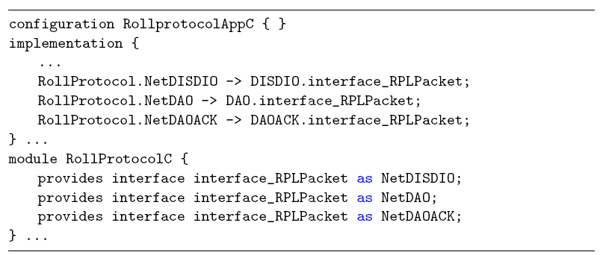
Step 2: Interface Conflicts
Introduces local name space for components providing the same interface:

Slide 10
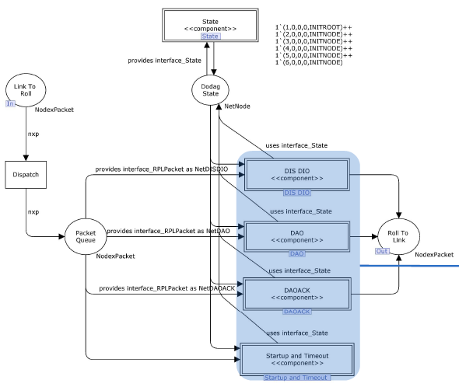
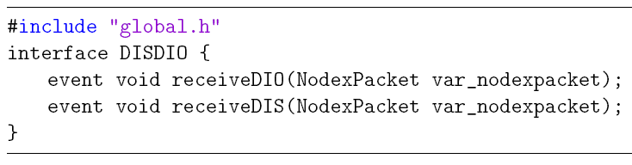
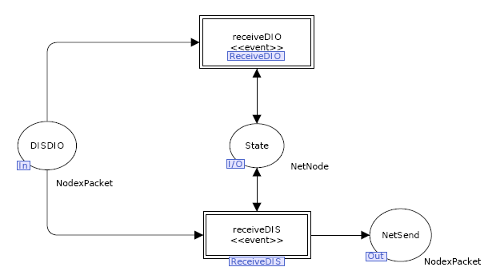
Step 3: Interface Signatures
Refines component level modules to explicitly specify commands and events:

Slide 11
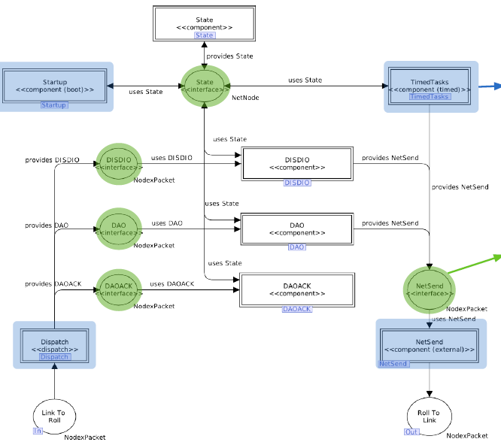
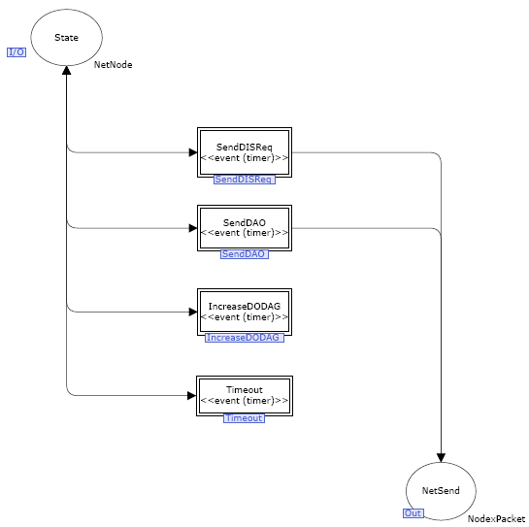
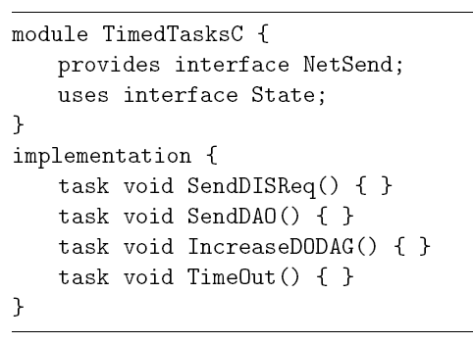
Step 4: Component Classification
Classifies components as boot-, timed-, dispatch-, external- and- regular components:

Slide 12
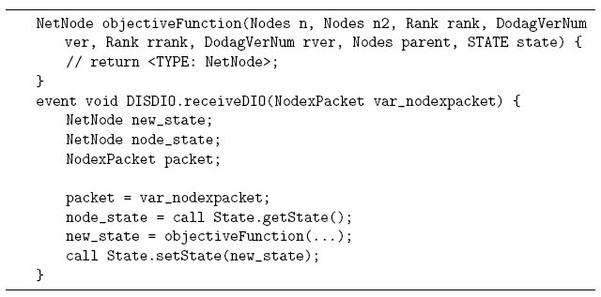
Step 5: Internal Behaviour
Makes explicit control flow and data access in command and event implementation:
Code generation at event and command level performed based on mathing of structural patterns.

Slide 13
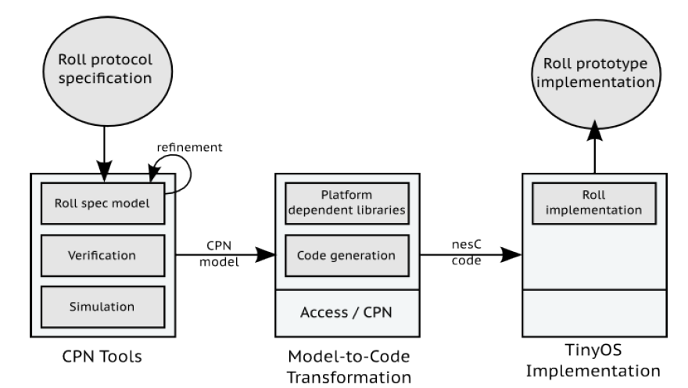
Code Generation
A template-based code generator implemented based on the Access/CPN Framework:
Template-based code generation.
Top-down traversal of the CPN model.
Templates determined from encountered pragmatics.
Top-down traversal of the CPN model invoking templates according to encountered pragmatics.

Slide 14
Conclusion and Future Work
A semi-automatic approach to code generation for the TinyOS Platform:
A five step methodology refining the model to a level of detail matching the target platform.
Pragmatics used to relate CPN model construct and elements to target platform via code generation templates.
The approach has been validated on the IETF RPL routing protocol for sensor networks.
Future work - formalisation and verification:
Formalisation of meta-models and transformation steps for the suggested refinement methodology.
Explore the application of model checking techniques for verification of refined models and generated code.

Slide 15
References
T. Winter et. al. RPL: IPv6 Routing Protocol for Low-Power and Lossy Networks. RFC 6550, 2012. Internet Engineering Task Force. http://tools.ietf.org/html/rfc6553
K. Jensen, L.M. Kristensen, and L. Wells. Coloured Petri Nets and CPN Tools for Modelling and Validation of Concurrent Systems. International Journal on Software Tools for Technology Transfer, 9(3-4):213–254, 2007.
P. Levis. TinyOS Programming. Cambridge University Press, 2009. www.tinyos.net
K.I.F. Simonsen, L.M. Kristensen, and E. Kindler. Code Generation for Protocol Software from CPN models Annotated with Pragmatics. Technical Report IMM-Technical Reports-2013-01, Technical University of Denmark, DTU Informatics, January 2013.
V. Veiset. An Approach to Semi-Automatic Code Generation for the TinyOS Platform using Coloured Petri Nets. Master’s thesis in software engineering, Bergen University College of Applied Sciences, 2013.
M. Westergaard. Access/CPN 2.0: A High-Level Interface to CPN Models. In Proc. of ICATPN’11, volume 6709 of LNCS, pages 328–337. Springer, 2011.

Slide 16

Poster Link

