Slide 1
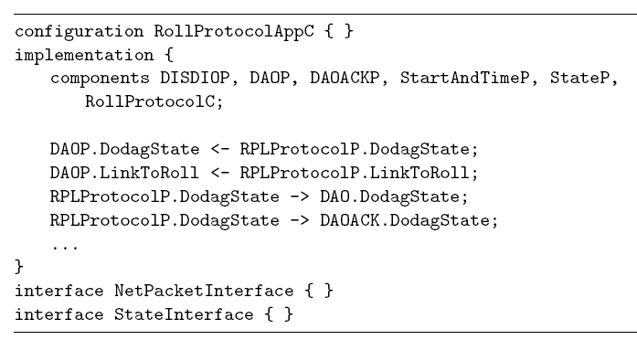
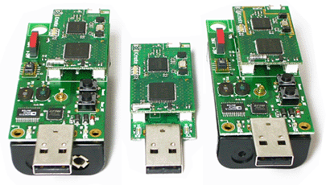
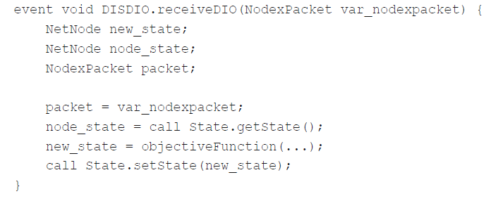

Transforming Platform Independent CPN Models into Code for the TinyOS Platform: A Case Study
?
Vegard Veiset and Lars M. Kristensen
Department of Computing
Bergen University College of Applied Sciences, NORWAY
Email: vegard.veiset@stud.hib.no / lmkr@hib.no
Notes:
This is some work done mostly by one of my master’s thesis students – Vegard Veiset.
It is about how to transform CPN models of communication protocols into code that can be deployed and executed on real platforms.
The motivation behind this work is that there are many examples where Coloured Petri nets have been successfully applied for modelling, specification, and verification of systems – but it is obvioulsy desireabe to be able to use also the models for automated code generation.

Slide 2
Motivation
Coloured Petri Nets (CPNs) widely used for modelling and verification of concurrent systems.
It is desirable to leverage the modelling and analysis efforts for automated code generation.
Limited work investigating automated code generation from CPN models.
Challenges in using CPN models for automated code generation purposes:
CPN models constructed for specification and verification are often at a high level of abstraction.
CPN models are target platform independent and without any obvious mapping from model element to target code.

Slide 3

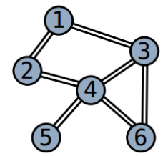
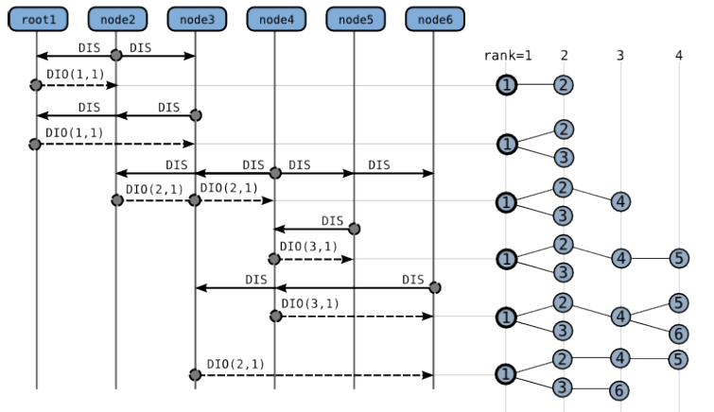
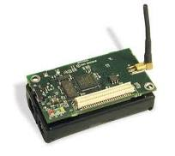
IEFT RPL Protocol
Routing protocol for distributed sensor networks currently being developed by the IETF:
Supports a sensor nodes in establishing a DODAG for data collection purposes.
Notes:
In this work we investigate how this can be done in the context of an industrial example of a communication protocols – namely the RPL protocol currently being developed by the IETF.
RPL is a routing protocol for sensor networks which by means of exchange of message allows sensor nodes to estabslish a destination-oriented directed acyclic graph that can be used for transmitting data from a sensor the sink of sine of the network.

Slide 4
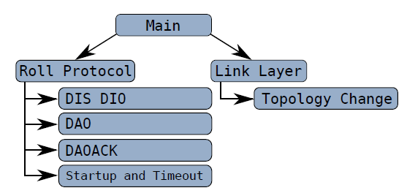
RPL CPN Model
A platform independent model specifying the operation of the RPL Protocol:
Notes:
So we have created a CPN model of the RPL protocol that specifies the operation of the protocol in a platform independent manner and we then investigate ..

Slide 5
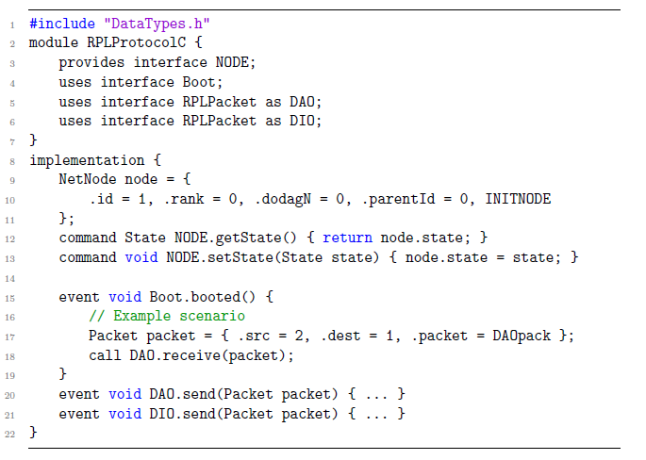

Platform: TinyOS and nesC
Operating system and programming language targeting resource constrained devices.
Applications are structured into components providing and using interfaces.
Component are wired into a configuration constituting an application.
Split-phase programming model based on commands, events, calls, and signals.
Notes:
How this model can be used to generate an implementation of the protocol for the TinyOS platform which is a operating system that runs on such small devices.

Slide 6
Refinement Methodology
A five step methodology for refining models to an abstraction level suited for code generation:
Component architecture identifying components and interfaces, and determining an application configuration.
Resolving interface conflicts allowing use of the same interface in multiple components of the application.
Component and interface signatures identifying commands and events and associated types.
Component classification into boot-, dispatch-, external-, timed-, and regular components.
Internal component behaviour providing control-flow oriented modelling of command and event implementation.
Each step adds model details and pragmatic annotations to the CPN model elements.
Notes:
The main result of the work is a refinment methodology consisting of give steps that eventually leads to a CPN model which contains sufficient details to allow for the generation of code.
More details on the methodology and the tool support that we have developed is provided as part of the poster session

Slide 7
Pragmatic <<annotations>>
Syntactical annotations added to CPN model elements.
Adds platform dependent elements to the CPN model.
Used to direct the code generation via binding to code generation templates.
Bridges the gap between a platform independent model and the target platform.

Slide 8
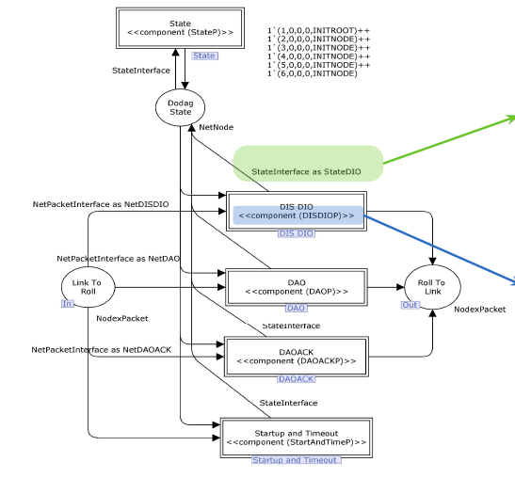
Step 1: Component Architecture
Identifies components and interfaces used and provided at the top-level of the CPN model:

Slide 9
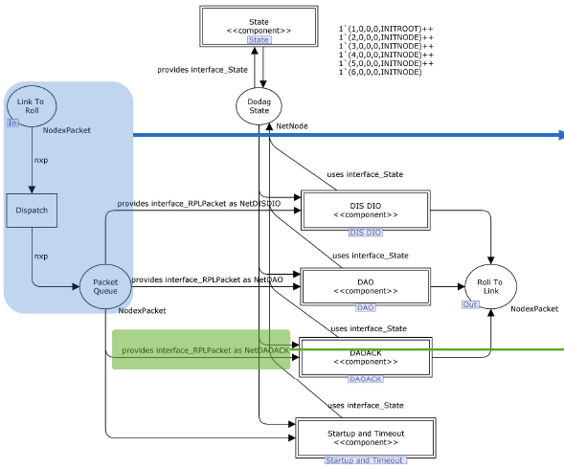
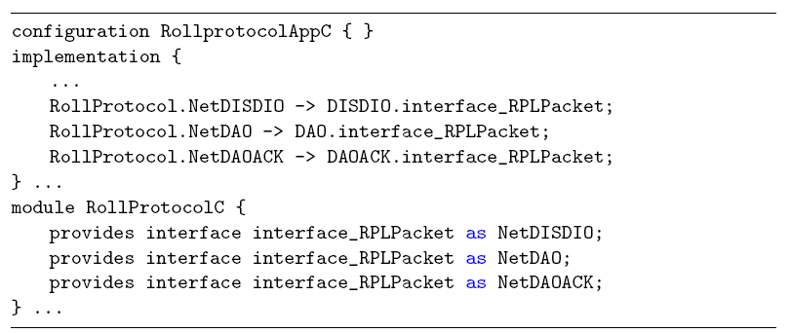
Step 2: Interface Conflicts
Introduces local name space for components providing the same interface:

Slide 10
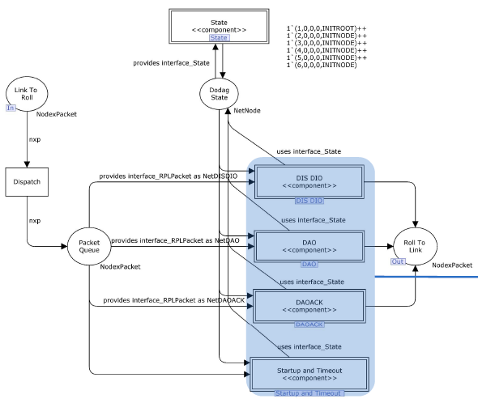
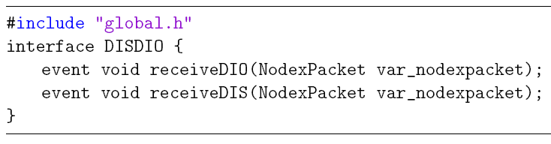
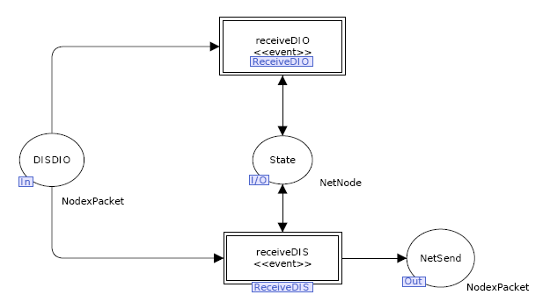
Step 3: Interface Signatures
Refines component level modules to explicitly specify commands and events:

Slide 11
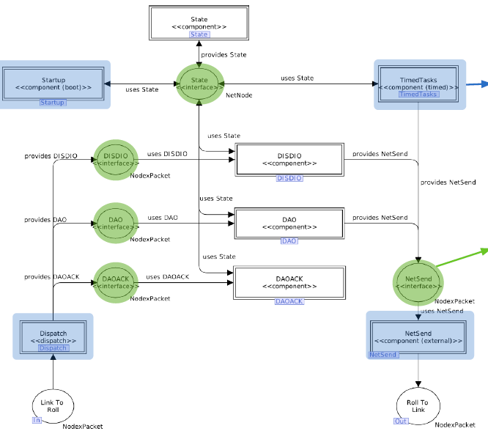
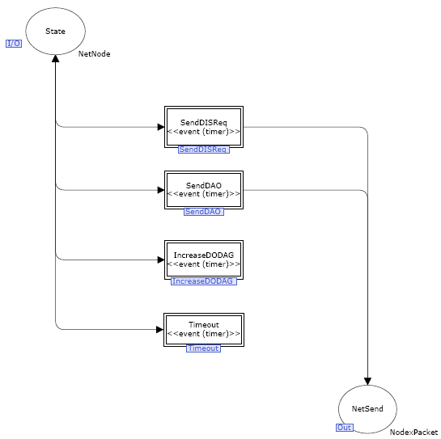
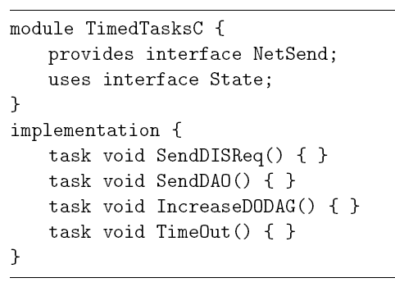
Step 4: Component Classification
Classifies components as boot-, timed-, dispatch-, external-, and regular components:

Slide 12
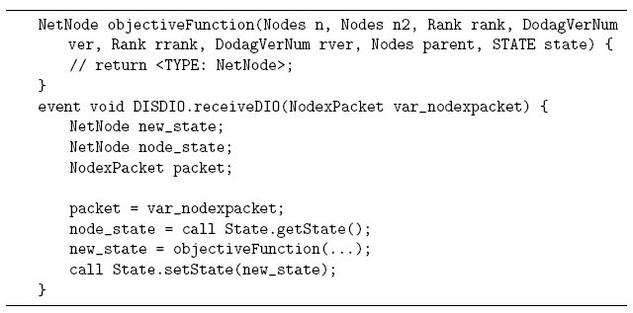
Step 5: Internal Behaviour
Makes explicit control flow and data access in command and event implementation:
Code generation at event and command level performed based on mathing of structural patterns.

Slide 13
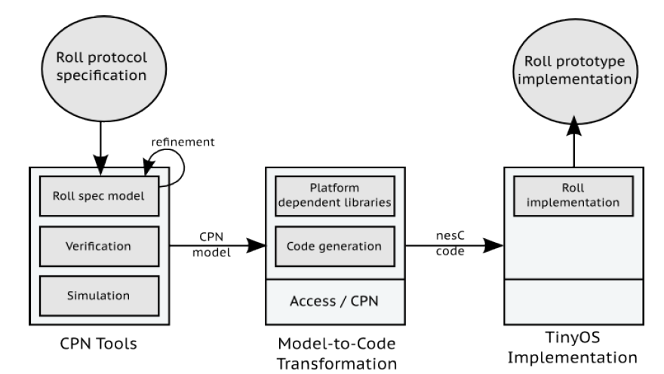
Code Generation
A template-based code generator implemented based on the Access/CPN Framework:
Template-based code generation.
Top-down traversal of the CPN model.
Templates determined from encountered pragmatics.
Top-down traversal of the CPN model invoking templates according to encountered pragmatics.

Slide 14
Conclusion and Future Work
A semi-automatic approach to code generation for the TinyOS Platform:
A five step methodology refining the model to a level of detail suitable for generating code for the target platform.
Pragmatics used to relate CPN model construct and elements to the target platform via code generation templates.
The approach has been validated on the IETF RPL routing protocol for sensor networks.
Future work - formalisation and verification:
Formalisation of meta-models and transformation steps for the suggested refinement methodology.
Explore the application of model checking techniques for verification of refined models and generated code.

Slide 15
References
T. Winter et. al. RPL: IPv6 Routing Protocol for Low-Power and Lossy Networks. RFC 6550, 2012. Internet Engineering Task Force. http://tools.ietf.org/html/rfc6553
K. Jensen, L.M. Kristensen, and L. Wells. Coloured Petri Nets and CPN Tools for Modelling and Validation of Concurrent Systems. In Springer STTT Journal, 9(3-4):213–254, 2007. www.cs.au.dk/CPnets/cpnbook
P. Levis. TinyOS Programming. Cambridge University Press, 2009. www.tinyos.net
K.I.F. Simonsen, L.M. Kristensen, and E. Kindler. Code Generation for Protocol Software from CPN models Annotated with Pragmatics. Technical Report IMM-Technical Reports-2013-01, Technical University of Denmark, DTU Informatics, January 2013.
V. Veiset. An Approach to Semi-Automatic Code Generation for the TinyOS Platform using Coloured Petri Nets. Master’s thesis in software engineering, Bergen University College of Applied Sciences, 2013.
M. Westergaard. Access/CPN 2.0: A High-Level Interface to CPN Models. In Proc. of ICATPN’11, vol. 6709 of Springer LNCS, pages 328–337, 2011.

Slide 16
Poster Link

