Slide 1
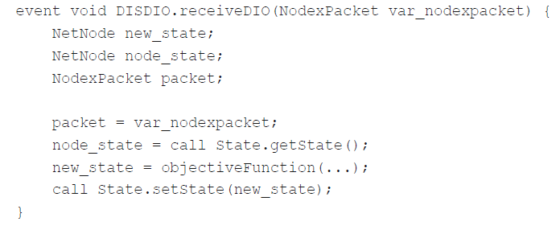
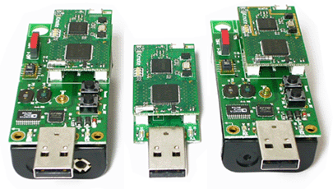
Transforming Platform Independent CPN Models into Code for the TinyOS Platform: A Case Study
Vegard Veiset and Lars M. Kristensen
Department of Computing
Bergen University College of Applied Sciences, NORWAY
Email: vegard.veiset@stud.hib.no / lmkr@hib.no
Notes:
The work presented here is joint work with Sami Evangelista at University of Paris Nord.
This work is linked to the sweep-line method which is one of out a wide collection of techniques available to alleviate the effect of the state explosion problem.

Slide 2
Motivation
CPNs have been widely used for modelling and validation of concurrent software systems*.
Desirable to leverage modelling and analysis effort by means of automatic code generation:
Simulation-based: the model simulator is embedded directly in the implementation.
State space-based: the state space of the model is computed and used as a basis for implementation.
Structure-based: structural analysis of the model for translation into programming language constructs.
CPN models are platform-independent and too abstract to be used directly for code generation.
*for a comprehensive list, see http://www.cs.au.dk/CPnets/intro/industrial.shtml
Notes:
And the modelling, simulation, verification have yielded useful insight into the design and behaviour of a system.
The construction of the model has hopefully indirectly contributed to make, e.g., a manual implementation easier but it would be nice to have some automatic support for code generation.
But there exists only limited work on automatic code-generation from CPNs:
A couple of example of simulation-based code generation where the idea is…
Limited examples of state-space-based due to inhereint problem with state space size and limitation to finite state systems.
Hardly any work on structure-based code generation despite it obvios advantages compared to simulation and state-space based approaches.

Slide 3

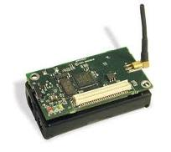
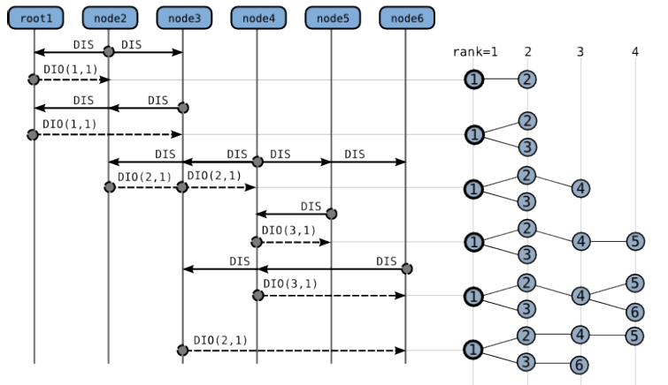
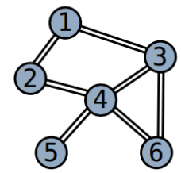
IEFT RPL Protocol
Routing protocol for sensor networks currently developed by the IETF:
Supports a collection of sensor to establish a DODAG for data collection.

Slide 4
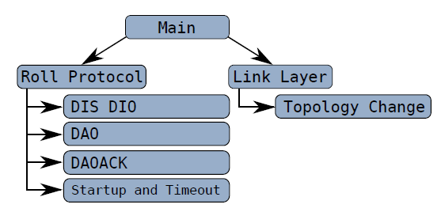
RPL CPN Model
A platform independent model specifying the operation of the RPL Protocol:

Slide 5

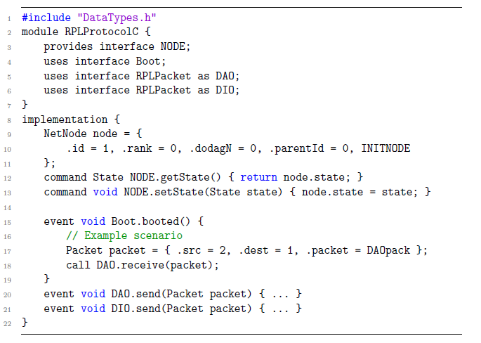
Platform: TinyOS and nesC
Operating system and programming language targeting constrained devices.
Application structured into component providing and using interfaces.
Split-phase programming model based on command and events.

Slide 6
Refinement Methodology
A five step methodology for refining the model to be suited for code generation:
Component architecture identifying components and interfaces.
Resolving interface conflicts allowing multiple uses of interfaces.
Component and interface signatures identifying commands and events and associated types.
Component classification identifying components as timed, external, boot, and generic.
Internal component behaviour providing control flow oriented modelling of commands and events.
Each step add model details and pragmatic annotations to the CPN model elements.

Slide 7
Pragmatics
Syntactical annotation added to the model in order to later direct the code generation.
Allows for bridging the gap between platform independent models and target platform.

Slide 8
Step 1: Component Architecture

Slide 9
Step 2:

Slide 10
Step 3:

Slide 11
Step 4:

Slide 12
Step 5:

Slide 13
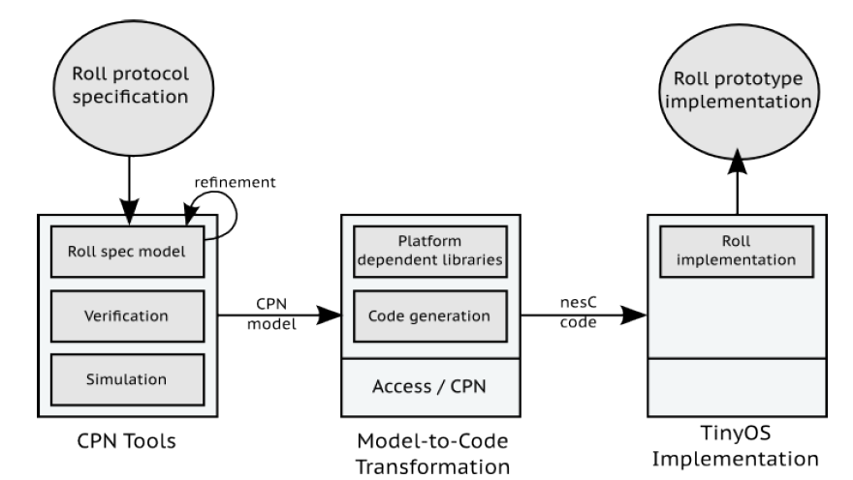
Code Generation
A template-based code generator implemented based on the Access/CPN Framework:
Template-based code generation.
Top-down traversal of the CPN model.
Templates determined from encountered pragmatics.
Top-down traversal of the CPN model invoking templates according to encountered pragmatics.

Slide 14
Conclusion and Future Work

