Slide 2
UPLB Network Queue Simulator (UNQS): Analyzing Network Performance for Internet Bandwidth Management
Leensey M. Lawas
BS Computer Science
June 1, 2018

Slide 3
Introduction

Slide 4
Flow of traffic data
A
Internet
B

Slide 5
Flow of traffic data (zoomed in to Internet)
Signal -> Frame -> Packet

Slide 6
Flow of traffic data (Network layer: packet)
Signal -> Frame -> Packet

Slide 7
Packet switching

Slide 8
Flow
The network link between a source IP address and a destination IP address where packet data is transfered.

Slide 9
Traffic engineering
Evaluating network performance and optimizing it.
D. Awduche, A. Chiu, A. Elwalid, and X. Xiao, “Overview and principles of internet traffic engineering,” The Internet Society, 2002.

Slide 10
Traffic engineering
Route
Selection
Algorithms
Bandwidth
Management

Slide 11
Traffic engineering
Route
Selection
Algorithms
Bandwidth
Management

Slide 12
Bandwidth Management
Allocation of available bandwidth depending on network traffic and client/service priority.
R. Kanu, S. Kuyoro, S. Ogunlere, and A. Adegbenjo, “Management and control of bandwidth in computer networks,” International Journal of Computer Networks and Wireless Communications, vol. 2, no. 3, pp. 342–348, 2012.

Slide 13
Main Objective
Simulate UPLB network traffic by identifying the most optimal bandwidth setting using the resulting network performance parameters, namely, duration, throughput, and flow loss.

Slide 14
Methodology

Slide 15
Methodology
Collect traffic data using ntopng.
Simulate the data using different bandwidth rates.
Compute the network performance metrics.
Observe the trend across varying bandwidth settings, compare them, and identify the optimal bandwidth rate.

Slide 16
Collect traffic data

Slide 17
Collect traffic data: ntopng configuration file
--pid-path=/var/tmp/ntopng.pid
--daemon
--interface=eth1
--http-port=3000
--local-networks="10.0.0.0/8, 172.16.0.0/16, 202.92.144.0/22"
--dns-mode=1
--data-dir=/var/tmp/ntopng
--community
--hw-timestamp-mode=ixia
--user="lmlawas"
--dump-flows="mysql;localhost;ntopng;flowsv4;root;<password>"
--dump-hosts=remote

Slide 18
Collect traffic data: running ntopng
sudo service ntopng start
or
ntopng /etc/ntopng/ntopng.conf

Slide 19
Simulate traffic data

Slide 20
First-In First-Out (FIFO)
Simplest queueing technique

Slide 21
First In-First Out (FIFO)
t=4
t=3
t=2
t=1
t=0
The buffer accepts flows by arrival time t and services them in chronological fashion.

Slide 22
UNQS Main Program Logic
Flow chart

Slide 23
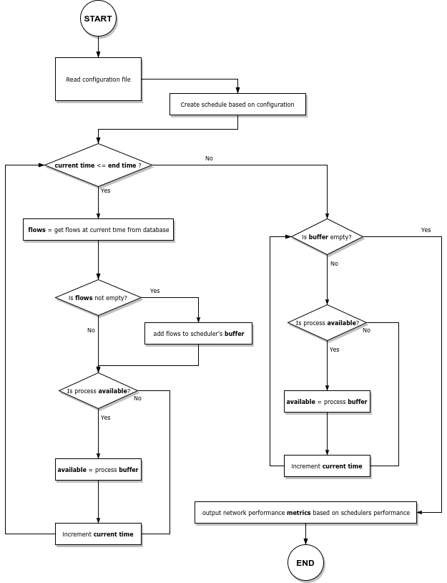
UNQS Main Program Logic

Slide 24
UNQS Main Program Logic

Slide 29
Compute network performance metrics

Slide 30
Compute network performance metric:
Duration (s)
Duration = finish time - start time

Slide 31
Compute network performance metric: Throughput (bps)
Throughput = total switched flows / duration

Slide 32
Compute network performance metric:
Flow loss (%)
Flow loss = [total dropped flows / (dropped flows + switched flows)] x 100

Slide 33
Determine most optimal bandwidth

Slide 34
Results and Discussion

Slide 35
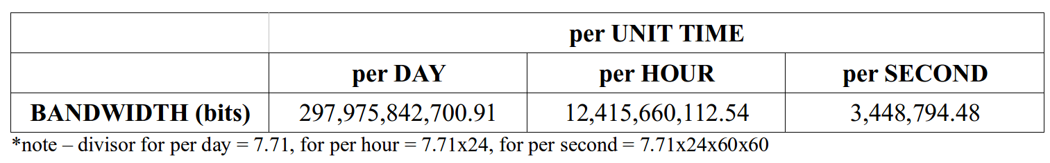
Results and Discussion: Bandwidth per unit time

Slide 36
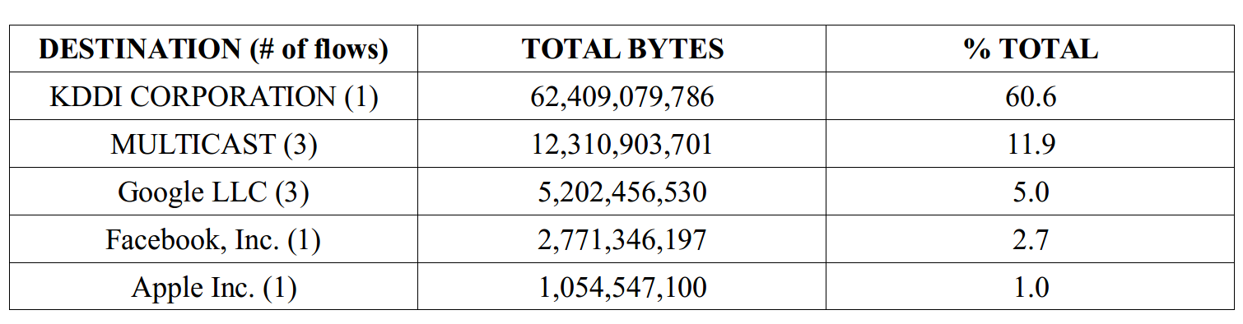
Results and Discussion: Top Out-Flows

Slide 37
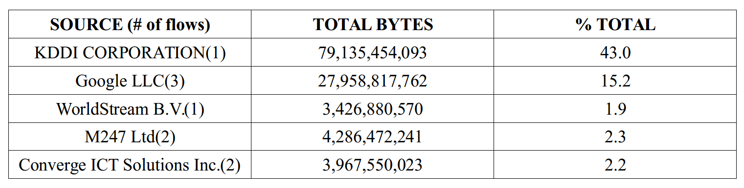
Results and Discussion: Top In-Flows

Slide 38
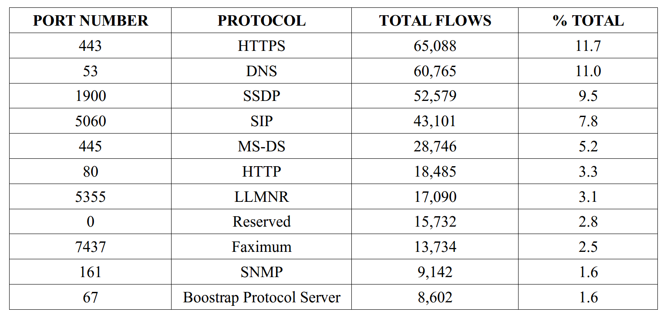
Results and Discussion: Top Applications

Slide 39
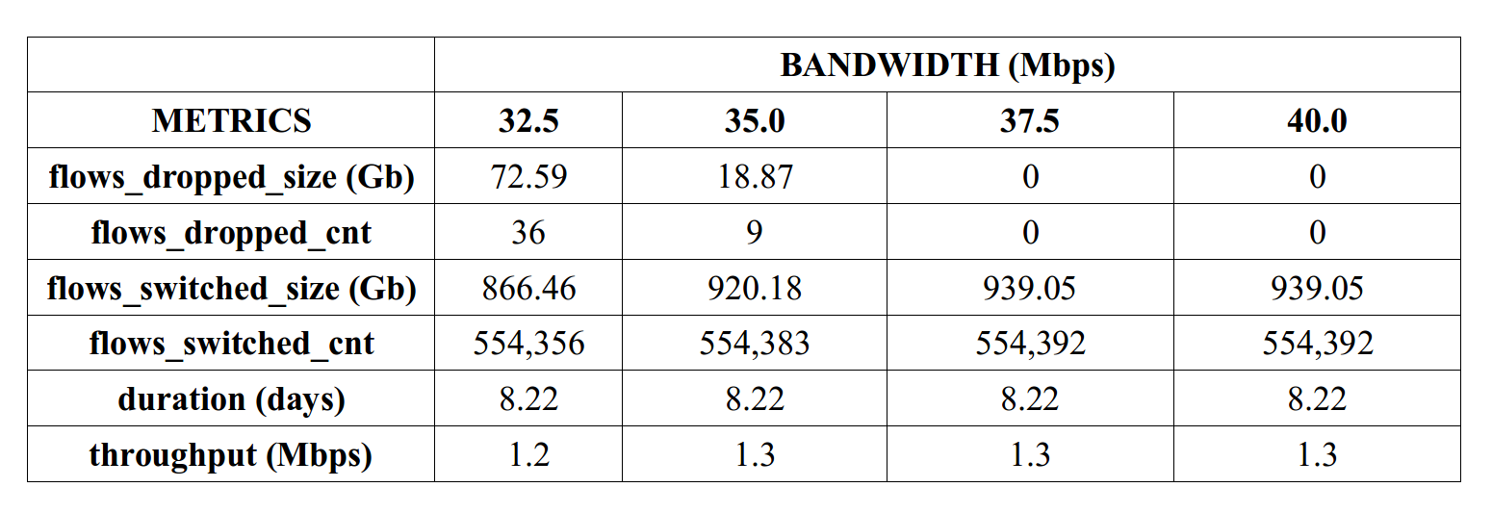
Results and Discussion: Simulation results per bandwidth

Slide 40
DEMO
UNQS program

Slide 41
Conclusion

Slide 42
37.5Mbps
Optimal bandwidth constraint with 0 flow loss

Slide 43
Recommendation/s
Based on collected data

Slide 44
Block
Untagged Ports
...by the firewall, like ports 0 and 7437, which have potential to receive harmful traffic data.

Slide 45
Maintain and use
Internal DNS Server
...to further reduce external DNS traffic.

Slide 46
Turn off
MS-DS traffic
...that consumes a large amount of the out-bound bandwidth.
Mirror Linux, Microsoft, and Apple traffic to monitor possible intrusions and unnecessary traffic within the network in order formulate and enforce policies to block and limit such traffic.

Slide 47
Mirror Linux, Microsoft and Apple traffic
...to monitor possible intrusions and unnecessary traffic within the network in order to formulate and enforce policies to block and limit such traffic.

Slide 48
Future Works

Slide 49
Implement other Queueing Techniques
...like PQ and WFQ which could further improve the network performance.
Mirror Linux, Microsoft, and Apple traffic to monitor possible intrusions and unnecessary traffic within the network in order formulate and enforce policies to block and limit such traffic.

Slide 50
Collect more data
...over a longer time period to discover a pattern in network traffic behavior depending on certain periods of time, such as peak season during enrollment period, etc.
Mirror Linux, Microsoft, and Apple traffic to monitor possible intrusions and unnecessary traffic within the network in order formulate and enforce policies to block and limit such traffic.

Slide 52
Thank you.

