Slide 1
Laravel 6.17.0
主題：基礎CRUD (建立、讀取、更新、刪除)
範圍：Route、Controller、Model、View
日期：2020-05-07

Slide 2
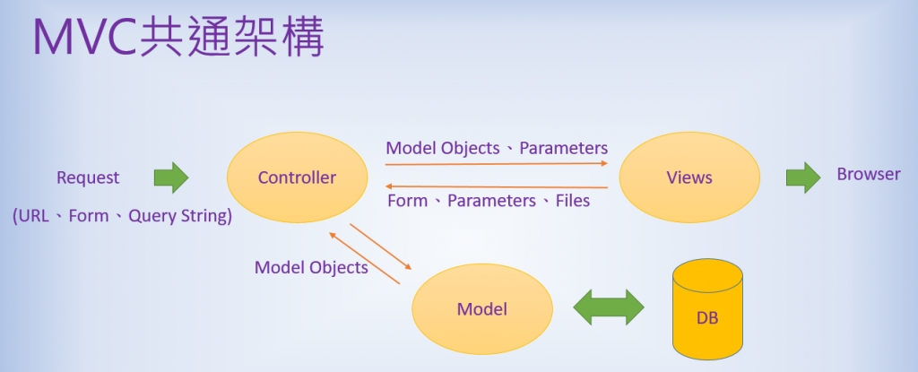

Slide 3
Just use Route-View
Return wellcome
Route::get('/', function () {
return view('welcome');
});
View
welcome.blade.php
Route
Controller
什麼也沒幹
web.php
Model
Database

Slide 4
Add Controller
MemberController
View
public function index()
{
return view("member");
}
member.blade.php
Route
Controller
web.php
MemberController.php
Index()
Route::get('/member/login', 'MemberController@index');
什麼也沒幹
Model
Database

Slide 5
Database、Model
php artisan make:model Post -m
php artisan make:model Post –migration
建立
App/Post.php
database/migrations/*_create_posts_table.php
-migration 可以順便建立資料庫遷移檔案
-m 縮寫，功能同上。
php artisan migrate
執行資料庫遷移
php artisan make:controller PostController --resource
建立app\Http\Controllers\PostController.php
--resource 可以幫助快速建立CRUD指令
# 可用參數請查 migrations
$table->bigIncrements('id');
$table->string('title');
$table->string('content');
$table->timestamps();

Slide 6
View
Read
Route
Controller
post/index.blade.php
web.php
PostController.php
Index()
public function index()
{
$posts = Post::all();
return View('post/index',[
'title'=> 'My Blog',
'posts'=> $posts
]);
}
Route::get('/posts', 'PostController@index')
Model
Database
Post.php
posts

Slide 7
View
Return View
單純控制畫面呈現，狀況同第四章PPT
Route
Controller
post/create.blade.php
web.php
PostController.php
create()
public function create()
{
return View('post/create',[
'title'=> '新增文章'
]);
}
Route::get('/post/create', 'PostController@create');
Model
Database
Post.php
posts

Slide 8
View
Create
redirect
Route
Controller
post/index.blade.php
web.php
PostController.php
public function store(Request $request)
{
$request->validate([
'title' => ['required', 'unique:posts', 'max:255'],
'content' => ['required'],
]);
$input = $request->all();
$post = new Post;
$post->title = $input['title'];
$post->content = $input['content'];
$post->save();
return redirect('/posts');
}
store()
Route::post('/post', 'PostController@store')
Model
Database
Post.php
posts

Slide 9
View
Read
Route
Controller
post/show.blade.php
web.php
PostController.php
show()
public function show($id)
{
$post = Post::findOrFail($id);
return View('post/show', [
'title' => 'My Blog - ' . $post->title,
'post' => $post
]);
}
Route::get(
'/post/{id}',
'PostController@show‘
)->name('show-post')
Model
Database
Post.php
posts

Slide 10
View
Update
redirect
Route
Controller
post/index.blade.php
web.php
PostController.php
update()
public function update(Request $request, $id)
{ $input = $request->all();
$post = Post::findOrFail($id);
$post->title = $input['title'];
$post->content = $input['content'];
$post->save();
return redirect('/posts');
}
Route::put(
'/post/{id}',
'PostController@update
)->name(‘update-post');
Model
Database
Post.php
posts

Slide 11
View
Delete
redirect
Route
Controller
post/index.blade.php
web.php
PostController.php
destroy()
public function destroy($id)
{
$post = Post::findOrFail($id);
$post->delete();
return redirect('/posts');
}
Route::delete(
'/post/{id}',
'PostController@destroy‘
)->name('delete-post');
Model
Database
Post.php
posts

Slide 12
View
Route
Controller
模組:
專門與資料庫溝通並提供調用方法
路由:
分發路徑該使用哪個控制器
控制器:
調配使用哪些模組及視圖模板
Model
Database

