Slide 1

COVID-19 Analysis
Olayemi Obayanju
Laura Michael

Slide 2
Motivation
The world is facing challenges of an increasing COVID-19 pandemic
Using our studies of Pandas, MatPlotLib and API, we wanted to analyze the U.S. COVID-19 case data
From this data analysis and visualization techniques, we hope to realize a better understanding of the pandemic

Slide 3

Questions & Data
To better understand the pandemic we came up with some Questions
Is there a difference in the number of cases in men and women?
Is there is a relationship between COVID-19 cases and “race/ethnicity”?
What are the trends in U.S. COVID-19 cases across age groups?
Answers to these questions will lead us to the patterns by analysing the data.
Lead Towards Pattern
Notes:
Describe whether you were able to answer these questions to your satisfaction, and briefly summarize your findings
If we go manually and try to analyze the data we didn’t find the satisfactory answer because looking at the data of 2609582 rows and getting the information is really a tough job. We can’t answer the questions easily by looking the CSV file we get from the internet.

Slide 4
Data Exploration
We used API to download the data set from the CDC website https://data.cdc.gov/Case-Surveillance/COVID-19-Case-Surveillance-Public-Use-Data/vbim-akqf
We found several data sets on the internet but felt this was the most complete and official.
The data ranges from 01-01-2020 through 8-16-2020 with over 3.6 million cases
We could only download 50,000 cases at a time and had to create a for loop to increment our request to get all of the cases.
We converted the data into a csv file to clean and work with the data

Slide 5
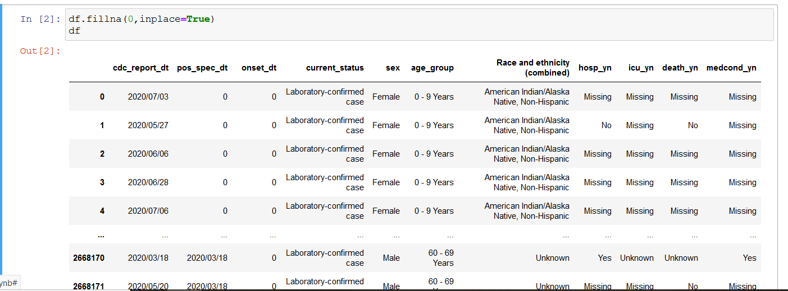
Data Clean up
We have lot of “NaN” values present in our data set.
To do the operations we need some values.
So we replaced all the NaN values with 0 by using the function fillna()

Slide 6
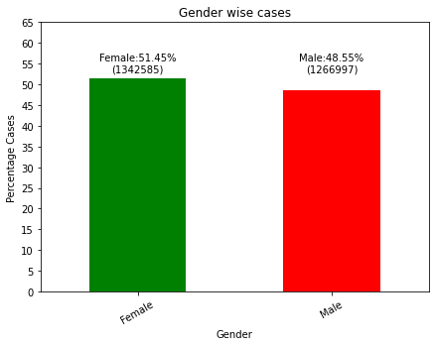
Gender Analysis & Conclusions
Q1. Is there a difference in the number of cases in men and women?
Answer: The U.S. COVID-19 cases are 51 % Female and 49% male
Females have a very small number more so we can say that:
“There is equal probability of COVID-19 situation for both Males and Females. Gender is not having any effect on COVID-19 Situation.”

Slide 7
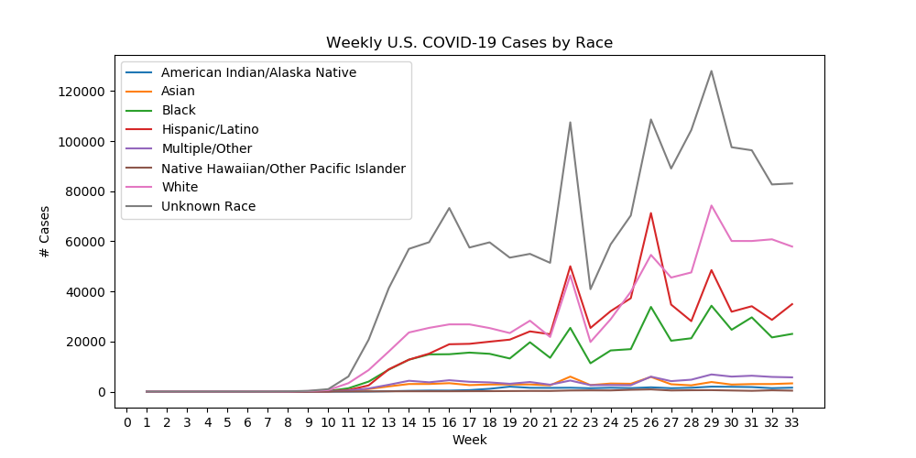
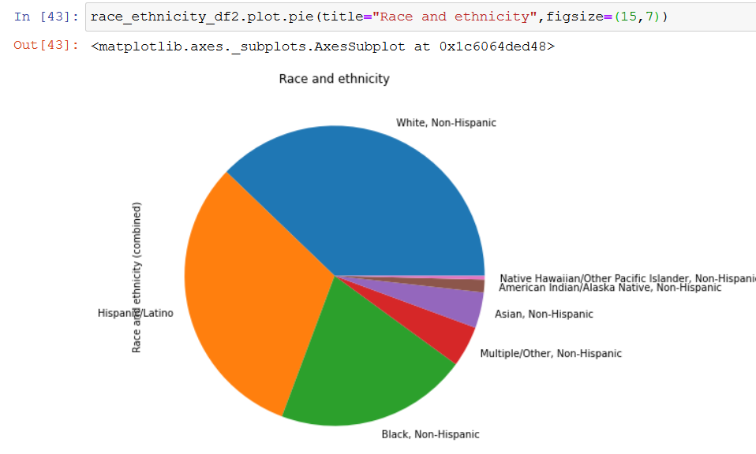
Race Analysis

Slide 8
Race Conclusions
Q2. Is there a relationship between COVID-19 cases and “race/ethnicity”?
Answer: From the figures we can see that “The highest number of cases are in “White, Non-Hispanic, and the lowest number of cases are in “Native Hawaiian/Other Pacific Islander, Non-Hispanic .” It is important to note that a very large number of cases (44%) are categorized as Unknown or Missing shown by the gray line.

Slide 9
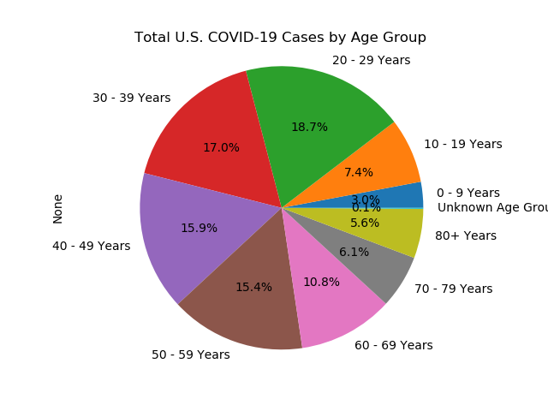
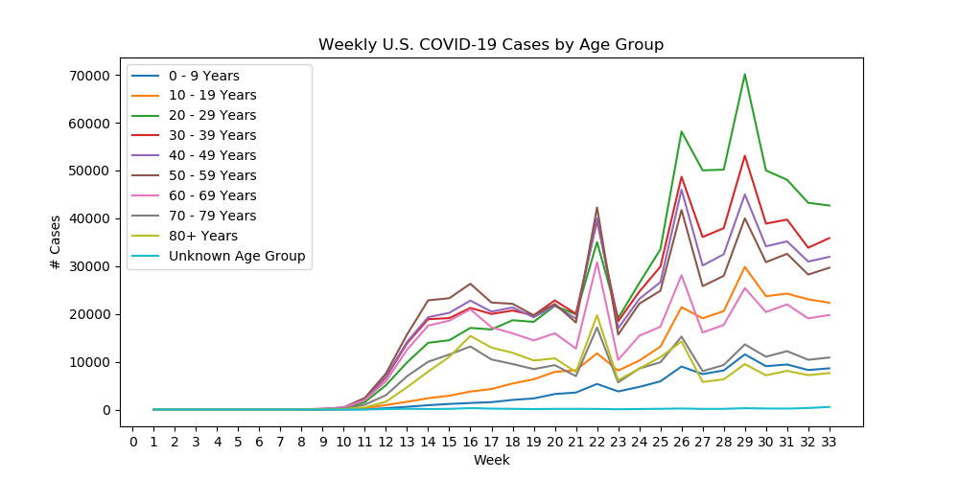
Age Group Analysis

Slide 10
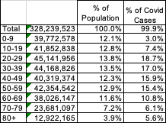
Age Group Conclusions
Q3. What are the trends in U.S. COVID-19 cases across age groups?
Answer: The 20-29 Years age group has seen a large increase in the number of cases since week 23 ( ending June 7) along with the 30-39, 40-49 and 50-59 age groups. The COVID-19 cases in the 0-9 and 10-19 age groups are well below their % of the population.
This chart shows the % COVID-19 cases with the estimated % of the U.S. population.
Census Data downloaded from: https://www.census.gov/data/tables/time-series/demo/popest/2010s-national-detail.html

Slide 11
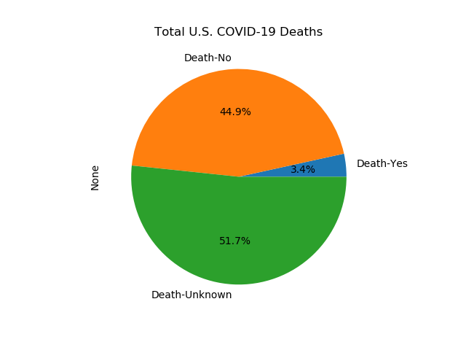
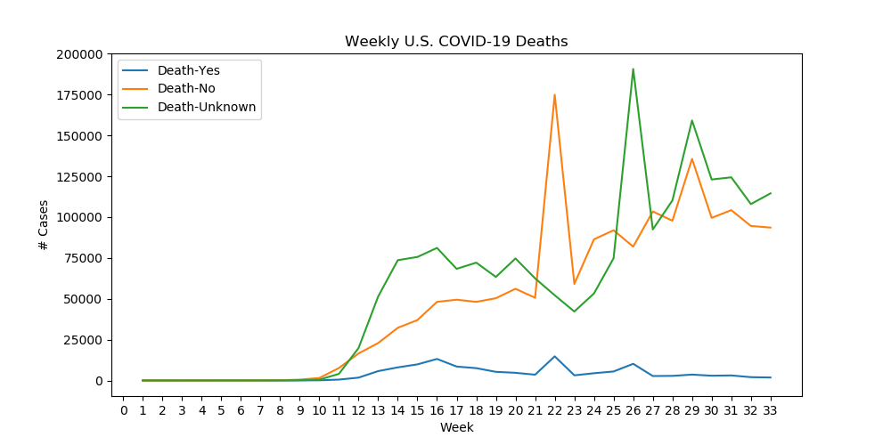
Deaths Analysis & Conclusions
During our analysis we were not planning to analyse the number of deaths, but could not overlook that 51.7% of the cases have a death status of “Missing” or “Unknown.”

Slide 12
Discussion
The analysis answers some questions
Gender does not seem to affect risk of contracting COVID-19
Working aged people seem to be most at-risk for contracting the disease
The analysis raises some questions
What factors are contributing to the increase in cases in the 20-29 Years age group?
Will 10-19 Years age group see an increase in cases when school is back in session?
Why are so many of the cases missing the race data?
Why are so many of the cases missing the death status?

Slide 13
Post Mortem
difficulties that arose
Finding the correct data set is the challenge. First we find the dataset but which do not have all the information's which is required.
Unwanted data: lot of data is missing and we have value “unknown”. Which leads to difficulty in analysis. We removed that data.
Graph Representation: To make the correct graph representation we made lot of changes so they are easily readable.
Future Scope:
We need to analyze the data over the time?
Finding the factors of White, Non-Hispanic having most number of cases.

Slide 14
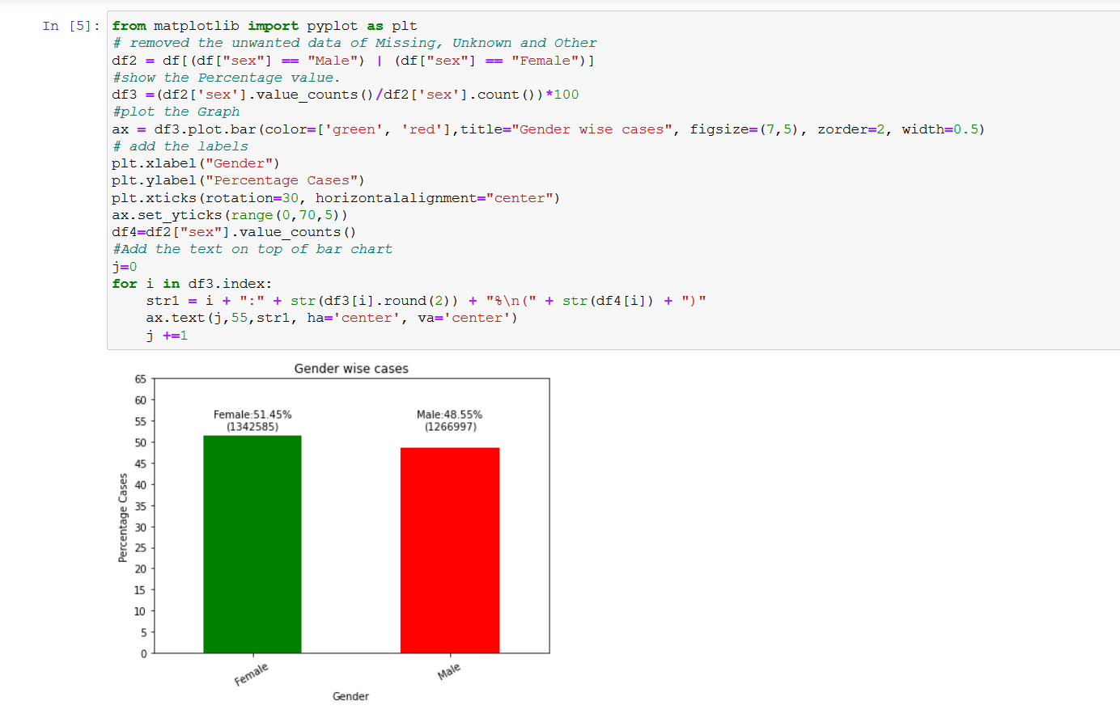
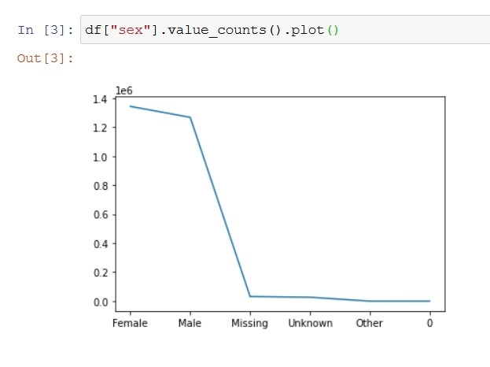
Before & After
Gender Plots

Slide 15
Challenges in Data Exploration
When we draw the graph for gender it look like…
We made the changes and removed the unwanted data of Missing, Unknown and Other info.
Changed the Graph to show the Percentage value.
Also added the bar Graph and added the values on top of each bar.

Slide 16
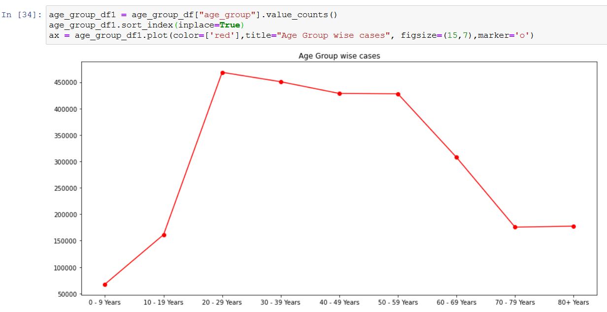
Data Analysis
Q. COVID-19 cases in the United States for trends across age groups?
Ans: From the Graph we can say that more cases can find for the age-group 20 to 50 years. “20-50 years age group has the highest number of cases.”

Slide 17
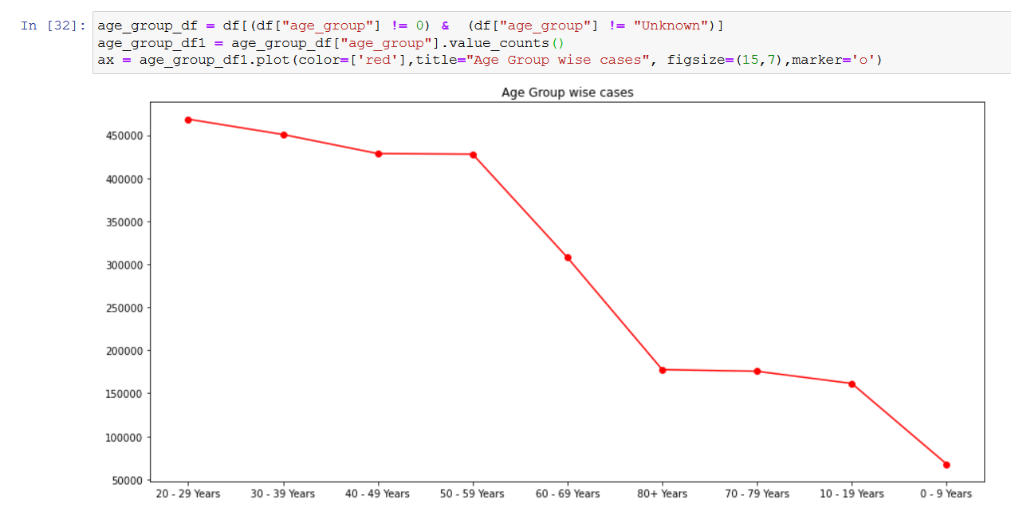
Challenges for age Group Graph
Before
After
Notes:
Challenges we face here is that the graph is coming as sorted value. So its difficult to read it. So we used the sort_index function to solve the issue.
We tried value_count(sort=False) option but it not helped.

