Slide 2
Motivation
World is facing the challenge of Covid-19 Pandemic.
Increasing Covid-19 Cases over the world.
Performing data analytics of Covid-19 cases using Pandas and Python.
simple data analysis and visualization techniques on the data sheet will Help to decide pattern.
pandas will save us time and analyse the data in an easy and direct way.
Learning of Panadas to use for general use cases.

Slide 3

Questions & Data
To Find the pattern we come up with some Questions
Do you think that Female are more affected than men?
COVID-19 cases in the United States for trends across age groups?
Is there is any relation of the Covid-19 cases with “race/ethnicity”?
Answers of this questions will lead us to the patterns by analysing the data.
Lead towards
Patten
Notes:
Describe whether you were able to answer these questions to your satisfaction, and briefly summarize your findings
If we go manually and try to analyze the data we didn’t find the satisfactory answer because looking at the data of 2609582 rows and getting the information is really a tough job. We can’t answer the questions easily by looking the CSV file we get from the internet.

Slide 4
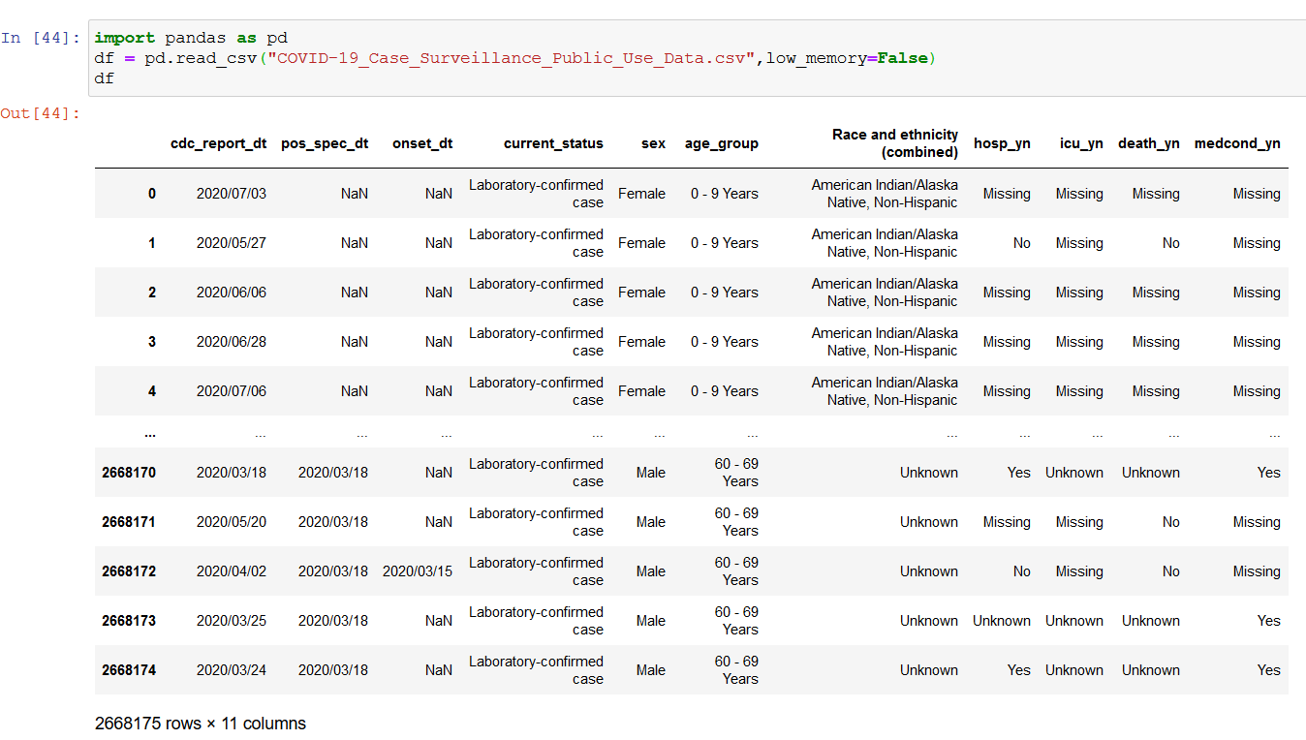
Data Exploration
We downloaded the data set from web-site https://data.cdc.gov/Case-Surveillance/COVID-19-Case-Surveillance-Public-Use-Data/vbim-akqf
We found lot of data sets on internet but we didn’t get the proper info.
We converted this csv file into Data frame with the help of the pandas “read_csv” function.

Slide 5
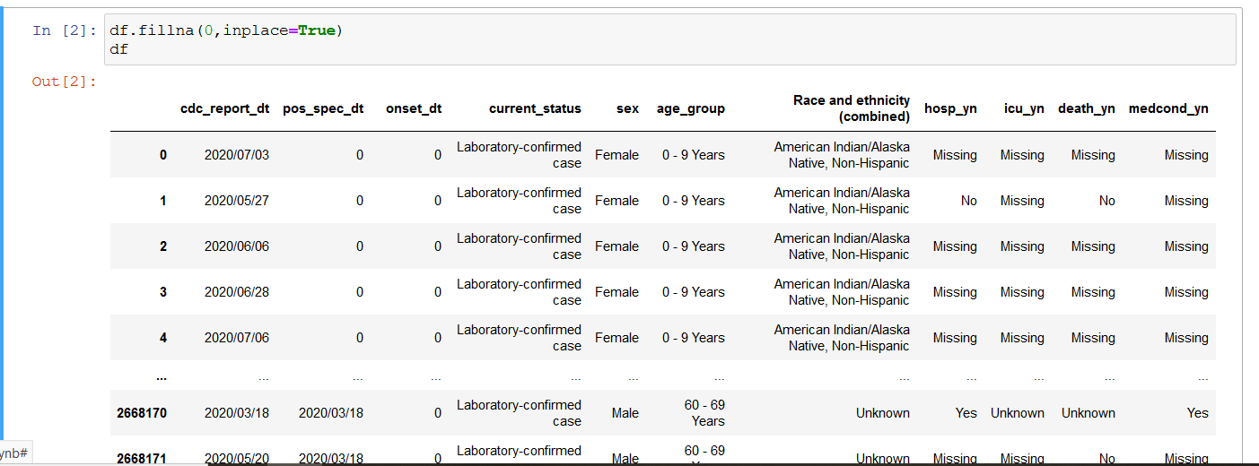
Data Clean up
We have lot of “NaN” values present in our data set.
To do the operations we need some values.
So we replaced all the NaN values with 0 by using the function fillna()

Slide 6
Challenges in data exploration
When we draw the graph for gender it look like…
We made the changes and removed the unwanted data of Missing, Unknown and Other info.
Changed the Graph to show the Percentage value.
Also added the bar Graph and added the values on top of each bar.

Slide 7
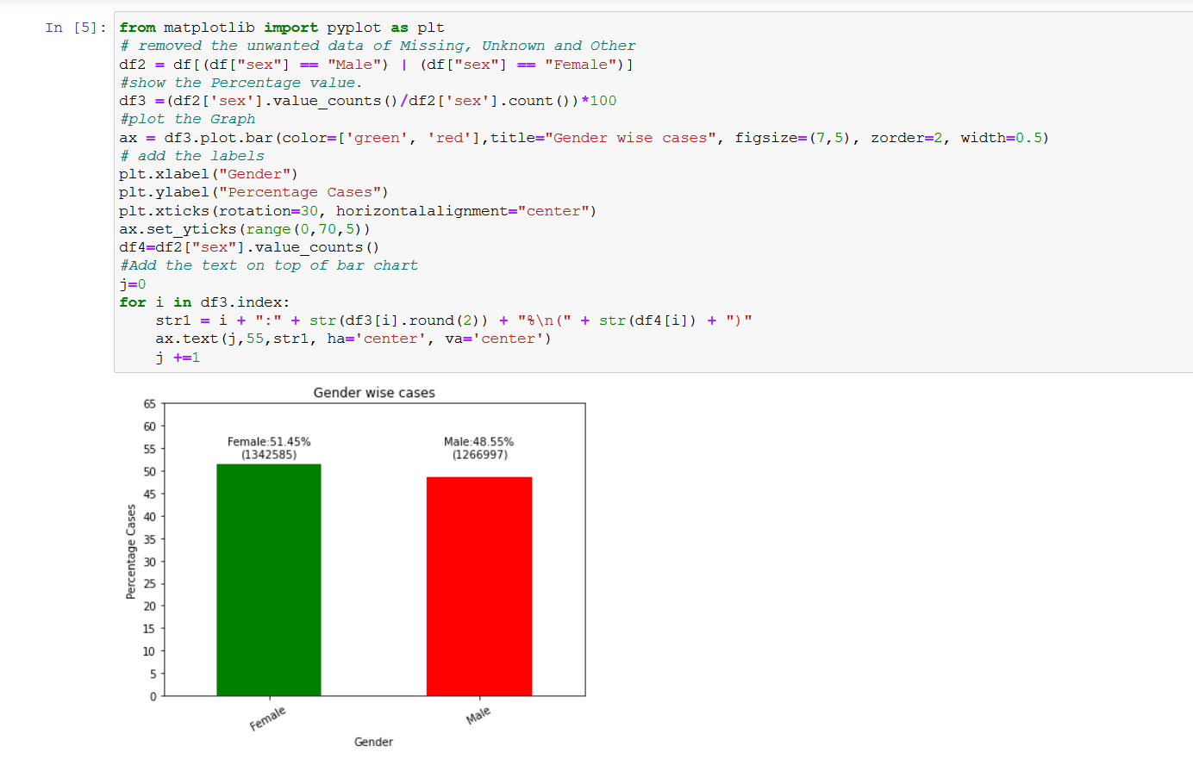
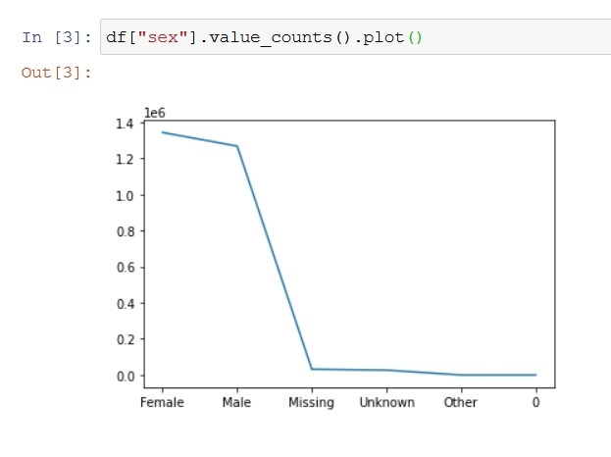
Before After

Slide 8
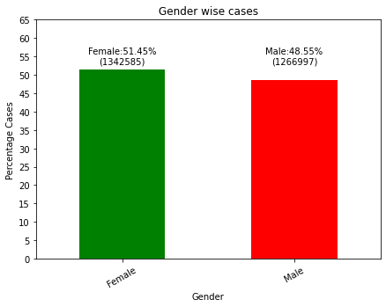
Data Analysis
Q1. Do you think that Female are more affected than men?
Ans: From the figure shown on the right, we can easily give
Answer of above question.
From the figure we can figure out that 51 % Females have the
Covid-19 situation and 49% male.
Female has the more numbers affected but its not too
Much So we can say that
“There is equal probability of covid-19 situation for both
Male and Female. Gender not having any effect on
Covid-19 Situation.”

Slide 9
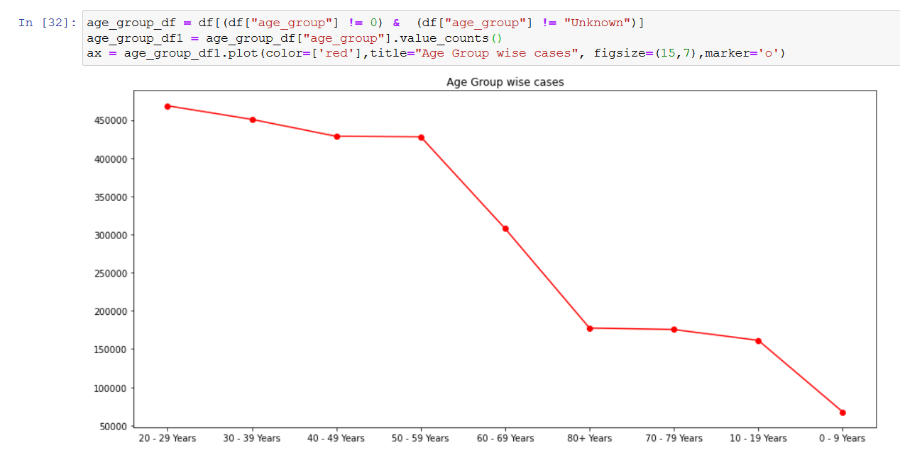
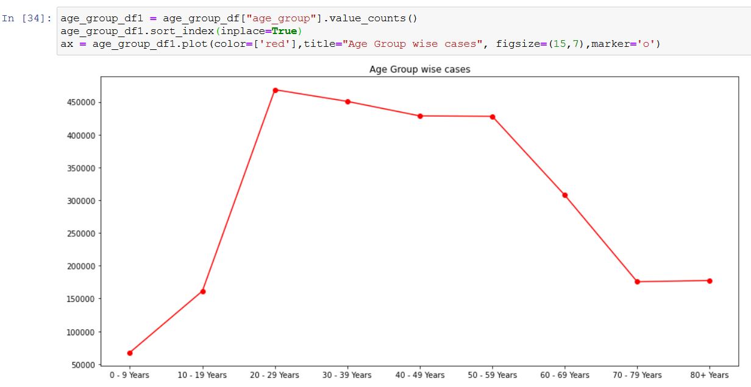
Challenges for age Group Graph
Before
After
Notes:
Challenges we face here is that the graph is coming as sorted value. So its difficult to read it. So we used the sort_index function to solve the issue.
We tried value_count(sort=False) option but it not helped.

Slide 10
Data Analysis
Q. COVID-19 cases in the United States for trends across age groups?
Ans: From the Graph we can say that more cases can find for the age-group 20 to 50 years. “20-50 years age group has the highest number of cases.”

Slide 11
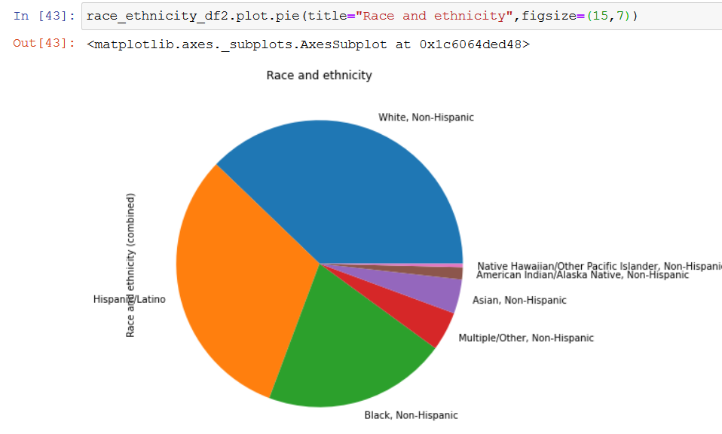
Data Analysis
Q. Is there is any relation of the Covid-19 cases with “race/ethnicity”?
Ans: From the figure we can say that “White, Non-Hispanic have most number of cases and “Native Hawaiian/Other Pacific Islander, Non-Hispanic ” having least number of cases.

Slide 12
Discussion
“Yes” we find what we expected.
Following are our Findings:
“There is equal probability of covid-19 situation for both Male and Female. Gender not having any effect on Covid-19 Situation.”
. “20-50 years age group has the highest number of cases.”
White, Non-Hispanic have most number of cases and “Native Hawaiian/Other Pacific Islander, Non-Hispanic ” having least number of cases.

Slide 13
Post Mortem
difficulties that arose
Finding the correct data set is the challenge. First we find the dataset but which do not have all the information's which is required.
Unwanted data: lot of data is missing and we have value “unknown”. Which leads to difficulty in analysis. We removed that data.
Graph Representation: To make the correct graph representation we made lot of changes so they are easily readable.
Future Scope:
We need to analyze the data over the time?
Finding the factors of White, Non-Hispanic having most number of cases.

