Slide 1
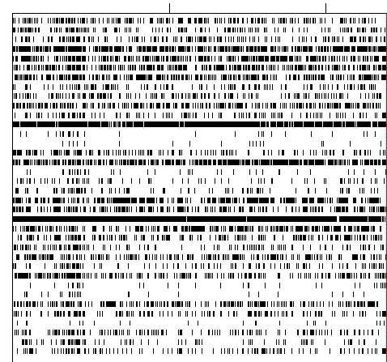
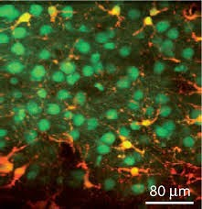
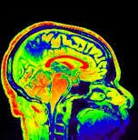
Statistical Models for Neural Data:
from regression / GLMs to Latent Variables
Nhat Le
Adapted from Jonathan Pillow, Cosyne 2018
Peer lecture
07/05/2018

Slide 2
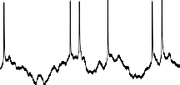



neural coding problem
membrane potential
spikes
imaging
stimulus
neural activity
How are stimuli and actions encoded in neural activity?
What aspects of neural activity carry information?

Slide 3
neural coding problem
membrane potential
spikes
imaging
stimulus
neural activity
encoding models
Approach: • develop ﬂexible statistical models of P(y|x)
quantify information carried in neural responses

Slide 4
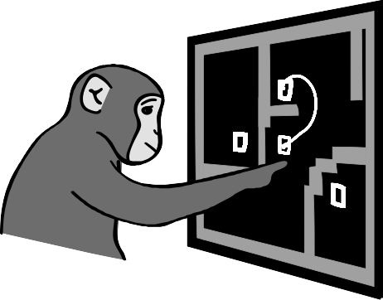
neural coding problem
membrane potential
spikes
[Kauffman et al 2014]
imaging
hand position
neural activity
encoding models
“regression models”
not restricted to sensory variables

Slide 5
latent variable models
membrane potential
latent variable
(unobserved or “hidden”)
spikes
imaging
neural activity
latent encoding models
capture hidden structure underlying neural activity (eg. low-dimensional or discrete states)

Slide 6
Outline
Simple GLM & Maximum Likelihood:
Example: Linear Poisson neuron
GLMs with spike history
GLMs with coupling between neurons

Slide 7


simple example #1: linear Poisson neuron
stimulus
?
Spike times
encoding models

Slide 8
simple example #1: linear Poisson neuron
An ‘experiment’
60
P (y|x)
(spike count)
40
20
0
0
20
40
(contrast)

Slide 9
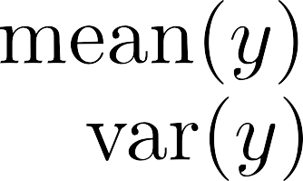
simple example #1: linear Poisson neuron
An ‘experiment’
60
Model: spike count follows a Poisson distribution with
P (y|x)
(spike count)
40
20
Goal: estimate
0
0
20
40
(contrast)

Slide 10
Quick note: the Poisson distribution
Story:
Rare events occur with a rate λ per unit time.
No "memory" of previous events.
= mean = variance
spike count
0 1 2 3 4 5 6 7 8 9 10

Slide 11

Maximum Likelihood Estimation:
given observed data
, find
that maximizes
60
P (y|x)
(spike count)
40
20
0
0
20
40
(contrast)
could in theory do this by turning a knob

Slide 12
Maximum Likelihood Estimation:
given observed data
, find
that maximizes
60
P (y|x)
(spike count)
40
20
0
0
20
40
(contrast)
could in theory do this by turning a knob

Slide 13
Maximum Likelihood Estimation:
given observed data
, find
that maximizes
60
P (y|x)
(spike count)
40
20
0
0
20
40
(contrast)
could in theory do this by turning a knob

Slide 14
Maximum Likelihood Estimation:
given observed data
, find
that maximizes
all spike counts
all stimuli
parameters
}
single-trial probability
Q: what assumption are we making about the responses? A: conditional independence across trials!

Slide 15
Likelihood function:
as a function of
likelihood
Because data are independent:
0
1
2

Slide 16
Likelihood function:
as a function of
likelihood
Because data are independent:
0
1
2
log
log-likelihood
0
1
2

Slide 17
log-likelihood
0
1
2
•Closed-form solution when model in “exponential family”

Slide 18
example #2: unknown neuron
100
75
50
25
(spike count)
0
-25
0
25
(contrast)
Be the computational neuroscientist: what model would you use?

Slide 19
Example 3: unknown neuron
100
75
50
25
(spike count)
0
-25
0
25
(contrast)
firing rate is nonlinear Poisson firing
More general setup:
This is a GLM!

Slide 20
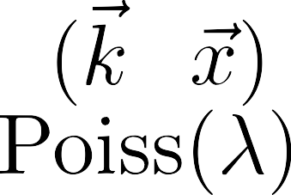
“basic” Poisson generalized linear model (GLM)
Linear-Nonlinear-Poisson (LNP) model
stimulus filter
exponential nonlinearity
Poisson spiking
λ(t)
stimulus
θ
f
noise
dimensionality reduction
nonlinear stretching
spike rate spike count
also known as a “cascade” model

Slide 21
What is a GLM?
Be careful about terminology:
GLM
General Linear Model
≠
GLM
Generalized Linear Model
(Nelder 1972)
Linear
Linear

Slide 22
Moral:
Be careful when naming your model!

Slide 23
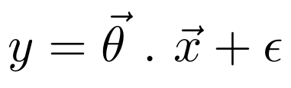
1. General Linear Model
Linear
Noise
“Dimensionality Reduction”
Examples:
1. Gaussian
2. Poisson

Slide 24
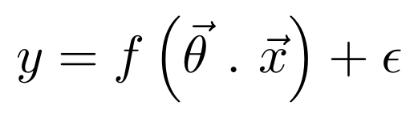
2. Generalized Linear Model
Linear
Nonlinear
Noise
Examples:
1. Gaussian
2. Poisson

Slide 25
2. Generalized Linear Model
Terminology:
Linear
Nonlinear
Noise
“distribution function”
“parameters”
= “link function”
= “the nonlinearity”

Slide 26
Applying it to data
y_{t} = ~k · ~x_{t}
linear ﬁlter
response at time t
+ noise
vector stimulus at time t
stimulus
response
00 0 0 0 0 0 00 0 0 0 0 0 1 0 0 0 0 0 0 0 1 0 1 0 0 0 0 0 1 1 0 0 0 0 0
time

Slide 27
y_{t} = ~k · ~x_{t}
response at time t
+ noise
vector stimulus at time t
linear ﬁlter
walk through the data one time bin at a time
t = 1
~x_{t}
stimulus
00 0 0 0 0 0 00 0 0 0 0 | 0 | 1 0 0 0 0 0 0 0 1 0 1 0 0 0 0 0 1 1 0 0 0 0 0
response
time
y_{t}

Slide 28
y_{t} = ~k · ~x_{t}
response at time t
+ noise
vector stimulus at time t
linear ﬁlter
walk through the data one time bin at a time
t = 2
~x_{t}
stimulus
00 0 0 0 0 0 00 0 0 0 0 0 | 1 |  | 0 0 0 0 0 0 0 1 0 1 0 0 0 0 0 1 1 0 0 0 0 0
response
time
y_{t}

Slide 29
y_{t} = ~k · ~x_{t}
response at time t
+ noise
vector stimulus at time t
linear ﬁlter
walk through the data one time bin at a time
t = 3
~x_{t}
stimulus
 |  | 0 | 0 0 0 0 0 0 1 0 1 0 0 0 0 0 1 1 0 0 0 0 0
response
00 0 0 0 0 0 00 0 0 0 0 0 1
time
y_{t}

Slide 30
y_{t} = ~k · ~x_{t}
response at time t
+ noise
vector stimulus at time t
linear ﬁlter
walk through the data one time bin at a time
t = 4
~x_{t}
stimulus
 |  | 0 | 0 0 0 0 0 1 0 1 0 0 0 0 0 1 1 0 0 0 0 0
response
00 0 0 0 0 0 00 0 0 0 0 0 1 0
time
y_{t}

Slide 31
y_{t} = ~k · ~x_{t}
response at time t
+ noise
vector stimulus at time t
linear ﬁlter
walk through the data one time bin at a time
t = 5
~x_{t}
stimulus
 |  | 0 | 0 0 0 0 1 0 1 0 0 0 0 0 1 1 0 0 0 0 0
response
00 0 0 0 0 0 00 0 0 0 0 0 1 0 0
time
y_{t}

Slide 32
y_{t} = ~k · ~x_{t}
response at time t
+ noise
vector stimulus at time t
linear ﬁlter
walk through the data one time bin at a time
t = 6
~x_{t}
stimulus
 |  | 0 | 0 0 0 1 0 1 0 0 0 0 0 1 1 0 0 0 0 0
response
00 0 0 0 0 0 00 0 0 0 0 0 1 0 0 0
time
y_{t}

Slide 33
Build up to following matrix version:
Y
= + noise
X~k
time
0
0
1
~
k
=
…
…
design matrix

Slide 34
Computing maximum likelihood estimate
Y
= + noise
X~k
time
0
0
1
~
k
=
…
…
1. “Linear-Gaussian” GLM:
stimulus covariance
spike-triggered avg (STA)

Slide 35
Computing maximum likelihood estimate
Y
= + noise
time
0
0
1
~
k
=
…
…
2. Poisson GLM:
(assumes exponential nonlinearity by default)

Slide 36
Computing maximum likelihood estimate
Y
= + noise
time
0
0
1
~
k
=
…
…
3. Bernoulli GLM:
outputs 0 and 1
“logistic regression”

Slide 37
Poisson GLM
stimulus filter
exponential nonlinearity
Poisson spiking
f
stimulus
λ(t)
k
spike rate
problem: assumes spiking depends only on stimulus!

Slide 38
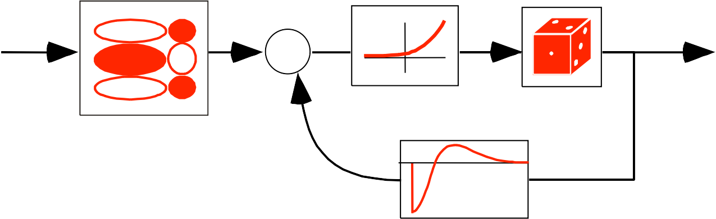
Poisson GLM with spike-history dependence
(Truccolo et al 2004, Gerstner 2001)
stimulus filter
exponential nonlinearity
f
probabilistic spiking
stimulus
+
post-spike filter
k
h
spike rate:
output: no longer a Poisson process
interpretation:“soft-threshold” integrate-and-ﬁre model

Slide 39
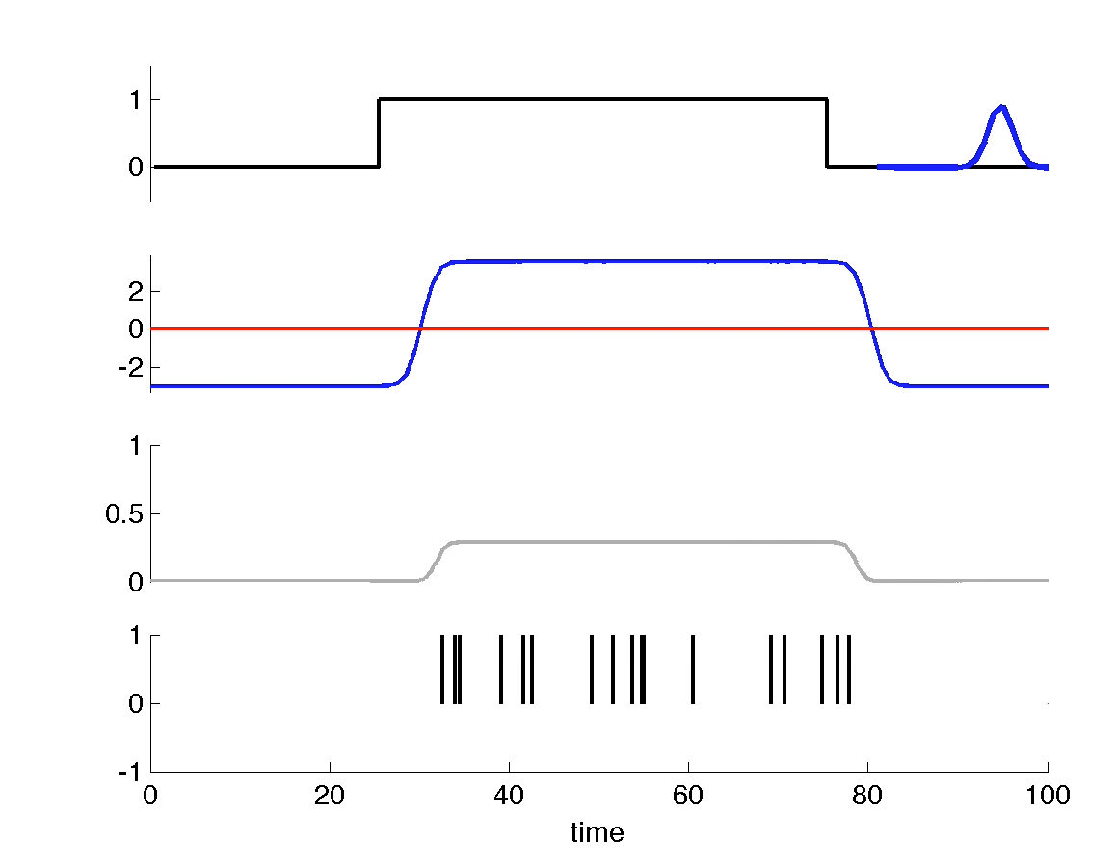
GLM dynamic behaviors
irregular spiking
stimulus
ﬁlter outputs
(“currents”)
p(spike)
post-spike ﬁlter h(t)

Slide 40
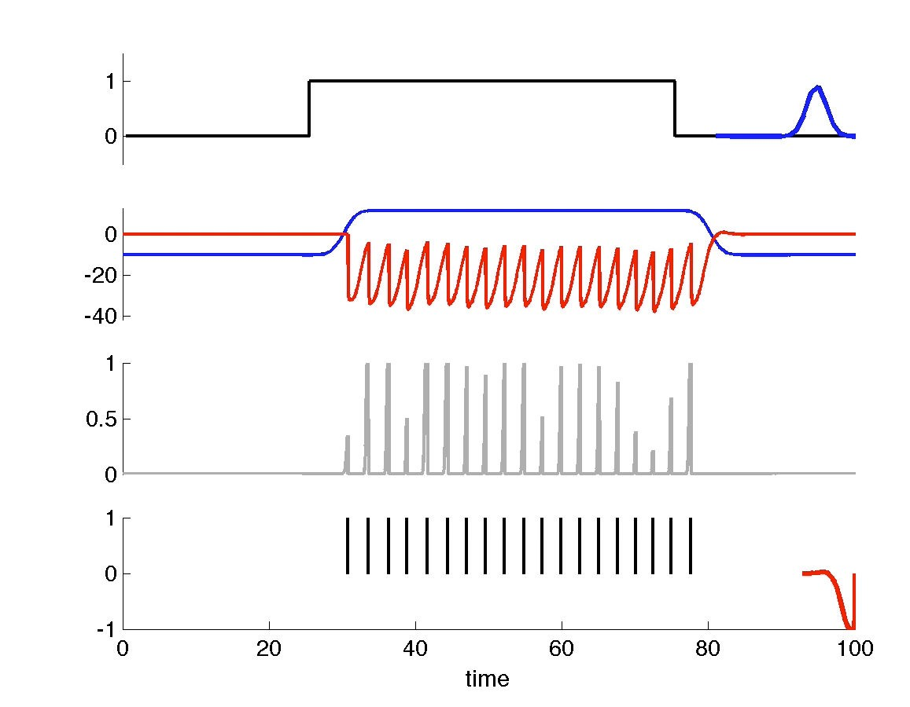
GLM dynamic behaviors
regular spiking
stimulus
ﬁlter outputs
(“currents”)
p(spike)
post-spike ﬁlter h(t)

Slide 41
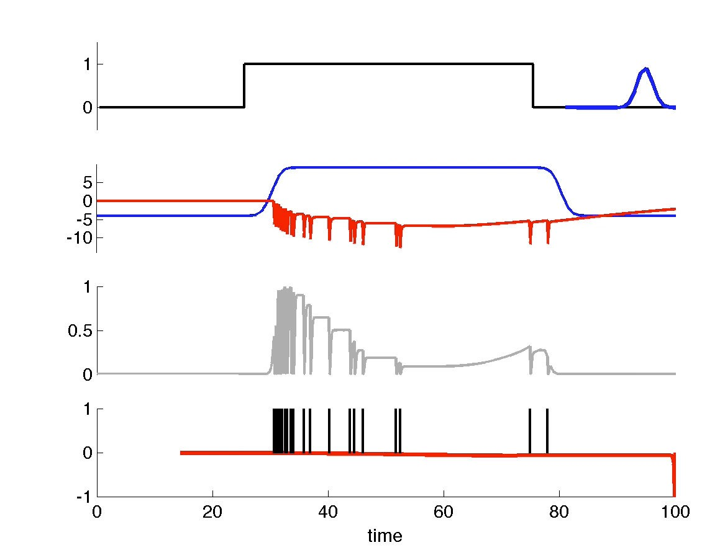
GLM dynamic behaviors
adaptation
stimulus
ﬁlter outputs
(“currents”)
p(spike)
post-spike ﬁlter h(t)

Slide 42
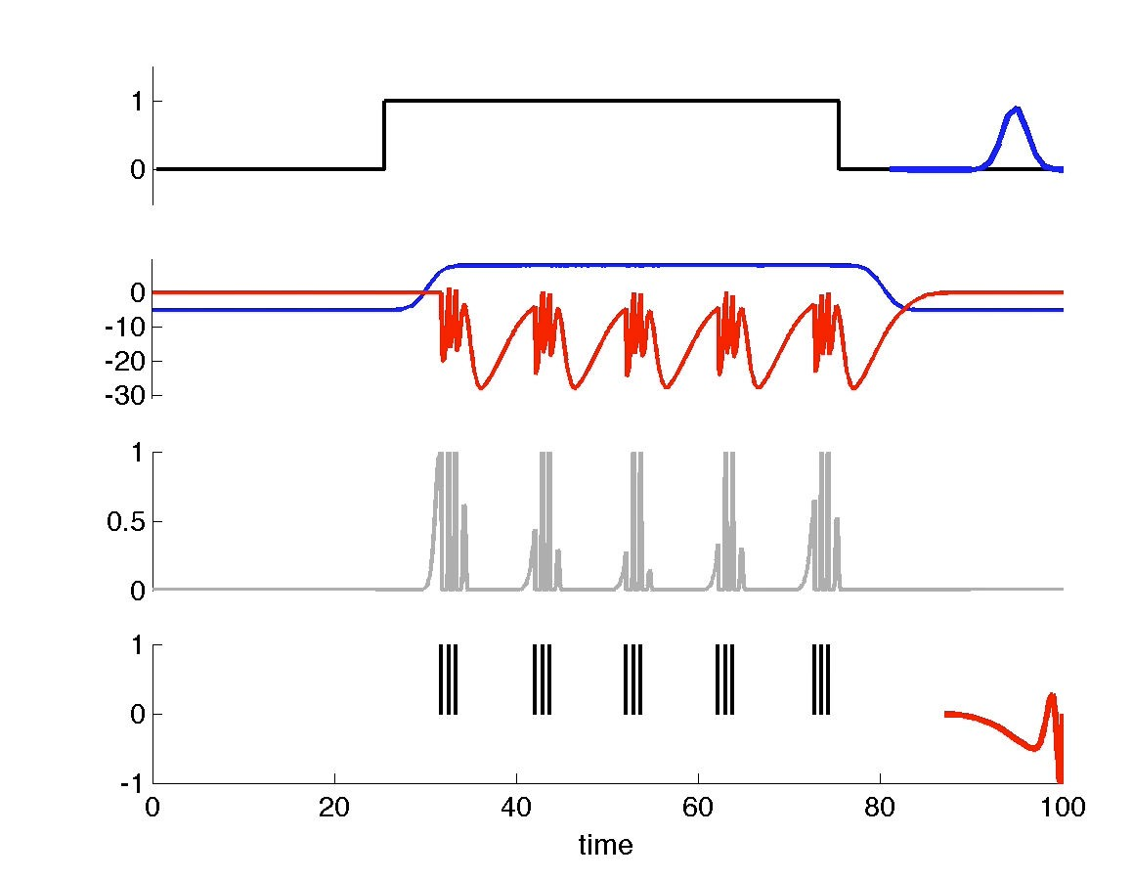
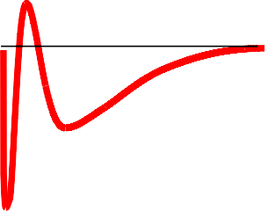
GLM dynamic behaviors
bursting
stimulus
ﬁlter outputs
(“currents”)
p(spike)
post-spike ﬁlter h(t)

Slide 43
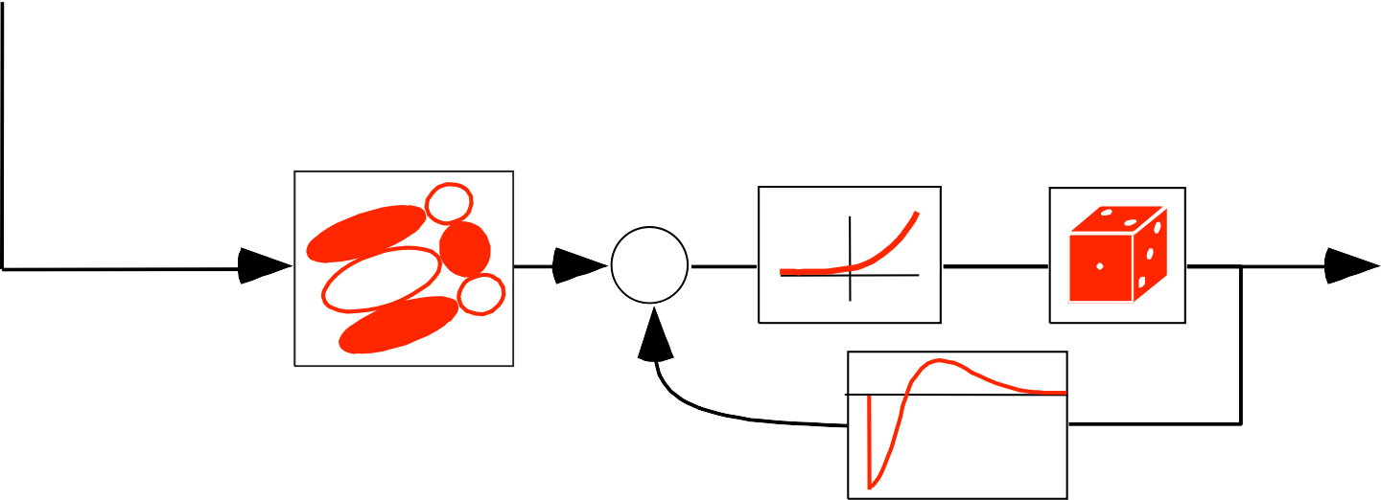
multi-neuron GLM
stimulus filter
exponential nonlinearity
probabilistic spiking
+
post-spike filter
neuron 1
stimulus
+
neuron 2

Slide 44
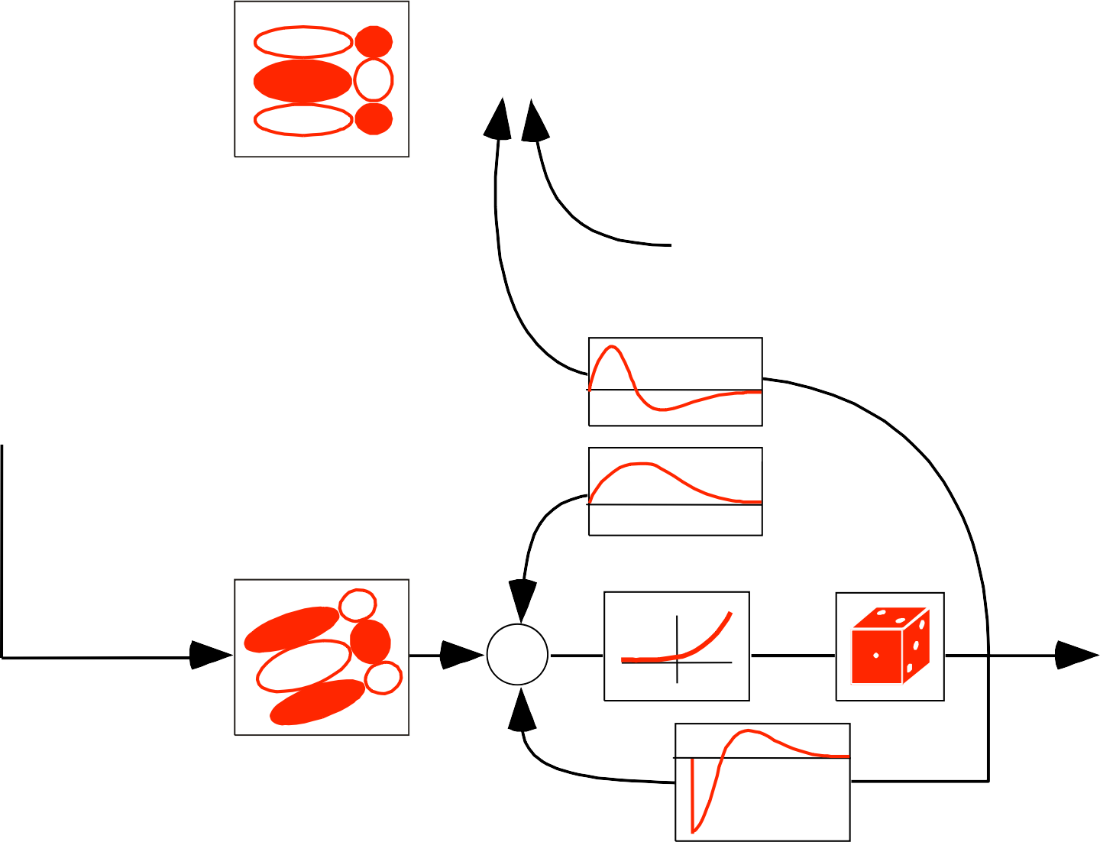
multi-neuron GLM
stimulus filter
exponential nonlinearity
probabilistic spiking
+
post-spike filter
neuron 1
stimulus
coupling filters
+
neuron 2

Slide 45
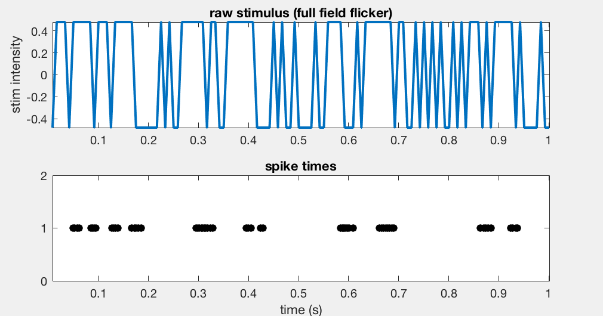
Example dataset
stimulus = binary flicker
parasol retinal ganglion cell spike responses
Uzzell et al (J Neurophys 04)

Slide 46
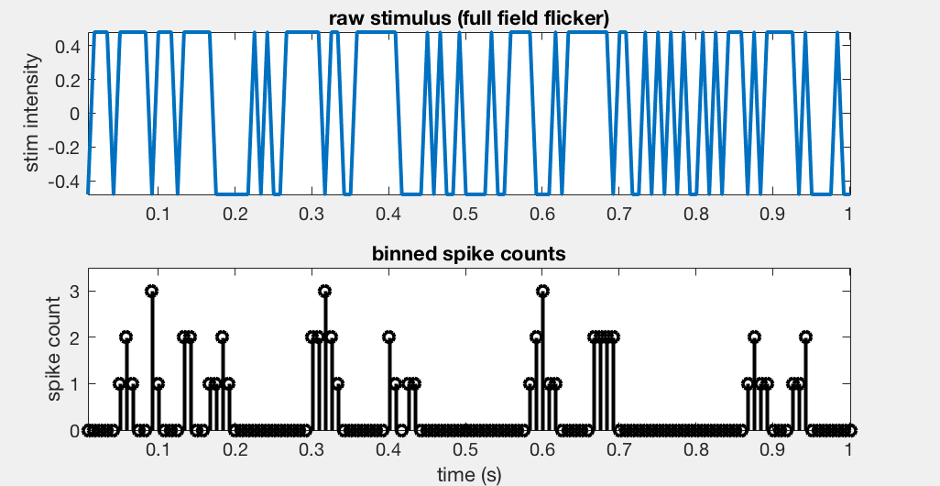
Example dataset
stimulus = binary flicker
parasol retinal ganglion cell spike responses
Uzzell et al (J Neurophys 04)

Slide 47
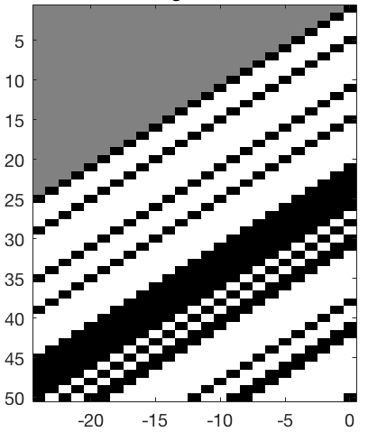
Stimulus-only GLM
design matrix
X
spike response
Y
model
time
time lag

Slide 48
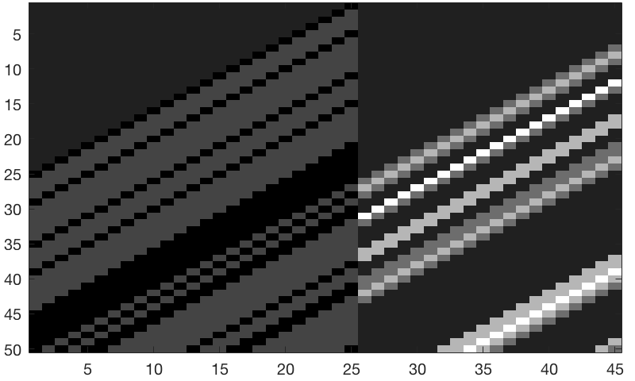
Stimulus + SpikeHistory GLM
design matrix
X
spike response
Y
model
model
time
stimulus portion
spike-history portion

Slide 49
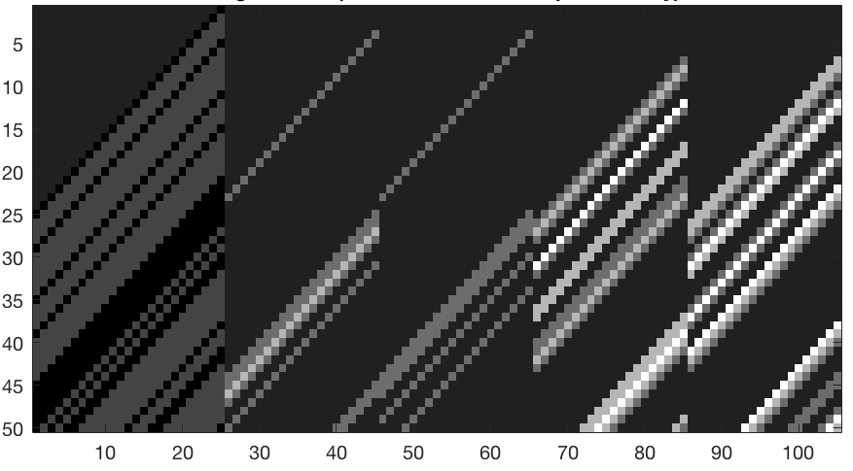
Stimulus + History + 3 Neuron Coupling GLM
design matrix
X
spike response
Y
model
model
time
stimulus portion
neuron 1 spike-hist
neuron 2 spike-hist
neuron 3 spike-hist
neuron 4 spike-hist

Slide 50
Summary

