Slide 1
Blockchain 101
Prassanna Ganesh Ravishankar
github.com/atemysemicolon
prassanna.io (under construction)

Slide 2
Introduction
Why I like blockchains
Keywords
Let’s introduce ourselves.
Why do we want to do this course.
Choose whatever language is comfortable!

Slide 3
Structure Talk
Introduction to Blockchains
Historical context
The need for third party or not
BlockchainTech – Hashes
BlockchainTech – Hashes of hashes

Slide 4
Structure Programming
Elements:
Elements:
Elements:
Loading and Saving
Building up
Building up
Block Templates
Synchronization
Deploy the blockchain as a microservice
Blockchain = chain of blocks
Creating a node
Building up
Node Transactions
Node to node communication

Slide 5
Structure Presentation and open ended discussions
When to blockchain and when not to
What’s next – Ethereum dev
Smart Contracts
Upcoming technologies
More into governed blockchains

Slide 6
Lets get in and then get out A brief introduction before we go in deep
What is a blockchain?
What is a blockchain then?
Not a relational database
Not a common folder such as dropbox or google drive
Isn’t contained in one server
Database is not anonymous
A collection of serializable data objects, called blocks
Connected through their hashes
Linked list : hashes instead of pointers
Technically, has no limit.
Represents, almost always a sequence of events
Transactions are “anonymous” as long as you don’t reveal your public key

Slide 7
blast from the past
Some history
Providing context
Motivations and inspirations

Slide 8
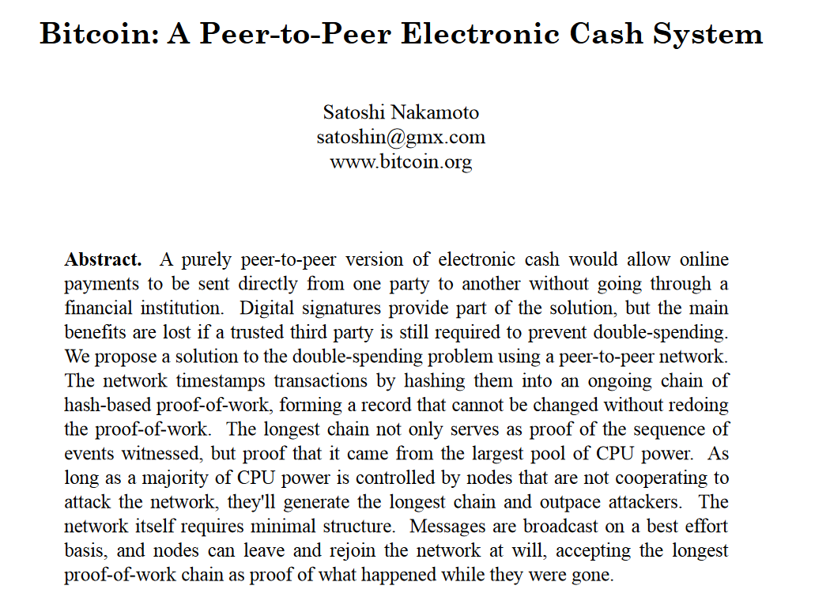
The birth of the blockchain Who is Nakamoto?
Does it matter who Nakamoto is?
It is compliant with the blockchain that his name stays public, yet anonymous
Started of as a currency mechanism
Possibilities : Cyberphunks
John Gilmore : A guarantee - with physics and mathematics, not with laws - that we can give ourselves real privacy of personal communications.
Bitcoin, a direct successor of HashCash

Slide 9
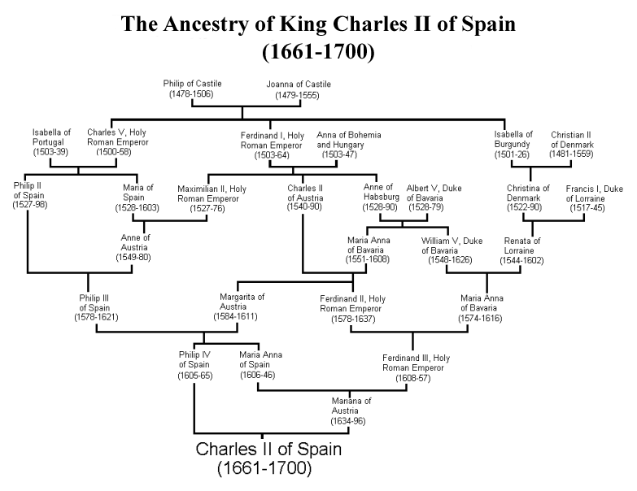
Human reference to technology
How are genes transferred? Based on the parents
Can we remember our family from the beginning of time?
Making babies – Do we require third parties?
What is the one thing that keeps growing and morphing beyond birth and death?
Your genes perhaps?

Slide 10
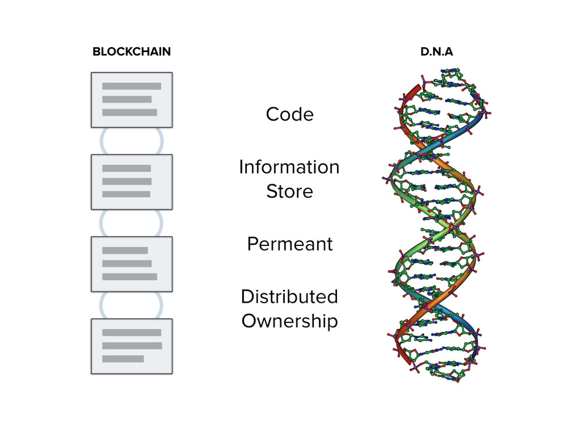
Biomorphic software design
Now you understand why the previous slide!
Organic design of software.
Blockchains are a chain of blocks(i.e information).
A new block is added onto the chain with “energy” being spent based on the “environment” of transactions – The proof of work paradigm
Don’t laugh

Slide 11
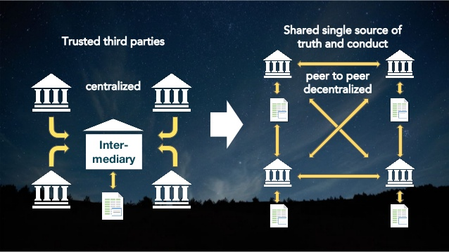
Third parties
Do we need third parties in transactions between two parties?
Banking
Downloading some famous software
Hosting a social network
Accessing Email
How does a blockchain replace the third party?
It uses your peers as the third party
Cryptographic proof instead of trust
Let’s start trusting people again by removing the need for trusting 3rd parties
Therefore everyone “owns” the blockchain, but no one can “edit” the past.

Slide 12
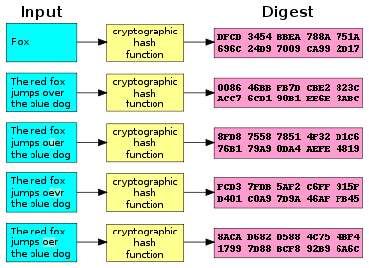
Hashes
Hashes : are mathematical functions that take string data of fixed length and turn it into numerical data of fixed length
If I send some data and some hash, the receiver can hash the data he receives and verify if that’s as expected
Easy way to verify data, not too intensive on the CPU

Slide 13
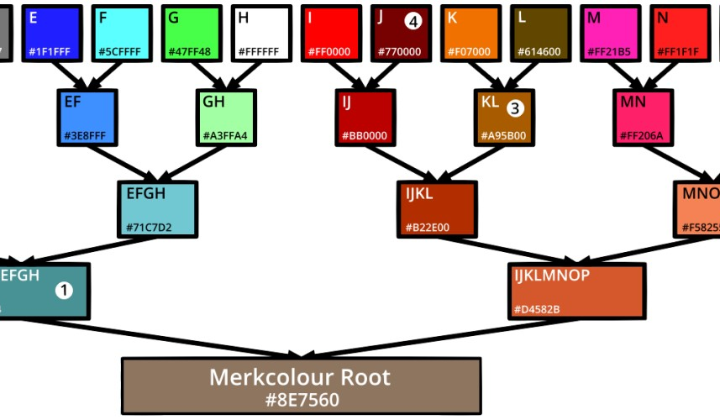
Why are hashes important?
Does it make sense using a hash for the entire blockchain, or using it Little by Little
Can I reverse all the combinations of colours if I reverse from the hash?
A merkle tree, is used in multiple applications
git to keep track of branches, and from where they branched out of
Apple has started using it to discover sectors of a corrupted hard disk, by having layers of hashes
Easy way to verify integrity in parts of a large, large structure of data

Slide 14
Mining Proof of work
What is mining?
Giving birth
The creation of a new block from the previously existing block on the chain
Mined blocks are verified and added to the chain
In the case of bitcoin, mined blocks are blocks that take a bunch of transactions, and collect them as a block
Proof of work is the Mining technique that Bitcoin uses
Idea – Energy spent cannot be reversed.
Keep adding a counter to your hash, till the hash follows a pattern
This pattern is defined by the “difficulty” of the network
Simple : Increment a counter till you get the required number of zeros in your hash

Slide 15
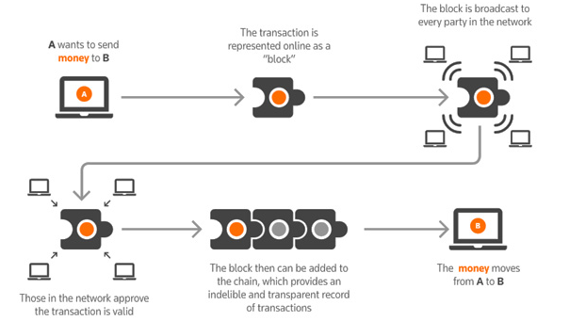
What is a ledger?
A place where transactions are stored
Banks do this (earlier in notebooks, now it computers)
Mafia dons also do this in notebooks
Let’s define the perfect Ledger
Anyone should be able to access the ledger
Anyone should be able to write transactions on the ledger
If the book is over, let’s index it and place it on the shelf, not in order
So if someone wants to steal it, or change transactions, they have to struggle to change the entries
Each new book starts with the location of the previous book

Slide 16

Back to our beloved blockchains
To summarize:
Blockchains are a collection of blocks
Blocks always have a field pointing to the previous block
Security comes from mining
If you change the content of the block, the hash would change, therefore the same counter will not follow the rule
Have to re-do the mining
For every block that comes after it
Where is the block stored?
Any one who is a full-node, stores the block
A full node may mine, but also can verify a new block
How do we verify the blockchain?
See if hashes computed for every block match the hash that’s reported
Go back till the first block and see if we get the genesis block

Slide 17
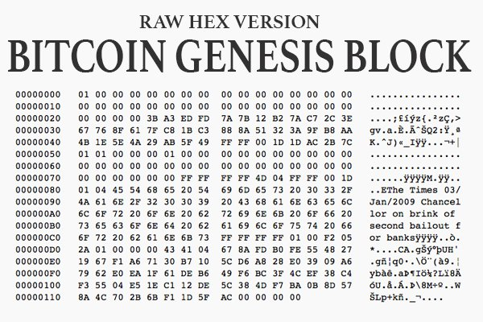
Lets get our hands dirty
Before we start programming, let’s just have a look at the bitcoin genesis block
Newspaper headline from The guardian on a particular day (don’t remember)
We can always cross reference this, to make sure we don’t get an entirely stupid chain
Open up PycharmEdu and open up the course.
Lets keep this interactive

