Slide 1

Master's degree in Computer Engineering, Cybersecurity and Artificial Intelligence - University of Cagliari
Course: Machine Learning Security
project # 1
Adversarial Attacks on RobustBench Models: A Comparative Evaluation of FMN and AutoAttack
Supervisor: Prof. Battista Biggio
Author: Lello Molinario: 70/90/00369
Link at the project code:
https://github.com/lmolinario/ML_Sec_project.git
Notes:
Good morning,
I'm going to present the project regarding Adversarial Attacks on RobustBench Models: A Comparative Evaluation of FMN and AutoAttack

Slide 2
Presentation Overview
• Introduction
• Adversarial Attacks: AutoAttack and FMN
• Setup for our project
• Results and Analysis
• Explainability: Integrated Gradients
• Conclusions and possible Future Developments
Notes:
In this presentation, we will explore the key motivations that led us to conduct this study, focusing on the importance of adversarial robustness in deep learning models.
We will then discuss the results obtained, comparing the effectiveness of AutoAttack and FMN.
Finally, we will highlight some limitations and challenges encountered during our analysis, providing insights into potential improvements and future research directions

Slide 3
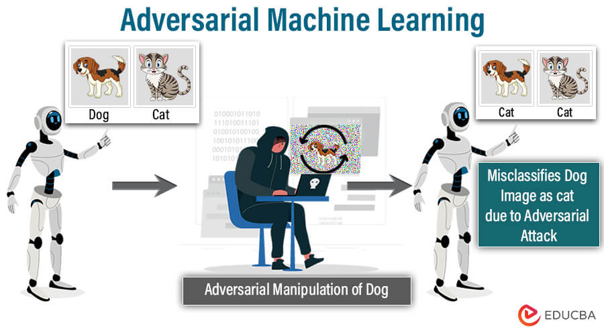
Neural Networks and Adversarial Attacks
Problem: Deep learning models are vulnerable to adversarial attacks.
Goal: Evaluate the robustness of RobustBench models by comparing FMN and AutoAttack.
Challenge: Some attacks are more effective than others under certain conditions.
https://www.educba.com/adversarial-machine-learning/
Notes:
Neural networks have revolutionized deep learning, but they suffer from a critical vulnerability: small perturbations, known as adversarial examples, can completely mislead their predictions.
This presents a major risk in real-world applications where safety and reliability are critical, such as cybersecurity, medical diagnosis, and autonomous driving.
To better understand and combat this problem, researchers have developed adversarial attack methods to systematically study how these perturbations affect model performance. The robustness of deep learning models against such attacks is a crucial factor in ensuring their safety and reliability

Slide 4

Project Overview – Comparing Adversarial Attacks
INSTRUCTION:
Re-evaluate 5 RobustBench models with another attack algorithm (e.g., FMN) and identify samples for which one attack works and the other doesn’t. Explain the results - i.e., provide some motivations on why one of the attacks did not work properly, while the other did.
Notes:
The project I am presenting today focuses on comparing two adversarial attack methods: AutoAttack and Fast Minimum-Norm (FMN) on five models from RobustBench, which serves as a widely recognized benchmark for evaluating adversarial robustness.
Our goal is to identify cases where one attack succeeds while the other fails.
By analyzing these instances, we aim to understand the underlying factors that contribute to these differences.

Slide 5
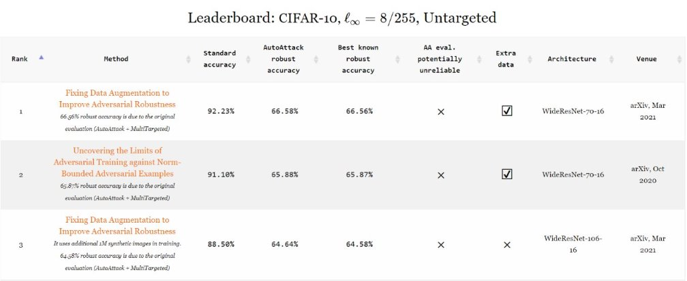
AutoAttack: A Comprehensive Adversarial Evaluation
AutoAttack is a set of 4 attacks:
APGD-CE: PGD variant based on Cross-Entropy
APGD-DLR: PGD variant with DLR Loss
FAB: Minimize the perturbation norm
Square Attack: Query-efficient black-box attack
https://github.com/fra31/auto-attack
Notes:
AutoAttack is an attack framework that consists of four different adversarial attacks, each designed to exploit different vulnerabilities in deep learning models.
PGD-CE and PGD-DLR are step-size-free versions of Projected Gradient Descent, designed to optimize attack success without requiring manual tuning.
The FAB attack is a norm minimization method that aims to find the smallest possible perturbation needed to fool a model.
Square Attack is a query-efficient black-box attack, meaning it can fool models even without direct access to gradients.
The main advantage of AutoAttack is that it combines these different attack methods to provide a comprehensive assessment of a model's robustness. Because it does not require manual tuning of parameters, it produces standardized and reliable robustness assessments.
However, a major disadvantage is its computational cost.
Running multiple attacks significantly increases the time required for evaluation, making it less practical for large-scale testing

Slide 6
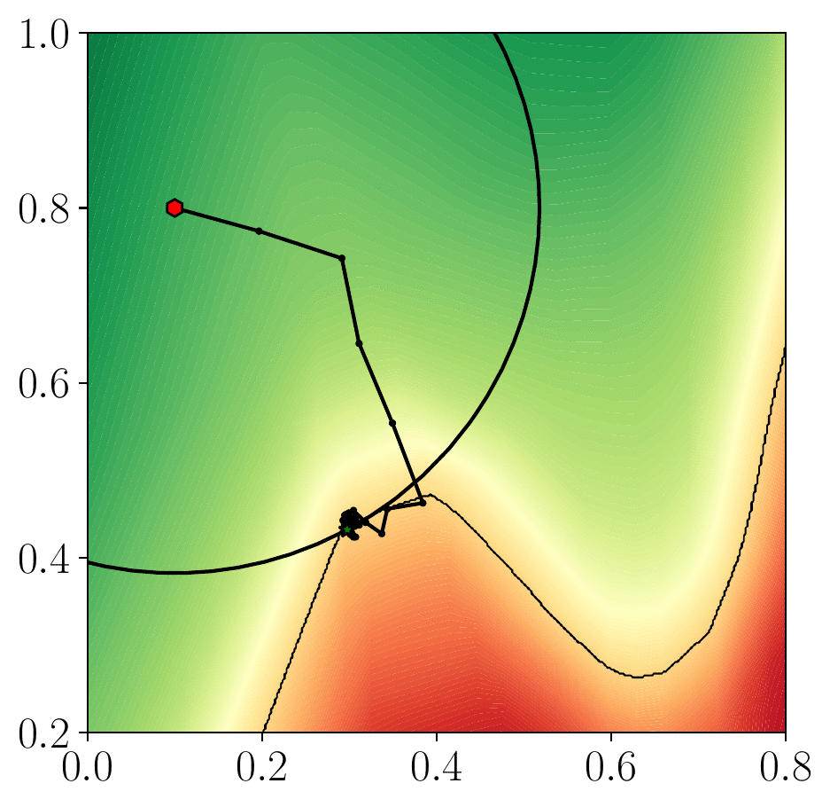
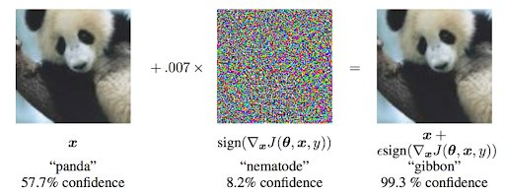
FMN: Efficient and Minimal Perturbation Attack
FMN Attack
Goal: Fool the model with the least possible perturbation.
Advantages:
Fast convergence
Works with different norms
Easy to optimize
https://github.com/pralab/Fast-Minimum-Norm-FMN-Attack
https://neptune.ai/blog/adversarial-attacks-on-neural-networks-exploring-the-fast-gradient-sign-method
Notes:
Fast Minimum-Norm (FMN) is an efficient adversarial attack that aims to generate the minimum possible perturbation needed to fool a deep learning model.
It calculates the gradient of the loss function with respect to the input image.
It perturbs the image in the direction that maximizes the model's loss, increasing the probability of misclassification.
The size of this perturbation is controlled by epsilon (ε), which determines how much the final adversarial example will differ from the original.
FMN is highly efficient because it converges quickly to local optima, requiring less computational effort than more complex attacks. It is also flexible because it works on different perturbation norms without requiring extensive tuning.
However, it has some limitations.
While FMN is designed for minimum perturbation, it does not always find the strongest adversarial examples.
In some cases, AutoAttack is more effective at fooling the model due to its set of multiple attack methods

Slide 7
Overview of the FMN vs. AutoAttack Comparison
Feature | AutoAttack | FMN
Attack Type | Ensemble of 4 attacks | Single attack
Objective | Robust evaluation | Minimal perturbation
Efficiency | Slower but precise | Faster
Hyperparameter-free | Yes | Yes
Norm Used | L∞​ | various norms
Application | Primarily used for robustness testing | Used for inducing adversarial perturbations
Notes:
This slide is just a little summary of the main differences between the two types of attack

Slide 8
Dataset – CIFAR-10 Models Selected from RobustBench
Dataset: CIFAR-10, L∞, eps=8/255
Model | Clean Accuracy | Architecture
Ding2020MMA | 84.36% | WideResNet-28-4
Wong2020Fast | 83.34% | PreActResNet-18
Andriushchenko2020Understanding | 79.84% | PreActResNet-18
Sitawarin2020Improving | 86.84% | WideResNet-34-10
Cui2023Decoupled_WRN-28-10 | 92.16% | WideResNet-28-10
https://github.com/RobustBench/robustbench
Notes:
The dataset used to compare attacks is CIFAR-10
CIFAR-10 is a widely used dataset in adversarial robustness research.
It consists of about 60,000 images (32x32 pixels) from 10 different classes.
It Commonly used in RobustBench to evaluate adversarial robustness.
The models I chose represent a different set of architectures.
They have different levels of robustness to adversarial attacks.
They have been evaluated in previous adversarial research, which makes them suitable for comparison.

Slide 9
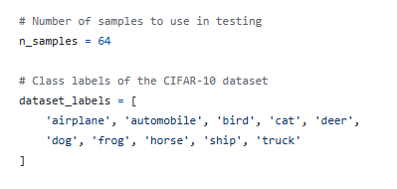
Experiment Setup – Attack Evaluation
How Were the Attacks Tested?
Each attack (AutoAttack and FMN) was run on the first 64 samples of CIFAR-10.
The evaluation focused on identifying the samples for which one attack works and the other does not and on the size of the perturbation.
The comparison highlights:
Effectiveness: which attack manages to fool the model.
Efficiency: How small the required perturbation is.
Notes:
To compare AutoAttack and FMN, I ran experiments on the first 64 samples of CIFAR-10.
The evaluation was structured around two main goals:
Identify samples where one attack succeeds while the other fails. Measure the size of the perturbation needed to fool the model.
Since FMN is designed to find the smallest possible perturbation, this comparison allows us to see how much distortion is needed for each attack to succeed.

Slide 10
Results: Autoattack VS FMN
Hyperparameters | Model | Autoattack Robust Accuracy | FMN Robust Accuracy
norm='Linf’ eps=8 / 255 ***************** Only for FMN steps: 500 max_stepsize: 1.0 gamma: 0.05 | Ding2020MMA | 31.25 % | 39.06 %
 | Wong2020Fast | 37.50 % | 42.19 %
 | Andriushchenko2020Understanding | 43.75 % | 43.75 %
 | Sitawarin2020Improving | 39.06 % | 39.06 %
 | Cui2023Decoupled_WRN-28-10 | 67.19 % | 67.19 %
Notes:
AutoAttack is generally more successful at fooling models because it combines multiple attack strategies, increasing the likelihood of bypassing the model's defenses.
However, this comes at the expense of larger perturbations, making adversarial examples more detectable.
FMN is faster (about 3x faster than AutoAttack), slightly less effective, but more efficient at minimizing perturbation norms. This makes its adversarial examples harder for humans to notice.
The attacks were conducted with L∞ norm constraints, which limit the maximum per-pixel change between the original and adversarial images.
FMN's success depends on balancing three key hyperparameters:
Steps (500): More iterations means better accuracy but slower execution.
Maximum step size (1.0): Controls how aggressively the attack updates the image.
Gamma (0.05): Ensures gradual and stable updates. If we want to increase the success of the attack, we need to find the right balance between step count, perturbation size (ε) and step regulation (max_stepsize, range).

Slide 11
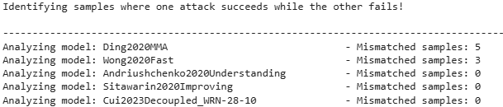
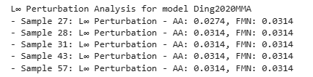
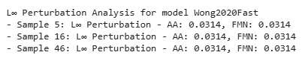
Analyzing Discordant Samples in RobustBench Models
Notes:
By analyzing the results, I identified discordant samples, which are cases where one attack succeeded and the other failed.
In the Ding2020MMA model, we found 5 discordant samples: 27, 28, 31, 43, and 57.
AutoAttack outperformed FMN in most cases because it applies a more aggressive perturbation strategy.
In the Wong2020Fast model, we found 3 discordant samples: 5, 16, and 46.
AutoAttack performed better overall, which indicates that this model is more robust to small perturbations (like FMN) but more vulnerable to larger perturbations (like AutoAttack).
For the other models, we found no discordant samples.
(This suggests that FMN and AutoAttack had the same effect, meaning that these models are equally vulnerable to both types of attacks.)

Slide 12

Explainability in Adversarial Attacks
It improves the linear approximation by referring to a counterfactual baseline inputs.
This implements a method for local explanation of predictions via attribution of relevance to each feature.
where:
x = input image,
x′ = baseline image (e.g., all zeros),
F(x) = model’s prediction function.
Notes:
Before we continue with the analysis of the results, it is essential to discuss an important concept in adversarial attacks: explainability.
Adversarial attacks introduce subtle perturbations that can fool deep learning models.
To understand their impact, we need to analyze which pixels contribute the most to the model's decision before and after the attack.
One of the most effective methods for this is Integrated Gradients (IG). Integrated Gradients works by:
Tracing gradients from a base image (e.g., a black image) to the actual input.
Accumulating these gradients to show which pixels influence the model's classification the most.
This technique provides a clearer picture of the model's vulnerabilities and helps us interpret the effectiveness of the attack.

Slide 13
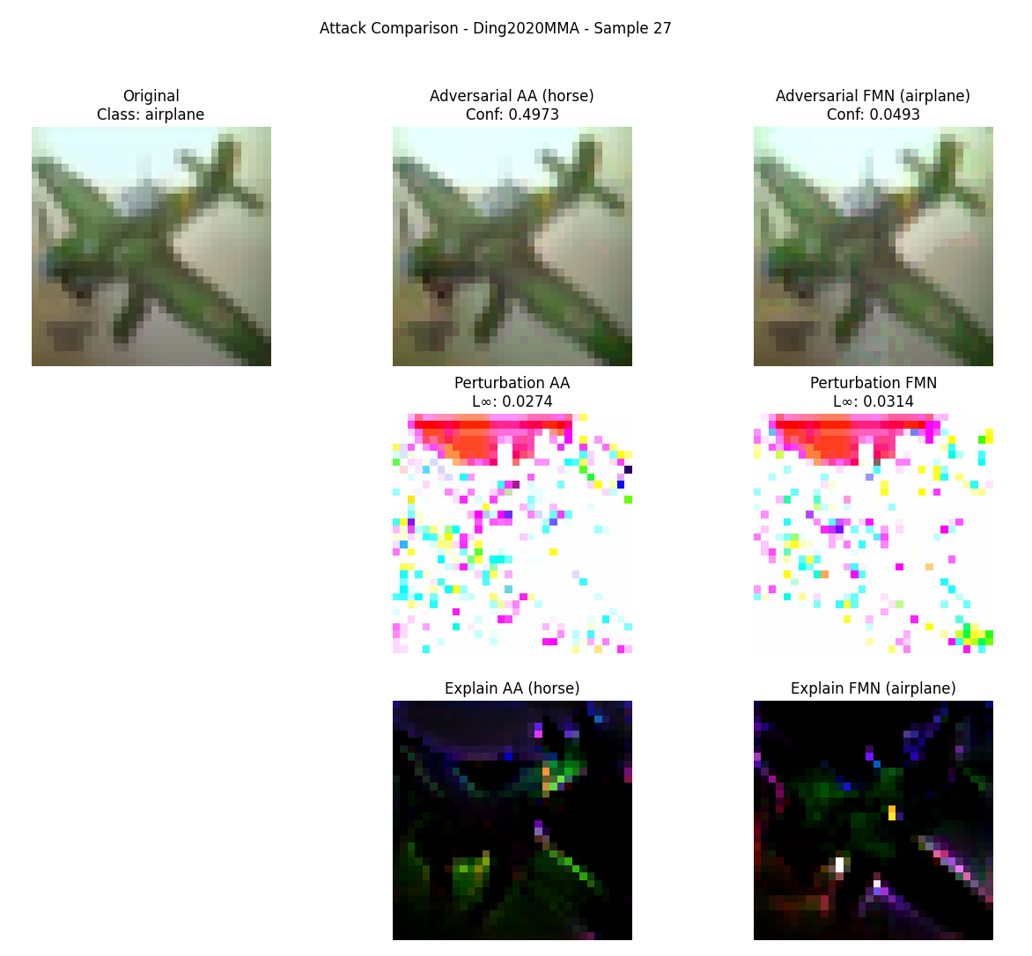
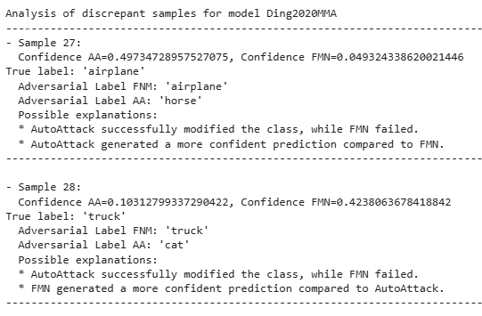
Explainability Comparison – AutoAttack vs FMN
Notes:
This slide provides an explainability-based comparison between AutoAttack and FMN.
At the top, we see three images:
On the left: the original image
In the center: the adversarial image generated by AutoAttack (AA)
On the right: the adversarial image generated by Fast Minimum-Norm (FMN)
At the bottom, we have perturbation maps and explainability heat maps (integrated gradients), showing which regions influenced the model's decision.
AutoAttack Results
The confidence score (0.4973) indicates that the model now assigns a probability of 49.73% to "straddle", meaning that the attack successfully changed the classification.
The perturbation map (L∞=0.0274) shows the intensity of the changes applied.
The explainability map highlights the most affected regions, showing how the attack changed the model's decision.
FMN Results
The model still classifies the image as "airplane" → Attack failed
The confidence score drops to 0.0493, showing that the attack had an effect but was not strong enough to fool the model
The perturbation (L∞=0.0314) is slightly higher than AutoAttack's, but less effective
The explainability heatmap shows that FMN changed fewer key features, meaning its impact on the classification was lower
Finally, AutoAttack managed to fool the model, showing that its aggressive perturbation approach is effective.
FMN failed because it aims to minimize the perturbation, which sometimes results in insufficient changes to change the class.
We need to ask why FMN failed?
FMN may have found a local minimum and was unable to significantly change the image.
The model may be more robust to FMN perturbations than the stronger ones from AutoAttack.
The key regions modified by AutoAttack and FMN are different, which leads to different classification impacts.

Slide 14
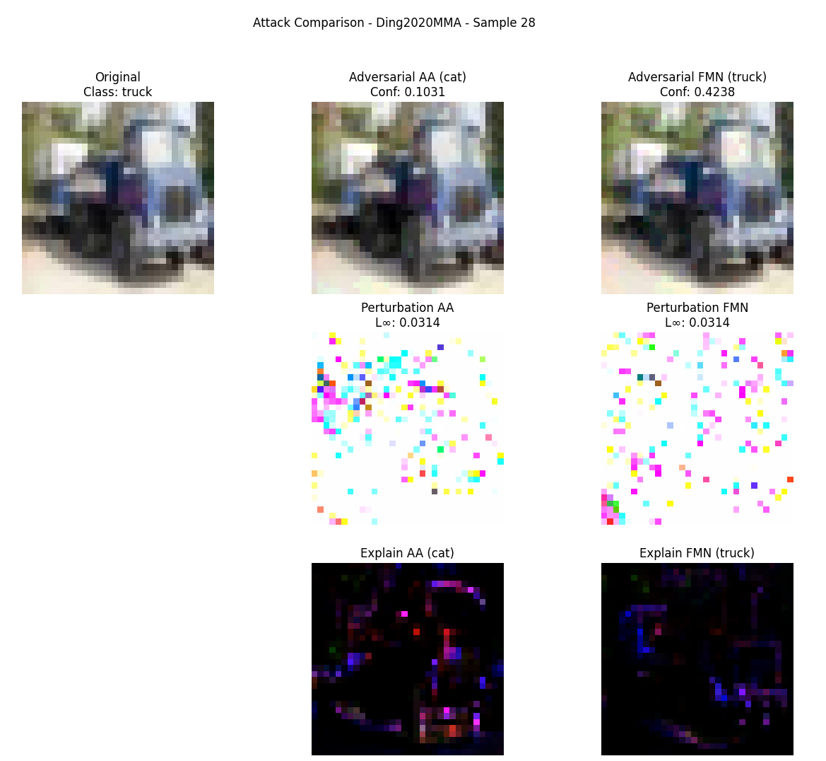
Explainability Comparison – Example 28
Notes:
This slide presents example 28, another interesting case where AutoAttack and FMN show different results.
In AutoAttack's analysis,
The model assigned a probability of 10.31% to "cat", meaning that the attack partially confused the model, but the class change was not completely convincing.
The perturbation map (L∞=0.0314) shows how AutoAttack altered specific areas of the image.
The explainability map highlights the most affected regions, showing which features contributed to the class change.
In FMN's analysis,
The model still classified the image as "truck" → The attack failed.
The confidence dropped to 42.38%, meaning that the model was less certain but not completely misled.
The magnitude of the perturbation (L∞=0.0314) is similar to AutoAttack, but the noise distribution is different, which likely explains why FMN was less effective. The explainability heatmap suggests that FMN did not alter the most influential regions, which is why the model maintained its classification.
AutoAttack was partially successful: it reduced the model's confidence in the correct class, but did not fully convince it of the new one.
FMN failed to cause a class switch, likely because it prioritizes the smallest perturbation, which may not be enough in some cases.
This example further supports the idea that AutoAttack's broader, more aggressive strategy tends to outperform FMN in fooling deep learning models

Slide 15
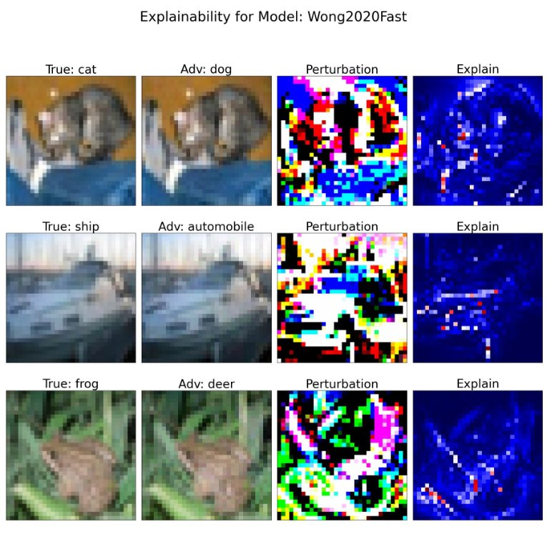
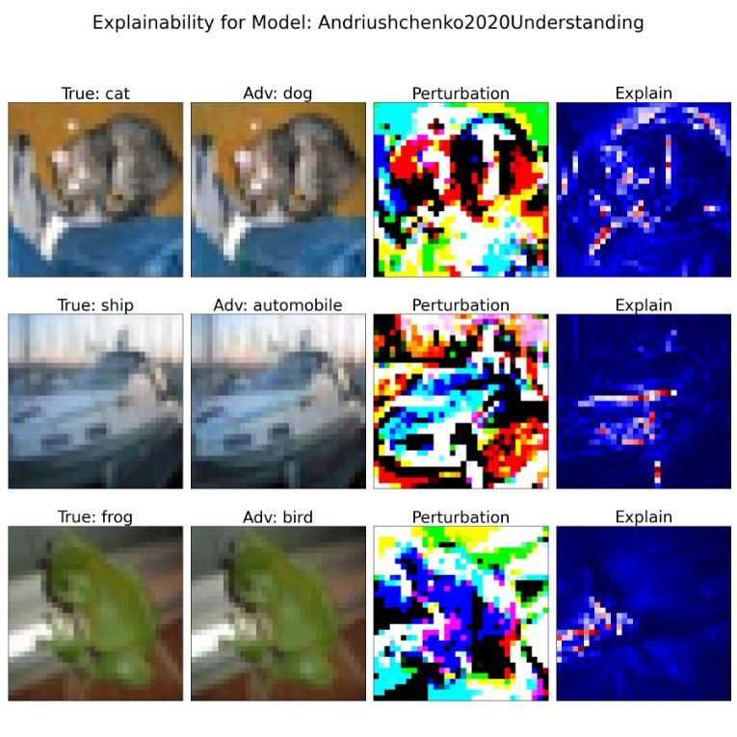
When FMN Succeeds – A Successful Minimal Perturbation Attack
Notes:
This slide presents an interesting case where FMN successfully fooled the model.
The adversarial images look almost identical to the original images, suggesting that FMN was able to fool the model without introducing any visible distortions.
The perturbations look similar to those of previous models, but with slightly different color variations, which may have affected the model's decision making differently.
The explainability heatmap still highlights important regions in blue and red, meaning that the model relied on these regions to make its decision.
This indicates that the attack successfully redirected the model's attention, leading to a misclassification.
In essence, both models are vulnerable to adversarial attacks, demonstrating that even subtle changes can manipulate classification decisions.

Slide 16
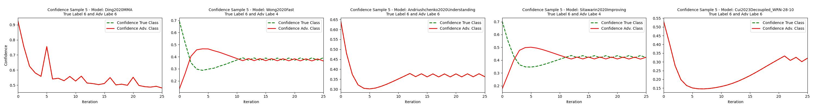
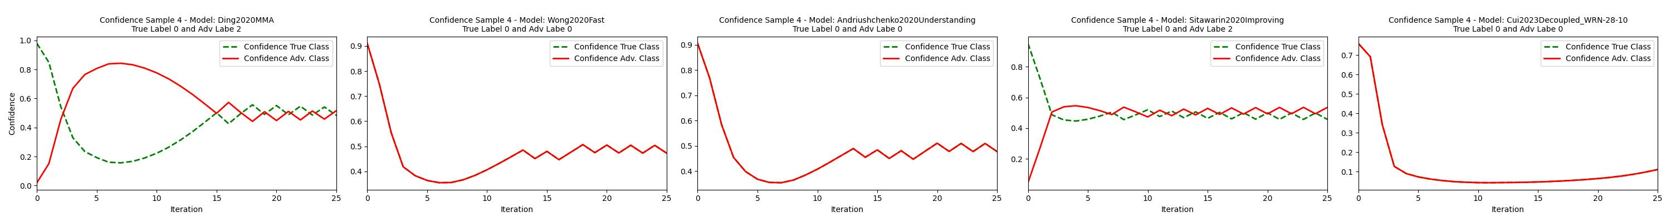
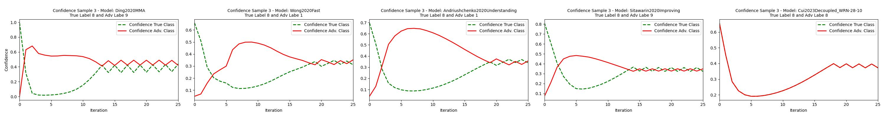
Understanding Adversarial Attacks with Convergence Plots
Notes:
Another way to analyze the impact of adversarial attacks is through convergence plots.
These plots help us visualize how confidence in a model evolves over the course of attack iterations.
Each plot shows:
Confidence in the original class (dashed green line)
Confidence in the adversarial class (solid red line)
The X-axis represents iterations (more iterations generally lead to a more successful attack).
The Y-axis represents confidence, showing how much the model believes in a given class.
Let's look at the analysis of sample #3
The Ding2020MMA model holds up for a few iterations before the attack starts working.
Wong2020Fast's confidence in the adversarial class gradually increases.
The Andriushchenko2020Understanding model's confidence in the original class slowly decreases, indicating greater robustness.
The Sitawarin2020Improvement model initially holds up but eventually fails.
The Cui2023Decoupled_WRN-28-10 model is the most vulnerable: its confidence in the original class drops almost immediately.
The robustness of the model varies significantly. Some models resist attacks better than others.
Andriushchenko2020Understanding appears to be the most robust, as its confidence drops slowly.
Cui2023Decoupled_WRN-28-10 is the most vulnerable, as its confidence in the original class drops quickly.

Slide 17
Conclusion & Future Directions
AutoAttack vs. FMN
AutoAttack showed a higher success rate, but with larger perturbations.
FMN was more efficient in terms of minimal perturbation, but with a lower success rate.
Implications for Robustness
Attack choices influence the security ratings of deep learning models.
The trade-off between effectiveness (success rate) and efficiency (minimal perturbation) is crucial.
Future Developments
Expand testing on more models and datasets.
Optimize FMN to be more effective without increasing the perturbation.
Integrate other explainability methods to improve attack understanding.
Notes:
In concluision: we compared two adversarial attacks: AutoAttack and FMN.
AutoAttack was more effective, achieving a higher success rate in fooling the models.
FMN was more efficient, requiring smaller perturbations, making the adversarial images less detectable.
These results highlight a trade-off: stronger attacks versus less image distortion.
The choice of attack has a direct impact on the perception of the robustness of the model.
If we evaluate a model with only one attack, we risk over- or underestimating its true security.
A full evaluation requires multiple attacks to get a complete view of the robustness.
In summary: attacks must be powerful, but also realistic and less detectable.
As a future development, we can improve FMN, aiming to increase its success rate while maintaining minimal perturbation.
and integrate additional explainability techniques to better understand how models react to attacks and where vulnerabilities exist.

Slide 18
Thanks for the attention
Notes:
So , the presentation is over,
Thank you for your attention!
If you have any questions, I am happy to answer.

