Slide 1

Master's degree in Computer Engineering, Cybersecurity and Artificial Intelligence - University of Cagliari
Course: Machine Learning Security
project # 1
Adversarial Attacks on RobustBench Models: A Comparative Evaluation of FMN and AutoAttack
Supervisor: Prof. Battista Biggio
Author: Lello Molinario: 70/90/00369
Link at the project code:
https://github.com/lmolinario/ML_Sec_project.git
Notes:
Good morning,
I'm going to present the project regarding Adversarial Attacks on RobustBench Models: A Comparative Evaluation of FMN and AutoAttack

Slide 2
Presentation Overview
• Introduction
• Adversarial Attacks: AutoAttack and FMN
• Setup for our project
• Results and Analysis
• Explainability: Integrated Gradients
• Conclusions and possible Future Developments
Notes:
In this presentation, we will explore the key motivations that led us to conduct this study, focusing on the importance of adversarial robustness in deep learning models. We will then discuss the results obtained, comparing the effectiveness of AutoAttack and FMN. Finally, we will highlight some limitations and challenges encountered during our analysis, providing insights into potential improvements and future research directions

Slide 3
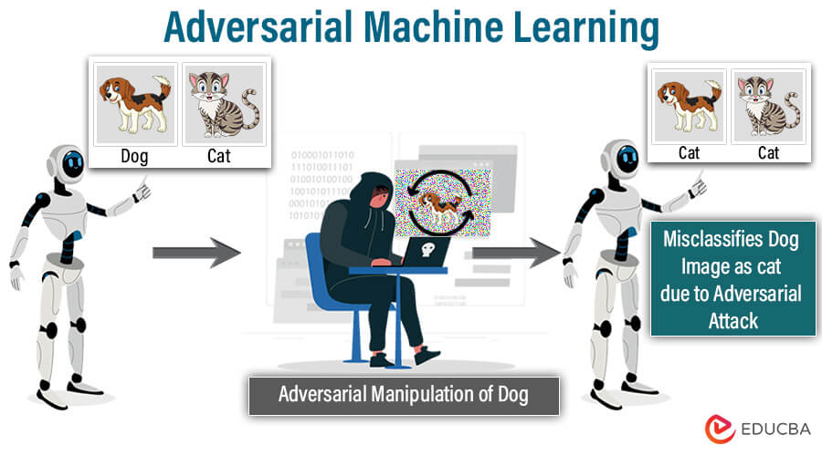
Neural Networks and Adversarial Attacks
Problem: Deep learning models are vulnerable to adversarial attacks.
Goal: Evaluate the robustness of RobustBench models by comparing FMN and AutoAttack.
Challenge: Some attacks are more effective than others under certain conditions.
https://www.educba.com/adversarial-machine-learning/
Notes:
Neural networks have revolutionized deep learning, achieving remarkable performance in various tasks. However, they suffer from a critical vulnerability: small, imperceptible perturbations—known as adversarial examples—can completely mislead their predictions.
This presents a major risk in real-world applications where security and reliability are paramount, such as cybersecurity, medical diagnosis, and autonomous driving. A subtle alteration to an input image, for example, can make a model misclassify it, which could lead to severe consequences.
To better understand and counteract this issue, researchers have developed adversarial attack methods to systematically study how these perturbations affect model performance. The robustness of deep learning models against such attacks is a crucial factor in ensuring their security and reliability

Slide 4

Project Overview – Comparing Adversarial Attacks
INSTRUCTION:
Re-evaluate 5 RobustBench models with another attack algorithm (e.g., FMN) and identify samples for which one attack works and the other doesn’t. Explain the results - i.e., provide some motivations on why one of the attacks did not work properly, while the other did.
Notes:
The project I am presenting today focuses on comparing two adversarial attack methods: AutoAttack and Fast Minimum-Norm (FMN).
To conduct this comparison, we selected five models from RobustBench, which serves as a widely recognized benchmark for evaluating adversarial robustness.
Our goal is to identify cases where one attack is successful while the other fails. By analyzing these instances, we aim to understand the underlying factors that contribute to these differences. This will provide insights into the strengths and weaknesses of each attack and their implications for model robustness

Slide 5
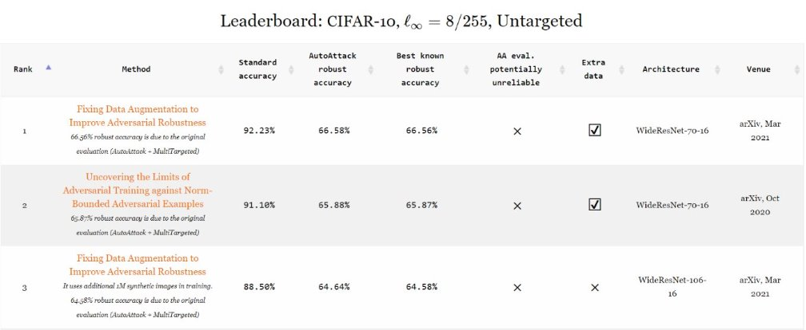
AutoAttack: A Comprehensive Adversarial Evaluation
AutoAttack is a set of 4 attacks:
APGD-CE: PGD variant based on Cross-Entropy
APGD-DLR: PGD variant with DLR Loss
FAB: Minimize the perturbation norm
Square Attack: Query-efficient black-box attack
https://github.com/fra31/auto-attack
Notes:
AutoAttack is a widely used attack framework that consists of four different adversarial attacks, each designed to exploit different vulnerabilities in deep learning models.
PGD-CE and PGD-DLR are step size-free versions of Projected Gradient Descent, designed to optimize attack success without requiring manual tuning.
FAB attack is a norm-minimization method that aims to find the smallest possible perturbation needed to fool a model.
Square Attack is a query-efficient black-box attack, which means it can fool models even without direct access to gradients.
The main advantage of AutoAttack is that it combines these diverse attack methods to provide a comprehensive evaluation of a model’s robustness. Since it does not require manual parameter tuning, it produces standardized and reliable robustness evaluations.
However, a major drawback is its computational cost. Running multiple attacks significantly increases the time required for evaluation, making it less practical for large-scale testing

Slide 6
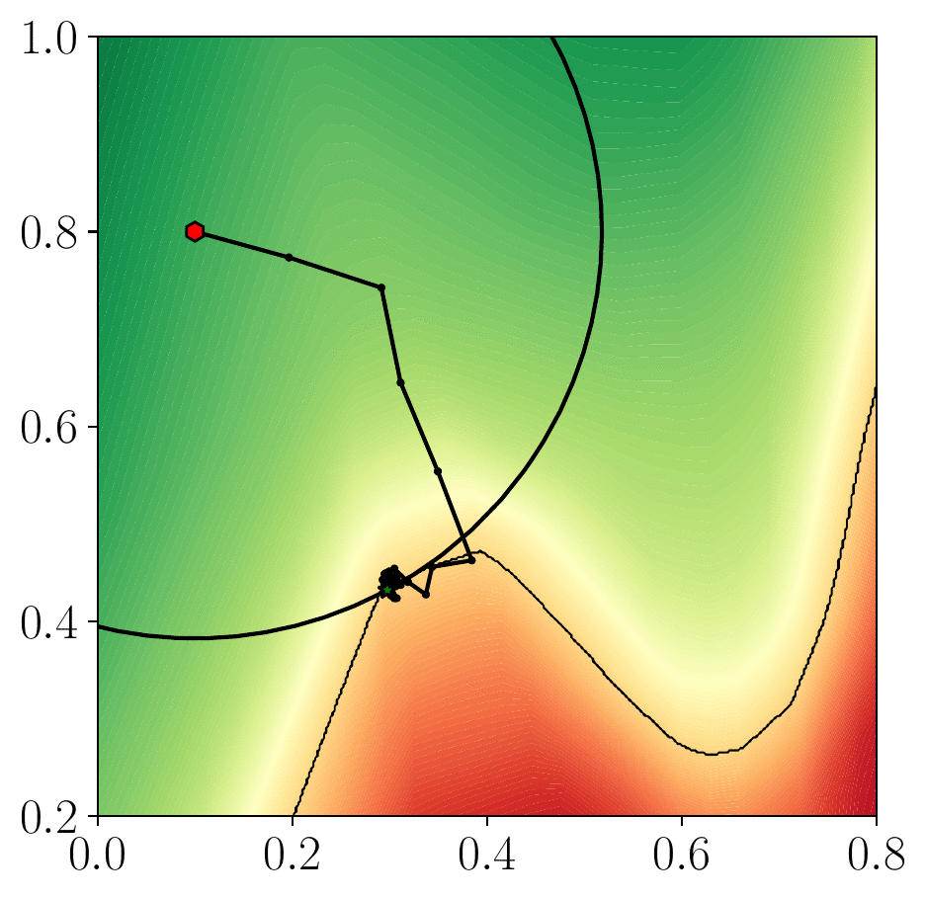
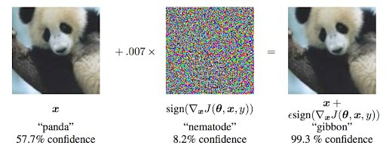
FMN: Efficient and Minimal Perturbation Attack
FMN Attack
Goal: Fool the model with the least possible perturbation.
Advantages:
Fast convergence
Works with different norms
Easy to optimize
https://github.com/pralab/Fast-Minimum-Norm-FMN-Attack
https://neptune.ai/blog/adversarial-attacks-on-neural-networks-exploring-the-fast-gradient-sign-method
Notes:
Fast Minimum-Norm (FMN) is an efficient adversarial attack that aims to generate the smallest possible perturbation needed to fool a deep learning model.
The core idea is straightforward:
FMN computes the gradient of the loss function with respect to the input image.
It perturbs the image in the direction that maximizes the model’s loss, increasing the likelihood of misclassification.
The size of this perturbation is controlled by epsilon (ε), which determines how much the final adversarial example will differ from the original.
FMN is highly efficient because it quickly converges to local optima, requiring less computational effort compared to more complex attacks. Additionally, it is flexible since it works across different perturbation norms without requiring extensive tuning.
However, it has some limitations. While FMN is designed for minimum perturbation, it does not always find the strongest adversarial examples. In some cases, AutoAttack is more effective at fooling the model due to its ensemble of multiple attack methods

Slide 7
Overview of the FMN vs. AutoAttack Comparison
Feature | AutoAttack | FMN
Attack Type | Ensemble of 4 attacks | Single attack
Objective | Robust evaluation | Minimal perturbation
Efficiency | Slower but precise | Faster
Hyperparameter-free | Yes | Yes
Norm Used | L∞​ | various norms
Application | Primarily used for robustness testing | Used for inducing adversarial perturbations
Notes:
This slide is just a little summary of the main differences between the two types of attack

Slide 8
Dataset – CIFAR-10 Models Selected from RobustBench
Dataset: CIFAR-10, L∞, eps=8/255
Model | Clean Accuracy | Architecture
Ding2020MMA | 84.36% | WideResNet-28-4
Wong2020Fast | 83.34% | PreActResNet-18
Andriushchenko2020Understanding | 79.84% | PreActResNet-18
Sitawarin2020Improving | 86.84% | WideResNet-34-10
Cui2023Decoupled_WRN-28-10 | 92.16% | WideResNet-28-10
https://github.com/RobustBench/robustbench
Notes:
The dataset used to compare attacks is CIFAR-10
CIFAR-10 is a widely used dataset in adversarial robustness research.
It consists of about 60,000 images (32x32 pixels) from 10 different classes.
Commonly used in RobustBench to evaluate adversarial robustness.
The models I chose represent a different set of architectures.
They have different levels of robustness to adversarial attacks.
They have been evaluated in previous adversarial research, which makes them suitable for comparison.

Slide 9
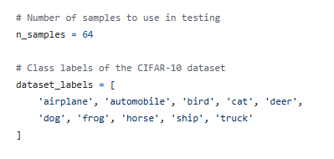
Experiment Setup – Attack Evaluation
How Were the Attacks Tested?
Each attack (AutoAttack and FMN) was run on the first 64 samples of CIFAR-10.
The evaluation focused on identifying the samples for which one attack works and the other does not and on the size of the perturbation.
The comparison highlights:
Effectiveness: which attack manages to fool the model.
Efficiency: How small the required perturbation is.
Notes:
To systematically compare AutoAttack and FMN, we conducted experiments on the first 64 samples of CIFAR-10.
The evaluation was structured around two main objectives:
Identifying samples where one attack succeeds while the other fails. This helps us understand the strengths and weaknesses of each attack in different scenarios.
Measuring the perturbation size required to fool the model. Since FMN is designed to find the smallest possible perturbation, this comparison allows us to see how much distortion is necessary for each attack to succeed.
By analyzing these factors, we gain insights into which attack is more effective under different conditions and how efficiently they generate adversarial examples

Slide 10
Results: Autoattack VS FMN
Hyperparameters | Model | Autoattack Robust Accuracy | FMN Robust Accuracy
norm='Linf’ eps=8 / 255 ********************* Only for FMN steps: 500 max_stepsize: 1.0 gamma: 0.05 | Ding2020MMA | 31.25 % | 39.06 %
 | Wong2020Fast | 37.50 % | 42.19 %
 | Andriushchenko2020Understanding | 43.75 % | 43.75 %
 | Sitawarin2020Improving | 39.06 % | 39.06 %
 | Cui2023Decoupled_WRN-28-10 | 67.19 % | 67.19 %
Notes:
Looking at the results, AutoAttack is generally more successful in fooling models because it combines multiple attack strategies, increasing the probability of bypassing model defenses. However, this comes at the cost of larger perturbations, making adversarial examples more detectable.
On the other hand, FMN is faster (about 3 times faster than AutoAttack), slightly less effective, but more efficient at minimizing perturbation norms. This makes its adversarial examples harder for humans to notice.
The attacks were conducted under L∞ norm constraints, which limit the maximum per-pixel change between the original and adversarial image. The success of FMN depends on balancing three key hyperparameters:
Steps (500): More iterations mean better precision but slower execution.
Max Step Size (1.0): Controls how aggressively the attack updates the image.
Range (0.05): Ensures gradual and stable updates.
If we want to increase attack success, we must find the right balance between step count, perturbation size (ε), and step adjustment (max_stepsize, range)."*

Slide 11
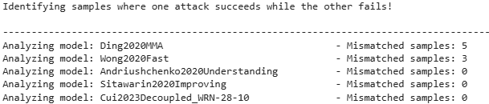
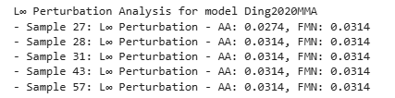
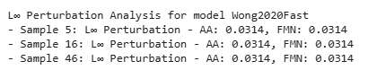
Analyzing Discordant Samples in RobustBench Models
Notes:
By analyzing the results, we identified discordant samples—cases where one attack was successful, and the other failed.
In the Ding2020MMA model, we found 5 discordant samples: 27, 28, 31, 43, and 57.
AutoAttack outperformed FMN in most cases because it applies a more aggressive perturbation strategy.
However, in sample 27, FMN was more effective—likely because it minimized the perturbation better, creating a subtle but still successful attack.
In the Wong2020Fast model, we found 3 discordant samples: 5, 16, and 46.
AutoAttack performed better overall, indicating that this model is more resistant to small perturbations (like FMN) but more vulnerable to stronger perturbations (like AutoAttack).
For the other models, we did not find any discordant samples. This suggests that FMN and AutoAttack had the same effect, meaning that these models are equally vulnerable to both types of attacks.
This analysis helps us understand the different strengths of each attack and how various models react differently to adversarial perturbations

Slide 12

Explainability in Adversarial Attacks
It improves the linear approximation by referring to a counterfactual baseline inputs.
This implements a method for local explanation of predictions via attribution of relevance to each feature.
where:
x = input image,
x′′ = baseline image (e.g., all zeros),
F(x) = model’s prediction function.
Notes:
Before continuing with the result analysis, it's crucial to discuss an important concept in adversarial attacks: explainability.
Adversarial attacks introduce subtle perturbations that can fool deep learning models. To understand their impact, we need to analyze which pixels contribute most to the model’s decision before and after the attack.
One of the most effective methods for this is Integrated Gradients (IG). IG works by:
Tracking gradients from a baseline image (e.g., a black image) to the actual input.
Accumulating these gradients to show which pixels most influence the model’s classification.
By applying Integrated Gradients, we can visualize feature importance and better understand how adversarial attacks alter model behavior. This technique provides a clearer picture of model vulnerabilities and helps us interpret attack effectiveness

Slide 13
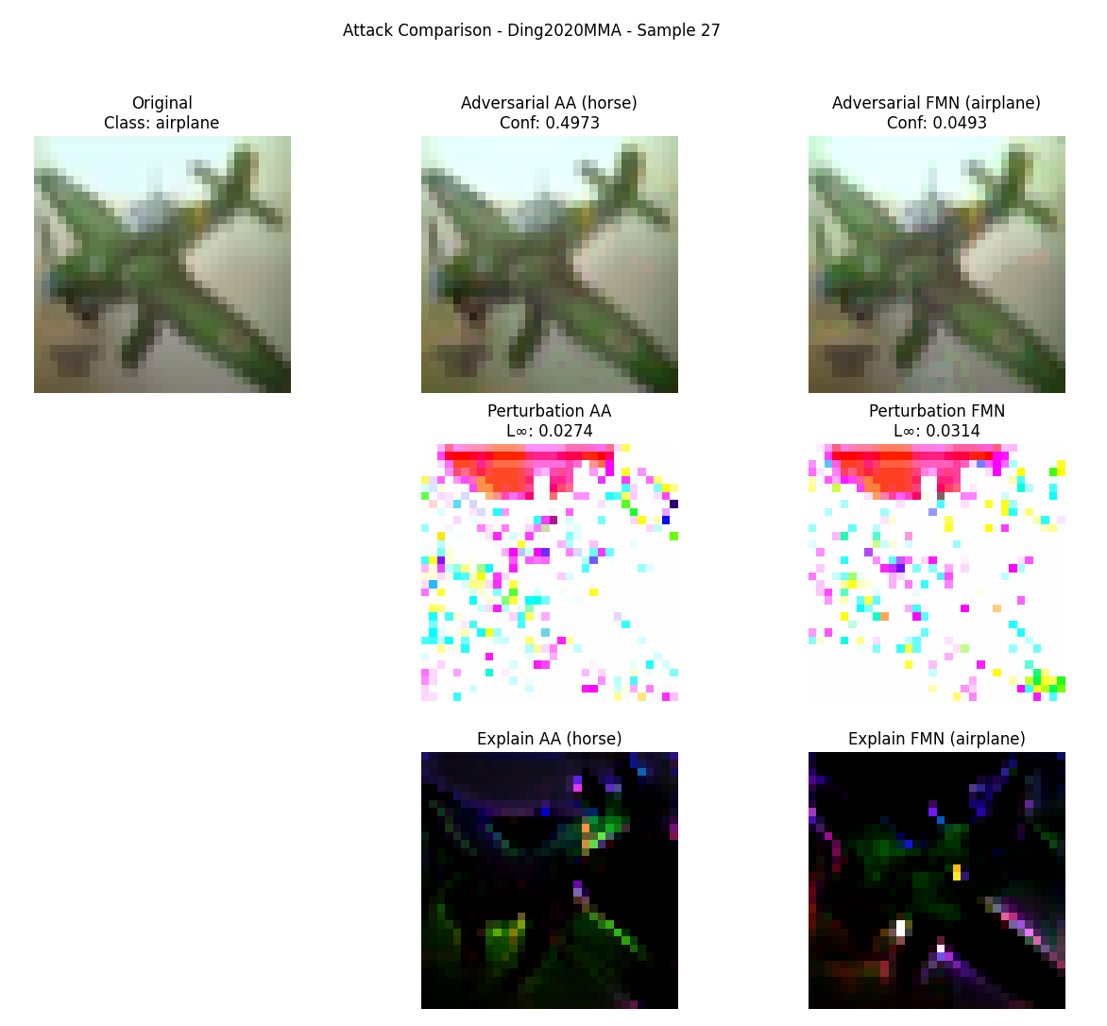
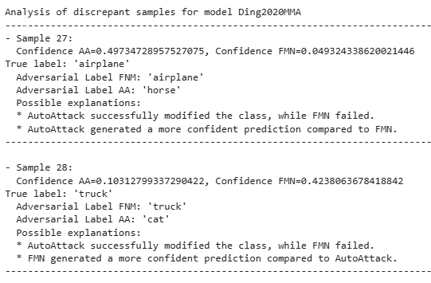
Explainability Comparison – AutoAttack vs FMN
Notes:
This slide provides an explainability-based comparison between AutoAttack and FMN.
At the top, we see three images:
Left: The original image
Center: The adversarial image generated by AutoAttack (AA)
Right: The adversarial image generated by Fast Minimum-Norm (FMN)
At the bottom, we have perturbation maps and explainability heatmaps (Integrated Gradients), showing which regions influenced the model’s decision.
AutoAttack Results
The confidence score (0.4973) indicates that the model now assigns a 49.73% probability to "horse", meaning the attack successfully altered the classification.
The perturbation map (L∞=0.0274) shows the intensity of modifications applied.
The explainability map highlights the regions most affected, showing how the attack shifted the model’s decision.
FMN Results
The model still classifies the image as "airplane" → Attack failed
The confidence score drops to 0.0493, showing the attack had an effect but was not strong enough to fool the model
The perturbation (L∞=0.0314) is slightly higher than AutoAttack’s, but less effective
The explainability heatmap shows that FMN altered fewer key features, meaning its impact on classification was lower
Key Takeaways
AutoAttack succeeded in fooling the model, proving its aggressive perturbation approach is effective.
FMN failed because it aims to minimize perturbation, which sometimes results in insufficient modifications to change the class.
Possible reasons for FMN's failure:
FMN may have found a local minimum and was unable to significantly alter the image.
The model may be more robust to FMN perturbations than to AutoAttack’s stronger ones.
The key regions altered by AutoAttack and FMN are different, leading to different classification impacts.
This comparison highlights why adversarial explainability is crucial—it helps us not only measure attack success but also understand how models react to different perturbations

Slide 14
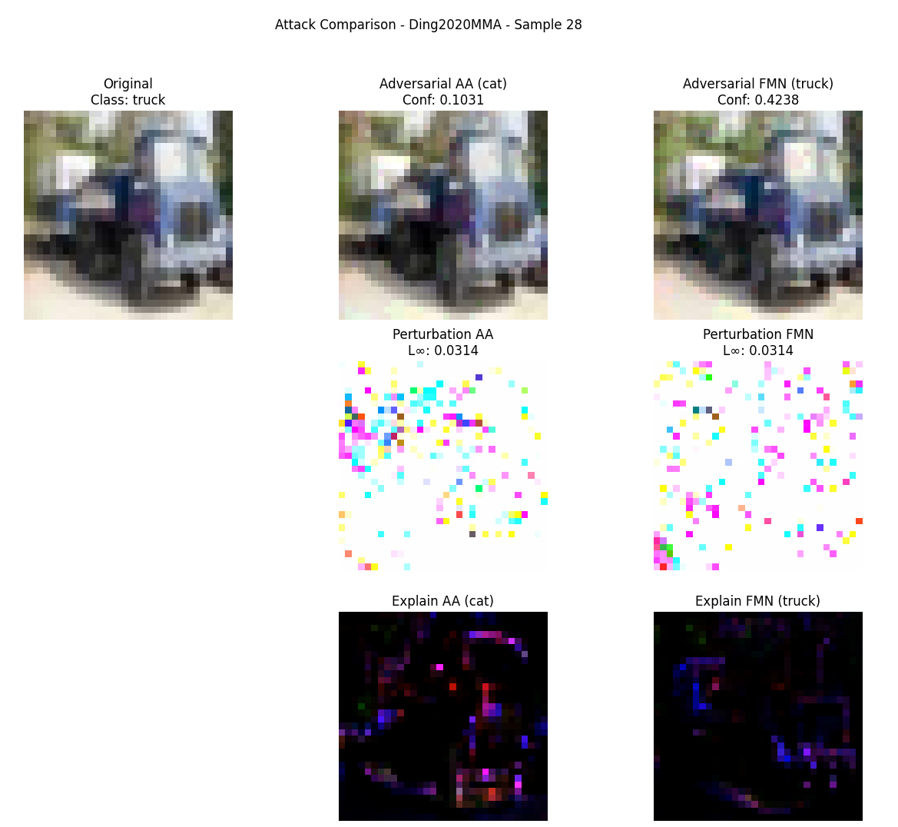
Explainability Comparison – Example 28
Notes:
This slide presents example 28, another interesting case where AutoAttack and FMN show different results.
AutoAttack Analysis
The model assigned a 10.31% probability to "cat", meaning the attack partially confused the model, but the class change was not fully convincing.
The perturbation map (L∞=0.0314) shows how AutoAttack altered specific areas of the image.
The explainability map highlights the most affected regions, showing which features contributed to the class change.
FMN Analysis
The model still classified the image as "truck" → Attack failed.
Confidence dropped to 42.38%, meaning the model was less certain but not fully misled.
Perturbation magnitude (L∞=0.0314) is similar to AutoAttack, but the distribution of noise differs, which likely explains why FMN was less effective.
The explainability heatmap suggests that FMN did not alter the most influential regions, which is why the model retained its classification.
Key Takeaways
AutoAttack was partially successful—it reduced the model’s confidence in the correct class but did not fully convince it of the new one.
FMN failed to cause a class change, likely because it prioritizes minimal perturbation, which may not be enough in some cases.
AutoAttack’s perturbation covers a wider range of key areas, making it more effective than FMN in this case.
This analysis suggests that FMN may be less effective on certain samples, possibly due to its perturbation generation strategy, which focuses on minimal distortion rather than maximizing attack success.
This example further supports the idea that AutoAttack’s broader, more aggressive strategy tends to outperform FMN in fooling deep learning models

Slide 15
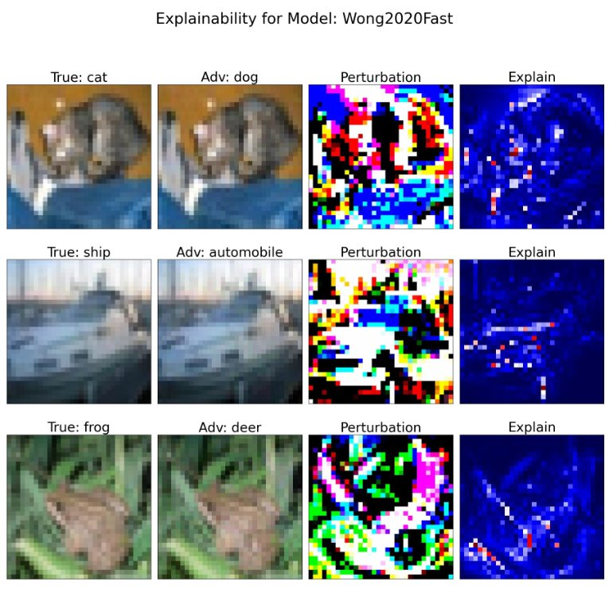
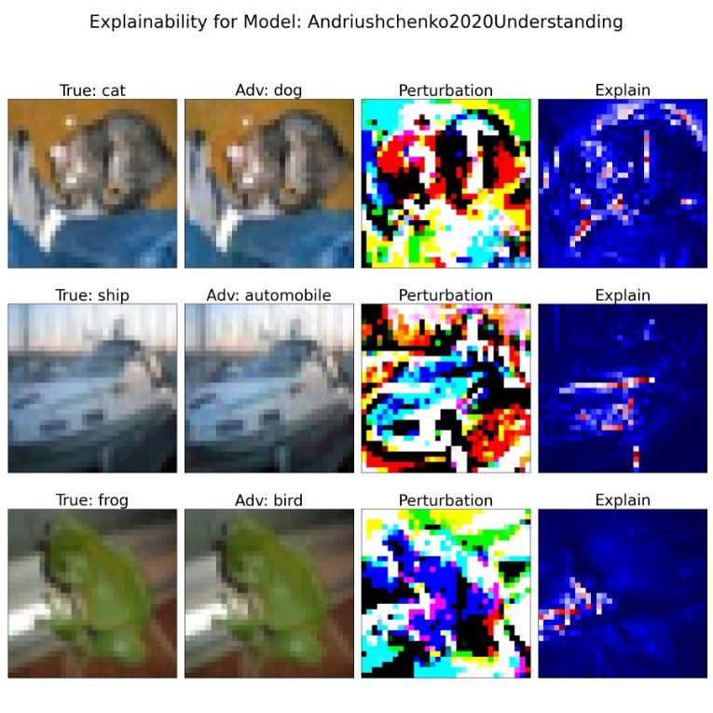
When FMN Succeeds – A Successful Minimal Perturbation Attack
Notes:
This slide presents an interesting case where FMN successfully fooled the model despite using only subtle perturbations.
Observations from Adversarial Images
The adversarial images look almost identical to the original ones, suggesting that FMN was able to mislead the model without introducing visible distortions.
The perturbations appear similar to those in previous models, but with slightly different color variations, which might have influenced the model's decision-making differently.
Explainability Map Insights
The explainability heatmap still highlights important regions in blue and red, meaning that the model relied on these areas to make its decision.
This indicates that the attack successfully redirected the model’s focus, leading to a misclassification.
Key Takeaways
FMN can succeed despite generating only minimal perturbations.
Both models are vulnerable to adversarial attacks, proving that even subtle modifications can manipulate classification decisions.
The explainability map confirms that the model shifted focus to different features, leading to misclassification with minimal changes.
This case reinforces the importance of adversarial robustness—if a model can be fooled by nearly imperceptible changes, it highlights a critical weakness in deep learning security

Slide 16
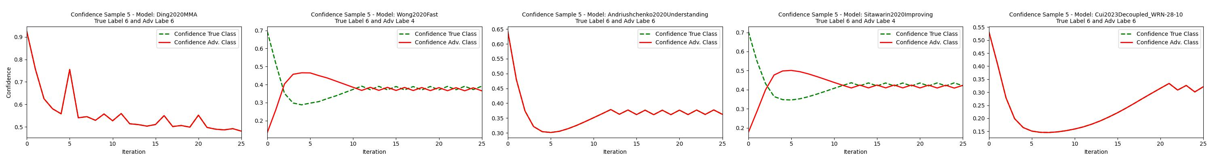
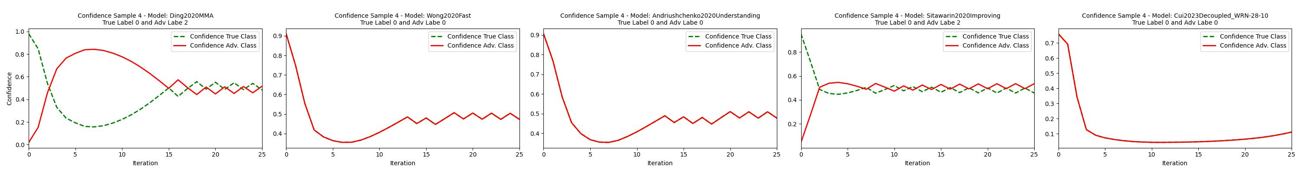
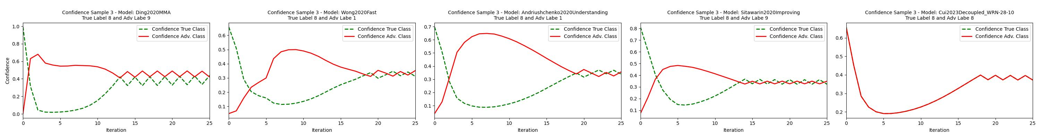
Understanding Adversarial Attacks with Convergence Plots
Notes:
Another way to analyze the impact of adversarial attacks is through convergence plots. These plots help us visualize how the confidence of a model evolves over attack iterations.
Each graph shows:
The confidence in the original class (dashed green line)
The confidence in the adversarial class (solid red line)
The X-axis represents iterations (more iterations generally lead to a more successful attack).
The Y-axis represents confidence, showing how much the model believes in a given class.
Example: Sample #3 Analysis
Ding2020MMA: Holds for a few iterations before the attack starts to succeed.
Wong2020Fast: The adversarial class confidence increases gradually.
Andriushchenko2020Understanding: The confidence in the original class decreases slowly, indicating stronger robustness.
Sitawarin2020Improving: The model initially resists but eventually fails.
Cui2023Decoupled_WRN-28-10: Most vulnerable—confidence in the original class drops almost immediately.
Key Takeaways
Model robustness varies significantly. Some models resist attacks better than others.
Andriushchenko2020Understanding appears more robust, as its confidence degrades slowly.
Cui2023Decoupled_WRN-28-10 is the most vulnerable, as its original class confidence collapses quickly.
Convergence plots help us analyze how attacks develop over time, highlighting weaknesses in model defenses.
This analysis reinforces the importance of evaluating adversarial robustness across different models, as some are much easier to fool than others

Slide 17
Summary & Future Directions
AutoAttack vs. FMN
AutoAttack showed a higher success rate, but with larger perturbations.
FMN was more efficient in terms of minimal perturbation, but with a lower success rate.
Implications for Robustness
Attack choices influence the security ratings of deep learning models.
The trade-off between effectiveness (success rate) and efficiency (minimal perturbation) is crucial.
Future Developments
Expand testing on more models and datasets.
Optimize FMN to be more effective without increasing the perturbation.
Integrate other explainability methods to improve attack understanding.
Notes:
This slide summarizes the main results of our analysis and highlights potential future directions.
Key Findings
We compared two adversarial attacks: AutoAttack and FMN.
AutoAttack was more effective, achieving a higher success rate in fooling models.
FMN was more efficient, requiring smaller perturbations, making adversarial images less detectable.
These results highlight a trade-off: stronger attacks vs. lower image distortion.
The Importance of Attack Selection
The choice of attack directly impacts the perception of model robustness.
If we evaluate a model with only one attack, we risk overestimating or underestimating its true security.
A comprehensive evaluation requires multiple attacks to gain a complete view of robustness.
Effectiveness vs. Efficiency is crucial—attacks must be powerful, but also realistic and less detectable.
Future Directions & Next Steps
Expand testing to more models and datasets to strengthen validation.
Enhance FMN, aiming to increase its success rate while maintaining minimal perturbation.
Integrate additional explainability techniques to better understand how models react to attacks and where vulnerabilities exist.
Final Takeaway
With this study, we have shown that evaluating robustness with multiple approaches is essential.
Understanding how models behave under attack helps in developing better defenses against adversarial threats.

Slide 18
Thanks for the attention
Notes:
So , the presentation is over,
Thank you for your attention!
If you have any questions, I am happy to answer.

