Slide 1

Evaluating the Robustness of AI-Based
Forensic Tools under Adversarial and
Anti-Forensic Attacks
Master’s Degree in Computer Engineering
Cybersecurity and Artificial Intelligence
Advisor
Candidate
Prof. Davide Maiorca
Lello Molinario
Co-Advisor
Student ID: 70/90/00369
Silvia Lucia Sanna, Ph.D.
Academic Year 2025/2026
Notes:
TIMING: 0:00–0:40
SPEAKER SCRIPT
Good morning. My name is Lello Molinario, and today I will present my Master's thesis entitled “Evaluating the Robustness of AI-Based Forensic Tools under Adversarial and Anti-Forensic Attacks”.
Artificial intelligence is increasingly integrated into digital forensic tools to help investigators analyze and classify relevant data. However, this introduces an important question: what happens when the data analyzed by these systems are intentionally manipulated to evade detection?
The main goal of my thesis is to investigate the operational robustness of AI-based forensic tools under adversarial and anti-forensic conditions. To study this problem experimentally, I use automated image classification as a representative case study.
MEMORY ANCHORS
AI forensic tools → relevant data → manipulation → operational robustness → image classification as case study
TRANSITION
I will start from the operational risk that motivated this work.

Slide 2
The operational risk is silent exclusion
LARGE
→
AI
→
MISS
image collections
assisted triage
relevant evidence
How does forensic image triage behave under
adversarial, anti-forensic and OOD inputs?
Clean accuracy may look reassuring while a relevant item is quietly moved out of the analyst’s priority queue.
Contribution: auditable robustness assessment—not a new firearm classifier.
Lello Molinario | MSc Thesis Defense
02
Notes:
TIMING: 0:40–1:25
SPEAKER SCRIPT
Digital investigations may involve very large amounts of data, and AI-based tools can help investigators prioritize what should be reviewed first.
However, the main operational risk is a false negative. A false positive creates additional work for the analyst, but a false negative may silently move relevant evidence out of the priority queue.
For this reason, good performance on clean data is not enough. The key question is how forensic triage behaves when the input is adversarial, anti-forensic, or out of distribution.
My contribution is therefore an auditable (oditable) robustness assessment, not the development of a new firearm classifier.
MEMORY ANCHORS
large data → AI triage → false positive = workload → false negative = silent exclusion → robustness
TRANSITION
To evaluate this problem systematically, I designed the FAIRLab protocol.

Slide 3
FAIRLab makes robustness auditable
01 · SOURCE
→
02 · VALIDATE
→
03 · FREEZE
heterogeneous pool
review + dedup
1,500 sources
↓
06 · INTERPRET
←
05 · EVALUATE
←
04 · PERTURB
normalize + interpret
3 proxies + 6 configs
10,000 variants
TRACEABILITY THROUGHOUT
deterministic identifiers · manifests · checksums · frozen configurations · source-to-output links
Lello Molinario | MSc Thesis Defense
03
Notes:
TIMING: 1:25–2:15
SPEAKER SCRIPT
FAIRLab is the experimental protocol used to make the robustness assessment traceable and auditable.
It connects six stages. I start from a heterogeneous image pool, validate and deduplicate it, and then freeze the source population. Next, I generate controlled perturbations, evaluate both transparent proxy models and commercial black-box configurations, normalize the observable outputs, and finally interpret the results in forensic terms.
Traceability is maintained throughout the process using deterministic identifiers, manifests, checksums, frozen configurations, and source-to-output links.
This is important because every reported result must be connected back to the original source and to the exact experimental condition.
MEMORY ANCHORS
source → validate → freeze → perturb → evaluate → interpret → traceability throughout
TRANSITION
The next slide shows the exact experimental population behind every comparison.

Slide 4
One population becomes 11,500 traceable files
1,500 SOURCE IMAGES
500
500
500
weapon
non-weapon
separate OOD branch
1,000 × 10 = 10,000
11,500
linked adversarial and anti-forensic variants
tool-facing files
The manipulated files are linked source–condition variants—not 10,000 independent cases.
OOD is evaluated separately and is not a third supervised class.
Lello Molinario | MSc Thesis Defense
04
Notes:
TIMING: 2:15–2:55
SPEAKER SCRIPT
The frozen population contains 1,500 source images: 500 weapon, 500 non-weapon, and 500 images in a separate out-of-distribution branch.
The 1,000 images belonging to the binary task are each linked to ten manipulated conditions, producing 10,000 adversarial and anti-forensic variants. Together with the 1,500 clean sources, the tool-facing bundle contains 11,500 files.
An important point is that these 10,000 manipulated files are not independent cases. They remain source-condition variants linked to the original images. The OOD branch is also evaluated separately (seperetly) and is not treated as a third supervised class.
MEMORY ANCHORS
1,500 sources → 500 / 500 / 500 OOD → 10,000 linked variants → 11,500 files → OOD separate
TRANSITION
Before moving to the tools, I will clarify how weapon, non-weapon and OOD play different roles.

Slide 5
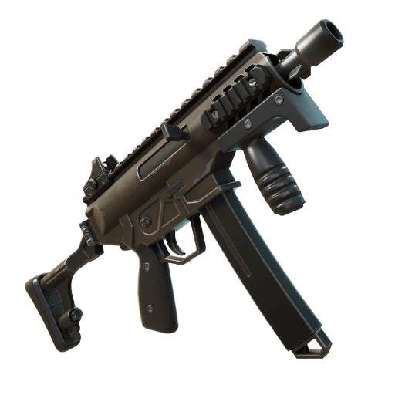
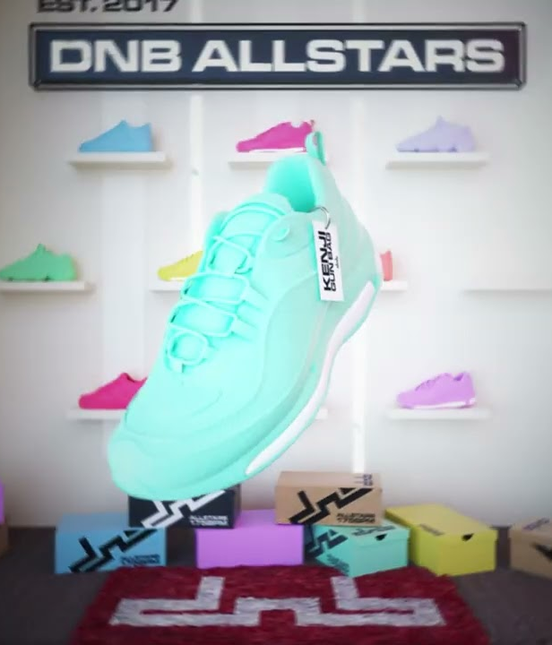
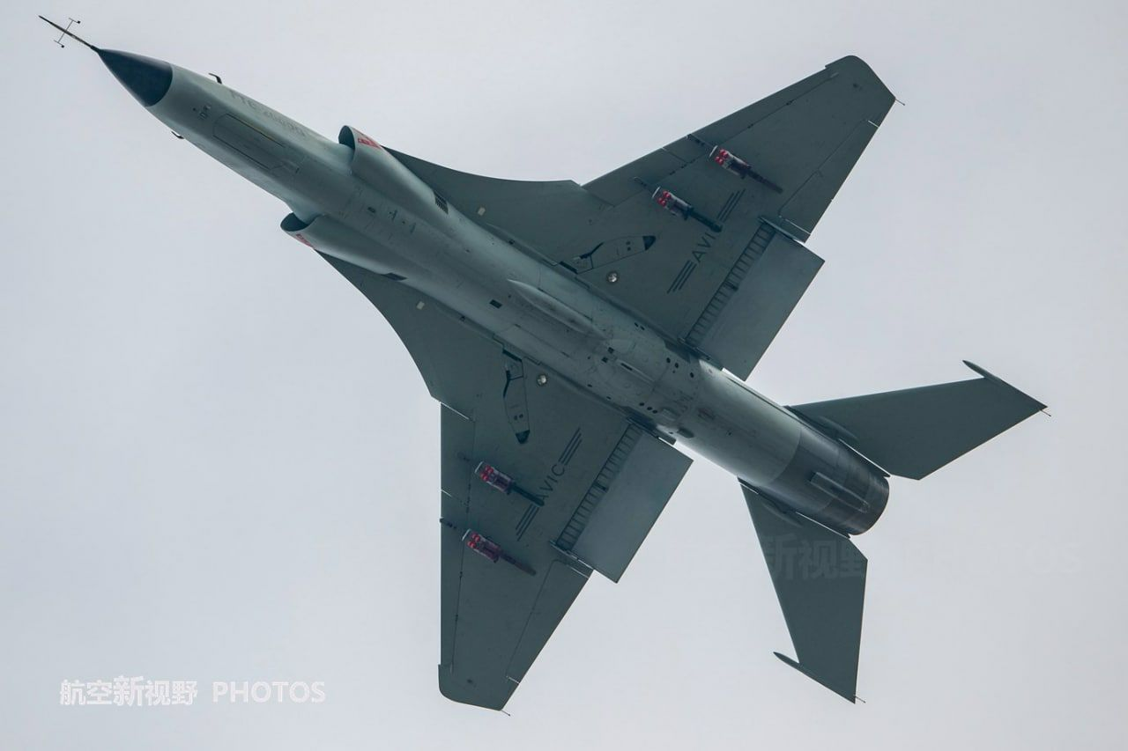
Weapon, non-weapon and OOD: distinct roles
Non_Arma.jpg
500
500
500
WEAPON
NON-WEAPON
OOD
IN-DISTRIBUTION POSITIVE
IN-DISTRIBUTION NEGATIVE
SEPARATE ROBUSTNESS BRANCH
Real firearm or firearm-like object, sufficiently visible and relevant to the binary triage task.
Realistic image with no firearm, still compatible with the visual domain of the binary task.
Borderline, synthetic, degraded, ambiguous or semantically external inputs: e.g., toys/replicas, CGI/cartoon, non-firearm weapons or war imagery.
Binary task = weapon vs non_weapon | OOD is not a third supervised class and is evaluated separately.
Lello Molinario | MSc Thesis Defense
05
Notes:
TIMING: 2:55–3:30
SPEAKER SCRIPT
Before moving to the tools, it is important to distinguish the three groups in the frozen source population.
Weapon and non-weapon form the supervised binary task. Weapon images contain a real firearm or firearm-like object that is sufficiently visible and relevant to the triage task. Non-weapon images are realistic negative samples with no firearm, but they still belong to the same visual domain.
OOD is different. It is a separate evaluation branch containing borderline, synthetic, degraded, ambiguous, or semantically external inputs, such as toys or replicas, CGI, non-firearm weapons, or war-related imagery.
So OOD is not a third supervised class. It is a stress-test branch used to observe how closed-set systems behave outside the intended binary distribution.
MEMORY ANCHORS
weapon = positive → non-weapon = negative → OOD = separate branch → not third class → stress test
TRANSITION
With this distinction clear, I can now explain the two evidence levels used in the evaluation.
[Sources]
- datasets/DATASET_CARD.md
- datasets/final/README.md

Slide 6
Two evidence levels, one experimental basis
TRANSPARENT PROXIES
BLACK-BOX SOFTWARE · 4 SYSTEMS / 6 CONFIGURATIONS
EfficientNet-B0
ResNet18
CLIP-based proxy
Magnet AXIOM / Magnet.AI
Excire Foto 2025 · D20 / D50 / D80
Cellebrite Inseyets
Magnet Griffeye / T3K CORE
All three white-box-capable · inspectable checkpoints
Observable tags · bookmarks · labels · semantic retrieval
EVALUATION PATHS
SOURCE MODEL
TRANSFER / RESPONSE
MODEL-AGNOSTIC
EfficientNet-B0: source-model evaluation
Proxy transfer · commercial empirical response
Color Shift and five anti-forensic transformations
Lello Molinario | MSc Thesis Defense
06
Notes:
TIMING: 3:30–4:25
SPEAKER SCRIPT
The evaluation uses two evidence levels.
The first level consists of three transparent, white-box-capable proxy models: EfficientNet-B0, ResNet18, and a CLIP-based supervised classifier. All three expose predictions, gradients, and fold-aware checkpoints; CLIP uses a frozen visual encoder and a supervised binary head.
The second level consists of four commercial black-box systems evaluated through six configurations. Here I can only observe analyst-visible outputs such as tags, bookmarks, labels, or semantic retrieval results.
The threat model specifies Goal, Knowledge, and Capability. The goal of model-dependent attacks is untargeted misclassification. Knowledge is gradient-based for FGSM, Sigma Zero, and the internal SuperDeepFool adapter, and score-based for One Pixel. Capability is constrained image manipulation at inference time. EfficientNet-B0 is the source model. Other proxies measure transfer, and commercial systems provide empirical responses to transferred artifacts. Color Shift and anti-forensic transformations are model-agnostic, with anti-forensics evaluated separately from adversarial attacks.
MEMORY ANCHORS
GKC: untargeted errors → gradient / score access → constrained test-time changes → source / transfer → model-agnostic conditions
TRANSITION
Because these systems expose different outputs, I need an explicit normalization step before comparing them.

Slide 7
Explicit mappings enable comparison
Observable outputs
→
Output mapping
→
Operational states
tags · bookmarks · labels · retrieval
version + configuration + export semantics
weapon · non_weapon · unknown
MISSED-TARGET RISK
REVIEW-WORKLOAD RISK
FNR
FPR
weapon → non_weapon
non_weapon → weapon
OOD weapon-assignment rate is reported separately; no unknown state occurred in 69,000 normalized decisions.
Lello Molinario | MSc Thesis Defense
07
Notes:
TIMING: 4:25–5:15
SPEAKER SCRIPT
Commercial forensic tools do not expose one common prediction interface. Depending on the tool, the observable result may be a tag, a bookmark, a label, or a retrieval hit.
For this reason, I freeze an output mapping for every tool version and configuration and normalize each observable result (rezalt) into three operational states: weapon, non-weapon, or unknown.
This allows directional errors to be compared consistently. The false-negative rate represents missed-target risk, while the false-positive rate represents additional review workload. OOD weapon assignment is reported separately because OOD images do not belong to the supervised binary task.
In the final 69,000 normalized commercial decisions, no unknown state occurred (occiurrd), but the protocol keeps this state explicit rather than silently treating unsupported output as negative.
MEMORY ANCHORS
heterogeneous outputs → frozen mapping → weapon / non_weapon / unknown → FNR = misses → FPR = workload → OOD separate
TRANSITION
With the comparison rules fixed, we can now examine (exemine) the main results.

Slide 8
Source-model collapse did not transfer uniformly
Worst observed adversarial condition per proxy; attacks were optimized only for EfficientNet-B0
EfficientNet-B0
ResNet18
CLIP proxy
CLEAN
CLEAN
CLEAN
97.8%
96.4%
92.7%
↓
−96.3 pp
↓
−4.6 pp
↓
−1.3 pp
1.5%
91.8%
91.4%
Sigma Zero · source
FGSM · transfer
FGSM · transfer
Largest anti-forensic proxy drop: 3.0 pp · ResNet18, histogram modification
Lello Molinario | MSc Thesis Defense
08
Notes:
TIMING: 5:15–6:15
SPEAKER SCRIPT
This slide distinguishes source-model evaluation from cross-model transfer.
EfficientNet-B0 reaches 97.8 percent accuracy on clean data. Under the strongest direct Sigma Zero condition, accuracy falls to 1.5 percent, corresponding to a drop of 96.3 percentage points.
However, the same generated artifacts do not transfer uniformly. The worst transferred accuracy is 91.8 percent for ResNet18 and 91.4 percent for the CLIP proxy.
These results show severe source-model vulnerability for EfficientNet-B0 and much smaller cross-model effects under the tested conditions. Limited transfer does not establish direct robustness of ResNet18 or CLIP because no attacks were optimized against them.
The largest aggregate anti-forensic proxy drop is smaller, at 3.0 percentage points, although directional errors still need to be considered.
MEMORY ANCHORS
97.8 clean → 1.5 Sigma Zero direct → −96.3 pp → limited transfer → anti-forensic aggregate drop smaller
TRANSITION
The commercial black-box results show configuration-dependent responses to the transferred artifacts.

Slide 9
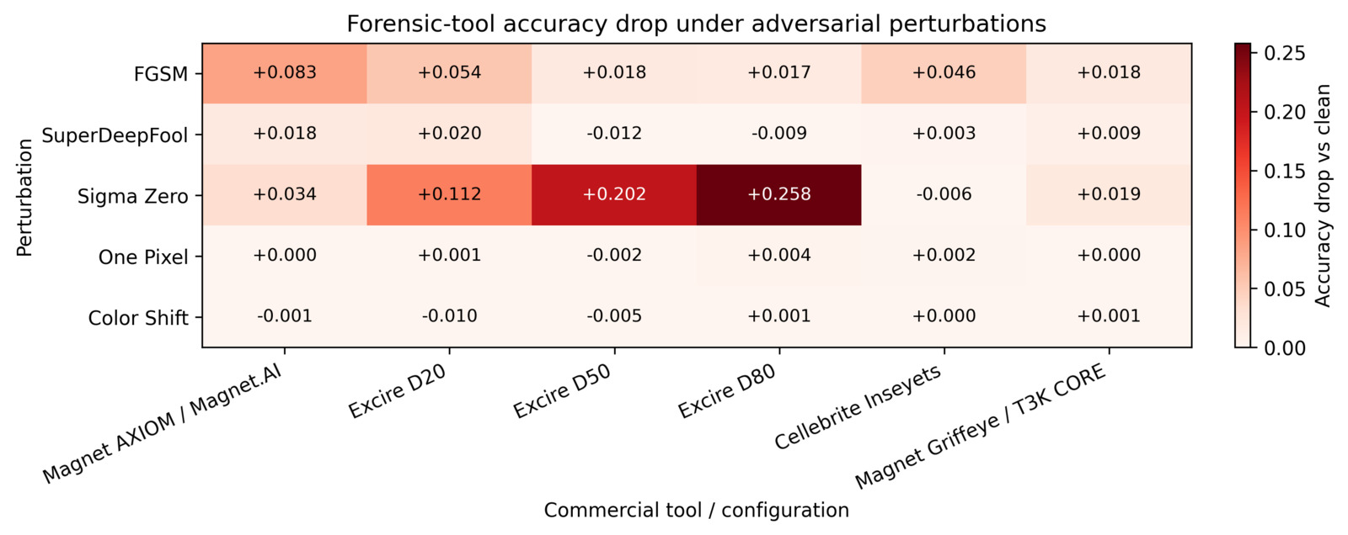
Black-box responses depended on configuration
Largest observed changes: Sigma Zero · Excire D50 −20.2 pp · D80 −25.8 pp
EfficientNet-B0 artifacts · no matched clean representation control
Lello Molinario | MSc Thesis Defense
09
Notes:
TIMING: 6:15–7:10
SPEAKER SCRIPT
This heatmap summarizes empirical responses to EfficientNet-B0-generated artifacts across the commercial black-box configurations.
I would not interpret every cell individually. The important message is heterogeneity: artifacts generated against EfficientNet-B0 produce different effects across different tools and even across different settings of the same tool.
The largest observed accuracy changes occur for Sigma Zero artifacts on Excire D50 and D80, with drops of 20.2 and 25.8 percentage points.
These artifacts were generated on EfficientNet-B0, not optimized against the proprietary models. FGSM, Sigma Zero, and SuperDeepFool were exported as 224 × 224 PNGs, while clean inputs retained native formats and sizes; One Pixel also used PNG serialization. Without a representation-matched clean control, the observed response may combine perturbation, resizing, and serialization effects.
For the same reason, this heatmap should be interpreted as a protocol-specific robustness profile, not as a universal ranking of products.
MEMORY ANCHORS
heatmap → configuration-dependent responses → D50 −20.2 pp / D80 −25.8 pp → representation caveat
TRANSITION
Configuration choices also change the ordinary clean-condition trade-off between misses and review workload.

Slide 10
A lower miss rate can create a larger review burden
Clean-condition directional error rates
EXCIRE D20 → D80
12.0% → 1.4%
missed-target rate
2.6% → 15.6%
false-positive rate
23.8% → 52.2%
OOD weapon assignment
No configuration minimizes missed targets, review workload and OOD assignments simultaneously.
Lello Molinario | MSc Thesis Defense
10
Notes:
TIMING: 7:10–8:05
SPEAKER SCRIPT
This slide shows why one overall accuracy value is not enough for forensic triage (triage).
For Excire, moving from distance 20 to distance 80 reduces the missed-target rate from 12.0 percent to 1.4 percent. This looks positive from the perspective of silent exclusion.
However, the false-positive rate increases from 2.6 to 15.6 percent, creating substantially more review work. At the same time, the OOD weapon-assignment rate increases from 23.8 to 52.2 percent.
So no configuration simultaneously minimizes missed targets, review workload, and OOD assignments. The operating point must therefore be interpreted according to the forensic use case rather than by selecting a single headline metric.
MEMORY ANCHORS
Excire D20 → D80 → FNR down 12.0 to 1.4 → FPR up 2.6 to 15.6 → OOD up 23.8 to 52.2
TRANSITION
The separate OOD branch makes this third type of behavior directly visible.

Slide 11
OOD images were still routed to weapon
Weapon-assignment rate on the separate 500-image OOD branch
83.6%
CLIP proxy
23.8–52.2%
black-box range
These are closed-set operating behaviors—not supervised false positives.
Lello Molinario | MSc Thesis Defense
11
Notes:
TIMING: 8:05–8:55
SPEAKER SCRIPT
All evaluated systems assign at least some out-of-distribution images to the weapon-oriented state.
The CLIP proxy reaches an OOD weapon-assignment rate of 83.6 percent, while the commercial configurations range from 23.8 to 52.2 percent.
These values must be interpreted carefully. OOD images are not part of the supervised weapon versus non-weapon task, so these are not ordinary supervised false-positive rates. They describe closed-set operating behavior when the system is forced to process inputs outside the intended binary distribution.
For CLIP (Contrastive Language-Image Pre-training), the reported value aggregates five fold-specific responses for each of the 500 OOD images. Each commercial configuration instead produces one normalized decision per OOD image.
MEMORY ANCHORS
OOD → weapon assignment exists in every system → CLIP 83.6 → black-box 23.8–52.2 → not supervised FPR
TRANSITION
The next example shows why even a maximally concentrated model output does not guarantee correctness.

Slide 12

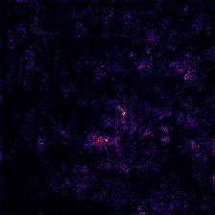

A maximally concentrated output can still be wrong
xai_case_0015
REFERENCE
PREDICTION
non_weapon
weapon
MAX-P
Perturbed input
IG magnitude
Attribution overlay
1.000
Sigma Zero
predicted class
qualitative only
Integrated Gradients supports diagnosis of selected proxy outputs.
It does not certify correctness, calibrate confidence, or explain proprietary black-box systems.
Lello Molinario | MSc Thesis Defense
12
Notes:
TIMING: 8:55–9:40
SPEAKER SCRIPT
This is a qualitative explainability example from the transparent proxy analysis.
In case 0015, the reference class is non-weapon. After the Sigma Zero perturbation, the proxy predicts weapon with a maximum predicted-class probability of 1 hundred percent.
Integrated Gradients is used here to inspect where the selected proxy response is concentrated. However, I deliberately keep the claim limited. The attribution is a diagnostic aid: it does not certify that the prediction is correct, it does not calibrate confidence, and it does not explain the internal behavior of proprietary black-box tools.
The important point is that a highly concentrated or apparently confident output can still be wrong.
MEMORY ANCHORS
case 0015 → non_weapon reference → Sigma Zero → weapon prediction → max-P 1.000 → IG diagnostic only
TRANSITION
These findings lead to a simple operational principle for the use of AI in forensic triage.

Slide 13
Human review remains the final decision gate
01
02
03
04
AI outputs
Prioritized queue
Human review
Documented action
tags · labels
semantic matches
workload
reduction
contextual
validation
defensible
forensic workflow
TRACE EVERY DECISION
tool version
configuration
output mapping
validation context
Use AI to prioritize evidence review—never to silently exclude it.
Lello Molinario | MSc Thesis Defense
13
Notes:
TIMING: 9:40–10:20
SPEAKER SCRIPT
AI can still provide substantial value in forensic workflows, but it should support prioritization rather than irreversible exclusion.
The AI output can create a prioritized review queue and reduce workload. The human analyst then validates the result in context and makes the final decision.
At the same time, each decision should preserve the tool version, configuration, output mapping, and validation context. This makes the workflow traceable and defensible.
The practical rule is therefore simple: use AI to prioritize evidence review, but never allow it to silently exclude potentially relevant evidence without human review.
MEMORY ANCHORS
AI output → prioritized queue → human review → documented action → trace every decision
TRANSITION
Before concluding, I will state the main boundaries of the study.

Slide 14
Claim boundaries keep the result defensible
CLAIM BOUNDARIES
METADATA SENSITIVITY
Corpus
1,500 images; one reviewer
15
of 11,500 files
Perturbations
one setting; bounded attack budgets
matched a predefined sensitive metadata term
Attack source
source model: EfficientNet-B0
Black-box
tool version + settings + output mapping
Leave-out differences were small
This does not prove causal irrelevance for every decision.
Legal scope
operational triage only; no legal claim
Protocol-specific assessment—not certification or universal ranking.
Lello Molinario | MSc Thesis Defense
14
Notes:
TIMING: 10:20–11:05
SPEAKER SCRIPT
The results should be interpreted within the boundaries of the frozen protocol.
The main limitations are the 1,500-image corpus with one reviewer, one setting per perturbation, the bounded One Pixel search, and generation only on EfficientNet-B0. SuperDeepFool results concern an internal single-cycle L2 adapter rather than the full published method. Commercial responses also depend on tool version, configuration, output mapping, and representation differences from native clean inputs.
I also evaluated possible metadata sensitivity. Fifteen of the 11,500 files matched a predefined sensitive metadata term. The leave-out differences were small, but this does not prove that metadata was causally irrelevant to every individual decision.
Finally, this work evaluates operational triage robustness. It does not claim legal admissibility, certification, or a universal ranking of commercial products.
MEMORY ANCHORS
1,500 / one reviewer → fixed budgets → internal SDF adapter → EfficientNet source → representation caveat → no legal claim
TRANSITION
I will finish with three messages to remember.

Slide 15

AI can prioritize evidence;
it must not silently exclude it.
01
Clean performance is only the baseline; robustness is condition-dependent.
02
Source evaluation, transfer, OOD and configuration trade-offs remain distinct.
03
FAIRLab makes those dimensions traceable, auditable and reviewable by a forensic expert.
Notes:
TIMING: 11:05–11:45
SPEAKER SCRIPT
I would like to conclude with three points.
First, clean performance is only the baseline. Robustness is condition-dependent, so clean accuracy alone is not sufficient.
Second, source-model evaluation, cross-model transfer, commercial responses, out-of-distribution behavior, and configuration trade-offs are different dimensions and should be interpreted separately.
Third, FAIRLab makes these dimensions traceable, auditable, and reviewable by a forensic expert.
The final message of the thesis is therefore: AI can prioritize evidence, but it must not silently exclude it.
MEMORY ANCHORS
clean is baseline → separate robustness dimensions → FAIRLab = traceable and auditable → AI prioritizes, never silently excludes
TRANSITION
Thank you for your attention.

Slide 16

Evaluating the Robustness of AI-Based
Forensic Tools under Adversarial and
Anti-Forensic Attacks
Thank you for listening!
Any questions?

Slide 17
Research questions and claim scope
RQ1
To what extent do the proxy models retain clean-baseline performance across separate OOD, adversarial and anti-forensic conditions?
RQ2
How do proxy responses differ across source-model evaluation, cross-model transfer and model-agnostic Color Shift?
RQ3
How do black-box outputs and configuration choices shape the observed operational profiles?
RQ4
Which directional errors, degradations, OOD assignments and unknown states matter for continued human review?
Scope: operational robustness under the frozen protocol—not certification, legal admissibility or universal ranking.
Lello Molinario | MSc Thesis Defense
B1
Notes:
BACKUP B1 — RESEARCH QUESTIONS AND CLAIM SCOPE
USE WHEN
The commission asks: “What are your formal research questions?” or “What exactly does the thesis claim?”
COMMISSION ANSWER
The thesis has four research questions. RQ1 evaluates proxy behavior under separate OOD, adversarial, and anti-forensic conditions. RQ2 compares proxy responses under source-model evaluation, empirical cross-model transfer, and model-agnostic Color Shift. RQ3 examines black-box outputs and configuration-dependent profiles. RQ4 addresses directional errors, degradations, OOD assignments, and unknown states relevant to continued human review.
The claim scope is deliberately limited: this is an operational robustness assessment under one frozen and traceable protocol. It is not a certification, a legal-admissibility assessment, or a universal product ranking.
KEY WORDS
RQ1 conditions → RQ2 source evaluation / cross-model transfer / Color Shift → RQ3 configurations → RQ4 directional errors

Slide 18
GKC threat model and perturbation suite
ADVERSARIAL / ADVERSARIAL-STYLE
ANTI-FORENSIC TRANSFORMATIONS
FGSM · gradient-based
One Pixel · score-based
Sigma Zero · gradient-based
SuperDeepFool · gradient-based
Color Shift · deterministic, model-agnostic
JPEG recompression
Resample / resize
Gaussian blur
Histogram modification
Contrast stretching
Goal: untargeted model-dependent attacks. Knowledge: gradients or scores.
Capability: constrained image changes at inference time (evasion).
Lello Molinario | MSc Thesis Defense
B2
Notes:
BACKUP B2 — GKC THREAT MODEL AND PERTURBATION SUITE
USE WHEN
The commission asks: “What is your threat model?” or “Which attacks and transformations did you evaluate?”
COMMISSION ANSWER
The adversarial or adversarial-style group includes FGSM, One Pixel, Sigma Zero, SuperDeepFool, and deterministic Color Shift. The anti-forensic group includes JPEG recompression, resampling or resize, Gaussian blur, histogram modification, and contrast stretching.
The adversarial threat model uses Goal, Knowledge, and Capability. Goal: the model-dependent attacks seek untargeted misclassification. Knowledge: FGSM, Sigma Zero, and the internal SuperDeepFool adapter use gradients, while One Pixel uses scores. Capability: the attacker modifies image inputs at inference time within the constraints of each condition, without altering model training. All three proxies are inspectable and white-box-capable, but only EfficientNet-B0 was used for model-dependent generation. ResNet18 and CLIP measure cross-model transfer; commercial systems provide empirical responses. Color Shift and the anti-forensic transformations are model-agnostic, with anti-forensics evaluated separately from adversarial attacks.
KEY WORDS
Goal: untargeted errors → Knowledge: gradient / score / model-agnostic → Capability: constrained evasion → source / transfer / commercial response

Slide 19
Traceability links sources to reported figures
SOURCE
DERIVATION
DECISION
METRIC
REPORT
dataset manifests
manual review
split + attack manifests
source–condition IDs
proxy predictions
normalized tool outputs
condition tables
directional errors
thesis figures
conclusion tables
Integrity and audit controls
SHA-256 digests for datasets, bundles, checkpoints and controlled artifacts
Frozen model, tool-version and configuration registries
Explicit output-normalization rules and unmatched/unknown handling
Repository scripts regenerate metrics and thesis-ready reporting assets
Lello Molinario | MSc Thesis Defense
B3
Notes:
BACKUP B3 — TRACEABILITY AND REPRODUCIBILITY
USE WHEN
The commission asks: “How can a reported result be audited?” or “How reproducible is the experiment?”
COMMISSION ANSWER
A reported result can be followed through a complete chain. I start from the source manifest and manual review, then use the source-condition identifier to link the derived variant. From there I can identify the proxy prediction or normalized commercial output, the metric table, and finally the figure or conclusion reported in the thesis.
Integrity is supported by SHA-256 digests, frozen model and tool-version registries, frozen configurations, and explicit normalization rules. The repository scripts regenerate the main metrics and thesis-ready reporting assets.
KEY WORDS
source → derivation → decision → metric → report → SHA-256 → frozen registries

Slide 20
Commercial clean metrics and OOD behavior
Configuration | Accuracy | Recall | FNR | FPR | OOD W-rate
Magnet.AI | 95.0% | 93.0% | 7.0% | 3.0% | 36.0%
Excire D20 | 92.7% | 88.0% | 12.0% | 2.6% | 23.8%
Excire D50 | 94.4% | 95.8% | 4.2% | 7.0% | 34.0%
Excire D80 | 91.5% | 98.6% | 1.4% | 15.6% | 52.2%
Cellebrite Inseyets | 96.4% | 96.8% | 3.2% | 4.0% | 29.2%
Griffeye / T3K | 97.8% | 96.4% | 3.6% | 0.8% | 26.0%
Interpret the rows as frozen operating profiles; the metrics do not establish a universal product ranking.
Lello Molinario | MSc Thesis Defense
B4
Notes:
BACKUP B4 — COMMERCIAL CLEAN METRICS AND OOD BEHAVIOR
USE WHEN
The commission asks for an exact number or compares two commercial configurations.
COMMISSION ANSWER
This table reports clean binary accuracy, recall, false-negative rate, false-positive rate, and a separate OOD weapon-assignment rate for each frozen configuration.
For example, Griffeye/T3K has 97.8 percent clean accuracy and 0.8 percent FPR in this protocol, while Excire D80 has the lowest FNR at 1.4 percent but a much higher FPR of 15.6 percent and an OOD weapon-assignment rate of 52.2 percent.
I would not use the table to declare a universally best product. These rows describe operating profiles under specific tool versions, settings, mappings, and one frozen dataset.
KEY WORDS
exact numbers → clean and OOD separate → operating profiles → no universal ranking

Slide 21
Fixed adversarial settings and claim boundaries
GRADIENT / SCORE-BASED
SPARSE / BOUNDARY-BASED
FGSM · ε = 8/255 · untargeted
fold-aware white-box checkpoint
One Pixel · one-pixel DE
50 iters · pop. 100 · seed 42
Sigma Zero · 1,000 reference steps
η₀ = 1.0 · σ = .001 · τ₀ = .3
SuperDeepFool · internal L₂ adapter
1 cycle · 50 inner · 1 projection
Source model: EfficientNet-B0 · PNG outputs
Color Shift: R +12 / G 0 / B −12 · saturation 1.10 · JPEG quality 95
Lello Molinario | MSc Thesis Defense
B5
Notes:
BACKUP B5 — FROZEN ADVERSARIAL SETTINGS
USE WHEN
The commission asks: “Which attack parameters did you use?” or “Were the attacks reproducible?”
COMMISSION ANSWER
FGSM uses a fixed epsilon of 8/255, with precedent in RobustBench CIFAR evaluation; this is not a forensic standard, and no epsilon sweep was performed. One Pixel uses score-based Differential Evolution over x, y, R, G, and B, with 50 maximum iterations, 100 candidates, seed 42, and stopping at a generation boundary after misclassification. This is a smaller budget than the original 400-candidate, 100-iteration setting; limited effectiveness does not establish general robustness.
Sigma Zero uses the defaults of the pinned adversarial-library reference function: 1,000 steps, eta zero 1.0, sigma 0.001, tau zero 0.3, threshold factor 0.01, and infinity-norm gradient normalization. The internal SuperDeepFool adapter uses L2 geometry, at most 50 DeepFool iterations, and one projection. Although the configured outer cap is 20, all 1,000 records show one executed cycle; failed projection falls back to the boundary point. This differs from the repeated boundary/projection procedure of published SDF infinity-one. Infinity denotes the inner iteration variant, not an L-infinity perturbation norm. Results describe this bounded internal adapter; Color Shift remains model-agnostic.
KEY WORDS
FGSM fixed 8/255 → One Pixel bounded 50/100 → Sigma Zero reference defaults → SDF internal L2 / one cycle

Slide 22
Frozen anti-forensic settings
SPATIAL / COMPRESSION
TONAL
JPEG · q70 · dimensions unchanged
Resize · 50% down/up · bicubic
Gaussian blur · radius 1.5
Histogram · per-channel equalization
Contrast · autocontrast · 1% cutoff
Other outputs · JPEG q95
Model-agnostic · 1,000 source-linked artifacts per condition
One fixed setting; no severity-response curve
Lello Molinario | MSc Thesis Defense
B6
Notes:
BACKUP B6 — FROZEN ANTI-FORENSIC SETTINGS
USE WHEN
The commission asks: “How did you control the anti-forensic transformations?”
COMMISSION ANSWER
Each anti-forensic condition uses one frozen, model-agnostic setting. JPEG recompression uses quality 70 without changing dimensions. Resize downsamples to 50 percent and restores the original size with bicubic interpolation. Gaussian blur uses radius 1.5. Histogram modification applies per-channel equalization, while contrast stretching uses autocontrast with a 1 percent cutoff.
The other transformations use JPEG quality 95. Each condition contains 1,000 source-linked artifacts for controlled paired comparison at one predefined setting. These results characterize the tested conditions, not a complete severity-response curve.
KEY WORDS
JPEG q70 → resize 50% bicubic → blur 1.5 → histogram equalization → autocontrast 1% → frozen/model-agnostic

Slide 23
How heterogeneous outputs became comparable
MAGNET
‘Possible weapons’ tag → weapon
GRIFFEYE
T3K ‘CORE/Violence/Firearm’ bookmark → weapon
EXCIRE
Hit in ≥1 of eight firearm-prompt lists → weapon · D20 / D50 / D80 kept separate
INSEYETS
Cellebrite: ‘Armi’, ‘Pistola’ or ‘Fucile’ classification → weapon
true → weapon · false → non_weapon · unsupported → unknown · 0 unknown in 69,000 decisions
Lello Molinario | MSc Thesis Defense
B7
Notes:
BACKUP B7 — BLACK-BOX OUTPUT NORMALIZATION
USE WHEN
The commission asks: “How did you compare tools that produce different kinds of outputs?”
COMMISSION ANSWER
I did not assume that the commercial systems expose the same classifier interface. Instead, I defined a frozen mapping for the analyst-visible output of each system.
Magnet uses the “Possible weapons” tag. Griffeye/T3K uses the CORE/Violence/Firearm bookmark. Excire uses a hit in at least one of eight frozen firearm-oriented prompt lists, with D20, D50, and D80 kept as separate configurations. Cellebrite uses the “Armi”, “Pistola”, or “Fucile” classifications.
The observable states are mapped to weapon, non-weapon, or unknown. Unsupported output is never silently converted to negative. No unknown state occurred in the final 69,000 normalized decisions.
KEY WORDS
observable outputs → frozen mapping → per-tool rule → unsupported = unknown, never negative → 0 unknown final

Slide 24
Metric denominators keep comparisons honest
ACC
Correct decisions / evaluated binary outputs
FNR
FN / (TP + FN) = 1 − recall · missed-target risk
FPR
FP / (FP + TN) · review-workload risk
OOD
Weapon assignments / OOD responses · reported separately
Proxy OOD: 5 folds × 500 = 2,500 responses · commercial OOD: 500 decisions/configuration
Lello Molinario | MSc Thesis Defense
B8
Notes:
BACKUP B8 — METRIC FORMULAS AND DENOMINATORS
USE WHEN
The commission asks about FNR, FPR, OOD rates, or why denominators differ.
COMMISSION ANSWER
Accuracy is the proportion of correct evaluated binary decisions. FNR is false negatives divided by true positives plus false negatives, so operationally it represents missed-target risk. FPR is false positives divided by false positives plus true negatives, so it represents additional review workload.
OOD weapon assignment is reported separately because OOD images do not belong to the supervised weapon/non-weapon task. For proxy OOD evaluation, five fold-specific checkpoints produce 2,500 responses from 500 images. Each commercial configuration produces one decision per OOD image, so its denominator is 500. Unknown outputs would be excluded from binary denominators and reported separately.
KEY WORDS
FNR = misses → FPR = workload → OOD separate → proxy denominator 2,500 → commercial denominator 500

Slide 25
Limitations define the next validation steps
BOUNDARY → NEXT STEP
FUTURE VALIDATION
Corpus
larger, heterogeneous, multi-reviewer sets
5
next steps
Conditions
sweeps; full SDF; matched controls
across data, tools and time
Tools
repeat across versions; track drift
Modalities
extend beyond still images
Generalizability must be tested
not assumed from one frozen protocol.
Governance
stronger audit and review controls
Expand the protocol without weakening traceability.
Lello Molinario | MSc Thesis Defense
B9
Notes:
BACKUP B9 — LIMITATIONS AND FUTURE VALIDATION
USE WHEN
The commission asks: “What would you do next?” or “How generalizable are these results?”
COMMISSION ANSWER
Further validation should use larger and more heterogeneous datasets with multiple reviewers, test parameter sweeps and matched attacks, evaluate the full iterative SuperDeepFool method, and include representation-matched clean controls. It should also repeat commercial evaluations across versions, extend beyond still images, and strengthen audit and human-review controls. These are future experiments, not results of the current study.
The objective is not simply to maximize accuracy. It is to test whether the observed operating profiles remain stable across data, tools, conditions, and time while preserving the traceability of every experimental decision.
KEY WORDS
larger multi-reviewer data → parameter sweeps/adaptive attacks → version drift → other modalities → stronger governance → preserve traceability

