Slide 1
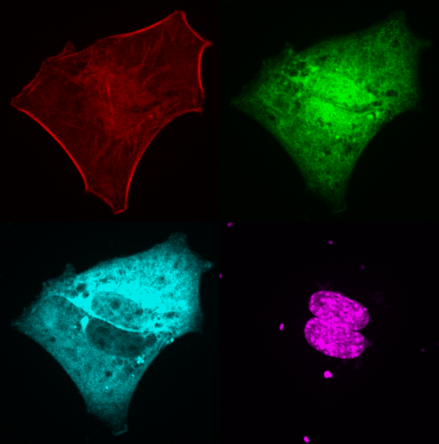
Role of MRTF as a mediator of mechanotransduction in the muscle cell
Lorraine Montel
PhD student 3rd year
Complex Systems and Materials University Paris Diderot
Sylvie Hénon
Collaboration :
Genetics, Development and Physiology
of Skeletal muscle
Institut Cochin
Athanassia Sotiropoulos

Slide 2

Mechanotransduction
Mechanical
Signal
Biological
Response
Mechanotransduction in the muscles
Mechanical Overload
No Mechanical Load
Exercise
Compensation
Immobilization
Denervation
Low gravity environment
HYPERTROPHY
ATROPHY
Right-handed javelin thrower
with bigger arm due to exercise

Slide 3
Mechanotransduction
Mechanical
Signal
Biological
Response
How does that work ?
Mechanical Overload
No Mechanical Load
Exercise
Compensation
Immobilization
Denervation
Low gravity environment
HYPERTROPHY
ATROPHY
Right-handed javelin thrower
with bigger arm due to exercise

Slide 4
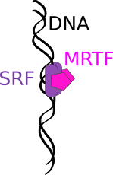
Serum Response Factor
Chromatin remodeling
Muscle adaptation
~ 900 target
genes
Muscle
differenciation
Muscle
development
Cytoskeleton
Migration/Invasion
EMT
Platelets
Cancer
Neural development

Slide 5
Srf is necessary for mechanically-induced hypertrophy/atrophy
 | WT | SRF loss of function | Active SRF | Nuclear MRTF
Overload
Denervation
Caloric Restriction
Work from the Sotiropoulos group from Insitut Cochin

Slide 6
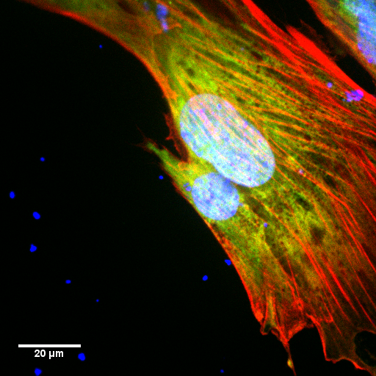
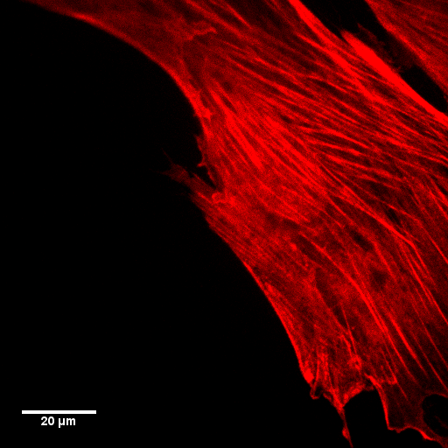
The actin cytoskeleton
Stress fibers
Cortex
Red : Filaments of actin
Green : Globular actin
Blue : DNA

Slide 7
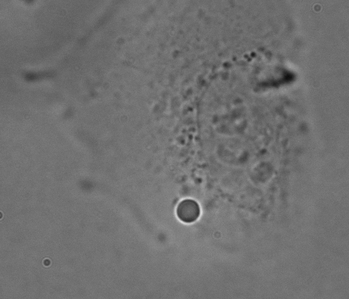
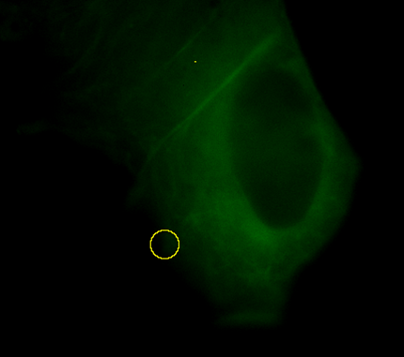
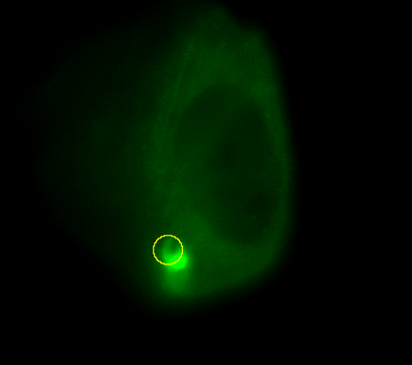
Mechanical cues induce modification
of the actin cytoskeleton
C2C12 mouse myoblast
GFP Actin
F_{trap}
5 µm
Before
After 60 minutes
Icard-Arcizet D. et al , Sylvie Hénon team
Notes:
Cells are continuosly exposed to mechanical cues such as compression or stretching.
These mechanical cues are known to induce a re-organization of cell cytoskeleton.
Applied stress to cells induces the formation of actin stress fibers that are important for cell motiliy and contractility.
In the second movie you can see that the application of a force in a precise site of the cell
induce the formation of an actin network at the site in which the force is applied

Slide 8
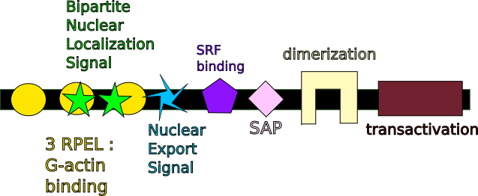
Myocardin-Related Transcription Factor : a G-actin sensor
NLS included in G-actin binding zone, linking actin binding and MRTF localization

Slide 9
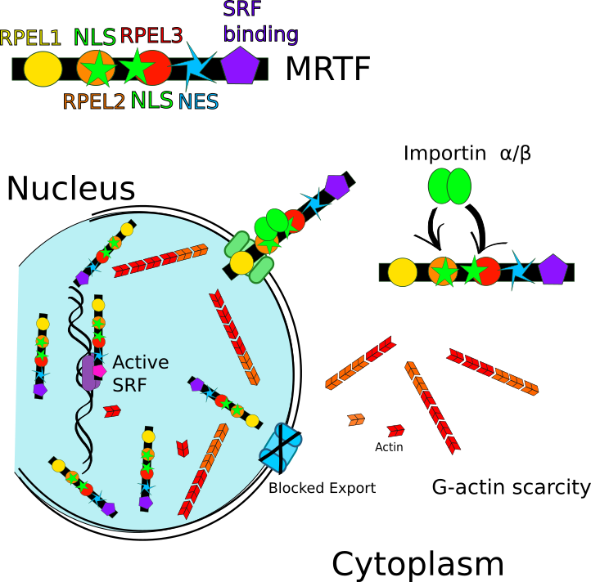
Nuclear MRTF in G-actin scarcity

Slide 10
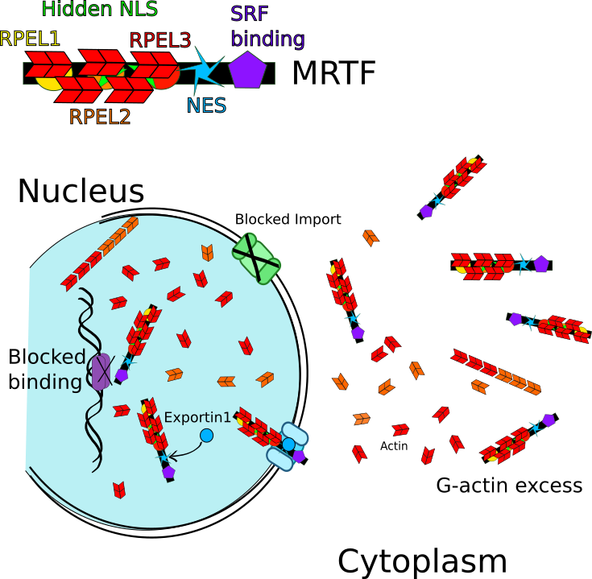
Cytoplasmic MRTF in G-actin Excess

Slide 11
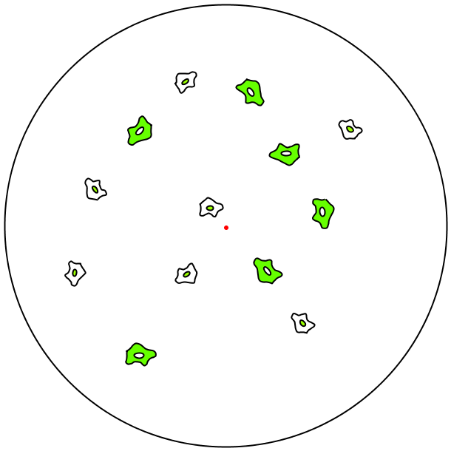

Experimental Set-up: Myoblasts on stretched PDMS substrate
Stretchable PDMS
C2C12 Myoblasts
MRTF-A GFP localization read-out
$$R_{0}$$

Slide 12
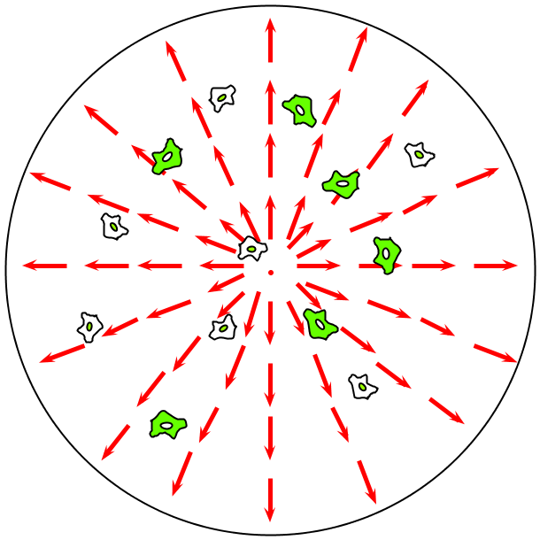
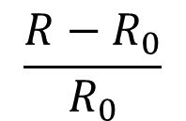
Experimental Set-up: Myoblasts on stretched PDMS substrate
Uniform radial constant strain
Strain rate :
$$\frac{{R−R}_{0}}{R_{0}}$$
R
MRTF-A GFP localization
read-out

Slide 13



Localization of MRTF-A
Cytoplasmic
Homogeneous
Nuclear
MRTF-A GFP
Actin mCherry
DAPI (Nucleus)

Slide 14
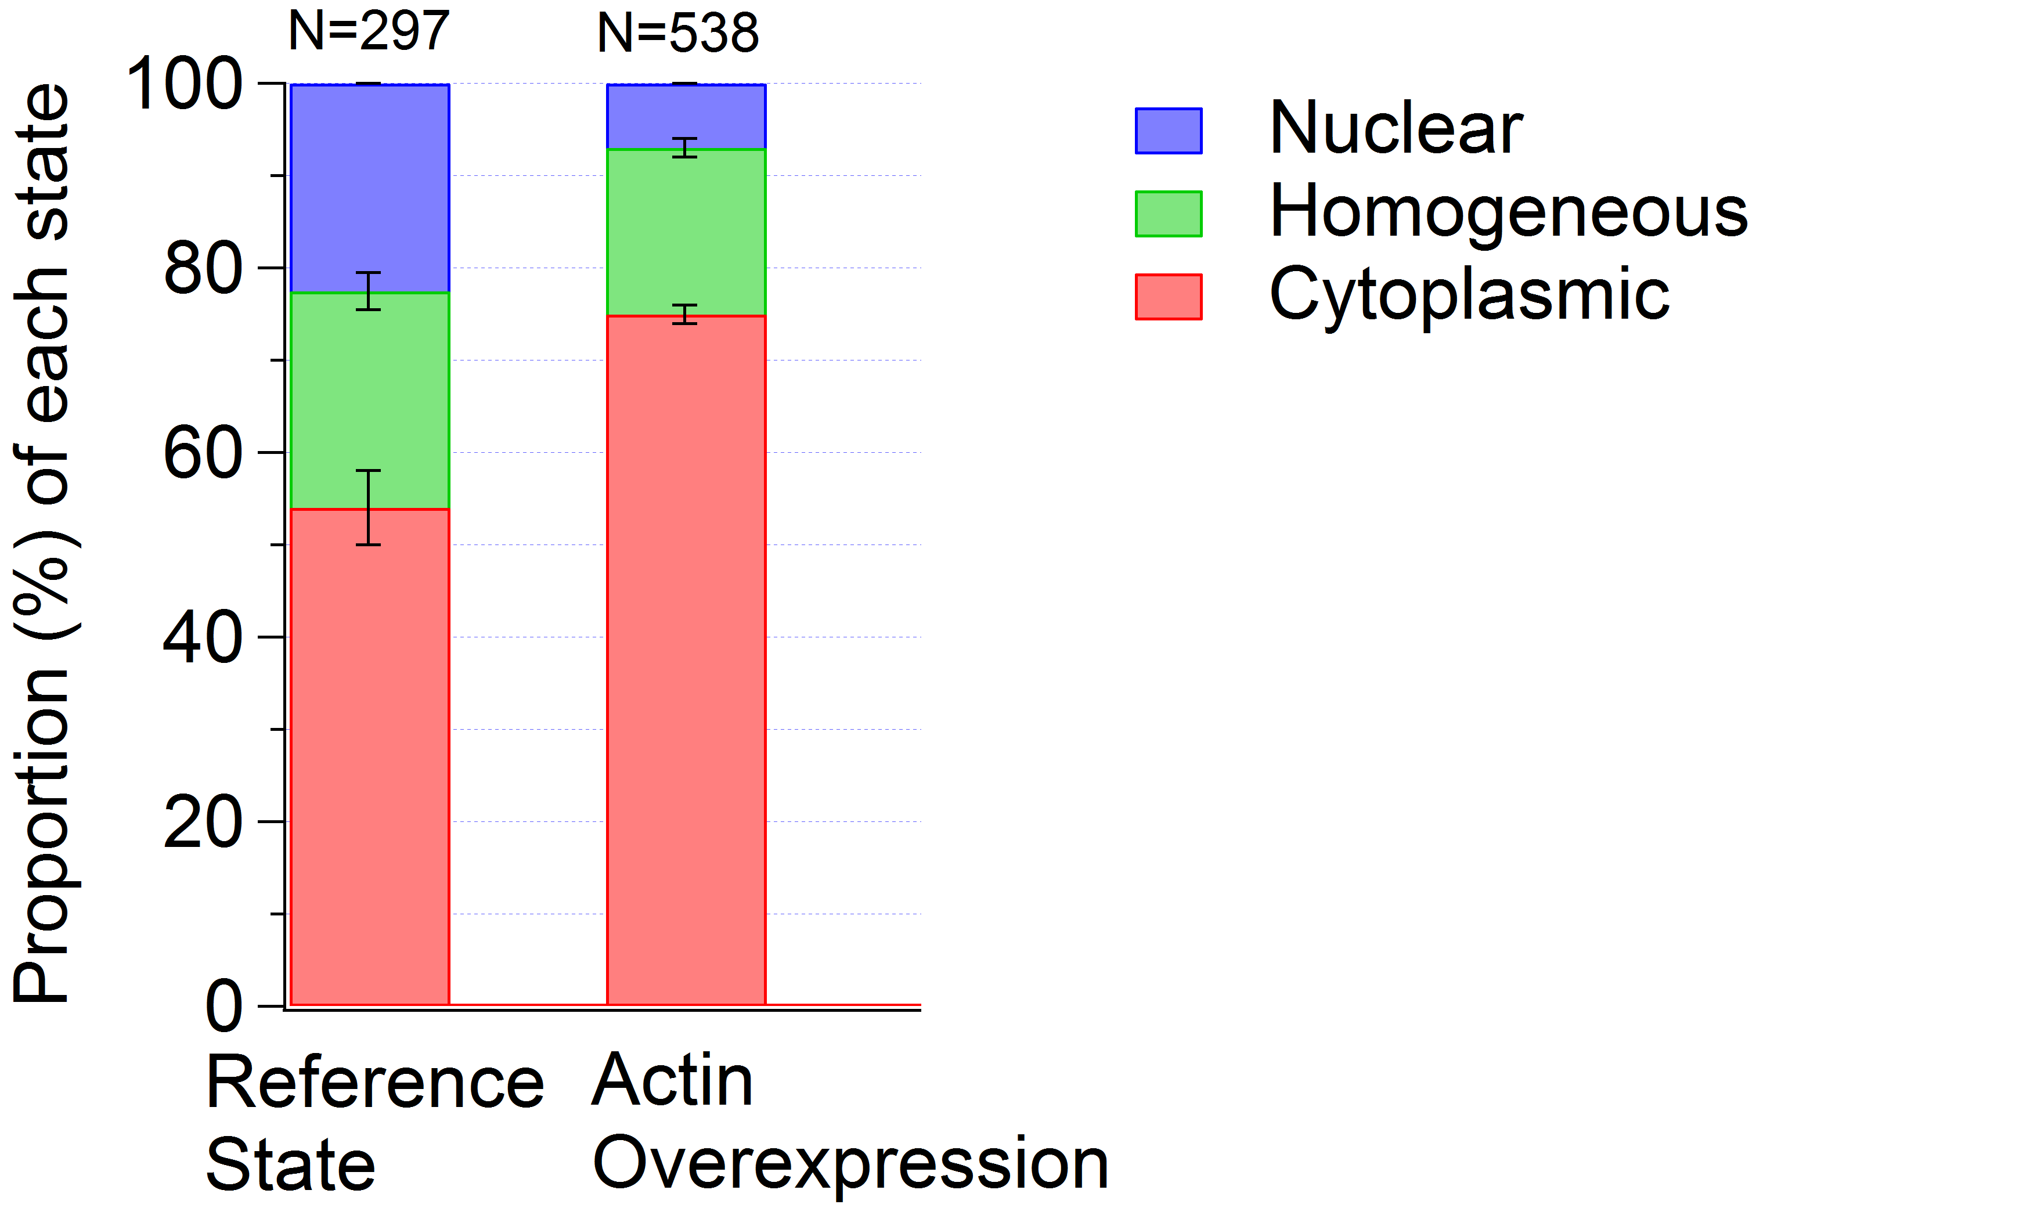
Influence of Actin Overexpression on MRTF-A Localization
MRTF-A Localization
Actin Overexpression
G-Actin Excess
Actin-MRTF-A Complex in the Cytoplasm

Slide 15
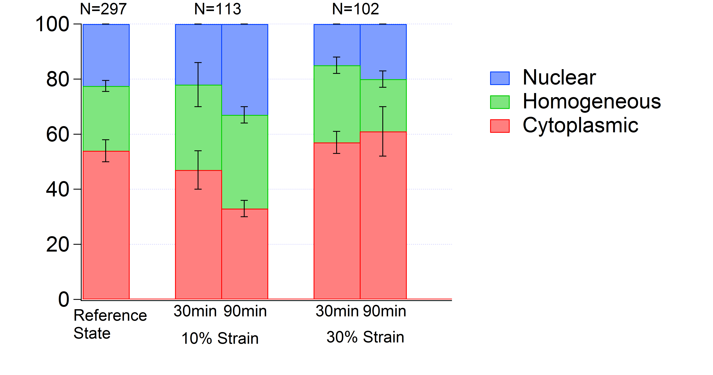
Influence of Stretching on MRTF-A localization
MRTF-A Localization
Verified at 10%
Actin Assembly
MRTF-A Entering the Nucleus
Mechanical
Cues
? at 30%

Slide 16
Classification of events
MRTF-A accumulation
MRTF-A expulsion
C
H
H
C
H
N
N
H
C
N
N
C

Slide 17
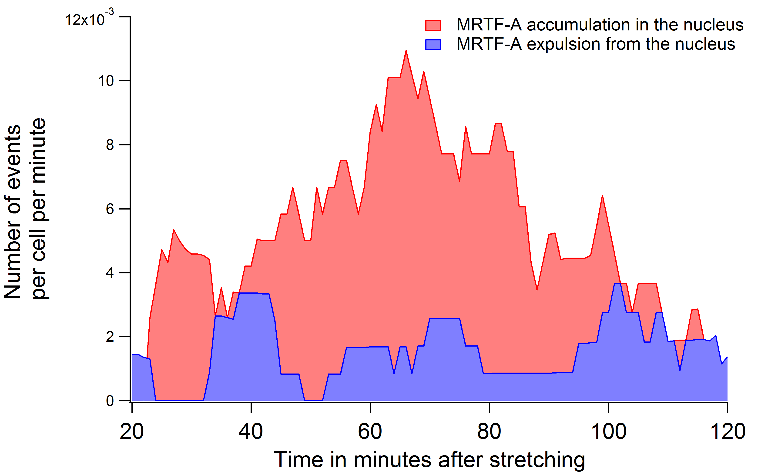
10% Strain Experiments
MRTF-A accumulation
C
H
H
N
C
N
MRTF-A expulsion
H
C
N
H
N
C

Slide 18
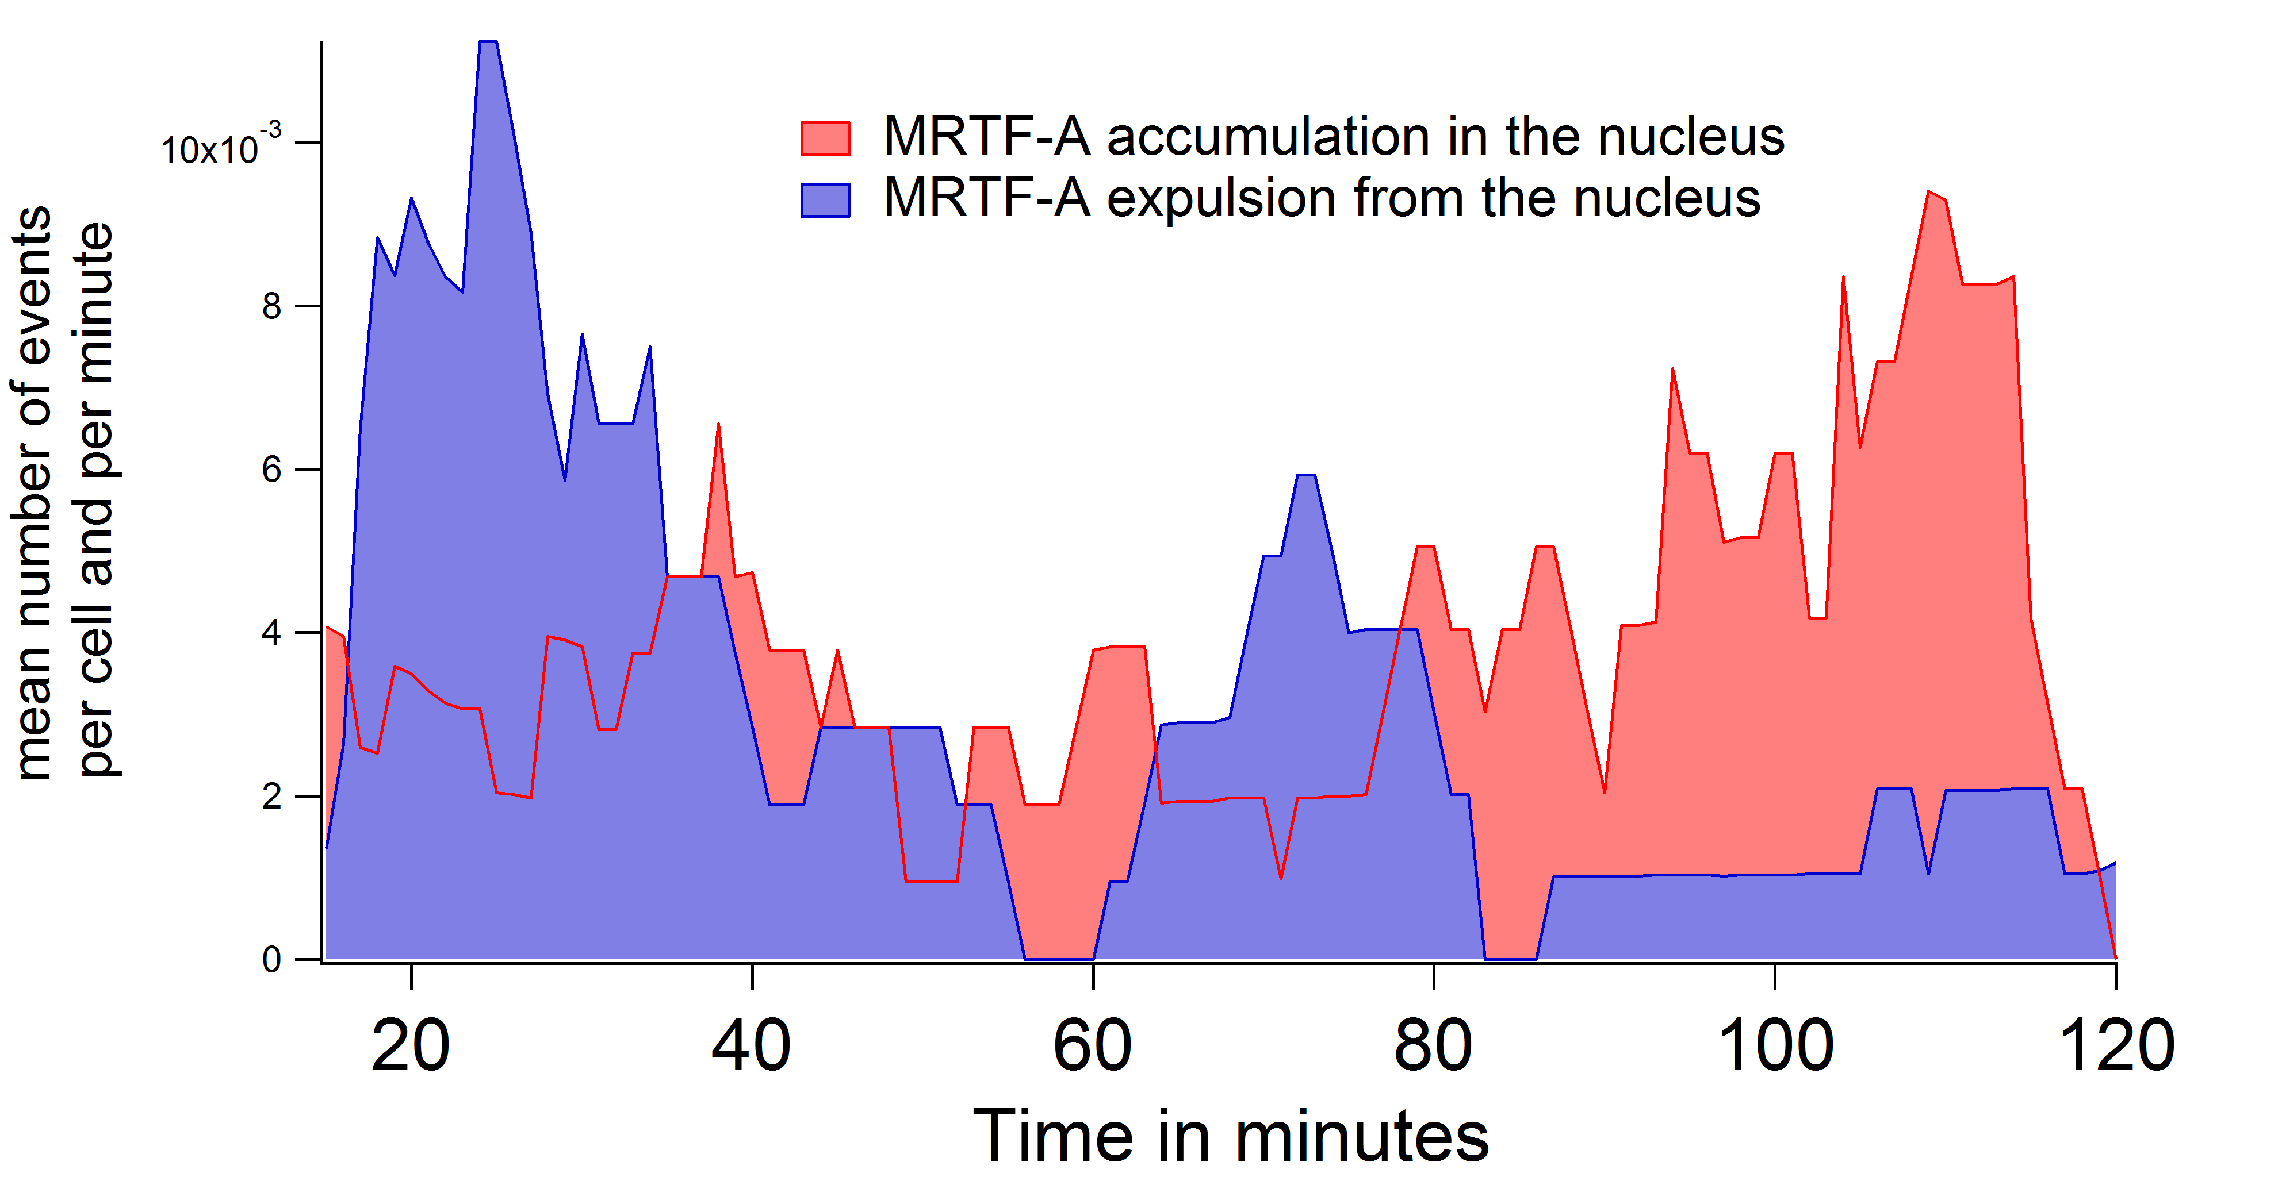
30% Strain Experiments
MRTF-A accumulation :
C
H
H
N
C
N
MRTF-A expulsion :
H
C
N
H
N
C
Expulsions at 30 min : Brutal destruction of actin filaments ?

Slide 19
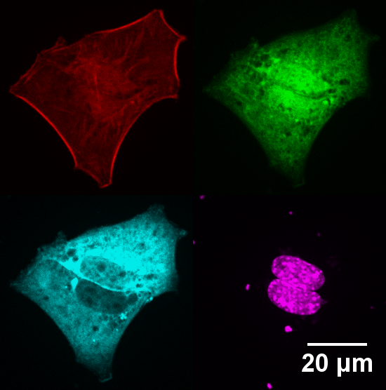
F/G ratio on fixed cells
Red : F-actin (Phalloidin)
Green : G-actin (DNase I)
Cyan : MRTF-A GFP
Magenta : Nucleus (DAPI)

Slide 20
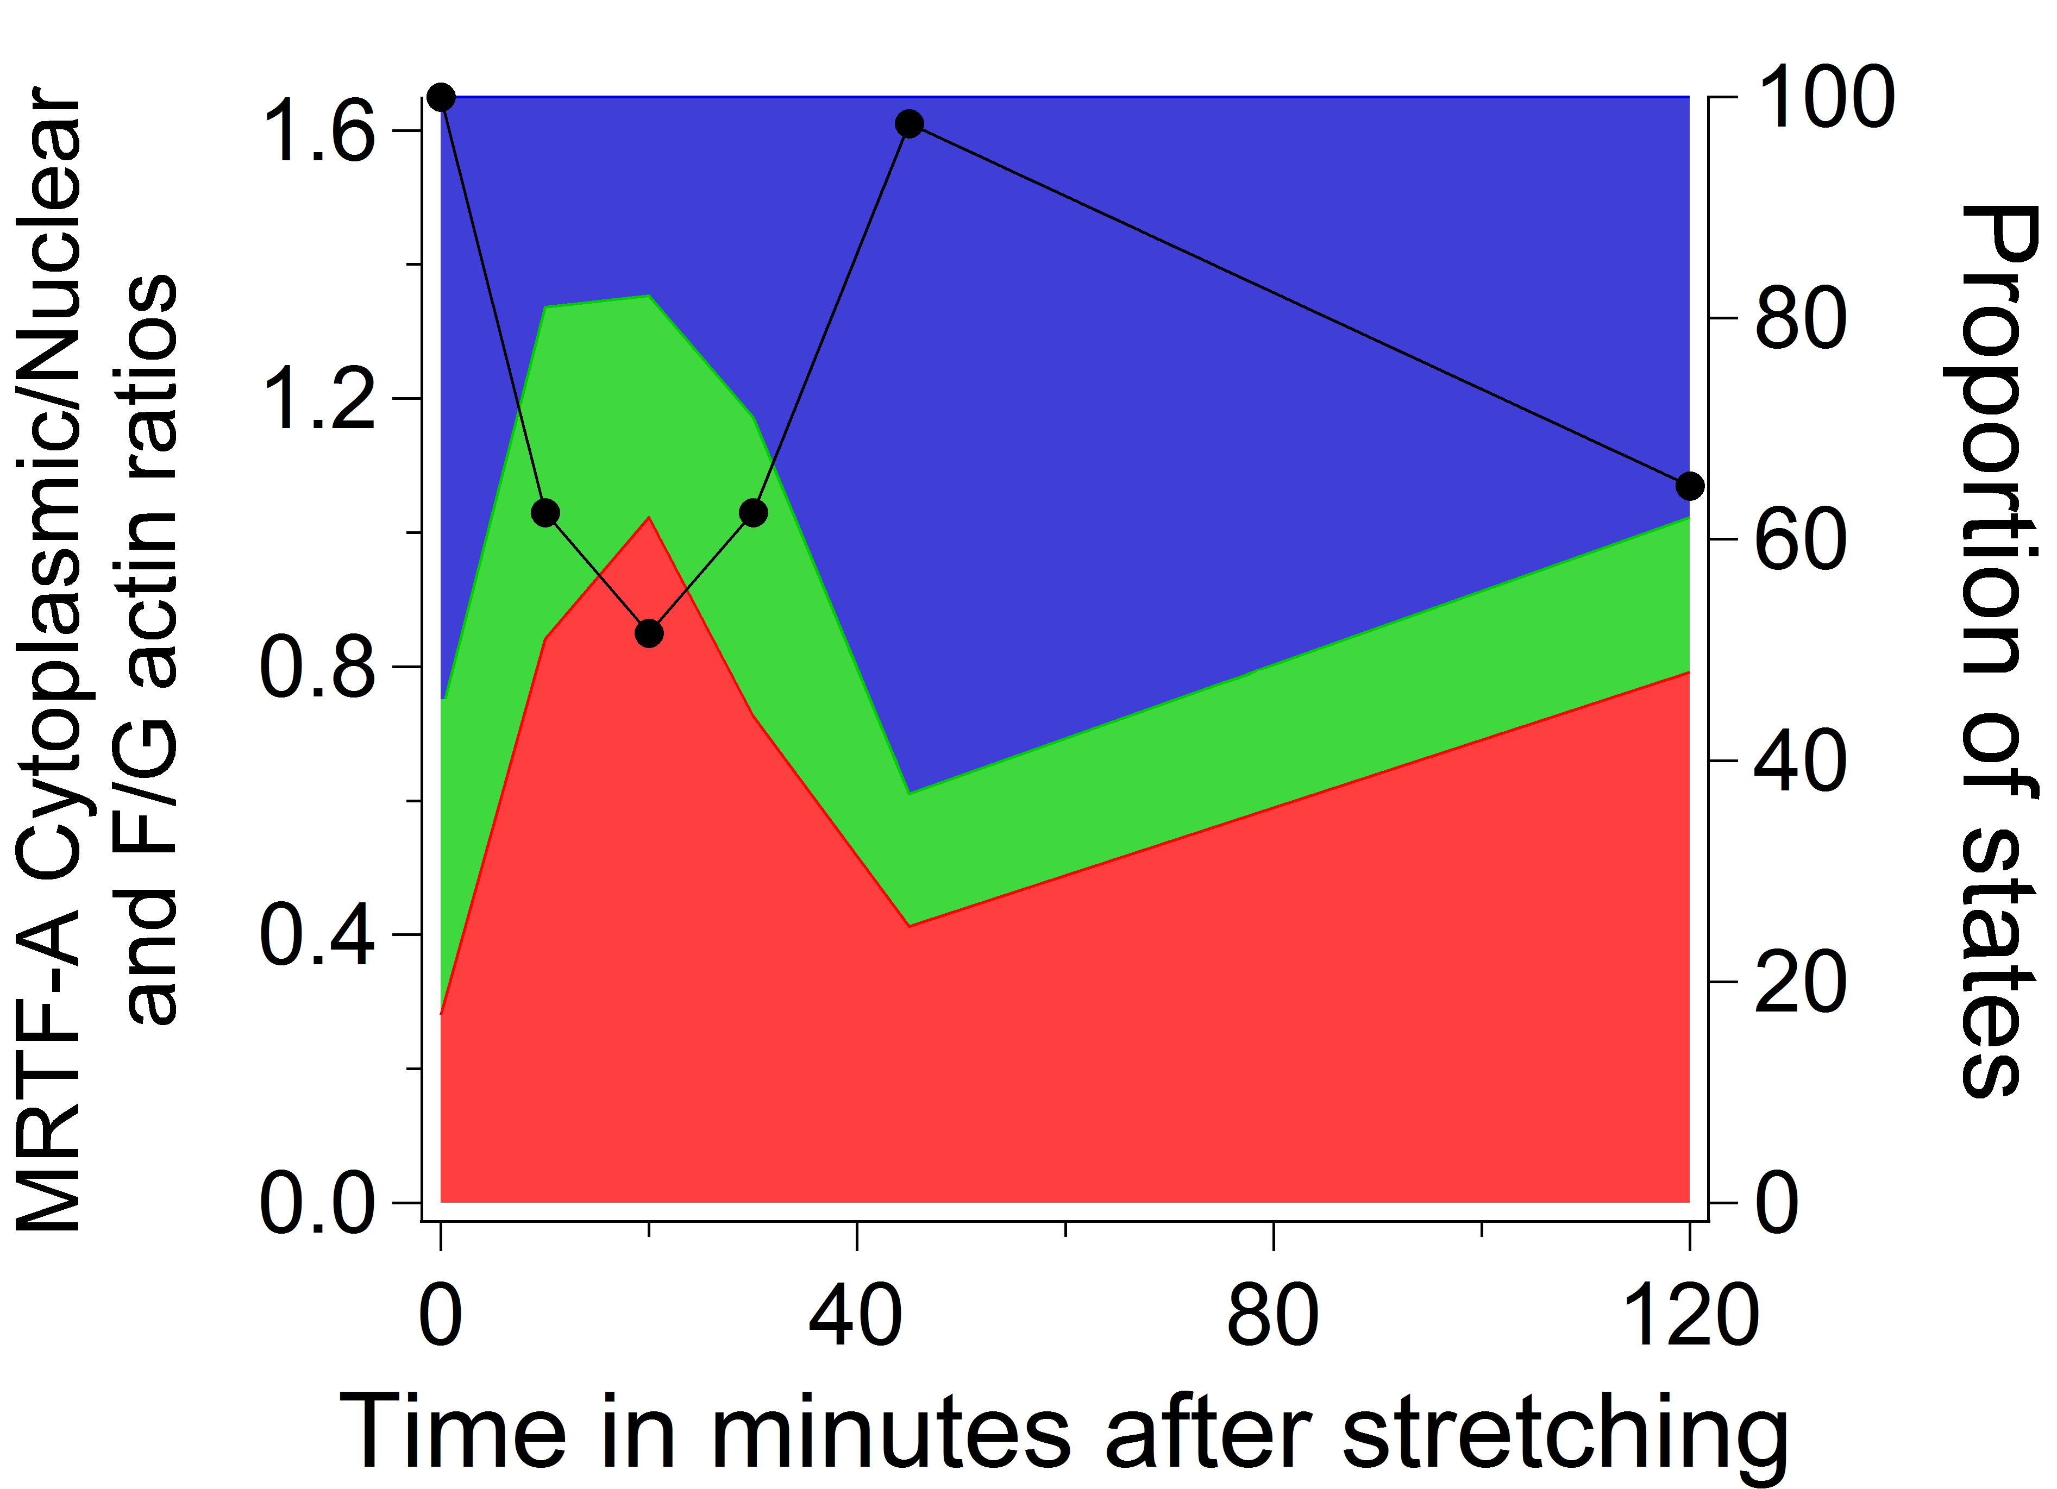
30% Strain Experiments on fixed cells
N
F/G actin ratio
H
C

Slide 21
Summary
actin assembly
G-actin scarcity
free
MRTF-A in the nucleus
active SRF
10%
looking at the cytoskeleton
strain
30%
actin disassembly
actin-mCherry plasmid
G-actin excess
actin-MRTF-A
complex in the cytoplasm
inactive
SRF

Slide 22
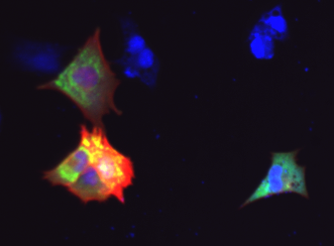
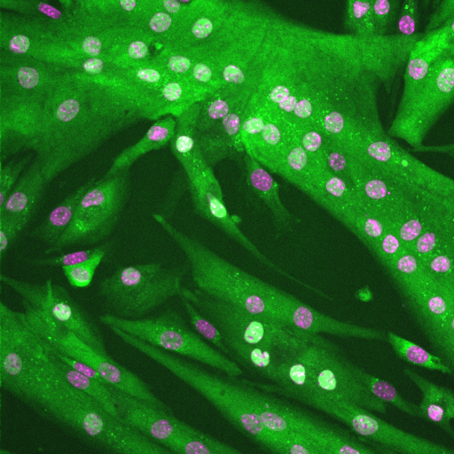
Perspective
Live visualization
of the cytoskeleton
(SiRactin, F-tractin)
AAV-infected MRTF-A GFP
primary myoblasts and
differenciated myotubes
What is the pathway
from mechanics to actin polymerization ?
Which target genes are activated ?

Slide 23






Acknowledgements
Collaboration :
Complex Systems and Materials University Paris Diderot
Sylvie Hénon
Genetics, Development and Physiology
of Skeletal muscle
Institut Cochin
A. Sotiropoulos
A. Pincini
A. Richert
L. Réa

