Slide 1













$$P=(X,Y,Z)$$
$$X$$
$$Y$$
$$P=(x, y, f)$$
$$Z$$
$$x$$
$$y$$
$$y$$
$$x$$
$$f$$
$$Y$$
$$X$$
$$Z$$

Slide 2




$$(a,b,c)$$
$$(x,y,z)$$
$$d$$
$$(u,v,0)$$

Slide 3
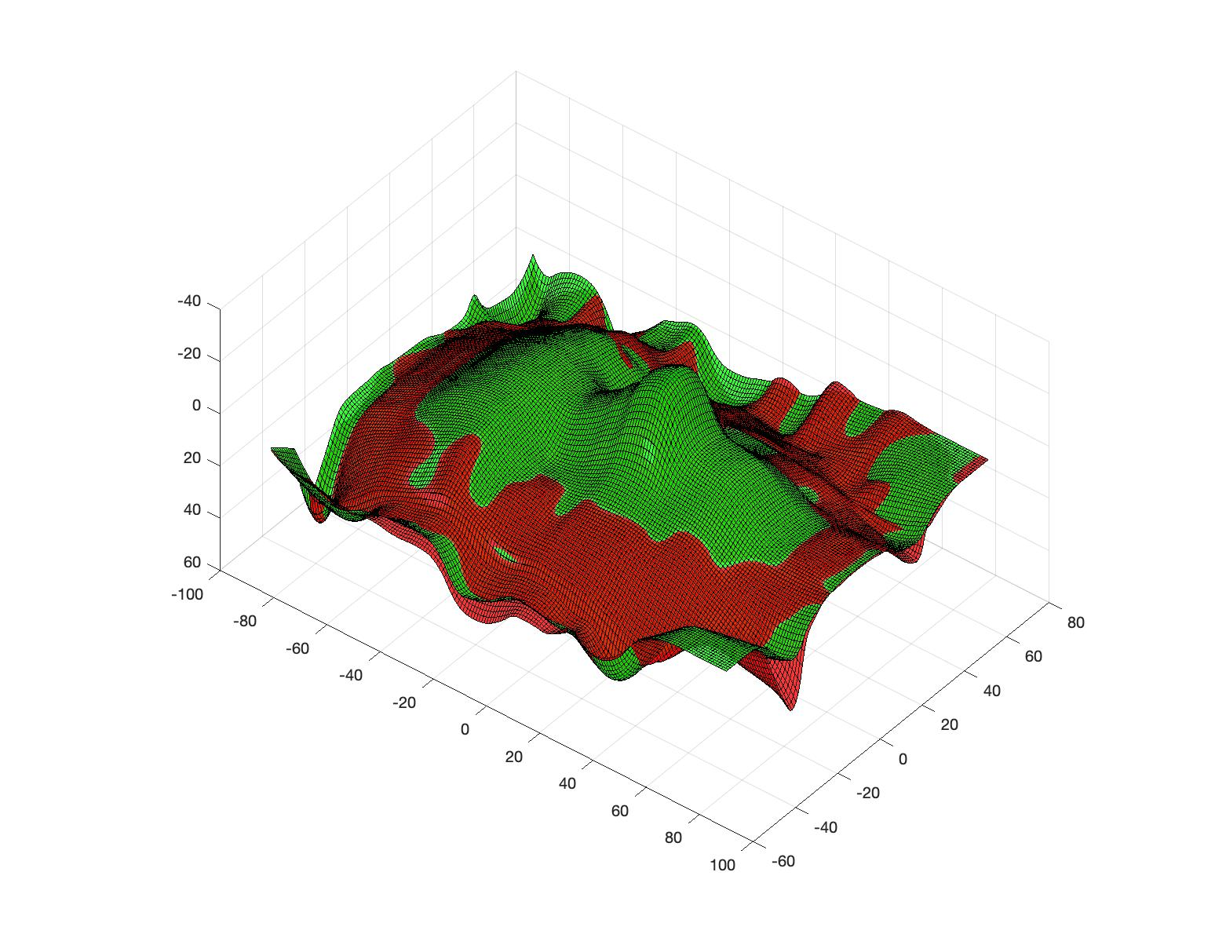
Non-linear
Linear

Slide 4
vertical offset

Slide 5
perpendicular offset

Slide 6
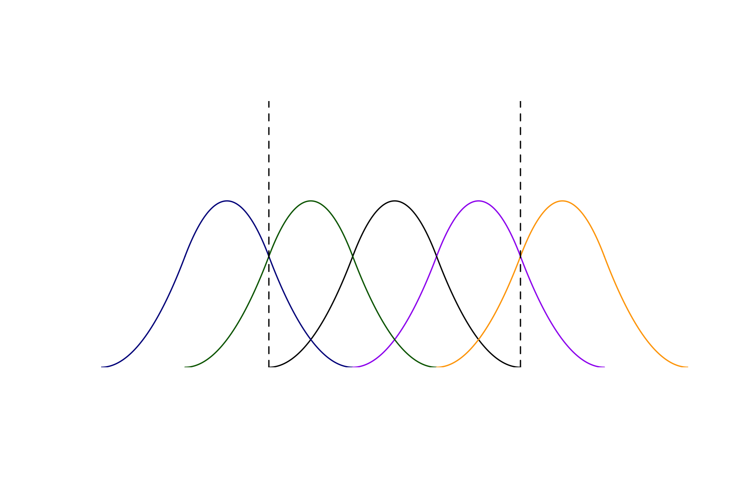

Spline
$ξ_{k}$ (Knots/boundaries)

Slide 7
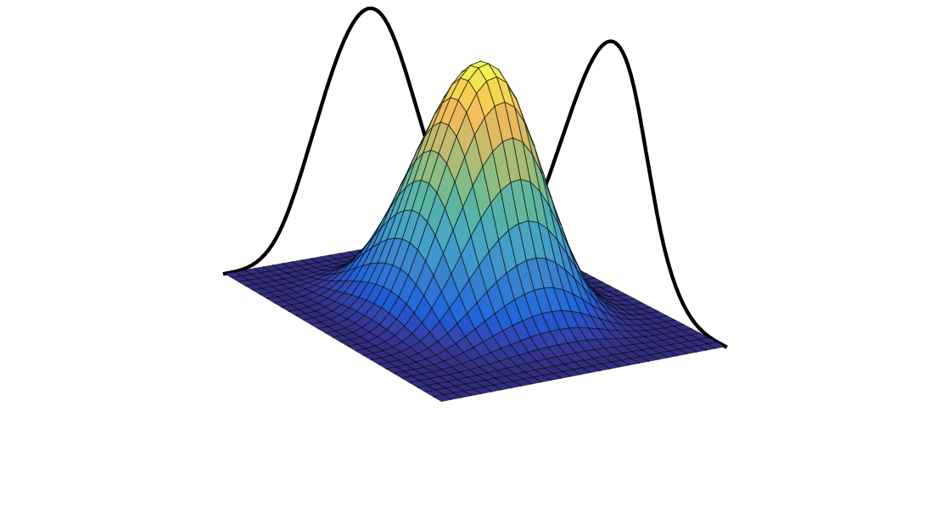

Boundaries ($ξ_{kl}$)

Slide 8
