Slide 1

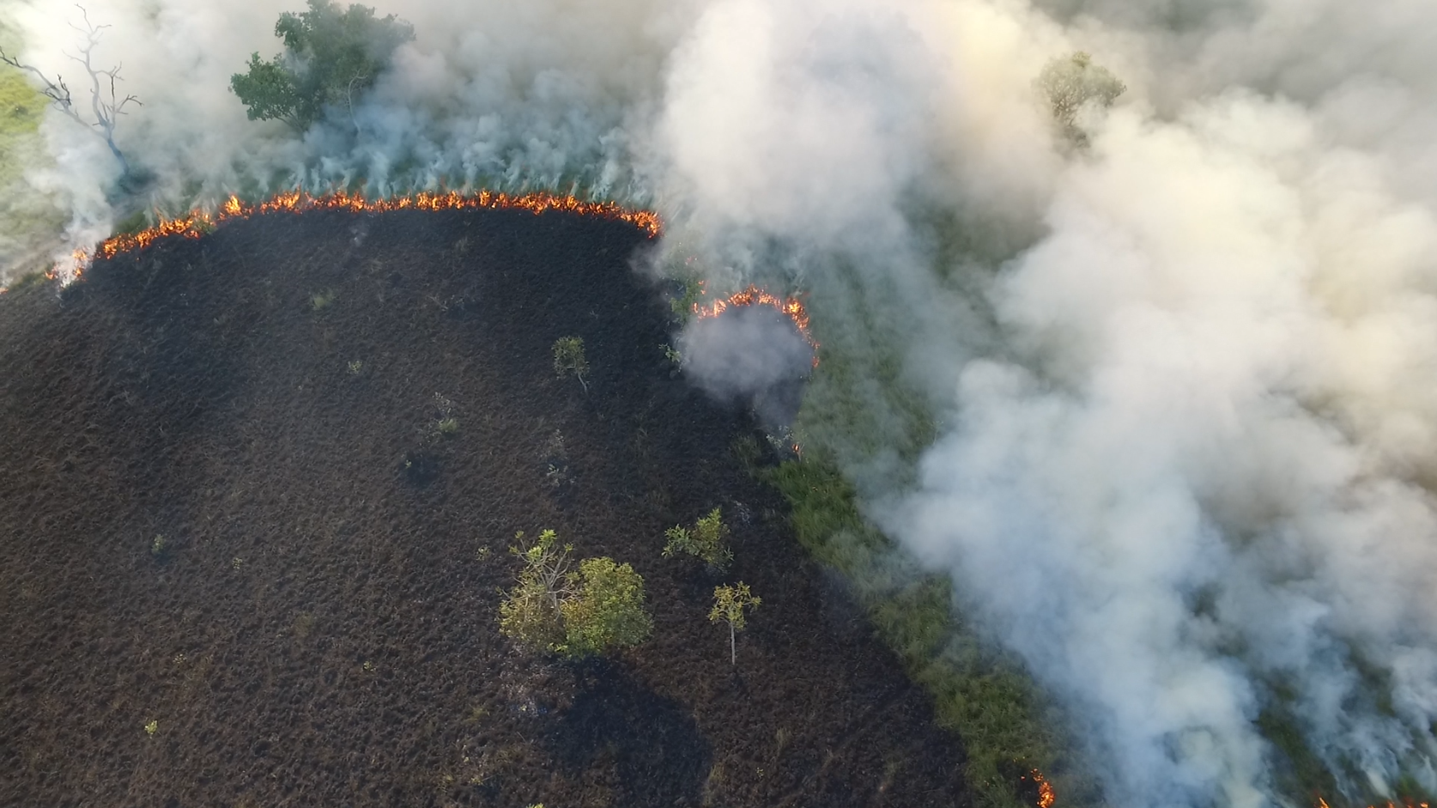



Brazil Data Cube Catalog Plugin for QGIS
The plugin accesses the Brazil Data Cube service [1]
to obtain the images.
The Brazil Data Cube (BDC) is a project of the National Institute for Space Research (Inpe) that makes remote sensing images available for the entire national territory.
The plugin uses images in the Cloud Optimized GeoTiff (COG) format.
These images are restricted to the Brazilian territory.
[1] https://data.inpe.br/bdc/sobre-o-brazil-data-cube/
Luiz Motta - 2025-10-10
<número> of 8

Slide 2
BDC Catalog Plugin
It searches the BDC for images in the COG format.
  Parameters:
    Collection and spatial resolution.
    Date range (start and end date).
    Bbox (Map canvas extent).
Result:
  Virtual mosaics with the collection bands.
    Scenes with the same date, orbit, and coordinate reference system (CRS).
    VRT format (accesses the bands via URL).
  Catalog (footprint) of the collection images containing the “items.”
<número> of 8

Slide 3
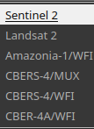
Interface - GUI
When the tool is activated, the plugin interface is added.
The plugin interface (Widget) is in the QGIS "Status Bar."
Run the search
<número> of 8

Slide 4

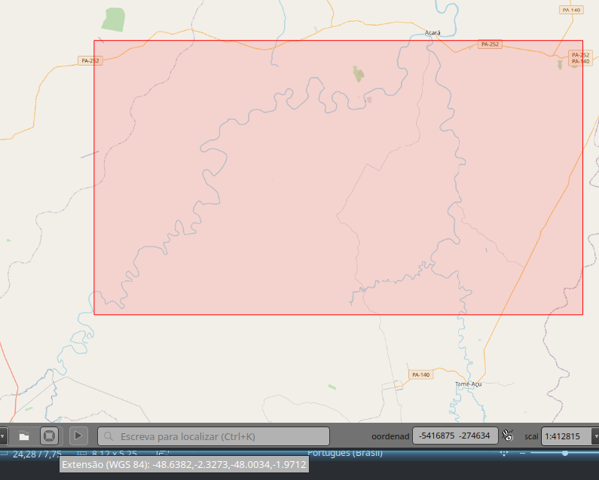
Interface – GUI (Continuação)
The collections are from the images that are made available in the COG format.
  When a collection is selected, the available resolutions are listed.
The Bbox for the image search is obtained by capturing the map view extent.
<número> of 8

Slide 5
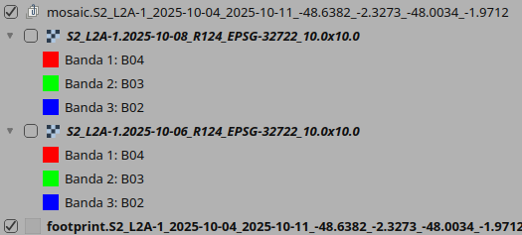

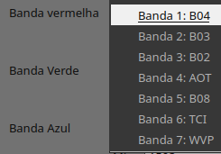
Result
Mosaic Group:
Collection ID, Date Range, and Bbox (coordinates).
  Mosaic:
  Collection ID, Pass Date, Coordinate Reference System (CRS), and Spatial Resolution.
Footprint (same rule as the group).
Images (VRTs) that compose the mosaic.
Identifies (names) the bands.
The first 3 bands for true color (or natural color).
<número> of 8

Slide 6
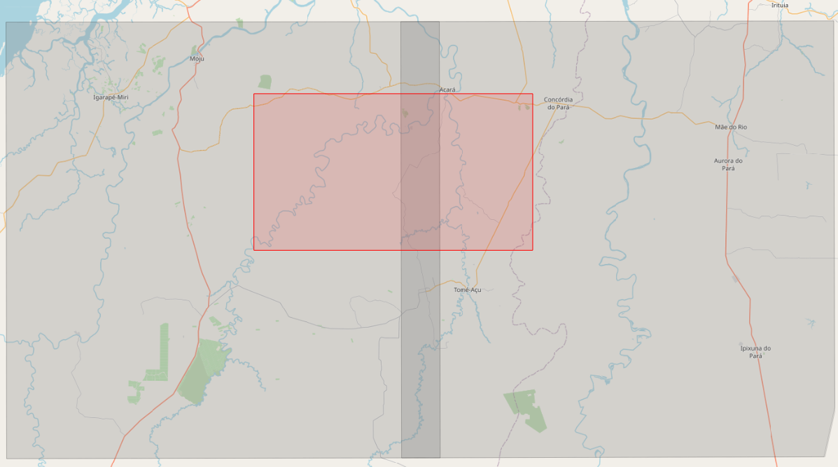
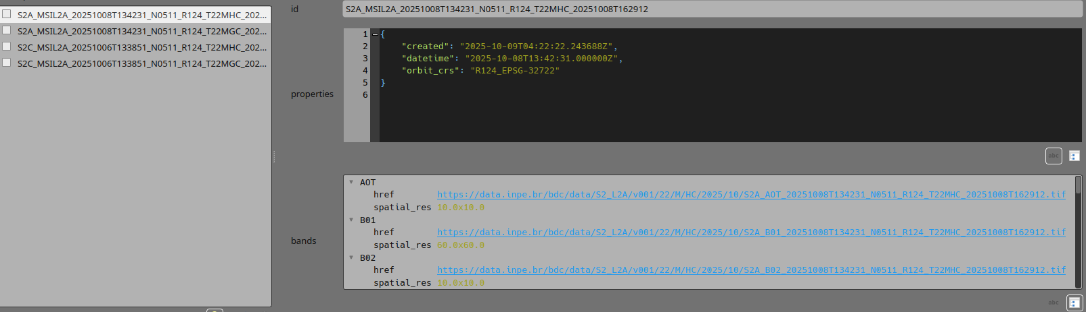
Result (Continuation)
Footprint with each scene separated.
Each feature has the Item ID from the BDC collection.
The feature's attributes contain the identification of the "assets" (band URLs) of the item.
<número> of 8

Slide 7
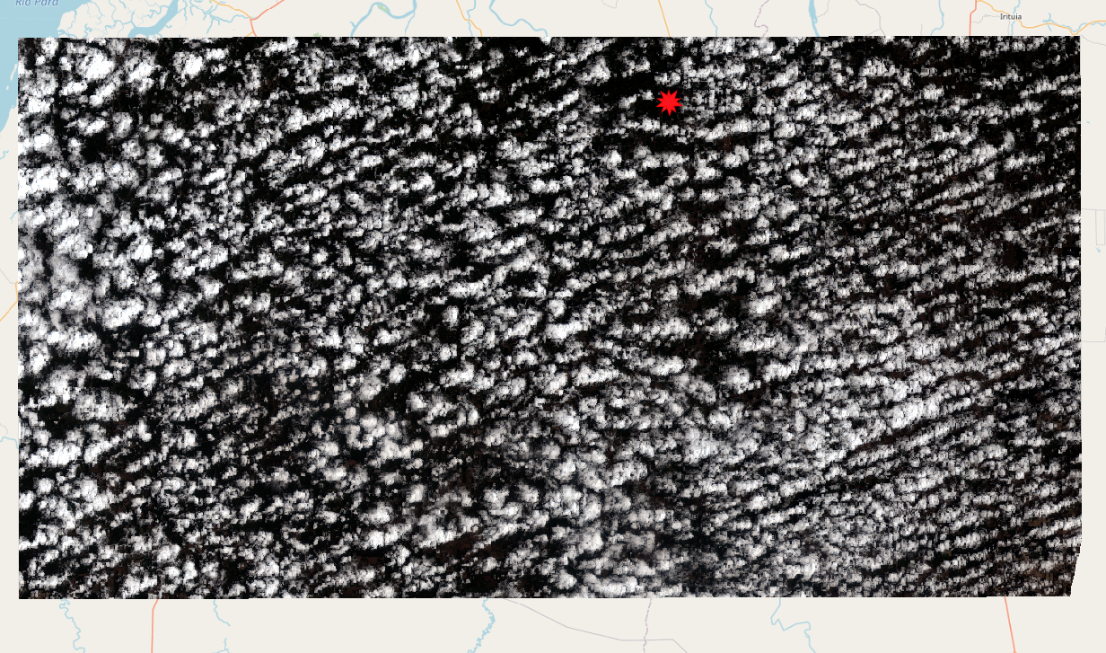
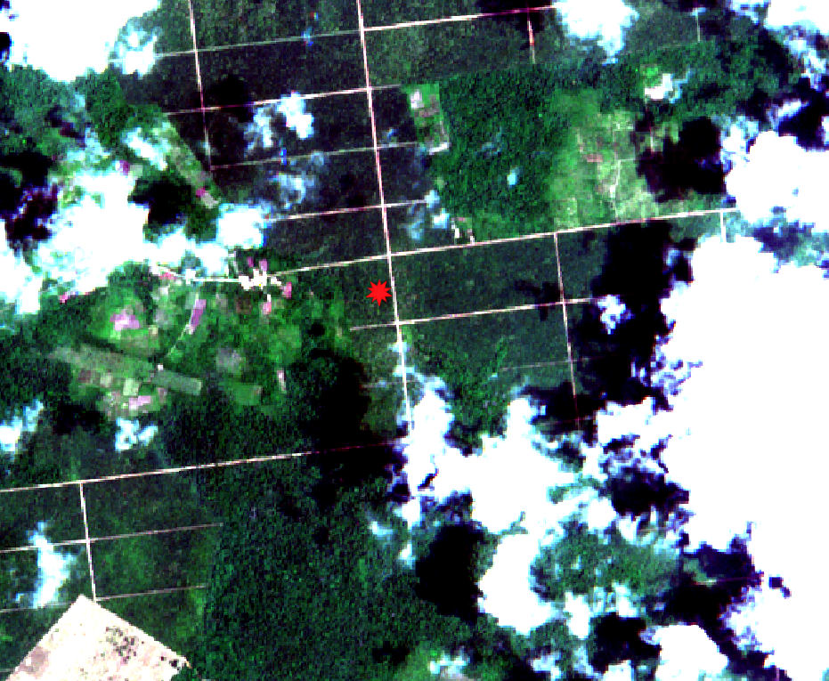
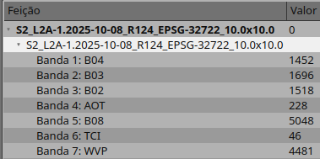
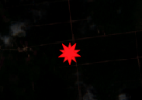
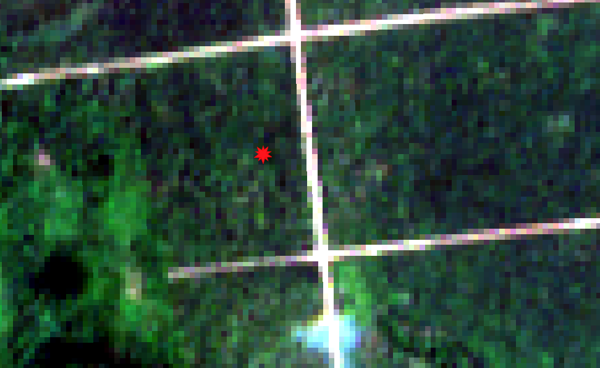
Result (Continuation)
Mosaic with the two scenes.
S2_L2A-1.2025-10-08_R124_EPSG-32722_10.0x10.0
Pixels with original values.
<número> of 8

Slide 8
Brazil Data Cube Catalog Plugin
The Plugin is part of the National Fire Information System (Sisfogo), developed by the National Center for Prevention and Combat of Forest Fires (Prevfogo)
Prevfogo is under the Directorate of Environmental Protection (Dipro) of the Brazilian Institute of Environment and Renewable Natural Resources (Ibama), which belongs to the Ministry of Environment and Climate Change (MMA) of the Brazilian Government.
Prevfogo → Dipro → Ibama → MMA
Luiz Motta - 2025-10-10
<número> of 8

