Slide 1
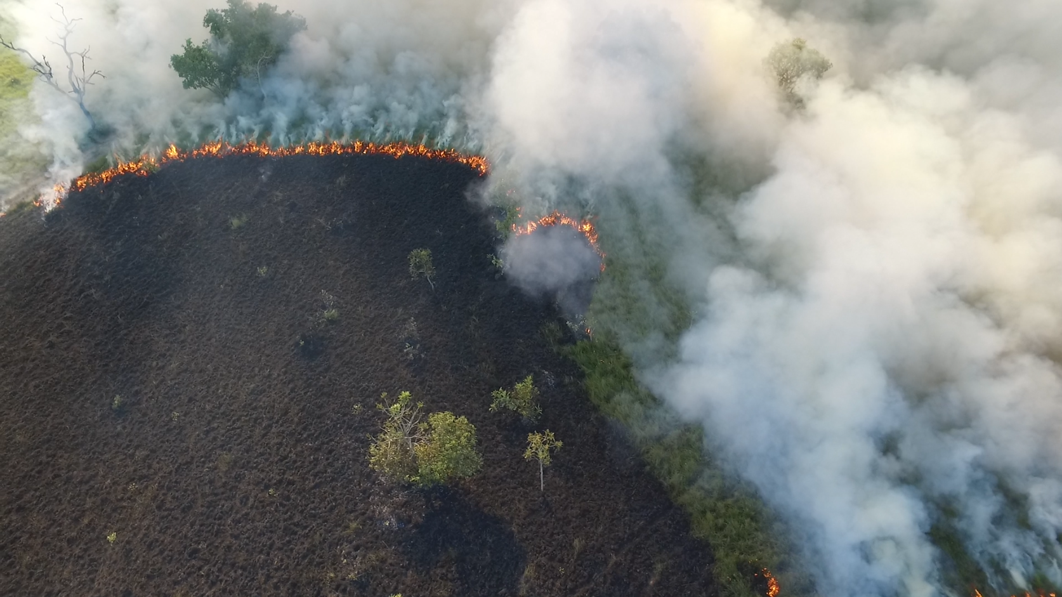


Plugin Magnifier for QGIS
This plugin creates a floating magnifier glass at the mouse cursor's position.
The magnifier displays a layer or a group of layers.
The layer or layer group corresponds to the item that is currently active in the Layers Panel (Legend).
The plugin allows you to define:
  The Zoom level of the active item in the magnifier.
  The size of the magnifier's viewing area on the map.
Luiz Motta - 2025-12-09
<número> of 7

Slide 2
Plugin Magnifier
The plugin is a visualization tool; when enabled, the active item in the Layers Panel (Legend) is shown inside a magnifier.
The magnifier floats dynamically on the map, following the mouse cursor's position.
The active item, which can be a layer or a layer group, is displayed inside the magnifier with a specific zoom level (zoom factor).
The size of the magnifier on the map can be selected by the user from fixed sizes (magnifier factor).
By clicking on the map, the factors (zoom and magnifier size) can be modified through an interface that appears in the status bar. The magnifier becomes static on the map, and upon clicking again, it returns to floating on the map.
<número> of 7

Slide 3
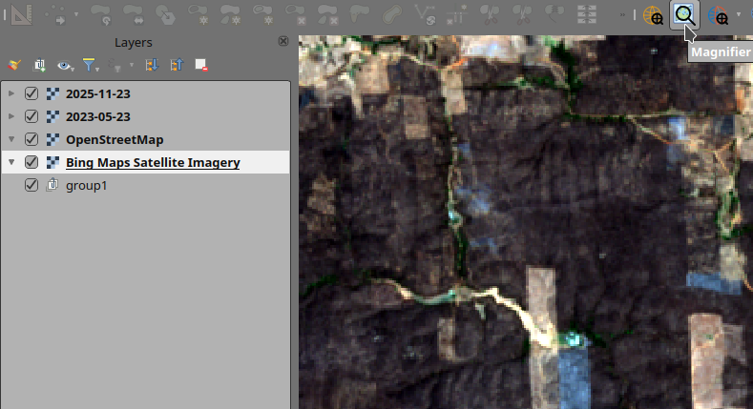
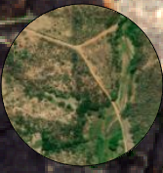
Interface - GUI
Select the item of interest in the Layers Panel (active item).
When enabling the tool, the active layer/group is used in the Magnifier.
As you move the mouse, the magnifier follows the cursor.
<número> of 7

Slide 4
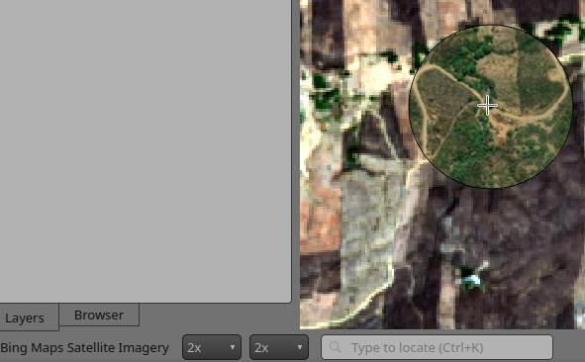
Interface – GUI (Continuation)
When clicking on the map, the interface for selecting the factors (Zoom and Magnifier size) is enabled.
<número> of 7

Slide 5
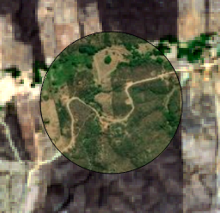
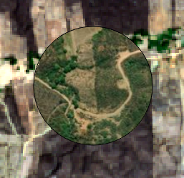
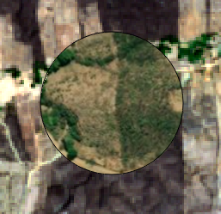
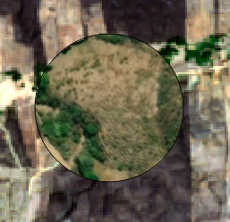

Interface – GUI (Continuation)
Zoom Factor
<número> of 7

Slide 6
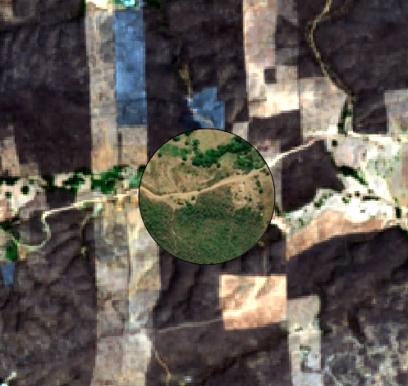
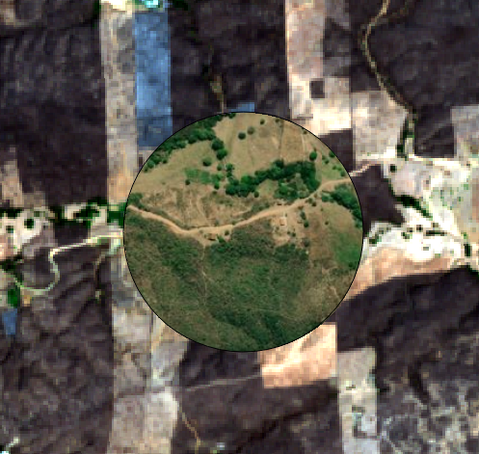
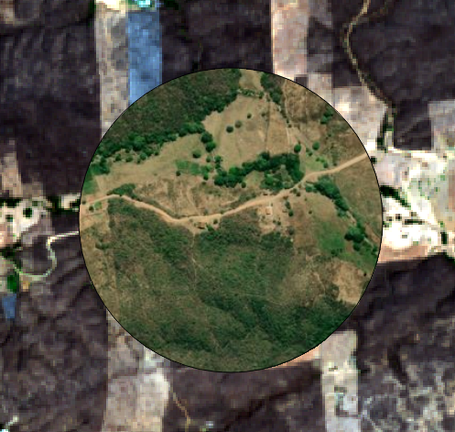
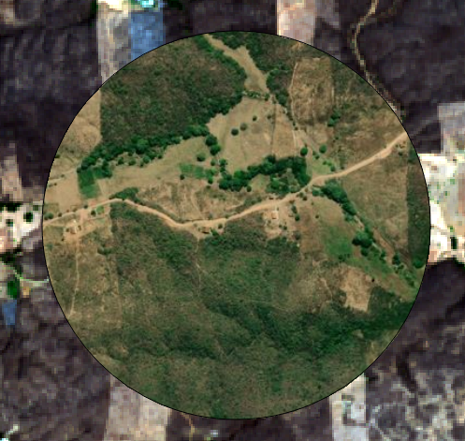
Interface – GUI (Continuation)
Magnifier Factor
<número> of 7

Slide 7
Plugin Magnifier
The Plugin is part of the National Fire Information System (Sisfogo), developed by the National Center for Prevention and Combat of Forest Fires (Prevfogo)
Prevfogo is under the Directorate of Environmental Protection (Dipro) of the Brazilian Institute of Environment and Renewable Natural Resources (Ibama), which belongs to the Ministry of Environment and Climate Change (MMA) of the Brazilian Government.
Prevfogo → Dipro → Ibama → MMA
<número> of 7

