Slide 1
Python/GalSim Image Simulator
Progress Report
May 6, 2015
Aaron Bunch
NASA/JPL

Slide 2
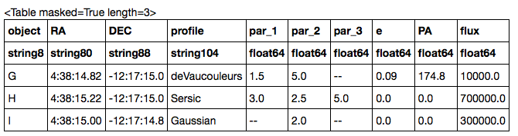
Astropy Parameter Tables
Reference Objects

Slide 3
Profile Parameters
Profile | Par-1 | Par-2 | Par-3
Gaussian | Sigma | FWHM | Half Light Radius
 | (one of these three is required)
Moffat | Beta | FWHM | Half Light Radius
 | (required) | (one of these two)
Sersic | Sersic index | Half Light Radius | Truncation Radius
 | (required) | (required) | (optional)
De Vaucouleurs | Half Light Radius | Truncation Radius | --
 | (required) | (optional) | --

Slide 4
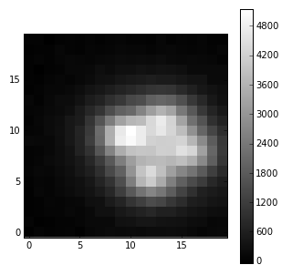
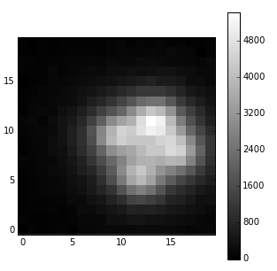
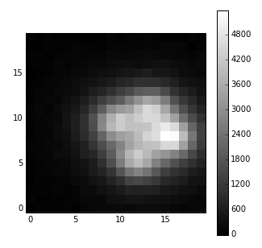
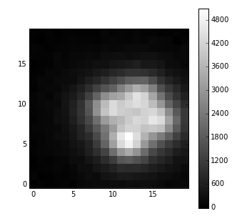
FITS Output
A
B
C
D

Slide 5
To Do:
Read magnitudes from a light-curve table, and calculate fluxes from zero-point and magnitudes.
Write more info to FITS headers (e.g., CRVAL1, CRVAL2, CRPIX1, CRPIX2).
Simulate changing background flux.

