Slide 1





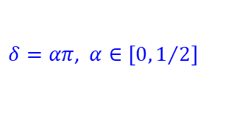
(a) H4 cluster
$$a$$
H
H
PES using a = 2.0 Bohr
$$a$$
$$a$$
$$δ$$
$$δ$$
H
H
$δ=απ$, $α∈\left[0, 1/2\right]$
Energy/Hartree
alpha
H4_aXXX_RHF_STO-3G_Int.txt ... RHF integrals
H4_aXXX_UNOMix_STO-3G_Int.txt ... Broken symmetry integrals
XXX represents alpha value (for example, H4_a200 means alpha = 0.200)

Slide 2



(b) P4 cluster
PES using a = 2.0 Bohr
H
H
$$a$$
$$a$$
$$α$$
H
H
Energy/Hartree
Alpha/Bohr
P4_aXXXXX_RHF_STO-3G_Int.txt ... RHF integrals
P4_aXXXXX_UNOMix_STO-3G_Int.txt ... Broken symmetry integrals
XXXXX represents alpha value (for example, P4_a02100 means alpha = 2.100)

Slide 3



(c) D4 cluster
$$a$$
$$α$$
$$a$$
PES using a = 2.0 Bohr
H
H
H
H
Energy/Hartree
Alpha/Bohr
D4_aXX_RHF_STO-3G_Int.txt ... RHF integrals
D4_aXX_UNOMix_STO-3G_Int.txt ... Broken symmetry integrals
XX represents alpha value (for example, D4_a12 means alpha = 1.2)

