Slide 1
The SMART Study microsite
Design review · October 2026
Notes:
Title layout. Deck title in sentence case; the subtitle says who it is for and when.

Slide 2

What families see
1
The signed-in pages for the restrict and delay groups
Notes:
Section layout. Number every section; pick the illustration that matches it.

Slide 3
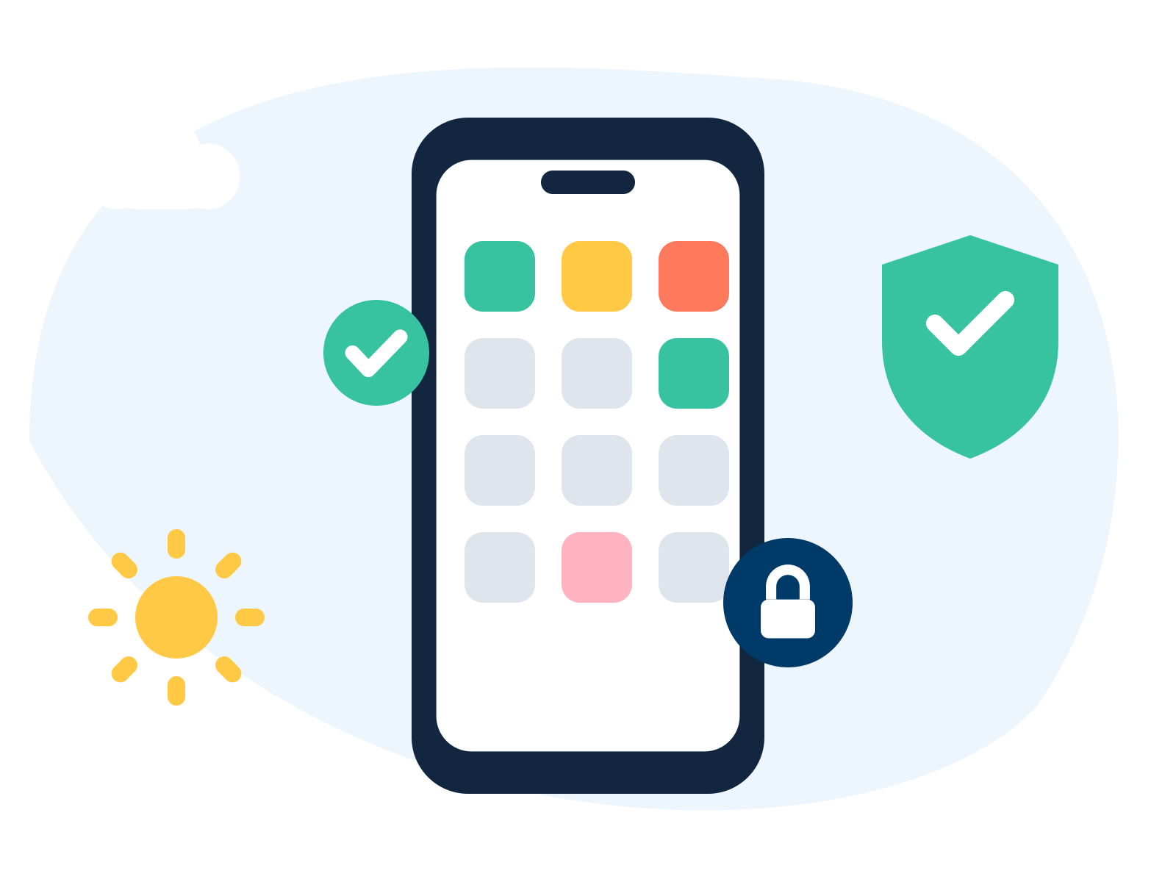
Three things for every family
Watch the welcome webinar
Set up their child's phone, or read the guide to waiting
Share a screen time screenshot once a month
Notes:
Text and picture layout. Keep points short enough to read at a glance.

Slide 4



Help is never more than one click away
Set-up guides
Videos
Get help
Step by step, with a picture of every screen.
The welcome webinar and a video for children.
Common questions, or email us directly.
Notes:
Title only layout with cards: white, rounded, soft shadow, an icon in a tinted tile. Three or four cards, rotating the tints.

Slide 5
80
primary schools in England
Families take part through their child's school, from April 2027 to April 2028.
Notes:
Big number layout. One number per slide, in numerals.

Slide 6

How a restrict family gets set up
1
2
3
Watch the welcome webinar
Set up your child's phone
Share a screen time screenshot
40 minutes
30 to 40 minutes
2 minutes, monthly
Notes:
Title only layout with steps: the sun number tile from the guides. Three or four steps.

Slide 7
What we still need to decide
Whether the name "SMART" appears on public pages (A4)
Which platform the real build uses (B2)
Whether to keep these illustrations or commission new ones (B5)
Notes:
Title and body layout. Five points at most.

Slide 8
A study identity of its own, with GOV.UK components underneath for accessible forms.
Decision B1, look and feel
Notes:
Quote layout. Always say who said it.

Slide 9
Questions?
smartphonestudy@public.io
Notes:
Closing layout. The ask or the contact route.

