Slide 1
Sigma_min
 | Uniaxial
 | T_p/H_d=1 | T_p/H_d=1.5 | T_p/H_d=14
Point A (x1) | 2.942446768300000 | 2.722951114200000 | 1.925316333800000
Point B (x2) | 2.935607373700000 | 2.721057593800000 | 1.925137460200000
Point A (x1)
Point B (x2)
Biaxial
T_p/H_d=1 | T_p/H_d=1.5 | T_p/H_d=14
2.015860319100000 | 2.404486894600000 | 1.596784085000000
2.013187766100000 | 2.404265463400000 | 1.596903532700000
Na Geometria T_p/H_d=14,
Intervalo do Sigma_min {20,40}
Notes:
C:\Manasses\all_uniaxial_biaxial_3_geometries\all_uniaxial_biaxial_3_geometries_NEW.m

Slide 2
Sigma min calculated via u_b_s_p_center_hole_withou_kirsch.m at
C:\Manasses\center_hole\u_b_s_p_center_hole_withou_kirsch.m
sig_min(cont_min)=matriz(end,9);
 | Uniaxial
 | T_p/H_d=1 | T_p/H_d=1.5 | T_p/H_d=14
Point A (x1) | 2.933690130700000 | 2.692401707200000 | 1.920085877200000
Point B (x2) | = | = | =
Point A (x1)
Point B (x2)
Biaxial
T_p/H_d=1 | T_p/H_d=1.5 | T_p/H_d=14
2.008045554200000 | 2.378486096900000 | 1.594718247700000
= | = | =
Notes:
C:\Manasses\all_uniaxial_biaxial_3_geometries\all_uniaxial_biaxial_3_geometries_NEW.m

Slide 3
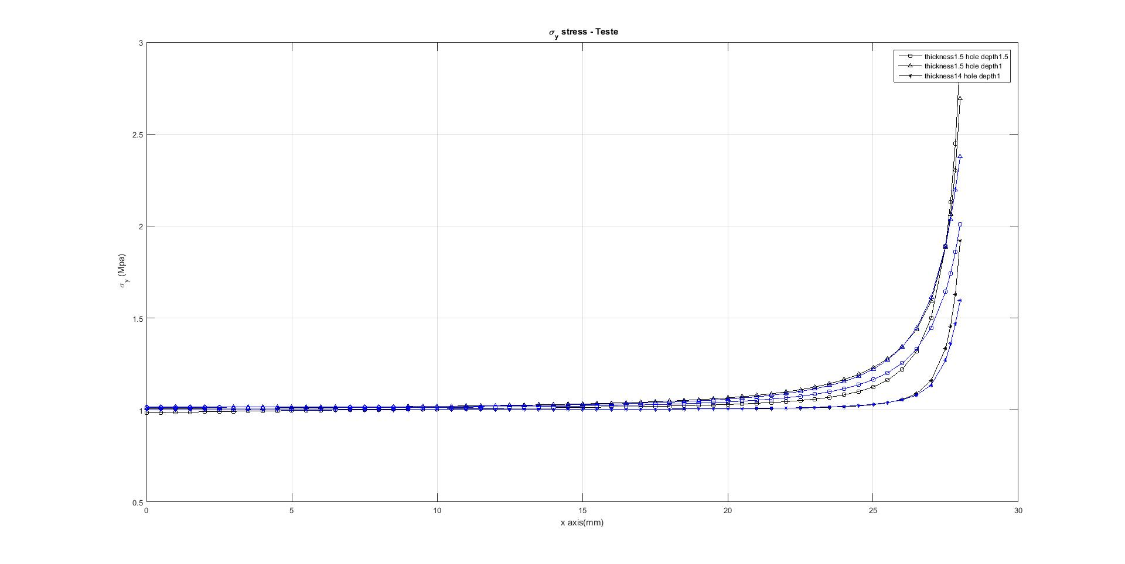
Sigma min calculated via u_b_s_p_center_hole_withou_kirsch.m at
C:\Manasses\center_hole\u_b_s_p_center_hole_withou_kirsch.m
sig_min(cont_min)=matriz(end,9);
 | Uniaxial
 | T_p/H_d=1 | T_p/H_d=1.5 | T_p/H_d=14
Point A (x1) | 2.933690130700000 | 2.692401707200000 | 1.920085877200000
Point B (x2) | = | = | =
Point A (x1)
Point B (x2)
Biaxial
T_p/H_d=1 | T_p/H_d=1.5 | T_p/H_d=14
2.008045554200000 | 2.378486096900000 | 1.594718247700000
= | = | =
Notes:
C:\Manasses\all_uniaxial_biaxial_3_geometries\all_uniaxial_biaxial_3_geometries_NEW.m

