Slide 1
Intrusion Detection System
Trần Hoàng Vũ
Lưu Minh Quân
Trần Tấn Thành

Slide 2
Nội dung
Giới thiệu bài toán
Hướng giải quyết

Slide 3

Giới thiệu bài toán
Notes:
It’s important to note that intrusion detection systems and intrusion prevention systems are both important parts of network integrity and include concepts that you may want to consider for IT security actions and decisions. Sometimes the systems overlap, and sometimes they’re combined or referred to together as IDPS.

Slide 4
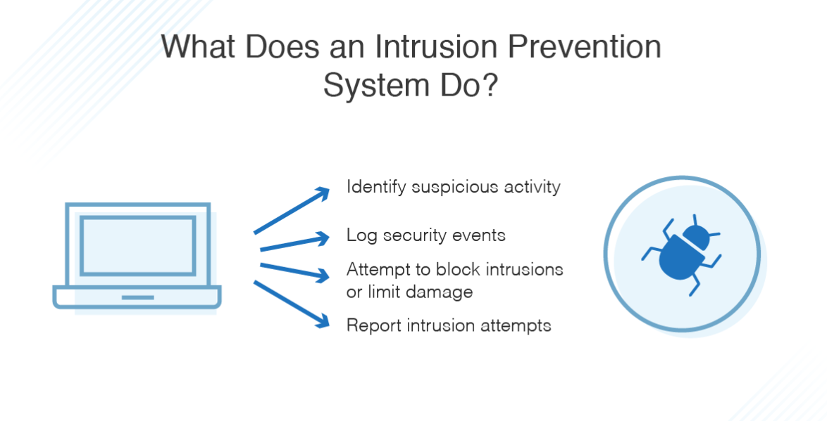
Giới thiệu bài toán
IPS
Notes:
all intrusion prevention begins with intrusion detection. But security systems can go one step further and act to stop ongoing and future attacks. When an IPS detects an attack, it can reject data packets, give commands to a firewall, and even sever a connection.

Slide 5
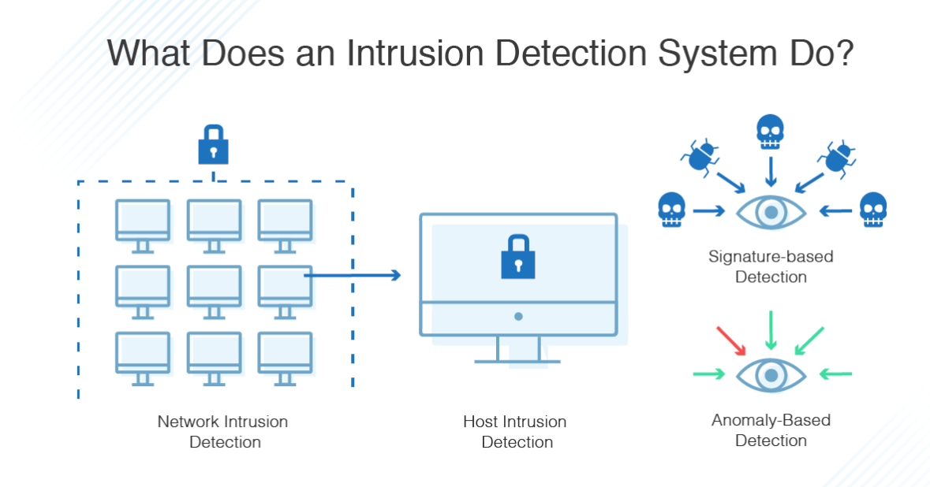
Giới thiệu bài toán
IDS
Notes:
An IDS monitors your network for possible dangerous activity, including malicious acts and violations of security protocols. When such a problem is detected, an IDS alerts the administrator but doesn’t necessarily take any other action.
Signature-based: Signature-based IDS relies on a preprogrammed list of known attack behaviors. It is similar to antivirus software
Signature-based IDS is popular and effective but is only as good as its database of known signatures. This makes it vulnerable to new attacks. Plus, attackers can and do frequently disguise their attacks to avoid common signatures that will be detected. Also, the most thorough signature-based IDS will have huge databases to check against, meaning big bandwidth demands on your system.
Anomaly-based: Anomaly-based IDS begins with a model of normal behavior on the network, then alert an admin anytime it detects any deviation from that model of normal behavior. Anomaly-based IDS begins at installation with a training phase where it “learns” normal behavior. AI and machine learning have been very effective in this phase of anomaly-based systems.
However, they can set off many false positives, since they don’t always distinguish well between attacks and benign anomalous behavior

Slide 6
Hướng giải quyết
Xây dựng hệ thống IDS dựa trên anomaly - base: Mô tả behavior bình thường (normal) và không bình thường (abnormal)
Sử dụng máy học để tiếp cận vấn đề:
Học không giám sát
Học có giám sát
Notes:
Statistics base: statistical properties such as mean and variance on normal transaction to build the normal profile [4]. The statistical tests are employed to determine whether the observed transaction deviates from the normal profile.
Knowledge-based techniques base: extract the knowledge from the specific attacks and system vulnerabilities. This knowledge can be further used to identify the intrusions or attacks happening in the network or system.
Machine learning-based techniques are broadly classified as Bayesian approaches, support vector machines, neural networks, fuzzy logic, and genetic algorithms. Their key advantage is flexibility, adaptability, and capture of interdependencies.

Slide 7
Hướng giải quyết
Các bước thực hiện:
Chọn dữ liệu
Feature extraction
So sánh kết quả giữa các phương pháp
Thử nghiệm
Notes:
Hướng tiếp cận Supervise:
The CTU-13 is a dataset of botnet traffic that was captured in the CTU University, Czech Republic, in 2011
EDA: EDA is for seeing what the data can tell us beyond the formal modeling or hypothesis testing task. Data visulization, ...
Feature Engineering: Feature engineering is the process of using domain knowledge to extract features from raw data via data mining techniques. These features can be used to improve the performance of machine learning algorithms. (Scaling, transform distibuition, …).
Challeng data imbalance
-Resampling
-Learn one class (learn normal data) detect abnormal data.
Feature Selection: The best features are selected based on scores of various statistical tests that determine their correlation with the target label, wrapper method, correlation method, enbedded menthod, according to the score of the classifier o avoid the curse of dimensionality,enhanced generalization by reducing overfitting[2] (formally, reduction of variance[1])
Feature reduction useful to visualize the dataset : (t-distributed Stochastic Neighbour Embedding) , PCA
Modeling: Sử dụng các thuật toán ML classifier: Logistic, ID3 , SVM / cluster / … sử dụng deep learning
Cần hạn chế báo động giả false positive (tăng precision) so với các thuật toán trước đây. Nhưng vẫn giữ được độ chính xác trong việc phát hiện abnormal data (tăng recall) (importan small false negative)

Slide 8
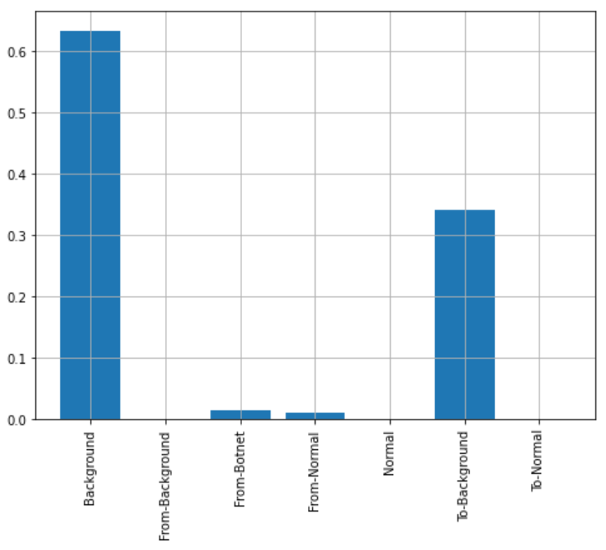
Kết quả
Phân tích dữ liệu CTU-13

Slide 9
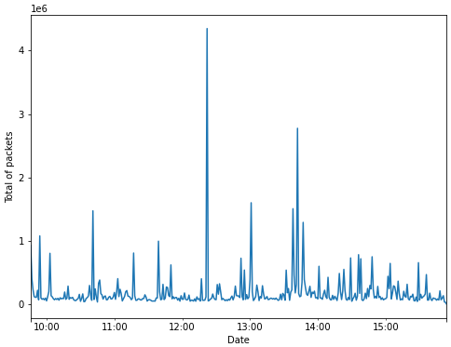
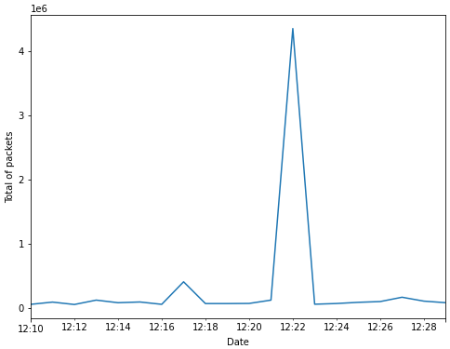
Kết quả
Phân tích dữ liệu CTU-13

Slide 10
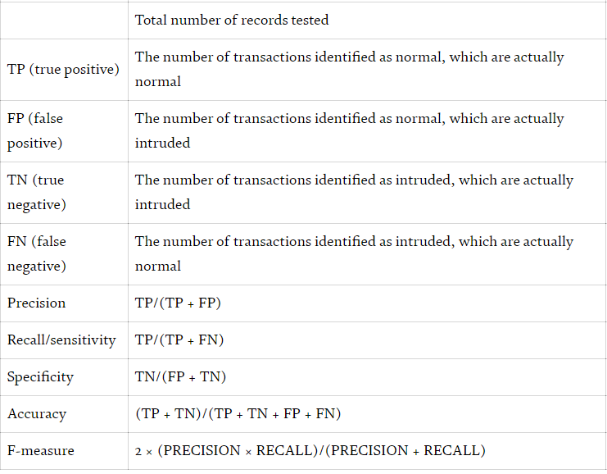
Kết quả
Metrics

Slide 11
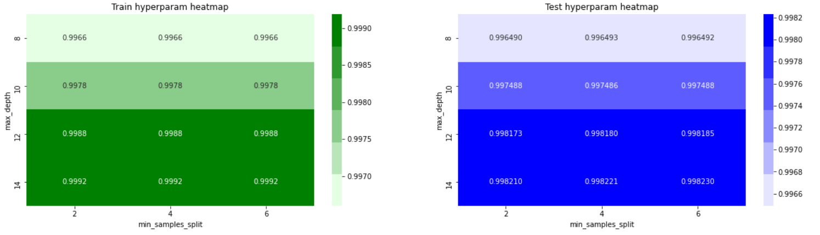
Kết quả
Decision tree

Slide 12
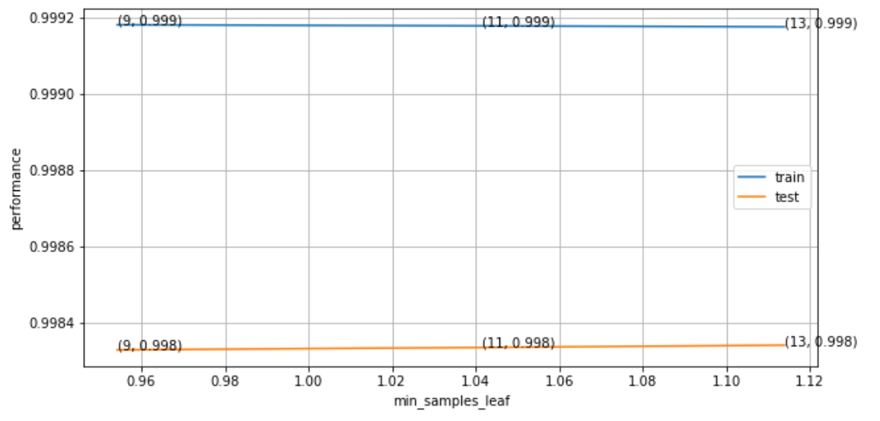
Kết quả
Decision tree

Slide 13
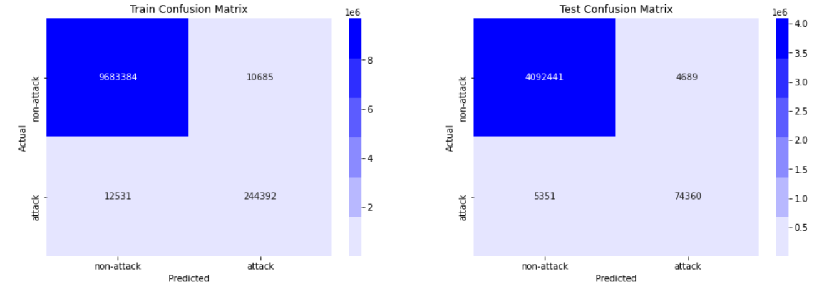
Kết quả
Decision tree

Slide 14
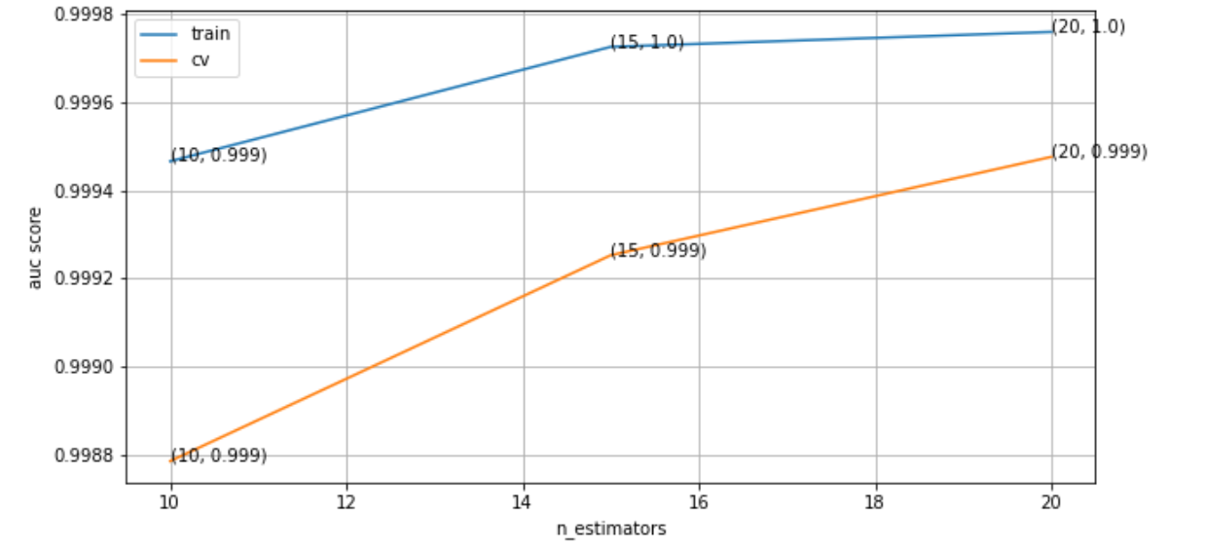
Kết quả
Random Forest

Slide 15
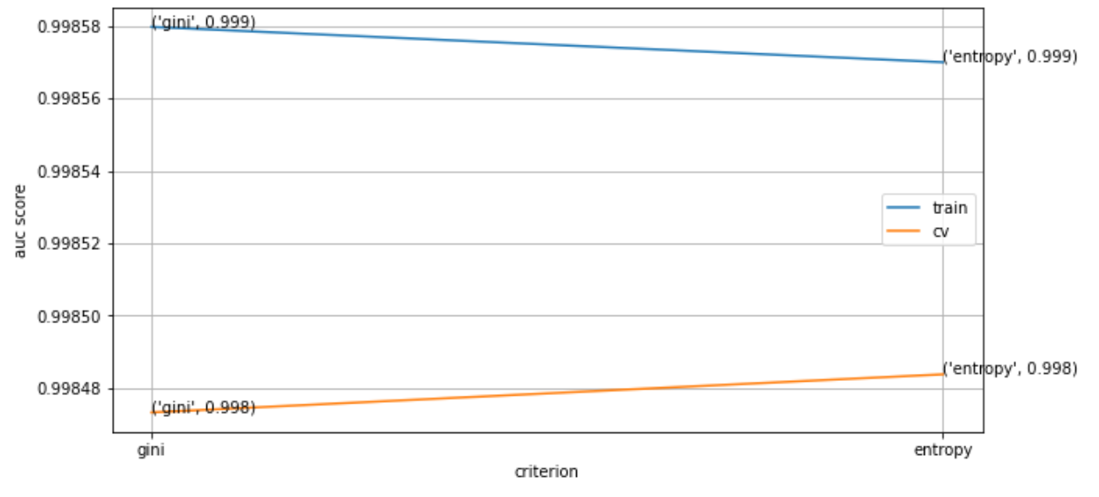
Kết quả
Random Forest

Slide 16
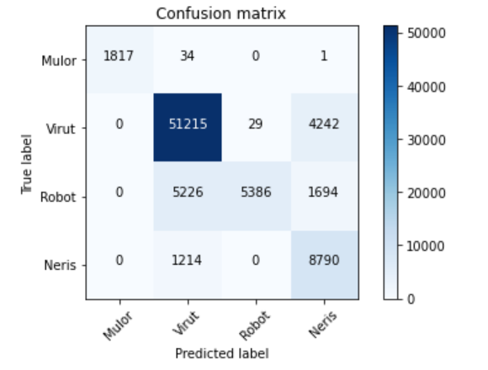
Kết quả
Multilayer Perceptron

Slide 17
Hướng giải quyết
Q&A

