Slide 1
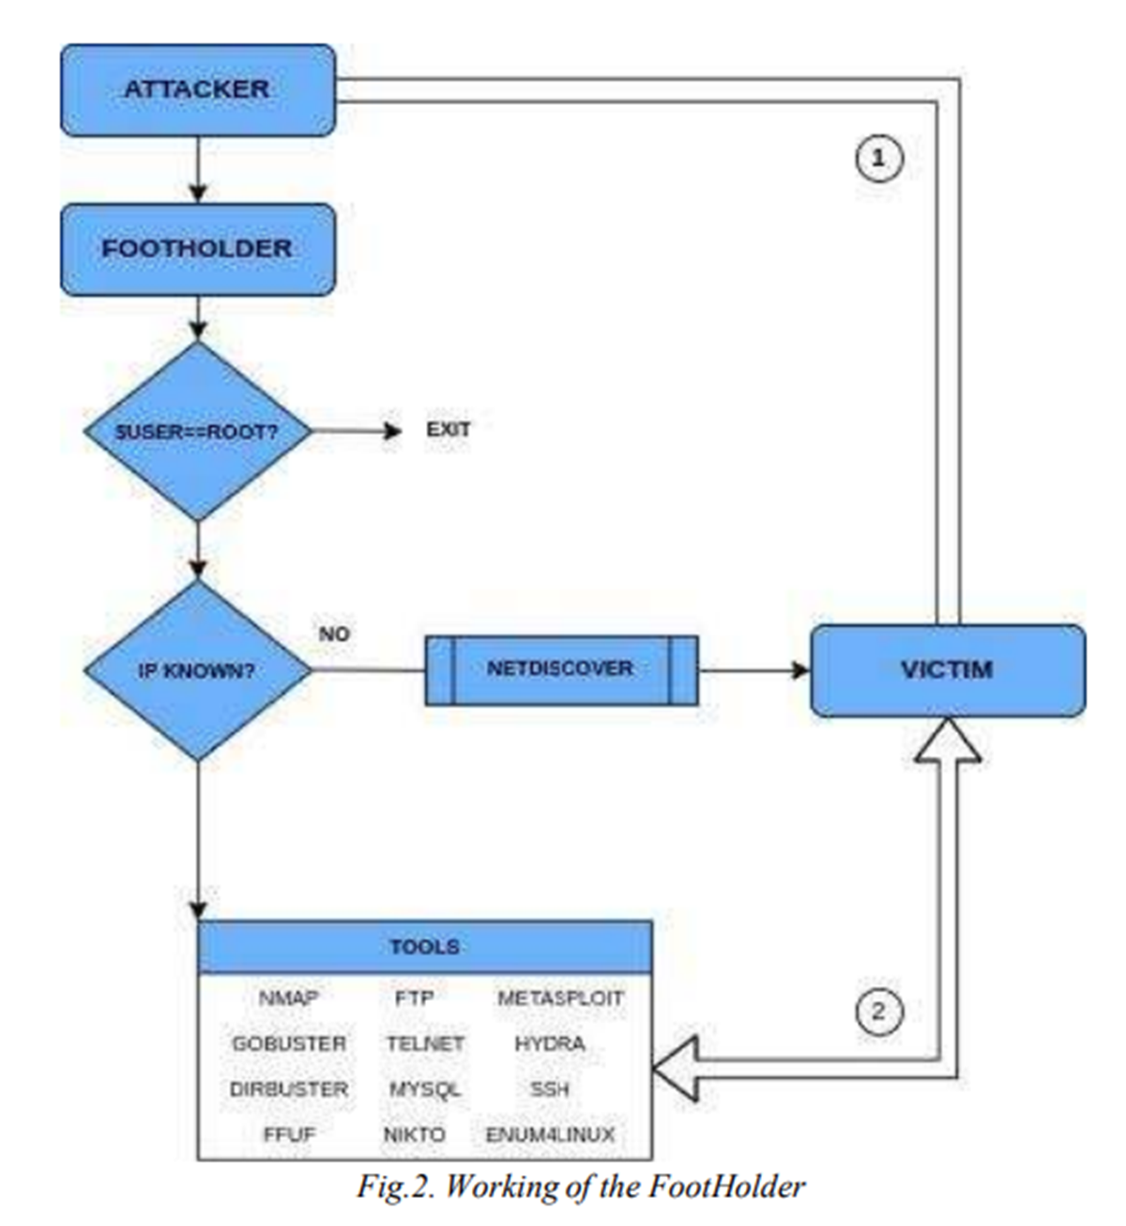
Footholder
lists the available tools
when the choice is made a brief explanation of the tool's features is shown

Slide 2
CyberCheck
Open-Source user-customizable OSINT and Web Vulnerability scanner
identify and target relevant data sources based on the specific requirements of the user
The use of an algorithm-based implementation comes only on the web scrapping modules of our work.
In-built scanning and browser-dependent packages
URL Redirection Check, IP Locator feature, PDF Metadata Analysis, and Clickjacking Vulnerability Detection

Slide 3
GPT
Auto GPT:
Reconnaissance & Planning
Devise an external penetration testing plan
Identify potential phishing targets (on Web page)
BabyAGI:
focuses on automated task generation, planning, and execution
HackingBuddyGPT
Gaining Access, Retaining Access, Exploitation
uses command output to identify potential security vulnerabilities
Provides exploitation example

Slide 4
Other General Tools
Nmap
Display ports, services, OS, fundamental vulnerabilities, and host detection
Burp Suite
Verify attack vectors and detect vuln (authentication, injection, and security misconfigurations)
track request and response between server and clients
OWASP ZAP
Identify Vulnerabilities on target website
Metasploit
Discovery, exploitation, and validation of vulnerabilities
Nessus
Detect multiple security vulnerabilities in the OS of targeted hosts, software patches, and services
Generate security recommendations
Show vulnerability category
Acunetix
Exploits XSS, SQL injections, Host Header Injection, and over 3000 other web vulnerabilities
Hydra
Brute Forcing
Maltego
OSINT tool for reconnaissance (analysis for connection related information )
Nikto
Execute and scan for multiple items including malicious files/ programs, and outdated versions in both software libraries and web servers.

Slide 5
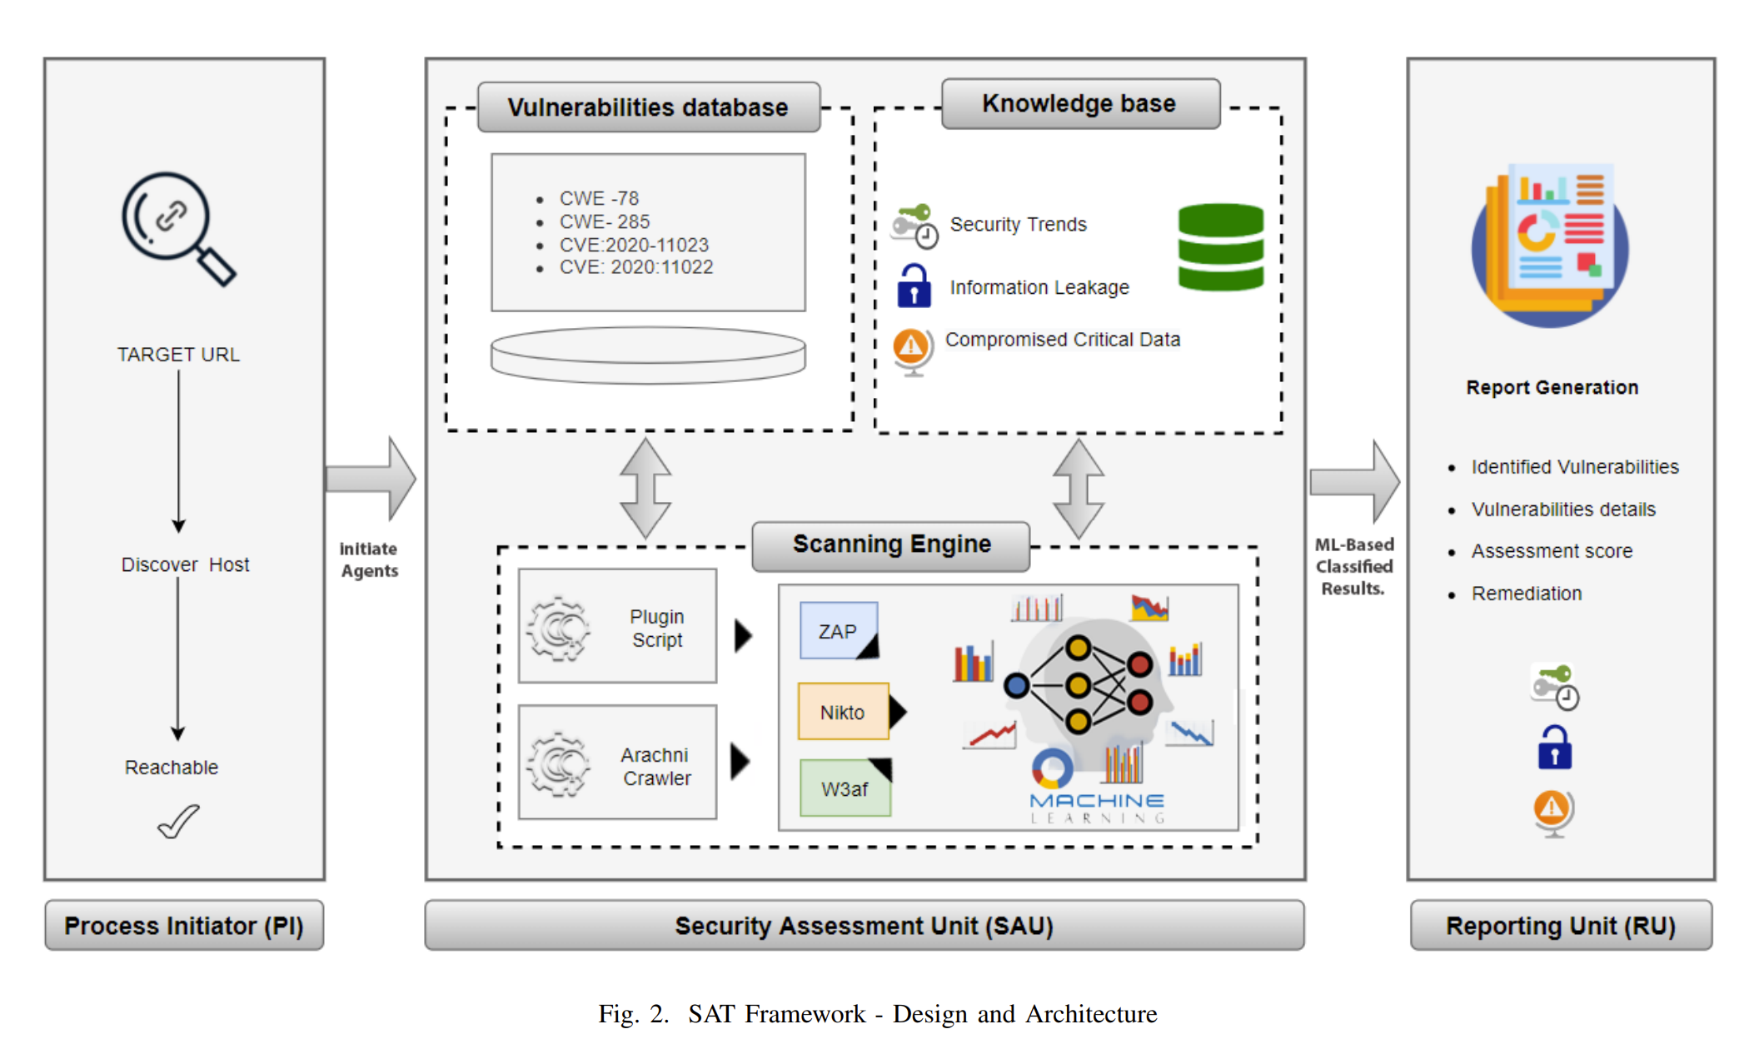
SAT: Integrated Multi-agent Blackbox Security Assessment Tool using Machine Learning
Three major components:
Process Initiator (PI): responsible for host discovery and initialization of the scanning process of the target URL
Security Assessment Unit (SAU): performs scanning of the input web application
Sub sections:
Scanning Engine: uses Arachni Crawler and provides features for custom plugin scripts
Vulnerabilities Database: contains a list of all possible vulnerabilities of OWASP top 10
Knowledgebase: AI (Artificial Intelligence) based analysis engine
Reporting Unit: produces thorough report identifying vulnerabilities & the details, assessment score, and possible remediation of each.

Slide 6
SAT: Integrated Multi-agent Blackbox Security Assessment Tool using Machine Learning
Three major components:
Process Initiator (PI): responsible for host discovery and initialization of the scanning process of the target URL
Security Assessment Unit (SAU): performs scanning of the input web application
Sub sections:
Scanning Engine
Vulnerabilities Database
Knowledgebase
Reporting Unit: produces thorough report, (includes vulnerabilities with their details, assessment score, and possible remediation).
Notes:
Scanning Engine: uses Arachni Crawler and provides features for custom plugin scripts
Vulnerabilities Database: contains a list of all possible vulnerabilities of OWASP top 10
Knowledgebase: AI (Artificial Intelligence) based analysis engine

