Slide 1


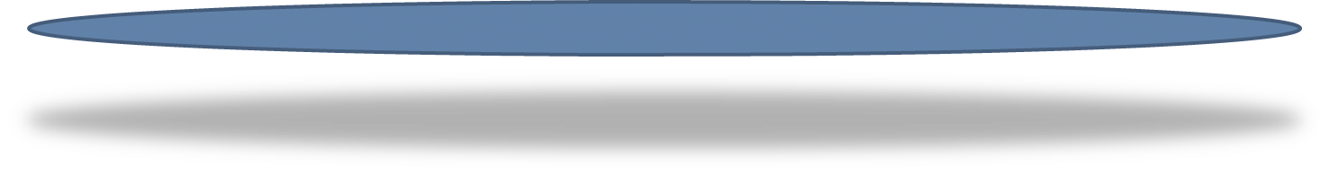

22NRM07 GuideRadPROS
Harmonisation, update and implementation of standards related to radiation protection dosimeters for photon radiation
Non-linearity investigation of a novel hybrid-dosimetry system according to IEC 62387:2020
Jelena Vlahović^{1,2}, Nikola Kržanović¹, Dušan Topalović¹, Miloš Živanović¹, Jelena Stanković Petrović¹, Olivier Van Hoey³, Hayo Zutz⁴, Ivana Komatina^{1,5}
¹ Department of Radiation and Environmental Protection, „VINČA" Institute of Nuclear Sciences - National Institute of the Republic of Serbia, University of Belgrade, Belgrade, Serbia ² Faculty of Sciences, University of Novi Sad, Novi Sad, Serbia ³ Belgian Nuclear Research Centre (SCK CEN), Mol, Belgium ⁴ Physikalisch-Technische Bundesanstalt, Braunschweig, Germany ⁵ Faculty of Physical Chemistry, University of Belgrade, Belgrade, Serbia
International Conference on Radiation Applications in Physics, Chemistry, Medical Sciences, Engineering and Environmental Sciences
June 10-12, 2024, University of Granada, Spain

Slide 2


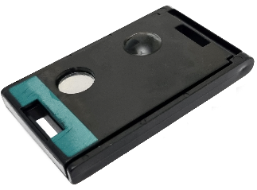
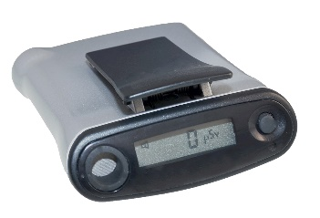
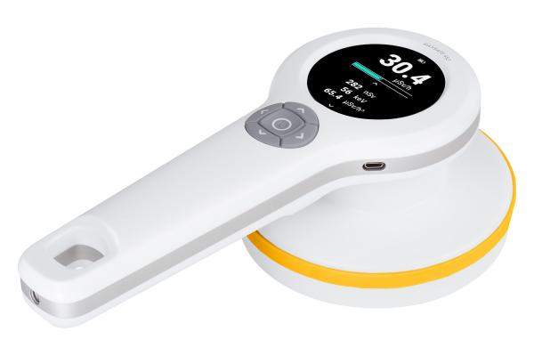
Advances in Dosimetry Technologies
Development of new technologies in dosimetry is aimed towards enhancing the performance and capabilities of radiation dose measurement systems.
Examples include: hybrid dosimeters, spectrodosimetry, computional dosimetry etc.
Hybrid dosimeters stand out by integrating multiple dosimetry techniques.
Benefits: delivery of improved accuracy and reliability in radiation protection dose measurements.
22NRM07 GuideRadPROS Joint Research Project and Work package 4

Slide 3
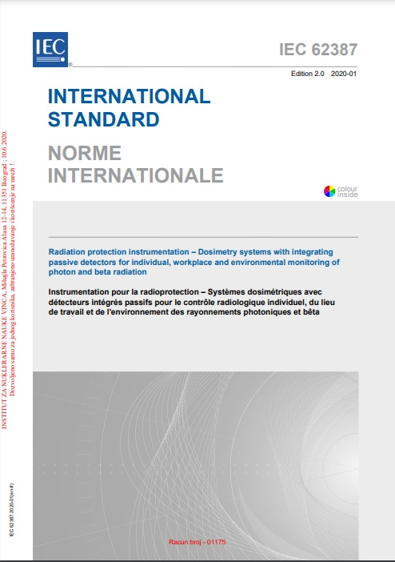
IEC 62387:2020 Compliance
Testing of hybrid dosimeters was conducted in accordance with the guidelines outlined in IEC 62387:2020.
These tests include: → Coefficient of Variation → Non-linearity → Overload characteristics, after effects, reusability → Radiation energy and angle of incidence
The non-linearity test
Response should be measured for at least the following values: at each limit of each order of magnitude of the measuring range, at approximately 30% of each full order of magnitude, at the limits of the measuring range and, in addition, in the vicinity of range changes.
The variation of results due to a change of the dose equivalent shall not exceed the values from -13 % to +18 %.
The mandatory measuring range is 0.1 mSv ≤ H ≤ 1 Sv.

Slide 4
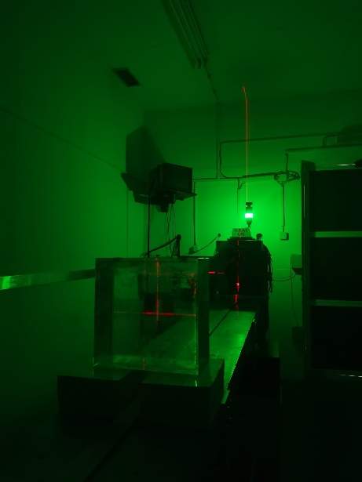
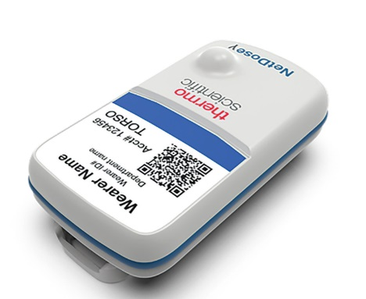
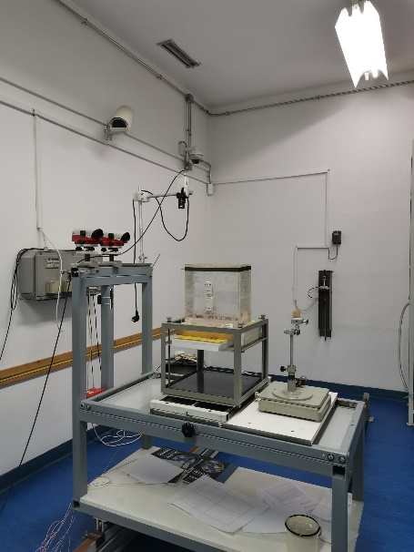
Experimental Setup for Non-linearity test
Conducted in reference X-ray and gamma-ray radiation fields, established according to ISO 4037:2019.
Radiation fields were generated by several ¹³⁷Cs and ⁶⁰Co radionuclides and an X-ray generator.
Dosimeters were placed on standard ISO water slab phantom.
3-mm PMMA layer used for high energy reference fields.

Slide 5
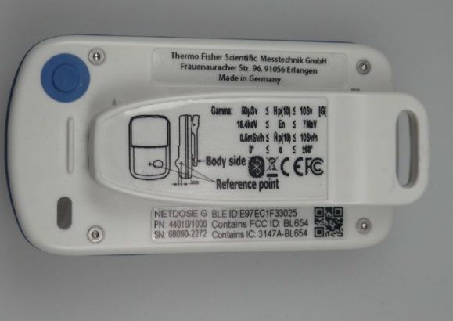
Test Results
Dose
1 μSv
3 μSv
7 μSv
30 μSv
70 μSv
300 μSv
700 μSv
1 mSv
3 mSv
7 mSv
30 mSv
70 mSv
100 mSv
300 mSv
700 mSv
1 Sv
3 Sv
7 Sv
Non-linearity was investigated within a wide range of dose values, corresponding to different exposure situations, including low doses encountered during regular monitoring, and the situations of exposure to high doses of radiation due to accidents.
50 μSv ≤ Hp (10) ≤ 10 Sv

Slide 6
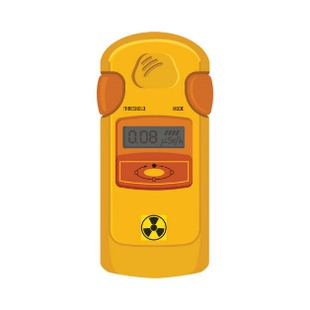
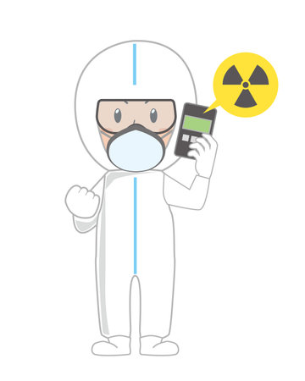
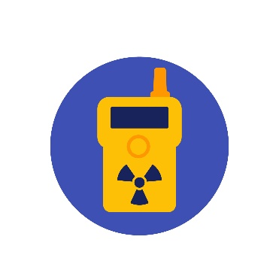
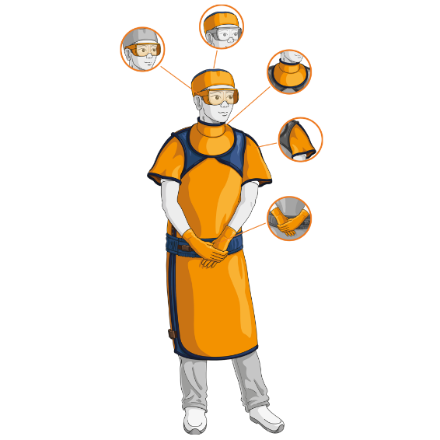
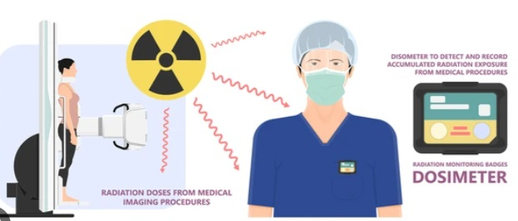
Conclusion
The test confirmed that the hybrid dosimeter complies with the requirements of IEC 62387:2020.
Type testing is important to ensure the reliability of measurements and acquired data.
The integration of multiple dosimetry techniques within hybrid dosimeters represents an advancment in dosimetry technology.
They enhance measurement accuracy and reliability, which are vital for both routine monitoring and emergency response scenarios.
The 22NRM07 GuideRadPROS project plays an important role in harmonizing standards and supproting innovation in radiation protection.

Slide 7
Thank you for your attention!
The project (22NRM07 GuideRadPROS) has received funding from the European Partnership on Metrology, co-financed from the European Union’s Horizon Europe Research and Innovation Programme and by the Participating States.
Funded by the European Union. Views and opinions expressed are however those of the author(s) only and do not necessarily reflect those of the European Union or EURAMET. Neither the European Union nor the granting authority can be held responsible for them.
http://projects.ciemat.es/web/guideradpros-euramet

