Slide 1

Fraudolent transaction classification
Riccardo la marca, matr. 1795030
big data computing course A.A. 2021/2022

Slide 2
overview
1
Introduction
2
Dataset
3
Explore and Feature Engineering
A brief presentation of the addressed problem
A brief description of the dataset used in the project
How the dataset was modified
4
Machine Learning Models
The ML models and Pipelines applied for the task
5
Results
A description of the results obtained from the previous step

Slide 3
ADDRESSED PROBLEM
1
Financial fraud is a problem that has a huge impact on the financial industry
Credit card fraud detection is a challenge mainly due to 2 problems that it poses
Both profiles of fraudolent and normal behaviours change
Usually used datasets are highly skewed
The goal of the task is to create a Machine Learning model that, given a set of samples of fraudolent and not fraudolent transactions, is capable of classifying whether a new transaction is fraudolent or not.

Slide 4
The dataset
~709 MiB
Divided into identity.csv and transaction.csv
590540 entries
434 features
Target feature is «isFraud». 0 means not fraudolent, 1 otherwise
The Dataset is available on Kaggle
2

Slide 5
EXPLORE AND Feature engineering OUTLINE
3
Merging
Transaction.csv and identity.csv have been merged together
Label Distributrion
The dataset is highly unbalanced
Missing Values
The dataset has a huge number of missing values
Feature Engineering
Drop some features
«Standardizing»
Apply «Imputing»
Use Pearson Correlation

Slide 6
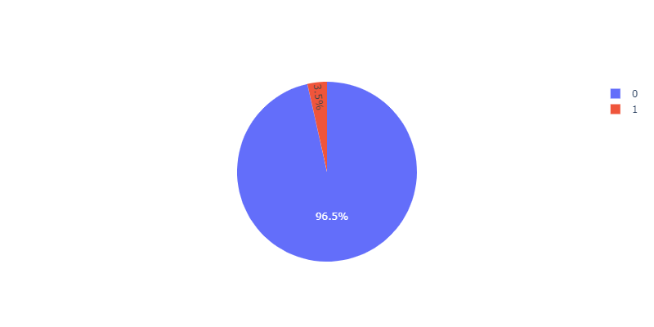
.1 - Label distribution
3
With respect to the target label «isFraud» the dataset results highly unbalanced
~96.5 % are not-fraudolent transactions
~3.5 % are fraudolent transactions
We have to handle this problem when splitting the dataset for training and testing the various ML models

Slide 7
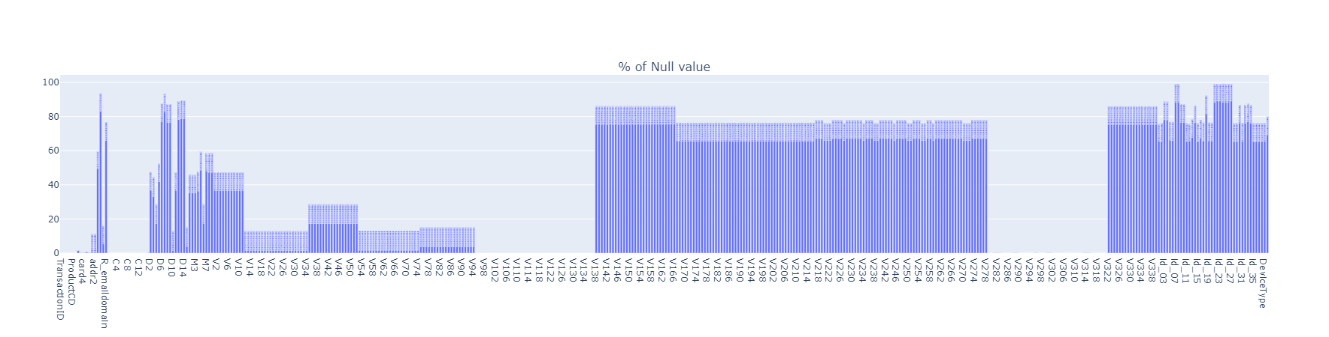
.2 – MISSING VALUES
3
The dataset has a high number of features with a huge percentage of missing values
The average range of percentages is ~70-90%
I handled this during the Feature Engineering step

Slide 8
.3 – FEATURE ENGINEERING
3
Features Dropping
Drop features with percentage value of missing values grater or equal to 90%
Standardization
Standardize certain features
Imputing
Use the imputer to replace null values in the dataset according to a specific strategy
Take yahoo.co.jp, yahoo.co.uk and yahoo.net, I replace it with yahoo
Given different values for the same feature but with equal meaning, replace with a single more general value
Pearson Correlation
Drop more features using the Pearson Correlation
Discrete values use strategy mean
Nulls in categorical values have been replaced with «N»
If the PC > .95, then drop that feature
Avoiding duplicate features

Slide 9
MACHINE LEARNING PIPELINE
Split
Data
Indexer
OHE
Optional
Cross Validator
Logistic Regression
Decision Tree
Random Forest
categorical
train
Vector Assembler
numerical
Optional
test
Standard Scaler
General Training Pipeline
model
Test
4

Slide 10
.1 – DATASET SPLITTING
The dataset is highly unbalanced, thus we cannot apply a simple random splitting
This might lead to a poor splitting strategy
For instance the test set ends up containing only examples that are labeled with the most representative class
In this case such a class is the one for non-fraudolent transactions
For this reason I used the so-called Stratified Random Sampling
It guarantees that both the training and the test split follow the same class distribution of the original dataset
For the experiments I selected 60% of 0’s and 70% of 1’s
After splitting we last with: 357041 x 232 (train set) and 233499 x 232 (test set)
4

Slide 11
.2 - EXPERIMENTS
Logistic Regression
Only numerical
(w/o standardization)
All features
Only categorical
Mix
(w/o standardization)
Decision Tree
Random Forest
4

Slide 12
.1 - EXPERIMENTAL RESULTS
5
 | Numerical |  | All Features | Categorical | Mix
 | with standardization | w/out standardize |  |  | with standardization | w/out standardize
Logistic Regression | 0.9772 | 0.97725 | 0.9777 | 0.9733 | 0.974 | 0.974
Decision Tree | 0.9773 | 0.9773 |  | 0.9734
Random Forest
Accuracy
 | Numerical |  | All Features | Categorical | Mix
 | with standardization | w/out standardize |  |  | with standardization | w/out standardize
Logistic Regression | 0.832 | 0.834 |  | 0.800 | 0.824 | 0.824
Decision Tree | 0.428 | 0.428 |  | 0.7074
Random Forest
AUC ROC

Slide 13
.2 - EXPERIMENTAL RESULTS
5
 | Numerical |  | All Features | Categorical | Mix
 | with standardization | w/out standardize |  |  | with standardization | w/out standardize
Logistic Regression | 0.7137 | 0.7139 |  | 0.5897 | 0.6352 | 0.6352
Decision Tree | 0.7138 | 0.7138 |  | 0.5961
Random Forest
F1-Score
 | Numerical |  | All Features | Categorical | Mix
 | with standardization | w/out standardize |  |  | with standardization | w/out standardize
Logistic Regression | 0.853/0.613 | 0.852/0.614 |  | 0.706/0.505 | 0.785/0.533 | 0.785/0.533
Decision Tree | 0.878/0.601 | 0.878/0.601 |  | 0.732/0.502
Random Forest
P/R

