Slide 1

Fraudolent transaction classification
Riccardo la marca, matr. 1795030
big data computing course A.A. 2021/2022

Slide 2
overview
1
Introduction
2
Dataset
3
Explore and Feature Engineering
A brief presentation of the addressed problem
A brief description of the dataset used in the project
How the dataset was modified
4
Machine Learning Models
The ML models and Pipelines applied for the task
5
Results
A description of the results obtained from the previous step

Slide 3
ADDRESSED PROBLEM
1
Financial fraud is a problem that has a huge impact on the financial industry
Credit card fraud detection is a challenge mainly due to 2 problems that it poses
Both profiles of fraudolent and normal behaviours change
Usually used datasets are highly skewed
The goal of the task is to create a Machine Learning model that, given a set of samples of fraudolent and not fraudolent transactions, is capable of classifying whether a new transaction is fraudolent or not.

Slide 4
The dataset
~709 MiB
Divided into identity.csv and transaction.csv
590540 entries
434 features
Target feature is «isFraud». 0 means not fraudolent, 1 otherwise
The Dataset is available on Kaggle
2

Slide 5
EXPLORE AND Feature engineering OUTLINE
3
Merging
Transaction.csv and identity.csv have been merged together
Label Distributrion
The dataset is highly unbalanced
Missing Values
The dataset has a huge number of missing values
Feature Engineering
Drop some features
«Standardizing»
Apply «Imputing»
Use Pearson Correlation

Slide 6
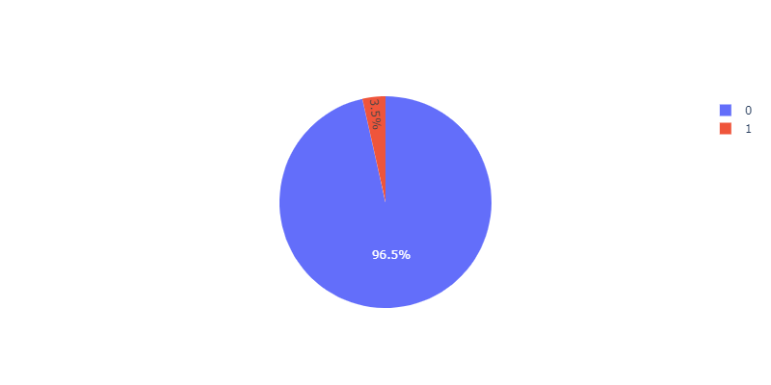
.1 - Label distribution
3
With respect to the target label «isFraud» the dataset results highly unbalanced
~96.5 % are not-fraudolent transactions
~3.5 % are fraudolent transactions
We have to handle this problem when splitting the dataset for training and testing the various ML models

Slide 7
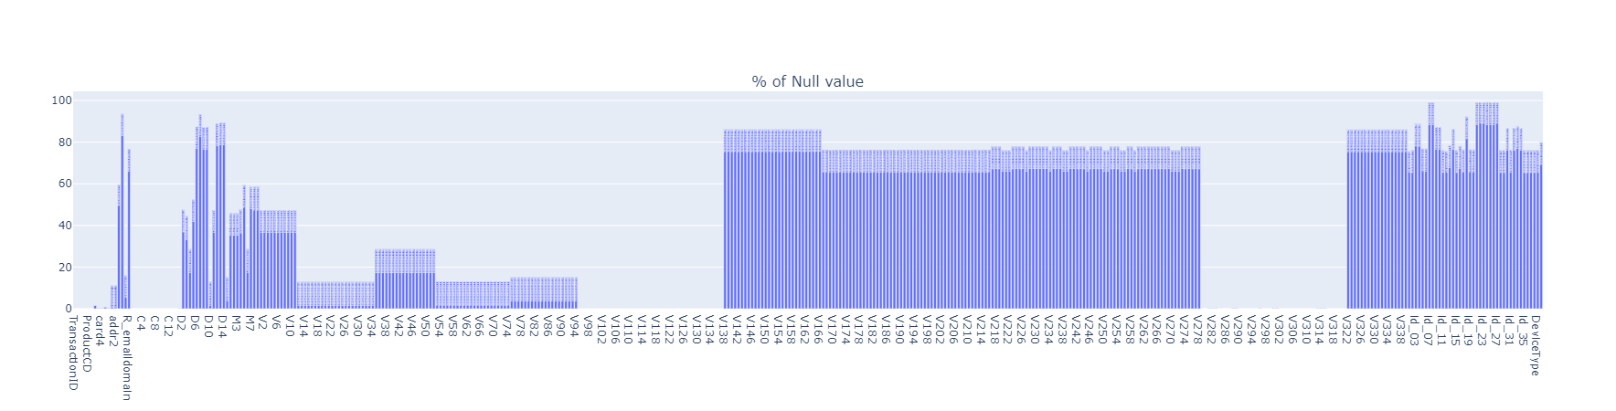
.2 – MISSING VALUES
3
The dataset has a high number of features with a huge percentage of missing values
The average range of percentages is ~70-90%
I handled this during the Feature Engineering step

Slide 8
.3 – FEATURE ENGINEERING
3
Features Dropping
Drop features with percentage value of missing values grater or equal to 90%
Standardization
Standardize certain features
Imputing
Use the imputer to replace null values in the dataset according to a specific strategy
Take yahoo.co.jp, yahoo.co.uk and yahoo.net, I replace it with yahoo
Given different values for the same feature but with equal meaning, replace with a single more general value
Pearson Correlation
Drop more features using the Pearson Correlation
Discrete values use strategy mean
Nulls in categorical values have been replaced with «N»
If the PC > .95, then drop that feature

Slide 9
.3.1 – FEATURE ENGINEERING - Standardization
3
Some categorical features have a lot a different values
This will leads to a lot of new features after applying One Hot Encoding
I decided to «Standardize» the values of some features
For instance, the features P_emaildomain and R_emaildomain have a lot of different values like
Yahoo.co.uk, yahoo.de, yahoo.co.jp etc. I take that features and replace with a common yahoo.
So also for other domains owned by google have been renamed with google, and so on …

Slide 10
MACHINE LEARNING PIPELINE
Split
Data
Indexer
OHE
Cross Validator
Logistic Regression
Decision Tree
Random Forest
test
train
Optional
categorical
Optional
Oversampler
Vector Assembler
numerical
Optional
Standard Scaler
Gradient BT
General Training Pipeline
model
Test
4

Slide 11
.1 – DATASET SPLITTING
The dataset is highly unbalanced, thus we cannot apply a simple random splitting
This might lead to a poor splitting strategy
For instance the test set ends up containing only examples that are labeled with the most representative class
In this case such a class is the one for non-fraudolent transactions
For this reason I used the so-called Stratified Random Sampling
It guarantees that both the training and the test split follow the same class distribution of the original dataset
For the experiments I selected 60% of 0’s and 70% of 1’s
After splitting we last with: 357041 x 232 (train set) and 233499 x 232 (test set)
4

Slide 12
.2 – TRAIN OVERSAMPLER
After the stratified sampling, the train dataset was still highly unbalanced
We have 342530 of 0s and 14511 of 1s.
I decided to apply oversampling on the train set
After this I had 342530 of equal entries for fraudolent transactions
I decided to keep only the 60% of them
That because, keeping all of them, I obtained a high number of False Positive
A high number of non fraduolent have been classified as fraduolent
Finally, the train set contains 63.3% of non fraud and 36.7% of fraudolent
4

Slide 13
.3 - EXPERIMENTS
Logistic Regression
Only numerical
(w/o standardization)
All features
Only categorical
Decision Tree
Random Forest
Gradient BT
oversampled
4

Slide 14
.1 - EXPERIMENTAL RESULTs
5
 | Numerical (oversample) |  | All Features (oversample) | Categorical (oversample)
 | with standardization | w/out standardize
Logistic Regression | 0.9772 (0.9099) | 0.97725 (0.9099) | 0.9777 (0.9033) | 0.9733 (0.8604)
Decision Tree | 0.9773 (0.8586) | 0.9773 (0.8586) | 0.9790 (0.8586) | 0.9734 (0.7862)
Random Forest | 0.9787 (0.9390) | 0.9789 (0.9397) | 0.9786 (0.9410) | 0.9734 (0.8829)
Gradient Boosted Tree | 0.9837 (0.9432) | 0.9838 (0.9428) | 0.9844 (0.9486) | 0.9746 (0.8823)
Accuracy

Slide 15
.2 - EXPERIMENTAL RESULTS
5
 | Numerical (oversample) |  | All Features (oversample) | Categorical (oversample)
 | with standardization | w/out standardize
Logistic Regression | 0.832 (0.840) | 0.834 (0.840) | 0.857 (0.862) | 0.800 (0.801)
Decision Tree | 0.428 (0.535) | 0.428 (0.535) | 0.858 (0.535) | 0.707 (0.679)
Random Forest | 0.844 (0.864) | 0.845 (0.866) | 0.848 (0.872) | 0.784 (0.810)
Gradient Boosted Tree | 0.913 (0.931) | 0.911 (0.930) | 0.920 (0.940) | 0.845 (0.850)
AUC ROC

Slide 16
.3 - EXPERIMENTAL RESULTS
5
 | Numerical (oversample) |  | All Features (oversample) | Categorical (oversample)
 | with standardization | w/out standardize
Logistic Regression | 0.7137 (0.6446) | 0.7139 (0.6446) | 0.7227 (0.6556) | 0.5897 (0.6109)
Decision Tree | 0.7138 (0.6101) | 0.7138 (0.6101) | 0.7472 (0.6101) | 0.5961 (0.5999)
Random Forest | 0.7406 (0.6787) | 0.7438 (0.6787) | 0.7390 (0.6842) | 0.4932 (0.6165)
Gradient Boosted Tree | 0.8148 (0.7267) | 0.8159 (0.7268) | 0.8245 (0.7416) | 0.6540 (0.6400)
F1-score

Slide 17
.4 - EXPERIMENTAL RESULTS
5
 | Numerical (oversample) |  | All Features (oversample) | Categorical (oversample)
 | with standardization | w/out standardize
Logistic Regression | 0.853/0.613 (0.572/0.737) | 0.852/0.614 (0.572/0.737) | 0.858/0.624 (0.574/0.764) | 0.706/0.505 (0.542/0.699)
Decision Tree | 0.878/0.601 (0.541/0.698) | 0.878/0.601 (0.541/0.698) | 0.869/0.654 (0.541/0.698) | 0.732/0.502 (0.529/0.692)
Random Forest | 0.935/0.613 (0.611/0.762) | 0.937/0.616 (0.612/0.761) | 0.930/0.613 (0.616/0.768) | 0.486/0.5 (0.550/0.701)
Gradient Boosted Tree | 0.932/0.723 (0.637/0.844) | 0.932/0.725 (0.637/0.845) | 0.937/0.735 (0.652/0.859) | 0.821/0.543 (0.559/0.748)
P/R

