Slide 1

What drives clinical weight improvement
among 9amHealth members?
Mostly medication + starting weight + time in program.
Engagement & education add a real, smaller, modifiable boost.
Luis M. Rangel Jr.

Slide 2
APPROACH
Analytical approach: locked population, clinical outcome, two lenses
Sub-questions / hypotheses:
H1 Heavier at baseline → larger loss (regression to the mean)
H2 Medication (GLP-1) drives more loss than coaching alone
H3 Engagement (logging volume) adds benefit on top of medication
H4 Module completion adds independent benefit
H5 Demographics (sex) relate to weight loss
H6 Engagement pays off differently by drug class
Outcome = % weight change · success = ≥5% loss (clinical bar).
Method = baseline-adjusted regression + LASSO (parsimony) + HC3 inference.
Full cohort description: Table 1 (appendix).
Step | N | Excl
Enrolled universe (demographics) | 865 | —
Has BW outcome (first + last) | 827 | 38
Eligible status (active / finished) | 825 | 2
9amHealth · Data Analyst Case Study
2

Slide 3
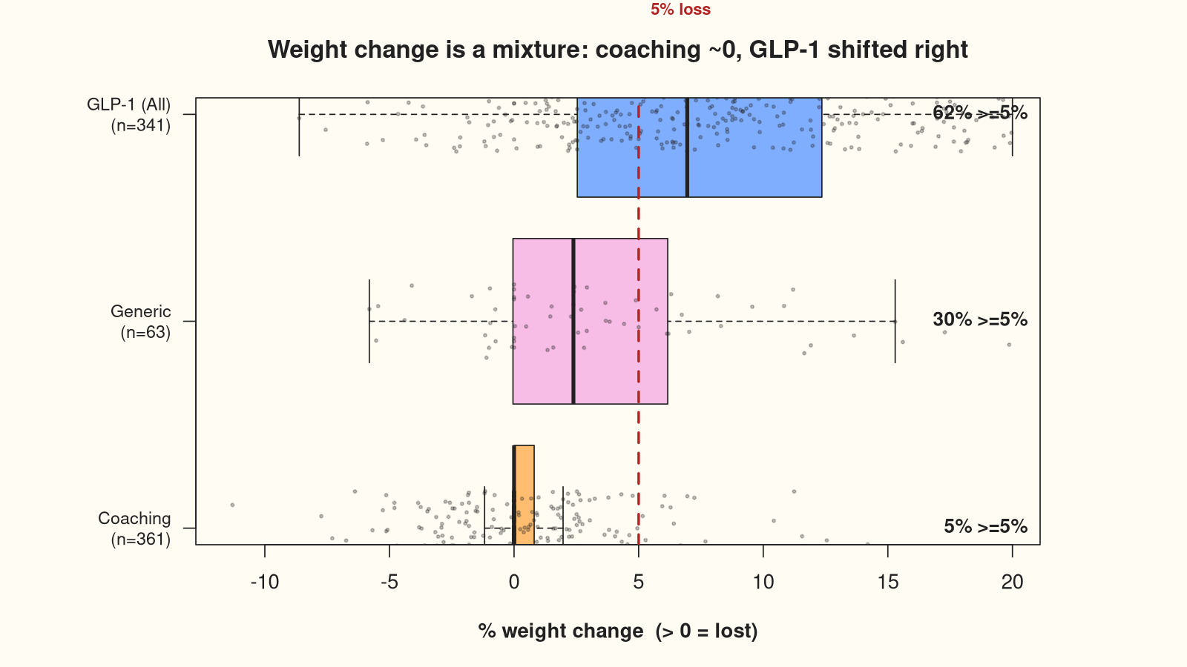
FINDINGS · WEIGHT
Meaningful weight loss is concentrated in GLP-1 members
Weight-change patterns:
• Overall median 1.3% loss
• 31% hit ≥5% (254 / 825)
≥5% responders by drug class:
• Coaching 5.3%
• Generic 30.2%
• GLP-1 (All) 61.9%
Coaching-only median = 0.0%
9amHealth · Data Analyst Case Study
3

Slide 4
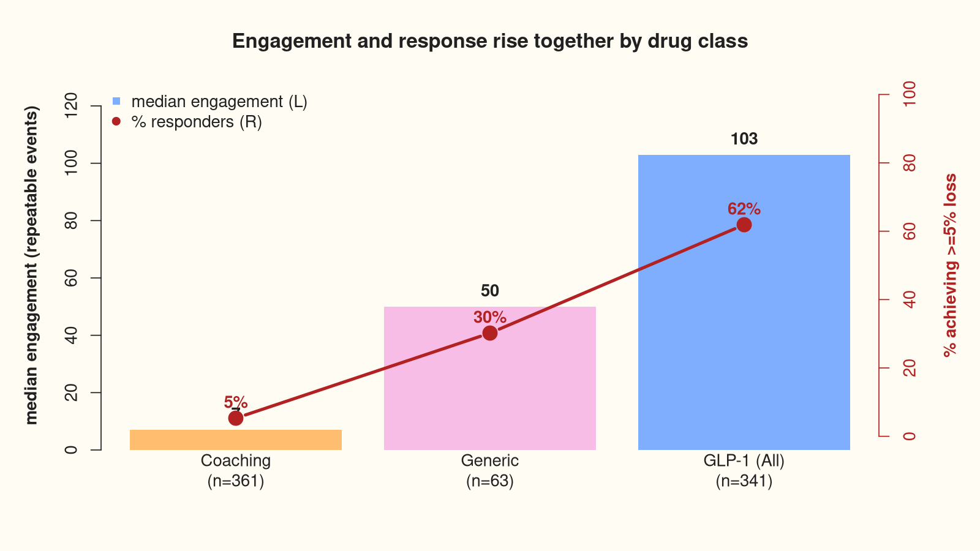
FINDINGS · ENGAGEMENT
Engagement isn't uniform — it tracks the medicated population
Engagement patterns:
• 825 / 825 have engagement data
Median volume_rep:
• 7 → 50 → 103
(Coaching → Generic → GLP-1)
• mod.mean: 0.31 → 0.90 → 2.70
Rises in the same order as the
responder rate — so how much of
it is real? (next slide)
9amHealth · Data Analyst Case Study
4

Slide 5
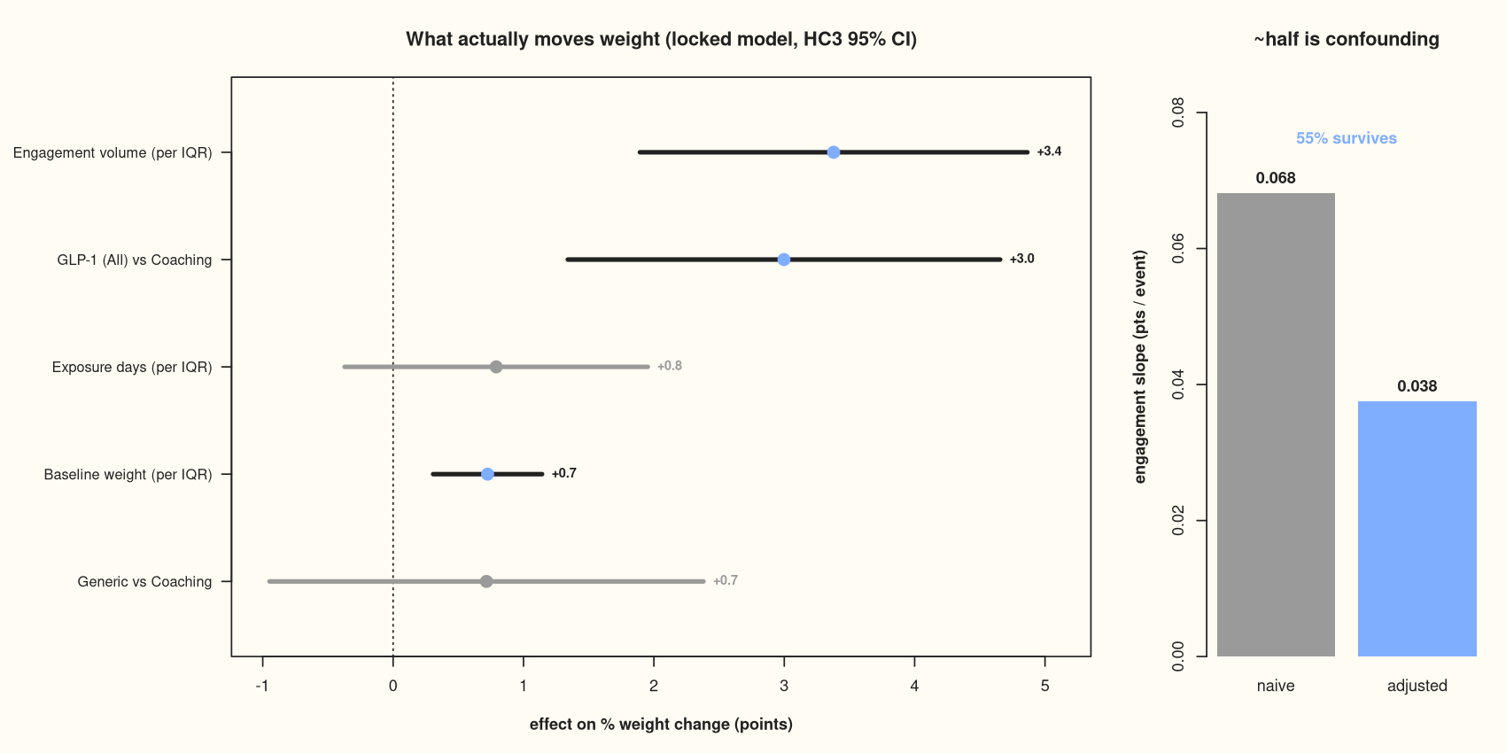
FINDINGS · DRIVERS
Engagement: ~half confounded, ~half a real, modifiable lever
Drivers (confound-adjusted):
Dominant (R² = 0.35): GLP-1
+3.0 pts, baseline, exposure.
Engagement: naive +0.068 →
adjusted +0.038 / event,
HC3 p < 1e-5.
~45% confounding, ~55% real.
Education adds: mod.mean
p = .009, breadth p = .011.
LASSO 'saw nothing' = predictive
parsimony, not inference.
9amHealth · Data Analyst Case Study
5

Slide 6
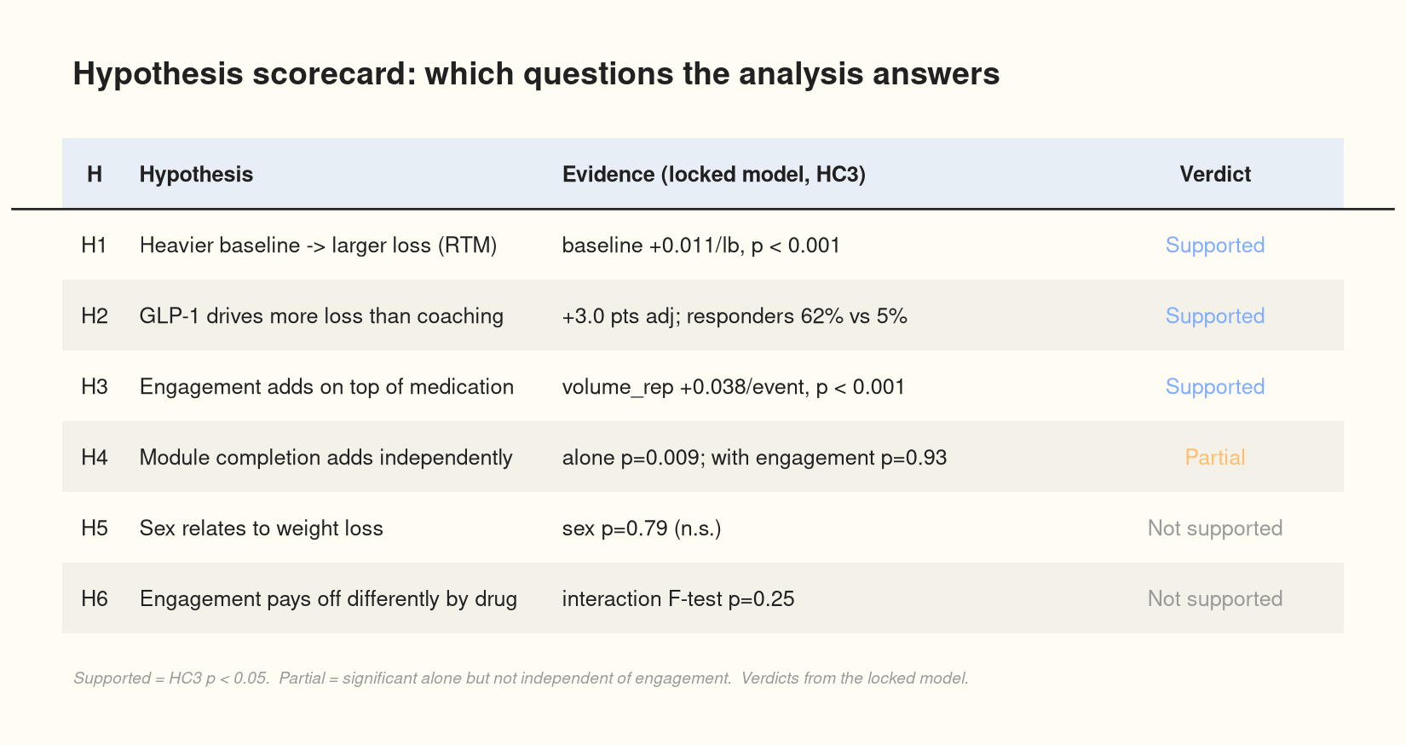
FINDINGS · SCORECARD
Which questions the analysis answers
9amHealth · Data Analyst Case Study
6

Slide 7
RECOMMENDATIONS
Recommendations
Clinical
Product
Business
GLP-1 is the strongest
weight-loss lever.
Coaching-only shows little
change on the scale — but body
weight can miss body-composition
gains; measure both.
Prioritize medication access
& titration.
Engagement (logging, breadth)
& module completion are real,
modifiable secondary levers.
Invest in the highest-yield —
but it's observational; run a
causal test (RCT / matched)
before over-investing.
Segment on drug class for
responder economics.
Forecast by medication mix,
with engagement / education
as incremental, controllable
upside.
9amHealth · Data Analyst Case Study
7

Slide 8
APPENDIX
Methods & Limitations
• Cohort exclusions: 865 → 827 (has weight) → 825 (active / finished)
• No age column (briefing said it would exist) — key limitation
• ≥5% = clinically meaningful weight-loss threshold
• Outcome = % change (decouples baseline), HC3 robust SE (heteroskedastic)
• LASSO (prediction / parsimony) vs HC3 (inference) — why they disagree
• Multiplicity: Bonferroni α = 0.005 → only volume_rep unambiguous
• Observational — associations, not causal; engagement may proxy adherence
• Endpoint: body weight can't separate fat vs lean mass (coaching ~0 may be recomposition)
• Full cohort description in Table 1 (next slide)
9amHealth · Data Analyst Case Study
8

Slide 9
Table 1 · Cohort description by treatment group
APPENDIX
Measure | Active Generic Medication (n=63) | GLP-1 Diabetes (n=7) | GLP-1 Weight (n=334) | Coaching (n=361) | Null (n=60)
Female (ref = Male) | 35 (55.6%) | 4 (57.1%) | 209 (62.6%) | 203 (56.2%) | 39 (65.0%)
Active (ref = Finished) | 55 (87.3%) | 7 (100.0%) | 324 (97.0%) | 326 (90.3%) | 51 (85.0%)
Ethnicity
Am. Indian/Alaska Native | 3 (4.8%) | 0 (0.0%) | 4 (1.2%) | 4 (1.1%) | 2 (3.3%)
Asian | 8 (12.7%) | 1 (14.3%) | 45 (13.5%) | 53 (14.7%) | 7 (11.7%)
Black/African American | 10 (15.9%) | 2 (28.6%) | 33 (9.9%) | 54 (15.0%) | 7 (11.7%)
Hispanic/Latino | 17 (27.0%) | 0 (0.0%) | 61 (18.3%) | 72 (19.9%) | 12 (20.0%)
Native HI/Pacific Islander | 1 (1.6%) | 0 (0.0%) | 2 (0.6%) | 4 (1.1%) | 0 (0.0%)
White | 29 (46.0%) | 4 (57.1%) | 213 (63.8%) | 209 (57.9%) | 31 (51.7%)
Multiethnic | 5 (7.9%) | 0 (0.0%) | 23 (6.9%) | 31 (8.6%) | 2 (3.3%)
Not Reported | 0 (0.0%) | 0 (0.0%) | 2 (0.6%) | 0 (0.0%) | 5 (8.3%)
Modules
Core | 3.3 (2.9) | 8.4 (1.1) | 7.7 (2.6) | 1.2 (2.3) | 1.6 (2.8)
Mindset | 0.1 (0.7) | 0.0 (0.0) | 1.1 (1.6) | 0.0 (0.1) | 0.0 (0.0)
Nutrition | 0.1 (0.5) | 0.7 (1.5) | 1.1 (1.6) | 0.0 (0.0) | 0.1 (0.4)
Physical Activity | 0.1 (0.4) | 0.0 (0.0) | 1.0 (1.6) | 0.0 (0.4) | 0.0 (0.1)
Engagement
Average number of distinct events | 13.0 (1.2) | 13.6 (1.0) | 13.7 (1.1) | 7.6 (3.0) | 8.9 (3.2)
Average number of repeatable events | 51.5 (29.0) | 124.1 (26.4) | 102.8 (36.3) | 13.4 (16.5) | 22.1 (29.4)
Average repeatable rate | 0.2 (0.2) | 0.5 (0.1) | 0.4 (0.1) | 0.1 (0.1) | 0.6 (1.9)
Outcomes
First BW measure | 229.5 (46.7) | 266.8 (77.6) | 230.4 (58.3) | 214.0 (54.9) | 233.0 (85.7)
Second BW measure | 222.9 (49.0) | 238.4 (75.8) | 212.7 (52.6) | 213.2 (54.8) | 231.3 (86.1)
Difference | 6.6 (14.4) | 28.4 (11.0) | 17.8 (16.7) | 0.8 (6.7) | 1.7 (7.6)
Study Measures
Days between measurements | 134.0 (70.5) | 232.1 (24.8) | 204.7 (46.7) | 53.7 (76.6) | 51.1 (77.7)
Length in Study | 233.1 (39.9) | 252.6 (8.9) | 247.0 (16.6) | 236.4 (23.6) | 202.2 (86.5)
9amHealth · Data Analyst Case Study
9

Slide 10
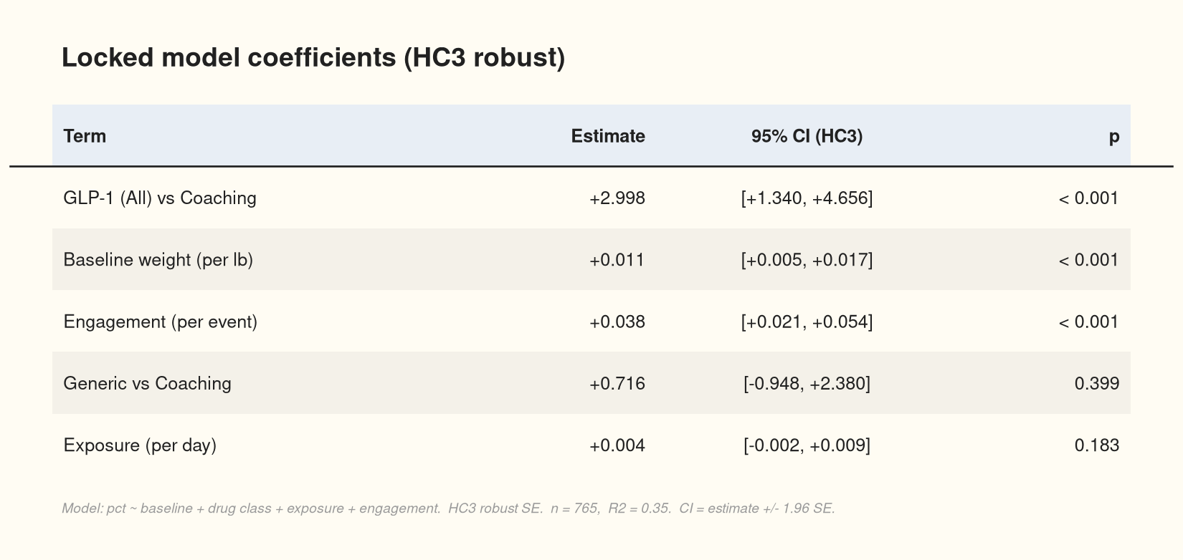
APPENDIX
Locked-model coefficients (HC3)
9amHealth · Data Analyst Case Study
10

Slide 11
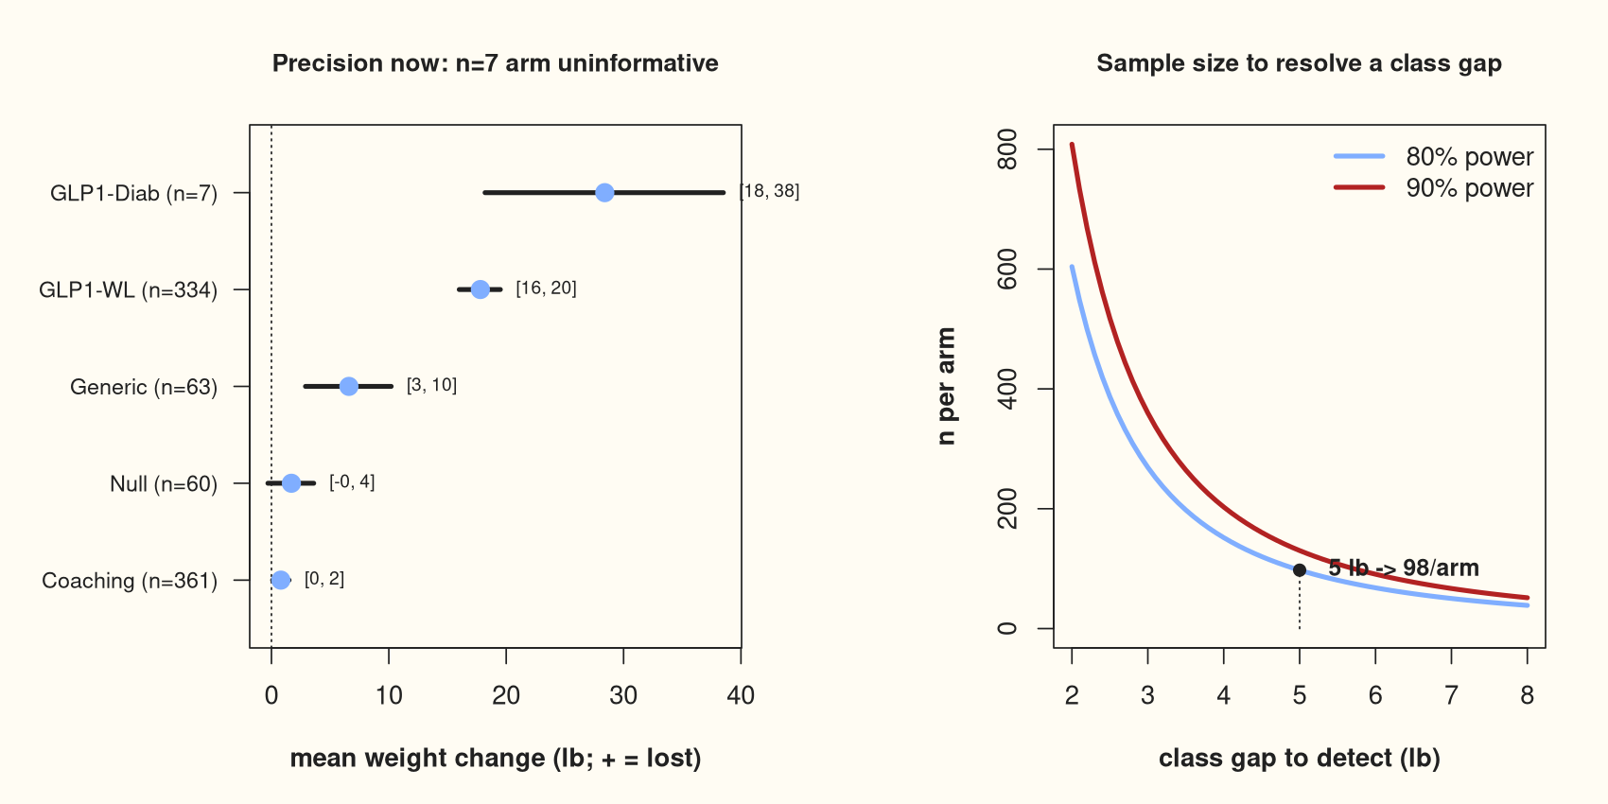
APPENDIX
Power & precision
9amHealth · Data Analyst Case Study
11

