Slide 1

Please re-use the slides under the conditions of the Creative Commons
Attribution license (CC BY). – Casey Greene

Slide 2

Understanding pediatric cancers at the single-cell level… …from bulk tissue.
Casey Greene

Slide 3
It’s now possible to measure what’s happening in individual cells.
Potential diagram of scRNA-seq but maybe covered on basic data types intro.

Slide 4
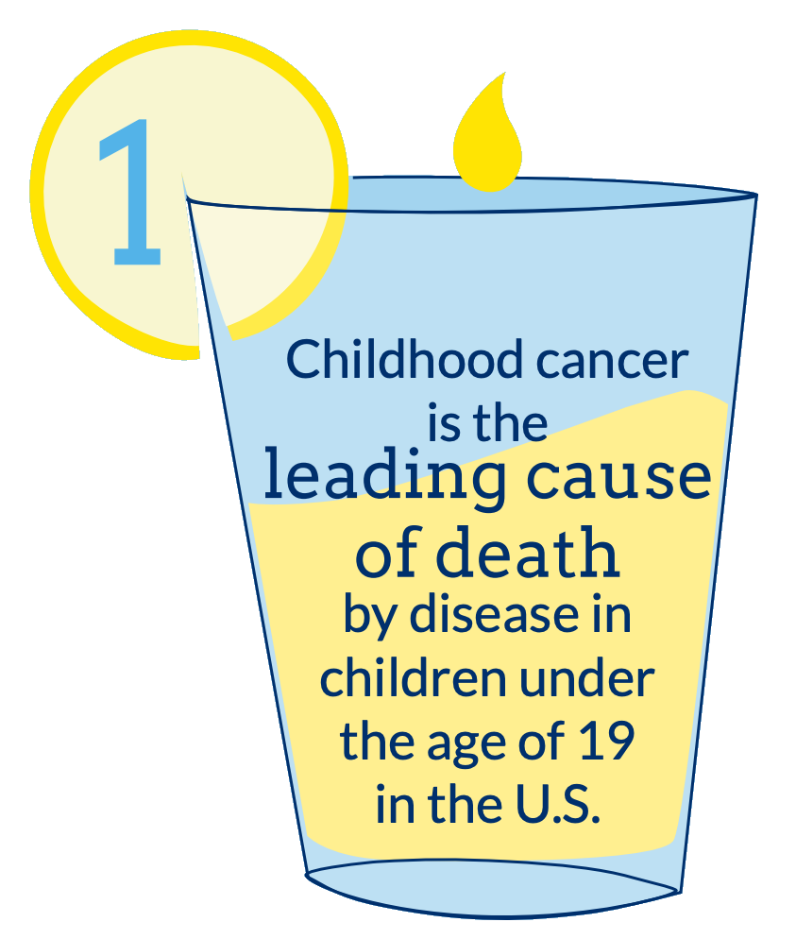
Childhood cancers are collectively deadly…
… but individually rare.
Notes:
Because these cancers are rare, it will take a while to get to a reasonable sample size for personalized-medicine analyses.

Slide 5
What we’ve got!
Single-cell profiles of normal tissue.
Single-cell profiles of some tumors (not all of the appropriate type).
Coming online: single-cell profiles of a very limited number of pediatric cancers.
Existing: bulk sequencing data – tumor in a blender – with important outcome data: survival, drug response, & more.

Slide 6
What we’ve got:
Single-cell
Bulk-profiled
+

Slide 7
What we want:
Drug Sensitive
Drug Resistant

Slide 8
This looks a lot like deconvolution
Single-cell
Bulk-profiled
+
=
Drug Sensitive
Drug Resistant

Slide 9
Why? Many reasons.
More clearly identify
signaling pathways
Measure
heterogeneity
Predict Prognosis

Slide 10
Why do we want it?
Which cell types contribute (either presence/absence or abundance) to better/worse outcome?
Are there any treatment x cell-type effects (very likely with new immunotherapy strategies)
Which pathways expressed in cancer cell fraction contribute to better/worse outcome?
There are very likely targeted therapy x pathway effects.
Do certain treatment strategies work better/worse with tumors where the cancer cells have heterogeneous expression profiles?

Slide 11
End of intro.

Slide 12
Anti-hint 1: cell types may be missing.
💥
💥
💥
💥
💥
💥
💥

Slide 13
Anti-hint 1: cell types may be missing.
💥
💥
💥
💥
💥
💥
💥

Slide 14
Anti-hint 2: cancer cells may differ between people.
💥
💥
💥
💥
💥
💥
💥

Slide 15
End of anti-hints.

Slide 16
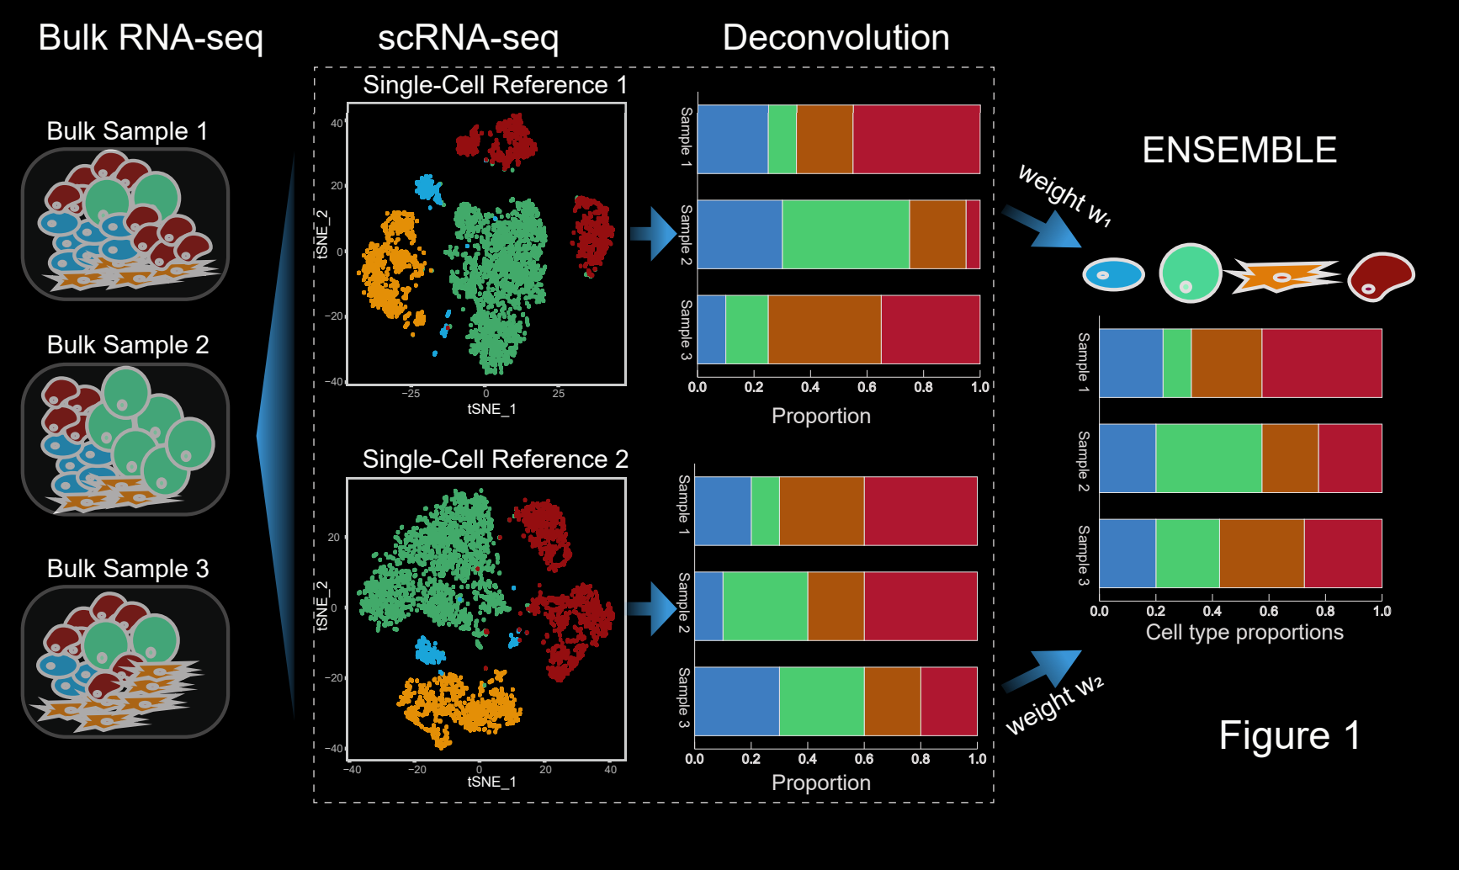
SCDC: Bulk Gene Expression Deconvolution by Multiple Single-Cell RNA Sequencing References
Adapted by Dong et al. 2019. CC BY-NC
Notes:
I’d probably mention SCDC (https://www.biorxiv.org/content/10.1101/743591v1.full ) and maybe another couple approaches. These address the general problem, but I’m not aware of any specific approach that is designed to work when those two bullet points in the anti-hint exist. Hopefully some folks at LMRL will come up with something. ☺

Slide 17
Potentially helpful: differences in bulk data may illuminate range of possibilities.
An iterative process that goes back and forth b/w deconvolution + feeding the residuals back in to generating “pathway” profiles for common genomic changes might actually work. I guess we can talk about this at the very end if there’s time. This can likely be augmented substantially by the very large collections of bulk data that exist.

