Slide 1
Learning latent phenotypes from biobanks
Dylan Kotliar
Harvard/MIT MD-PhD Program
Broad Institute

Slide 2
What is a biobank?
Genetic variants (10⁶)
1
People (10⁵)
Association strength
Variant position in genome
genotype
phenotype

Slide 3
What is a biobank?
Genetic variants (10⁶)
Phenotypes (10⁴)
People (10⁶)
genotype
phenotype

Slide 4
What is a biobank?
Genetic variants (10⁶)
Phenotypes (10⁴)
Diagnoses
Diagnosed w/ diabetes?
Survey questions
Are you a morning person?
Clinical labs
Total cholesterol
People (10⁶)
Imaging
Brain MRI
Medical records
genotype
phenotype

Slide 5
How are biobanks used?
Genetic variants (10⁶)
Phenotypes (10⁴)
Heart attack
People (10⁶)
genotype
phenotype

Slide 6
How are biobanks used?
Genetic variants (10⁶)
Phenotypes (10⁴)
Heart attack
Diabetes
People (10⁶)
genotype
phenotype

Slide 7
How are biobanks used?
Genetic variants (10⁶)
Phenotypes (10⁴)
Heart attack
Diabetes
Stroke
...
People (10⁶)
...
genotype
phenotype
Notes:
https://ukbb-rg.hail.is/correlation_plots_agglo.html

Slide 8
How are biobanks used?
Genetic variants (10⁶)
Phenotypes (10⁴)
Heart attack
Diabetes
Stroke
...
People (10⁶)
...
High-effect genetic variants
genotype
phenotype
biology
Notes:
https://ukbb-rg.hail.is/correlation_plots_agglo.html

Slide 9
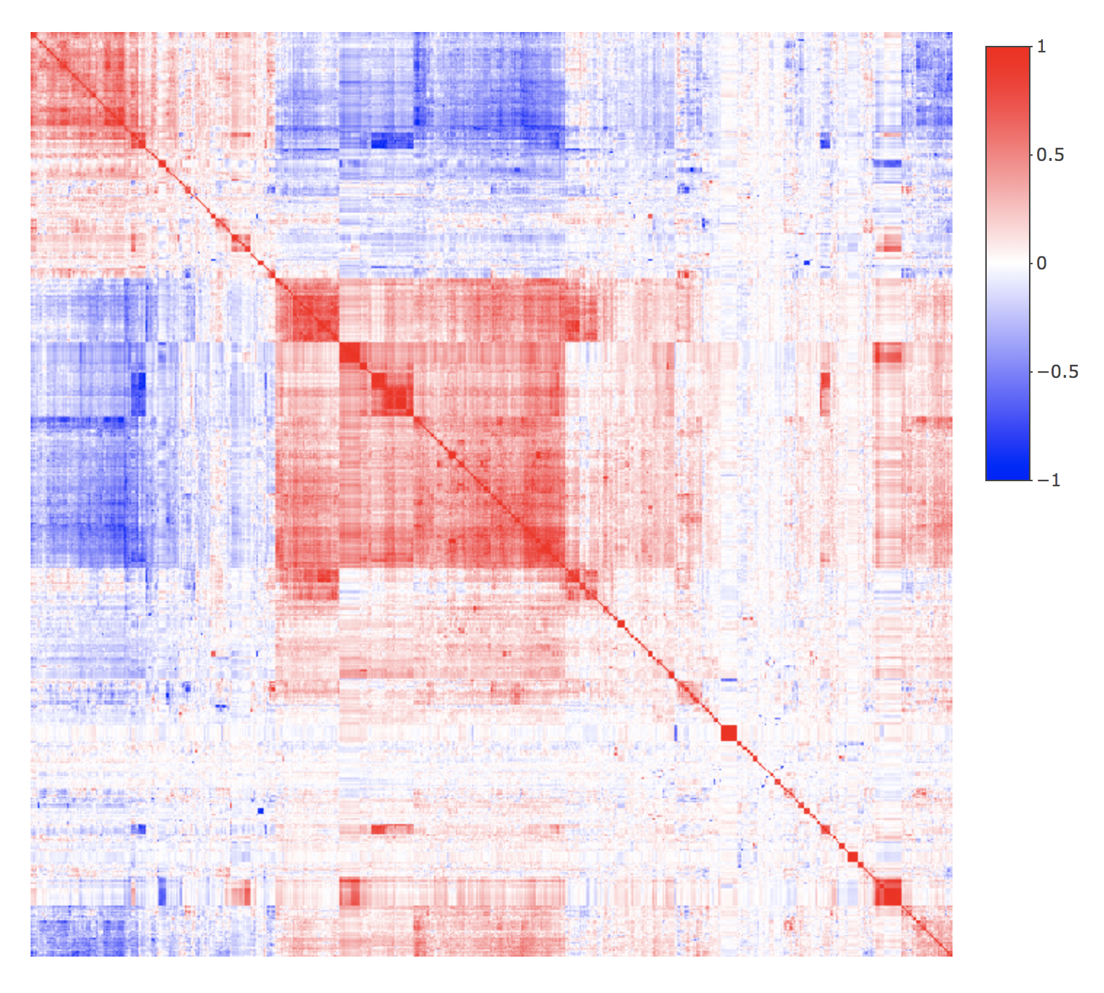
Observed phenotypes have shared structure!
~4k phenotypes
~4k phenotypes
[from https://ukbb-rg.hail.is/]

Slide 10
Phenotypes taken individually seem sub-optimal
Reflective of smaller set of underlying traits
Overly coarse on their own
heart attack
BMI
arthritis
diabetes
stroke
“How happy are you?”
OR
cholesterol
blood pressure
inflammation
anxiety
pain
depression
genotype
environment
genotype
environment
Notes:
The shared structure might be an opportunity to address some limitations of the one-phenotype at a time GWAS.

Slide 11
Specific questions
How can we refine the phenotypes in this data set?
By finding latent axes of phenotypic variation, or
By finding sub-phenotypes
How would we know if we’re doing a good job?

