Slide 1
Phenotypic data: a crash course

Slide 2
The central dogma
DNA
RNA
protein

Slide 3
The central dogma
DNA
RNA
protein
phenotype
#cells

Slide 4
The central dogma
DNA
RNA
protein
phenotype
#cells
#individuals

Slide 5
Genotype data
DNA
RNA
protein
phenotype
#cells
#individuals
human genome (~10⁹ base pairs)
A/A C/C A/A C/C G/G G/G T/T C/C A/A
A/A C/C A/A G/C G/G G/G T/T C/C T/A
⋮ ⋮ ⋮ ⋮ ⋮ ⋮ ⋮ ⋮ ⋮
A/A C/C A/A G/G G/G G/G G/T C/C A/A
A/A C/C A/A C/C G/G G/G T/T C/C A/A
Individuals

Slide 6
Genotype data
DNA
RNA
protein
phenotype
#cells
#individuals
human genome (~10⁹ base pairs)
Most spots:
no variation observed
A/A C/C A/A C/C G/G G/G T/T C/C A/A
A/A C/C A/A G/C G/G G/G T/T C/C T/A
⋮ ⋮ ⋮ ⋮ ⋮ ⋮ ⋮ ⋮ ⋮
A/A C/C A/A G/G G/G G/G G/T C/C A/A
A/A C/C A/A C/C G/G G/G T/T C/C A/A
Individuals

Slide 7
Genotype data
DNA
RNA
protein
phenotype
#cells
#individuals
human genome (~10⁹ base pairs)
Most spots:
no variation observed
Single nucleotide polymorphism (SNP):
spot with variation
A/A C/C A/A C/C G/G G/G T/T C/C A/A
A/A C/C A/A G/C G/G G/G T/T C/C T/A
⋮ ⋮ ⋮ ⋮ ⋮ ⋮ ⋮ ⋮ ⋮
A/A C/C A/A G/G G/G G/G G/T C/C A/A
A/A C/C A/A C/C G/G G/G T/T C/C A/A
Individuals

Slide 8
Genotype data
DNA
RNA
protein
phenotype
#cells
#individuals
human genome (~10⁹ base pairs)
Most spots:
no variation observed
Single nucleotide polymorphism (SNP):
spot with variation
Can code as 0/1/2
A/A C/C A/A C/C G/G G/G T/T C/C A/A
A/A C/C A/A G/C G/G G/G T/T C/C T/A
⋮ ⋮ ⋮ ⋮ ⋮ ⋮ ⋮ ⋮ ⋮
A/A C/C A/A G/G G/G G/G G/T C/C A/A
A/A C/C A/A C/C G/G G/G T/T C/C A/A
Individuals

Slide 9
Genotype data
DNA
RNA
protein
phenotype
#cells
#individuals
human genome (~10⁹ base pairs)
Most spots:
no variation observed
Single nucleotide polymorphism (SNP):
spot with variation
Can code as 0/1/2
0 0 0 0 0 0 0 0 0
0 0 0 1 0 0 0 0 1
⋮ ⋮ ⋮ ⋮ ⋮ ⋮ ⋮ ⋮ ⋮
0 0 0 2 0 0 1 0 0
0 0 0 0 0 0 0 0 0
Individuals

Slide 10
Genotype data
DNA
RNA
protein
phenotype
#cells
#individuals
human genome (~10⁹ base pairs)
Most spots:
no variation observed
Single nucleotide polymorphism (SNP):
spot with variation
Can code as 0/1/2
#common SNPs ≈ 10⁷
0 0 0 0 0 0 0 0 0
0 0 0 1 0 0 0 0 1
⋮ ⋮ ⋮ ⋮ ⋮ ⋮ ⋮ ⋮ ⋮
0 0 0 2 0 0 1 0 0
0 0 0 0 0 0 0 0 0
Individuals

Slide 11
Genome-wide association study (GWAS)
DNA
RNA
protein
phenotype
#cells
#individuals
SNPs (10⁶ – 10⁷)
X
individuals (10⁴ – 10⁵)

Slide 12
Genome-wide association study (GWAS)
DNA
RNA
protein
phenotype
#cells
#individuals
SNPs (10⁶ – 10⁷)
X
Y
individuals (10⁴ – 10⁵)

Slide 13
Genome-wide association study (GWAS)
DNA
RNA
protein
phenotype
#cells
#individuals
SNPs (10⁶ – 10⁷)
T
X
Y
individuals (10⁴ – 10⁵)
≈
α
α_{i} =
marginal correlation of SNP i to phenotype

Slide 14
Gene expression
DNA
RNA
protein
phenotype
#cells
#individuals
human genome

Slide 15
Gene expression
DNA
RNA
protein
phenotype
#cells
#individuals
human genome
gene 1
gene 2
…
gene 20,000

Slide 16
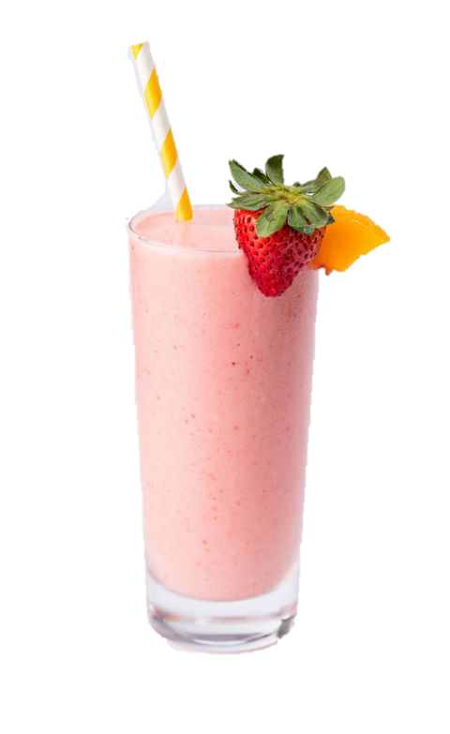
Bulk RNA sequencing
DNA
RNA
protein
phenotype
#cells
#individuals
human genome
gene 1
gene 2
…
gene 20,000
1 2 … 0
3 6 … 2
⋮ ⋮ ⋮
6 7 … 6
3 2 … 9
individuals
cheap
many individuals
but: only averages

Slide 17
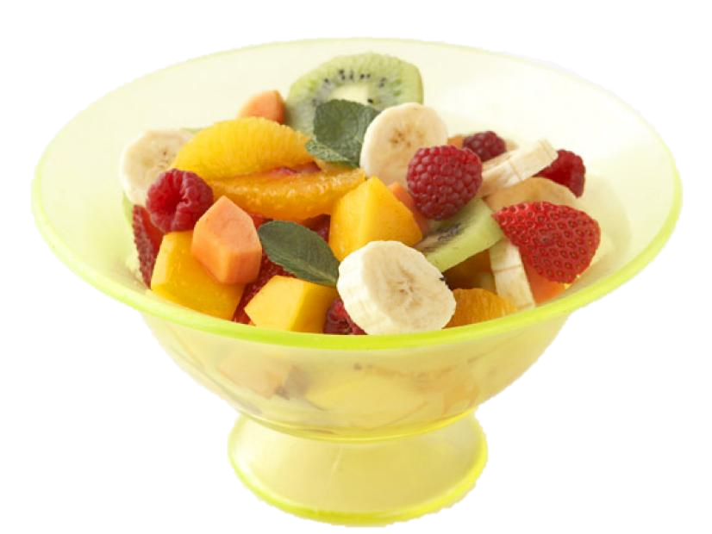
Single-cell RNA sequencing
DNA
RNA
protein
phenotype
#cells
#individuals
human genome
gene 1
gene 2
…
gene 20,000
4 8 … 2
2 2 … 2
⋮ ⋮ ⋮
7 1 … 1
1 1 … 6
cells
expensive
few individuals
but: single-cell resolution

Slide 18
Summary
DNA
RNA
protein
phenotype
#cells
#individuals
genes (10³)
SNPs (10⁶ – 10⁷)
bulk RNA sequencing
genotype matrix
individuals (10²)
individuals (10⁴ – 10⁵)
single-cell RNA sequencing
(per individual)
cells (10³)

