Slide 1
Biological data: a crash course
Yakir Reshef

Slide 2
The central dogma
DNA
RNA
protein

Slide 3
The central dogma
DNA
RNA
protein
phenotype
#cells
Notes:
TODO: change cell outlines

Slide 4
The central dogma
DNA
RNA
protein
phenotype
#cells
#people

Slide 5
Genotype data
DNA
RNA
protein
phenotype
#cells
#people
human genome (~10⁹ base pairs)
A/A C/C A/A C/C G/G G/G T/T C/C A/A
A/A C/C A/A G/C G/G G/G T/T C/C T/A
⋮ ⋮ ⋮ ⋮ ⋮ ⋮ ⋮ ⋮ ⋮
A/A C/C A/A G/G G/G G/G G/T C/C A/A
A/A C/C A/A C/C G/G G/G T/T C/C A/A
people

Slide 6
Genotype data
DNA
RNA
protein
phenotype
#cells
#people
human genome (~10⁹ base pairs)
Two alleles at each spot
A/A C/C A/A C/C G/G G/G T/T C/C A/A
A/A C/C A/A G/C G/G G/G T/T C/C T/A
⋮ ⋮ ⋮ ⋮ ⋮ ⋮ ⋮ ⋮ ⋮
A/A C/C A/A G/G G/G G/G G/T C/C A/A
A/A C/C A/A C/C G/G G/G T/T C/C A/A
people

Slide 7
Genotype data
DNA
RNA
protein
phenotype
#cells
#people
human genome (~10⁹ base pairs)
Two alleles at each spot
Most spots:
no variation observed
A/A C/C A/A C/C G/G G/G T/T C/C A/A
A/A C/C A/A G/C G/G G/G T/T C/C T/A
⋮ ⋮ ⋮ ⋮ ⋮ ⋮ ⋮ ⋮ ⋮
A/A C/C A/A G/G G/G G/G G/T C/C A/A
A/A C/C A/A C/C G/G G/G T/T C/C A/A
people

Slide 8
Genotype data
DNA
RNA
protein
phenotype
#cells
#people
human genome (~10⁹ base pairs)
Two alleles at each spot
Most spots:
no variation observed
Genetic variants
can be coded as 0/1/2
A/A C/C A/A C/C G/G G/G T/T C/C A/A
A/A C/C A/A G/C G/G G/G T/T C/C T/A
⋮ ⋮ ⋮ ⋮ ⋮ ⋮ ⋮ ⋮ ⋮
A/A C/C A/A G/G G/G G/G G/T C/C A/A
A/A C/C A/A C/C G/G G/G T/T C/C A/A
people

Slide 9
Genotype data
DNA
RNA
protein
phenotype
#cells
#people
human genome (~10⁹ base pairs)
Two alleles at each spot
Most spots:
no variation observed
Genetic variants
can be coded as 0/1/2
0 0 0 0 0 0 0 0 0
0 0 0 1 0 0 0 0 1
⋮ ⋮ ⋮ ⋮ ⋮ ⋮ ⋮ ⋮ ⋮
0 0 0 2 0 0 1 0 0
0 0 0 0 0 0 0 0 0
people

Slide 10
Genotype data
DNA
RNA
protein
phenotype
#cells
#people
genetic variants (10⁶ – 10⁷)
X
people (10⁴ – 10⁵)

Slide 11
Genome-wide association study (GWAS)
DNA
RNA
protein
phenotype
#cells
#people
genetic variants (10⁶ – 10⁷)
X
Y
Heart attack
Schizophrenia
Rheumatoid arthritis
Height/BMI/…
people (10⁴ – 10⁵)
e.g.,

Slide 12
Genome-wide association study (GWAS)
DNA
RNA
protein
phenotype
#cells
#people
genetic variants (10⁶ – 10⁷)
T
X
Y
people (10⁴ – 10⁵)
≈
α
α_{i} =
marginal correlation of SNP i to phenotype

Slide 13
Gene expression
DNA
RNA
protein
phenotype
#cells
#people
human genome

Slide 14
Gene expression
DNA
RNA
protein
phenotype
#cells
#people
human genome
gene 1
gene 2
…
gene 20,000

Slide 15
Single-cell RNA sequencing
DNA
RNA
protein
phenotype
#cells
#people
human genome
gene 1
gene 2
…
gene 20,000
4 8 … 2
2 2 … 2
⋮ ⋮ ⋮
7 1 … 1
1 1 … 6
cells

Slide 16
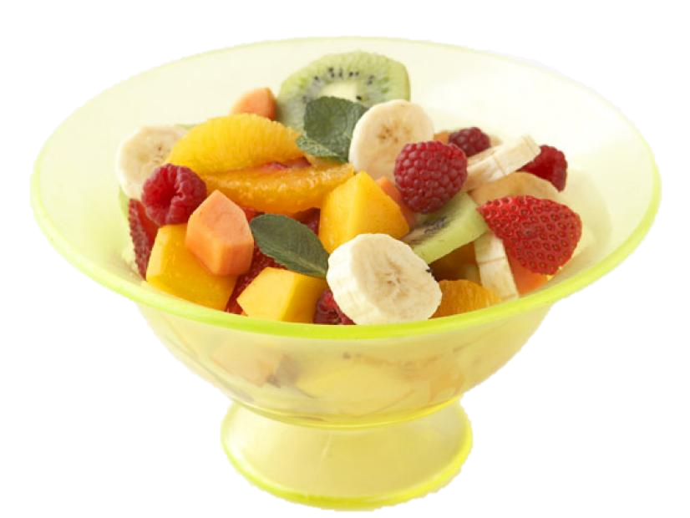
Single-cell RNA sequencing
DNA
RNA
protein
phenotype
#cells
#people
human genome
gene 1
gene 2
…
gene 20,000
4 8 … 2
2 2 … 2
⋮ ⋮ ⋮
7 1 … 1
1 1 … 6
cells
expensive
few individuals
but: single-cell resolution

Slide 17

Bulk RNA sequencing
DNA
RNA
protein
phenotype
#cells
#people
human genome
gene 1
gene 2
…
gene 20,000
1 2 … 0
people

Slide 18
Bulk RNA sequencing
DNA
RNA
protein
phenotype
#cells
#people
human genome
gene 1
gene 2
…
gene 20,000
1 2 … 0
3 6 … 2
⋮ ⋮ ⋮
6 7 … 6
3 2 … 9
people

Slide 19
Bulk RNA sequencing
DNA
RNA
protein
phenotype
#cells
#people
human genome
gene 1
gene 2
…
gene 20,000
1 2 … 0
3 6 … 2
⋮ ⋮ ⋮
6 7 … 6
3 2 … 9
people
cheap
many individuals
but: only averages

Slide 20
Summary
DNA
RNA
protein
phenotype
#cells
#people
genes (10⁴)
SNPs (10⁶ – 10⁷)
bulk RNA sequencing
genotype matrix
people (10²)
people (10⁴ – 10⁵)
single-cell RNA sequencing
(per individual)
cells (10³)

