Slide 1
Learning latent phenotypes from biobanks
Dylan Kotliar
Harvard/MIT MD-PhD Program
Broad Institute

Slide 2
What is a biobank?
~1M
1
~10k
genotype
phenotype

Slide 3
What is a biobank?
~1M
1
~100k
genotype
phenotype

Slide 4
What is a biobank?
~1M
~10k
~1M
genotype
phenotype

Slide 5
What is a biobank?
~1M
~10k
Diagnoses Diagnosed w/diabetes?
Survey questions “How happy are you?”
Clinical labs Total cholesterol
Imaging Brain MRI
Medical records
~1M
genotype
phenotype

Slide 6
How are biobanks used?
~1M
~10k
Heart attack
~1M
- High-effect genetic variants
- Signal-to-noise (“heritability”)
genotype
phenotype

Slide 7
How are biobanks used?
~1M
~10k
Heart attack
Diabetes
~1M
- High-effect genetic variants
- Signal-to-noise (“heritability”)
genotype
phenotype

Slide 8
How are biobanks used?
~1M
~10k
Heart attack
Diabetes
Stroke
...
~1M
...
- High-effect genetic variants
- Signal-to-noise (“heritability”)
genotype
phenotype
Notes:
https://ukbb-rg.hail.is/correlation_plots_agglo.html

Slide 9
How are biobanks used?
~1M
~10k
Heart attack
Diabetes
Stroke
...
~1M
...
- High-effect genetic variants
- Signal-to-noise (“heritability”)
genotype
phenotype
biology
Notes:
https://ukbb-rg.hail.is/correlation_plots_agglo.html

Slide 10
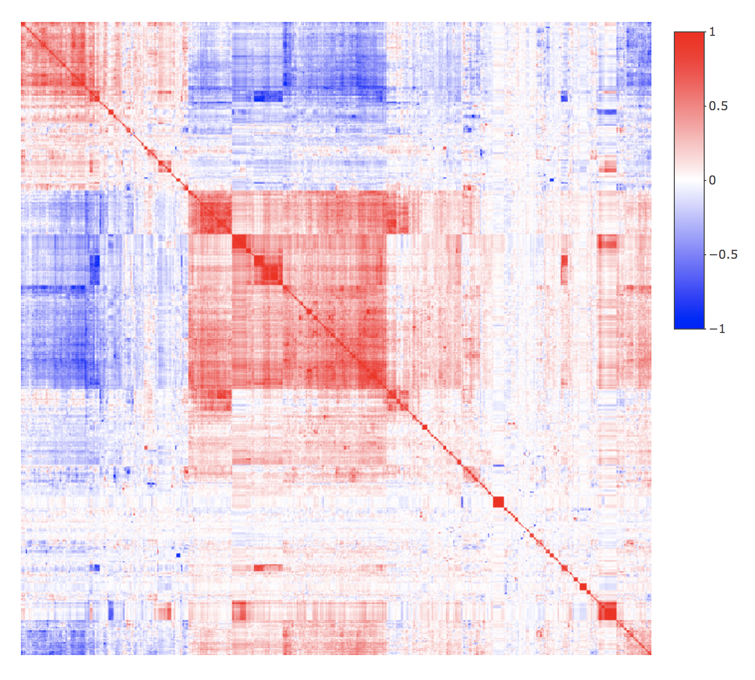
Observed phenotypes have shared structure!
~4k phenotypes
~4k phenotypes
[from https://ukbb-rg.hail.is/]

Slide 11
Phenotypes taken individually seem sub-optimal
Reflective of smaller set of underlying traits
Overly coarse on their own
heart attack
BMI
LDL
diabetes
stroke
“How happy are you?”
OR
lipids
blood pressure
inflammation
anxiety
addiction
depression
genotype
environment
genotype
environment

Slide 12
Specific questions
How can we refine the phenotypes in this data set?
By finding latent axes of phenotypic variation, or
By finding sub-phenotypes
How would we know if we’re doing a good job?

