Slide 1
What can we generate in biology?
Smita Krishnaswamy
Yale University

Slide 2
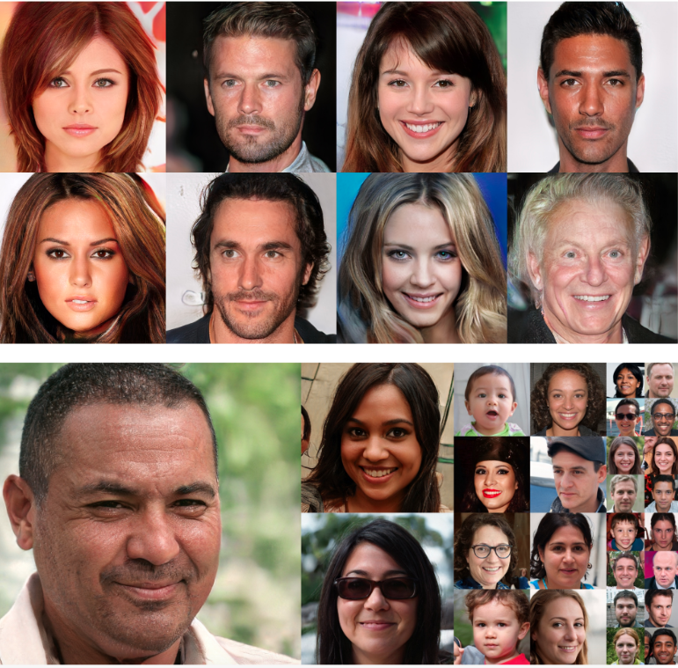
Generative models (VAEs, GANs) are wildly popular in ML
Unlike probabilistic models, and Bayesian models
Not difficult to fit
No prior knowledge of probability distribution structure
Question: How can we use this power in Biology?

Slide 3
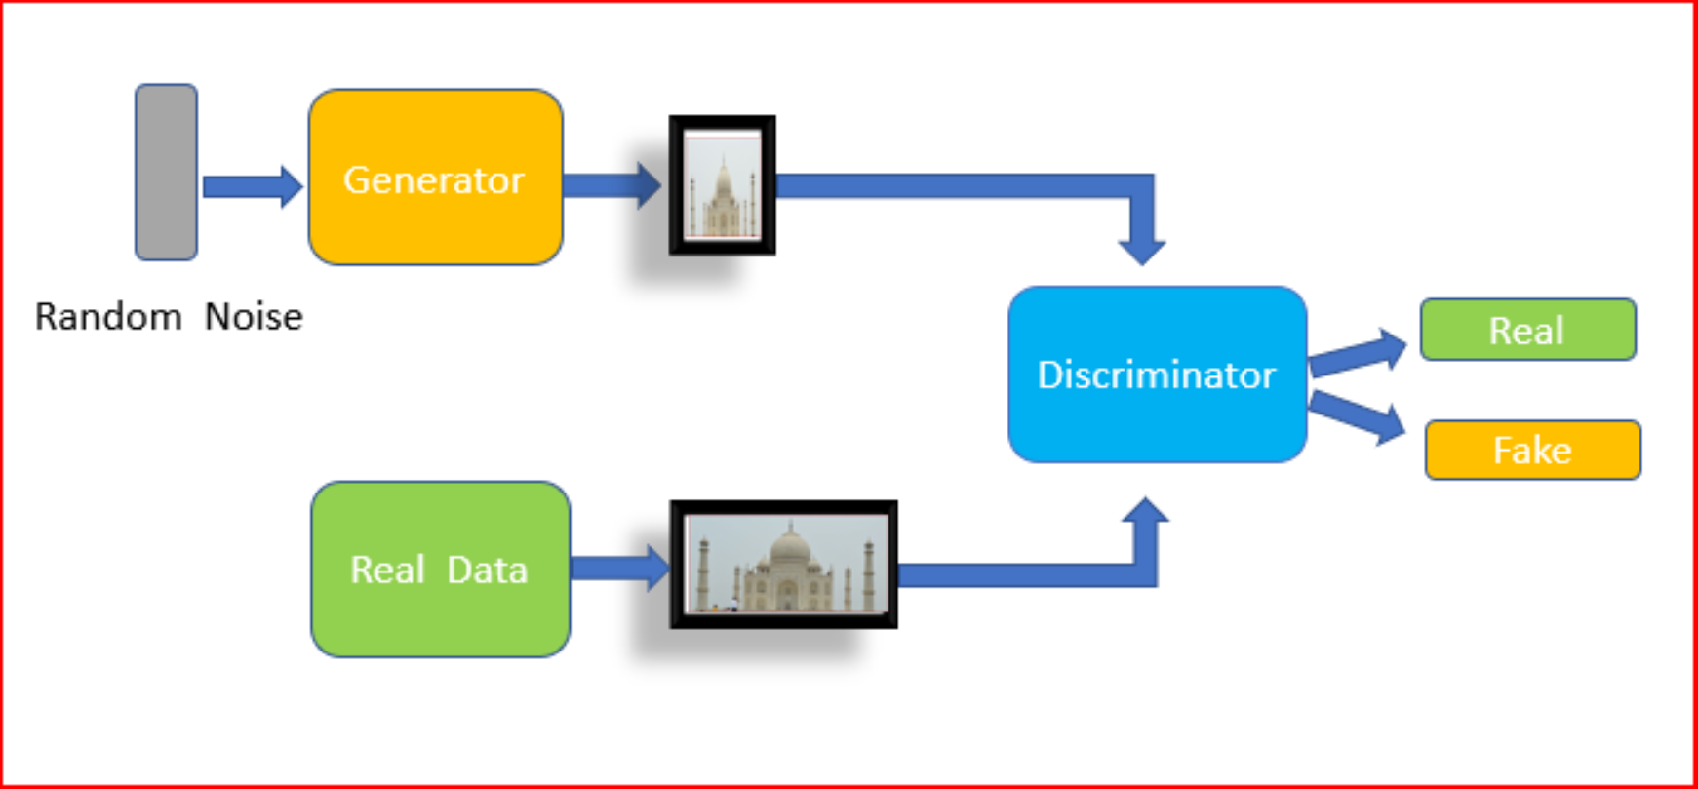
GANs
Source: https://medium.com/datadriveninvestor/generative-adversarial-network-gan-using-keras-ce1c05cfdfd3

Slide 4
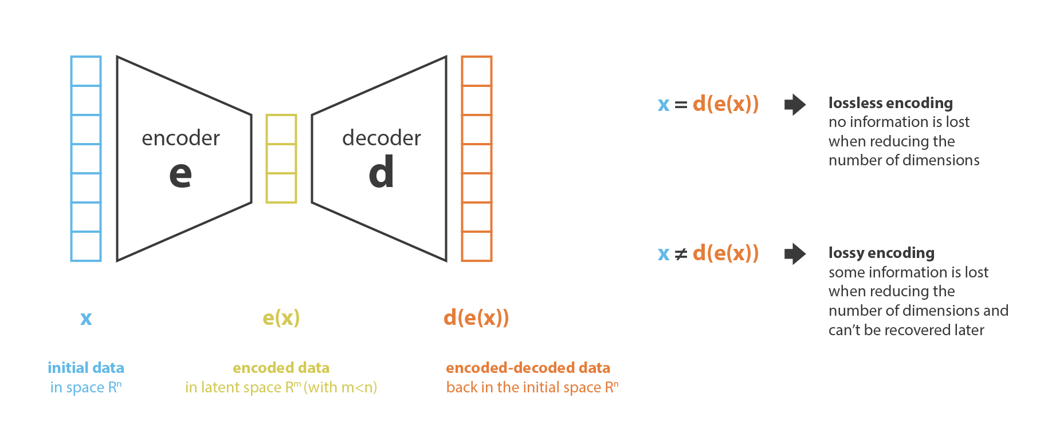
Autoencoders and Embeddings
Autoencoders

Slide 5
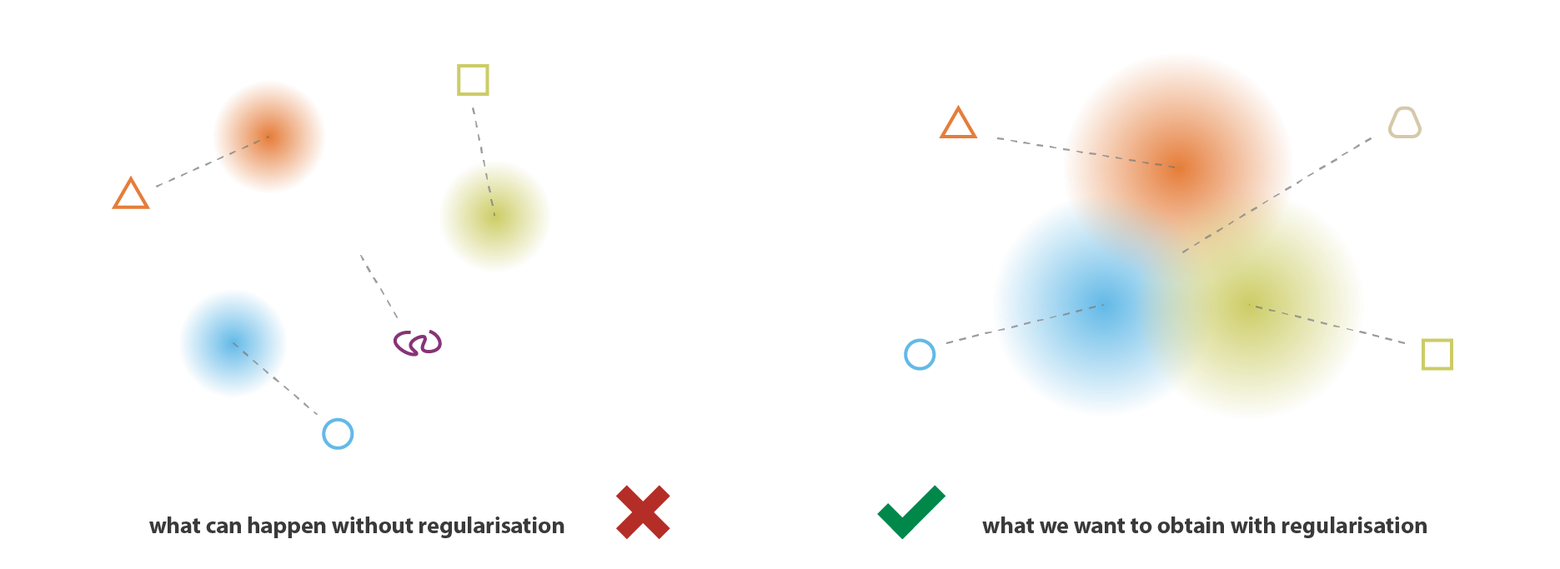
VAEs: Reshaped Embeddings for Generation
Source: https://towardsdatascience.com/understanding-variational-autoencoders-vaes-f70510919f73

Slide 6
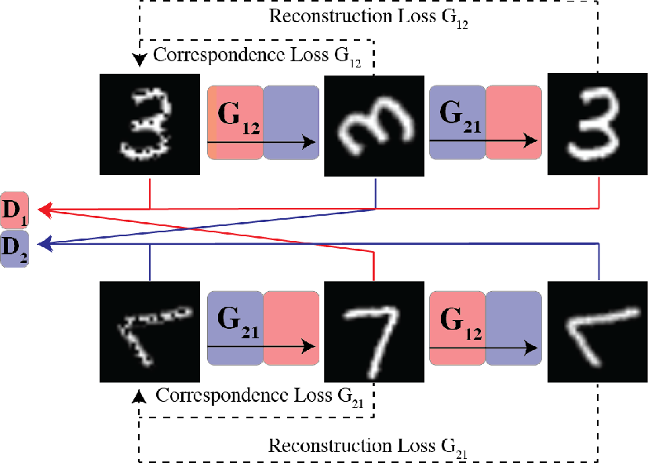
Cycle GANs, Modification

Slide 7
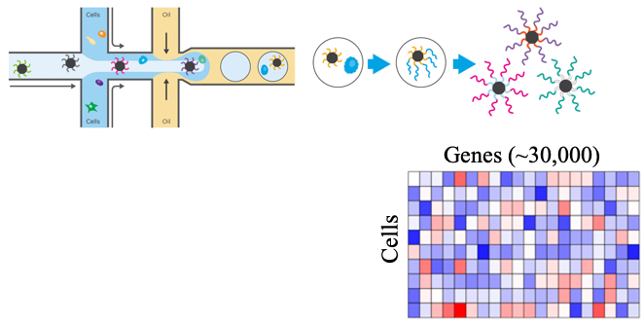
Single-Cell RNA Sequencing Data
Measures gene expression counts per cell.
Made feasible in high throughput by droplet-based
technologies [Klein et al, Cell 2015, Macusko et al. Cell 2015]

Slide 8
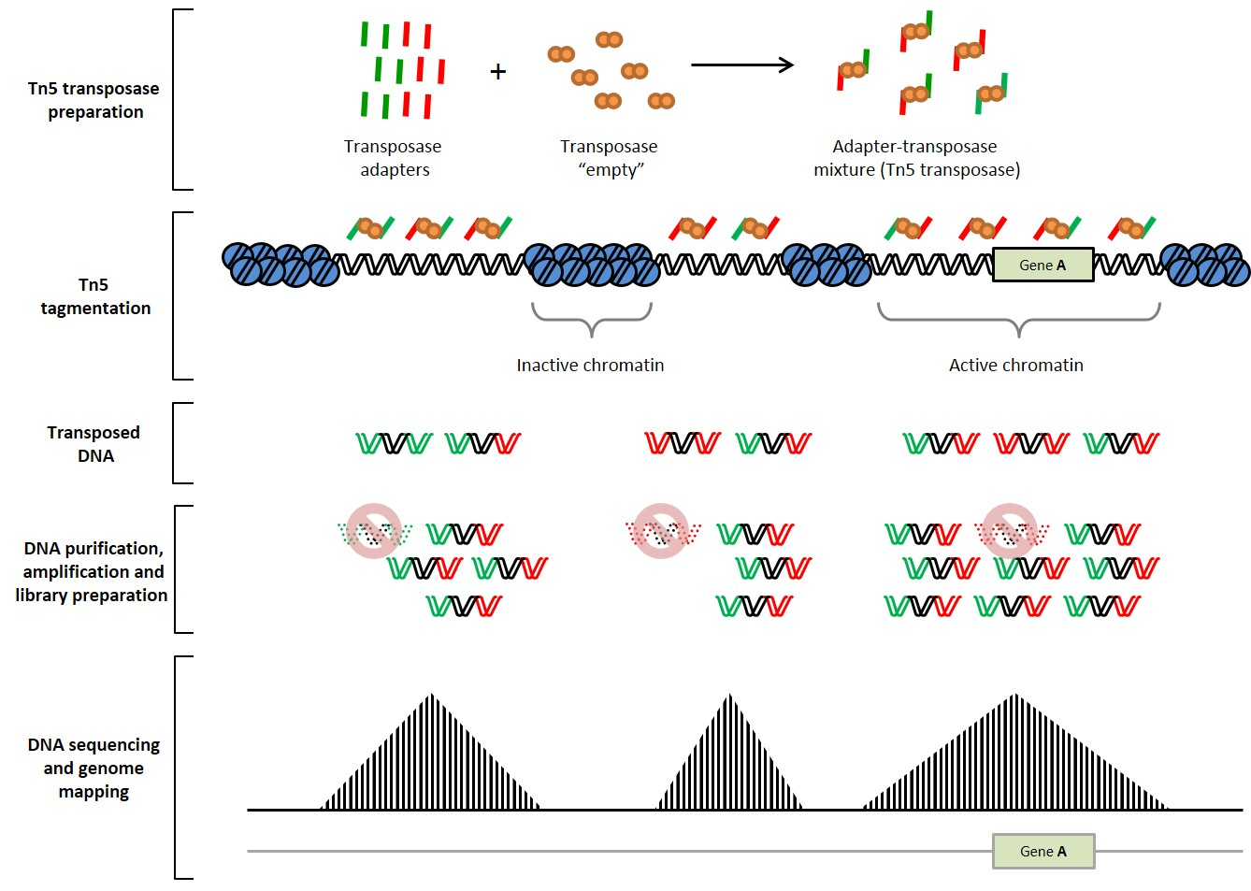
scATAC-seq Data
Measures chromatin accessibility in single cell resolution
Buenrostro et al. Nature 2015

Slide 9
How are they useful in biology?
Is generating fake data useful?
What can it be used for?

