Slide 1
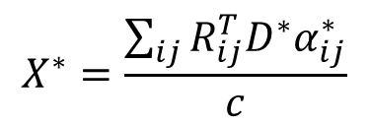
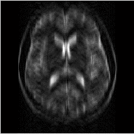
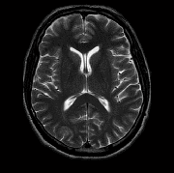

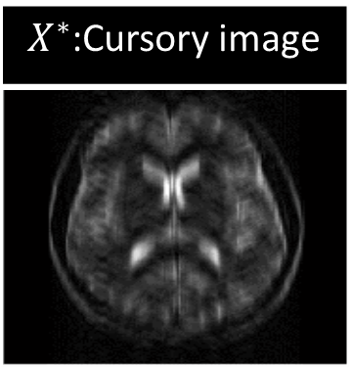
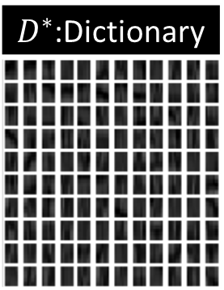
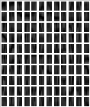
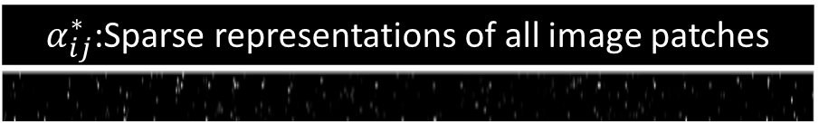
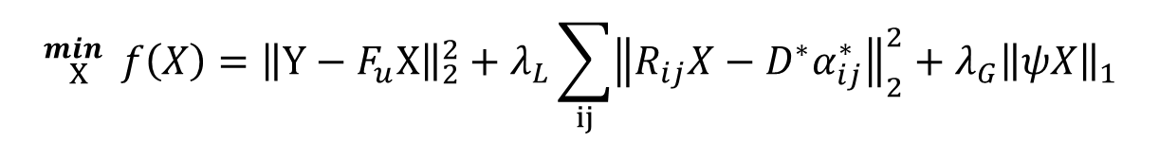
Step5
$D^{∗}$:Dictionary
Local sparse coding
Dictionary learning
Zero-filed image
N
END
Stop
Criterion
Y
$α_{ij}^{∗}$:Sparse representations of all image patches
Step2
Step3
$$X^{∗}=\frac{\sum_{ij}{R_{ij}^{T}D^{∗}α_{ij}^{∗}}}{c}$$
Step1
Zero-filled IDFT
Y:k-space measurements
$X^{∗}$:Cursory image
Recovered image
START
Global sparse reconstruction
$${}_{X }^{min}{ }{f\left(X\right)=\left\|Y−F_{u}X\right\|}_{2}^{2}+λ_{L}\sum_{ij}{{\left\|R_{ij}X−D^{∗}α_{ij}^{∗}\right\|}_{2}^{2}}+{λ_{G}\left\|ψX\right\|}_{1}$$
Step4

