Slide 1
ELK-DIAGNOSTICS
ES 8 人工驗證報告
Bundle Route B｜故障觸發、採集、離線診斷、還原
16 CASES
Elasticsearch 8.14.3
2026-07-27
Notes:
[Sources]
- /Users/russell.chen/workspace/lab/elk-diagnostics/bundle-playbook-es8-20260727-102156/P00/bundle/version.json
- /Users/russell.chen/workspace/lab/elk-diagnostics/bundle-playbook-es8-20260727-102156/P00/bundle/cluster_health.json
[/Sources]

Slide 2
EXECUTIVE SUMMARY
目標診斷 16／16 符合預期
基線：ES 8.14.3｜1 node｜cluster green｜basic license｜39 endpoints
16 / 16
16 / 16
14 + 2
Fault 目標規則
符合預期
Post-restore
目標規則回到 pass
14 完整驗證
2 項附條件
ES 8 MANUAL VERIFICATION
2
Notes:
[Sources]
- /Users/russell.chen/workspace/lab/elk-diagnostics/reports/bundle-playbook-es8-20260727-102156/verification-summary.json
- /Users/russell.chen/workspace/lab/elk-diagnostics/bundle-playbook-es8-20260727-102156/P00/bundle/_status.txt
- /Users/russell.chen/workspace/lab/elk-diagnostics/bundle-playbook-es8-20260727-102156/P00/bundle/cluster_health.json
[/Sources]

Slide 3
METHOD
Route B 將採集與診斷完全分離
1
2
3
4
Trigger
Collect
Diagnose
Restore
→
→
→
Shell 製造
單一故障
Shell 採集
39 個 API
Binary 離線
分析 Bundle
Shell 還原
並重新採集
診斷階段使用 env -i 清除 ES 連線環境，證明報告只依賴 Bundle。
ES 8 MANUAL VERIFICATION
3
Notes:
[Sources]
- /Users/russell.chen/workspace/lab/elk-diagnostics/docs/VERIFICATION-BUNDLE-PLAYBOOK.md
- /Users/russell.chen/workspace/lab/elk-diagnostics/dev/phase0/bundle-case.sh
[/Sources]

Slide 4
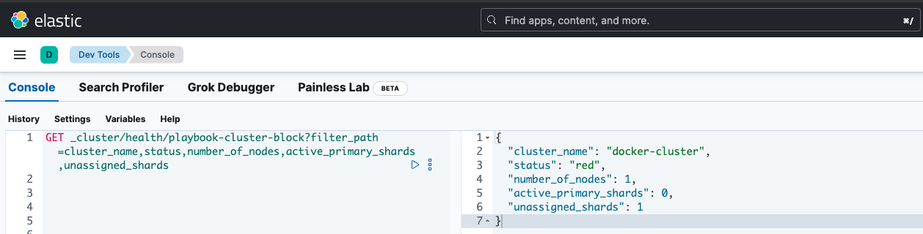
FAULT CASE
P01｜叢集層 Allocation 封鎖
CRITICAL
觸發
cluster.routing.allocation.enable = none
觀測
Primary shard 無法配置，叢集轉為 red。
診斷
cluster_health = critical
還原後
目標檢查 = pass
ES 8 MANUAL VERIFICATION
4
Notes:
This cluster has 1 unavailable primary shard.
[Sources]
- /Users/russell.chen/workspace/lab/elk-diagnostics/reports/bundle-playbook-es8-20260727-102156/P01-fault/bundle-report.json
- /Users/russell.chen/workspace/lab/elk-diagnostics/reports/bundle-playbook-es8-20260727-102156/post-P01/bundle-report.json
- /Users/russell.chen/workspace/lab/elk-diagnostics/bundle-playbook-es8-20260727-102156/P01-fault/screenshots/P01-cluster-health-red.png
[/Sources]

Slide 5
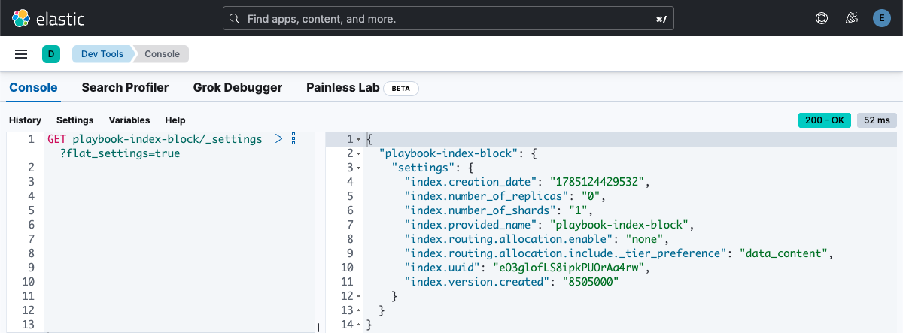
FAULT CASE
P02｜Index 層 Allocation 封鎖
CRITICAL
觸發
index.routing.allocation.enable = none
觀測
單一 index 的 primary shard 無法配置。
診斷
cluster_health = critical
還原後
目標檢查 = pass
受影響 index 為 red，index setting 精確判定在 Bundle 中回報 unknown；cluster health 與 allocation guidance 仍正確。
ES 8 MANUAL VERIFICATION
5
Notes:
This cluster has 1 unavailable primary shard.
[Sources]
- /Users/russell.chen/workspace/lab/elk-diagnostics/reports/bundle-playbook-es8-20260727-102156/P02-fault/bundle-report.json
- /Users/russell.chen/workspace/lab/elk-diagnostics/reports/bundle-playbook-es8-20260727-102156/post-P02/bundle-report.json
- /Users/russell.chen/workspace/lab/elk-diagnostics/bundle-playbook-es8-20260727-102156/P02-fault/screenshots/P02-index-allocation-none.png
[/Sources]

Slide 6
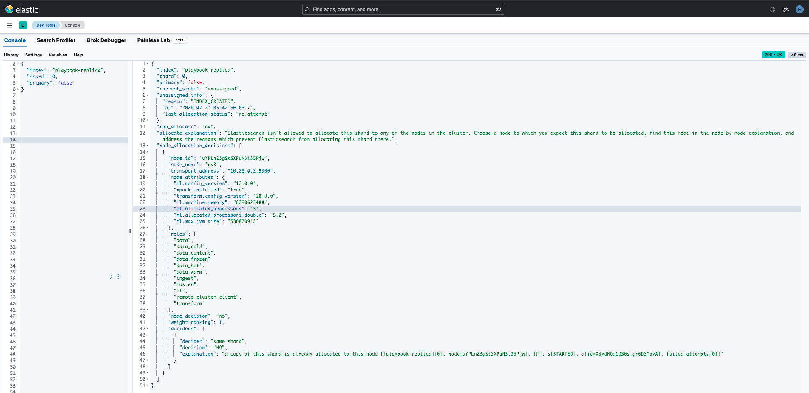
FAULT CASE
P03｜Replica 無法配置
WARNING
觸發
單節點建立 1 個 replica
觀測
Replica 不能與 primary 位於同一節點，叢集為 yellow。
診斷
cluster_health = warning
還原後
目標檢查 = pass
ES 8 MANUAL VERIFICATION
6
Notes:
This cluster has 1 unavailable replica shard.
[Sources]
- /Users/russell.chen/workspace/lab/elk-diagnostics/reports/bundle-playbook-es8-20260727-102156/P03-fault/bundle-report.json
- /Users/russell.chen/workspace/lab/elk-diagnostics/reports/bundle-playbook-es8-20260727-102156/post-P03/bundle-report.json
- /Users/russell.chen/workspace/lab/elk-diagnostics/bundle-playbook-es8-20260727-102156/P03-fault/screenshots/P03-same-shard.png
[/Sources]

Slide 7
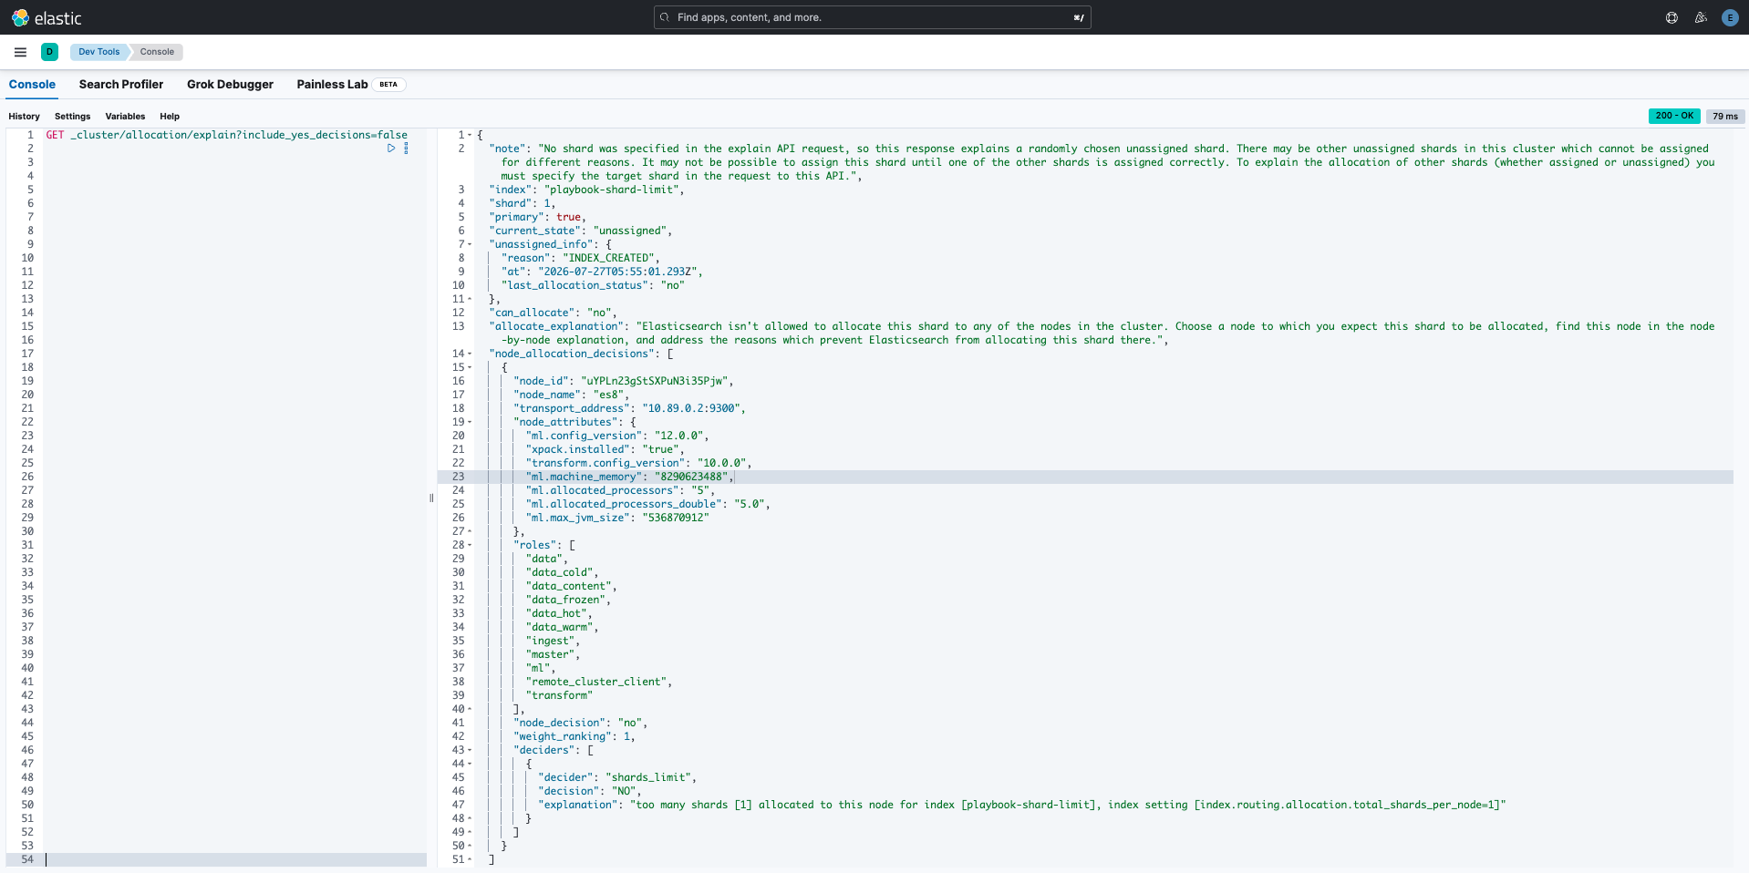
FAULT CASE
P04｜Index Shards-per-node 超限
CRITICAL
觸發
index.routing.allocation.
total_shards_per_node
觀測
shards_limit decider 拒絕配置 primary shard。
診斷
cluster_health = critical
還原後
目標檢查 = pass
ES 8 MANUAL VERIFICATION
7
Notes:
This cluster has 1 unavailable primary shard.
[Sources]
- /Users/russell.chen/workspace/lab/elk-diagnostics/reports/bundle-playbook-es8-20260727-102156/P04-fault/bundle-report.json
- /Users/russell.chen/workspace/lab/elk-diagnostics/reports/bundle-playbook-es8-20260727-102156/post-P04/bundle-report.json
- /Users/russell.chen/workspace/lab/elk-diagnostics/bundle-playbook-es8-20260727-102156/P04-fault/screenshots/P04-shards-limit.png
[/Sources]

Slide 8
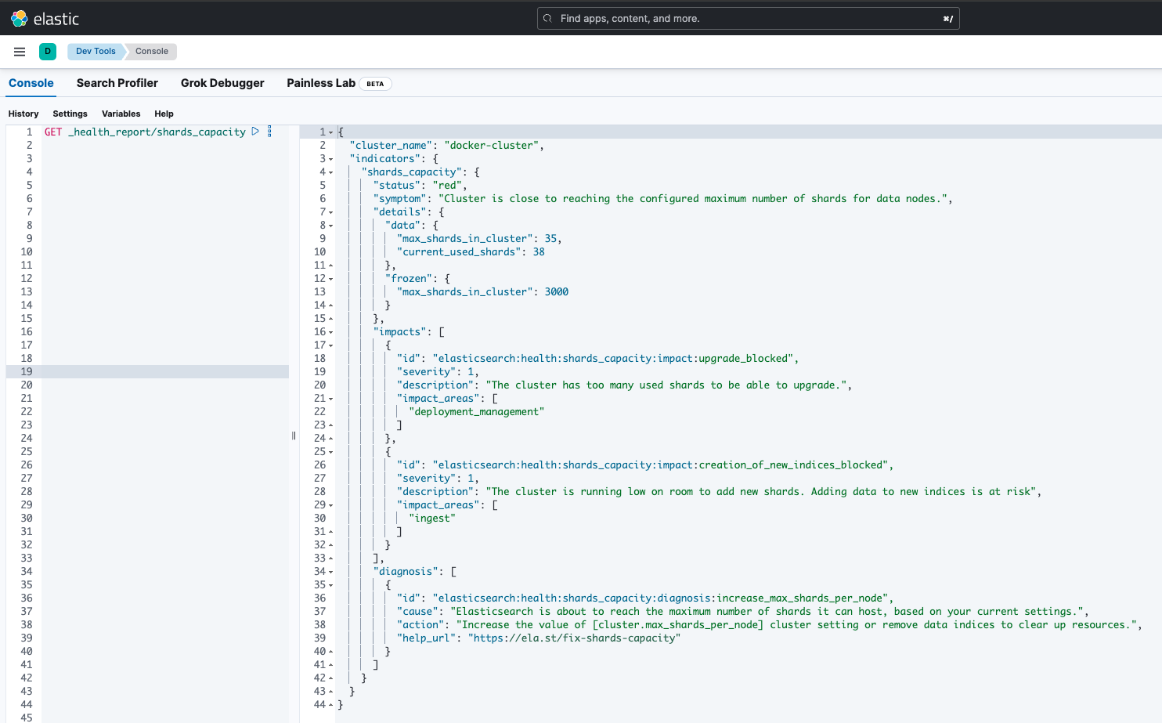
FAULT CASE
P05｜叢集 Shard 容量達上限
CONDITIONAL
觸發
降低 cluster.max_shards_per_node
觀測
Health Report 判定 shards_capacity 為 red。
診斷
shards_capacity = critical
還原後
目標檢查 = pass
多因子案例：同時存在 2 個未配置 replica；容量判定有效，但不是純單因子驗證。
ES 8 MANUAL VERIFICATION
8
Notes:
Cluster is close to reaching the configured maximum number of shards for data nodes.
[Sources]
- /Users/russell.chen/workspace/lab/elk-diagnostics/reports/bundle-playbook-es8-20260727-102156/P05-fault/bundle-report.json
- /Users/russell.chen/workspace/lab/elk-diagnostics/reports/bundle-playbook-es8-20260727-102156/post-P05/bundle-report.json
- /Users/russell.chen/workspace/lab/elk-diagnostics/bundle-playbook-es8-20260727-102156/P05-invalid-replica-contaminated/screenshots/P05-shards-capacity-red.png
[/Sources]

Slide 9
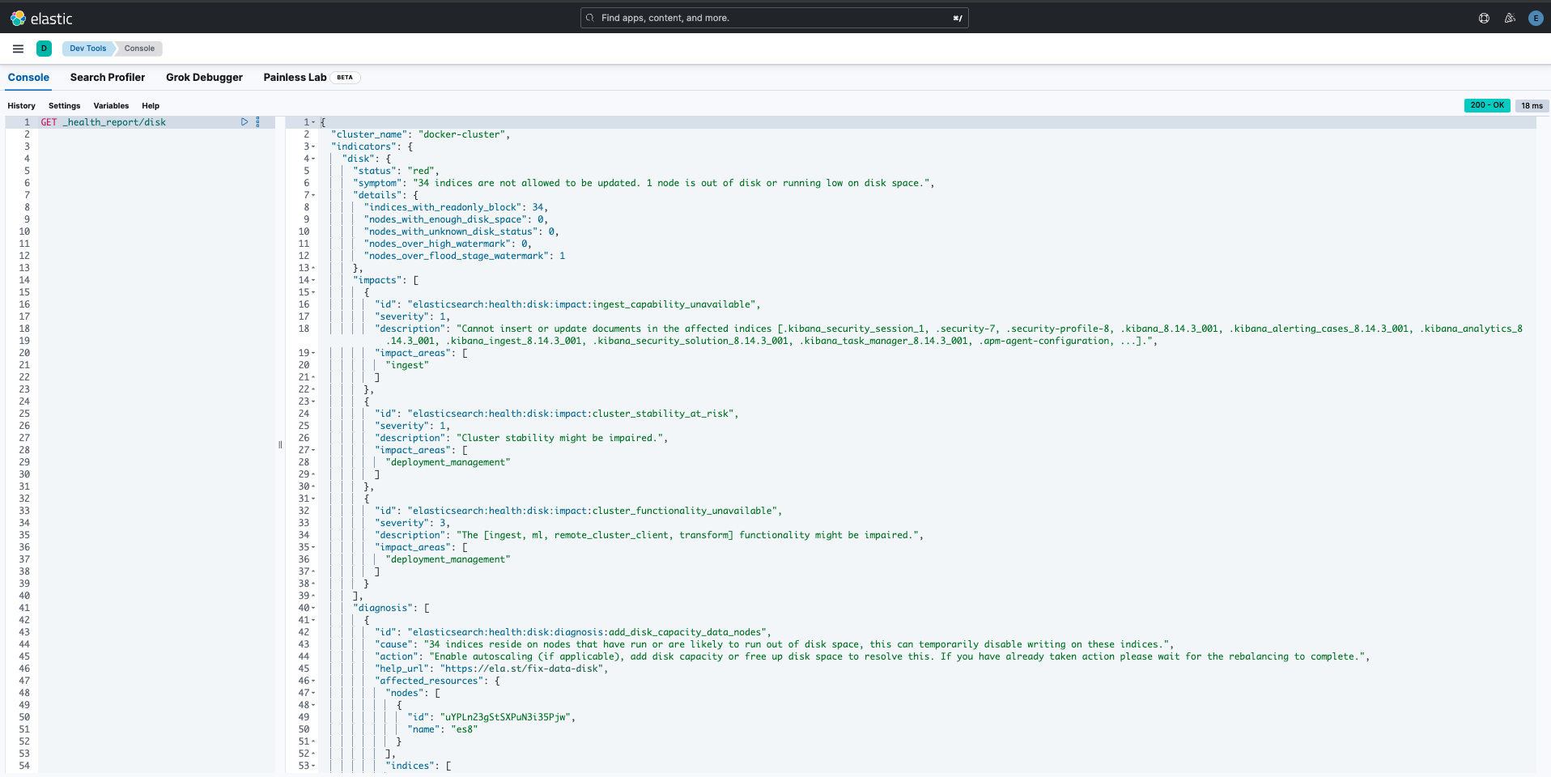
FAULT CASE
P06｜磁碟 Watermark 超限
CRITICAL
觸發
將 low / high / flood_stage 壓低於實際使用率
觀測
Health Report 判定磁碟容量不足並限制 index 寫入。
診斷
disk = critical
還原後
目標檢查 = pass
ES 8 MANUAL VERIFICATION
9
Notes:
34 indices are not allowed to be updated. 1 node is out of disk or running low on disk space.
[Sources]
- /Users/russell.chen/workspace/lab/elk-diagnostics/reports/bundle-playbook-es8-20260727-102156/P06-fault/bundle-report.json
- /Users/russell.chen/workspace/lab/elk-diagnostics/reports/bundle-playbook-es8-20260727-102156/post-P06/bundle-report.json
- /Users/russell.chen/workspace/lab/elk-diagnostics/bundle-playbook-es8-20260727-102156/P06-fault/screenshots/P06-disk-red.png
[/Sources]

Slide 10
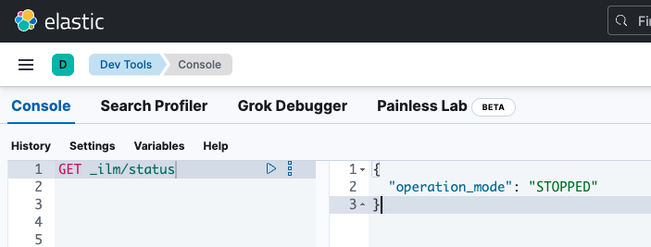
FAULT CASE
P07｜ILM 被停止
CRITICAL
觸發
POST _ilm/stop
觀測
ILM operation_mode 變為 STOPPED。
診斷
ilm_slm_status = critical
還原後
目標檢查 = pass
ES 8 MANUAL VERIFICATION
10
Notes:
ILM 已停止，生命週期動作不執行（SLM 亦連帶暫停）
[Sources]
- /Users/russell.chen/workspace/lab/elk-diagnostics/reports/bundle-playbook-es8-20260727-102156/P07-fault/bundle-report.json
- /Users/russell.chen/workspace/lab/elk-diagnostics/reports/bundle-playbook-es8-20260727-102156/post-P07/bundle-report.json
- /Users/russell.chen/workspace/lab/elk-diagnostics/bundle-playbook-es8-20260727-102156/P07-fault/screenshots/P07-ilm-stopped.png
[/Sources]

Slide 11
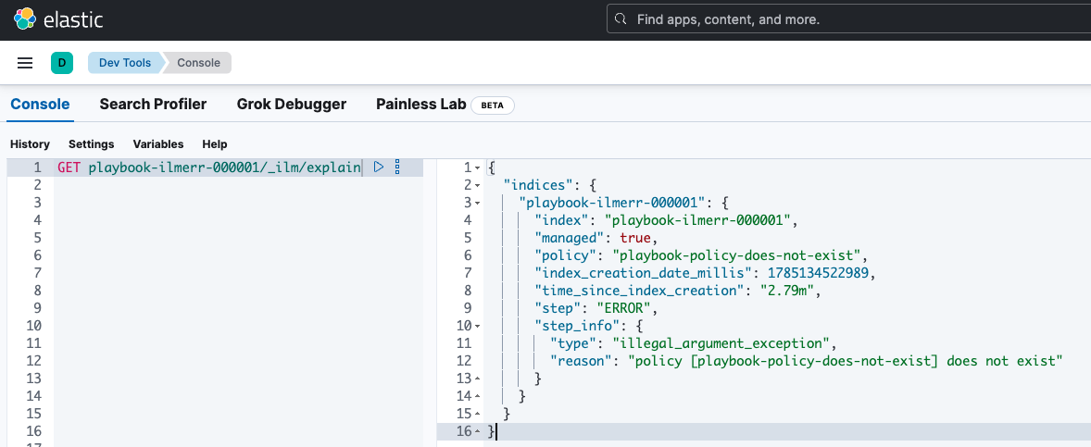
FAULT CASE
P08｜ILM 進入 ERROR Step
CRITICAL
觸發
Index 指向不存在的 ILM policy
觀測
Index 維持 green，但 ILM step 進入 ERROR。
診斷
ilm_slm_status = critical
還原後
目標檢查 = pass
ES 8 MANUAL VERIFICATION
11
Notes:
1 個 index 處於 ILM ERROR step
[Sources]
- /Users/russell.chen/workspace/lab/elk-diagnostics/reports/bundle-playbook-es8-20260727-102156/P08-fault/bundle-report.json
- /Users/russell.chen/workspace/lab/elk-diagnostics/reports/bundle-playbook-es8-20260727-102156/post-P08/bundle-report.json
- /Users/russell.chen/workspace/lab/elk-diagnostics/bundle-playbook-es8-20260727-102156/P08-fault/screenshots/P08-ilm-policy-missing.png
[/Sources]

Slide 12
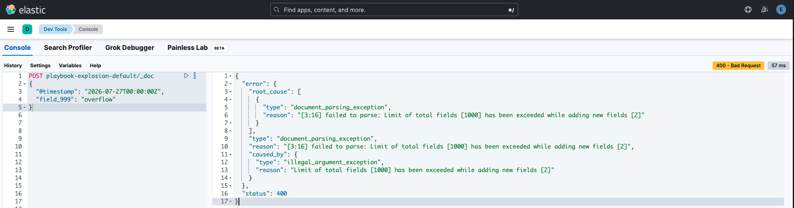
FAULT CASE
P09｜Mapping 欄位膨脹
CRITICAL
觸發
Data stream 建立 1,000 個 mapping 欄位
觀測
診斷器保留 .ds-* backing index 並判定達到欄位上限。
診斷
mapping_explosion = critical
還原後
目標檢查 = pass
本環境預設上限為 1,000；目前產品仍以固定預設值判定，尚未讀取每個 index 的實際上限。
ES 8 MANUAL VERIFICATION
12
Notes:
1 個 index 欄位數達/超過上限 1000，新欄位寫入將被拒
[Sources]
- /Users/russell.chen/workspace/lab/elk-diagnostics/reports/bundle-playbook-es8-20260727-102156/P09-fault/bundle-report.json
- /Users/russell.chen/workspace/lab/elk-diagnostics/reports/bundle-playbook-es8-20260727-102156/post-P09/bundle-report.json
- /Users/russell.chen/workspace/lab/elk-diagnostics/bundle-playbook-es8-20260727-102156/P09-fault/screenshots/P09-mapping-explosion.png
[/Sources]

Slide 13
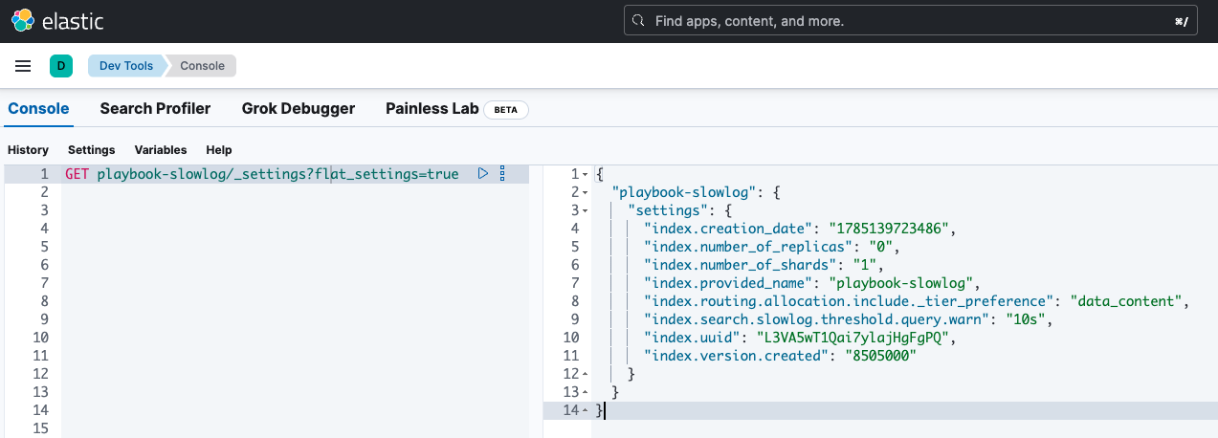
FAULT CASE
P10｜Search Slow Log 設定盤點
PASS
觸發
query.warn threshold = 10s
觀測
工具正確列出已開啟 slow log 的 index。
診斷
search_slow_log = pass
還原後
目標檢查 = pass
此項只盤點設定，不讀取或分析 slow log 內容。
ES 8 MANUAL VERIFICATION
13
Notes:
已於 1 個 index 開啟 search slow log
[Sources]
- /Users/russell.chen/workspace/lab/elk-diagnostics/reports/bundle-playbook-es8-20260727-102156/P10-fault/bundle-report.json
- /Users/russell.chen/workspace/lab/elk-diagnostics/reports/bundle-playbook-es8-20260727-102156/post-P10/bundle-report.json
- /Users/russell.chen/workspace/lab/elk-diagnostics/bundle-playbook-es8-20260727-102156/P10-fault/screenshots/P10-search-slowlog-enabled.png
[/Sources]

Slide 14
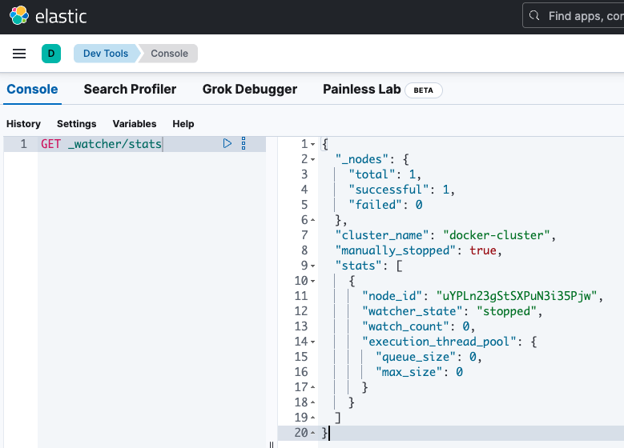
FAULT CASE
P11｜Watcher 被手動停止
PARTIAL
觸發
POST _watcher/_stop
觀測
Watcher stats 回報 manually_stopped=true。
診斷
watcher = warning
還原後
目標檢查 = pass
Basic license、watch_count=0；只證明 API 狀態可被解析，不能視為完整 Watcher 功能故障驗證。
ES 8 MANUAL VERIFICATION
14
Notes:
Watcher 已手動停止，watch 不會執行
[Sources]
- /Users/russell.chen/workspace/lab/elk-diagnostics/reports/bundle-playbook-es8-20260727-102156/P11-fault/bundle-report.json
- /Users/russell.chen/workspace/lab/elk-diagnostics/reports/bundle-playbook-es8-20260727-102156/post-P11/bundle-report.json
- /Users/russell.chen/workspace/lab/elk-diagnostics/bundle-playbook-es8-20260727-102156/P11-fault/screenshots/P11-watcher-stopped.png
[/Sources]

Slide 15
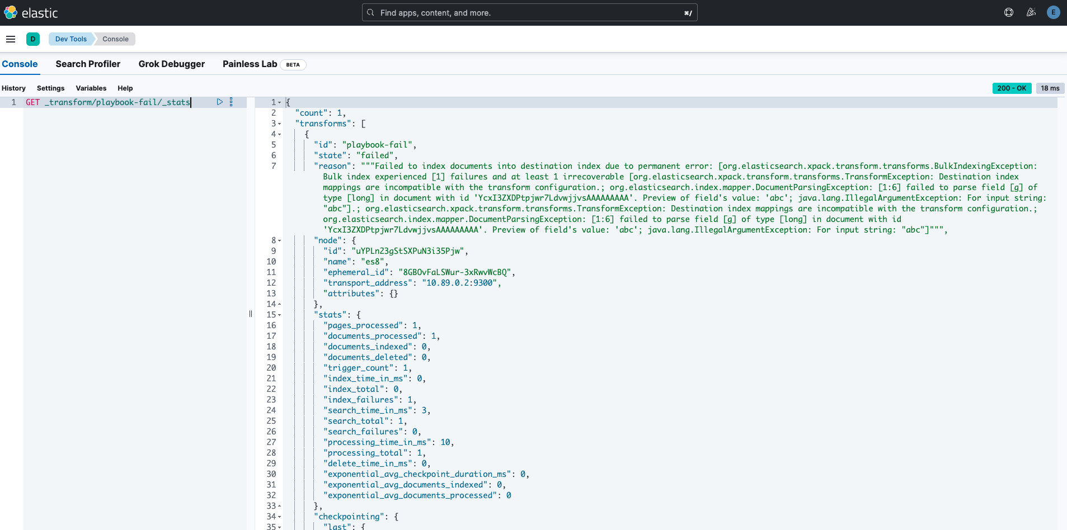
FAULT CASE
P12｜Transform 因欄位型別衝突失敗
CRITICAL
觸發
Source g=keyword；Destination g=long
觀測
字串值無法寫入 long 欄位，Transform state=failed。
診斷
transforms = critical
還原後
目標檢查 = pass
ES 8 MANUAL VERIFICATION
15
Notes:
1 個 transform 處於 failed
[Sources]
- /Users/russell.chen/workspace/lab/elk-diagnostics/reports/bundle-playbook-es8-20260727-102156/P12-fault/bundle-report.json
- /Users/russell.chen/workspace/lab/elk-diagnostics/reports/bundle-playbook-es8-20260727-102156/post-P12/bundle-report.json
- /Users/russell.chen/workspace/lab/elk-diagnostics/bundle-playbook-es8-20260727-102156/P12-fault/screenshots/P12-transform-failed.png
[/Sources]

Slide 16
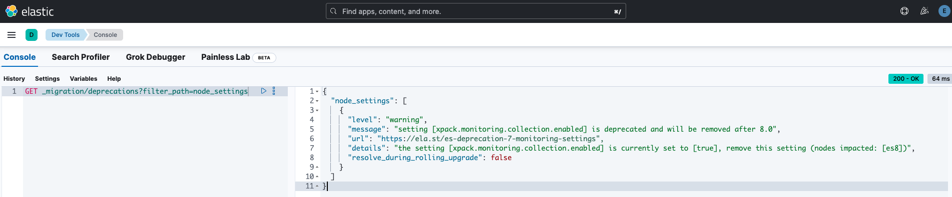
FAULT CASE
P13｜Legacy Monitoring 設定已棄用
WARNING
觸發
xpack.monitoring.collection.enabled = true
觀測
Migration Deprecations 在 node_settings 回報 warning。
診斷
upgrade_deprecations = warning
還原後
目標檢查 = pass
ES 8 MANUAL VERIFICATION
16
Notes:
1 項 warning deprecation
[Sources]
- /Users/russell.chen/workspace/lab/elk-diagnostics/reports/bundle-playbook-es8-20260727-102156/P13-fault/bundle-report.json
- /Users/russell.chen/workspace/lab/elk-diagnostics/reports/bundle-playbook-es8-20260727-102156/post-P13/bundle-report.json
- /Users/russell.chen/workspace/lab/elk-diagnostics/bundle-playbook-es8-20260727-102156/P13-fault/screenshots/P13-monitoring-deprecation-warning.png
[/Sources]

Slide 17
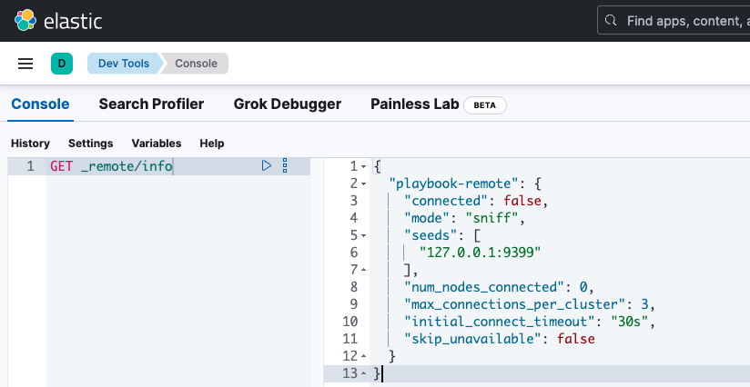
FAULT CASE
P14｜Remote Cluster 無法連線
WARNING
觸發
Remote seed 指向無服務的 127.0.0.1:9399
觀測
Remote info 回報 connected=false、0 nodes。
診斷
remote_clusters = warning
還原後
目標檢查 = pass
ES 8 MANUAL VERIFICATION
17
Notes:
1 個 remote cluster 未連線
[Sources]
- /Users/russell.chen/workspace/lab/elk-diagnostics/reports/bundle-playbook-es8-20260727-102156/P14-fault/bundle-report.json
- /Users/russell.chen/workspace/lab/elk-diagnostics/reports/bundle-playbook-es8-20260727-102156/post-P14/bundle-report.json
- /Users/russell.chen/workspace/lab/elk-diagnostics/bundle-playbook-es8-20260727-102156/P14-fault/screenshots/P14-remote-cluster-disconnected.png
[/Sources]

Slide 18
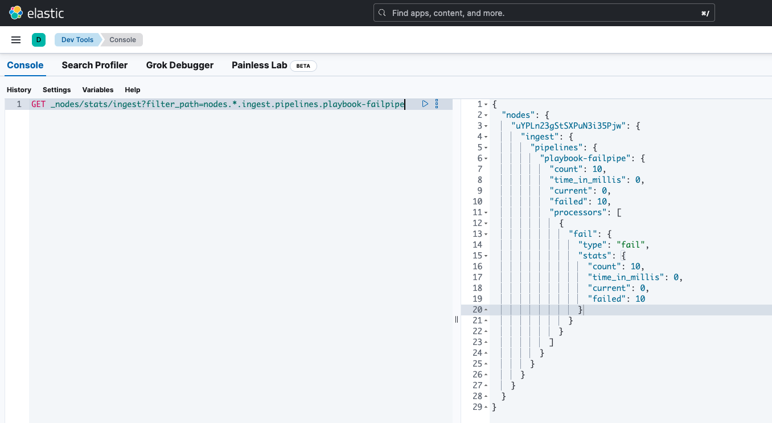
FAULT CASE
P15｜Ingest Pipeline 持續失敗
WARNING
觸發
Fail processor 拒絕 10 筆文件
觀測
Pipeline stats 累積 count=10、failed=10。
診斷
ingest_pipeline_errors = warning
還原後
目標檢查 = pass
ES 8 MANUAL VERIFICATION
18
Notes:
1 個 ingest pipeline 失敗率 >10%（累積值）
[Sources]
- /Users/russell.chen/workspace/lab/elk-diagnostics/reports/bundle-playbook-es8-20260727-102156/P15-fault/bundle-report.json
- /Users/russell.chen/workspace/lab/elk-diagnostics/reports/bundle-playbook-es8-20260727-102156/post-P15/bundle-report.json
- /Users/russell.chen/workspace/lab/elk-diagnostics/bundle-playbook-es8-20260727-102156/P15-fault/screenshots/P15-ingest-pipeline-failed-count.png
[/Sources]

Slide 19
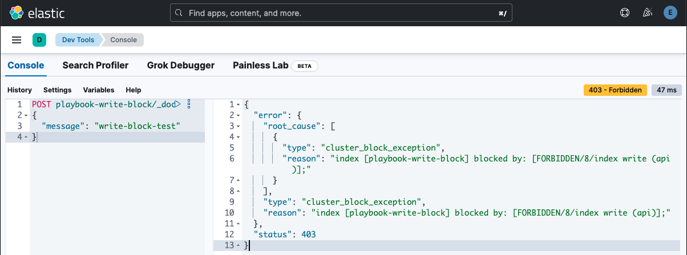
FAULT CASE
P16｜Index Write Block
CRITICAL
觸發
index.blocks.write = true
觀測
寫入被 HTTP 403 cluster_block_exception 拒絕。
診斷
index_read_write_blocks = critical
還原後
目標檢查 = pass
ES 8 MANUAL VERIFICATION
19
Notes:
1 個非系統 index 存在讀寫或 metadata block
[Sources]
- /Users/russell.chen/workspace/lab/elk-diagnostics/reports/bundle-playbook-es8-20260727-102156/P16-fault/bundle-report.json
- /Users/russell.chen/workspace/lab/elk-diagnostics/reports/bundle-playbook-es8-20260727-102156/post-P16/bundle-report.json
- /Users/russell.chen/workspace/lab/elk-diagnostics/bundle-playbook-es8-20260727-102156/P16-fault/screenshots/P16-write-rejected-403.png
[/Sources]

Slide 20
QUALIFICATIONS
通過不等於沒有邊界
P05
多因子
Shard capacity 判定有效；同時存在 2 個 unassigned replica。
P11
授權
Basic license、watch_count=0；僅驗證 API 狀態解析。
P09
門檻
目前使用固定 1,000；尚未讀取 index 實際 total_fields.limit。
P10
資料範圍
只盤點 slow-log 設定，不分析 slow-log 事件。
BASE
環境
單節點造成 master SPOF／replica 韌性 warning，屬測試背景。
ES 8 MANUAL VERIFICATION
20
Notes:
[Sources]
- /Users/russell.chen/workspace/lab/elk-diagnostics/reports/bundle-playbook-es8-20260727-102156/verification-summary.json
- https://www.elastic.co/docs/reference/elasticsearch/index-settings/mapping-limit
- https://www.elastic.co/docs/api/doc/elasticsearch/v8/operation/operation-license-post
[/Sources]

Slide 21
CONCLUSION
Bundle Route B
已具備可重複驗證基礎
下一步
修正 P09 實際門檻讀取｜加入授權感知 P11｜決定是否補跑純單因子 P05｜複驗 ES 9
ES 8 MANUAL VERIFICATION
21
Notes:
[Sources]
- /Users/russell.chen/workspace/lab/elk-diagnostics/reports/bundle-playbook-es8-20260727-102156/verification-summary.json
- /Users/russell.chen/workspace/lab/elk-diagnostics/docs/VERIFICATION-BUNDLE-PLAYBOOK.md
[/Sources]

