Slide 1

THINS
Sharp interface fluid vacuum flow
Vincent Moreau & Luca Massidda

Slide 2
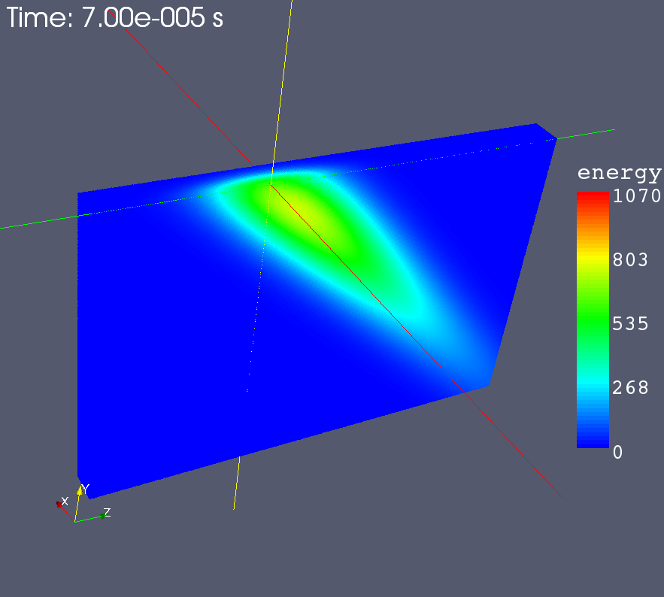
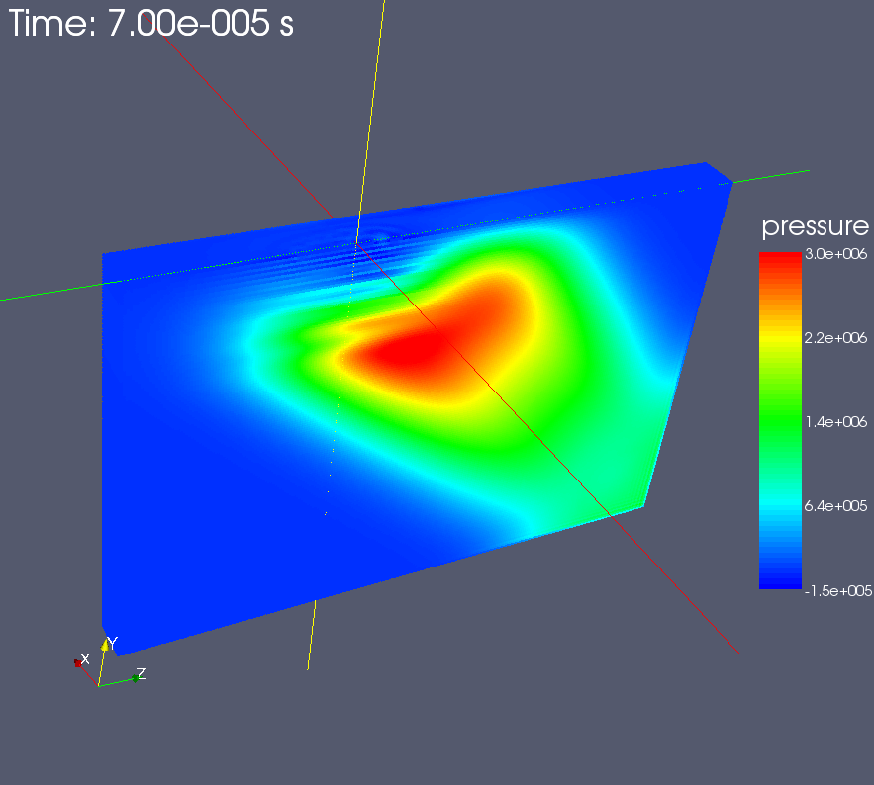
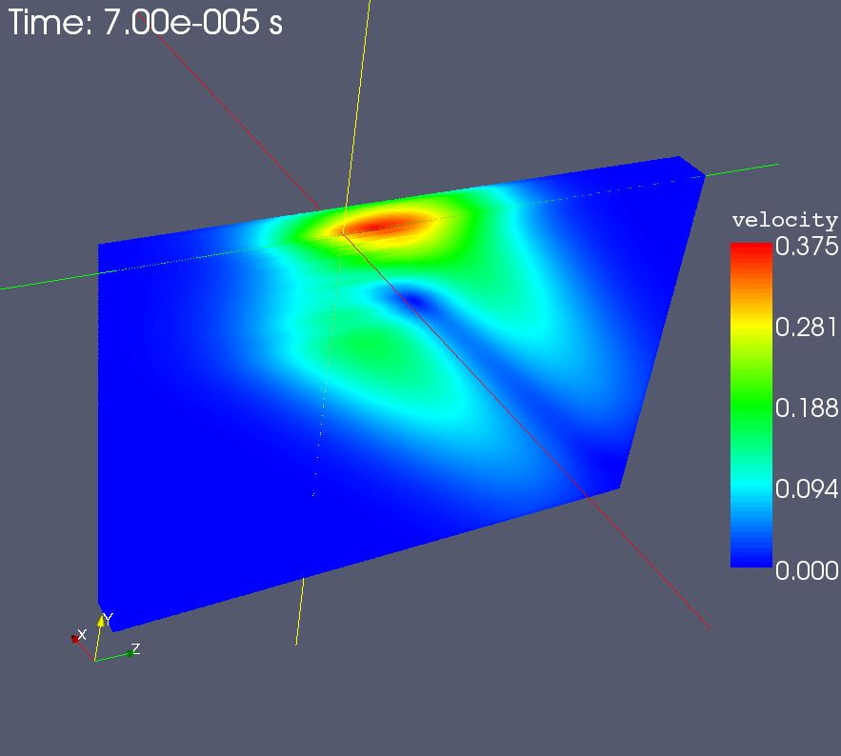
SPH analysis
The SPH model of a liquid metal target for the ESS has been analyzed as a test case. The model is a portion of the liquid metal bath, with rigid boundaries and a free surface.
The code has run on a linux 64bit pc, the run time is approx 2 hours for 1 million particles and 0.1ms transient simulation.
Energy, pressure and velocity magnitude distribution for half model are shown

Slide 3



SPH parallelization
The limiting fctor for the previous simulation was on the model size due to the memory occupancy of the data structure.
CUDA, OpenCL and FPGA technologies have been studied for an efficient porting of the code.
The code has been redesigned with new data structures for parallelization.
CUDA parallelization is almost complete.
Simulations with 10million particles are foreseen for a single Tesla card.
Speedup factor at the moment is almost 25x, the ESS simulation would take less than 5 minutes!
Debugging and optimization phase has been started.

Slide 4
Load conditions
ESS facility aims at producing high energy spallation neutrons, by the interaction of a pulsed high energy proton beam with an appropriate target material
Liquid target has been considered as an option for the design and a free surface concept has been proposed by KIT
The long pulse duration and the free surface allow to attenuate the pressure waves that are generated due to the sudden beam power deposition
Beam properties
Proton energy | 2.5 GeV
Mean current | 2 mA
Beam power | 5 MW
Pulse frequency | 20 Hz
Power on target | 2.3 MW
Property (1atm) | LBE
Density [kg/m3] | 10338
Std. Weight [g/mol] | 208.2
Melting point [K] | 397.7
Boiling point [K] | 1943
Heat cap. [J/mol K] | 30.8
Vapor pr. @700K [Pa] | 10⁻⁴
Sound velocity [m/s] | 1774
Thermal exp. [μ/mK] | 123

Slide 5
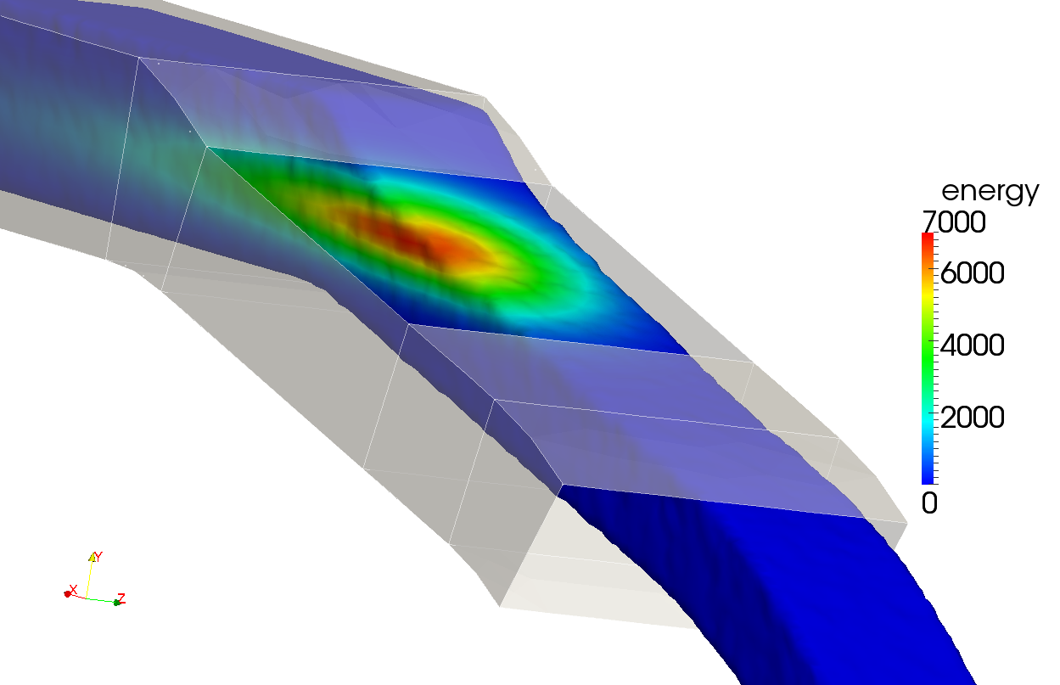
Load conditions
Beam power deposition has been evaluated through neutronics and was approximated with the expressions:
The following coordinate transformation has been applied to include the effect of the oblique beam impact on the free surface
Channel properties
Width | 220 mm
Inlet height | 110 mm
Nozzle height | 85 mm
Window length | 235 mm
Flow vel. In nozzle | 2 m/s

Slide 6
Simulation setup slow transients
The transient simulations are run on a Tesla C1060 GPU
The material properties for slow transients without pressure waves are modified with respect to standard values
The particle number varies during simulation, around 1million particles are used with a GPU occupancy < 1GBThe following EOS for LBE is adopted
Model properties
Particle diameter | d | 4 mm
Smooth length | h | 4.8 mm
Density | ρ | 10338 kg/m3
Speed of sound | c | 17.4 m/s
Gruneisen par. | Γ | 0
Time step | Δt | 200 μs

Slide 7
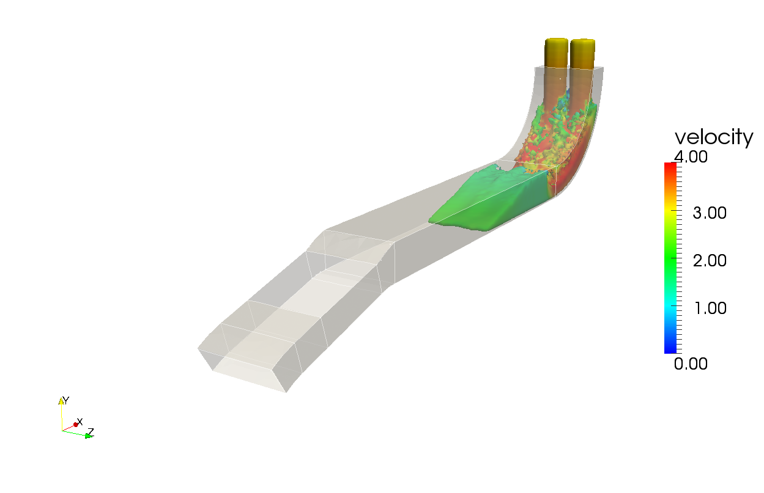
Filling

Slide 8
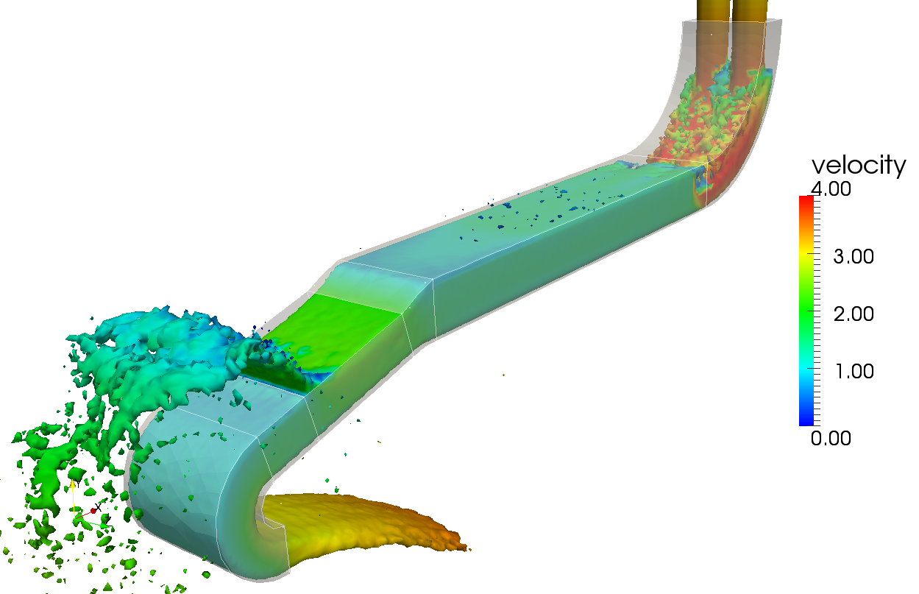
Bent channel

Slide 9
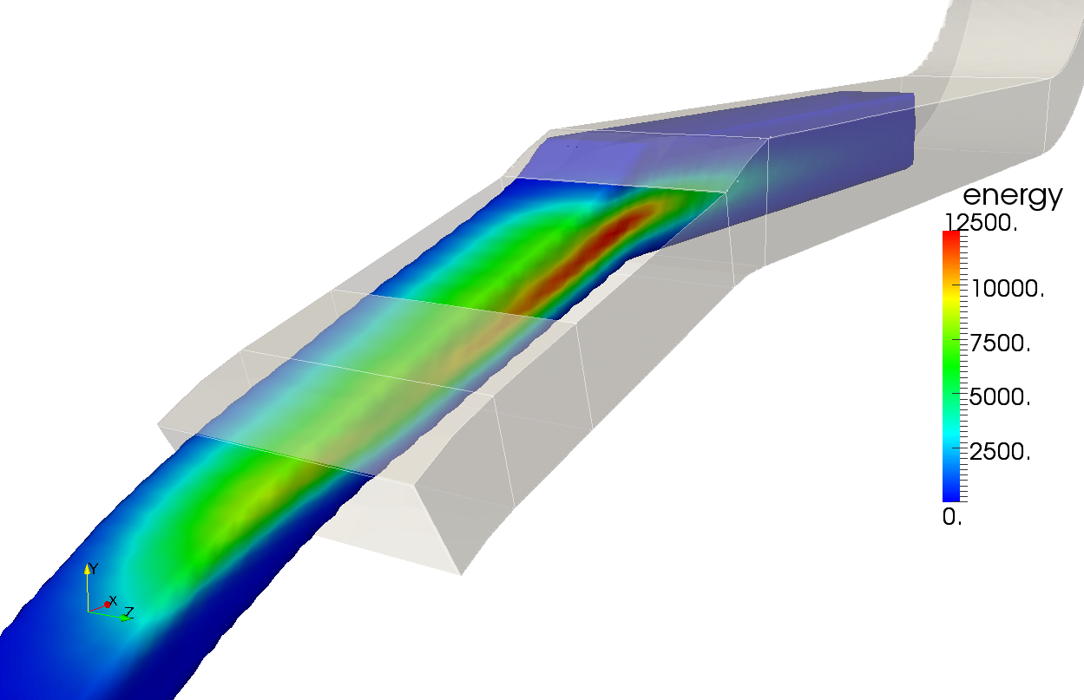
Beam power deposition

Slide 10
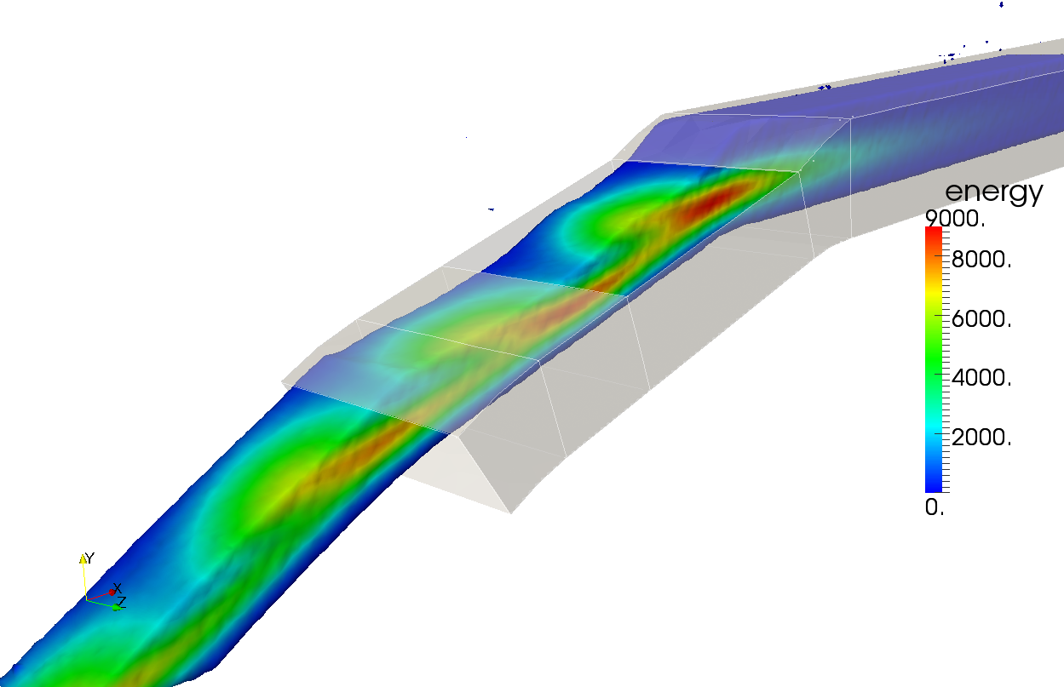
Beam power deposition 2x speed

Slide 11
Simulation setup fast transients
The correct values of the material properties are adopted
The ime step reduces as well as the maximum simulation time
4 beam hits are analyzed to check the beam power superposition effects
Model properties
Particle diameter | d | 4 mm
Smooth length | h | 4.8 mm
Density | ρ | 10338 kg/m3
Speed of sound | c | 1740 m/s
Gruneisen par. | Γ | 2.6
Time step | Δt | 2 μs

Slide 12
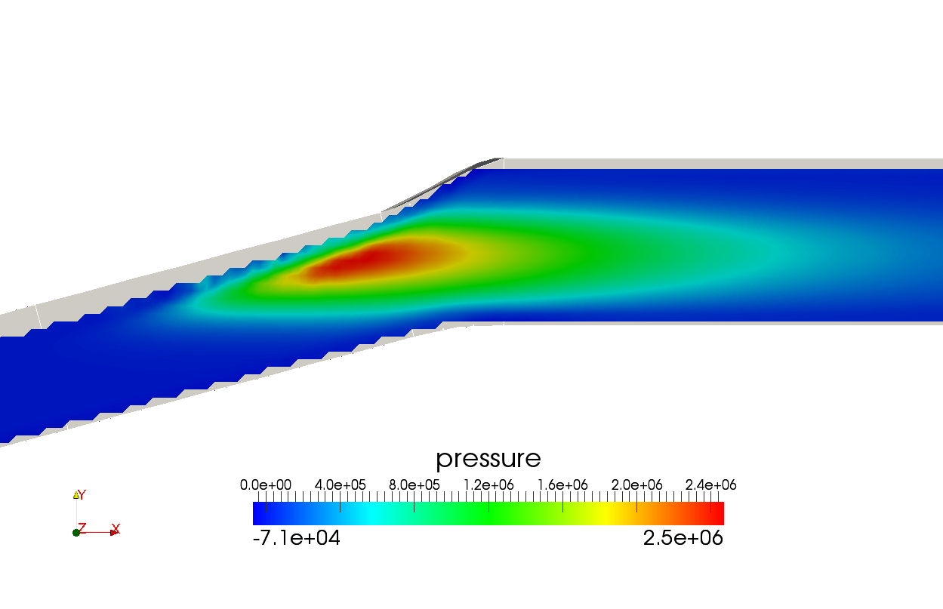
Pressure waves in the channel

Slide 13
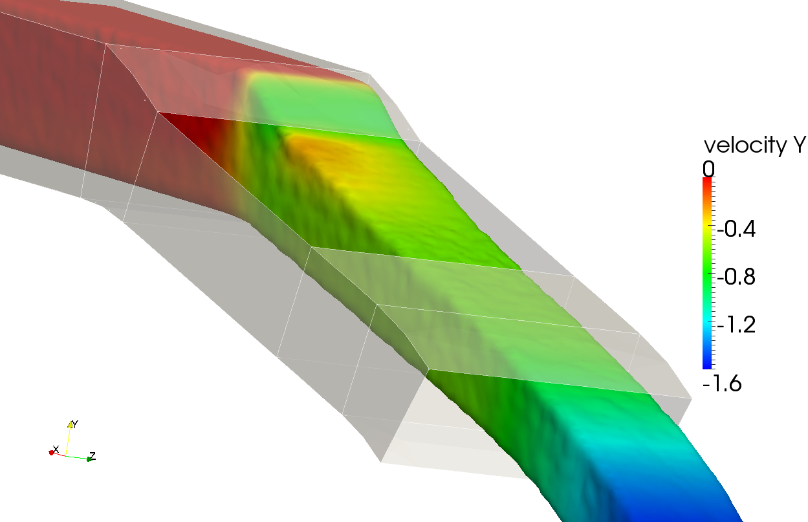
Fast transient

Slide 14
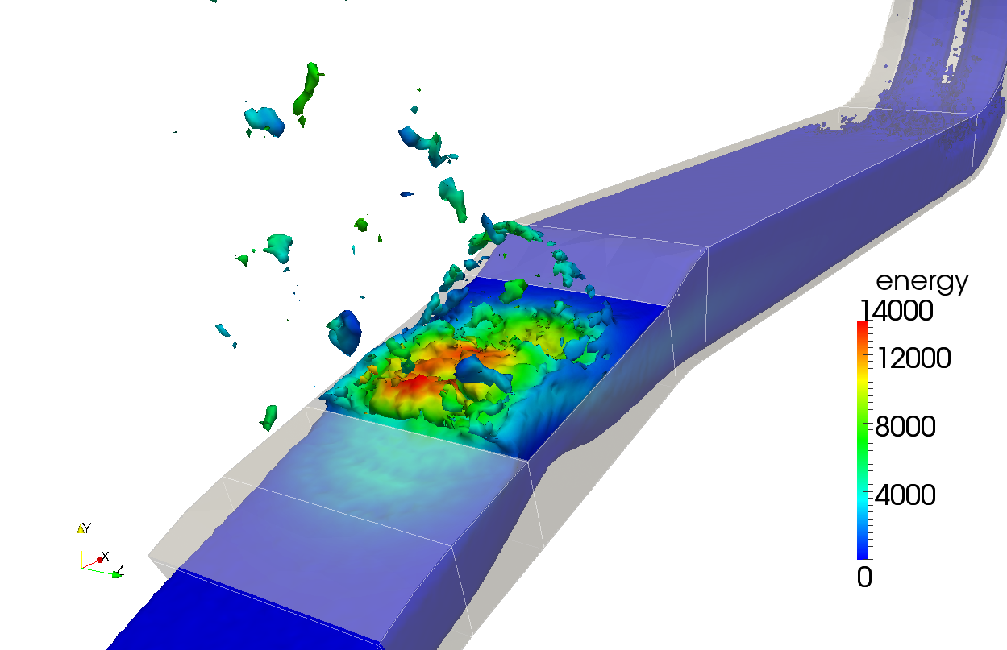
Fast transient short pulse

Slide 15
Conclusions
The SPH code Armando has been successfully rewritten for the GPU architecture
A significant advantage has been obtained from the new architecture, with speedups with respect to the CPU version higher than 60x
Analyses that had to be limited in length and accuracy due to the computational requirement can now be run on a desktop pc with an acceleration card
The code allows to simulate slow and fast transients for free surface flows with beam interaction
The analysis procedure has been setup and applyed to a free surface target concept

