Slide 1

THINS
Sharp interface fluid vacuum flow
Vincent Moreau & Luca Massidda

Slide 2
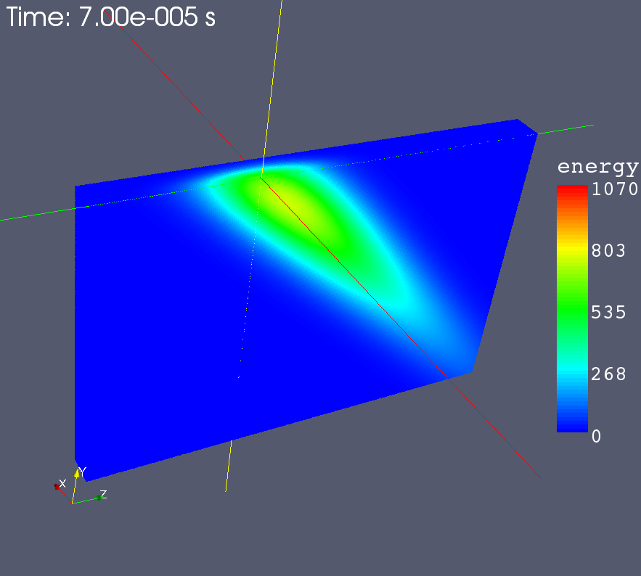
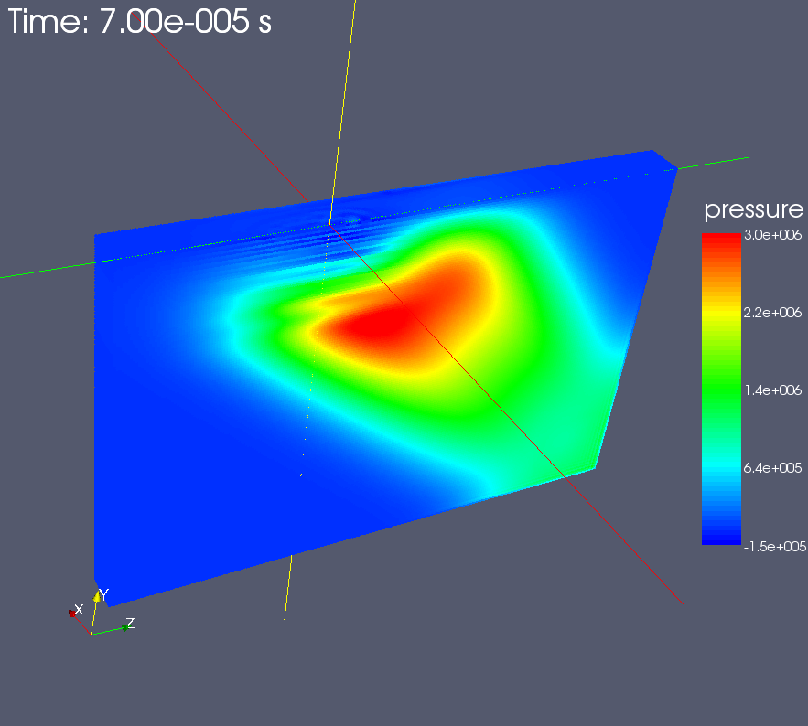
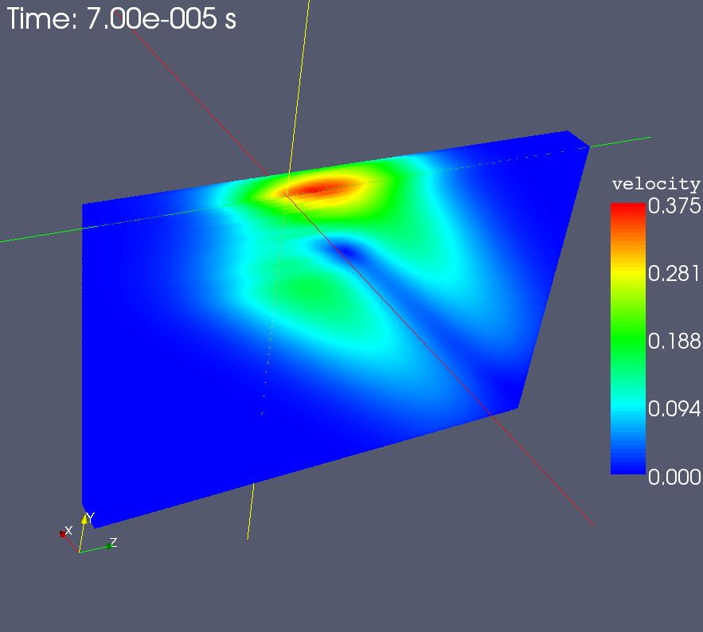
SPH analysis
The SPH model of a liquid metal target for the ESS has been analyzed as a test case. The model is a portion of the liquid metal bath, with rigid boundaries and a free surface.
The code has run on a linux 64bit pc, the run time is approx 2 hours for 1 million particles and 0.1ms transient simulation.
Energy, pressure and velocity magnitude distribution for half model are shown

Slide 3



SPH parallelization
The limiting fctor for the previous simulation was on the model size due to the memory occupancy of the data structure.
CUDA, OpenCL and FPGA technologies have been studied for an efficient porting of the code.
The code has been redesigned with new data structures for parallelization.
CUDA parallelization is almost complete.
Simulations with 10million particles are foreseen for a single Tesla card.
Speedup factor at the moment is almost 25x, the ESS simulation would take less than 5 minutes!
Debugging and optimization phase has been started.

