Slide 1
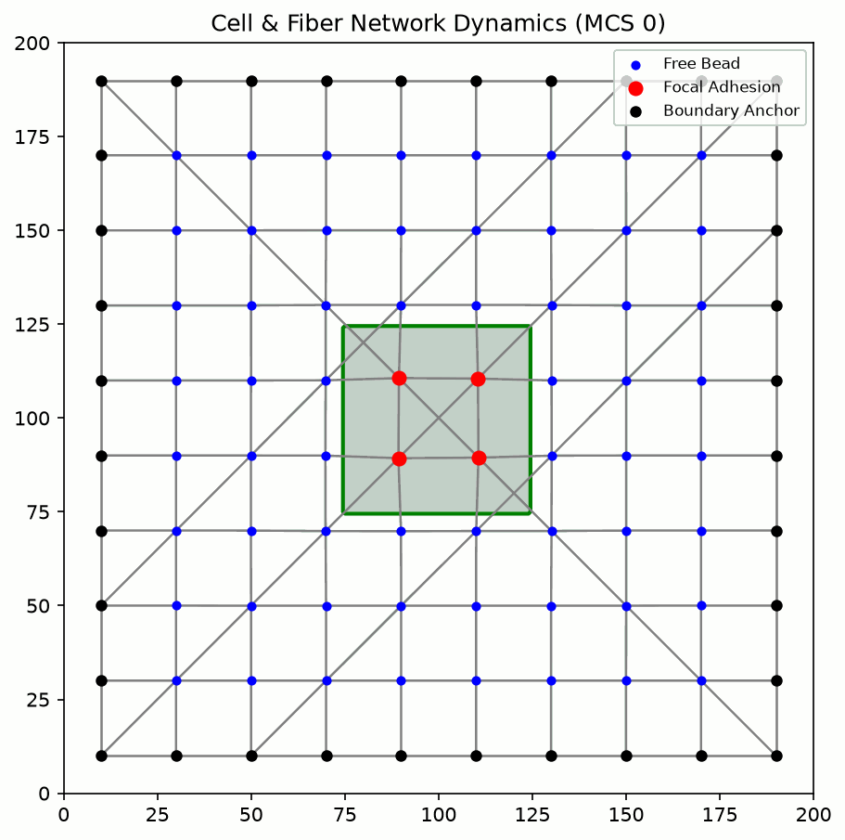

Slide 2
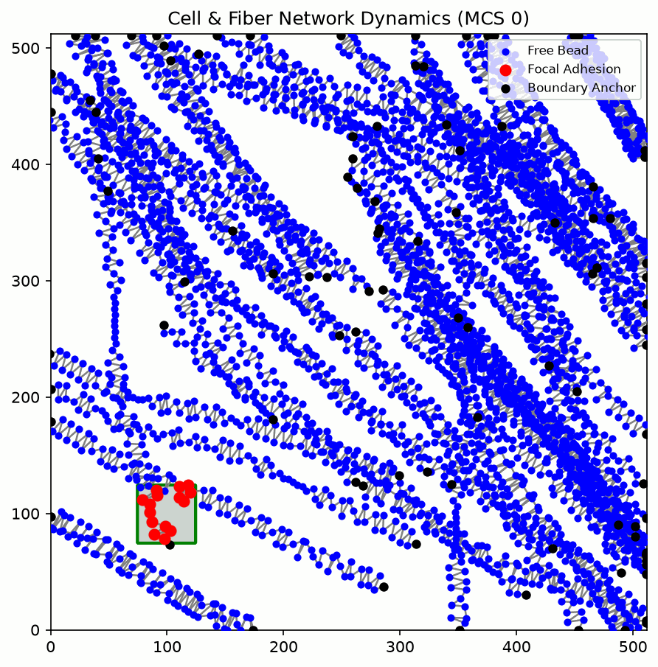
Every 10 spline point

Slide 3
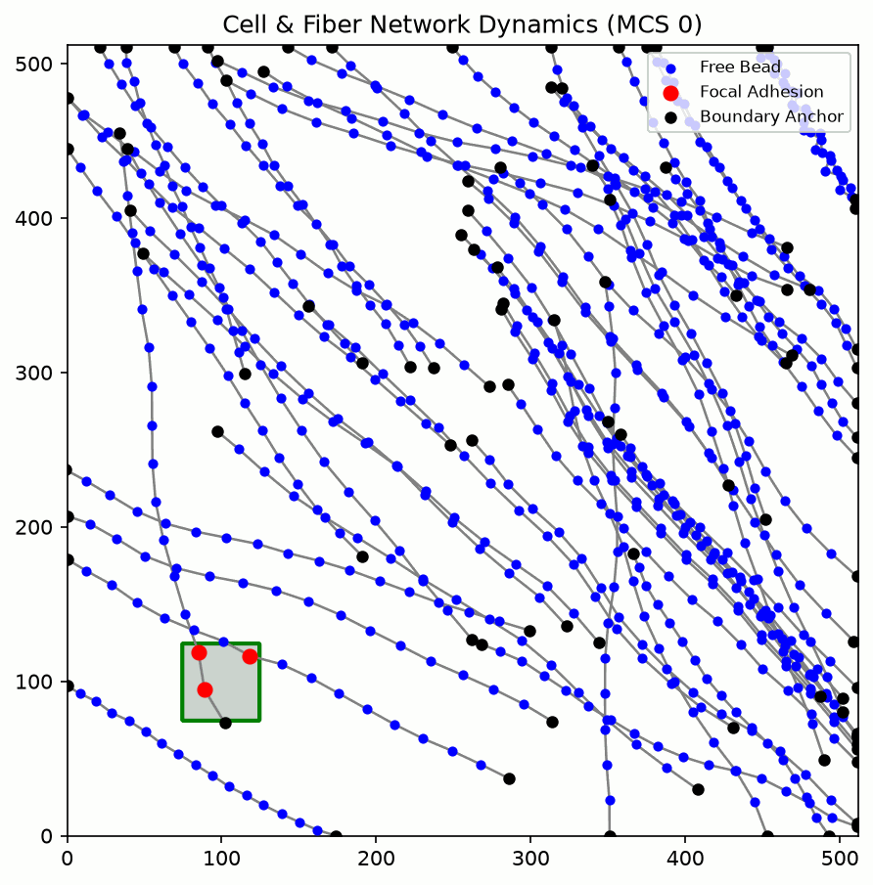
Every 50 spline point

Slide 4
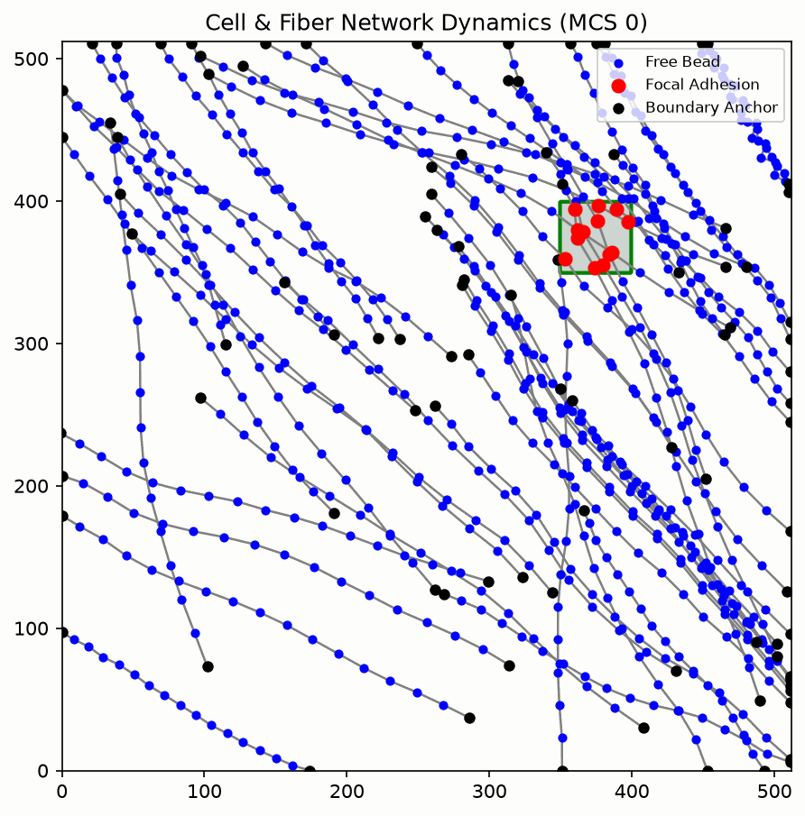
Every 50 spline point

Slide 5
Every 50 spline point
targetVol = 2000

