Slide 1
Intro to Javascript

Slide 2
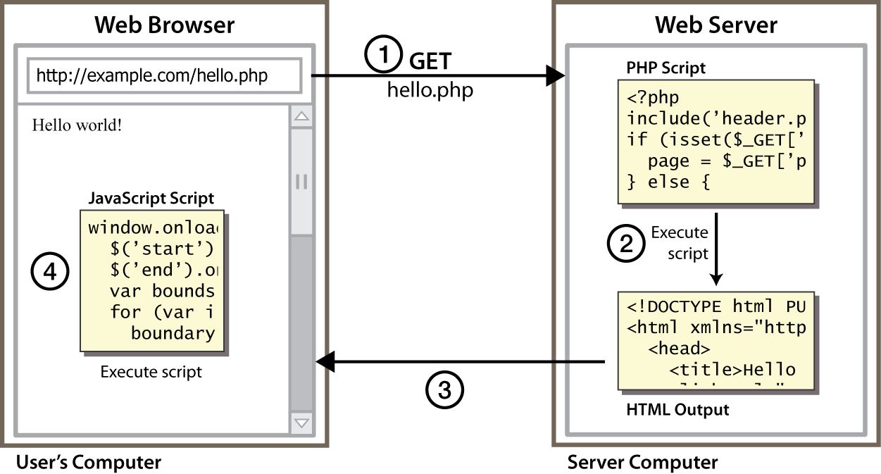
Client Side Scripting

Slide 3
Why use client-side programming?
PHP already allows us to create dynamic web pages. Why also use client-side scripting?
client-side scripting (JavaScript) benefits:
usability: can modify a page without having to post back to the server (faster UI)
efficiency: can make small, quick changes to page without waiting for server
event-driven: can respond to user actions like clicks and key presses

Slide 4
What is Javascript?
a lightweight programming language ("scripting language")
used to make web pages interactive
insert dynamic text into HTML (ex: user name)
react to events (ex: page load user click)
get information about a user's computer (ex: browser type)
perform calculations on user's computer (ex: form validation)
a web standard (but not supported identically by all browsers)
NOT related to Java other than by name and some syntactic similarities

Slide 5

Javascript vs Java
interpreted, not compiled
more relaxed syntax and rules
fewer and "looser" data types
variables don't need to be declared
errors often silent (few exceptions)
key construct is the function rather than the class
"first-class" functions are used in many situations
contained within a web page and integrates with its HTML/CSS content

Slide 6

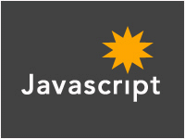
Javascript vs Java
+
=

Slide 7
Linking to a JavaScript file: script
<script src="filename" type="text/javascript"></script> HTML
script tag should be placed in HTML page's head
script code is stored in a separate .js file
JS code can be placed directly in the HTML file's body or head (like CSS)
but this is bad style (should separate content, presentation, and behavior

Slide 8
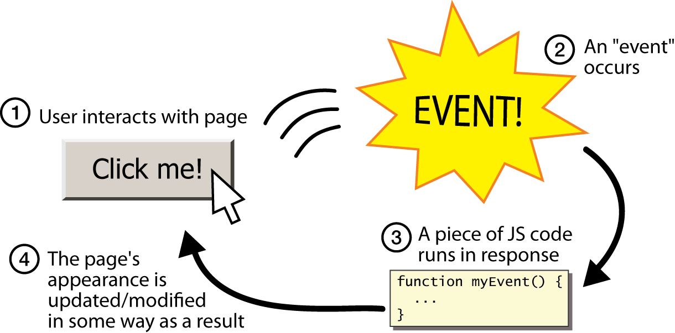
Event-driven programming
split breaks apart a string into an array using a delimiter
can also be used with regular expressions (seen later)
join merges an array into a single string, placing a delimiter between them

Slide 9
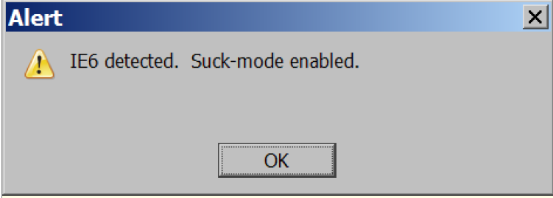
A JavaScript statement: alert
alert("IE6 detected. Suck-mode enabled."); JS
a JS command that pops up a dialog box with a message

Slide 10
Event-driven programming
you are used to programs start with a main method (or implicit main like in PHP)
JavaScript programs instead wait for user actions called events and respond to them
event-driven programming: writing programs driven by user events
Let's write a page with a clickable button that pops up a "Hello, World" window...

Slide 11
Buttons
<button>Click me!</button> HTML
button's text appears inside tag; can also contain images
To make a responsive button or other UI control:
choose the control (e.g. button) and event (e.g. mouse 1. click) of interest
write a JavaScript function to run when the event occurs
attach the function to the event on the control

Slide 12
JavaScript functions
function name() {
statement ;
statement ;
...
statement ;
} JS
function myFunction() {
alert("Hello!");
alert("How are you?");
} JS
the above could be the contents of example.js linked to our HTML page
statements placed into functions can be evaluated in response to user events

Slide 13
Event handlers
<element attributes onclick="function();">... HTML
<button onclick="myFunction();">Click me!</button> HTML
JavaScript functions can be set as event handlers
when you interact with the element, the function will execute
onclick is just one of many event HTML attributes we'll use
but popping up an alert window is disruptive and annoying
A better user experience would be to have the message appear on the page...

Slide 14
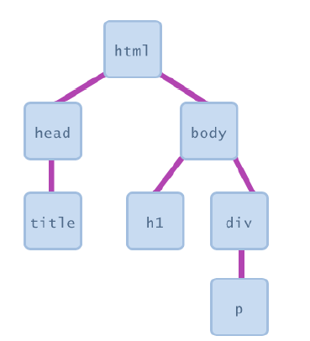
Document Object Model (DOM)
most JS code manipulates elements on an HTML page
we can examine elements' state
e.g. see whether a box is checked
we can change state
e.g. insert some new text into a div
we can change styles
e.g. make a paragraph red

Slide 15
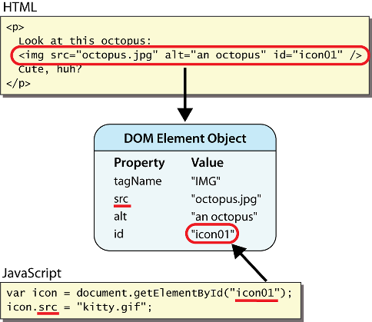
DOM element objects

Slide 16
Accessing elements: document.getElementById
var name = document.getElementById("id");
JS
<button onclick="changeText();">Click me!</button>
<span id="output">replace me</span>
<input id="textbox" type="text" /> HTML
function changeText() {
var span = document.getElementById("output");
var textBox = document.getElementById("textbox");
textbox.style.color = "red";
} JS

Slide 17
Accessing elements: document.getElementById
document.getElementById returns the DOM object for an element with a given id
can change the text inside most elements by setting the innerHTML property
can change the text in form controls by setting the value property

Slide 18
Changing element style: element.style
Attribute | Property or style object
color | color
padding | padding
background-color | backgroundColor
border-top-width | borderTopWidth
Font size | fontSize
Font famiy | fontFamily
function changeText() {
//grab or initialize text here
// font styles added by JS:
text.style.fontSize = "13pt";
text.style.fontFamily = “Arial";
text.style.color = "red";
} JS

